Slide 1
Crop data analytics using non-image features

Slide 2
Data needed :
Crop details
Weather information
Soil conditions
Location
Date of sowing
Farm report
Earlier advices

Slide 3
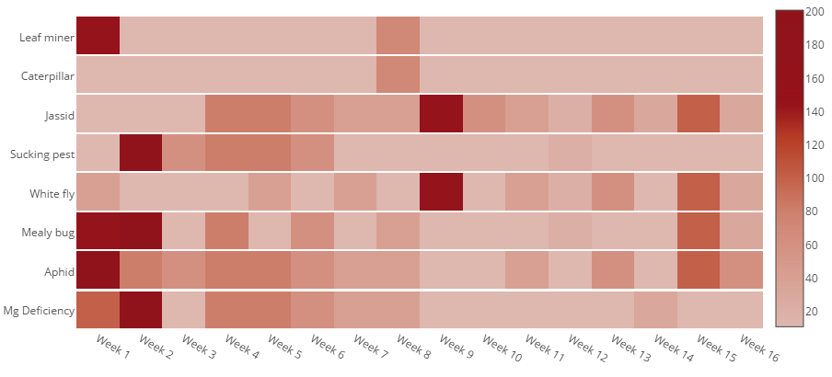
Dynamics of a single cotton crop :
High severity
Low
severity
Visualization of provided data

Slide 4
So far, though we have analyzed the data provided and observed some pattern, we were not able to draw much conclusion with this small data.
We need more data regarding advices and also other factors including Weather, Location, soil conditions, crop details, dates of sowing and farm reports to build the model.
Please provide us as much data as you can regarding the factors mentioned.

Slide 5
Thank you

