Slide 1
Crop data analytics using image and non-image features
Team members : Asish Varanasi
Dheeraj Raghavendra
Purnachand Jaddu
Mentors : Dr. Avinash Sharma
Dr. P. Krishna Reddy

Slide 2
Motivation
Agriculture plays a vital role in economy for developing countries like India.
Rapid technological advancement - but not much focus on agricultural domain.
Several newly emerging problems in agriculture.
In 2012, the NCRB of India reported 13,754 farmer suicides.
Hence, a need for guidance to the farmers.
Esagu is one such platform.

Slide 3
Key pain points
Recommendation of Diagnostics:
Accuracy
Timely advice
Minimum required input
Ease of communication
Cost effectiveness
Feedback system

Slide 4
Insights mining
Periodic behaviour of diseases with respect to :
Season
Crop
Pesticides/Fertilizers
Location
Pests

Slide 5
Visualization
Heatmaps showing the variation in the intensity of factors w.r.t:
➤Time
➤Location
Plots like Bar charts, Pie diagrams etc.
A dashboard for interactive visualization of the data.

Slide 6
Data
Input data primarily contains non-image features.
Weather details, soil conditions and farm report constitute the major part.
Pre-processing involving data cleaning, integration and normalization.
Finally, analyzation after data transformation.

Slide 7
Representation
PGM (Probabilistic Graphical Model)
Farms as vertices and edges indicating the dependency on various factors.
Graph signalling
A plot of the condition of each farm with respect to time/season.

Slide 8
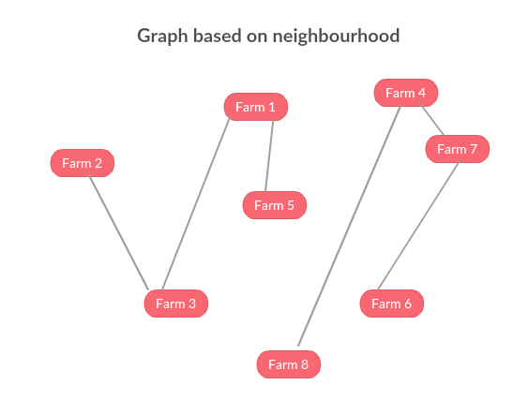

Slide 9
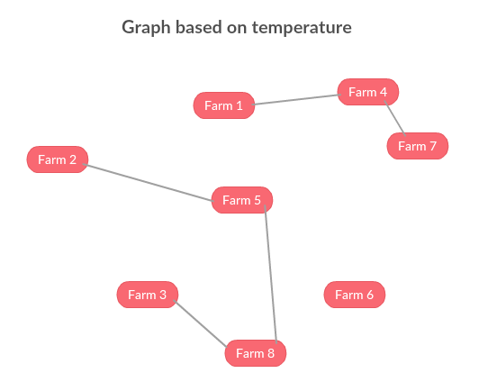

Slide 10
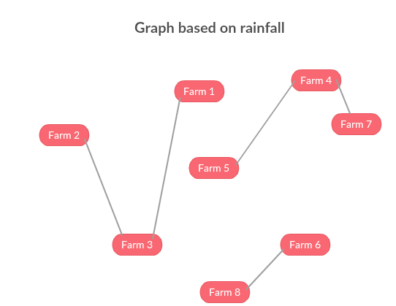

Slide 11
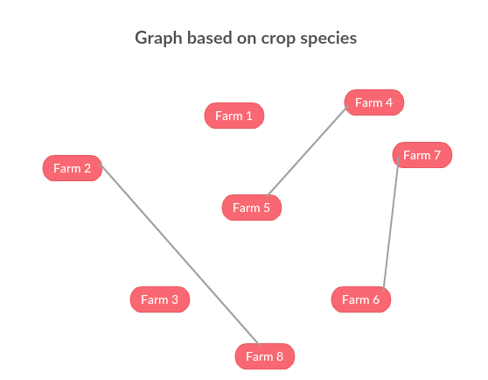

Slide 12
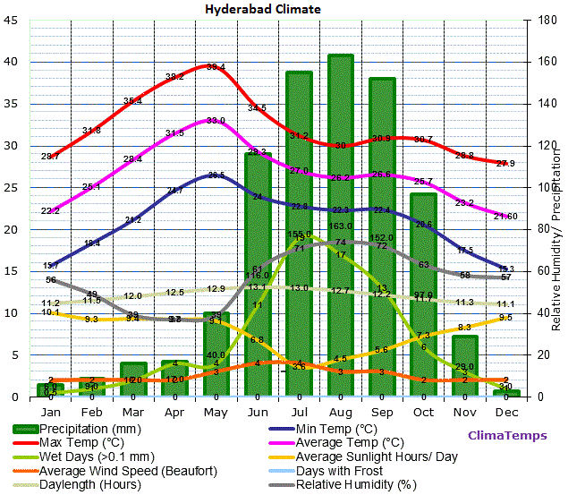

Slide 13
Models
Graphical method
Taking into account all the dependencies in the graphs, we model the system.
Spectral analysis
Considering timely behaviour of the respective feature.
Topic modeling
Discovering the abstract symptoms using keywords.
Predicting the solution using Multi View Learning techniques.

Slide 14
Specific MVL solution will depend on the data.
If the dimension is large, then we have to use Canonical Correlation Analysis.
If the entire data is labeled, we can use multiview supervised learning.
If we have both labeled and unlabeled data, then we have to use multiview semi supervised learning.
Several such procedures like active learning, ensemble learning etc.
Finally, a feedback to improve the accuracy of the prediction algorithm.

Slide 15
Progress
First, we were given the data regarding a single cotton crop for one season.
Heatmap visualization was performed on that data.
Later, text analysis was performed on 5 year data regarding several crops across several villages.
Visualization was done using several plots like histograms and pie charts.

Slide 16
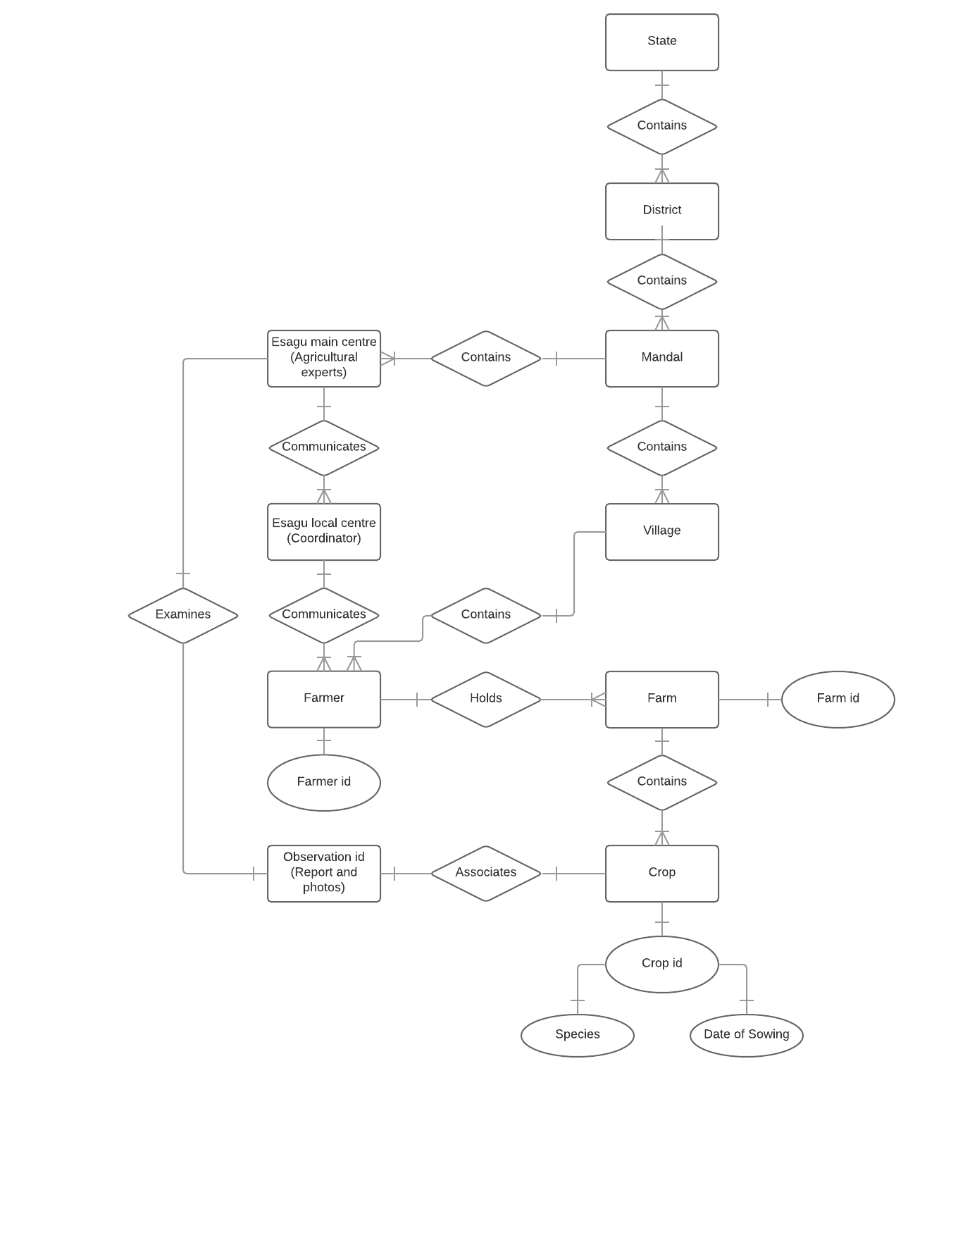
ER diagram

Slide 17
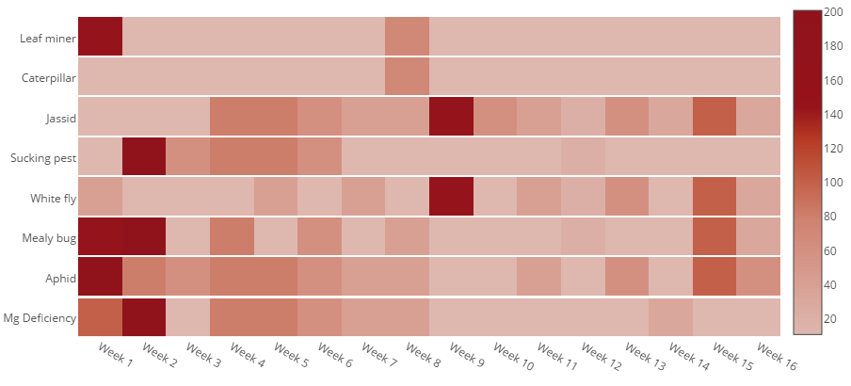
Dynamics of a single cotton crop (25-7-16 to 7-11-16)
High severity
Low
severity
Visualization of provided data

Slide 18
Text analysis
Performed on data corresponding to several farms for 5 years (2012 to 2016).
Total number of advices = 6764.
The occurrences of different problems were counted by identifying corresponding keywords.
Advices containing more than one problem would increment the count of respective problems

Slide 19
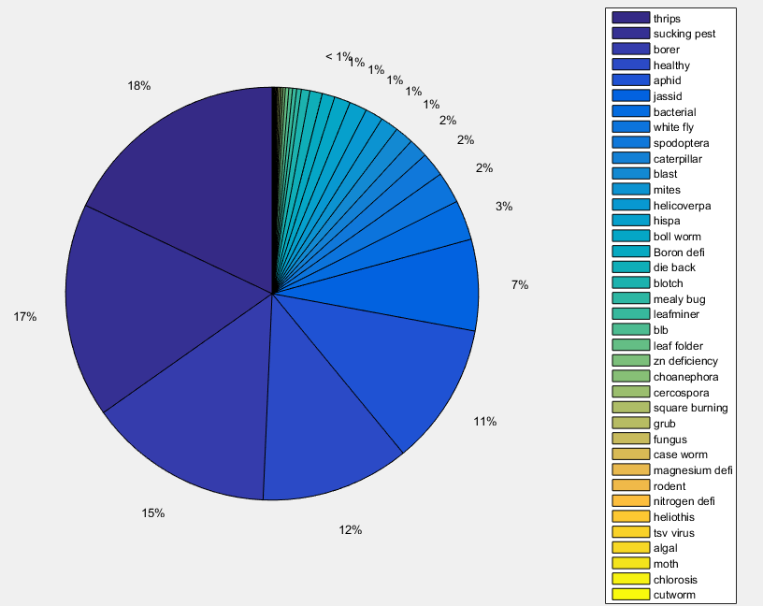

Slide 20
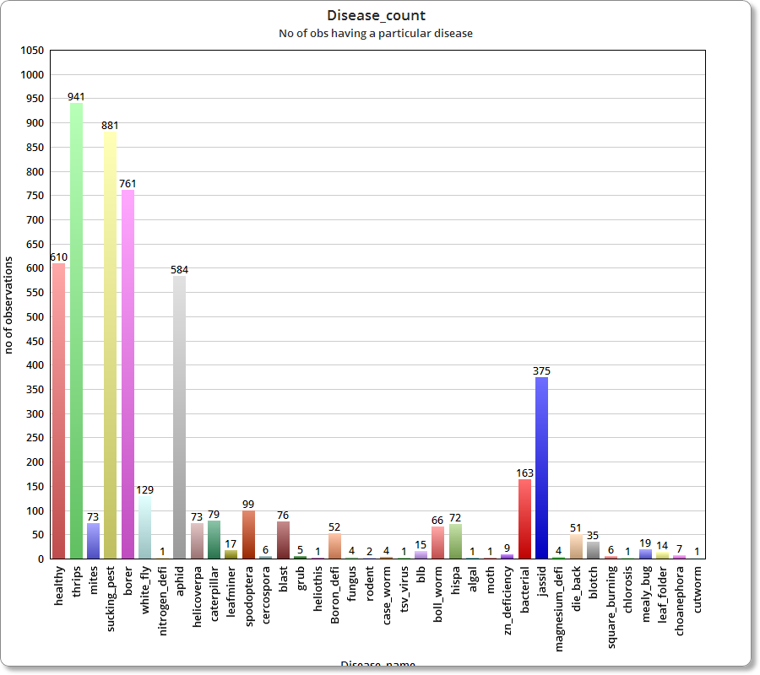

Slide 21
But here, the entries do not sum up to 6764. They sum up to a total of 5239. It is due to following reasons :
Some of the advices are regarding fertilizers and do not contain the problem.
Advices containing general preventive measures.

Slide 22
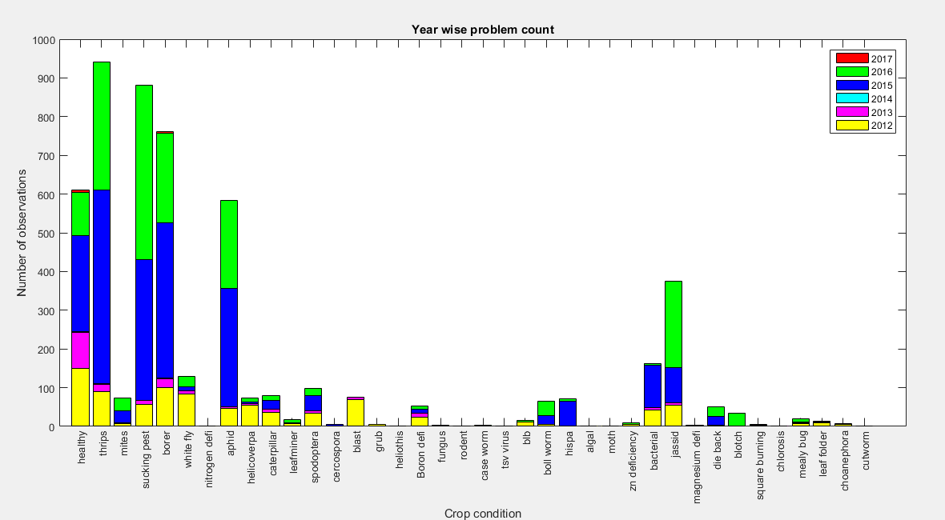

Slide 23
Year : Number of advices
2012 : 1834
2013 : 672
2014 : 6
2015 : 2400
2016 : 1841
2017 : 11

Slide 24
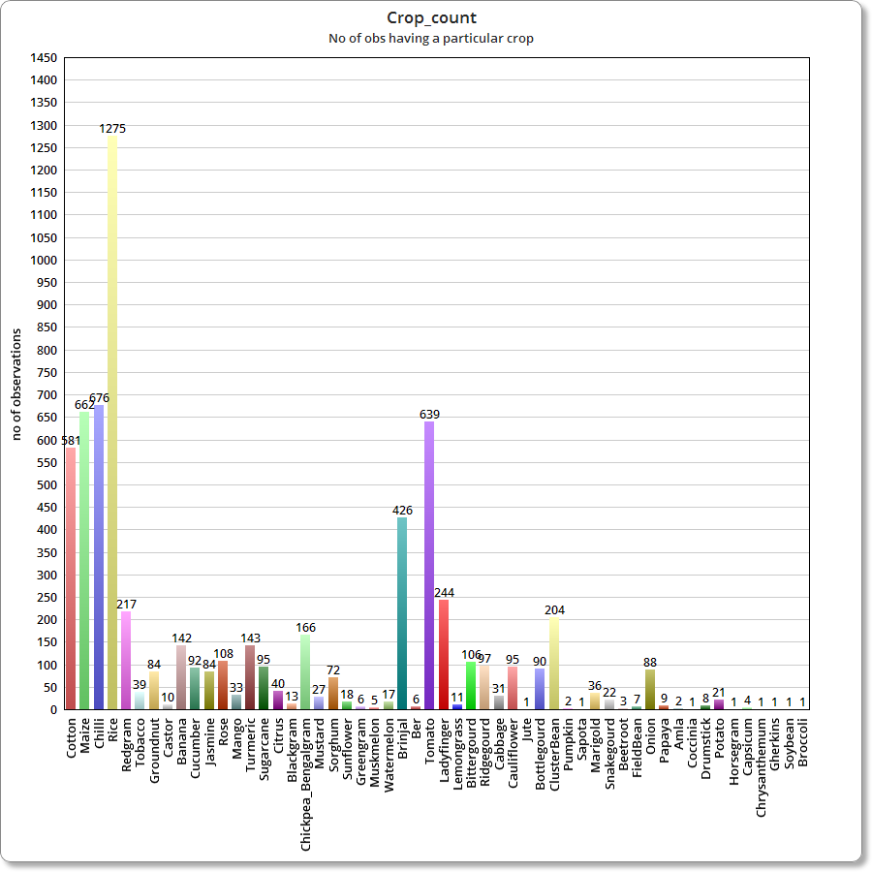

Slide 25
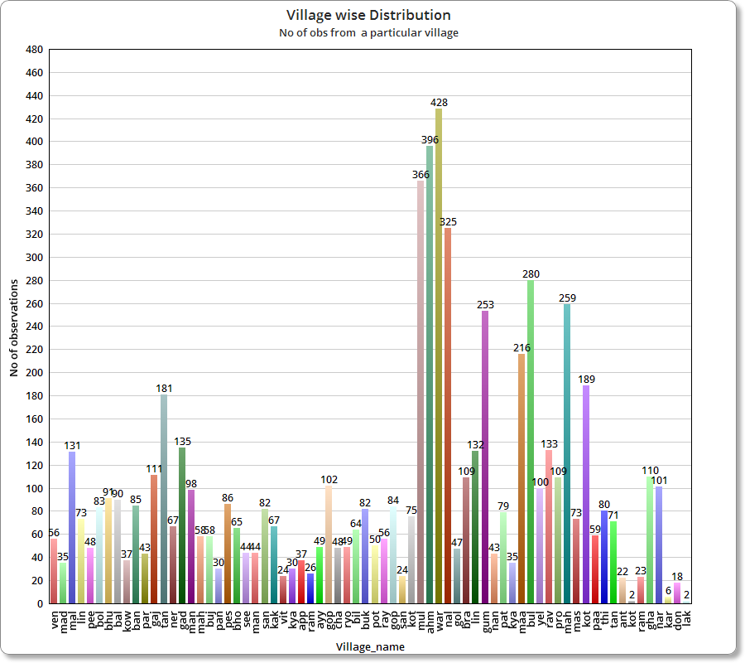

Slide 26
Timeline
One week from now : Developing dashboard for interactive visualization of the data and prescriptive analytics service.
One month from now : Model implementation.
Next semester : recommender system.

Slide 27
References
http://insait.in/AIPA2012/articles/009.pdf
http://www.saravananraj.net/wp-content/uploads/2014/12/45_AFITA_ICT-for-Agricultural-extension_India.pdf
http://insait.in/AIPA2012/articles/005.pdf
https://www.researchgate.net/publication/233572675_Analysing_dynamics_of_crop_problems_by_applying_text_analysis_methods_on_farm_advisory_data_of_eSaguTM.

