Slide 1
Crop data analytics using non-image features

Slide 2
Data needed :
Crop details
Weather information
Soil conditions
Location
Date of sowing
Farm report
Earlier advices

Slide 3
Data available :
Weather details of Ranga reddy district
But farms are in Medak district.
List of advices delivered previously.
No other information is available.
All the crops are of cotton and belong to same locality.

Slide 4
Text analysis of advisory data :
Carried out by identifying the keywords.
Similarity threshold was set and data divided was into clusters.
Clusters were refined using k-means algorithm.
Only textual data of advices was used.
No other information was considered.

Slide 5
Results :
In a week, around 20% of farms have faced distinct problems.
~40% of farms were in clusters of size > 5
2 or more farms belonging to same cluster eventually fell into different clusters in the subsequent weeks.
Though all of them were cotton crops belonging to same area, they were facing different problems.
⇒ Other factors were not the same.

Slide 6
Limitations of textual analysis:
Same pesticide which may control multiple pests.
Different pesticides suggested by various scientists for the same problem.
Preventive measure suggested in the anticipation of a pest will be counted as if the problem has occurred.

Slide 7
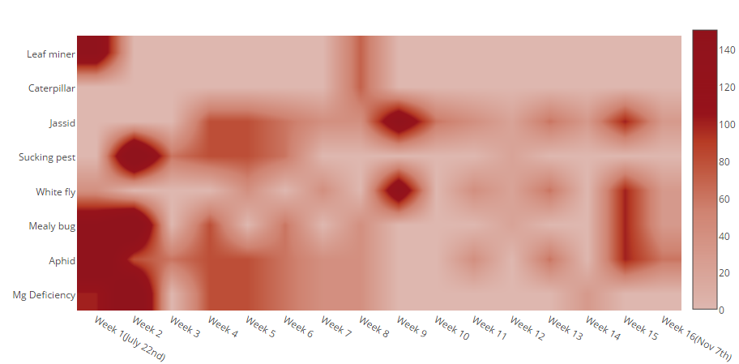
Dynamics of a single cotton crop :
High intensity
Low
intensity

Slide 8
Observations :
We find that a certain pest(aphid) is common to the cotton crop throughout its growth.
Certain pests like the whitefly start attacking the plant at a certain stage of growth.
Some pests are confined to only initial stages of growth.
Occurrence of certain problem is most likely to cause another problem/pest.
Considering all the mentioned factors and also by carrying out text analysis, we can improve the accuracy of the prediction.

Slide 9
Thank you

