Slide 1
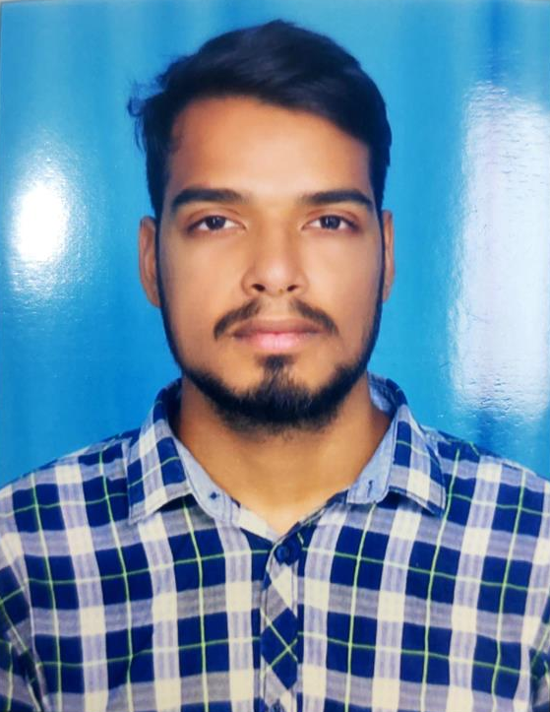
Dheeraj Sai Tiwari - Contact: +91 6281954503 | dheerajsaitiwari1110@gmail.com | linkedin | Github
Professional Summary:
A results-oriented Computer Science professional currently specializing in AI & Data Science at VIT. Combines a strong academic foundation with hands-
on industry experience in technical analysis and support at Amazon. Proven ability to deliver end-to-end solutions, from developing full-stack applications
with the MERN stack to deploying interactive machine learning models in NLP and Computer Vision.
Professional Experience:
Amazon | CS CAP Associate (2024)
- Provided high-level technical support for customer accounts and digital services. Proactively identified and prevented potential issues by gathering and analyzing intelligence, ensuring a high-quality customer experience.
Web Development Internships | Oasis Infobyte & The Sparks Foundation (2023)
- Designed, developed, and deployed dynamic web applications using React.js. Contributed to key projects, including a basic banking system and a donation page with a payment gateway.
Education:
M.Tech - Artificial Intelligence and Data Science, Vellore Institute of Technology, Chennai | 2024 (Pursuing)
B.Tech - Computer Science and Engineering, JNTU, Hyderabad | 2023
Project Highlights:
- Automated Email Intelligence System
* Engineered a solution using LLMs and NLP to automatically classify, summarize, and extract action items from emails. Integrated Gmail and Twilio APIs for a multi-channel real-time alert system.
- Interactive Deep Learning Application
* Developed and deployed a Pix2Pix GAN for bidirectional image processing. Delivered the model as a real-time, interactive Streamlit web application, demonstrating strong deployment skills.
- Full-Stack Task Management Platform
* Built a complete, full-stack web application for creating, assigning, and tracking tasks using the MERN stack (MongoDB, Express.js, React, Node.js).
Technical Capabilities :
* AI & Machine Learning: Large Language Models (LLMs), Natural Language Processing (NLP), Computer Vision, Deep Learning (CNNs, GANs), TensorFlow
* Full-Stack & Languages: MERN Stack, React, Node.js, Python, Java, JavaScript, SQL, HTML/CSS
* Tools & Platforms: Git, Azure, Google Cloud Platform (GCP), Streamlit, VS Code

