Slide 1
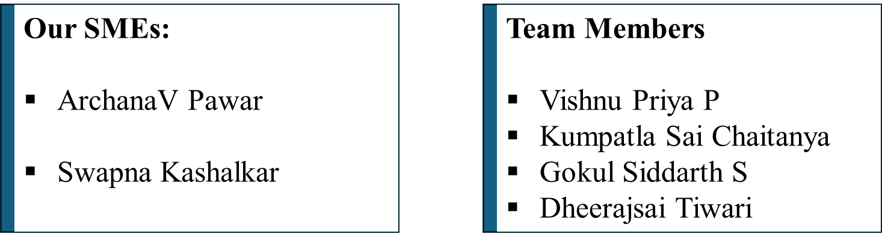
Prompt-Driven Full Stack Application Development with GitHub Copilot, Integrated Standards Checklist, and Code Review

Slide 2
Introduction:
A robust, full-stack Inventory Management System developed using prompt-driven GitHub Copilot workflows, designed for local deployment without cloud dependencies. This project demonstrates how AI-assisted development can accelerate delivery while maintaining high code quality through structured standards and best practices.
Tech Stack:
Frontend: Angular (TypeScript, HttpClient, Reactive Forms)
Backend: ASP.NET Core Web API (C#)
Database: SQL Server / LocalDB via Entity Framework Core

Slide 3
Problem Statement:
Manual code reviews are time-consuming and effort-intensive.
Slow down development velocity and delay releases.
Prone to human errors, missing coding or security standards.
Quality depends heavily on reviewer expertise.
Results in inconsistent quality and standards

Slide 4
Purpose & Key Benefits
Automate First-Pass Code Reviews
Accelerated Development Velocity
Enhanced Code Quality & Security
Instant Developer Feedback
Consistent Coding Standards

Slide 5
Existing Manual Process | Proprosed System
Developer ➔ WAIT (8-10 Hours) ➔ Manual Review(1-2 Hours) ➔ Slow Feedback Loop | Developer ➔ AI Review (< 2 Minutes) ➔ Developer Fixes ➔ Focused Human Review(~30 Minutes)
Productivity Impact: • High Cost: Developer wait time & context switching. • Bottleneck: Senior developer time is blocked. | Productivity Impact: • High Gain: Instant feedback keeps developers in flow. • Efficiency: Senior time is focused only on critical logic.
Total Review Cycle: 1-2 DAYS | Total Review Cycle: < 1 HOUR

Slide 6
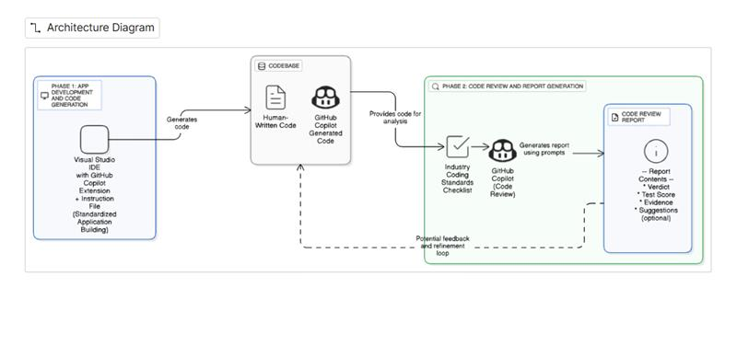
Architecture:
Fig.1 Architecture Diagram for Prompt-Driven App Development and Code Review Workflow Using GitHub Copilot

Slide 7
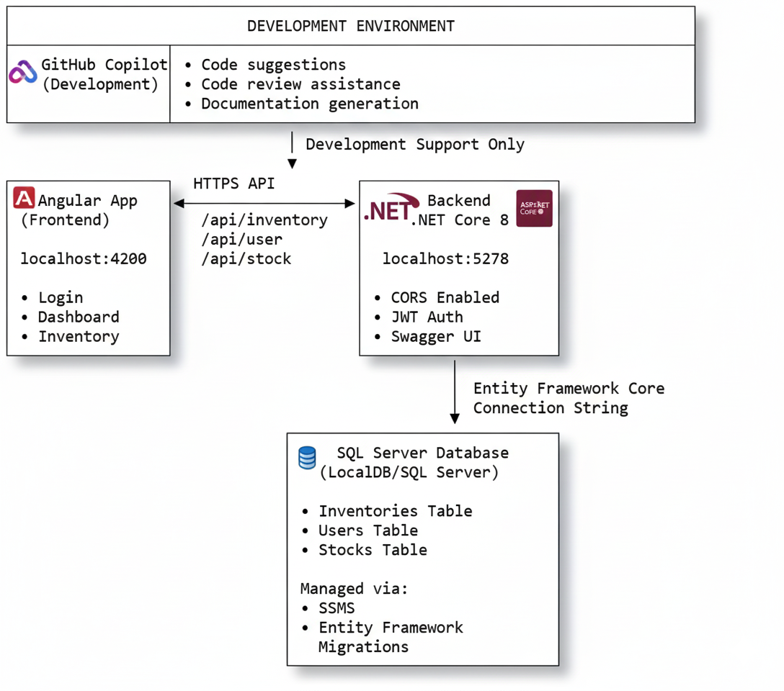
Project Flow:
Fig 2: Overview of the development environment and architecture, showing GitHub Copilot integration with Angular frontend, .NET Core 8 backend, and SQL Server database.

Slide 8
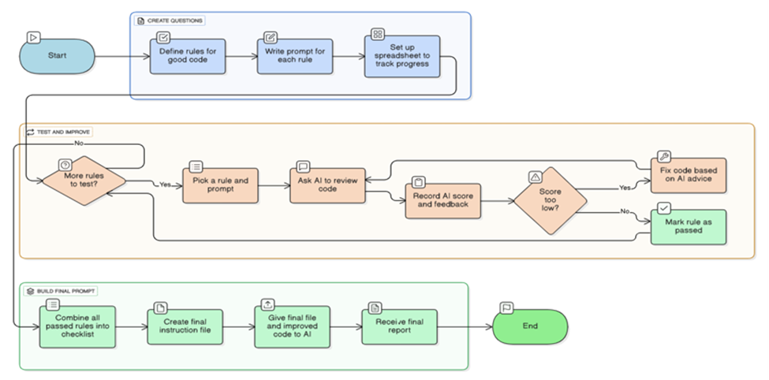
AI-Driven Code Review and Prompt Refinement Workflow
Figure 3: Flowchart depicting the iterative process of code creation, testing, and refinement using AI-driven feedback and rule-based prompts.

Slide 9
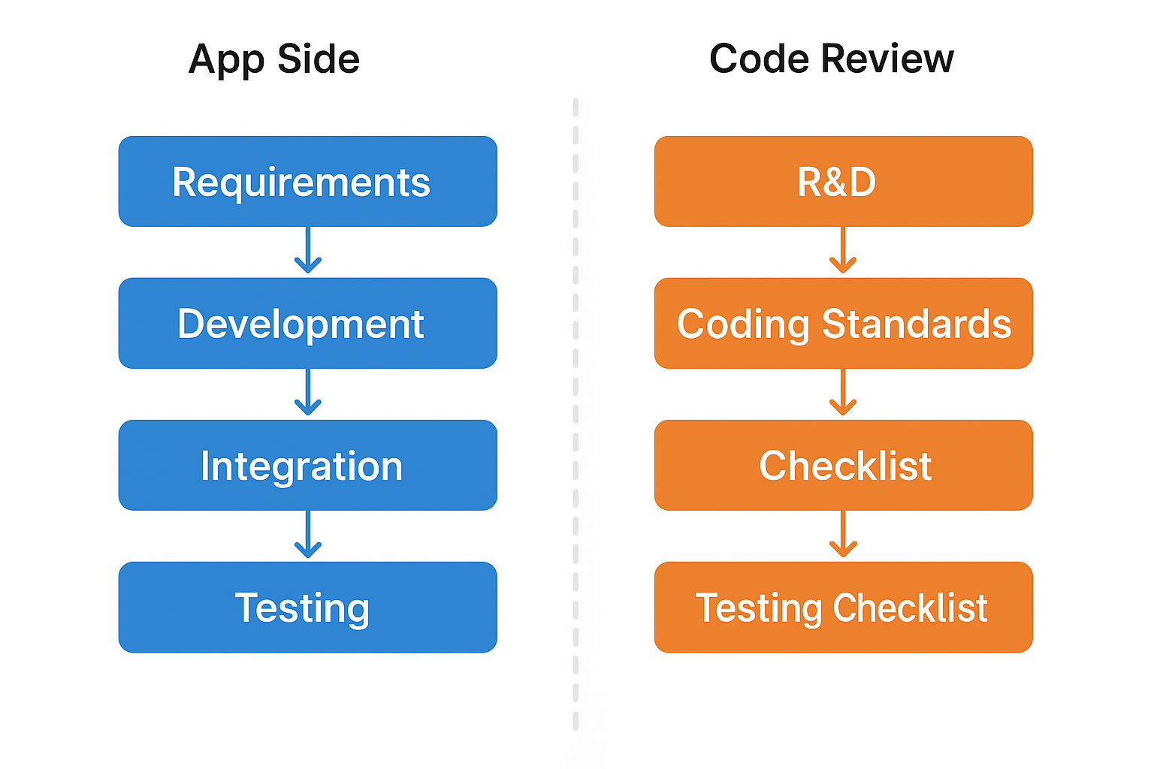
Project Phases:

Slide 10
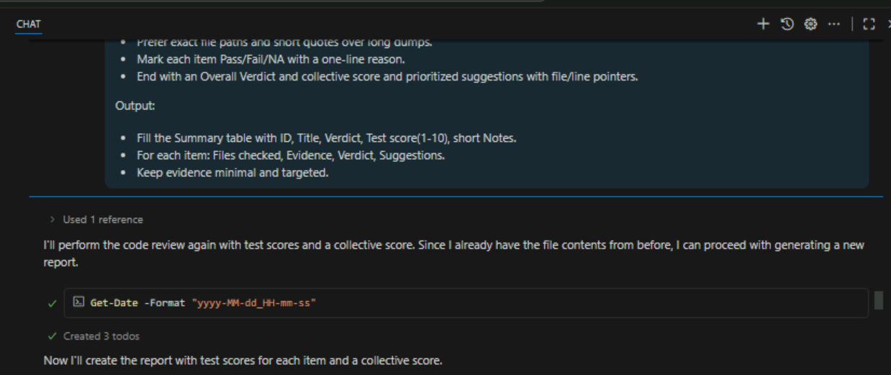
Results : Front-End Part's Code Review Checklist

Slide 12
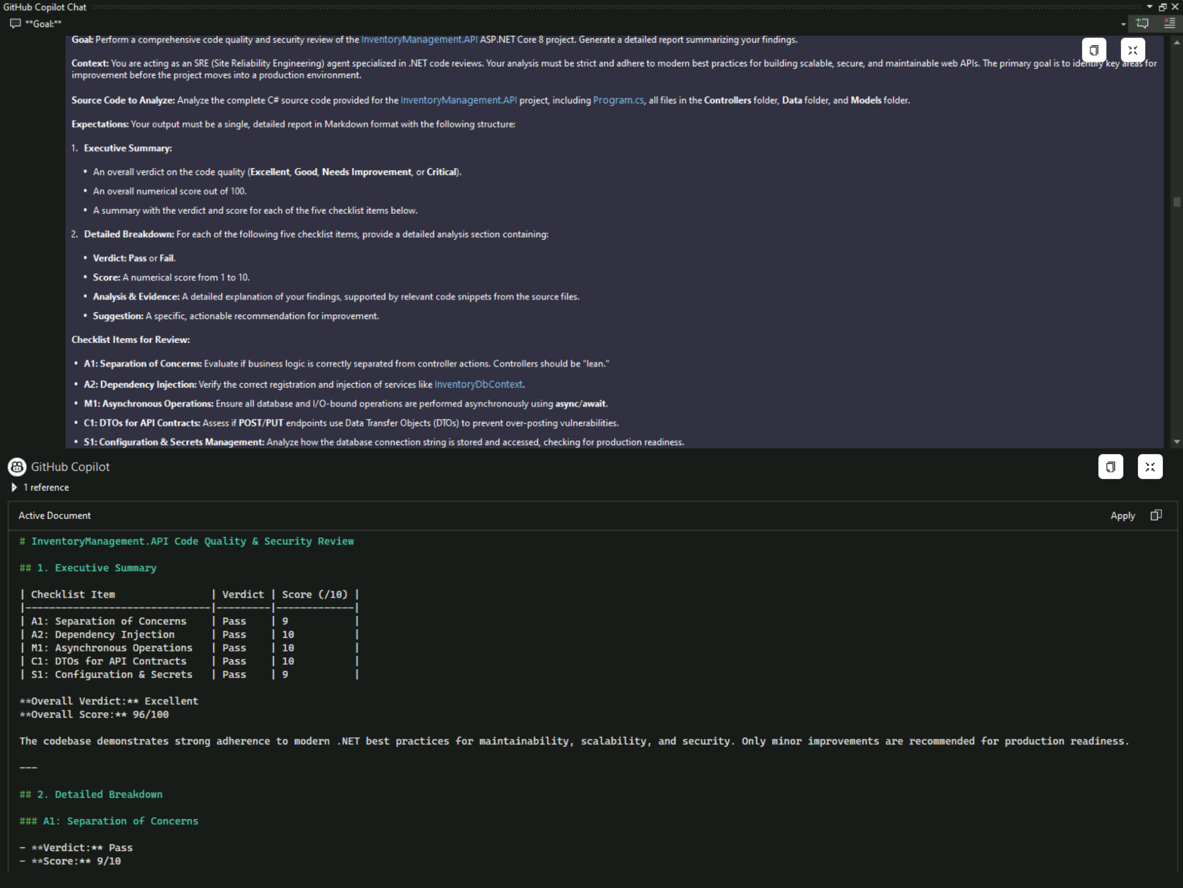
Back-End Part's Code Review Checklist:

Slide 13
Demo

Slide 14
Future Use-Case Enhancements:
Automated Pull Request Review System
Role-Based Review Prompts
Copilot-Driven Code Quality Dashboard
Integration with Project Management Tools
Copilot-Powered Documentation Generator

Slide 15
Constraints

Slide 16
Conclusion
Conclusion Highlights
Delivered a working full-stack inventory system (Angular + ASP.NET Core + SQL Server)
Frontend-backend integration over HTTPS with CORS and Swagger validation
Durable data operations verified in SSMS across Inventories, Users, and Stocks
GitHub Copilot-assisted review rated with strong scores in:
🎓 Demo-ready for classrooms and internal tooling.
🚀 Foundation ready for future enhancements: auth hardening, reporting, predictive inventory

Slide 17
Thankyou

