Slide 1
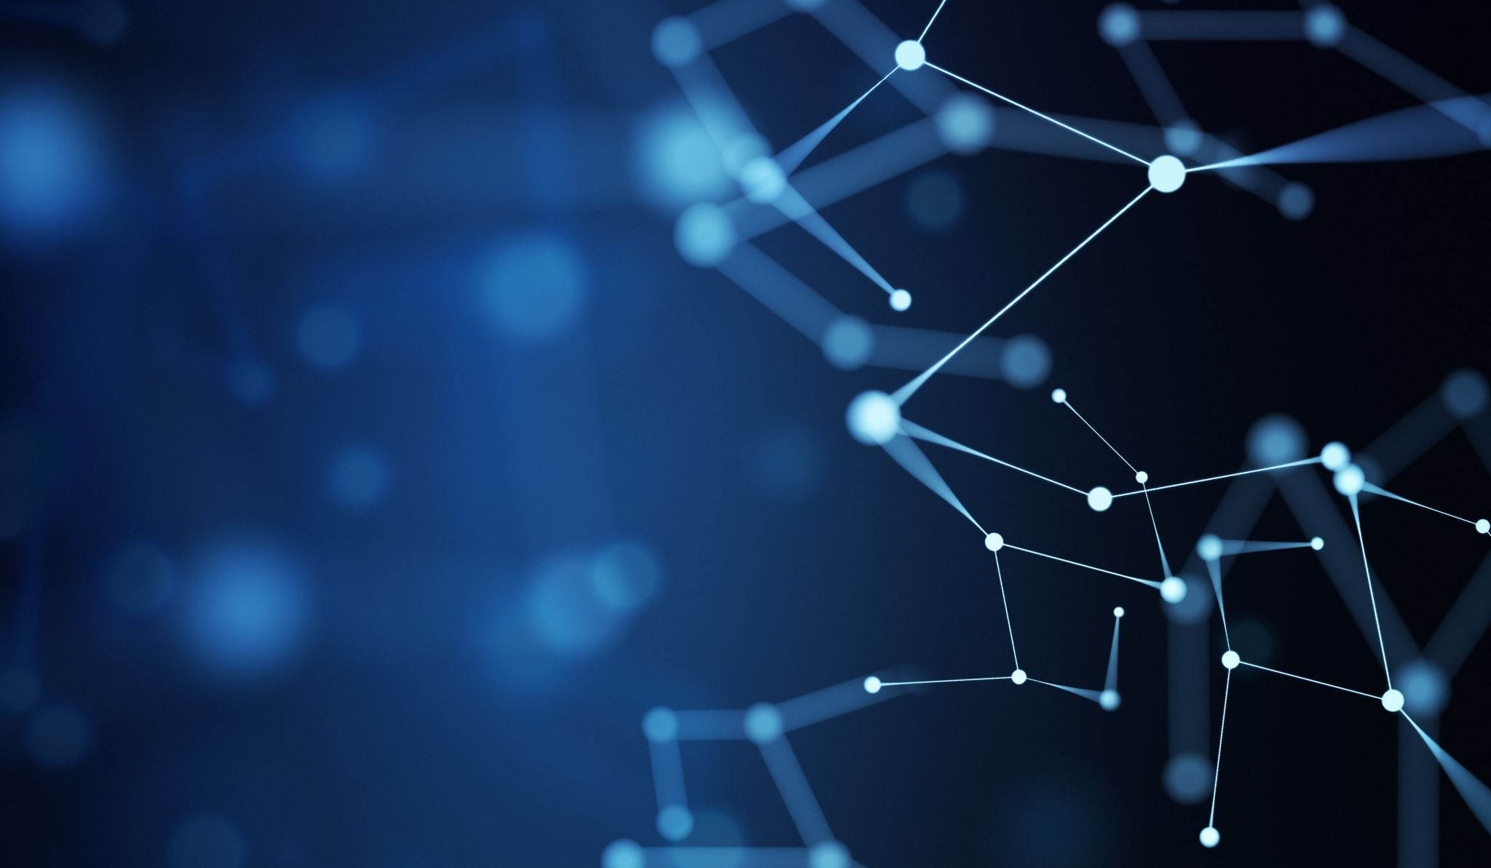
Enhancing Audio Clarity through Disfluency Detection and Removal with CNN
CS6611-CREATIVE AND INNOVATIVE PROJECT
Team -35
Team Members:
Pooja M J (2021503532)
Manokar S (2021503028)
Bhumisvara K (2021503704)
Mentor:
Dr. B. Thanasekhar

Slide 2
Problem Statement
​
The frequent occurrence of disfluencies poses a significant challenge for effective communication processing. These interruptions disrupt the fluency, lead to the misinterpretation of the speaker’s intended message and degradation in overall audio quality. Additionally, accommodating rapid speech requires the strategic inclusion of silent pauses in the audio content. ​
In such instances, there is a need for the detection and removal of these disfluencies in the recorded audio to enhance the overall speech quality and analyzing the speaker’s delivery of speech for improving their communication skills.

Slide 3
Existing Works
The following are a few existing works in the field of audio processing along with its limitations:
1) Cleanvoice AI - Not targeting disfluencies like repetitions.
2) Praat – Lacks automation for removal process.
3) Speechmatics - Limited customization options.
4) Audacity – Lacks disfluency detection.

Slide 4
Objectives
Improve the overall quality and fluency of the spoken content through precise detection and efficient removal of disfluencies.
Inclusion of silent pauses to accommodate speakers with fast-paced delivery.
Ensure that the removal of such disfluencies does not affect the intended meaning or conveyance of the actual message.
Perform detailed analysis by comparing the audio content, emphasizing speaker’s speech rate to assess improvements effectively.
Implement a question pool generation system based on the audio content.

Slide 5
Literature Survey
S.No | Name of the paper and published year | Methodology | Limitations
1. | FluentNet: End-to-End Detection of Stuttered Speech Disfluencies with Deep Learning Tedd Kourkounakis, Amir hossein Hajavi, Ali Etemad. IEEE Transactions, 2021 | This paper involves the design of FluentNet, an automated stuttered speech detection. The network focuses on learning spectral frame-level representations and uses mechanism to better focus on the necessary features for stutter classification. | Restricted datasets, minimal data impact, and exclusive focus on binary detection without detailed analysis of distinct disfluency types.
2. | Convolutional Neural Networks for Speech Recognition Ossama Abdel-Hamid, Abdel- rahman Mohamed, Hui Jiang, Li Deng, Gerald Penn, and Dong Yu IEEE Transactions, 2014 | This includes the use of hybrid DNN- HMM framework, description of basic CNN, proposal of limited-weight- sharing scheme, experiments on CNNs with FWS (Full Weight Sharing) and LWS (Limited Weight Sharing), and the use of a bigram language model in decoding. | Cross-cultural validation and emphasis on classification raise concerns about the model's generalizability in Automatic Speech Recognition tasks.

Slide 6
Literature Survey
S.No | Name of the paper and published year | Methodology | Limitations
3. | End-to-End Neural Based Modification of Noisy Speech for Speech-in-Noise Intelligibility Improvement Muhammed P.V. Shifas, Yannis Stylianou IEEE Transactions, 2022 | This includes the development of an end-to- end neural network approach for improving speech intelligibility in noisy conditions, training of both causal and non-causal FFTNet versions and utilization of a Teacher- Student approach | Enhancements for real-time capability and efficiency are crucial, while potential integration with ASR systems could amplify recognition accuracy.
4. | Automatic Detection of Disfluency Boundaries in Spontaneous Speech of Children Using Audio–Visual Information Serdar Yildirim, Shrikanth Narayanan IEEE Transactions, 2009 | This paper includes a hidden event language model, prosodic cues, and innovative techniques like hidden-event part-of-speech modeling, multipass linear fold algorithm for sentence boundary detection, and various feature selection and classification methods for comprehensive disfluency detection. | Reliance on pitch breaks for disfluent boundaries, influenced by time intervals without modeling dynamic gestures explicitly.

Slide 7
Literature Survey
S.No | Name of the paper and published year | Methodology | Limitations
5. | A CNN-Based Automated Stuttering Identification System Yash Prabhu, Naeem Seliya IEEE Conference, 2022 | The methodology used in the study involved creating a CNN-based model, training and testing it using the Sep- 28k dataset, using different training validation test splits, and measuring accuracy, recall, and precision using a confusion matrix. | Limited comparative analysis with other stuttering prediction systems. English-specific dataset may hinder multilingual performance.
6. | Audio and ASR-based Filled Pause Detection Aggelina Chatziagapi, Dimitris Sgouropoulos, Constantinos Karouzos, Shrikanth Narayanan IEEE Conference, 2022 | This paper introduces a framework for filled pause detection, utilizing both audio and textual data with separate experiments. It employs a CNN architecture for audio and a novel approach for text classification, addressing challenges posed by ASR systems with non-zero word error rates. | ASR systems face challenges with disfluencies, accurate annotation, limited corpora, proposing semi-automatic annotation as a solution.

Slide 8
Literature Survey
S.No | Name of the paper and published year | Methodology | Limitations
7. | Improved Features and Models for Detecting Edit Disfluencies in Transcribing Spontaneous Mandarin Speech Che-Kuang Lin, Lin-Shan Lee IEEE Transactions, 2009 | This involves developing features specific to Mandarin edit disfluencies and proposing an improved model combining decision trees and maximum entropy to detect IPs. The techniques were verified through experiments on a spontaneous Mandarin speech corpus. | Accurate classification of edit disfluency types and balancing computational complexity pose challenges for real-time feasibility..
8. | Edit disfluency detection and correction using a cleanup language model and an alignment model Jui-Feng Yeh, Chung-Hsien Wu IEEE Transactions, 2006 | The paper employs acoustic features and Gaussian Mixture Model (GMM) for IP detection, incorporating hypothesis testing. It implements a two-stage disfluency correction module and evaluates performance on the Mandarin Conversational Dialogue Corpus. | Overcoming challenges with subwords and improving restart disfluency performance is crucial for enhancement.

Slide 9
Literature Survey
S.No | Name of the paper and published year | Methodology | Limitations
9. | Recognizing Disfluencies in Conversational Speech Matthew Lease, Student Member, IEEE, Mark Johnson, and Eugene Charniak IEEE Transactions, 2006 | The methodology involves utilizing a stochastic Tree Adjoining Grammar (TAG) noisy-channel model to generate candidate repair analyses, scoring fluency using a probabilistic syntactic language model, and selecting the most likely analysis with a maximum- entropy model. | Disfluency detection in the paper, employing a stochastic Tree Adjoining Grammar model, faces challenges with syntactic ambiguity.
10. | Generation of Multiple- Choice Questions From Textbook Contents of School- Level Subjects Jianxing Yu, Qinliang Su, Xiaojun Quan IEEE Transactions, 2023 | This paper involves the development of a system for automatic generation of MCQs using a pipeline with four primary modules: preprocessing, sentence selection, key selection, and distractor generation. | The system's domain-specific features may need adjustments for adaptation to non-educational contexts.

Slide 10
Proposed Work
To utilize Convolutional Neural Networks (CNN) for analyzing the audio signals and addressing interruptions, particularly for speakers with fast-paced speech.
Mel-frequency cepstral coefficients (MFCCs) or other features will be extracted from the preprocessed audio to capture speaker characteristics and speech patterns.
Train the model and optimize the accuracy in detecting various disfluencies.
For fast speakers, pauses will be inserted between speech segments based on the predicted disfluency locations and speaker's speaking rate.
Remove the detected disfluencies using interpolation, noise reduction, or dynamic time warping and ensure that the removal process maintains the naturalness and authenticity of the speaker's voice.
An interactive question pool will be generated based on the audio content and also the performance of the speaker will be evaluated by analyzing the speech rate.

Slide 11
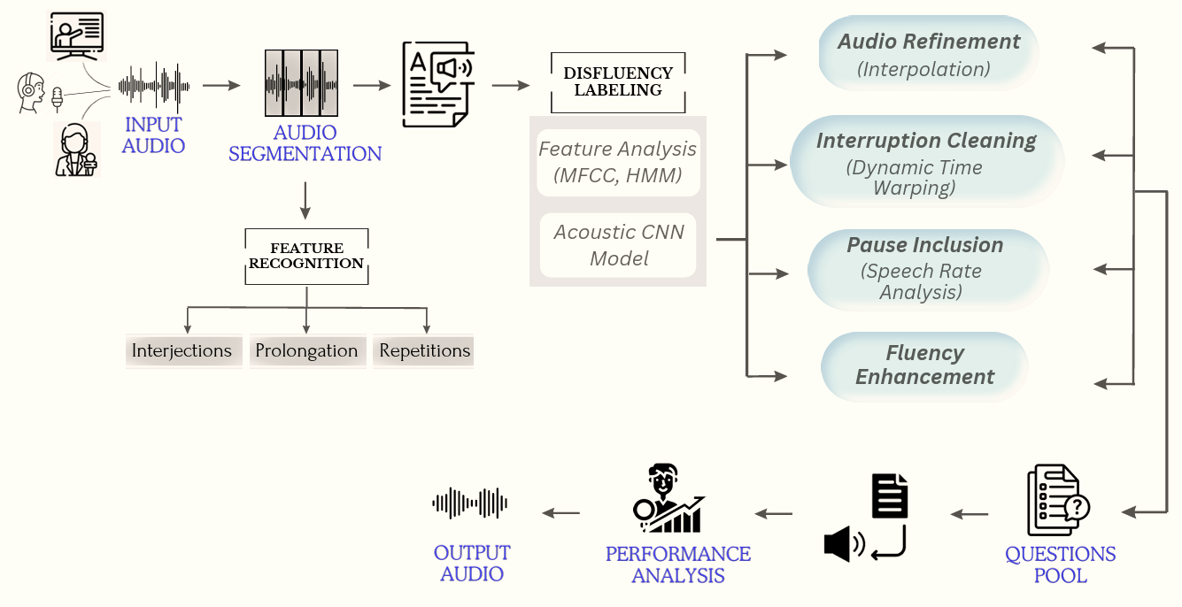
System Architecture

Slide 12
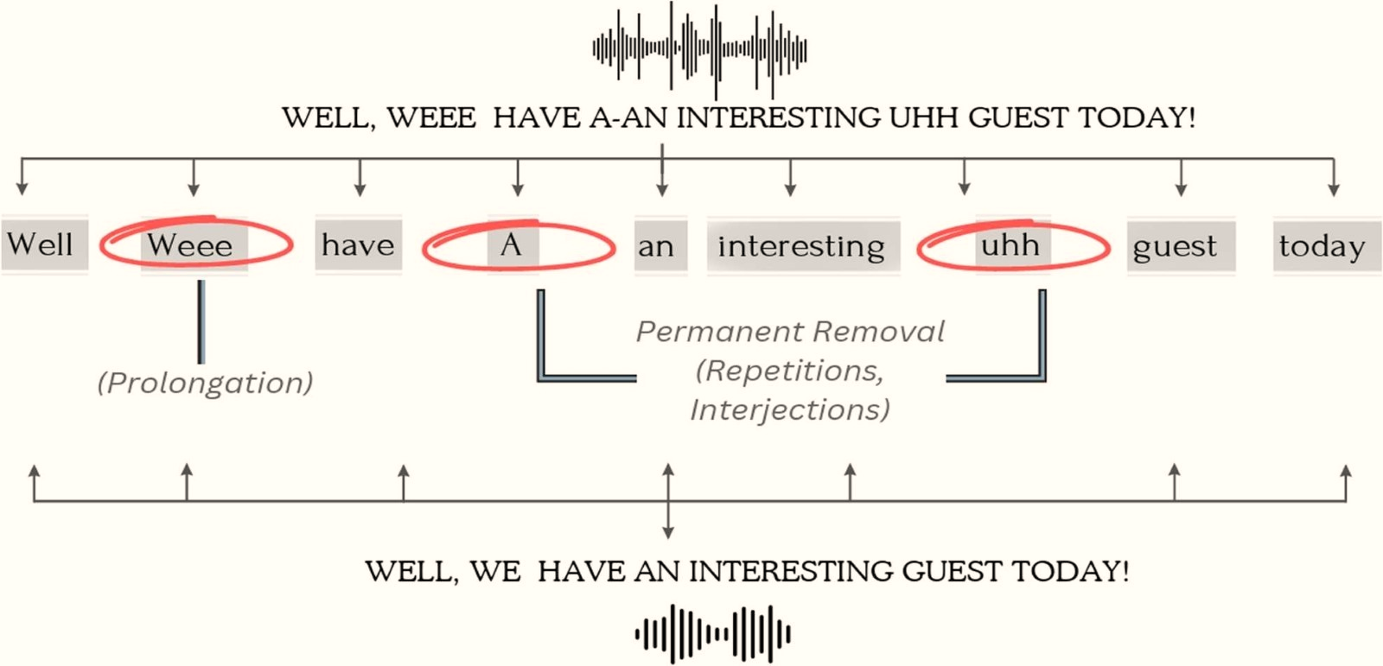
Illustration

Slide 13
Modules
1) Data Preparation and Feature Analysis: Collect a diverse dataset containing both fluent and disfluent speech recordings.
2) Training the Model: Design and train the CNN model to identify disfluencies based on features.
3) Disfluency Detection: Implement the trained CNN model to effectively identify disfluencies within speech segments.
4) Inclusion of Pauses: Insert pauses between speech segments based on the predicted disfluency locations and speaker's speaking rate.
5) Disfluency Elimination: Removes the identified disfluencies using techniques like interpolation, noise reduction, or dynamic time warping.
6) Questions Pool Generation: Generating questions based on the audio content to prompt user reflection or feedback
7) Speaker’s Performance Analysis: Could analyze speech rate changes to assess the impact of disfluency removal on speaking pace.

Slide 14
Module - 1
DATA PREPARATION:
Collect a diverse set of labelled audio recordings, ensuring a balanced representation of fluent and disfluent speech.
Organize the data into appropriate categories for training and testing purposes.
Audio Segmentation:
Audio Segmentation divides raw audio data into smaller segments or frames..
Segments enable feature extraction, capturing acoustic properties.
Acoustic properties are essential for identifying filled pauses and disfluencies.
Improved detection contributes to better classification outcomes.

Slide 15
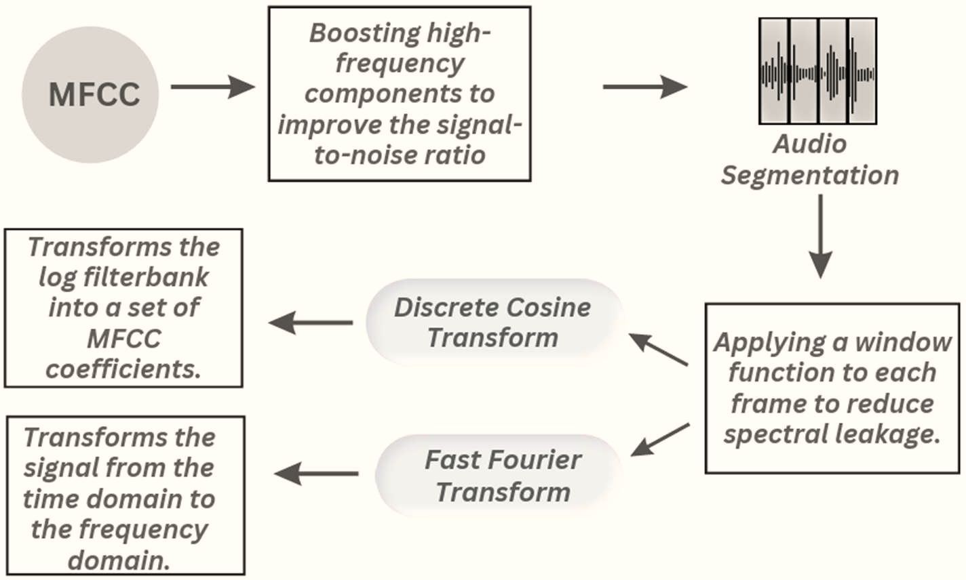
Mel-Frequency Ceptral Coefficients (MFCC)

Slide 16
Algorithm: MFCC Feature Extraction
Input: Audio Signal
Output: MFCC Features
Function: extract_MFCC(audio_signal, sample_rate, frame_length, frame_step)
Steps:
Define a pre-emphasis coefficient.
Apply a filter to the audio signal:
pre_emphasized_signal = audio_signal[n] + alpha * audio_signal[n-1]
3. Initialize empty list to store frames (frames = [])
4. frame = pre_emphasized_signal[frame_size-1]
5. Loop through each frame in the list:
i. windowed_frame = frame * window_function(len(frame))
ii. Compute the magnitude spectrum using DFT:
magnitude_spectrum = abs(fft(windowed_frame))
iii. Compute the DCT of the log mel energies:
mfcc_coefficients = dct(log_mel_energies)
6. End loop.

Slide 17
Evaluation Metrics
Disfluency Detection Accuracy
Fluency of the generated audio
Overall speech quality improvement
Speaker’s Performance Analysis
1) Pre-emphasis operation: y(t)=x(t)−α⋅x(t−1) where x(t) is the input signal, y(t)
is the output signal, and α is the pre-emphasis coefficient.
2) The DFT formula is: X(k) = ∑^{𝑵–𝟏} 𝒙(𝒏). 𝒆^{–𝒋𝟐𝝅𝒌𝒏/𝑵} where X(k) is the DFT coefficient at frequency bin k, x(n) is the input signal, and N is the frame length.

Slide 18
References
1. T. Kourkounakis, A. Hajavi and A. Etemad, "FluentNet: End-to-End Detection of Stuttered Speech Disfluencies With Deep Learning," in IEEE/ACM Transactions on Audio, Speech, and Language Processing, vol. 29, pp. 2986-2999, 2021, doi: 10.1109/TASLP.2021.3110146.
2. O. Abdel-Hamid, A. -r. Mohamed, H. Jiang, L. Deng, G. Penn and D. Yu, "Convolutional Neural Networks for Speech Recognition," in IEEE Transactions on Audio, Speech, and Language Processing, vol. 22, no. 10, pp. 1533-1545, Oct. 2014, doi: 10.1109/TASLP.2014.2339736.
3. M. P. V. Shifas, C. Zorilă and Y. Stylianou, "End-to-End Neural Based Modification of Noisy Speech for Speech-in-Noise Intelligibility Improvement," in IEEE/ACM Transactions on Audio, Speech, and Language Processing, vol. 30, pp. 162-173, 2022, doi: 10.1109/TASLP.2021.3126947. .
4. S. Yildirim and S. Narayanan, "Automatic Detection of Disfluency Boundaries in Spontaneous Speech of Children Using Audio–Visual Information," in IEEE Transactions on Audio, Speech, and Language Processing, vol. 17, no. 1, pp. 2-12, Jan. 2009, doi: 10.1109/TASL.2008.2006728.
5. Y. Prabhu and N. Seliya, "A CNN-Based Automated Stuttering Identification System," 2022 21st IEEE International Conference on Machine Learning and Applications (ICMLA), Nassau, Bahamas, 2022, pp. 1601-1605, doi: 10.1109/ICMLA55696.2022.00247.

Slide 19
A. Chatziagapi et al., "Audio and ASR-based Filled Pause Detection," 2022 10th International Conference on Affective Computing and Intelligent Interaction (ACII), Nara, Japan, 2022, pp. 1- 7, doi: 10.1109/ACII55700.2022.9953889.
7) C. -K. Lin and L. -S. Lee, "Improved Features and Models for Detecting Edit Disfluencies in Transcribing Spontaneous Mandarin Speech," in IEEE Transactions on Audio, Speech, and Language Processing, vol. 17, no. 7, pp. 1263-1278, Sept. 2009, doi: 10.1109/TASL.2009.2014792..
8. Jui-Feng Yeh and Chung-Hsien Wu, "Edit disfluency detection and correction using a cleanup language model and an alignment model," in IEEE Transactions on Audio, Speech, and Language Processing, vol. 14, no. 5, pp. 1574-1583, Sept. 2006, doi: 10.1109/TASL.2006.878267.
9. M. Lease, M. Johnson and E. Charniak, "Recognizing disfluencies in conversational speech," in IEEE Transactions on Audio Processing, vol. 14, Sept. 2006, doi:
10.1109/TASL.2006.878269. 10. D. R. CH and S. K. Saha, "Generation of Multiple-Choice Questions From Textbook Contents of School-Level Subjects," in IEEE Transactions on Learning Technologies, vol. 16, no. 1, pp. 40- 52, 1 Feb. 2023, doi: 10.1109/TLT.2022.3224232.

Slide 20
Thank you!

