Slide 1
Deep Learning Module 2
Dr S.Rajarajeswari

Slide 2
What is a Convolutional Neural Network (CNN)?
In deep learning, a convolutional neural network (CNN/ConvNet) is a class of deep neural networks, most commonly applied to analyze visual imagery.
The CNN architecture uses a special technique called Convolution instead of relying solely on matrix multiplications like traditional neural networks.
Convolutional networks use a process called convolution, which combines two functions to show how one changes the shape of the other.
The bottom line is that the role of the convolutional networks is to reduce the images into a form that is easier to process, without losing features that are critical for getting a good prediction.

Slide 3
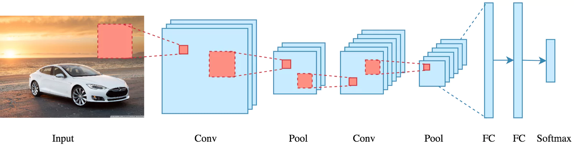

Slide 4
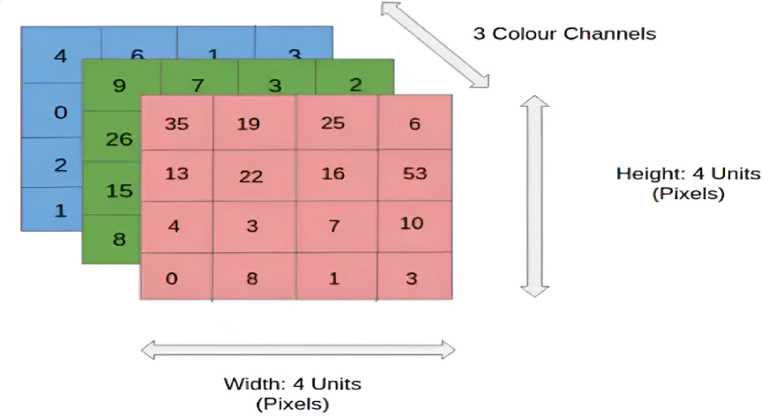
How Does CNN Work?
Before we go to the working of Convolutional neural networks (CNN), let’s cover the basics, such as what an image is and how it is represented.
An RGB image is nothing but a matrix of pixel values having three planes, whereas a grayscale image is the same, but it has a single plane.
Take a look at this image to understand more.

Slide 5
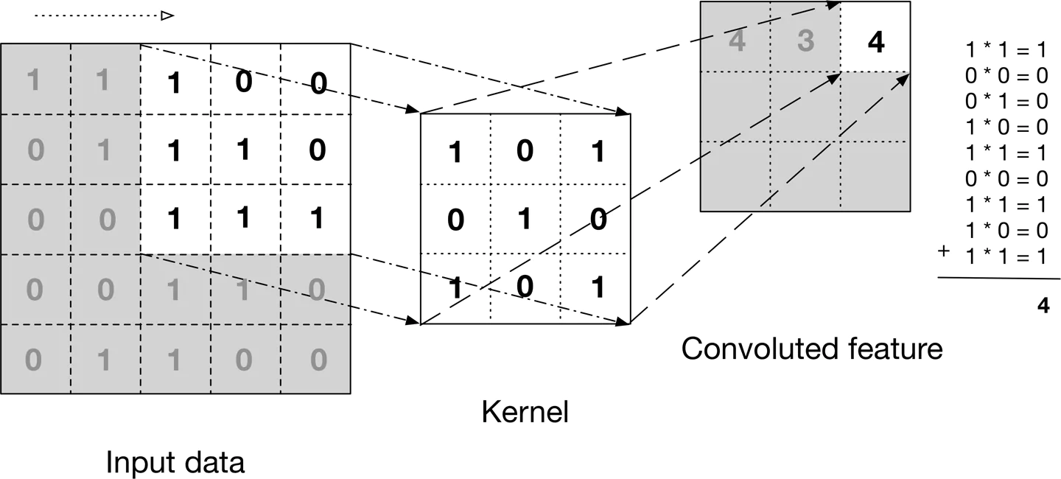
For simplicity, let’s stick with grayscale images as we try to understand how CNNs work.

Slide 6
The above image shows what a convolution is.
We take a filter/kernel(3×3 matrix) and apply it to the input image to get the convolved feature. This convolved feature is passed on to the next layer.

Slide 7
In the case of the RGB color channel, take a look at this animation to understand its working

Slide 8
The number of parameters in a CNN layer depends on the size of the receptive fields (filter kernels) and the number of filters.
Each neuron in a CNN layer receives inputs from a local region of the previous layer, known as its receptive field.
The receptive fields move over the input, calculating dot products and creating a convolved feature map as the output.
Usually, this map then goes through a rectified linear unit (ReLU) activation function.
Classic CNN architectures like LeNet and more modern ones like ResNet employ this fundamental principle.
Convolutional neural networks are composed of multiple layers of artificial neurons.

Slide 9
Artificial Neurons’ Role in CNN
Artificial neurons, a rough imitation of their biological counterparts, are mathematical functions that calculate the weighted sum of multiple inputs and output an activation value.
When you input an image into a ConvNet, each layer generates several activation functions that are passed on to the next layer for feature extraction.

Slide 10
Feature Extraction in CNN
The first layer usually extracts basic features such as horizontal or diagonal edges.
This output is passed on to the next layer, which detects more complex features such as corners or combinational edges.
As we move deeper into the network, it can identify even more complex features such as objects, faces, etc.
Unlike recurrent neural networks, ConvNets are feed-forward networks that process the input data in a single pass.

Slide 11
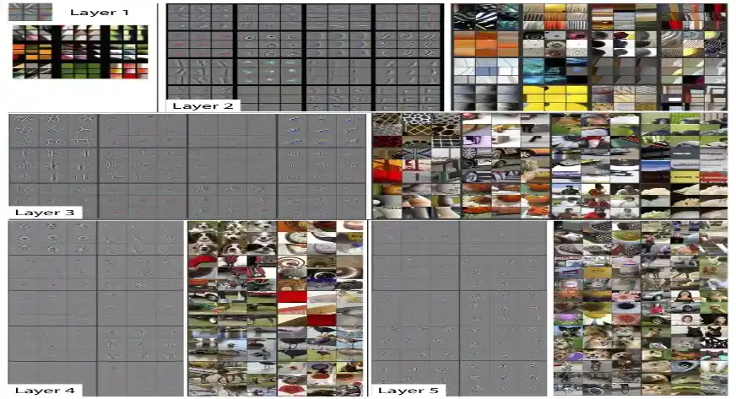

Slide 12
Based on the activation map of the final convolution layer, the classification layer outputs a set of confidence scores (values between 0 and 1) that specify how likely the image is to belong to a “class.”
For instance, if you have a ConvNet that detects cats, dogs, and horses, the output of the final layer is the possibility that the input data contains any of those animals.
Gradient descent is commonly used as the optimization algorithm during training to adjust the weights of the input layer and subsequent layers.

Slide 13
Convolutional neural networks (CNNs) in Deep Learning
CNNs were first developed and used around the 1980s.
The most that a Convolutional Neural Network (CNN) could do at that time was recognize handwritten digits.
It was mostly used in the postal sector to read zip codes, PIN codes, etc.
The important thing to remember about any deep learning model is that it requires a large amount of data to train and also requires a lot of computing resources.
This was a major drawback for CNNs at that period, and hence, CNNs were only limited to the postal sectors and it failed to enter the world of machine learning.
Backpropagation, the algorithm used to train neural networks, was also computationally expensive at the time.

Slide 14
In 2012, Alex Krizhevsky recognized the potential to revive deep learning using multi-layered neural networks.
This revival was made possible due to three key factors:
The availability of large datasets.
The creation of specialized datasets like ImageNet, which contained millions of labeled images.
The increased availability of computing resources.
These advancements allowed researchers to bring back and improve upon earlier approaches to deep learning.

Slide 15
Computer Vision
Some of the computer vision problems
Image classification
Object detection
Neural style transfer
One major problem with computer vision problems is that the input data can get really big.
Suppose an image is of the size 68 X 68 X 3.
The input feature dimension then becomes 12,288.
This will be even bigger if we have larger images (say, of size 720 X 720 X 3).
Now, if we pass such a big input to a neural network, the number of parameters will swell up to a HUGE number (depending on the number of hidden layers and hidden units).
This will result in more computational and memory requirements – not something most of us can deal with.

Slide 16


Slide 17
Convolutional Neural Networks (CNNs) have an input layer, an output layer, numerous hidden layers, and millions of parameters, allowing them to learn complicated objects and patterns.
It uses Convolution and pooling processes sub-sample the given input before applying an activation function.
All layers consist of hidden neurons that connect partially, with a completely connected layer at the end producing the output layer.
The output shape is similar to the size of the input image.

Slide 18
Convolution is the process of combining two functions to produce the output of the other function.
The input image is convoluted with the application of filters in CNNs, resulting in a Feature map.
Filters are weights and biases that are randomly generated vectors in the network.
Instead of having individual weights and biases for each neuron, CNN uses the same weights and biases for all neurons.
Many filters can be created, each of which catches a different aspect from the input.
Kernels are another name for filters.

Slide 19
CNN operations
The name “Convolutional neural network” indicates that the network employs a mathematical operation called Convolution.
Convolution is a specialized kind of linear operation.
Convnets are simply neural networks that use convolution in place of general matrix multiplication in at least one of their layers.
Convolution between two functions in mathematics produces a third function expressing how the shape of one function is modified by other

Slide 20
Image processing utilizes convolution, a mathematical operation where a matrix (or kernel) traverses the image and performs a dot product with the overlapping region.
A convolution operation involves the following steps:
Define a small matrix (filter).
This kernel moves across the input image.
At each location, the convolution operation computes the dot product of the kernel and the portion of the image it overlaps.
The result of each dot product forms a new matrix that represents transformed features of the original image.
The primary goal of using convolution in image processing is to extract important features from the image and discard the rest.
This results in a condensed representation of an image.

Slide 21
How Convolution Works in CNNs
Convolution Neural Networks (CNNs) are a deep learning architectures that use multiple convolutional layers combined with multiple Neural Network Layers.
Each layer applies different filters (kernels) and captures various aspects of the image.
With increasing layers, the features extracted become dense.
The initial layers extract edges and texture, and the final layers extract parts of an image, for example, a head, eyes, or a tail.

Slide 22
Here is how convolution works in CNNs:
Layers: Lower layers capture basic features, while deeper layers identify more complex patterns like parts of objects or entire objects.
Learning Process: CNNs learn the filters during training. The network adjusts the filters to minimize the loss between the predicted and actual outcomes, thus optimizing the feature extraction process.
Pooling Layers: After the convolution operations, pooling takes place, which reduces the spatial size of the representation. A pooling layer in CNN downsamples the spatial dimensions of the input feature maps and reduces their size while preserving important information.
Activation Functions: Neural networks use activation functions, like ReLU (Rectified Linear Unit), at the end to introduce non-linearities. This helps the model learn more complex patterns.

Slide 23
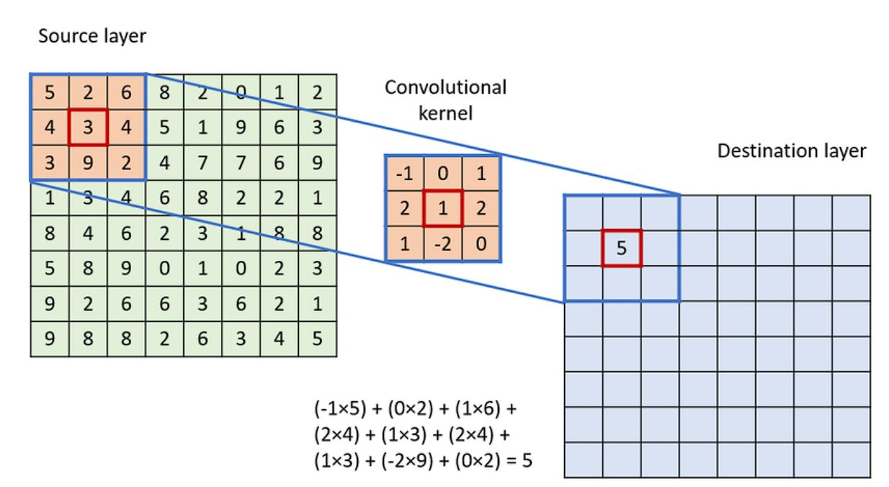

Slide 24
To apply the convolution:
Overlay the Kernel on the Image: Start from the top-left corner of the image and place the kernel so that its center aligns with the current image pixel.
Element-wise Multiplication: Multiply each element of the kernel with the corresponding element of the image it covers.
Summation: Sum up all the products obtained from the element-wise multiplication. This sum forms a single pixel in the output feature map.
Continue the Process: Slide the kernel over to the next pixel and repeat the process across the entire image.

Slide 25
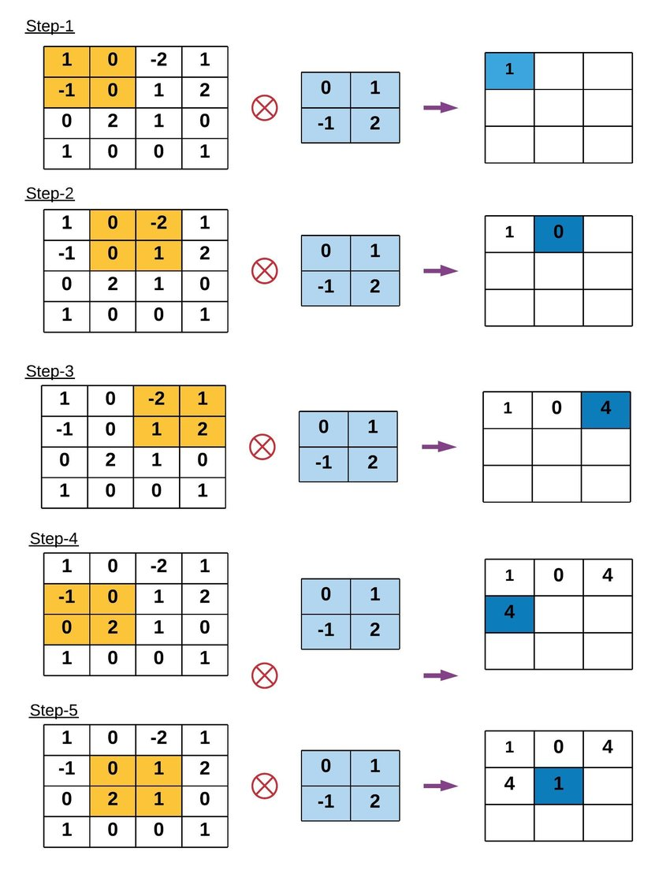
Example of Convolution Operation

Slide 26
Key Terms in Convolution Operation
Kernel Size: The convolution operation uses a filter, also known as a kernel, which is typically a square matrix.
Common kernel sizes are 3×3, 5×5, or even larger.
Larger kernels analyze more context within an image but come at the cost of reduced spatial resolution and increased computational demands.
Stride: Stride is the number of pixels by which the kernel moves as it slides over the image.
A stride of 1 means the kernel moves one pixel at a time, leading to a high-resolution output of the convolution.
Increasing the stride reduces the output dimensions, which can help decrease computational cost and control overfitting but at the loss of some image detail.
Padding: Padding involves adding an appropriate number of rows and columns (typically of zeros) to the input image borders.
This ensures that the convolution kernel fits perfectly at the borders, allowing the output image to retain the same size as the input image, which is crucial for deep networks to allow the stacking of multiple layers.

Slide 27
Types of Convolution Operations
1D Convolution
1D convolution is similar in principle to 2D convolution used in image processing.
In 1D convolution, a kernel or filter slides along the input data, performing element-wise multiplication followed by a sum, just as in 2D, but here the data and kernel are vectors instead of matrices.

Slide 28
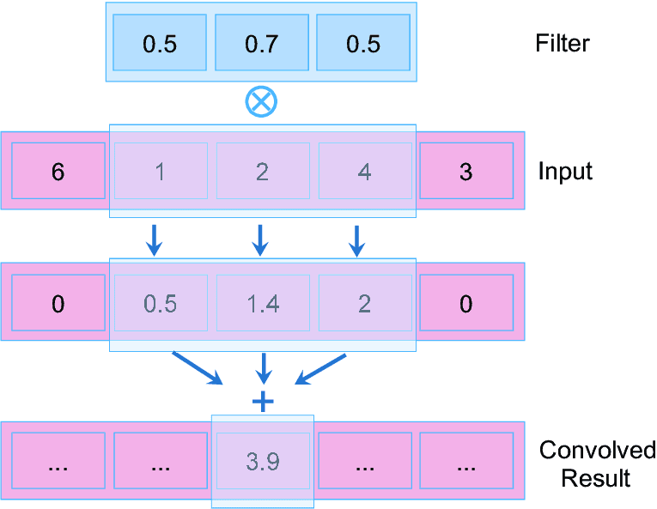

Slide 29
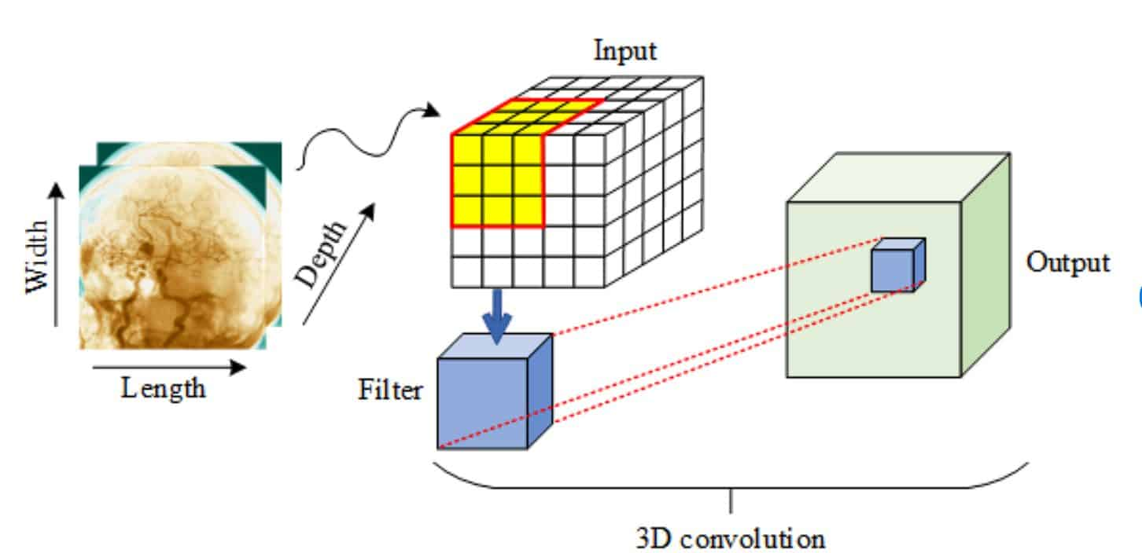
3D Convolution
3D convolution extends the concept of 2D convolution by adding a dimension, which is useful for analyzing volumetric data.
Like 2D convolution, a three-dimensional kernel moves across the data, but it now simultaneously processes three axes (height, width, and depth).

Slide 30
Padding
Padding refers to the process of adding extra pixels (usually zeros) around the border of the input image.
And strides refer to the number of pixels by which the filter (or kernel) moves or slides across the input image.

Slide 31
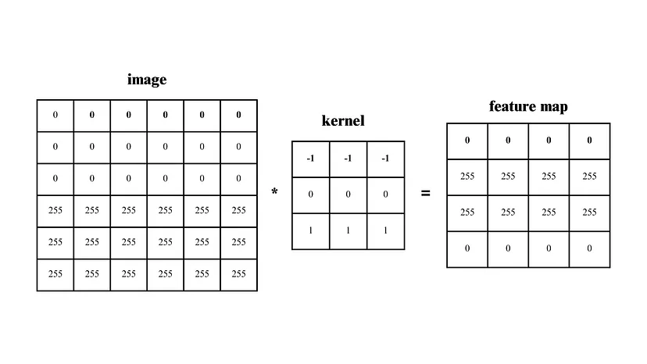

Slide 32
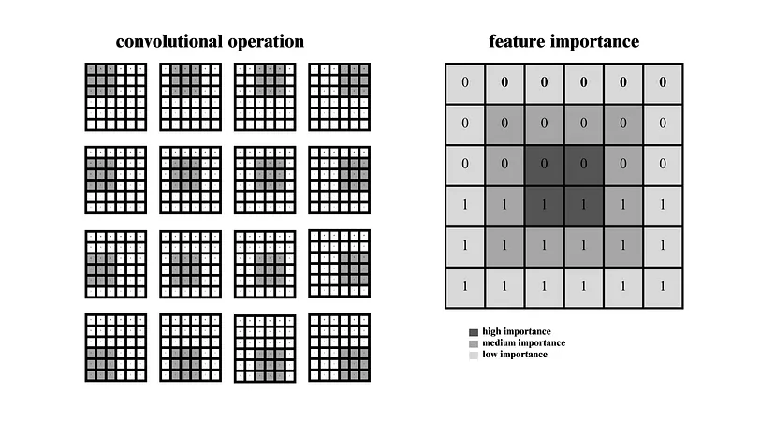

Slide 33
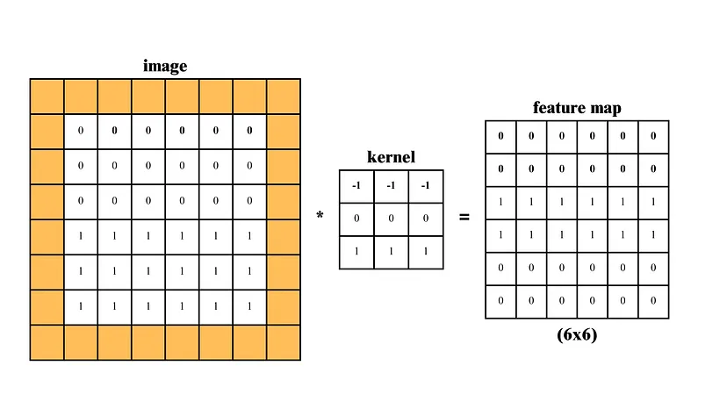

Slide 34
Strides
Strides basically indicate the “jumping of kernels”. In convolution operation, the kernel moves into one box on the right side after an operation is complete. But we can specify how many boxes it will exclude in every jumping.

Slide 35
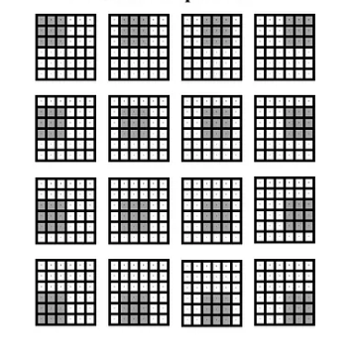
Strides 1

Slide 36
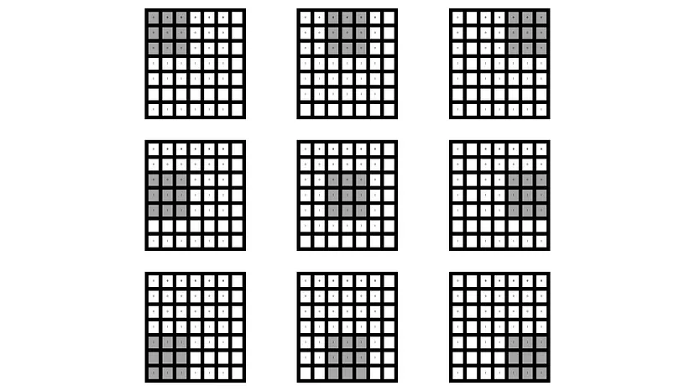
Strides 2

Slide 37
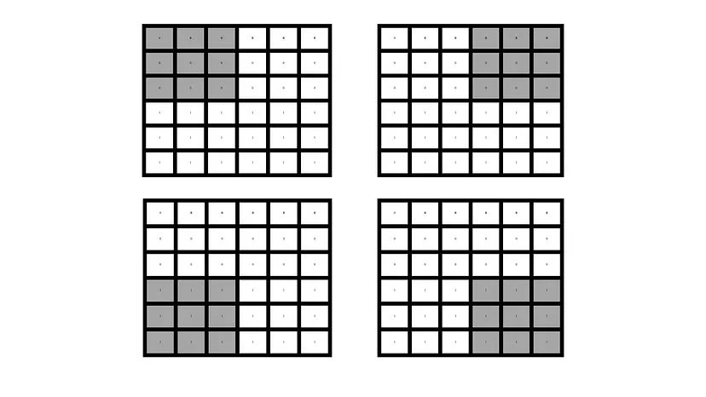
Stride 3

Slide 38
Why do we use striding?
1. In some projects you don’t need to extract all features from input datasets. You just need to extract high level features. In those cases, we need to use striding, because it specify the jump of the kernel, the more striding will be applied, the more low level feature will be ignored.
2. Sometimes we have limited computing resources with comparison of the size of the datasets. The more striding will be applied, the more high-level feature it will extract, the less computing resource will be needed. Also, the time will decrease.

Slide 39
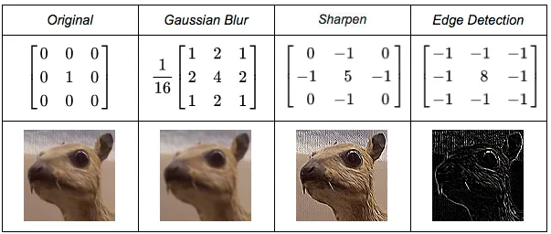
Convolution Kernels
A kernel is a small 2D matrix whose contents are based upon the operations to be performed.
A kernel maps on the input image by simple matrix multiplication and addition, the output obtained is of lower dimensions and therefore easier to work with.

Slide 40
Output Size
if the input is n X n and the filter size is f X f, then the output size will be (n-f+1) X (n-f+1):
Input: n X n
Filter size: f X f
Output: (n-f+1) X (n-f+1)

Slide 41
With padding
Input: n X n
Padding: p
Filter size: f X f
Output: (n+2p-f+1) X (n+2p-f+1)
There are two common choices for padding:
Valid: It means no padding. If we are using valid padding, the output will be (n-f+1) X (n-f+1)
Same: Here, we apply padding so that the output size is the same as the input size, i.e., n+2p-f+1 = n So, p = (f-1)/2

Slide 42
With strided
Input: n X n
Padding: p
Stride: s
Filter size: f X f
Output: [(n+2p-f)/s+1] X [(n+2p-f)/s+1]
Stride helps to reduce the size of the image, a particularly useful feature.

Slide 43
3D
Input: n X n X n_{c}
Filter: f X f X n_{c}
Padding: p
Stride: s
Output: [(n+2p-f)/s+1] X [(n+2p-f)/s+1] X n_{c}’
Here, n_{c} is the number of channels in the input and filter, while n_{c}’ is the number of filters.
Reference:
https://www.analyticsvidhya.com/blog/2018/12/guide-convolutional-neural-network-cnn/

Slide 44

Convolution Output Spatial Size
A 2D Convolution output feature size is determined by the formula,
where,
O: Output size
n: Input size (height or width)
f: kernel size
p: Padding
s: Stride
Suppose you have a 32×32 input with 3×3 kernel (f), same padding (p = 1 ) and No stride (i.e. s = 1)
The output feature map size is calculated as follows:

Slide 46

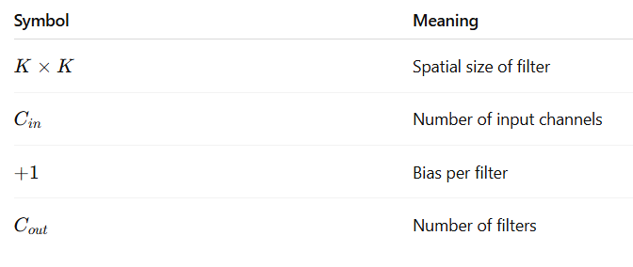
HOW TO CALCULATE NUMBER OF PARAMETERS

Slide 47

Input: 32 × 32 × 3 Kernel: 3 × 3 Filters: 16
$\left(3×3×3+1\right)×16$
$\left(27+1\right)×16=448$
Total parameters = 448

Slide 48

Input channels: 64 Kernel: 5 × 5 Filters: 128
$\left(5×5×64+1\right)×128$
$\left(1600+1\right)×128=204,928$

Slide 49
Pooling Layer
Pooling, also known as subsampling or downsampling, is a technique used in CNNs to reduce the spatial dimensions of feature maps while retaining essential information.
It helps in controlling the model’s complexity, reducing overfitting, and improving computational efficiency by reducing the number of parameters and computation required in subsequent layers.
The pooling operation involves sliding a two-dimensional filter over each channel of feature map and summarising the features lying within the region covered by the filter.

Slide 50
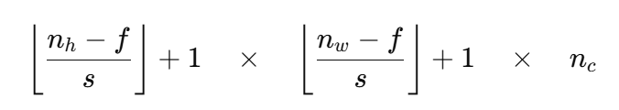
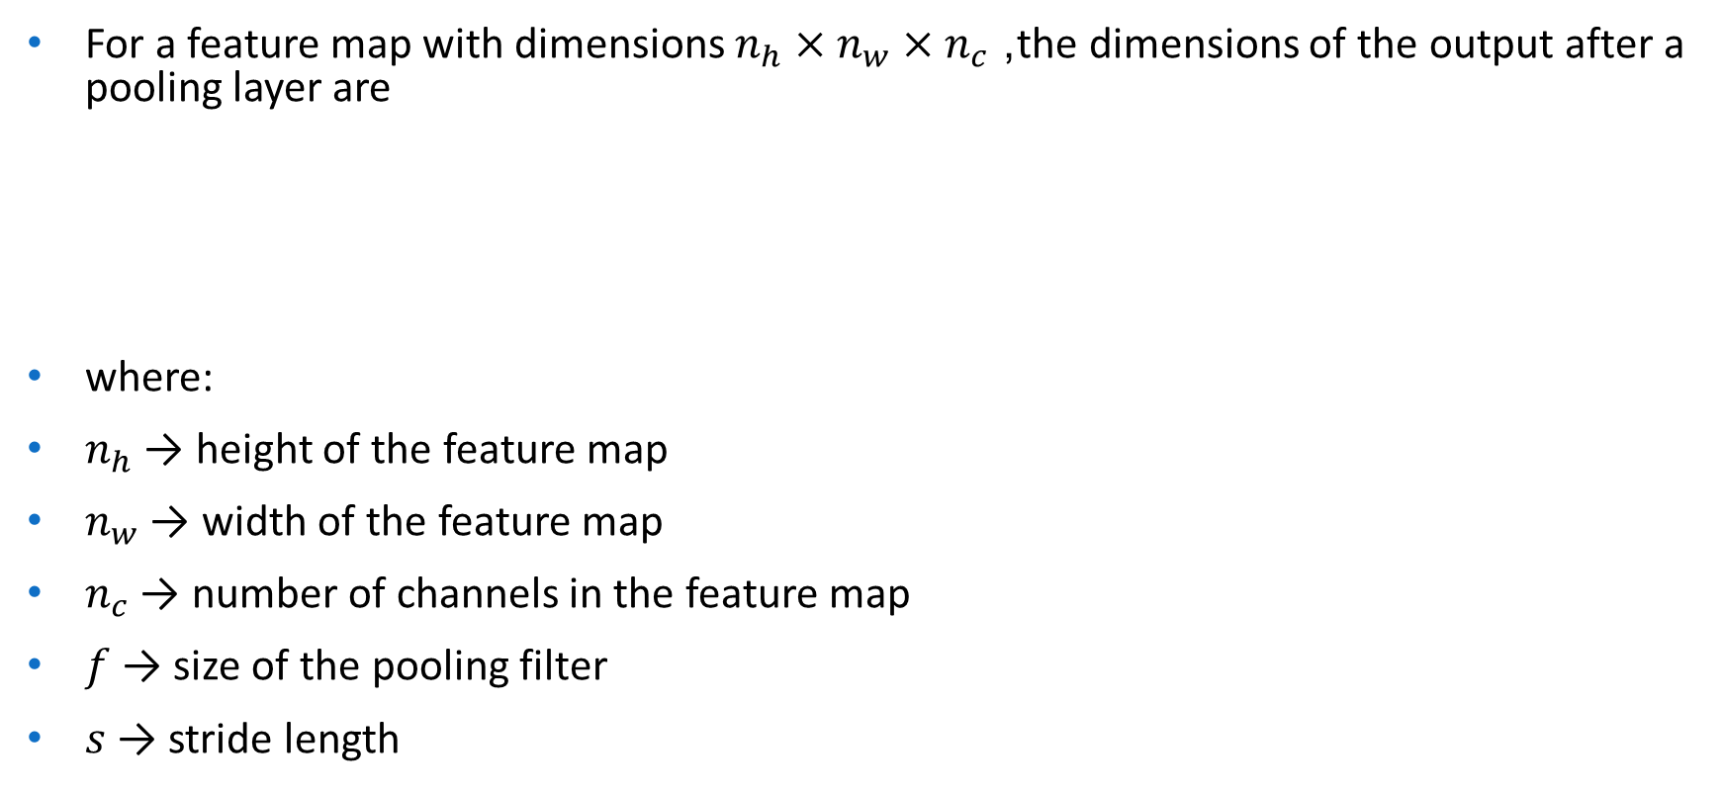
For a feature map with dimensions $n_{h}×n_{w}×n_{c}$, the dimensions of the output after a pooling layer are
where:
$n_{h}$ → height of the feature map
$n_{w}$ → width of the feature map
$n_{c}$ → number of channels in the feature map
$f$ → size of the pooling filter
$s$ → stride length

Slide 51
Why are Pooling Layers Important?
Dimensionality Reduction: Pooling layers reduce the spatial size of the feature maps, which decreases the number of parameters and computations in the network. This makes the model faster and more efficient.
Translation Invariance: Pooling helps the network become invariant to small translations or distortions in the input image. For example, even if an object in an image is slightly shifted, the pooled output will remain relatively unchanged.
Overfitting Prevention: By reducing the spatial dimensions, pooling layers help prevent overfitting by providing a form of regularization.
Feature Hierarchy: Pooling layers help build a hierarchical representation of features, where lower layers capture fine details and higher layers capture more abstract and global features.

Slide 52
Types of Pooling Layers
Max Pooling
Max pooling selects the maximum element from the region of the feature map covered by the filter.
Thus, the output after max-pooling layer would be a feature map containing the most prominent features of the previous feature map.
Max pooling layer preserves the most important features (edges, textures, etc.) and provides better performance in most cases.

Slide 53
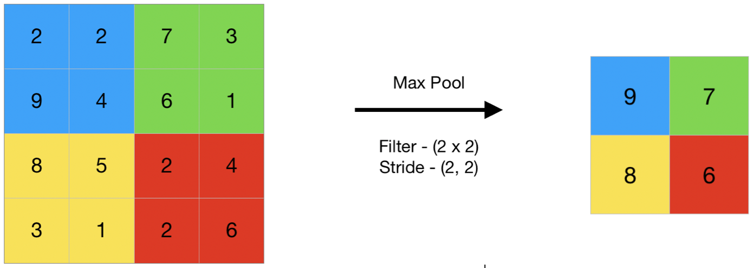

Slide 54
2. Average Pooling
Average pooling computes the average of the elements present in the region of feature map covered by the filter.
Thus, while max pooling gives the most prominent feature in a particular patch of the feature map, average pooling gives the average of features present in a patch.
Average pooling provides a more generalized representation of the input.
It is useful in the cases where preserving the overall context is important.

Slide 55
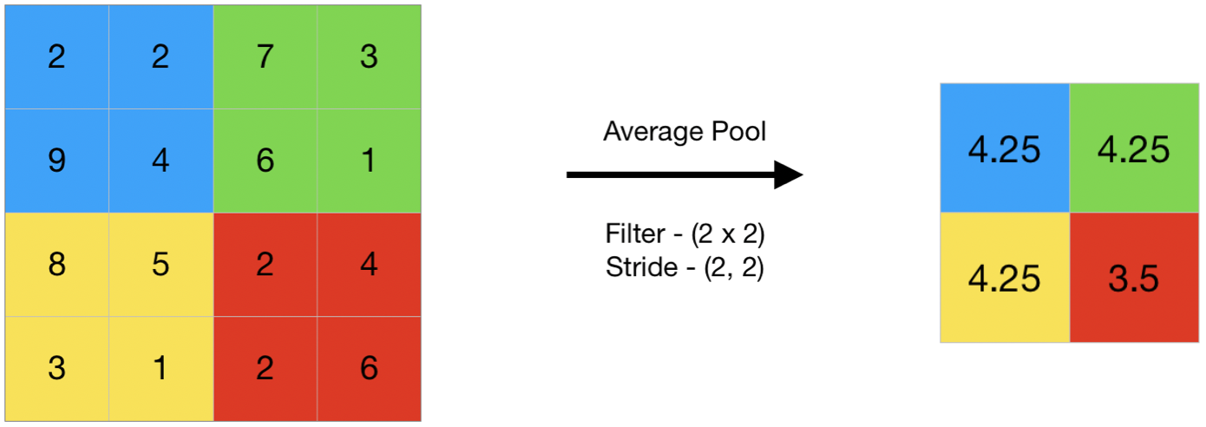

Slide 56
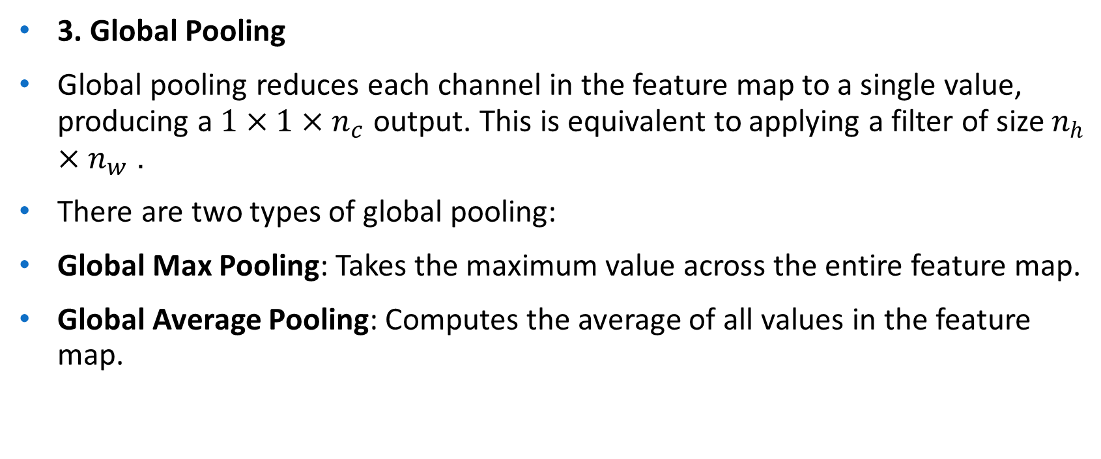
3. Global Pooling
Global pooling reduces each channel in the feature map to a single value, producing a $1×1×n_{c}$ output. This is equivalent to applying a filter of size $n_{h}×n_{w}$.
There are two types of global pooling:
Global Max Pooling: Takes the maximum value across the entire feature map.
Global Average Pooling: Computes the average of all values in the feature map.

Slide 57
How Pooling Layers Work?
Define a Pooling Window (Filter): The size of the pooling window (e.g., 2x2) is chosen, along with a stride (the step size by which the window moves). A common choice is a 2x2 window with a stride of 2, which reduces the feature map size by half.
Slide the Window Over the Input: The pooling operation is applied to each region of the input feature map covered by the window.
Apply the Pooling Operation: Depending on the type of pooling (max, average, etc.), the operation extracts the required value from each window.
Output the Downsampled Feature Map: The result is a smaller feature map that retains the most important information.

Slide 58
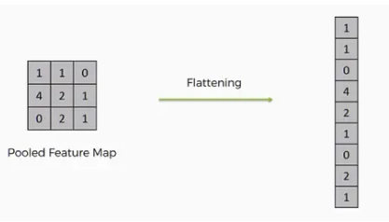
Flatten
Flattening is used to convert all the resultant 2-Dimensional arrays from pooled feature maps into a single long continuous linear vector.
The flattened matrix is fed as input to the fully connected layer to classify the image.

Slide 59
There are three variants of pooling operation depending on roots of regularization technique:
Stochastic pooling: Randomly picked activation within each pooling region is considered than deterministic pooling operations for regularization of the network. Stochastic pooling performs reduction of feature size but denies role for selecting features judiciously for the sake of regularization. Although clipping of negative output from ReLU activation helps to carry some of the selection responsibility.
Overlapping pooling: Overlapping pooling operation shares responsibility of local connection beyond the size of previous convolutional filter, which breaks orthogonal responsibility between pooling layer and convolutional layer. So, no information is gained if pooling windows overlap
Fractional pooling:Reduction ratio of filter size due to pooling can be controlled by a fractional pooling concept, which helps to increase the depth of the network. Unlike stochastic pooling, the randomness is related to the choice of pooling regions, not the way pooling is performed inside each of the pooling regions.

Slide 60
Overlapping pooling
Overlapping pooling occurs when the stride (S) is smaller than the pooling window size (F).
This causes successive pooling windows to share common input elements, i.e., they overlap.
S<F ⇒ Overlapping Pooling​

Slide 61
Why Overlapping Pooling is Used
Preserves more spatial information than non-overlapping pooling
Produces smoother feature maps
Helps reduce over-aggressive information loss
Pool size (F×F) | Stride (S) | Overlap
2×2 | 2 | No overlap
3×3 | 2 | Partial overlap
3×3 | 1 | Heavy overlap

Slide 62

Example : Max Pooling (Overlapping)
Given
Input (1D for clarity):
$\left[1 3 2 4 6\right]$
Pool size $F=3$
Stride $S=1$
Window | Elements | Max
1 | {1,3,2} | 3
2 | {3,2,4} | 4
3 | {2,4,6} | 6

Slide 63

Percentage of Overlap
1D Overlap
$\text{Overlap} \text{\%}=\frac{F−S}{F}×100$
2D Overlap
$\boxed{\text{Overlap} \text{\%}={\left(\frac{F−S}{F}\right)}^{2}×100}$

Slide 64

Total Pooling Regions in Overlapping Pooling
$\text{Total} \text{pooling} \text{regions}=H_{out}×W_{out}$
Overlapping pooling ⇒ More pooling regions ⇒ More retained information

Slide 65
Aspect | Non-Overlapping | Overlapping
Stride | S = F | S < F
Information loss | Higher | Lower
Output size | Smaller | Larger
Computation | Less | More
Used in | VGG | AlexNet

Slide 66
Advantages and Disadvantages
Advantages
Better feature preservation
Reduced aliasing effects
Improved accuracy in early CNNs
Disadvantages
Higher computation cost
Less dimensionality reduction
Mostly replaced by strided convolutions

Slide 67
https://d2l.ai/chapter_convolutional-neural-networks/pooling.html
https://mariammohamedfawzy.wordpress.com/2018/04/23/overlapping-pooling-and-overfitting/

Slide 68
CNN Architecture
Most CNN designs share a common set of parts:
Filters
Activation units
Down sampling layers
Dense layers
Output functions

Slide 69
Each of these layers in CNN plays a specific role, contributing to effective feature extraction and accurate predictions within the CNN architecture in deep learning. Below is a CNN architecture diagram in deep learning:

Slide 70
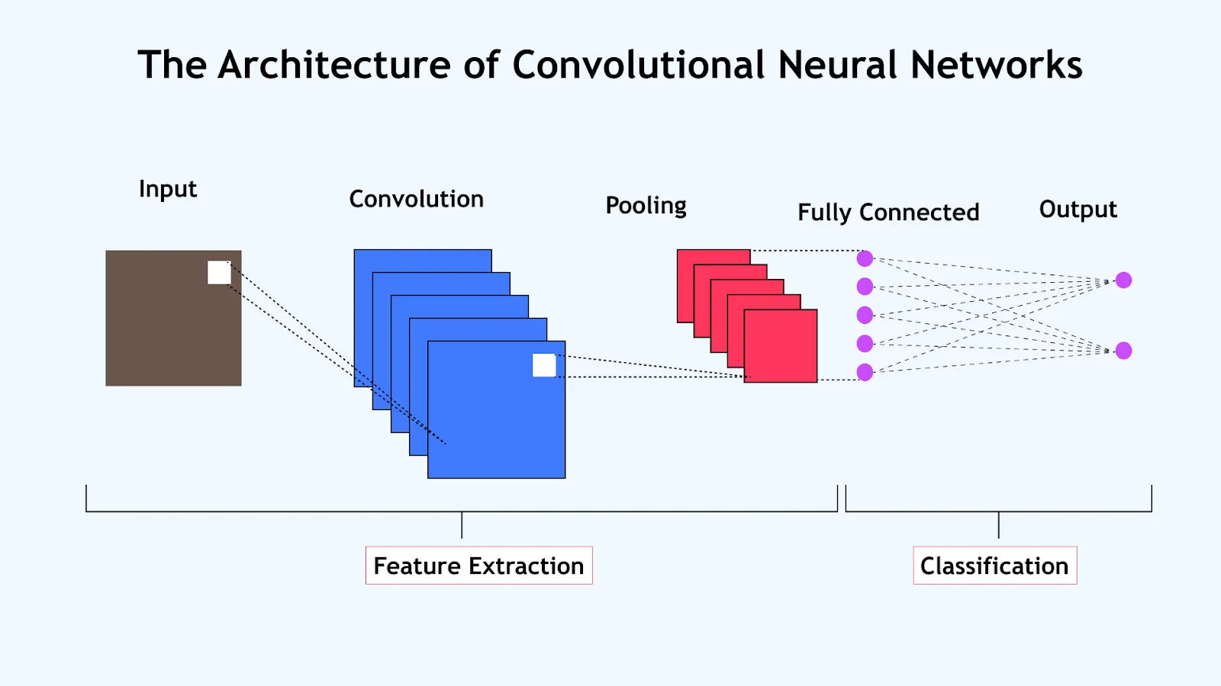

Slide 71
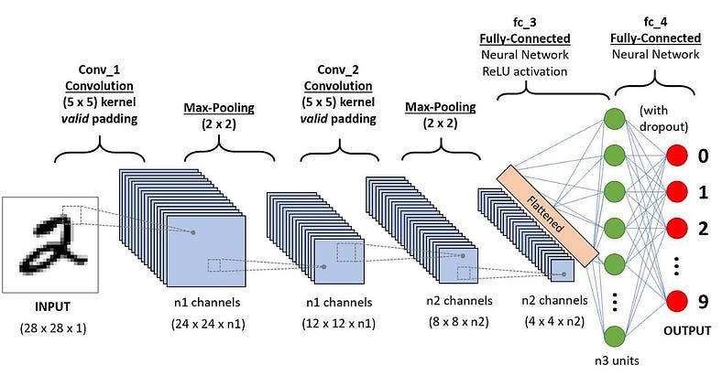

Slide 72
The above CNN diagram shows:
Component | Purpose
Filters | Extract edges, textures, and shapes
Activation units | Add nonlinearity to learn complex patterns
Downsampling | Reduce data size while keeping key details
Dense layers | Combine features for final decisions
Output functions | Convert scores into probabilities

Slide 73
Layers used to build CNN
Convolutional neural networks are distinguished from other neural networks by their superior performance with image, speech, or audio signal inputs. They have three main types of layers, which are:
Convolutional layer
Pooling layer
Fully-connected (FC) layer

Slide 74

Convolutional layer
This layer is the first layer that is used to extract the various features from the input images.
In this layer, We use a filter or Kernel method to extract features from the input image.

Slide 75
Pooling layer
The primary aim of this layer is to decrease the size of the convolved feature map to reduce computational costs.
This is performed by decreasing the connections between layers and independently operating on each feature map
. Depending upon the method used, there are several types of Pooling operations.
We have Max pooling and average pooling.

Slide 76
Fully-connected layer
The Fully Connected (FC) layer consists of the weights and biases along with the neurons and is used to connect the neurons between two different layers.
These layers are usually placed before the output layer and form the last few layers of a CNN Architecture.
Dropout
Another typical characteristic of CNNs is a Dropout layer.
The Dropout layer is a mask that nullifies the contribution of some neurons towards the next layer and leaves unmodified all others.

Slide 77
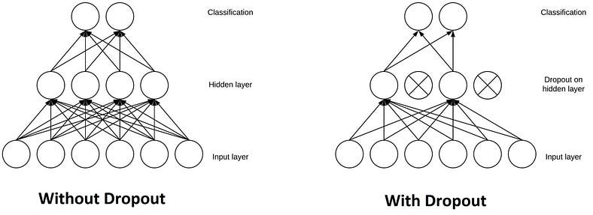

Slide 78
Activation Function
An Activation Function decides whether a neuron should be activated or not.
This means that it will decide whether the neuron’s input to the network is important or not in the process of prediction.
There are several commonly used activation functions such as the ReLU, Softmax, tanH, and the Sigmoid functions.
Each of these functions has a specific usage.

Slide 79
Sigmoid — For a binary classification in the CNN model
tanH - The tanh function is very similar to the sigmoid function. The only difference is that it is symmetric around the origin. The range of values, in this case, is from -1 to 1.
Softmax- It is used in multinomial logistic regression and is often used as the last activation function of a neural network to normalize the output of a network to a probability distribution over predicted output classes.
RelU- the main advantage of using the ReLU function over other activation functions is that it does not activate all the neurons at the same time.

Slide 80
Receptive field in deep learning
The receptive field (RF) is a fundamental concept in deep learning—especially in Convolutional Neural Networks (CNNs)—that describes how much of the input data influences a particular neuron (activation) in a given layer.
Receptive Field = the region of the input that a neuron “sees.”
In early layers → small, local regions
In deeper layers → larger, more global regions
In very deep layers → neuron may depend on almost the entire input
This mirrors the human visual cortex, where early neurons detect edges and later neurons recognize objects.

Slide 81
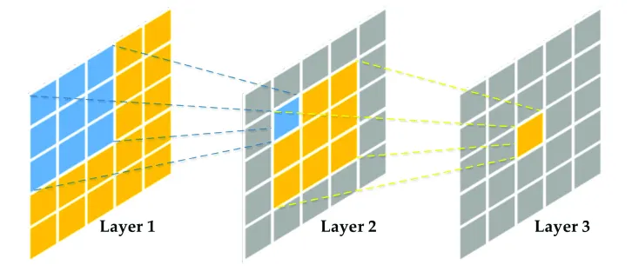

Slide 82
The receptive field is determined by the size of the convolutional kernel (also known as the filter) and the stride used during the convolution operation.
The receptive field of a neuron in a particular layer can be thought of as the area of the input image that directly influences the neuron’s output.

Slide 83
Local Receptive Field: In the initial layers of a CNN, individual neurons have a small local receptive field, which means they only look at a small portion of the input image. As you move deeper into the network, the receptive field of neurons typically grows, allowing them to capture information from larger regions of the input.
Spatial Hierarchy: CNNs are designed in a hierarchical manner, where each layer captures features from a larger portion of the input than the previous layer. This hierarchy helps in recognizing both low-level features (e.g., edges and textures) and high-level features (e.g., object parts and objects) as you progress through the layers.
Receptive Field Size Calculation: The size of the receptive field for a neuron in a given layer depends on the size of the convolutional kernel and the strides used. If a layer uses larger kernels and strides, its neurons have larger receptive fields. Conversely, smaller kernels and strides result in smaller receptive fields.
Padding: Padding is often used to control the size of the output feature maps. Zero-padding the input can be employed to ensure that the output feature maps have the same spatial dimensions as the input. This can be useful for maintaining the spatial hierarchy and avoiding a reduction in spatial resolution too quickly.

Slide 84
Real-World Applications
Optimizing the receptive field is critical for the success of various AI solutions.
Autonomous Driving: In AI for automotive, perception systems must simultaneously track minute details and large obstacles. A vehicle needs a small receptive field to identify distant traffic lights, while simultaneously requiring a large receptive field to understand the trajectory of a nearby truck or the curvature of the road lane. This multi-scale perception ensures better AI safety and decision-making.
Medical Diagnostics: When applying AI in healthcare, radiologists rely on models to spot anomalies in scans. For identifying brain tumors, the network requires a large receptive field to understand the brain's overall symmetry and structure. However, to detect micro-calcifications in mammography, the model relies on early layers with small receptive fields sensitive to subtle texture changes.

Slide 85
To fully understand network design, it is helpful to differentiate the receptive field from similar terms:
Receptive Field vs. Kernel: The kernel (or filter) size defines the dimensions of the sliding window (e.g., 3x3) for a single convolution operation. The receptive field is an emergent property representing the total accumulated input area affecting a neuron. A stack of multiple 3x3 kernels will result in a receptive field much larger than 3x3.
Receptive Field vs. Feature Map: A feature map is the output volume produced by a layer, containing the learned representations. The receptive field describes the relationship between a single point on that feature map and the original input image.
Receptive Field vs. Context Window: While both terms refer to the scope of perceived data, "context window" is typically used in Natural Language Processing (NLP) or video analysis to denote a temporal or sequential span (e.g., token limit). Receptive field strictly refers to the spatial area in grid-like data (images).

Slide 86
https://medium.com/data-science/advanced-topics-in-deep-convolutional-neural-networks-71ef1190522d
https://towardsdatascience.com/r-cnn-fast-r-cnn-faster-r-cnn-yolo-object-detection-algorithms-36d53571365e/
https://www.mathworks.com/help/vision/ug/getting-started-with-r-cnn-fast-r-cnn-and-faster-r-cnn.html
https://d2l.ai/chapter_computer-vision/rcnn.html

Slide 88
Convolution Neural Networks
LeNet
At a high level, LeNet (LeNet-5) consists of two parts:
(i) a convolutional encoder consisting of two convolutional layers; and
(ii) a dense block consisting of three fully connected layers.
The architecture is summarized

Slide 89
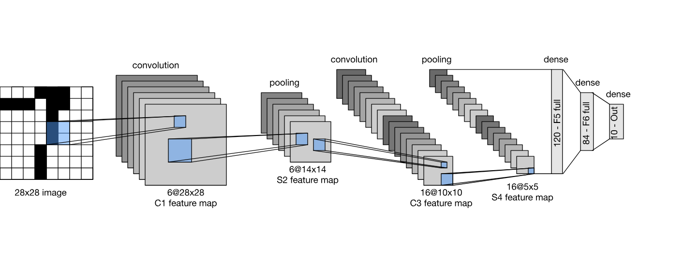

Slide 90
The basic units in each convolutional block are a convolutional layer, a sigmoid activation function, and a subsequent average pooling operation.
Note that while ReLUs and max-pooling work better, they had not yet been discovered.
Each convolutional layer uses a kernel and a sigmoid activation function.
These layers map spatially arranged inputs to a number of two-dimensional feature maps, typically increasing the number of channels.
The first convolutional layer has 6 output channels, while the second has 16.
Each pooling operation (stride 2) reduces dimensionality by a factor of via spatial downsampling.
The convolutional block emits an output with shape given by (batch size, number of channel, height, width).

Slide 91
In order to pass output from the convolutional block to the dense block, we must flatten each example in the minibatch.
In other words, we take this four-dimensional input and transform it into the two-dimensional input expected by fully connected layers: as a reminder,
the two-dimensional representation that we desire uses the
first dimension to index examples in the minibatch and
the second to give the flat vector representation of each example.
LeNet’s dense block has three fully connected layers, with 120, 84, and 10 outputs, respectively. Because we are still performing classification, the 10-dimensional output layer corresponds to the number of possible output classes.
https://d2l.ai/chapter_convolutional-neural-networks/lenet.html

Slide 92
Input → C1 → S2 → C3 → S4 → C5 → F6 → Output
1. Input Layer
Size: 32 × 32 × 1
MNIST (28×28) is padded to 32×32
2. C1: Convolution Layer
Filters: 6
Kernel size: 5 × 5
Output size: 28 × 28 × 6
Activation: tanh
Learns basic features like edges
3. S2: Subsampling (Pooling) Layer
Type: Average pooling
Kernel: 2 × 2
Output size: 14 × 14 × 6
Reduces spatial size and computation
4. C3: Convolution Layer
Filters: 16
Kernel: 5 × 5
Output size: 10 × 10 × 16
Learns complex features (curves, patterns)
5. S4: Subsampling Layer
Average pooling
Output size: 5 × 5 × 16
6. C5: Convolution Layer (acts like FC)
Filters: 120
Kernel: 5 × 5
Output: 1 × 1 × 120
Fully connected to previous layer
7. F6: Fully Connected Layer
Neurons: 84
Activation: tanh
8. Output Layer
Neurons: 10
Represents digits 0–9
Originally used Softmax-like classifier

Slide 93
Deep Convolutional Models
Deep Convolutional Models(DCMs) are neural networks with many stacked convolutional layers designed to automatically learn hierarchical features from data—especially images, videos, and spatial signals.
“Deep” = multiple convolution + non-linear + pooling layers “Convolutional” = local receptive fields + shared weights
They are the backbone of CNNs used in:
Image classification
Object detection
Medical imaging
Satellite imagery
Autonomous driving
Video analytics

Slide 94
Layer Depth | What the Network Learns
Shallow layers | Edges, corners, textures
Middle layers | Shapes, motifs, parts
Deep layers | Objects, semantics, context

Slide 95
What are the layers in a DCNN model?
A deep convolutional neural network architecture includes five components:
1. Convolutional layer and rectified linear unit (ReLu) 2. Pooling layer 3. Fully connected layer 4. Dropout 5. Activation functions

Slide 96
A deep convolutional neural network is composed of five layers.
The convolutional and ReLU layer is used to extract features from the input images.
The pooling layer reduces the computational cost.
The fully connected layer initiates the classification stage.
The dropout layer tackles overfitting by randomly dropping a few neurons from the model.
And finally, the activation functions layer is where the model collects the dots among the data points and learns.

Slide 97
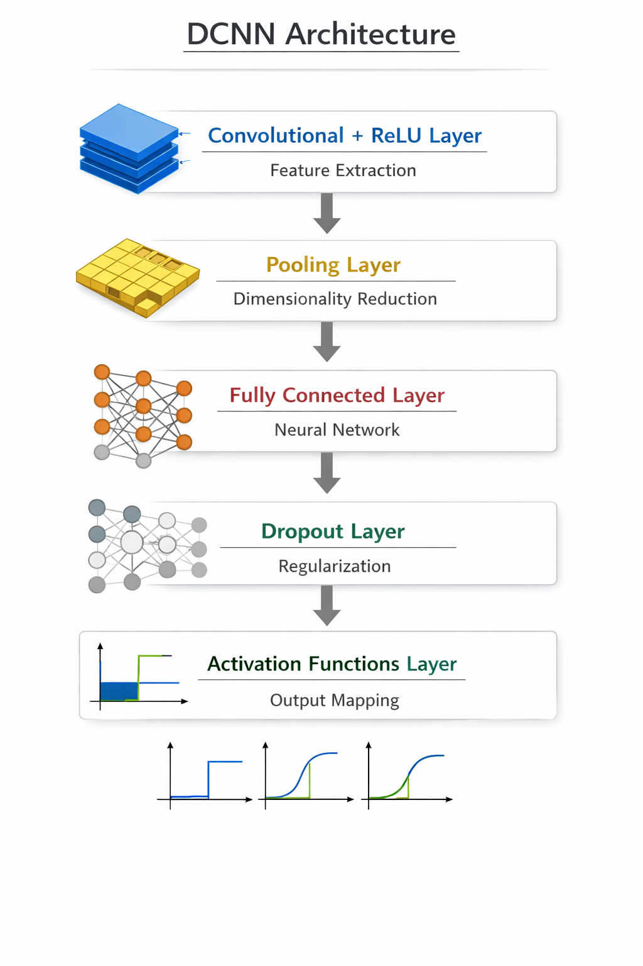

Slide 98
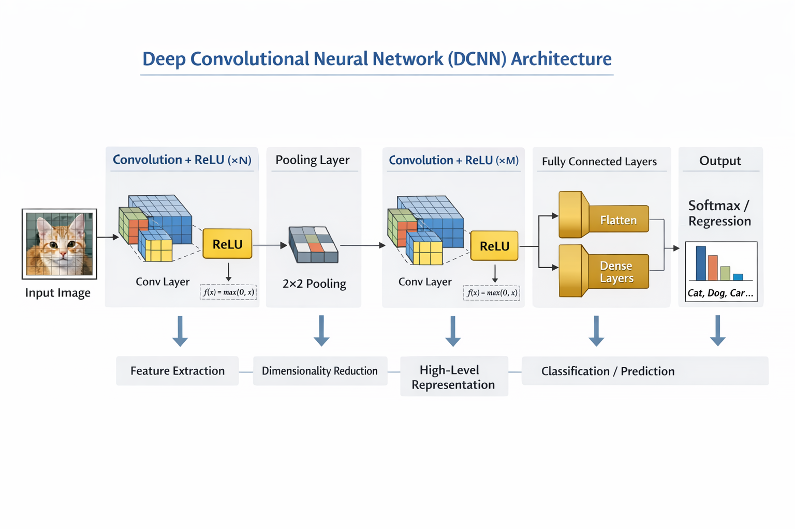

Slide 99
1. Convolutional Layer and ReLu
This layer is the first layer that is used to extract the various features from the input images.
In this layer, the mathematical operation of convolution is performed between the input image and a filter of a particular size MxM.
By sliding the filter over the input image, the dot product is taken between the filter and the parts of the input image with respect to the size of the filter (MxM).
The output is termed as the feature map which gives us information about the image such as the corners and edges.
Later, this feature map is fed to other layers to learn several other features of the input image.

Slide 100
2. Pooling Layer
In most cases, a convolutional layer is followed by a pooling layer.
The primary aim of this layer is to decrease the size of the convolved feature map to reduce computational costs.
This is performed by decreasing the connections between layers and independently operating on each feature map.
Depending upon the method used, there are several types of pooling operations.
In max pooling, the largest element is taken from the feature map.
Average pooling calculates the average of the elements in a predefined size image section.
The total sum of the elements in the predefined section is computed in sum pooling
The pooling layer usually serves as a bridge between the convolutional layer and the fully connected layer

Slide 101
3. Fully Connected Layer
The fully connected (FC) layer consists of the weights and biases along with the neurons and is used to connect the neurons between two different layers.
These layers are usually placed before the output layer and form the last few layers of a CNN architecture.
In this, the input image from the previous layers is flattened and fed to the FC layer.
The flattened vector then undergoes a few more FC layers where mathematical operations usually take place.
In this stage, the classification process begins to take place.

Slide 102
4. Dropout Layer
Usually, when all the features are connected to the FC layer, it can cause overfitting in the training data set.
Overfitting occurs when a particular model works so well on the training data causing a negative impact on the model’s performance when used on new data.
To overcome this problem, a dropout layer is utilized, wherein a few neurons are dropped from the neural network during the training process resulting in reduced size of the model.
On passing a dropout of 0.3, 30 percent of the nodes are dropped out randomly from the neural network.

Slide 103
5. Activation Functions Layer
Finally, one of the most important parameters of the CNN model is the activation function.
They are used to learn and approximate any kind of continuous and complex relationship between variables of the network.
In simple words, it decides which information of the model should fire in the forward direction and which ones should not at the end of the network.
It adds non-linearity to the network.
There are several commonly used activation functions such as the ReLU, Softmax, tanH, and the Sigmoid functions.
Each of these functions has a specific usage.
For a binary classification CNN model, Sigmoid and softmax functions are preferred and for multiclass classification, softmax is used.

Slide 104
How Does a DCNN Work?
However, When presented with a new image, the CNN doesn’t know exactly where these features will match, so it tries them everywhere, in every possible position.
It matches feature matrices in steps by shifting the defined steps at a time. In calculating the match to a feature across the whole image, we make it a filter.
The math we use to do this is called convolution, from which convolutional neural networks take their name.

Slide 105
The next step is to repeat the convolution process in its entirety for each of the other features.
The result is a set of filtered images, one for each of our filters.
It’s convenient to think of this whole collection of convolution operations as a single processing step.

Slide 106
Now comes the step where we introduce so-called “non-linearity” in our model, so that our model can predict and learn non-linear boundaries.
A very common way to do this is using a nonlinear function (like ReLU or GeLU).
The most popular non-linear function is ReLU which performs a simple math operation: wherever a negative number occurs, swap it out for a 0.
This helps the CNN stay mathematically healthy by keeping learned values from getting stuck near zero or blowing up toward infinity.
Note that this convolution and ReLU operation may create massive feature maps, and it’s crucial to reduce the feature map size while keeping the identified feature intact.

Slide 107
Pooling is a way to take large images and shrink them down while preserving the most important information in them.
It consists of stepping a small window across an image and taking the maximum value from the window at each step. In practice, a window of two or three pixels on a side and steps of two pixels work well.
A pooling layer is just the operation of performing pooling on an image or a collection of images.
The output will have the same number of images, but they will each have fewer pixels.
This is also helpful in managing the computational load.

Slide 108
Once the desired amount of convolution operations are performed,depending upon the designed model, it is now time to make use of the power of deep learning neural networks to harness the full potential of the operations performed in earlier stages.
But before we pass the pooled feature maps to the neural network for learning, we need to flatten the matrices.
The reason is very obvious: a neural network only accepts a single dimension input. So, we stack them like Lego bricks.
In the end, raw images get filtered, rectified, and pooled to create a set of shrunken, feature-filtered images, and now it is ready to go into the world of neurons, a neural network.

Slide 109
The fully connected layers in the neural network take the high-level filtered images, one dimension rectified pooled feature map, and translate them into votes (or signals).
These votes are expressed as weights, or connection strengths, between each value and each category.
When a new image is presented to the CNN, it percolates through the lower layers until it reaches the fully connected layer at the end.
Then an election is held. The answer with the most votes wins and is declared the category of the input.

Slide 110
Challenges in Deep Convolutional Models
1. Vanishing / Exploding Gradients
Especially in very deep networks
2. Overfitting
Due to large parameter count
3. Computational Cost
Memory and GPU intensive
4. Degradation Problem
Accuracy decreases when depth increases (not overfitting)

Slide 111
Solutions to Deep CNN Challenges
Problem | Solution
Vanishing gradients | ReLU, BatchNorm
Overfitting | Dropout, augmentation
Degradation | Residual connections
High computation | Depthwise separable conv

Slide 112
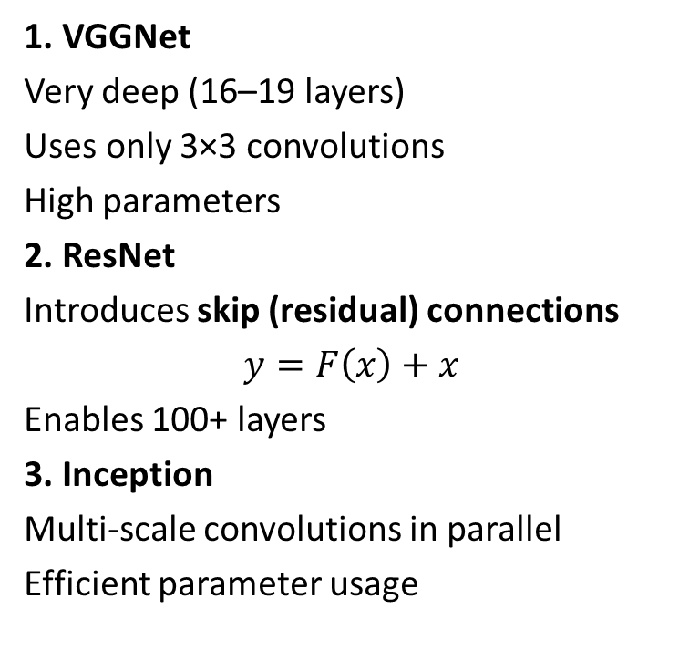
Popular Deep Convolutional Models
1. VGGNet
Very deep (16–19 layers)
Uses only 3×3 convolutions
High parameters
2. ResNet
Introduces skip (residual) connections
$$y=F\left(x\right)+x$$
Enables 100+ layers
3. Inception
Multi-scale convolutions in parallel
Efficient parameter usage
4. DenseNet
Each layer connects to all previous layers
Strong feature reuse
5. MobileNet
Depthwise separable convolutions
Lightweight for edge devices

Slide 113
AlexNet: AlexNet is a CNN architecture that was developed by Alex Krizhevsky, Ilya Sutskever and Geoffrey Hinton in 2012.
It was the first CNN to win the ImageNet Large Scale Visual Recognition Challenge (ILSVRC) a major image recognition competition.
It consists of several layers of convolutional and pooling layers followed by fully connected layers.
The architecture includes five convolutional layers, three pooling layers and three fully connected layers.

Slide 114
AlexNet
AlexNet is a deep learning model that made a big impact in image recognition.
It became famous for its ability to classify images accurately.
It won the ImageNet Large Scale Visual Recognition Challenge (ILSVRC) 2012 with a top-5 error rate of 15.3% (beating the runner up which had a top-5 error rate of 26.2%).
Most important features of the AlexNet are:
Overfitting Prevention: Dropout (0.5) was applied to the first two fully connected layers and data augmentation dynamically expanded the dataset hence both helping in reducing overfitting.
Faster Training: ReLU activation was used instead of tanh or sigmoid, leading to a 6× speedup in training by avoiding activation saturation.

Slide 115
AlexNet stands as a key milestone in computer vision, demonstrating the power of deep architectures for image recognition.
With eight layers, 62.3 million parameters, and innovations like ReLU activation and dropout, it laid the foundation for modern AI models.

Slide 116
AlexNet Architecture
AlexNet comprises a rather simple architecture compared to the latest Deep Learning Models. It consists of 8 layers: 5 convolutional layers and 3 fully connected layers.
However, it integrates several key innovations of its time, including the ReLU Activation Functions, Local Response Normalization (LRN), and Overlapping Max Pooling. We will look at each of them below.

Slide 117
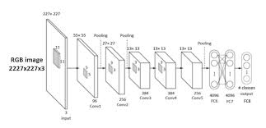

Slide 118
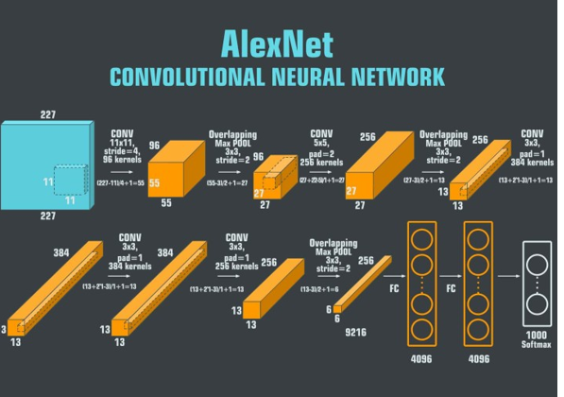

Slide 119
Input Layer
AlexNet takes images of the Input size of 227x227x3 RGB Pixels.
Convolutional Layers
First Layer: The first layer uses 96 kernels of size 11×11 with a stride of 4, activates them with the ReLU activation function, and then performs a Max Pooling operation.
Second Layer: The second layer takes the output of the first layer as the input, with 256 kernels of size 5x5x48.
Third Layer: 384 kernels of size 3x3x256. No pooling or normalization operations are performed on the third, fourth, and fifth layers.
Fourth Layer: 384 kernels of size 3x3x192.
Fifth Layer: 256 kernels of size 3x3x192.
Fully Connected Layers
The fully connected layers have 4096 neurons each.
Output Layer
The output layer is a SoftMax layer that outputs probabilities of the 1000 class labels.

Slide 120
Alexnet
It uses
Stochastic Gradient Descent
Momentum
Weight Decay
Data Augmentation
Dropout Layers
Overlapping Pooling

Slide 121
ImageNet
ImageNet is a vast visual database designed for object recognition research.
It consists of over 14 million hand-annotated images with over 20,000 categories.
This dataset played a major role in the success of AlexNet and the advancements in DL, as there was no large dataset on which Deep NNs could be trained previously.

Slide 122
Purpose of ImageNet
ImageNet was created to:
Provide massive labeled image data
Enable training of deep convolutional neural networks
Benchmark image recognition algorithms
Before ImageNet, datasets were too small for deep CNNs.

Slide 123
The ImageNet project also conducts an annual ImageNet Large Scale Visual Recognition Challenge (ILSVRC) where researchers evaluate their algorithms to classify objects and scenes correctly.
The competition is important because it enables researchers to push the limits of existing models and invent new methodologies.
Several breakthrough models have been unveiled in this competition, AlexNet being one of them.

Slide 124
Residual Networks (ResNet) - Deep Learning
To overcome the challenges of training very deep neural networks, Residual Networks (ResNet) was introduced, which uses skip connections that allow the model to learn residual mappings instead of direct transformations making deep neural networks easier to train.
It helps prevent vanishing gradient problems in very deep models.
Skip connections let information flow directly across layers.
ResNet enables building networks with hundreds or even thousands of layers.
It is widely used in computer vision tasks like image classification and object detection.
The ResNet architecture enables the network to learn multiple layers of features without getting stuck in local minima, a common issue with deep networks.

Slide 125
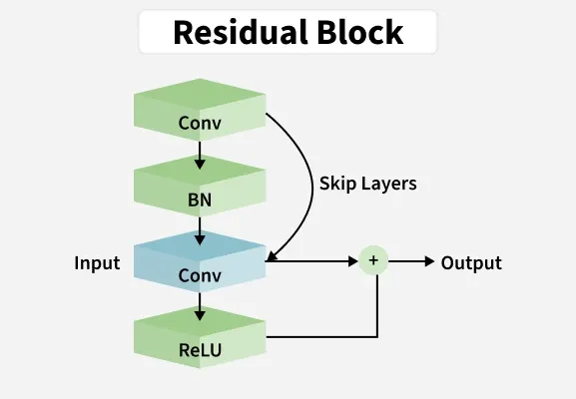

Slide 126
ResNet stands for Residual Network. It is an innovative neural network architecture that was first introduced by Kaiming He, Xiangyu Zhang, Shaoqing Ren, and Jian Sun in their 2015 computer vision research paper titled ‘Deep Residual Learning for Image Recognition’.
This model was immensely successful, as can be ascertained from the fact that its ensemble won the top position at the ILSVRC 2015 classification competition with a training error of only 3.57%.
Additionally, it also came first in ImageNet detection, ImageNet dataset localization, COCO detection, and COCO segmentation in the ILSVRC & COCO in 2015 competitions.
Additionally, ResNet has many variants that run on the same concept but have different numbers of pooling layers. Resnet 50 is used to denote the variant that can work with 50 neural network layers.

Slide 127
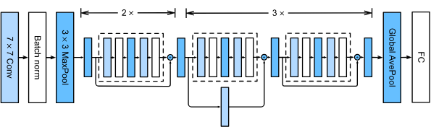

Slide 128
There are four convolutional layers in each module
Together with the first convolutional layer and the final fully connected layer, there are 18 layers in total.
Therefore, this model is commonly known as ResNet-18.
By configuring different numbers of channels and residual blocks in the module, we can create different ResNet models, such as the deeper 152-layer ResNet-152.
Although the main architecture of ResNet is similar to that of GoogLeNet, ResNet’s structure is simpler and easier to modify.

Slide 129
What are the Features of ResNet?
Residual Connections: ResNet incorporates residual connections, which allow for training very deep neural networks and alleviate the vanishing gradient problem.
Identity Mapping: ResNet uses identity mapping as the residual function, which makes the training process easier by learning the residual mapping rather than the actual mapping.
Depth: ResNet enables the creation of very deep neural networks, which can improve performance on image recognition tasks.
Fewer Parameters: ResNet achieves better results with fewer parameters, making it computationally more efficient.
State-of-the-art Results: ResNet has achieved state-of-the-art results on various image recognition tasks and has become a widely used benchmark for image recognition tasks.
General and Effective Approach: The authors conclude that residual connections are a general and effective approach for enabling deeper networks.

Slide 130
How ResNet Works?
ResNet works by adding residual connections to the network, which helps to maintain the information flow throughout the network and prevents the gradients from vanishing.
The residual connection is a shortcut that allows the information to bypass one or more layers in the network and reach the output directly.
The residual connection allows the network to learn the residual function and make small updates to the parameters, which enables the network to converge faster and achieve better performance.
This enables the network to learn residual functions and helps the network to converge faster and achieve better performance.
The residual connection is based on the idea that instead of trying to learn the complex mapping between the inputs and the outputs, it is easier to learn the residual function, which maps the inputs to the desired outputs.

Slide 131
Variants
Model | Depth
ResNet-18 | 18 layers
ResNet-34 | 34 layers
ResNet-50 | 50 layers
ResNet-101 | 101 layers
ResNet-152 | 152 layers
https://viso.ai/deep-learning/resnet-residual-neural-network/

Slide 132
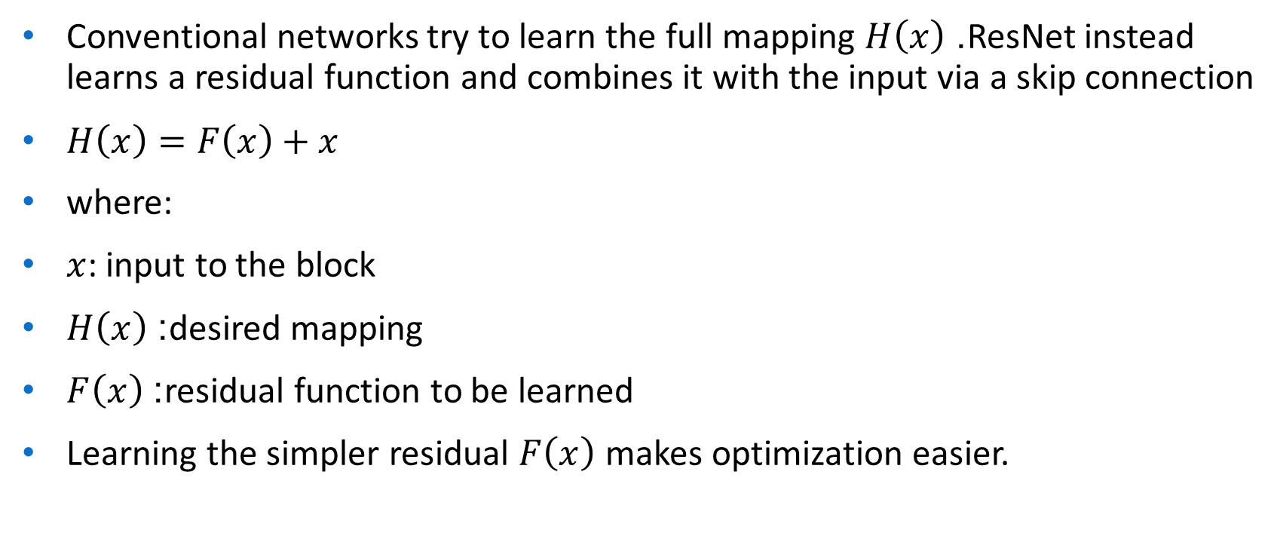
How ResNet Works
Conventional networks try to learn the full mapping $H\left(x\right)$. ResNet instead learns a residual function and combines it with the input via a skip connection
$H\left(x\right)=F\left(x\right)+x$
where:
$x$: input to the block
$H\left(x\right)$: desired mapping
$F\left(x\right)$: residual function to be learned
Learning the simpler residual $F\left(x\right)$ makes optimization easier.

Slide 133
1. Residual Block: A Residual Block contains:
One or more convolutional layers
A skip connection that bypasses these layers
Addition of input to convolution output
This ensures uninterrupted flow of information and gradients

Slide 134
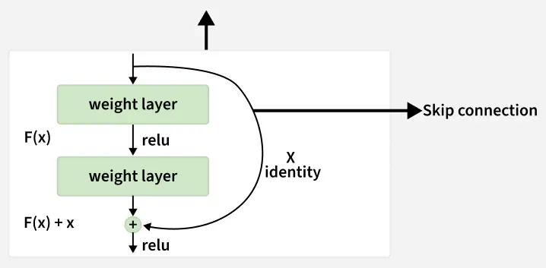

Slide 135
2. Skip (Shortcut) Connection
Bypasses one or more layers
Adds input directly to output
Prevents vanishing gradients
Improves parameter updates

Slide 136
Handling Dimension Mismatch: When input and output dimensions differ
Zero Padding: Adds extra zeros to the input to match output dimensions in a residual block
Linear Projection: Uses a learnable 1x1 convolution to match input and output dimensions for the skip connection.
3. Stacking Residual Blocks : Multiple residual blocks can be stacked to create deep architectures. This allows networks to go very deep without suffering from degradation.
4. Global Average Pooling (GAP): Before the final fully connected layer ResNet uses GAP:
Converts each feature map to a single value by averaging
Reduces parameters less overfitting
Produces compact feature representation

Slide 137
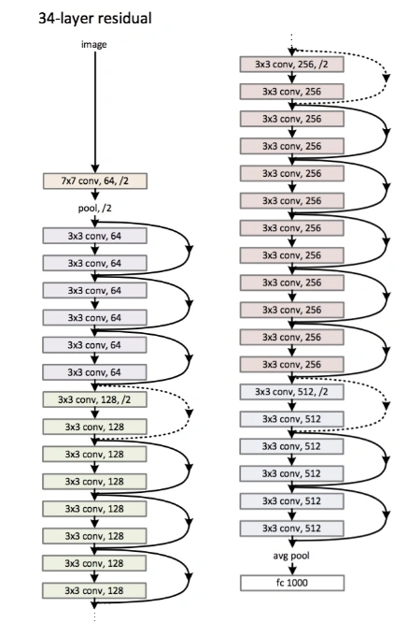

Slide 138
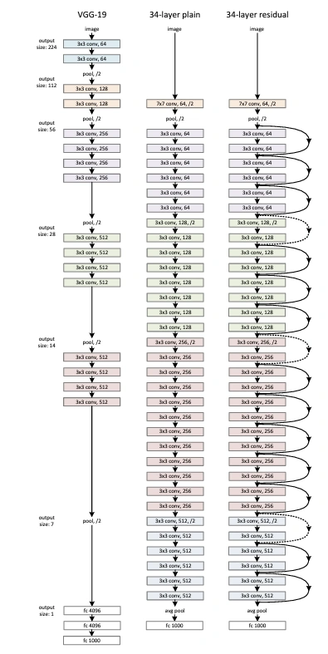

Slide 139
Very Deep Convolutional Networks (VGG)
VGG stands for Visual Geometry Group; it is a standard deep Convolutional Neural Network (CNN) architecture with multiple layers.
The “deep” refers to the number of layers with VGG-16 or VGG-19 consisting of 16 and 19 convolutional layers.
The VGG architecture is the basis of ground-breaking object recognition models.
Developed as a deep neural network, the VGGNet also surpasses baselines on many tasks and datasets beyond ImageNet.
Moreover, it is still one of the most popular image recognition architectures.

Slide 140
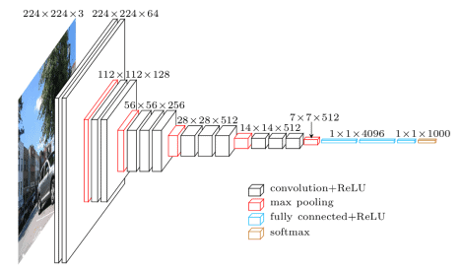

Slide 141
The VGG models were introduced by Karen Simonyan and Andrew Zisserman in their 2014 paper titled "Very Deep Convolutional Networks for Large-Scale Image Recognition.“
The primary objective was to investigate the effect of increasing the depth of CNNs on large-scale image recognition tasks.
VGG-16 and VGG-19, with 16 and 19 weight layers respectively, were among the most notable models presented in the paper.
Their design was characterized by using small 3x3 convolution filters consistently across all layers, which simplified the network structure and improved performance.

Slide 142
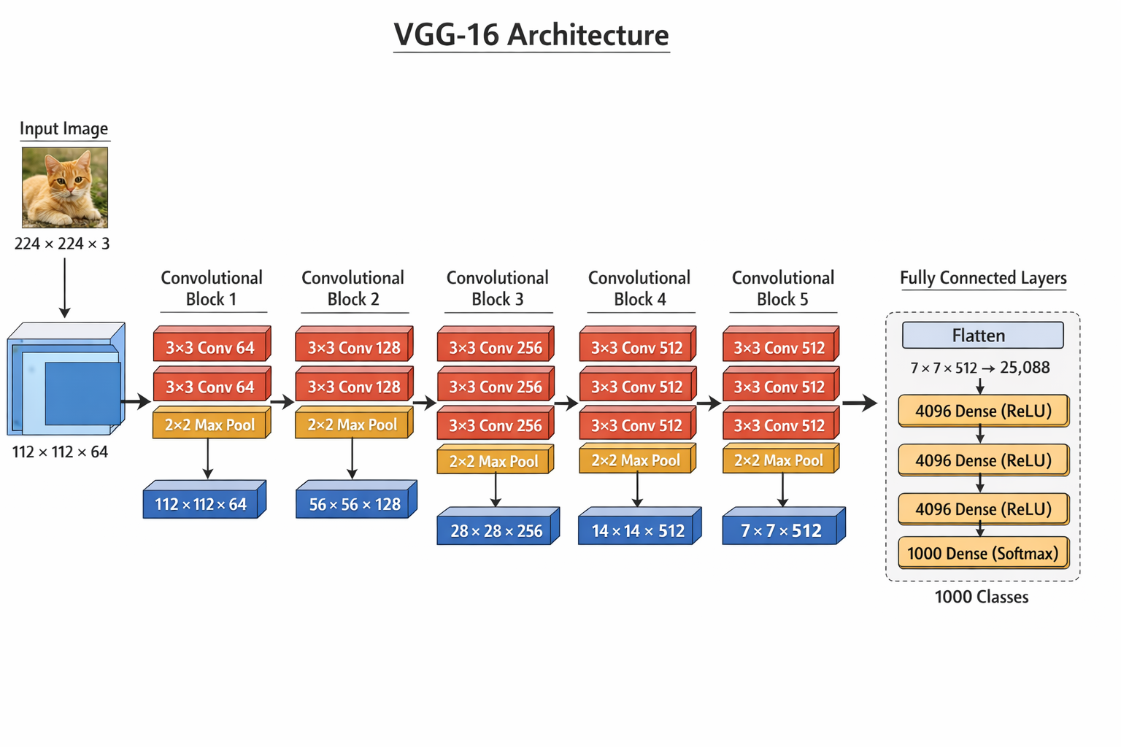
VGG 16 Architecture

Slide 143
VGG-16 Architecture
Input
224 × 224 × 3 RGB image
Convolution Block 1
Conv (3×3, 64) → ReLU
Conv (3×3, 64) → ReLU
Max Pool (2×2, stride 2)
Output: 112 × 112 × 64

Slide 144
Convolution Block 2
Conv (3×3, 128) → ReLU
Conv (3×3, 128) → ReLU
Max Pool (2×2)
Output: 56 × 56 × 128
Convolution Block 3
Conv (3×3, 256) → ReLU
Conv (3×3, 256) → ReLU
Conv (3×3, 256) → ReLU
Max Pool (2×2)
Output: 28 × 28 × 256
Convolution Block 4
Conv (3×3, 512) → ReLU
Conv (3×3, 512) → ReLU
Conv (3×3, 512) → ReLU
Max Pool (2×2)
Output: 14 × 14 × 512
Convolution Block 5
Conv (3×3, 512) → ReLU
Conv (3×3, 512) → ReLU
Conv (3×3, 512) → ReLU
Max Pool (2×2)
Output: 7 × 7 × 512

Slide 145
Fully Connected Layers
Flatten → 4096
FC → 4096 (ReLU)
FC → 4096 (ReLU)
FC → 1000 (Softmax)
1000 classes for ImageNet

Slide 147
VGG-19 Architecture
VGG-19 is a deep convolutional neural network with 19 weight layers, comprising 16 convolutional layers and 3 fully connected layers. The architecture follows a straightforward and repetitive pattern, making it easier to understand and implement.
The key components of the VGG-19 architecture are:
Convolutional Layers: 3x3 filters with a stride of 1 and padding of 1 to preserve spatial resolution.
Activation Function: ReLU (Rectified Linear Unit) applied after each convolutional layer to introduce non-linearity.
Pooling Layers: Max pooling with a 2x2 filter and a stride of 2 to reduce the spatial dimensions.
Fully Connected Layers: Three fully connected layers at the end of the network for classification.
Softmax Layer: Final layer for outputting class probabilities.

Slide 148
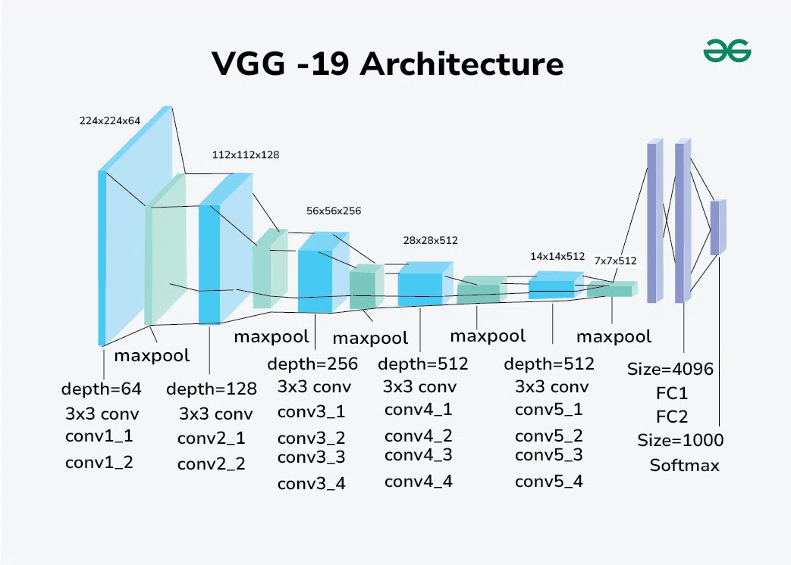
Detailed Layer-by-Layer Architecture of VGG-Net 19
The VGG-19 model consists of five blocks of convolutional layers, followed by three fully connected layers. Here is a detailed breakdown of each block:

Slide 149
Block 1
Conv1_1: 64 filters, 3x3 kernel, ReLU activation
Conv1_2: 64 filters, 3x3 kernel, ReLU activation
Max Pooling: 2x2 filter, stride 2
Block 2
Conv2_1: 128 filters, 3x3 kernel, ReLU activation
Conv2_2: 128 filters, 3x3 kernel, ReLU activation
Max Pooling: 2x2 filter, stride 2
Block 3
Conv3_1: 256 filters, 3x3 kernel, ReLU activation
Conv3_2: 256 filters, 3x3 kernel, ReLU activation
Conv3_3: 256 filters, 3x3 kernel, ReLU activation
Conv3_4: 256 filters, 3x3 kernel, ReLU activation
Max Pooling: 2x2 filter, stride 2

Slide 150
Block 4
Conv4_1: 512 filters, 3x3 kernel, ReLU activation
Conv4_2: 512 filters, 3x3 kernel, ReLU activation
Conv4_3: 512 filters, 3x3 kernel, ReLU activation
Conv4_4: 512 filters, 3x3 kernel, ReLU activation
Max Pooling: 2x2 filter, stride 2
Block 5
Conv5_1: 512 filters, 3x3 kernel, ReLU activation
Conv5_2: 512 filters, 3x3 kernel, ReLU activation
Conv5_3: 512 filters, 3x3 kernel, ReLU activation
Conv5_4: 512 filters, 3x3 kernel, ReLU activation
Max Pooling: 2x2 filter, stride 2
Fully Connected Layers
FC1: 4096 neurons, ReLU activation
FC2: 4096 neurons, ReLU activation
FC3: 1000 neurons, softmax activation (for 1000-class classification)

Slide 151
Architectural Design Principles
The VGG-19 architecture follows several key design principles:
Uniform Convolution Filters: Consistently using 3x3 convolution filters simplifies the architecture and helps maintain uniformity.
Deep Architecture: Increasing the depth of the network enables learning more complex features.
ReLU Activation: Introducing non-linearity helps in learning complex patterns.
Max Pooling: Reduces the spatial dimensions while preserving important features.
Fully Connected Layers: Combines the learned features for classification.

Slide 152
Impact and Legacy of VGG-19
Influence on Subsequent Models
The simplicity and effectiveness of VGG-19 influenced the design of subsequent deep learning models.
Architectures like ResNet and Inception drew inspiration from the depth and uniformity principles established by VGG models.
VGG-19's deep yet straightforward architecture demonstrated that increasing depth could significantly improve performance in image recognition tasks.
Use in Transfer Learning
VGG-19 has been extensively used in transfer learning due to its robust feature extraction capabilities.
Pre-trained VGG-19 models on large datasets like ImageNet are often fine-tuned for various computer vision tasks, including object detection, image segmentation, and style transfer.

Slide 153
Research and Industry Applications
VGG-19 has found applications in numerous research and industry projects.
Its architecture has been used as a baseline in academic research, enabling comparisons with newer models.
In industry, VGG-19's pre-trained weights serve as powerful feature extractors in applications ranging from medical imaging to autonomous vehicles.

Slide 154
GoogLeNet (Inception V1)
GoogLeNet (Inception V1) is a deep convolutional neural network architecture designed for efficient image classification.
It introduces the Inception module, which performs multiple convolution operations (1x1, 3x3, 5x5) in parallel, along with max pooling and concatenates their outputs.
The architecture is deep, yet optimized for speed and performance, which makes it suitable for large-scale visual recognition tasks.
It brought forward innovative architectural choices such as 1×1 convolutions, global average pooling and the Inception module, all aimed at improving depth and computational efficiency.

Slide 155
When designing a deep learning model, one needs to decide what convolution filter size to use (whether it should be 3×3, 5×5, or 1×1) as it affects the model’s learning and performance, and when to max pool the layers.
However, the inception module, the key innovation introduced by a team of Google researchers, solved this problem creatively.
Instead of deciding what filter size to use and when to perform a max pooling operation, they combined multiple convolution filters.
Stacking multiple convolution filters together instead of just one increases the parameter count many times.
However, GoogLeNet demonstrated by using the inception module that depth and width in a neural network could be increased without exploding computations.
We will investigate the inception module in depth.

Slide 156
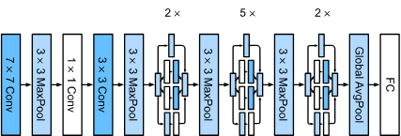

Slide 157
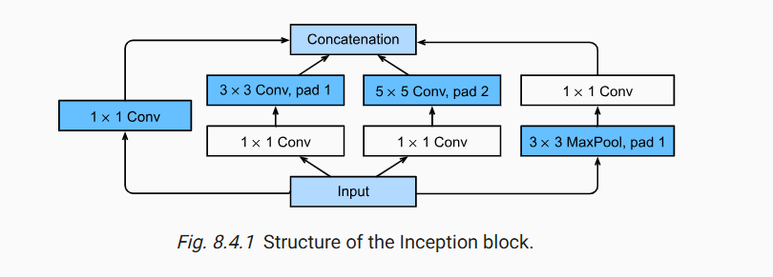

Slide 158
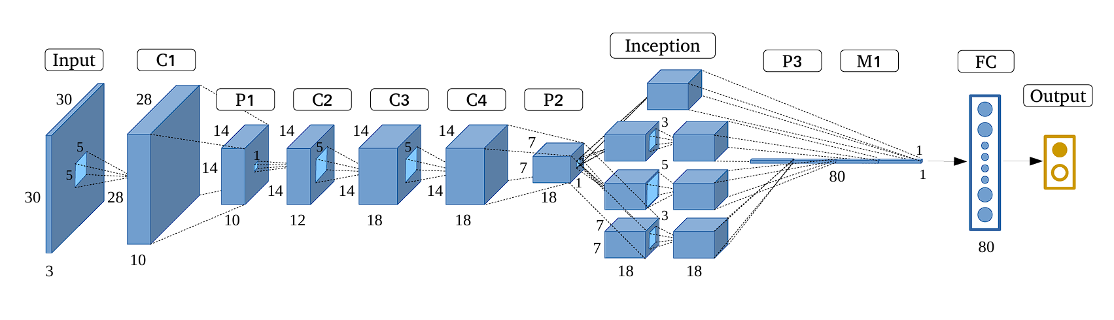

Slide 159
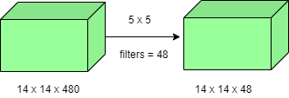
Key Features of GoogLeNet
The GoogLeNet architecture is very different from previous architectures such as AlexNet and ZF-Net. It uses many different kinds of methods such as:
1. 1×1 Convolutions
One of the core techniques employed in GoogLeNet is the use of 1×1 convolutions, primarily for dimensionality reduction. These layers help decrease the number of trainable parameters while enabling deeper and more efficient architectures.
Example Comparison:
Without 1×1 Convolution:(14×14×48)×(5×5×480)=112.9M operations

Slide 160

With 1×1 Convolution:(14×14×16)×(1×1×480)+(14×14×48)×(5×5×16)=5.3M operations
2. Global Average Pooling
In traditional architectures like AlexNet, fully connected layers at the end introduce a large number of parameters. GoogLeNet replaces these with Global Average Pooling, which computes the average of each feature map (e.g. converting 7×7 maps to 1×1), this significantly reduces the model’s parameter count and solves overfitting.
Benefits:
Zero additional trainable parameters
Reduces overfitting
Improves top-1 accuracy by approximately 0.6%

Slide 161
3. Inception Module
The Inception module is the architectural core of GoogLeNet. It processes the input using multiple types of operations in parallel, including 1×1, 3×3, 5×5 convolutions and 3×3 max pooling. The outputs from all paths are concatenated depth-wise.
Purpose: Enables the network to capture features at multiple scales effectively.
Advantage: Improves representational power without dramatically increasing computation.

Slide 162


Slide 163
4. Auxiliary Classifiers
To address the vanishing gradient problem during training, GoogLeNet introduces auxiliary classifiers(intermediate branches that act as smaller classifiers). These are active only during training and help regularize the network.
Structure of Each Auxiliary Classifier:
Average pooling layer (5×5, stride 3)
1×1 convolution (128 filters, ReLU)
Fully connected layer (1024 units, ReLU)
Dropout layer (dropout rate = 0.7)
Fully connected softmax layer (1000 classes)
The auxiliary losses are added to the main loss with a weight of 0.3 to stabilize training.

Slide 164
5. Model Architecture
GoogLeNet is a 22-layer deep network (excluding pooling layers) that emphasizes computational efficiency, making it feasible to run even on hardware with limited resources.
Below is Layer by Layer architectural details of GoogLeNet.

Slide 165


Slide 166
The architecture also contains two auxiliary classifier layer connected to the output of Inception (4a) and Inception (4d) layers.

Slide 167


Slide 168


Slide 169


Slide 170


Slide 171


Slide 172


Slide 173


Slide 174


Slide 175
Key highlights of the architecture:
Input Layer: Accepts a 224×224 RGB image as input.
Initial Convolutions and Pooling: Applies a series of standard convolutional and max pooling layers to downsample the input and extract low-level features.
Local Response Normalization (LRN): Normalizes the feature maps early in the network to improve generalization.
Inception Modules: Each module processes the input through 1×1, 3×3, and 5×5 convolutions, as well as 3×3 max pooling, all in parallel. The outputs are concatenated along the depth dimension, allowing the network to capture both fine and coarse features.
Auxiliary Classifiers: Appear as smaller branches connected to intermediate layers of the network. Include average pooling, 1×1 convolutions, fully connected layers, and softmax outputs.
Final Layers: Uses global average pooling (7×7) to reduce each feature map to a single value. Followed by a fully connected layer and a softmax activation to produce the final classification output.

Slide 176
DenseNet
Convolutional neural networks (CNNs) have been at the forefront of visual object recognition.
From the pioneering LeNet to the widely used VGG and ResNets, the quest for deeper and more efficient networks continues.
A significant breakthrough in this evolution is the Densely Connected Convolutional Network, or DenseNet, introduced by Gao Huang, Zhuang Liu, Laurens van der Maaten, and Kilian Q. Weinberger.
DenseNet's novel architecture improves information flow and gradient propagation, offering numerous advantages over traditional CNNs and ResNets.

Slide 177
DenseNet, short for Dense Convolutional Network, is a deep learning architecture for convolutional neural networks (CNNs) introduced by Gao Huang, Zhuang Liu, Laurens van der Maaten, and Kilian Q. Weinberger in their paper titled "Densely Connected Convolutional Networks" published in 2017.
DenseNet revolutionized the field of computer vision by proposing a novel connectivity pattern within CNNs, addressing challenges such as feature reuse, vanishing gradients, and parameter efficiency.
Unlike traditional CNN architectures where each layer is connected only to subsequent layers, DenseNet establishes direct connections between all layers within a block.
This dense connectivity enables each layer to receive feature maps from all preceding layers as inputs, fostering extensive information flow throughout the network.

Slide 178
Key Characteristics of DenseNet
Alleviated Vanishing Gradient Problem: Dense connections ensure that gradients can flow directly to earlier layers, mitigating the vanishing gradient issue common in deep networks.
Improved Feature Propagation: Each layer has direct access to the gradients from the loss function and the original input signal, promoting better feature propagation.
Feature Reuse: By concatenating features from all preceding layers, DenseNet encourages feature reuse, reducing redundancy and improving efficiency.
Reduced Parameters: Despite its dense connections, DenseNet is parameter-efficient. It eliminates the need to relearn redundant features, resulting in fewer parameters compared to traditional networks.

Slide 179
Comparing DenseNet with Other CNN Architectures
Aspect | DenseNet | ResNet | VGG | Inception (GoogLeNet) | AlexNet
Connectivity | Dense connections | Shortcut connections | Sequential | Parallel paths | Sequential
Gradient Flow | Excellent | Good | Moderate | Good | Moderate
Parameter Efficiency | High | Moderate | Low | Moderate | Low
Feature Reuse | Extensive | Some | Minimal | Moderate | Minimal
Vanishing Gradient | Mitigated | Mitigated | Prone | Mitigated | Prone
Depth | Very deep, fewer parameters | Very deep | Deep, limited by training | Deep | Shallow compared to modern
Computational Cost | Moderate, higher memory usage | Moderate to high | High | Moderate | Moderate to high
Training Complexity | Moderate | Moderate to high | High | Moderate | Moderate
Performance | High, state-of-the-art | High, state-of-the-art | Good, but outperformed | High, competitive | Good for its time
Applications | Classification, detection, segmentation | Classification, detection, segmentation | Classification, feature extraction | Classification, detection, segmentation | Classification, early benchmarks
Introduced | 2017 | 2015 | 2014 | 2015 | 2012

Slide 180

Architecture of DenseNet
DenseNet introduces a paradigm shift by connecting each layer to every other layer in a feed-forward manner.
Unlike traditional CNNs, which have a single connection between consecutive layers, DenseNet ensures that each layer receives inputs from all preceding layers and passes its output to all subsequent layers.
This results in a network with L(L+1)/2 direct connections for L layers, significantly enhancing information flow.

Slide 181


Slide 182


Slide 183

Dense Block
Dense blocks are the building blocks of DenseNet architectures.
Each dense block consists of multiple convolutional layers, typically followed by batch normalization and a non-linear activation function (e.g., ReLU).
Importantly, each layer within a dense block receives feature maps from all preceding layers as inputs, facilitating feature reuse and propagation.
Within a dense block, each layer receives the concatenated output of all preceding layers as its input.
If a dense block has m layers, and each layer produces k feature maps (where k is known as the growth rate), the l-th layer will have $k×\left(l+l_{0}\right)$ input feature maps (where $l_{0}$ is the number of input channels to the dense block).

Slide 184


Slide 185
Example of a Dense Block:
Layer 1: Receives input feature maps.
Layer 2: Receives input feature maps + output of Layer 1.
Layer 3: Receives input feature maps + output of Layer 1 + output of Layer 2.
This pattern continues for all layers within the block, ensuring a highly interconnected architecture.

Slide 186
Transition Layer
Transition layers are used to connect dense blocks. They serve two main purposes: reducing the number of feature maps and downsampling the spatial dimensions of the feature maps.
This helps in maintaining the computational efficiency and compactness of the network. A typical transition layer consists of:
Batch Normalization: Normalizes the feature maps.
1x1 Convolution: Reduces the number of feature maps.
Average Pooling: Downsamples the spatial dimensions.

Slide 187
Growth Rate (k)
The growth rate ( k ) is a critical hyperparameter in DenseNet. It defines the number of feature maps each layer in a dense block produces.
A larger growth rate means more information is added at each layer, but it also increases the computational cost. The choice of k affects the network's capacity and performance.
DenseNet Variants
DenseNet comes in several variants, distinguished primarily by their depth and number of layers:
DenseNet-121: Contains 121 layers, known for its balanced trade-off between computational efficiency and accuracy. Ideal for tasks requiring moderate computational resources.
DenseNet-169: With 169 layers, this variant provides deeper feature extraction, suitable for more complex datasets where higher accuracy is needed.
DenseNet-201 and DenseNet-264: These variants offer even deeper architectures, suitable for highly complex tasks requiring extensive feature representation.

Slide 188
Variant | Layers | Parameters | Typical Use Cases
DenseNet-121 | 121 | 7.98M | General-purpose image classification, object detection
DenseNet-169 | 169 | 14.15M | Advanced image recognition, medical image analysis
DenseNet-201 | 201 | 20.01M | High-accuracy tasks, detailed feature extraction
DenseNet-264 | 264 | 33.34M | Complex visual tasks, extensive datasets

Slide 189
Advantages of DenseNet
Reduced Vanishing Gradient Problem: Dense connections improve gradient flow and facilitate the training of very deep networks.
Feature Reuse: Each layer has access to all preceding layers' feature maps, promoting the reuse of learned features and enhancing learning efficiency.
Fewer Parameters: DenseNets often have fewer parameters compared to traditional CNNs with similar depth due to efficient feature reuse.
Improved Accuracy: DenseNets have shown high accuracy on various benchmarks, such as ImageNet and CIFAR.

Slide 190
Limitations of DenseNet
High Memory Consumption: Dense connections increase memory usage due to the storage requirements for feature maps, making DenseNet less practical for devices with limited memory.
Computational Complexity: The extensive connectivity leads to increased computational demands, resulting in longer training times and higher computational costs, which may not be ideal for real-time applications.
Implementation Complexity: Managing and concatenating a large number of feature maps adds complexity to the implementation, requiring careful tuning of hyperparameters and regularization techniques to maintain performance and stability.
Risk of Overfitting: Although DenseNet reduces overfitting through better feature reuse, there is still a risk, particularly if the network is not properly regularized or if the training data is insufficient.

Slide 191
Mobilenet V2 Architecture
The need for efficient neural network architectures has grown with the proliferation of mobile devices and the demand for on-device AI applications.
Traditional deep learning models are computationally expensive and require significant memory, making them unsuitable for deployment on resource-constrained devices.
MobileNet V2 addresses these challenges by introducing an optimized architecture that balances performance and efficiency.

Slide 192


Slide 193


Slide 194


Slide 195
Key Features of MobileNet V2
1. Inverted Residuals
MobileNet V2 introduces the concept of inverted residuals with linear bottlenecks. This approach preserves the input and output dimensions while performing the intermediate layers in a lower-dimensional space, reducing the computational cost. The inverted residual block consists of three layers:
1x1 Convolution (Expansion Layer): Expands the input channels by a factor, increasing the dimensionality of the data.
Depthwise Convolution: Applies a depthwise convolution to each expanded channel independently, performing spatial convolution.
1x1 Convolution (Projection Layer): Projects the expanded data back to a lower-dimensional space, reducing the number of channels to the desired output size.

Slide 196
Flow of data inside one block:
Input (narrow: h × w × k channels)
1×1 conv + ReLU6 → expand to h × w × (t·k) (wide)
Depthwise 3×3 conv + ReLU6 → still wide, spatial filtering is cheap
1×1 conv + Linear (no ReLU!) → project back to h × w × k' (narrow again)
Add shortcut: output = projection + input (only if stride=1 and channels match)

Slide 197


Slide 198
2. Depthwise Separable Convolutions
Similar to MobileNet V1, MobileNet V2 utilizes depthwise separable convolutions, which split a standard convolution into two operations: depthwise convolution and pointwise convolution.
This separation significantly reduces the number of parameters and computations, making the network more efficient.
3. Linear Bottlenecks
The architecture incorporates linear bottlenecks between layers, ensuring that the manifold of the input data is not overly compressed.
This technique helps in retaining more information and improving model accuracy.
The linear bottleneck layer follows the pattern of 1x1 convolution for expansion, depthwise convolution for spatial filtering, and another 1x1 convolution for projection.

Slide 199


Slide 200
4. ReLU6 Activation Function
MobileNet V2 employs the ReLU6 activation function, a modified version of the ReLU function.
ReLU6 restricts the activation values to a range of [0, 6], providing better quantization properties for efficient computation on mobile devices.
This activation function helps in achieving a balance between accuracy and efficiency.

Slide 201
MobileNet V2 Architecture
The MobileNet V2 architecture is built upon several key building blocks, including the inverted residual block, which is the core component of the network.
Network Structure
MobileNet V2 follows a streamlined architecture consisting of:
Initial Convolution Layer: A standard convolution layer with 32 filters and a stride of 2.
Series of Inverted Residual Blocks: The network contains several stages, each with a specific number of inverted residual blocks. The expansion factors, output channels, and strides vary across stages to manage the computational complexity and receptive field.
Final Convolution Layer: A 1x1 convolution layer with 1280 filters, followed by a global average pooling layer.
Fully Connected Layer: A fully connected layer with softmax activation for classification tasks.

Slide 202
Detailed Layer Configuration
Layer Type | Input Size | Output Size | Kernel Size | Stride | Expansion Factor
Initial Conv | 224x224x3 | 112x112x32 | 3x3 | 2 | -
Inverted Residual Block | 112x112x32 | 112x112x16 | 3x3 | 1 | 1
Inverted Residual Block x2 | 112x112x16 | 56x56x24 | 3x3 | 2 | 6
Inverted Residual Block x3 | 56x56x24 | 28x28x32 | 3x3 | 2 | 6
Inverted Residual Block x4 | 28x28x32 | 14x14x64 | 3x3 | 2 | 6
Inverted Residual Block x3 | 14x14x64 | 14x14x96 | 3x3 | 1 | 6
Inverted Residual Block x3 | 14x14x96 | 7x7x160 | 3x3 | 2 | 6
Inverted Residual Block x1 | 7x7x160 | 7x7x320 | 3x3 | 1 | 6
Final Conv | 7x7x320 | 7x7x1280 | 1x1 | 1 | -
Global Avg Pooling | 7x7x1280 | 1x1x1280 | - | - | -
Fully Connected | 1x1x1280 | 1x1x1000 | - | - | -

Slide 203
Advantages of MobileNet V2
Efficiency: MobileNet V2 achieves a good balance between accuracy and efficiency, making it ideal for mobile and embedded applications.
Flexibility: The architecture can be easily scaled to meet the specific needs of different applications by adjusting the width multiplier and resolution multiplier.
Improved Performance: Compared to its predecessor, MobileNet V2 provides better performance with fewer parameters and lower computational cost.

Slide 204
Applications of MobileNet V2
MobileNet V2 is well-suited for a variety of applications, including:
Image Classification: Efficiently classifying images on mobile devices with limited computational resources.
Object Detection: Serving as a backbone for lightweight object detection models.
Semantic Segmentation: Enabling real-time segmentation tasks on resource-constrained devices.
Embedded Vision: Powering vision-based applications in embedded systems, such as drones, robots, and IoT devices.

Slide 205


