Slide 1
Autoencoders- Variants
Dr S.Rajarajeswari

Slide 2
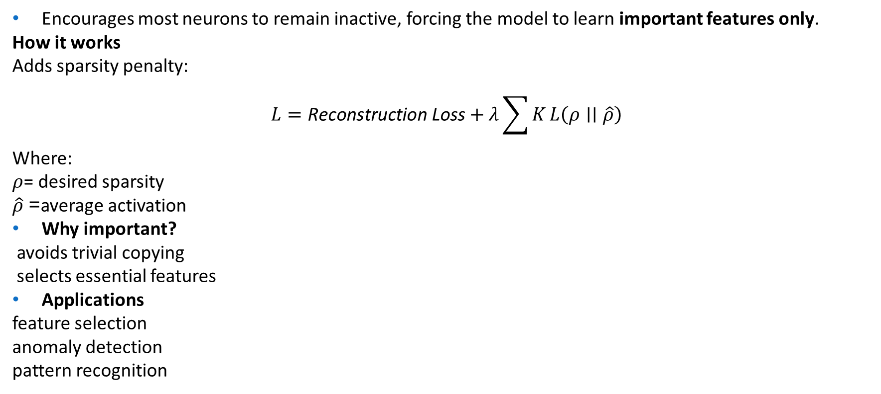
Sparse Autoencoder
Encourages most neurons to remain inactive, forcing the model to learn important features only.
How it works
Adds sparsity penalty:
$$L=\text{Reconstruction} \text{Loss}+λ\sum{K}L\left(ρ∣∣\hat{ρ}\right)$$
Where:
$ρ$= desired sparsity
$\hat{ρ}$= average activation
Why important?
avoids trivial copying
selects essential features
Applications
feature selection
anomaly detection
pattern recognition

Slide 3
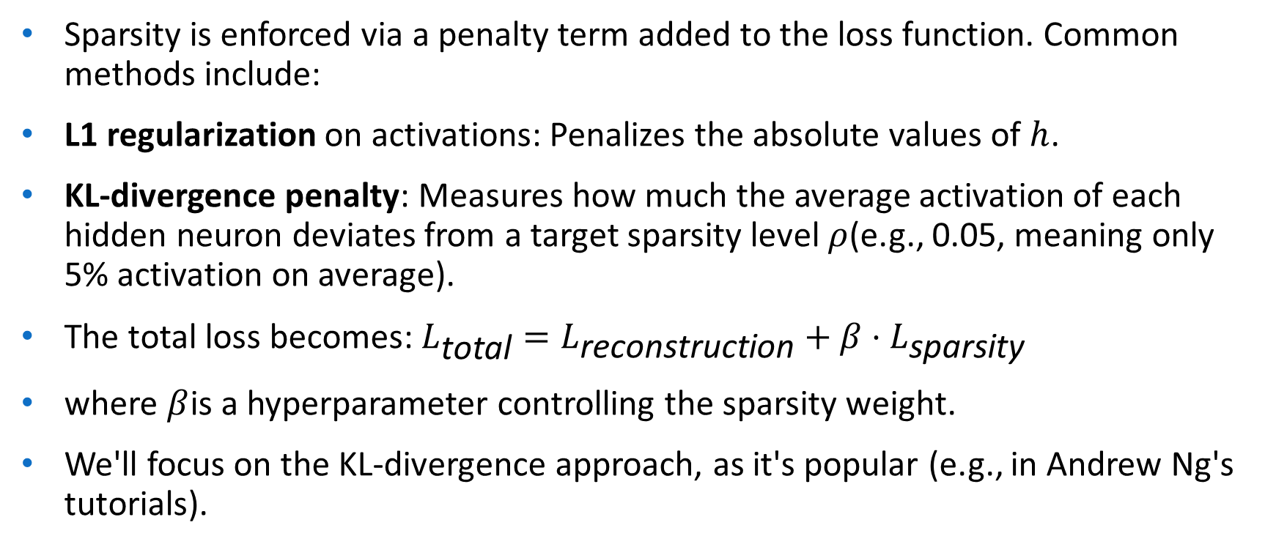
Sparsity is enforced via a penalty term added to the loss function. Common methods include:
L1 regularization on activations: Penalizes the absolute values of $h$.
KL-divergence penalty: Measures how much the average activation of each hidden neuron deviates from a target sparsity level $ρ$(e.g., 0.05, meaning only 5% activation on average).
The total loss becomes: $L_{\text{total}}=L_{\text{reconstruction}}+β⋅L_{\text{sparsity}}$
where $β$is a hyperparameter controlling the sparsity weight.
We'll focus on the KL-divergence approach, as it's popular (e.g., in Andrew Ng's tutorials).

Slide 4
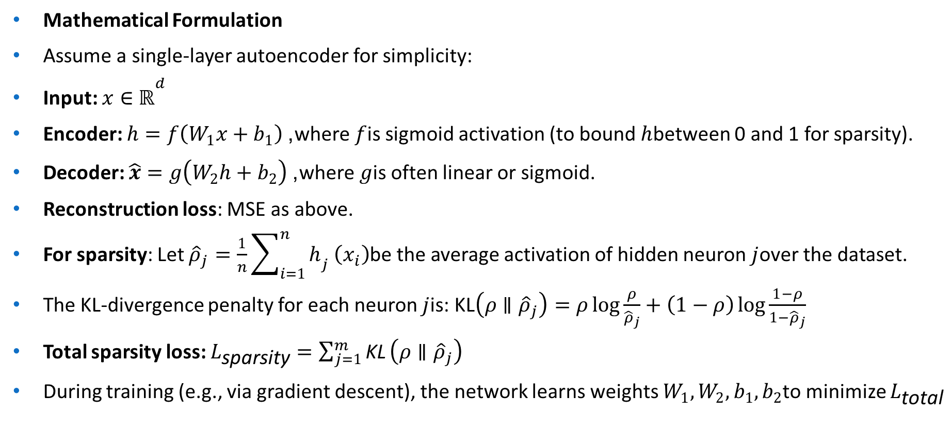
Mathematical Formulation
Assume a single-layer autoencoder for simplicity:
Input: $x∈ℝ^{d}$
Encoder: $h=f\left(W_{1}x+b_{1}\right)$, where $f$is sigmoid activation (to bound $h$between 0 and 1 for sparsity).
Decoder: $\hat{x}=g\left(W_{2}h+b_{2}\right)$, where $g$is often linear or sigmoid.
Reconstruction loss: MSE as above.
For sparsity: Let ${\hat{ρ}}_{j}=\frac{1}{n}\sum_{i=1}^{n}{h_{j}}\left(x_{i}\right)$be the average activation of hidden neuron $j$over the dataset.
The KL-divergence penalty for each neuron $j$is: $\text{KL}\left(ρ∥{\hat{ρ}}_{j}\right)=ρ\log{\frac{ρ}{{\hat{ρ}}_{j}}}+\left(1−ρ\right)\log{\frac{1−ρ}{1−{\hat{ρ}}_{j}}}$
Total sparsity loss: $L_{\text{sparsity}}=\sum_{j=1}^{m}{\text{KL}}\left(ρ∥{\hat{ρ}}_{j}\right)$
During training (e.g., via gradient descent), the network learns weights $W_{1},W_{2},b_{1},b_{2}$to minimize $L_{\text{total}}$

Slide 5
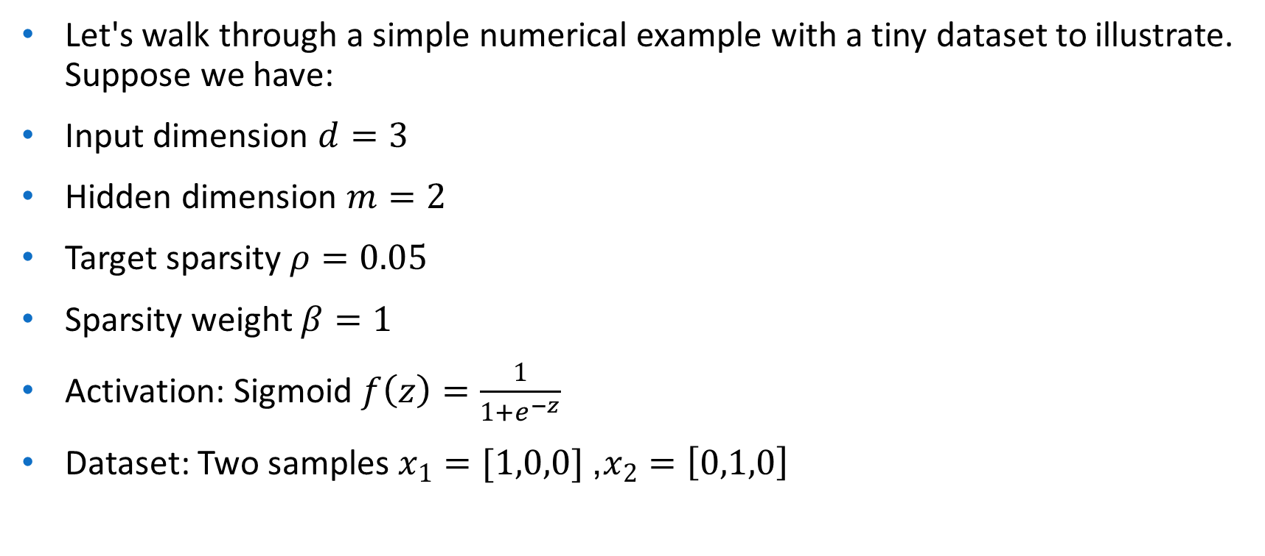
Let's walk through a simple numerical example with a tiny dataset to illustrate. Suppose we have:
Input dimension $d=3$
Hidden dimension $m=2$
Target sparsity $ρ=0.05$
Sparsity weight $β=1$
Activation: Sigmoid $f\left(z\right)=\frac{1}{1+e^{−z}}$
Dataset: Two samples $x_{1}=[1,0,0]$, $x_{2}={\left[0,1,0\right]}^{}$

Slide 6
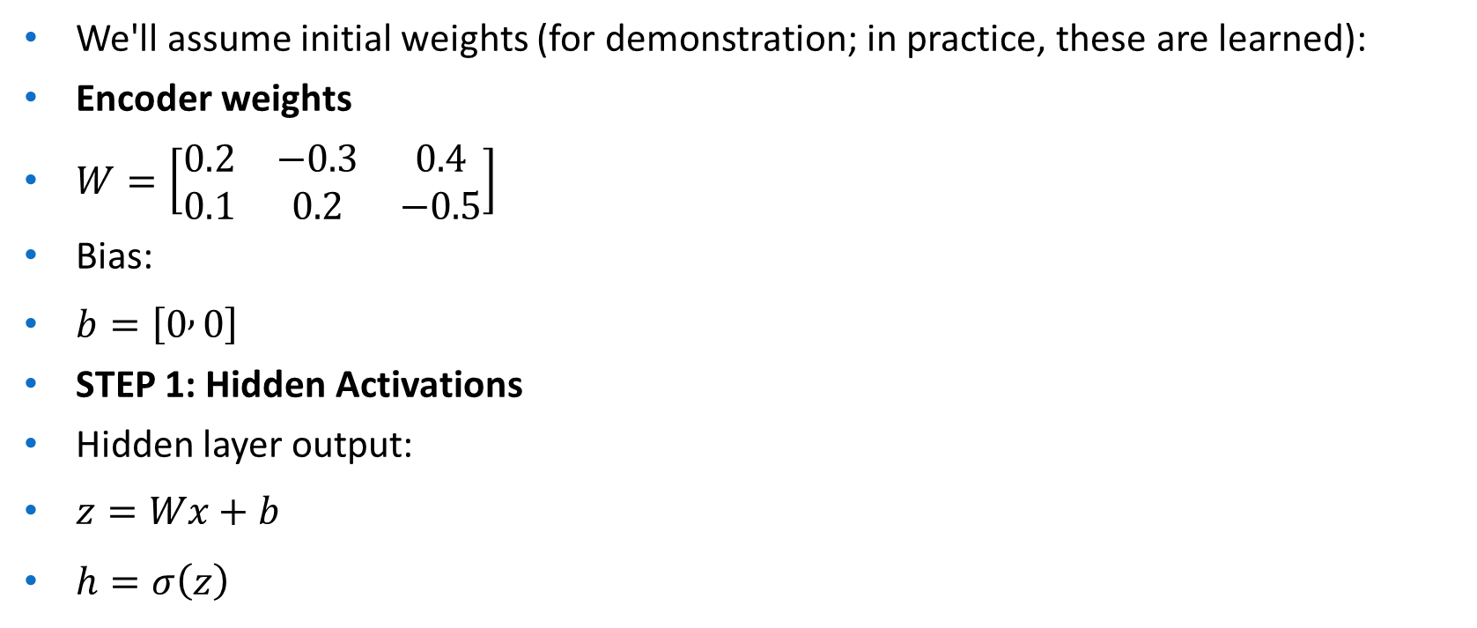
We'll assume initial weights (for demonstration; in practice, these are learned):
Encoder weights
$W=\left[\begin{matrix}0.2 & −0.3 & 0.4 \\ 0.1 & 0.2 & −0.5\end{matrix}\right]$
Bias:
$b=\left[0 , 0\right]$
STEP 1: Hidden Activations
Hidden layer output:
$z=Wx+b$
$h=σ\left(z\right)$

Slide 7
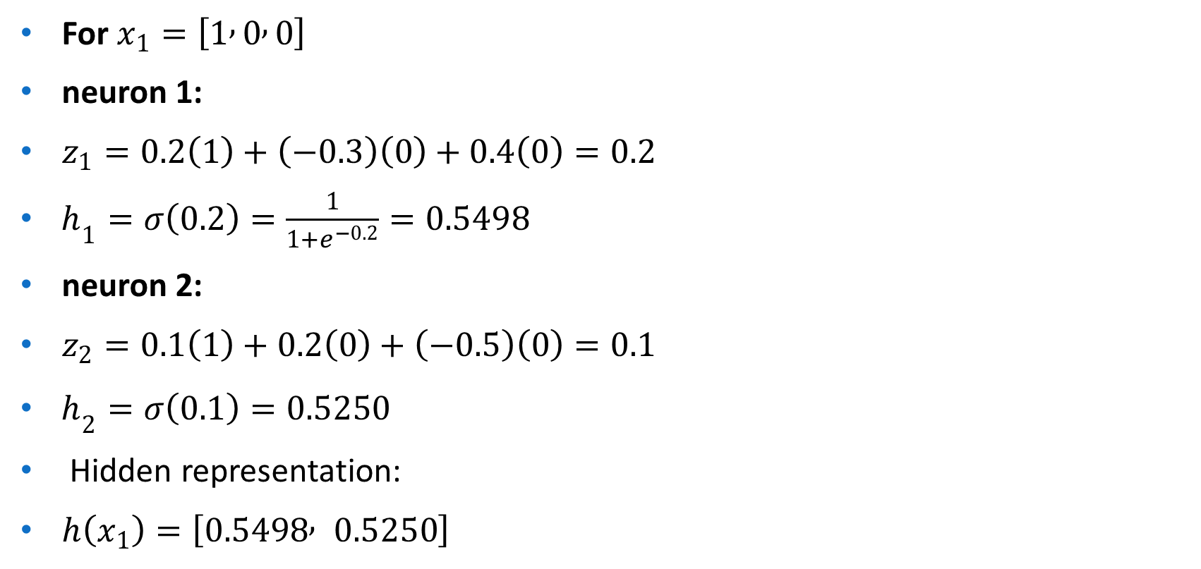
For $x_{1}=\left[1 , 0 , 0\right]$
neuron 1:
$z_{1}=0.2\left(1\right)+\left(−0.3\right)\left(0\right)+0.4\left(0\right)=0.2$
$h_{1}=σ\left(0.2\right)=\frac{1}{1+e^{−0.2}}=0.5498$
neuron 2:
$z_{2}=0.1\left(1\right)+0.2\left(0\right)+\left(−0.5\right)\left(0\right)=0.1$
$h_{2}=σ\left(0.1\right)=0.5250$
Hidden representation:
$h\left(x_{1}\right)=\left[0.5498 , 0.5250\right]$

Slide 8
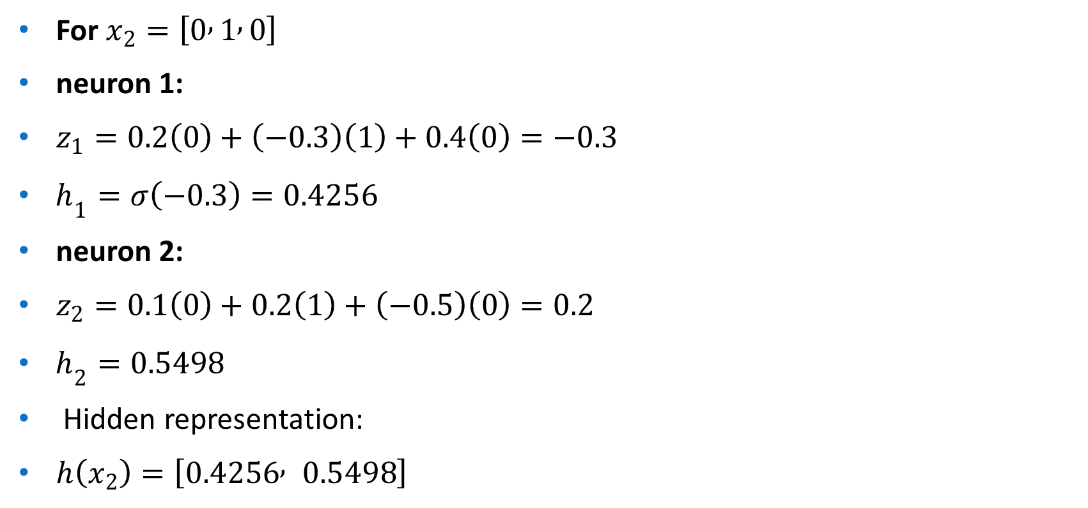
For $x_{2}=\left[0 , 1 , 0\right]$
neuron 1:
$z_{1}=0.2\left(0\right)+\left(−0.3\right)\left(1\right)+0.4\left(0\right)=−0.3$
$h_{1}=σ\left(−0.3\right)=0.4256$
neuron 2:
$z_{2}=0.1\left(0\right)+0.2\left(1\right)+\left(−0.5\right)\left(0\right)=0.2$
$h_{2}=0.5498$
Hidden representation:
$h\left(x_{2}\right)=\left[0.4256 , 0.5498\right]$

Slide 9

Hidden activations:
$h_{1}=\left[0.5498 , 0.5250\right]$
$h_{2}=\left[0.4256 , 0.5498\right]$
Assume Decoder Weights
(Since not given, we must define them to proceed numerically)
Let:
$W^{′}=\left[\begin{matrix}0.3 & −0.2 \\ 0.4 & 0.1 \\ −0.3 & 0.2\end{matrix}\right]$
Bias:
$b^{′}=\left[0 , 0 , 0\right]$
Output activation: Sigmoid

Slide 10
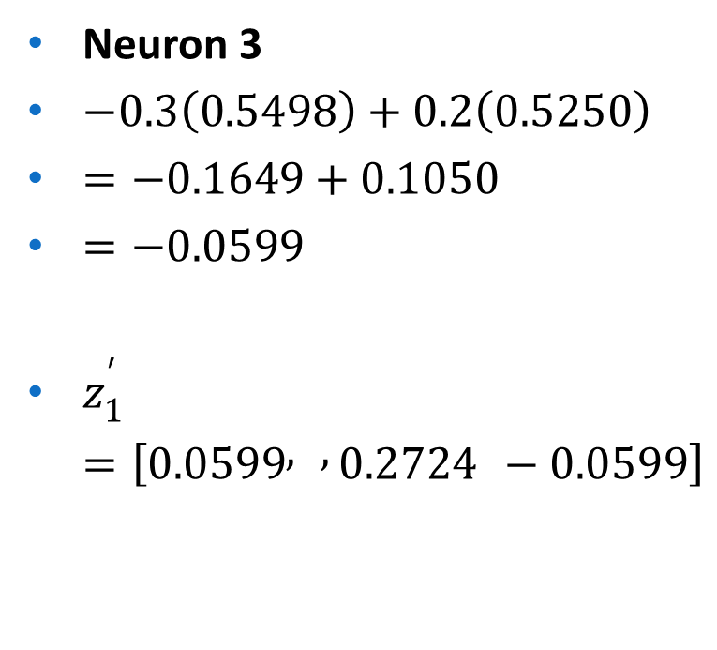
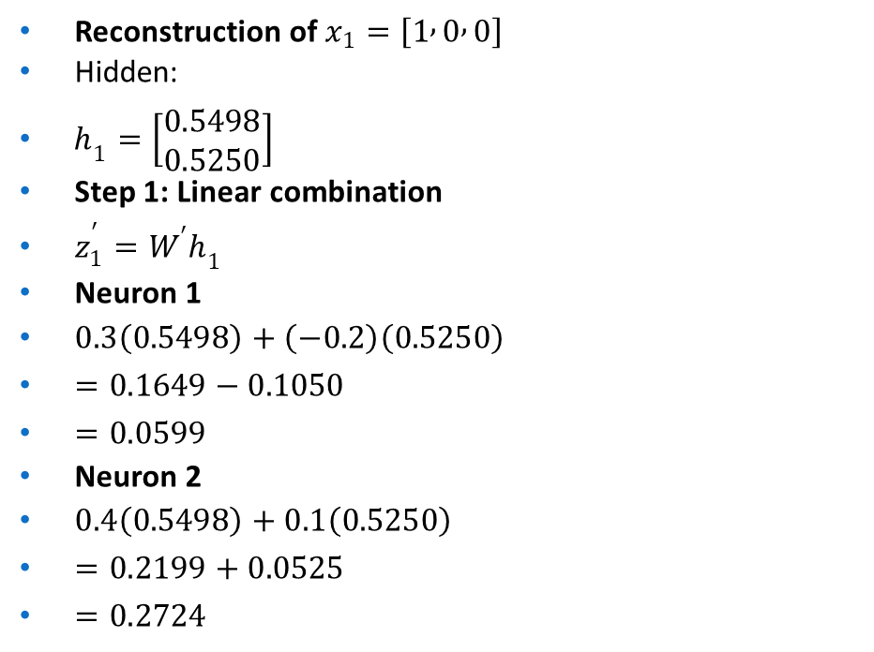
Neuron 3
$−0.3\left(0.5498\right)+0.2\left(0.5250\right)$
$=−0.1649+0.1050$
$=−0.0599$
$z_{1}^{′}=\left[0.0599 , , 0.2724 −0.0599\right]$
Reconstruction of $x_{1}=\left[1 , 0 , 0\right]$
Hidden:
$h_{1}=\left[\begin{matrix}0.5498 \\ 0.5250\end{matrix}\right]$
Step 1: Linear combination
$z_{1}^{′}=W^{′}h_{1}$
Neuron 1
$0.3\left(0.5498\right)+\left(−0.2\right)\left(0.5250\right)$
$=0.1649−0.1050$
$=0.0599$
Neuron 2
$0.4\left(0.5498\right)+0.1\left(0.5250\right)$
$=0.2199+0.0525$
$=0.2724$

Slide 11

Apply sigmoid
$σ\left(0.0599\right)=0.5150$
$σ\left(0.2724\right)=0.5677$
$σ\left(−0.0599\right)=0.4850$
Reconstruction
${\hat{x}}_{1}=\left[0.5150 , , 0.5677 0.4850\right]$
Original:
$x_{1}=\left[1 , 0 , 0\right]$

Slide 12
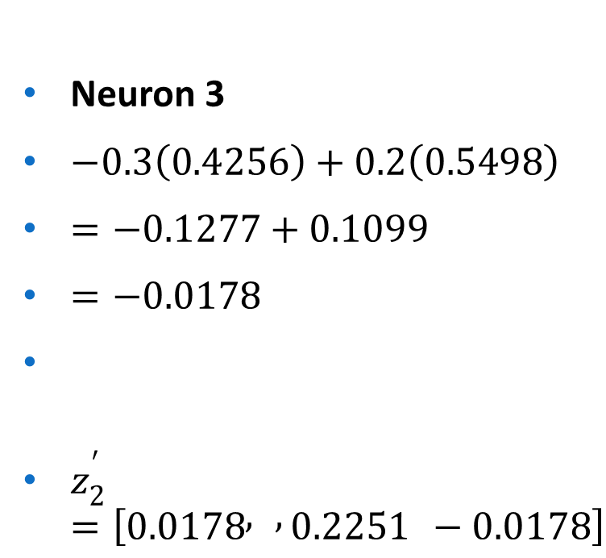
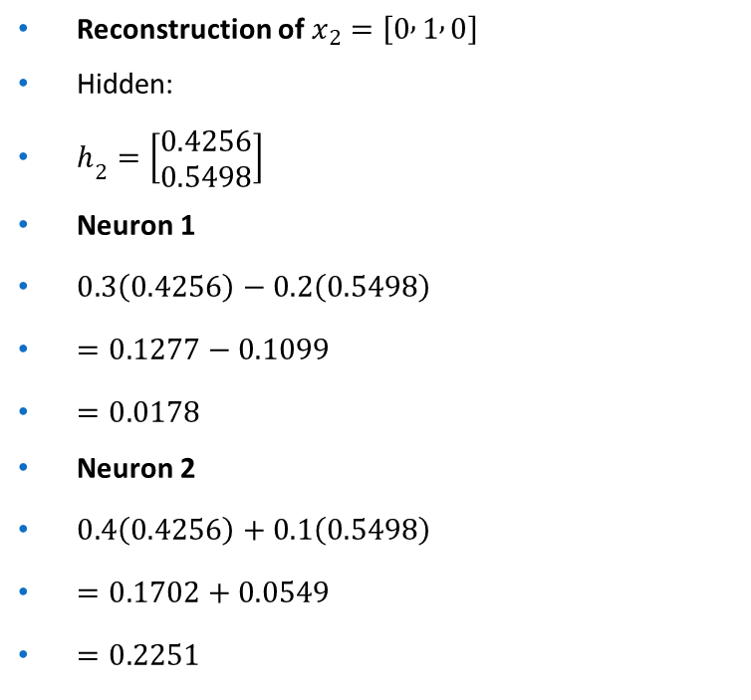
Reconstruction of $x_{2}=\left[0 , 1 , 0\right]$
Hidden:
$h_{2}=\left[\begin{matrix}0.4256 \\ 0.5498\end{matrix}\right]$
Neuron 1
$0.3\left(0.4256\right)−0.2\left(0.5498\right)$
$=0.1277−0.1099$
$=0.0178$
Neuron 2
$0.4\left(0.4256\right)+0.1\left(0.5498\right)$
$=0.1702+0.0549$
$=0.2251$
Neuron 3
$−0.3\left(0.4256\right)+0.2\left(0.5498\right)$
$=−0.1277+0.1099$
$=−0.0178$
$z_{2}^{′}=\left[0.0178 , , 0.2251 −0.0178\right]$

Slide 13
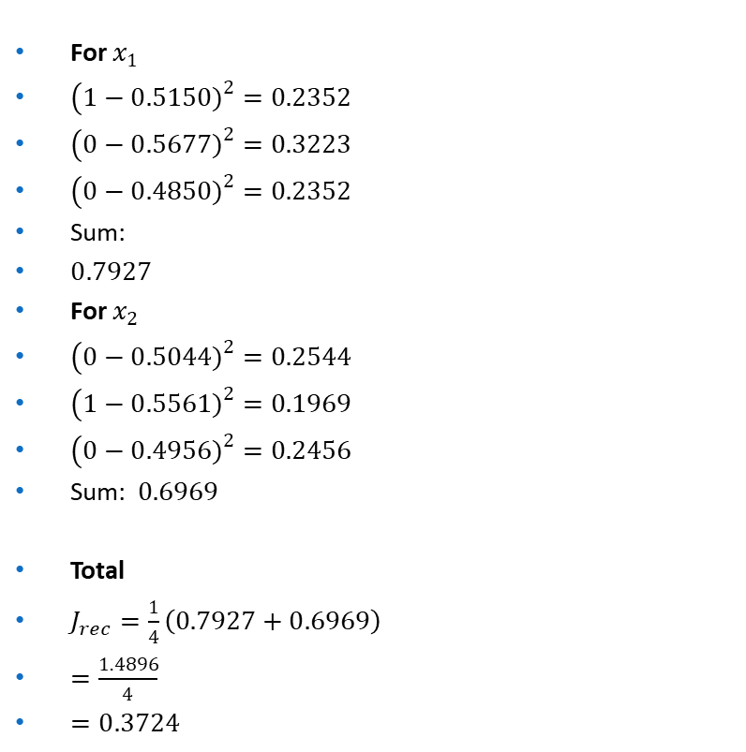
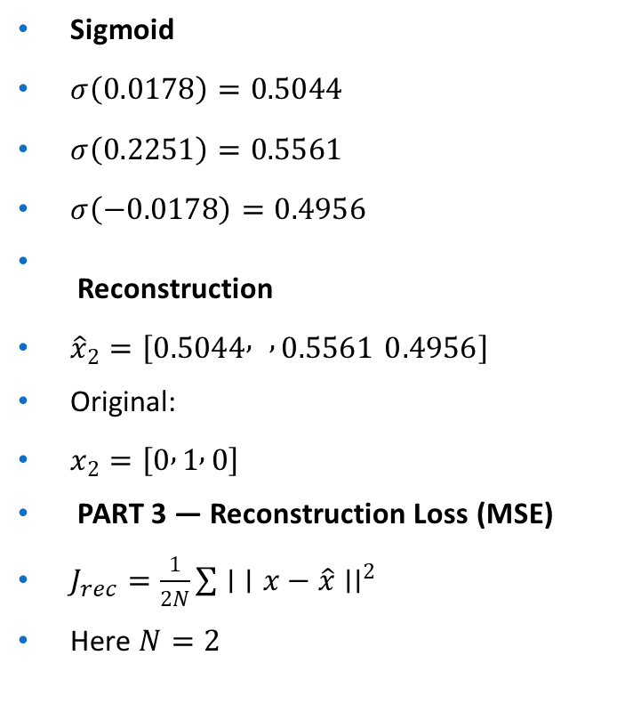
Sigmoid
$σ\left(0.0178\right)=0.5044$
$σ\left(0.2251\right)=0.5561$
$σ\left(−0.0178\right)=0.4956$
Reconstruction
${\hat{x}}_{2}=\left[0.5044 , , 0.5561 0.4956\right]$
Original:
$x_{2}=\left[0 , 1 , 0\right]$
PART 3 — Reconstruction Loss (MSE)
$J_{rec}=\frac{1}{2N}\sum{∣}∣x−\hat{x}∣∣^{2}$
Here $N=2$
For $x_{1}$
$\left(1−0.5150{\left.)\right.}^{2}=0.2352\right.$
$\left(0−0.5677{\left.)\right.}^{2}=0.3223\right.$
$\left(0−0.4850{\left.)\right.}^{2}=0.2352\right.$
Sum:
$0.7927$
For $x_{2}$
$\left(0−0.5044{\left.)\right.}^{2}=0.2544\right.$
$\left(1−0.5561{\left.)\right.}^{2}=0.1969\right.$
$\left(0−0.4956{\left.)\right.}^{2}=0.2456\right.$
Sum: $0.6969$
Total
$J_{rec}=\frac{1}{4}\left(0.7927+0.6969\right)$
$=\frac{1.4896}{4}$
$=0.3724$

Slide 14
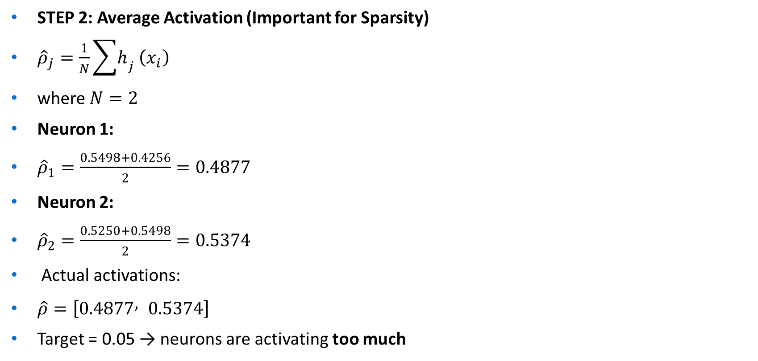
STEP 2: Average Activation (Important for Sparsity)
${\hat{ρ}}_{j}=\frac{1}{N}\sum{h_{j}}\left(x_{i}\right)$
where $N=2$
Neuron 1:
${\hat{ρ}}_{1}=\frac{0.5498+0.4256}{2}=0.4877$
Neuron 2:
${\hat{ρ}}_{2}=\frac{0.5250+0.5498}{2}=0.5374$
Actual activations:
$\hat{ρ}=\left[0.4877 , 0.5374\right]$
Target = 0.05 → neurons are activating too much

Slide 15

STEP 3: KL Divergence Sparsity Penalty
$KL\left(ρ∣∣\hat{ρ}\right)=ρ\log{\frac{ρ}{\hat{ρ}}}+\left(1−ρ\right)\log{\frac{1−ρ}{1−\hat{ρ}}}$
Neuron 1
$KL=0.05\log{\frac{0.05}{0.4877}}+0.95\log{\frac{0.95}{0.5123}}$
$=0.05log⁡\left(0.1026\right)+0.95log⁡\left(1.854\right)$
$=0.05\left(−2.28\right)+0.95\left(0.617\right)$
$=−0.114+0.586$
$=0.472$

Slide 16

Neuron 2
$KL=0.05\log{\frac{0.05}{0.5374}}+0.95\log{\frac{0.95}{0.4626}}$
$=0.05\left(−2.37\right)+0.95\left(0.718\right)$
$=−0.118+0.682$
$=0.564$
STEP 4: Total Sparsity Penalty
$\sum{K}L=0.472+0.564=1.036$
Since $β=1$:
$\text{Sparsity} \text{penalty}=1.036$

Slide 17
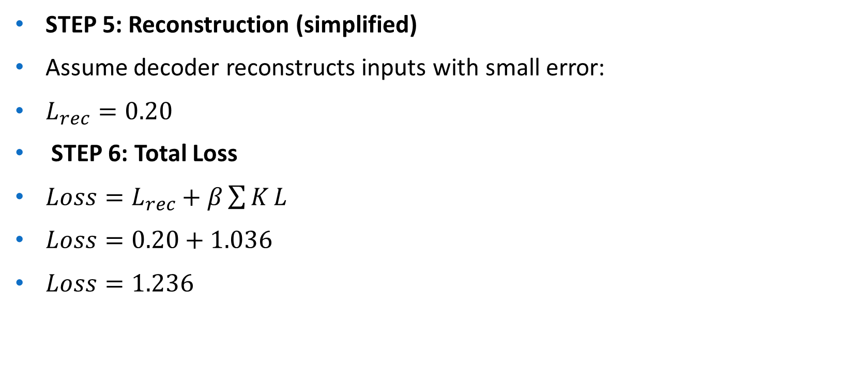
STEP 5: Reconstruction (simplified)
Assume decoder reconstructs inputs with small error:
$L_{rec}=0.20$
STEP 6: Total Loss
$Loss=L_{rec}+β\sum{K}L$
$Loss=0.20+1.036$
$Loss=1.236$

Slide 18

FINAL RESULTS
Hidden activations
$h\left(x_{1}\right)=\left[0.5498 , 0.5250\right]$
$h\left(x_{2}\right)=\left[0.4256 , 0.5498\right]$
Average activation
$\left[0.4877 , 0.5374\right]$
Sparsity penalty
$1.036$
Total loss
$1.236$

Slide 19

How to Arrive at the Solution
Activations: Matrix multiplication $W_{1}x$followed by sigmoid. Use the formula $f\left(z\right)=1/\left(1+exp⁡\left(−z\right)\right)$. For each sample, compute element-wise.
Reconstruction: Similar matrix op with $W_{2}h$.
MSE: Euclidean distance squared, averaged over samples. Compute per element: sum of (diff)^2.
Average ${\hat{ρ}}_{j}$: Mean of h_j across all samples.
KL Divergence: Plug into the formula. Use log base e (natural log). For small $ρ$, high $\hat{ρ}$leads to large penalties, encouraging lower activations during training.
In practice, you'd backpropagate gradients to update weights, but here we just computed the forward pass loss.
This example shows high sparsity penalty because activations are around 0.5-0.6, far from 0.05. Training would adjust weights to reduce this (e.g., by making biases more negative).

Slide 20
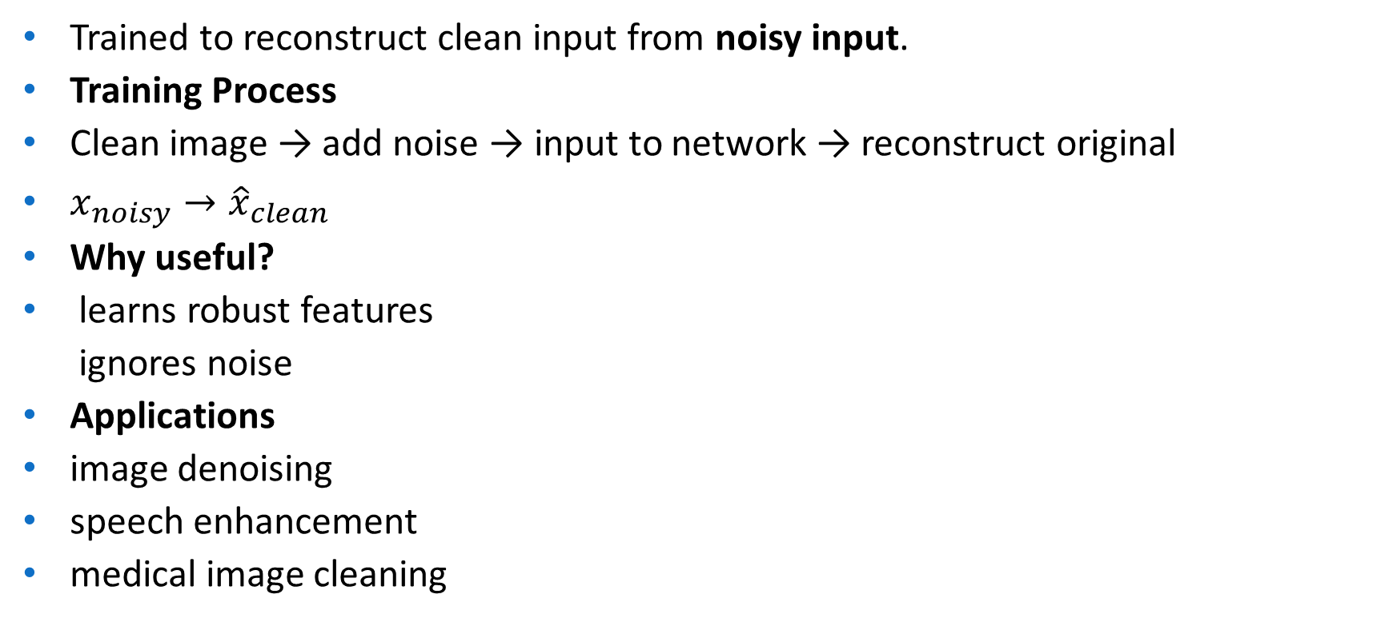
Denoising Autoencoder (DAE)
Trained to reconstruct clean input from noisy input.
Training Process
Clean image → add noise → input to network → reconstruct original
$x_{noisy}→{\hat{x}}_{clean}$
Why useful?
learns robust features ignores noise
Applications
image denoising
speech enhancement
medical image cleaning

Slide 21

Basic Idea
Instead of:
$x→\hat{x}$
we train using:
$\tilde{x}→x$
Where:
$x$= original input
$\tilde{x}$= corrupted input
$\hat{x}$= reconstructed clean output

Slide 22
Types of Noise Used
Masking Noise
Random inputs set to zero
Gaussian Noise
Add small random values
Salt & Pepper Noise
Random pixels set to 0 or 1
Dropout Noise
Random features dropped

Slide 23
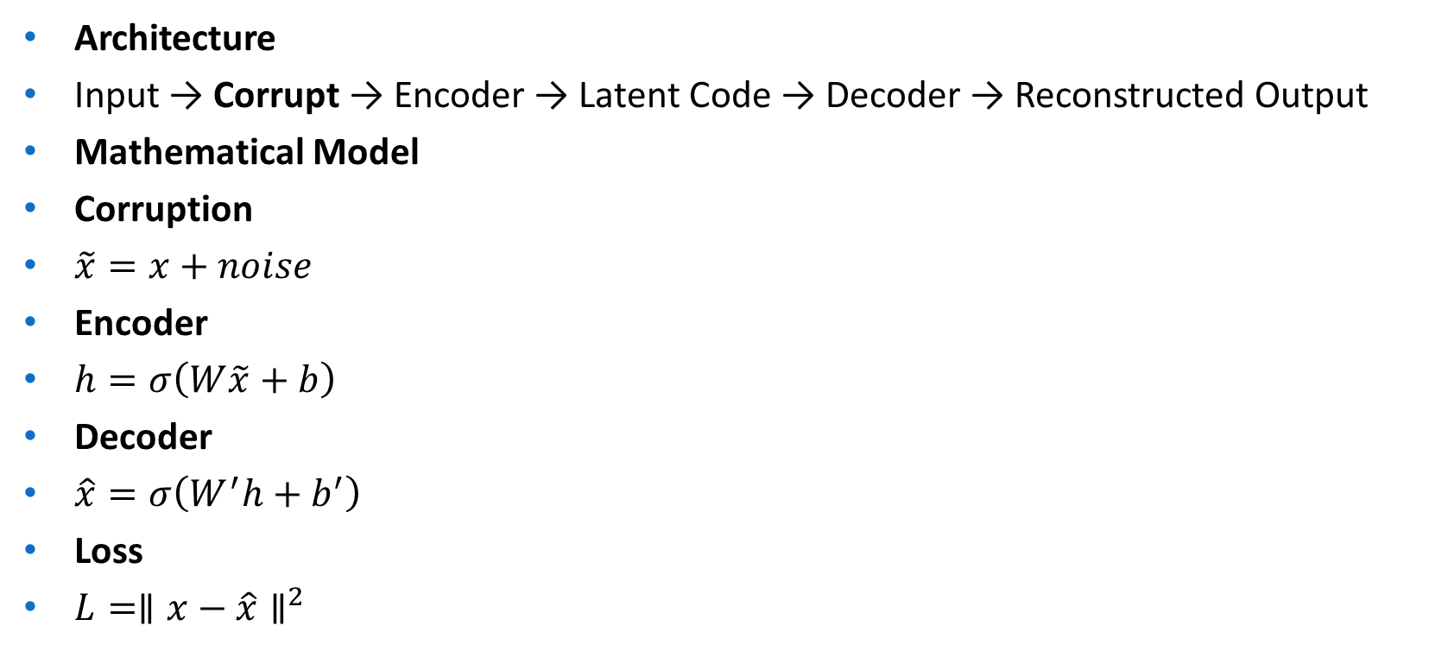
Architecture
Input → Corrupt → Encoder → Latent Code → Decoder → Reconstructed Output
Mathematical Model
Corruption
$\tilde{x}=x+noise$
Encoder
$h=σ\left(W\tilde{x}+b\right)$
Decoder
$\hat{x}=σ\left(W^{′}h+b^{′}\right)$
Loss
$L=∥x−\hat{x}∥^{2}$

Slide 24
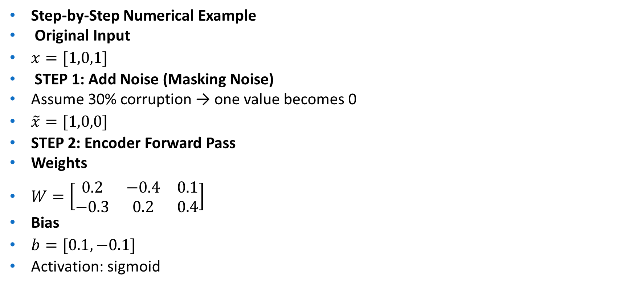
Step-by-Step Numerical Example
Original Input
$x=[1,0,1]$
STEP 1: Add Noise (Masking Noise)
Assume 30% corruption → one value becomes 0
$\tilde{x}=[1,0,0]$
STEP 2: Encoder Forward Pass
Weights
$W=\left[\begin{matrix}0.2 & −0.4 & 0.1 \\ −0.3 & 0.2 & 0.4\end{matrix}\right]$
Bias
$b=[0.1,−0.1]$
Activation: sigmoid

Slide 25
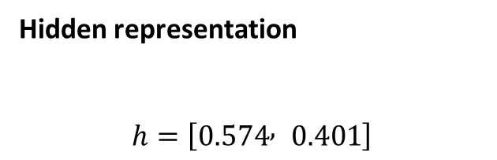
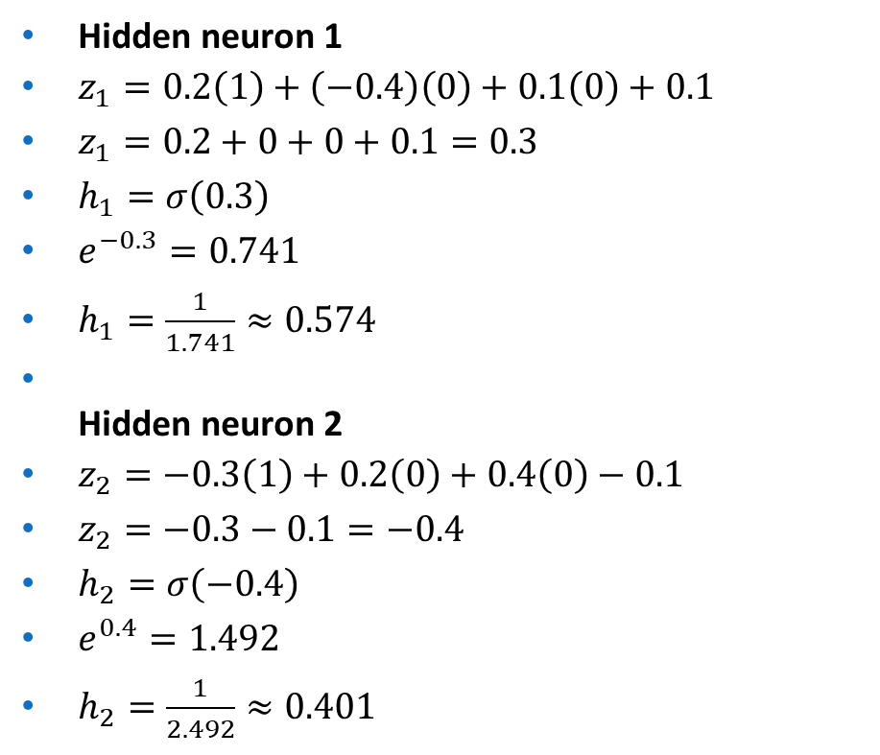
Hidden neuron 1
$z_{1}=0.2\left(1\right)+\left(−0.4\right)\left(0\right)+0.1\left(0\right)+0.1$
$z_{1}=0.2+0+0+0.1=0.3$
$h_{1}=σ\left(0.3\right)$
$e^{−0.3}=0.741$
$h_{1}=\frac{1}{1.741}≈0.574$
Hidden neuron 2
$z_{2}=−0.3\left(1\right)+0.2\left(0\right)+0.4\left(0\right)−0.1$
$z_{2}=−0.3−0.1=−0.4$
$h_{2}=σ\left(−0.4\right)$
$e^{0.4}=1.492$
$h_{2}=\frac{1}{2.492}≈0.401$
Hidden representation
$$h=\left[0.574 , 0.401\right]$$

Slide 26
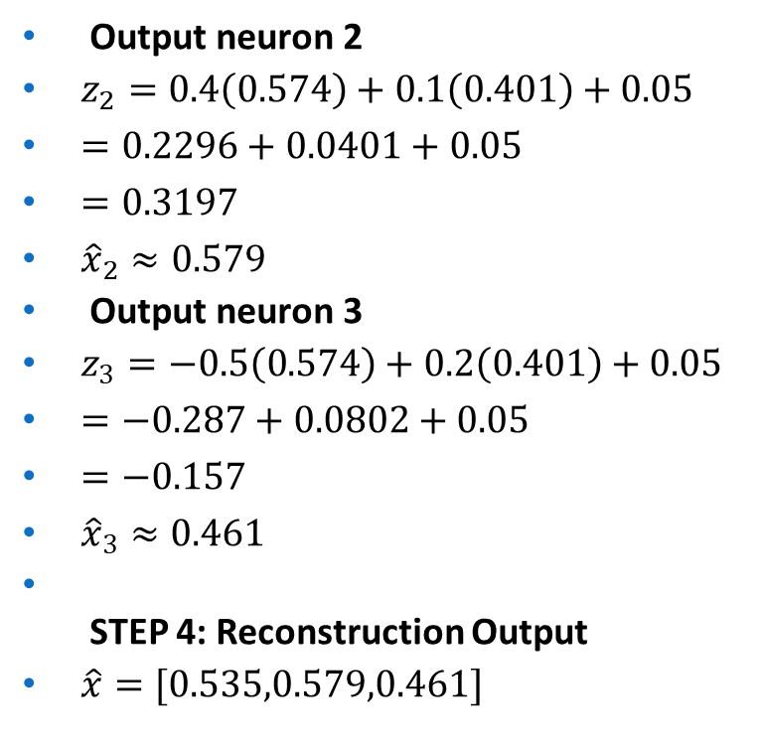
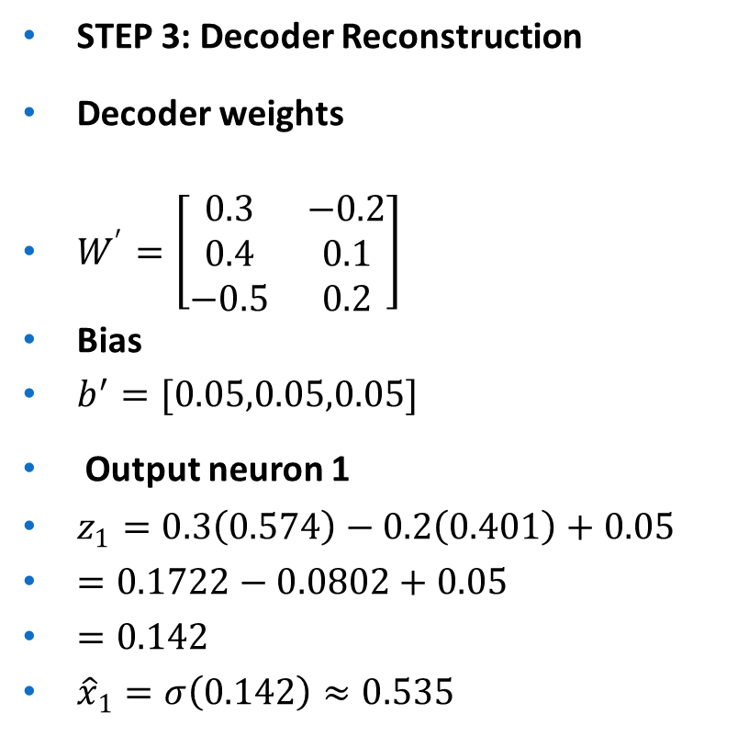
STEP 3: Decoder Reconstruction
Decoder weights
$W^{′}=\left[\begin{matrix}0.3 & −0.2 \\ 0.4 & 0.1 \\ −0.5 & 0.2\end{matrix}\right]$
Bias
$b^{′}=[0.05,0.05,0.05]$
Output neuron 1
$z_{1}=0.3\left(0.574\right)−0.2\left(0.401\right)+0.05$
$=0.1722−0.0802+0.05$
$=0.142$
${\hat{x}}_{1}=σ\left(0.142\right)≈0.535$
Output neuron 2
$z_{2}=0.4\left(0.574\right)+0.1\left(0.401\right)+0.05$
$=0.2296+0.0401+0.05$
$=0.3197$
${\hat{x}}_{2}≈0.579$
Output neuron 3
$z_{3}=−0.5\left(0.574\right)+0.2\left(0.401\right)+0.05$
$=−0.287+0.0802+0.05$
$=−0.157$
${\hat{x}}_{3}≈0.461$
STEP 4: Reconstruction Output
$\hat{x}=[0.535,0.579,0.461]$

Slide 27
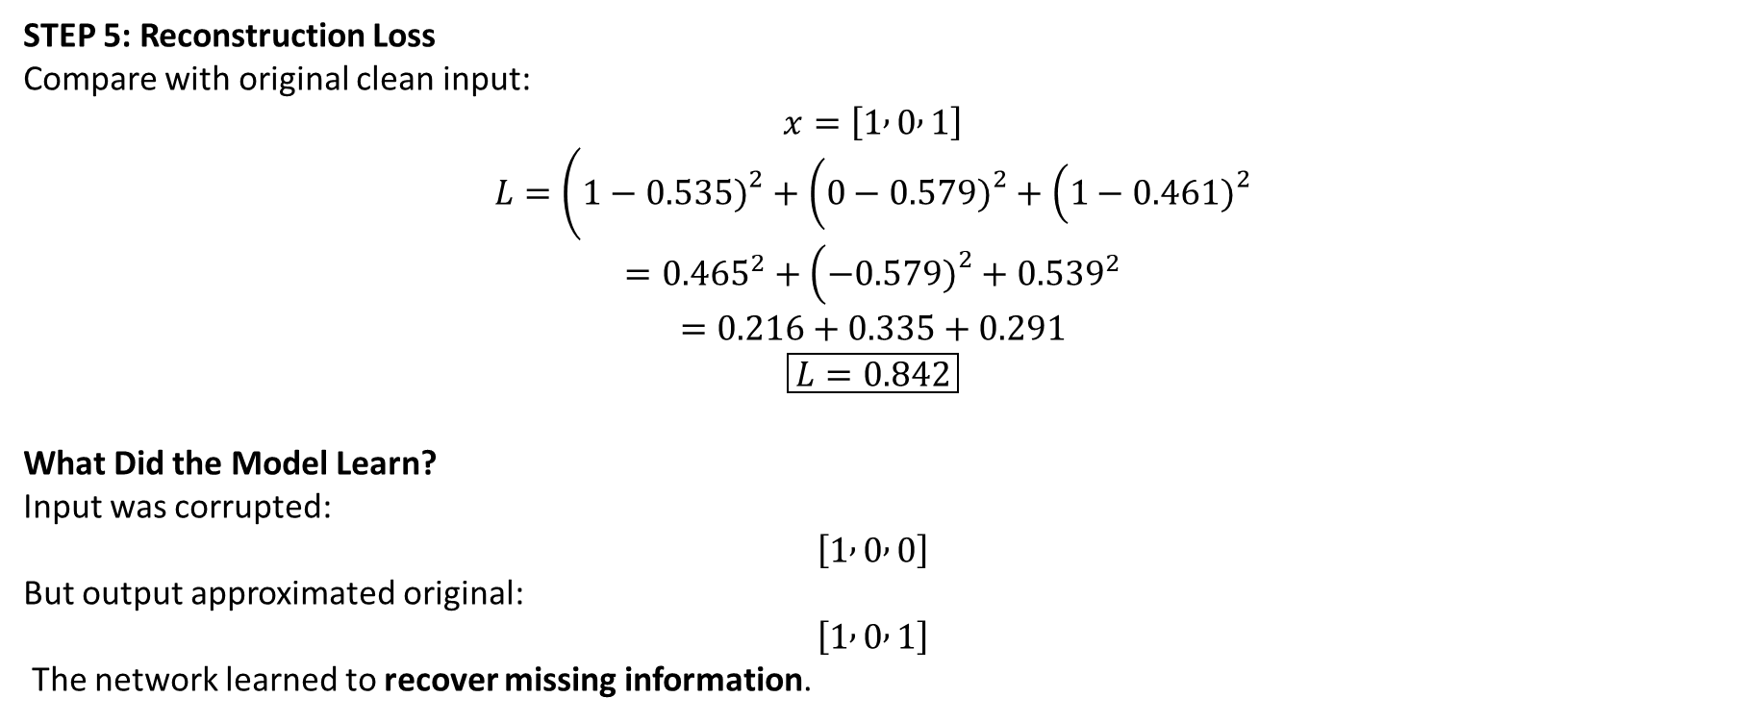
STEP 5: Reconstruction Loss
Compare with original clean input:
$$x=\left[1 , 0 , 1\right]$$
$$L=\left(1−0.535{\left.)\right.}^{2}+\left(0−0.579{\left.)\right.}^{2}+\left(1−0.461{\left.)\right.}^{2}\right.\right.\right.$$
$$={0.465}^{2}+\left(−0.579{\left.)\right.}^{2}+{0.539}^{2}\right.$$
$$=0.216+0.335+0.291$$
$$\boxed{L=0.842}$$
What Did the Model Learn?
Input was corrupted:
$$\left[1 , 0 , 0\right]$$
But output approximated original:
$$\left[1 , 0 , 1\right]$$
The network learned to recover missing information.

Slide 28
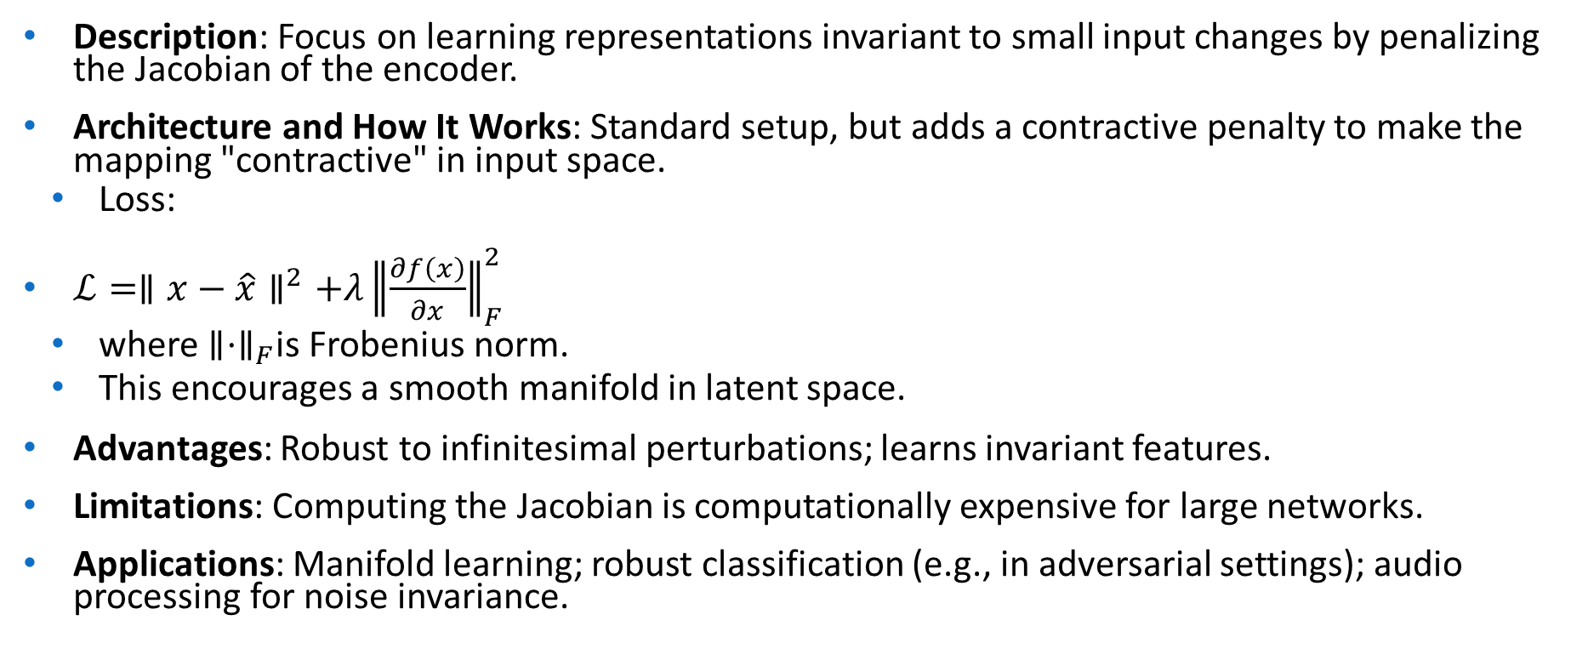
Contractive Autoencoders
Description: Focus on learning representations invariant to small input changes by penalizing the Jacobian of the encoder.
Architecture and How It Works: Standard setup, but adds a contractive penalty to make the mapping "contractive" in input space.
Loss:
$ℒ=∥x−\hat{x}∥^{2}+λ{∥\frac{∂f\left(x\right)}{∂x}∥}_{F}^{2}$
where $∥⋅∥_{F}$is Frobenius norm.
This encourages a smooth manifold in latent space.
Advantages: Robust to infinitesimal perturbations; learns invariant features.
Limitations: Computing the Jacobian is computationally expensive for large networks.
Applications: Manifold learning; robust classification (e.g., in adversarial settings); audio processing for noise invariance.

Slide 29
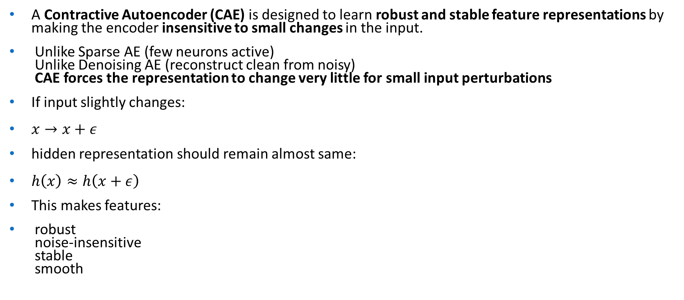
Contractive Autoencoder (CAE)
A Contractive Autoencoder (CAE) is designed to learn robust and stable feature representations by making the encoder insensitive to small changes in the input.
Unlike Sparse AE (few neurons active) Unlike Denoising AE (reconstruct clean from noisy) CAE forces the representation to change very little for small input perturbations
If input slightly changes:
$x→x+ε$
hidden representation should remain almost same:
$h\left(x\right)≈h\left(x+ε\right)$
This makes features:
robust noise-insensitive stable smooth

Slide 30
. This term penalizes large derivatives of the encoder function with respect to the input, making the representation more robust to small perturbations in the input data.
The idea is to encourage the mapping to the latent space to be "contractive," meaning nearby inputs map to nearby points in the latent space, improving robustness and feature extraction.

Slide 31
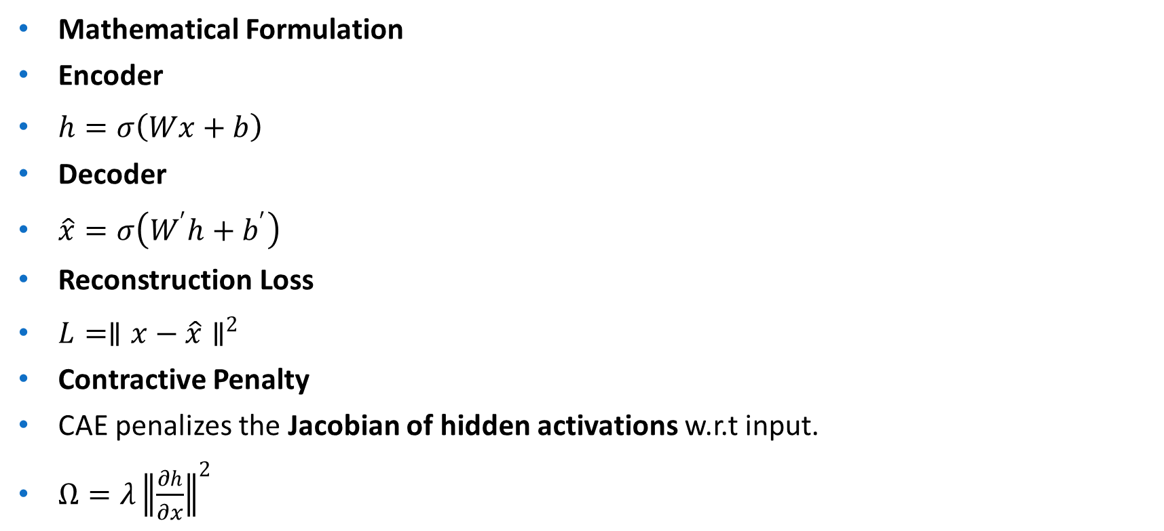
Mathematical Formulation
Encoder
$h=σ\left(Wx+b\right)$
Decoder
$\hat{x}=σ\left(W^{′}h+b^{′}\right)$
Reconstruction Loss
$L=∥x−\hat{x}∥^{2}$
Contractive Penalty
CAE penalizes the Jacobian of hidden activations w.r.t input.
$Ω=λ{∥\frac{∂h}{∂x}∥}^{2}$

Slide 32

For sigmoid activation:
$\frac{∂h_{j}}{∂x_{i}}=h_{j}\left(1−h_{j}\right)W_{ji}$
Contractive penalty becomes:
$Ω=λ\sum_{j}{{\left(h_{j}\left(1−h_{j}\right)\right)}^{2}}\sum_{i}{W_{ji}^{2}}$
Final Loss
$J=L+Ω$

Slide 33

Input
$x=[1,0,1]$
Network:
Input = 3
Hidden = 2
Output = 3
Activation = sigmoid
STEP 1: Encoder Forward Pass
Weights
$W=\left[\begin{matrix}0.2 & −0.4 & 0.1 \\ −0.3 & 0.2 & 0.4\end{matrix}\right]$
Bias
$b=[0.1,−0.1]$

Slide 34

Hidden neuron 1
$z_{1}=0.2\left(1\right)+\left(−0.4\right)\left(0\right)+0.1\left(1\right)+0.1$
$z_{1}=0.4$
$h_{1}=σ\left(0.4\right)=0.5987$
Hidden neuron 2
$z_{2}=−0.3\left(1\right)+0.2\left(0\right)+0.4\left(1\right)−0.1$
$z_{2}=0$
$h_{2}=0.5$
Hidden representation
$h=\left[0.5987 , 0.5\right]$

Slide 35

STEP 2: Decoder Reconstruction
Using:
$W^{′}=\left[\begin{matrix}0.3 & −0.2 \\ 0.4 & 0.1 \\ −0.5 & 0.2\end{matrix}\right]$
Bias:
$b^{′}=\left[0.05 , 0.05 , 0.05\right]$
Following same calculations:
$\hat{x}=[0.532,0.584,0.463]$

Slide 36
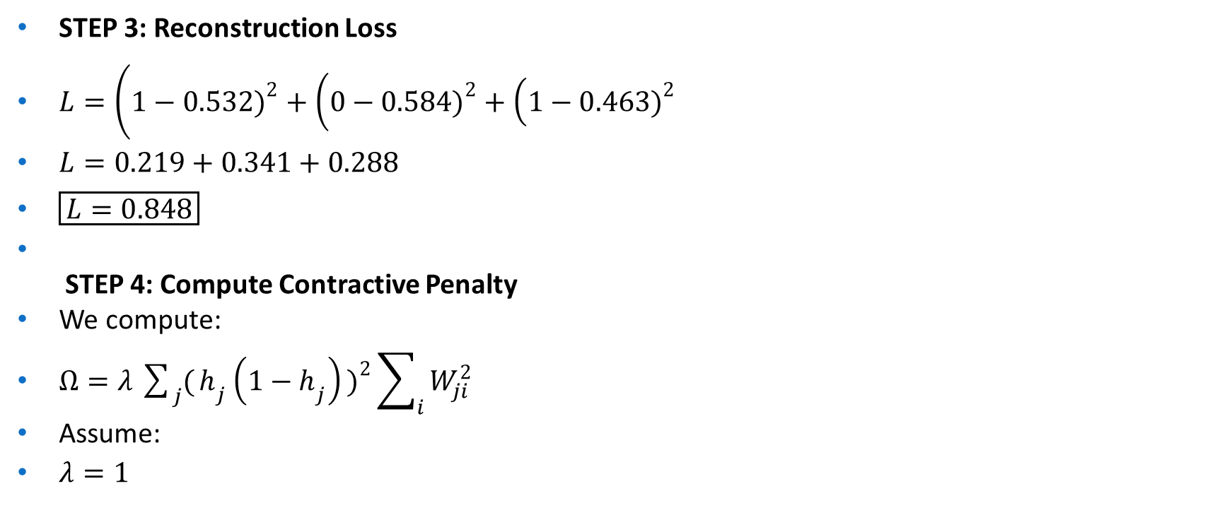
STEP 3: Reconstruction Loss
$L=\left(1−0.532{\left.)\right.}^{2}+\left(0−0.584{\left.)\right.}^{2}+\left(1−0.463{\left.)\right.}^{2}\right.\right.\right.$
$L=0.219+0.341+0.288$
$\boxed{L=0.848}$
STEP 4: Compute Contractive Penalty
We compute:
$Ω=λ\sum_{j}{(}\left.h_{j}\left(1−h_{j}\right){\left.)\right.}^{2}\sum_{i}{W_{ji}^{2}}\right.$
Assume:
$λ=1$

Slide 37

For hidden neuron 1
Compute derivative factor
$h_{1}\left(1−h_{1}\right)=0.5987\left(1−0.5987\right)$
$=0.5987×0.4013$
$=0.240$
Square:
$\left(0.240{\left.)\right.}^{2}=0.0576\right.$
Sum of squared weights
${0.2}^{2}+\left(−0.4{\left.)\right.}^{2}+{0.1}^{2}\right.$
$=0.04+0.16+0.01=0.21$
Contribution neuron 1
$0.0576×0.21=0.0121$

Slide 38

For hidden neuron 2
$h_{2}\left(1−h_{2}\right)=0.5\left(0.5\right)=0.25$
Square:
${0.25}^{2}=0.0625$
Sum weights:
$\left(−0.3{\left.)\right.}^{2}+{0.2}^{2}+{0.4}^{2}\right.$
$=0.09+0.04+0.16=0.29$
Contribution:
$0.0625×0.29=0.0181$
Total Contractive Penalty
$Ω=0.0121+0.0181$
$\boxed{Ω=0.0302}$

Slide 39

STEP 5: Final Loss
$J=L+Ω$
$J=0.848+0.0302$
$\boxed{J=0.878}$
Final Results
Hidden activations
$\left[0.5987 , 0.5\right]$
Reconstruction loss
$0.848$
Contractive penalty
$0.0302$
Final loss
$\boxed{0.878}$

Slide 40
Convolutional Autoencoders (CAEs)
Description: Adapted for grid-structured data like images, using convolutional layers to preserve spatial hierarchies.
Architecture and How It Works: Encoder uses conv/pooling layers to downsample to latent (flattened or volumetric); decoder uses transposed conv/upsampling to reconstruct.
Loss: Similar to basic MSE, but often perceptual losses for images.
Variant: Can be denoising or variational (e.g., Convolutional VAEs).
Advantages: Efficient for high-dimensional spatial data; captures local patterns like textures.
Limitations: Assumes grid structure; less flexible for non-image data.
Applications: Image compression (better than JPEG for certain artifacts); video frame prediction; medical imaging (e.g., MRI reconstruction).

Slide 41
A Convolutional Autoencoder (CAE) is a deep learning model designed to compress and reconstruct image data using convolutional layers instead of fully connected layers.
Ideal for images Preserves spatial structure Learns visual features like edges & textures
Why Convolutional Autoencoders?
Traditional autoencoders:
ignore spatial structure too many parameters for images
CAE solves this by:
using convolution filters preserving pixel relationships reducing parameters learning spatial features

Slide 42
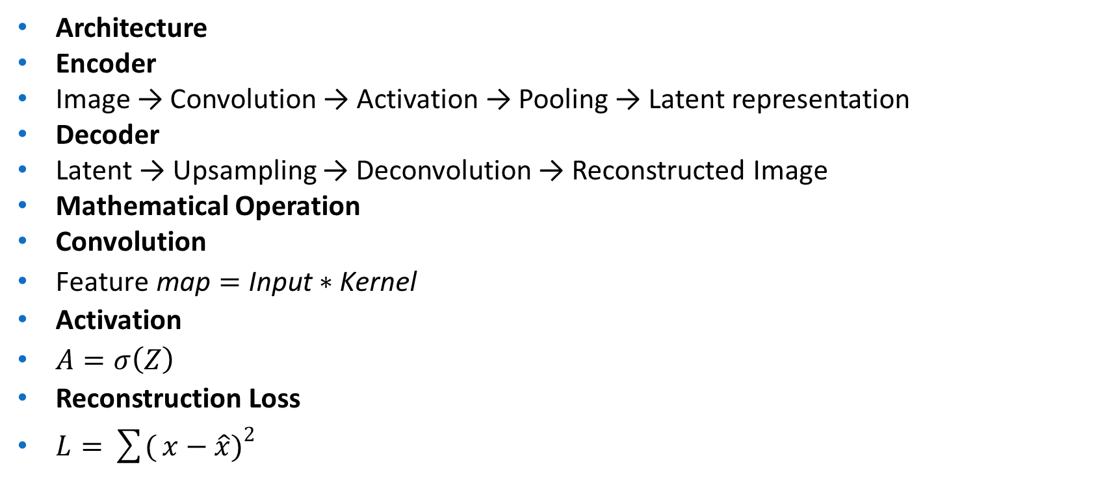
Architecture
Encoder
Image → Convolution → Activation → Pooling → Latent representation
Decoder
Latent → Upsampling → Deconvolution → Reconstructed Image
Mathematical Operation
Convolution
$\text{Feature} \text{map}=\text{Input}∗\text{Kernel}$
Activation
$A=σ\left(Z\right)$
Reconstruction Loss
$L=\sum{(}\left.x−\hat{x}{\left.)\right.}^{2}\right.$

Slide 43
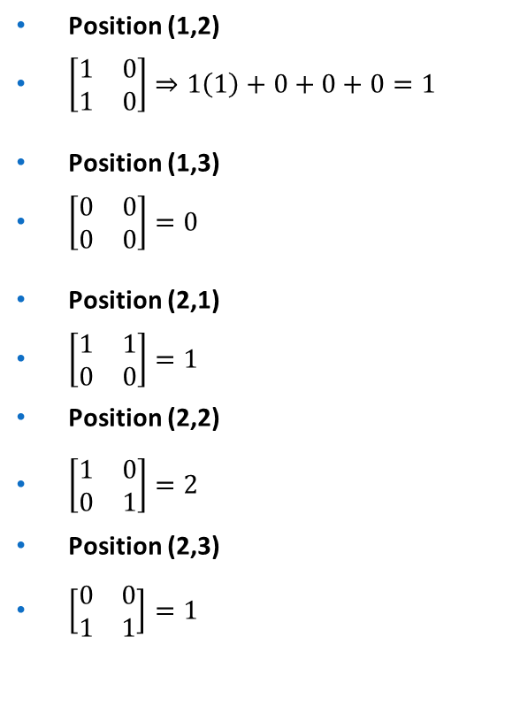
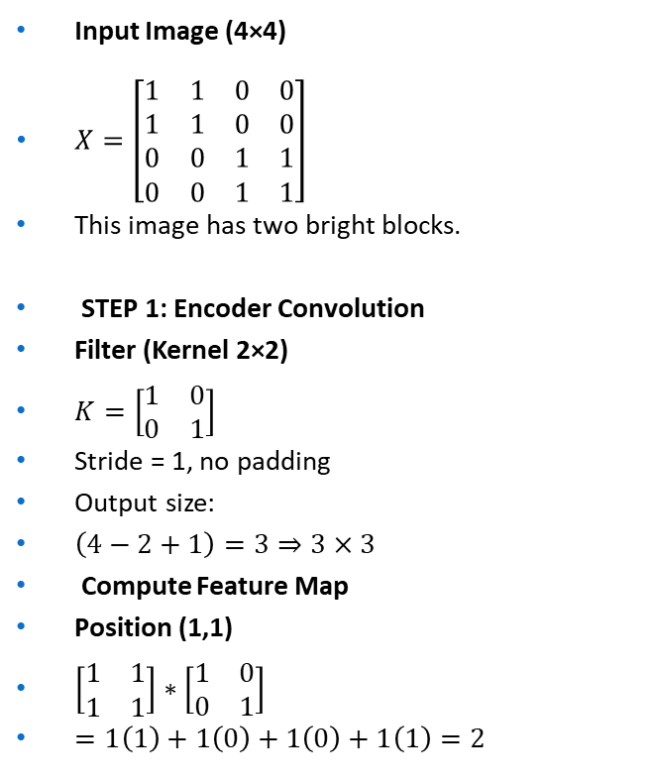
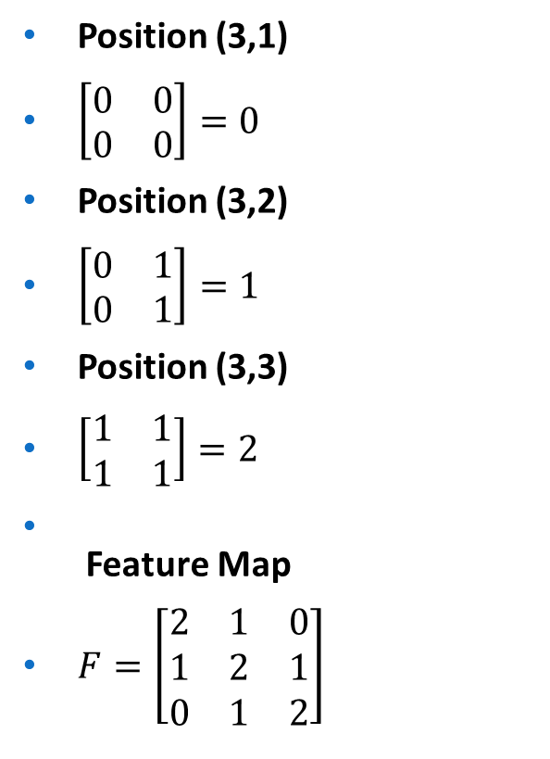
Input Image (4×4)
$X=\left[\begin{matrix}1 & 1 & 0 & 0 \\ 1 & 1 & 0 & 0 \\ 0 & 0 & 1 & 1 \\ 0 & 0 & 1 & 1\end{matrix}\right]$
This image has two bright blocks.
STEP 1: Encoder Convolution
Filter (Kernel 2×2)
$K=\left[\begin{matrix}1 & 0 \\ 0 & 1\end{matrix}\right]$
Stride = 1, no padding
Output size:
$\left(4−2+1\right)=3⇒3×3$
Compute Feature Map
Position (1,1)
$\left[\begin{matrix}1 & 1 \\ 1 & 1\end{matrix}\right]∗\left[\begin{matrix}1 & 0 \\ 0 & 1\end{matrix}\right]$
$=1\left(1\right)+1\left(0\right)+1\left(0\right)+1\left(1\right)=2$
Position (1,2)
$\left[\begin{matrix}1 & 0 \\ 1 & 0\end{matrix}\right]⇒1\left(1\right)+0+0+0=1$
Position (1,3)
$\left[\begin{matrix}0 & 0 \\ 0 & 0\end{matrix}\right]=0$
Position (2,1)
$\left[\begin{matrix}1 & 1 \\ 0 & 0\end{matrix}\right]=1$
Position (2,2)
$\left[\begin{matrix}1 & 0 \\ 0 & 1\end{matrix}\right]=2$
Position (2,3)
$\left[\begin{matrix}0 & 0 \\ 1 & 1\end{matrix}\right]=1$
Position (3,1)
$\left[\begin{matrix}0 & 0 \\ 0 & 0\end{matrix}\right]=0$
Position (3,2)
$\left[\begin{matrix}0 & 1 \\ 0 & 1\end{matrix}\right]=1$
Position (3,3)
$\left[\begin{matrix}1 & 1 \\ 1 & 1\end{matrix}\right]=2$
Feature Map
$F=\left[\begin{matrix}2 & 1 & 0 \\ 1 & 2 & 1 \\ 0 & 1 & 2\end{matrix}\right]$

Slide 44
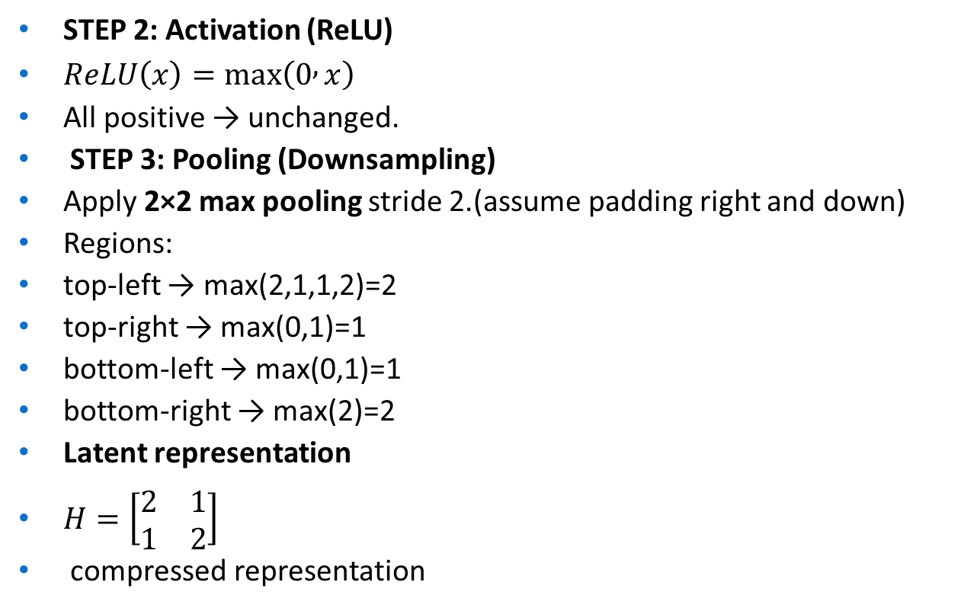
STEP 2: Activation (ReLU)
$ReLU\left(x\right)=max⁡\left(0 , x\right)$
All positive → unchanged.
STEP 3: Pooling (Downsampling)
Apply 2×2 max pooling stride 2.(assume padding right and down)
Regions:
top-left → max(2,1,1,2)=2
top-right → max(0,1)=1
bottom-left → max(0,1)=1
bottom-right → max(2)=2
Latent representation
$H=\left[\begin{matrix}2 & 1 \\ 1 & 2\end{matrix}\right]$
compressed representation

Slide 45
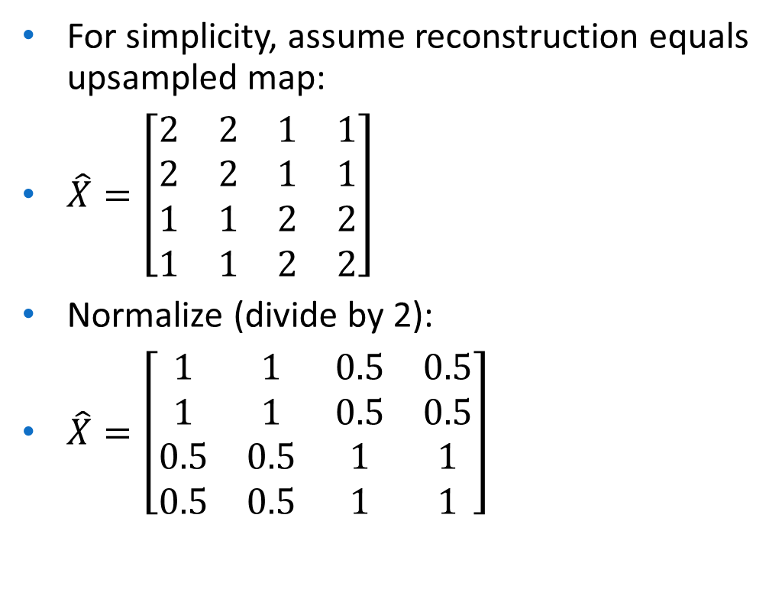
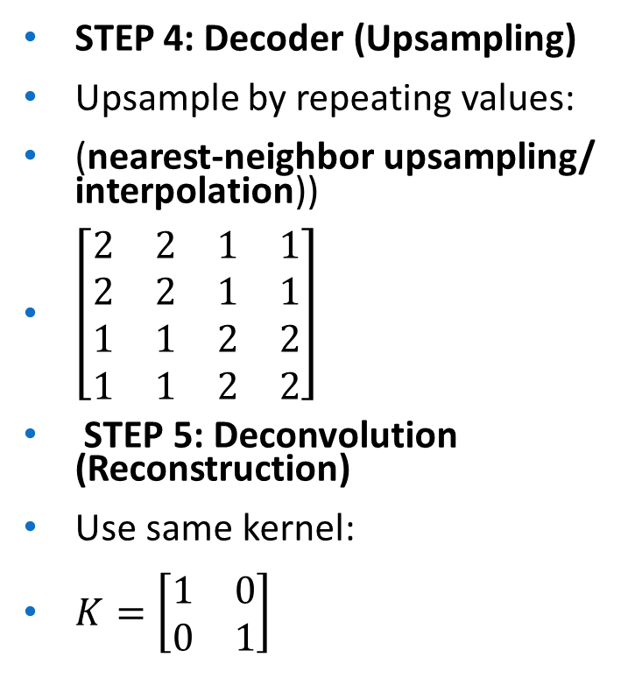
STEP 4: Decoder (Upsampling)
Upsample by repeating values:
(nearest-neighbor upsampling/ interpolation))
$\left[\begin{matrix}2 & 2 & 1 & 1 \\ 2 & 2 & 1 & 1 \\ 1 & 1 & 2 & 2 \\ 1 & 1 & 2 & 2\end{matrix}\right]$
STEP 5: Deconvolution (Reconstruction)
Use same kernel:
$K=\left[\begin{matrix}1 & 0 \\ 0 & 1\end{matrix}\right]$
For simplicity, assume reconstruction equals upsampled map:
$\hat{X}=\left[\begin{matrix}2 & 2 & 1 & 1 \\ 2 & 2 & 1 & 1 \\ 1 & 1 & 2 & 2 \\ 1 & 1 & 2 & 2\end{matrix}\right]$
Normalize (divide by 2):
$\hat{X}=\left[\begin{matrix}1 & 1 & 0.5 & 0.5 \\ 1 & 1 & 0.5 & 0.5 \\ 0.5 & 0.5 & 1 & 1 \\ 0.5 & 0.5 & 1 & 1\end{matrix}\right]$

Slide 46

STEP 6: Reconstruction Loss
Original:
$X=\left[\begin{matrix}1 & 1 & 0 & 0 \\ 1 & 1 & 0 & 0 \\ 0 & 0 & 1 & 1 \\ 0 & 0 & 1 & 1\end{matrix}\right]$
Reconstructed:
values differ only where 0.5 appears.
Error per such cell:
$\left(0−0.5{\left.)\right.}^{2}=0.25\right.$
Number of such cells = 8
$L=8×0.25=2$

Slide 47

Final Results
Encoded representation
$\left[\begin{matrix}2 & 1 \\ 1 & 2\end{matrix}\right]$
Reconstructed image approximates original.
Reconstruction loss
$\boxed{L=2}$

Slide 48

Adversarial Autoencoders (AAEs)
Description: Integrate Generative Adversarial Networks (GANs) to match the latent distribution to a prior, improving generation quality.
Architecture and How It Works: Encoder-decoder as in VAE, but a discriminator distinguishes latent samples from prior (e.g., Gaussian). Train adversarially: Encoder fools discriminator.
Loss: Reconstruction + adversarial (min-max game):
No explicit KL like VAEs.
Advantages: Sharper generations than VAEs; flexible priors.
Limitations: Inherits GAN instability (mode collapse, training oscillations).
Applications: Semi-supervised learning (use latent for classification); high-quality image synthesis; clustering with adversarial regularization.

Slide 49

An Adversarial Autoencoder (AAE) combines:
Autoencoder (for reconstruction) Adversarial training (like GANs)
to force the latent space to follow a desired probability distribution.
It merges Autoencoders + Generative Adversarial Networks (GANs).
Architecture
AAE has three components:
Encoder
Maps input → latent code
$z=E\left(x\right)$
Decoder
Reconstructs input
$\hat{x}=D\left(z\right)$
Discriminator
Distinguishes:
✔ real samples from prior distribution ✔ fake latent codes from encoder

Slide 50

Training Objectives
Reconstruction Loss
Ensures accurate reconstruction:
$L_{rec}=∣∣x−\hat{x}∣∣^{2}$
Adversarial Loss
Encoder tries to fool discriminator:
$L_{adv}=\log{D}\left(z\right)+log⁡\left(1−D\left(E\left(x\right)\right)\right)$
Goal: make encoded vectors look like samples from prior distribution.
Training Steps
Step A: Autoencoder training
Reconstruct input
Step B: Discriminator training
Distinguish real vs encoded latent vectors
Step C: Encoder adversarial training
Fool discriminator

Slide 51


Input
$x=\left[1 , 0\right]$
Network:
Input layer = 2
Hidden (latent) = 1
Output = 2
Activation = sigmoid
Prior distribution: Gaussian $N\left(0 , 1\right)$
STEP 1: Encoder
Weights
$W=\left[\begin{matrix}0.6 & −0.4\end{matrix}\right]$
Bias:
$b=0.1$
Compute latent code
$z=0.6\left(1\right)+\left(−0.4\right)\left(0\right)+0.1$
$z=0.7$
Apply sigmoid:
$z=σ\left(0.7\right)$
$e^{−0.7}=0.4966$
$z=\frac{1}{1.4966}≈0.668$
Encoded latent vector
$z=0.668$

Slide 52


STEP 2: Decoder Reconstruction
Decoder weights
$W^{′}=\left[\begin{matrix}0.5 \\ −0.3\end{matrix}\right]$
Bias:
$b^{′}=\left[0.05 , 0.05\right]$
Output neuron 1
$z_{1}=0.5\left(0.668\right)+0.05=0.384$
${\hat{x}}_{1}=σ\left(0.384\right)≈0.595$
Output neuron 2
$z_{2}=−0.3\left(0.668\right)+0.05=−0.150$
${\hat{x}}_{2}=σ\left(−0.150\right)≈0.463$
Reconstruction
$\hat{x}=\left[0.595 , 0.463\right]$
STEP 3: Reconstruction Loss
$L_{rec}=\left(1−0.595{\left.)\right.}^{2}+\left(0−0.463{\left.)\right.}^{2}\right.\right.$
$={0.405}^{2}+\left(−0.463{\left.)\right.}^{2}\right.$
$=0.164+0.214$
$\boxed{L_{rec}=0.378}$

Slide 53


STEP 4: Adversarial Training
The discriminator receives:
real latent sample from Gaussian
Assume:
$z_{real}=−0.2$
Fake latent from encoder
$z_{fake}=0.668$
Discriminator model
Simple logistic classifier:
$D\left(z\right)=σ\left(wz+b\right)$
Assume:
$w=2, b=0$
Discriminator output for real sample
$D\left(−0.2\right)=σ\left(−0.4\right)$
$=0.401$
Discriminator output for fake sample
$D\left(0.668\right)=σ\left(1.336\right)$
$e^{−1.336}=0.263$
$D=\frac{1}{1.263}≈0.792$

Slide 54


STEP 5: Discriminator Loss
$L_{D}=−\left[\log{D}\left(z_{real}\right)+log⁡\left(1−D\left(z_{fake}\right)\right)\right]$
$=−\left[log⁡\left(0.401\right)+log⁡\left(1−0.792\right)\right]$
$=−\left[log⁡\left(0.401\right)+log⁡\left(0.208\right)\right]$
$log⁡\left(0.401\right)=−0.915$
$log⁡\left(0.208\right)=−1.571$
$L_{D}=−\left(−2.486\right)$
$\boxed{L_{D}=2.486}$
STEP 6: Encoder Adversarial Loss
Encoder wants discriminator to believe fake is real.
$L_{adv}=−log⁡\left(D\left(z_{fake}\right)\right)$
$=−log⁡\left(0.792\right)$
$=0.233$
STEP 7: Total AAE Loss
Assume weight:
$λ=1$
$L_{total}=L_{rec}+L_{adv}$
$=0.378+0.233$
$\boxed{L_{total}=0.611}$

Slide 55

Final Results
Latent code $z=0.668$
Reconstruction $\left[0.595 , 0.463\right]$
Reconstruction loss $0.378$
Discriminator loss $2.486$
Encoder adversarial loss $0.233$
Total loss $\boxed{0.611}$

Slide 56


Variational Autoencoders (VAEs)
Description: Probabilistic extension for generative modeling, where the latent space is a distribution rather than a fixed vector, enabling sampling and interpolation.
Architecture and How It Works: Encoder outputs parameters of a distribution (e.g., mean $μ$and variance $σ^{2}$for Gaussian). Sample $z∼𝒩\left(μ , σ^{2}\right)$using reparameterization trick ($z=μ+σ⊙ε$, $ε∼𝒩\left(0 , 1\right)$) for backpropagation. Decoder generates from $z$.
Loss: Evidence Lower Bound (ELBO):

Slide 57
where first term is reconstruction, second regularizes to a prior (e.g., standard Gaussian).To derive ELBO: Start from
approximate by maximizing the bound.
Advantages: Generative capabilities (sample new data); smooth, continuous latent space for interpolation.
Limitations: Reconstructions can be blurry due to averaging in the loss; assumes simple priors (e.g., Gaussian), limiting complex distributions.
Applications: Image generation (e.g., faces in CelebA dataset); anomaly detection (low likelihood flags outliers); drug discovery (generating molecular structures).

Slide 58
A Variational Autoencoder (VAE) is a probabilistic generative model that learns how data is distributed and can generate new samples similar to the training data.
Unlike traditional autoencoders that learn a fixed latent vector, VAEs learn a distribution.

Slide 59

Key Idea
Instead of encoding input into a single point:
$x→z$
VAE encodes input into a distribution:
$x→\left(μ , σ\right)$
Then samples:
$z=μ+σε, ε∼N\left(0 , 1\right)$
This is called the reparameterization trick.

Slide 60

Architecture
Encoder outputs:
Mean vector $μ$
Standard deviation $σ$
Sampling layer
$z=μ+σε$
Decoder reconstructs input

Slide 61

Loss Function (Core of VAE)
VAE loss has two components:
1. Reconstruction Loss
Measures reconstruction accuracy.
$L_{rec}=∣∣x−\hat{x}∣∣^{2}$
2. KL Divergence Loss
Ensures latent distribution matches standard normal.
$L_{KL}=\frac{1}{2}\sum{(}\left.μ^{2}+σ^{2}−\ln{σ^{2}}−1\right)$
Total Loss
$L=L_{rec}+L_{KL}$

Slide 62


Input
$x=\left[1 , 0\right]$
Latent dimension = 1
STEP 1: Encoder Outputs μ and σ
Assume network produces:
$μ=0.6$
$σ=0.8$
STEP 2: Sampling (Reparameterization Trick)
Sample:
$ε∼N\left(0 , 1\right)$
Assume:
$ε=0.5$
Compute latent variable
$z=μ+σε$
$z=0.6+0.8\left(0.5\right)$
$z=0.6+0.4=1.0$
Sampled latent vector
$z=1.0$

Slide 63


STEP 3: Decoder Reconstruction
Decoder weights:
$W^{′}=\left[\begin{matrix}0.7 \\ −0.5\end{matrix}\right]$
Bias:
$b^{′}=\left[0.1 , 0.1\right]$
Activation: sigmoid
Output neuron 1
$z_{1}=0.7\left(1.0\right)+0.1=0.8$
${\hat{x}}_{1}=σ\left(0.8\right)$
$=\frac{1}{1+e^{−0.8}}≈0.690$
Output neuron 2
$z_{2}=−0.5\left(1.0\right)+0.1=−0.4$
${\hat{x}}_{2}=σ\left(−0.4\right)≈0.401$
Reconstruction
$\hat{x}=\left[0.690 , 0.401\right]$

Slide 64

STEP 4: Reconstruction Loss
$L_{rec}=\left(1−0.690{\left.)\right.}^{2}+\left(0−0.401{\left.)\right.}^{2}\right.\right.$
$={0.310}^{2}+{0.401}^{2}$
$=0.096+0.161$
$\boxed{L_{rec}=0.257}$

Slide 65


STEP 5: KL Divergence
Formula:
$L_{KL}=\frac{1}{2}\left(μ^{2}+σ^{2}−\ln{σ^{2}}−1\right)$
Substitute:
$=\frac{1}{2}\left({0.6}^{2}+{0.8}^{2}−ln⁡\left({0.8}^{2}\right)−1\right)$
$=\frac{1}{2}\left(0.36+0.64−ln⁡\left(0.64\right)−1\right)$
$=\frac{1}{2}\left(1−\left(−0.446\right)−1\right)$
$=\frac{1}{2}\left(0.446\right)$
$\boxed{L_{KL}=0.223}$
STEP 6: Total VAE Loss
$$L=L_{rec}+L_{KL}$$
$$L=0.257+0.223$$
$$\boxed{L=0.480}$$

Slide 66

Final Results
Mean & variance learned
$μ=0.6, σ=0.8$
Sampled latent vector
$z=1.0$
Reconstruction
$\left[0.690 , 0.401\right]$
Reconstruction loss
$0.257$
KL divergence
$0.223$
Total loss
$\boxed{0.480}$

Slide 67
Comparisons and Evolution
Undercomplete vs. Overcomplete: Trade-off between compression and richness; sparse/denoising often build on these.
Deterministic vs. Probabilistic: Basic types are deterministic; VAEs/AAEs add stochasticity for generation.
Evolution: From simple compression (1980s) to generative (VAEs 2013, AAEs 2015); modern hybrids like VQ-VAE (vector-quantized) or beta-VAE (disentangled) address limitations.
Choosing a Type: For compression, use undercomplete/CAE; for generation, VAE/AAE; for robustness, DAE/sparse.

Slide 68
Type | Key Idea | Strength | Use Case
Vanilla | Basic reconstruction | Simple | Compression
Sparse | Few active neurons | Feature selection | Anomaly detection
Denoising | Remove noise | Robust learning | Image cleaning
Contractive | Robust to small changes | Stability | Signal processing
Variational | Probabilistic latent space | Data generation | AI creativity
Convolutional | Spatial features | Images | Vision tasks

Slide 69
Autoencoder use cases
Both generative and deterministic autoencoders have a wide variety of use cases across different fields and data types.
Data compression: Autoencoders naturally learn a compressed representation of input data.
Dimensionality reduction: The encodings learned by autoencoders can be used as input to larger, composite neural networks. Dimensionality reduction of complex data can extract features relevant to other tasks, as well as increase computational speed and efficiency.
Anomaly detection and facial recognition: Autoencoders can detect anomalies, fraud or other defects—and, conversely, confirm a genuine match—by determining the reconstruction loss of examined data relative to the “normal” or “genuine” example it’s compared against.
Image denoising and audio denoising: Denoising autoencoders can remove extraneous artifacts or corruption that does not match the latent space representation learned by the network.

Slide 70
Image reconstruction: Inverting techniques learned for denoising, autoencoders can fill in missing elements of an image. They can be similarly used to colorize images.
Generative tasks: VAEs and adversarial autoencoders (AAEs), which learn probabilistic distributions akin to those learned by VAEs but use an adversarial discriminator network (similar to generative adversarial networks) in place of KL divergence, have been used with great success for generative tasks. Prominent generative applications of autoencoders include OpenAI’s original Dall-E model for image generation⁶ and even the generation of molecular structures used for medications.⁷

