Slide 1
Decoding in Transformers

Slide 2
Decoding Methods
Refers to how the model generates the next token during inference. Since you work deeply with LLMs (FDPs, certification prep, etc.)
Deterministic Decoding
Stochastic (Sampling-Based) Decoding

Slide 3
Deterministic Decoding Methods
Always produce the same output for the same input.
Greedy Decoding
At each step, choose the token with the highest probability.
Pros | Cons
Fast | Can miss better global sequences
Simple | Often repetitive
Deterministic | Gets stuck in local optimum

Slide 4
Deterministic Decoding Methods
Beam Search
Keep top-k sequences (beams) at every step.
Beam width = k
Expands each beam
Keeps best k cumulative probability sequences
Pros | Cons
Better global optimization than greedy | Computationally expensive
Good for structured tasks | Can produce generic responses
 | Low diversity

Slide 5
Stochastic (Sampling-Based) Decoding
introduce randomness → more creative outputs.
Random Sampling
Instead of picking the max probability token, sample from the distribution.
Low-probability nonsense tokens may get sampled.

Slide 6
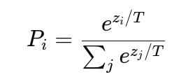
Stochastic (Sampling-Based) Decoding
Temperature Sampling
Controls randomness by scaling logits, temperature modifies distribution before softmax
Where:
T < 1 → more deterministic
T = 1 → normal softmax
T > 1 → more random

Slide 7
Stochastic (Sampling-Based) Decoding
Top-K Sampling
Keep only top K most probable tokens, renormalize, then sample.
Example:
K = 50 → sample only from top 50 tokens.
Advantage - Reduces nonsense sampling.

Slide 8
Stochastic (Sampling-Based) Decoding
Top-P (Nucleus) Sampling
Instead of fixed K:
Choose smallest set of tokens whose cumulative probability ≥ p.
Then sample from that subset.
Example: p = 0.9
Merits - Dynamic vocabulary size,
More adaptive than Top-K

Slide 9

Activation Functions in Recent Transformer Models
ReLU (Original Transformer – 2017)
Demerits
Non-smooth
Dead neuron problem
Not ideal for very deep LLMs

Slide 10

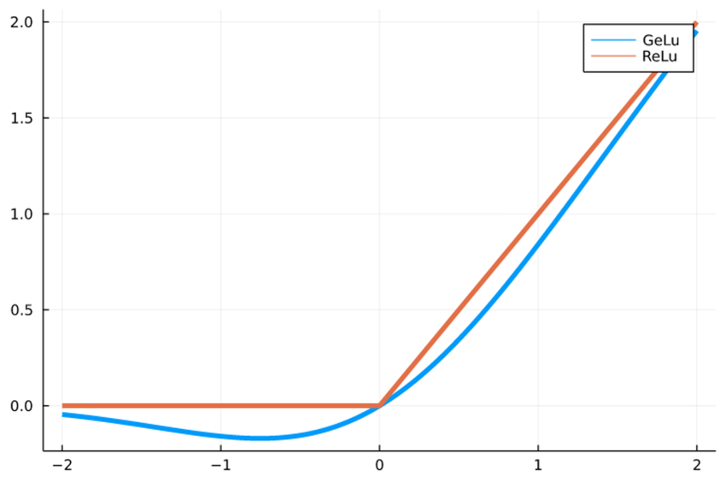
Activation Functions in Recent Transformer Models
GELU (Gaussian Error Linear Unit)
Used in:
BERT, GPT-2, GPT-3
Properties
Smooth
Non-monotonic, Probabilistic interpretation
Better gradient flow
GELU ≈ "soft probabilistic ReLU"

Slide 11

Activation Functions in Recent Transformer Models
SiLU / Swish
Used in:
PaLM, LLaMA (base building block)
Properties
Smooth
Self-gating behavior
Strong empirical performance in large-scale models

Slide 12

Activation Functions in Recent Transformer Models
GLU (Gated Linear Unit)
One projection controls (gates) another.
GeGLU (GELU-based GLU)
Used in - T5

Slide 13

Activation Functions in Recent Transformer Models
SwiGLU (Most Popular in Modern LLMs)
Used in
PaLM, LLaMA 2, Mistral 7B, Gemini
Properties
Better scaling behavior
More stable for very deep networks
Improved perplexity
Efficient parameter usage

Slide 14
Positional Encoding
Transformer has no recurrence (RNN) and no convolution (CNN) → it processes all tokens in parallel, so it does not inherently know which word comes first.
Self-attention only sees tokens as a set, not a sequence.
Input=Token Embedding+Positional Encoding

Slide 15
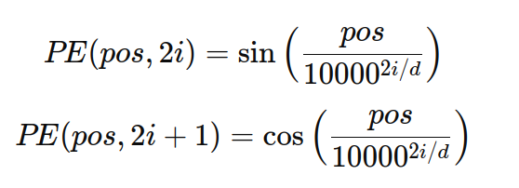
Absolute Positional Encoding (Original Transformer)
Each position gets a unique pattern using sine & cosine waves.
Advantages - No training needed
Generalizes to longer sequences
Encodes relative distance implicitly
Limitation - Fixed representation, Less flexible than learned methods

Slide 16
Learned Positional Embeddings
Each position has a learnable vector like word embeddings.
Used in: BERT, GPT-2
PE(pos)=learned vector
Pros - Flexible, Learns task-specific patterns
Cons - Cannot generalize beyond training length, Fixed max sequence length

Slide 17

Relative Positional Encoding
Absolute encoding tells: “This is position 10”
Relative encoding tells: “Token A is 3 positions away from token B”
This is more useful for language.
Used in: Transformer-XL, T5
Attention score modified using relative distance:
R_{i-j} = relative position embedding

Slide 18
Relative Positional Encoding
Benefits
Better long context modeling
Captures distance relationships

