Slide 1
Deep Learning Module 3
Dr S.Rajarajeswari

Slide 2
Exponentially Weighted Average
During training, gradients can fluctuate a lot due to:
Mini-batch noise
Non-convex loss surfaces
Outliers
Instead of using the current value only, EWA keeps a memory of the past, but gives:
More weight to recent values
Less weight to older values
Think of it as a smooth trend line rather than a jagged curve.

Slide 3
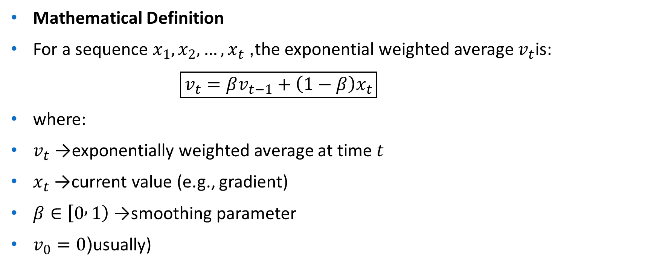
Mathematical Definition
For a sequence $x_{1},x_{2},…,x_{t}$, the exponential weighted average $v_{t}$is:
$\boxed{v_{t}=βv_{t−1}+\left(1−β\right)x_{t}}$
where:
$v_{t}$→ exponentially weighted average at time $t$
$x_{t}$→ current value (e.g., gradient)
$β∈\left[0 , 1\right)$→ smoothing parameter
$v_{0}=0$(usually)

Slide 4
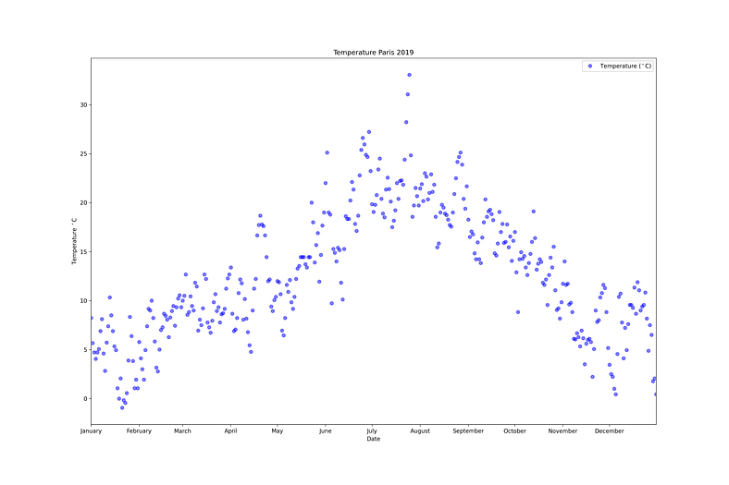
Lets make an example based on the temperatures of Paris, France, in 2019

Slide 5
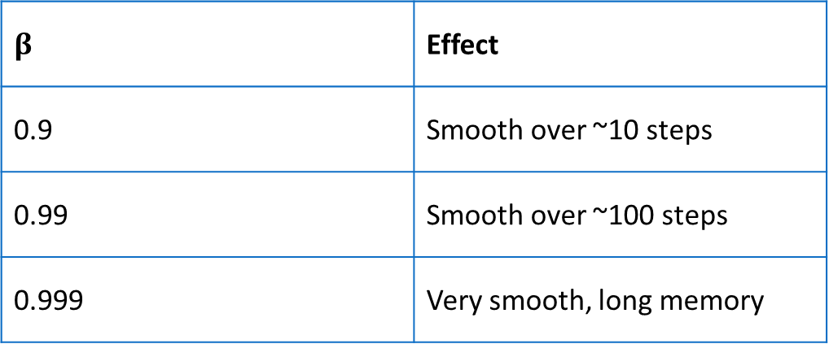

Role of the Parameter $β$
$$β$$ | Effect
0.9 | Smooth over ~10 steps
0.99 | Smooth over ~100 steps
0.999 | Very smooth, long memory

Slide 6
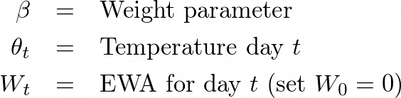
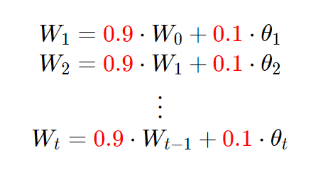
For this example, suppose that β = 0.9, so the EWA aims to combine the temperature of the current day with the previous temperatures.

Slide 7
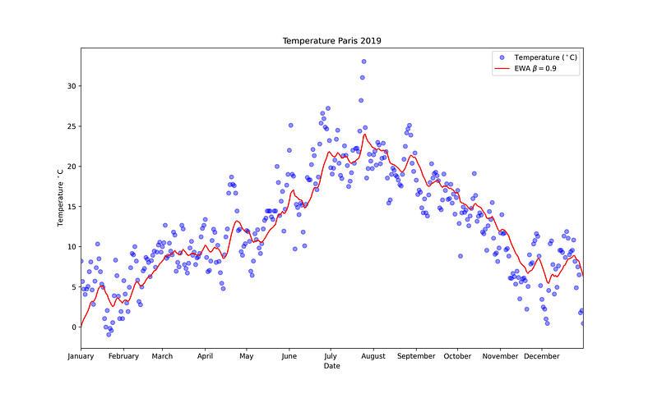
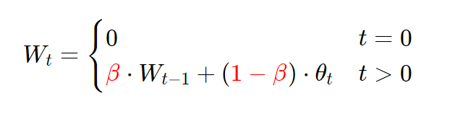
In general to compute the EWA for a given weight parameter β we use
If we plot this in red, we can see that what we get is a moving average of the daily temperature, it’s like a smooth, less noisy curve.

Slide 8

EWA in Optimization Algorithms
Momentum Gradient Descent
Uses EWA of gradients:
$v_{t}=βv_{t−1}+\left(1−β\right)g_{t}$
$θ=θ−αv_{t}$
Reduces oscillations Accelerates convergence

Slide 9

RMSProp
Uses EWA of squared gradients:
$s_{t}=βs_{t−1}+\left(1−β\right)g_{t}^{2}$
$θ=θ−\frac{α}{\sqrt{s_{t}+ε}}g_{t}$
Adaptive learning rate Handles vanishing/exploding gradients

Slide 10

Adam (Adaptive Moment Estimation)
Combines Momentum + RMSProp:
$m_{t}=β_{1}m_{t−1}+\left(1−β_{1}\right)g_{t}$
$v_{t}=β_{2}v_{t−1}+\left(1−β_{2}\right)g_{t}^{2}$
Bias correction:
${\hat{m}}_{t}=\frac{m_{t}}{1−β_{1}^{t}}, {\hat{v}}_{t}=\frac{v_{t}}{1−β_{2}^{t}}$
Update:
$θ=θ−\frac{α{\hat{m}}_{t}}{\sqrt{{\hat{v}}_{t}}+ε}$

Slide 11
Hyperparameter Tuning
Hyperparameter tuning is the process of selecting the optimal values for a machine learning model's hyperparameters.
These are typically set before the actual training process begins and control aspects of the learning process itself.
Effective tuning helps the model learn better patterns, avoid overfitting or underfitting and achieve higher accuracy on unseen data.

Slide 12
Why Hyperparameter Tuning is Important
Controls speed of convergence
Affects bias–variance trade-off
Prevents overfitting / underfitting
Directly impacts final accuracy and loss
Even a good model can fail with poor hyperparameters.

Slide 13
Techniques for Hyperparameter Tuning
GridSearchCV
RandomizedSearchCV
Bayesian Optimization

Slide 14
1. GridSearchCV
GridSearchCV is a brute-force technique for hyperparameter tuning.
It trains the model using all possible combinations of specified hyperparameter values to find the best-performing setup.
It is slow and uses a lot of computer power which makes it hard to use with big datasets or many settings.
It works using below steps:
Create a grid of potential values for each hyperparameter.
Train the model for every combination in the grid.
Evaluate each model using cross-validation.
Select the combination that gives the highest score.

Slide 15
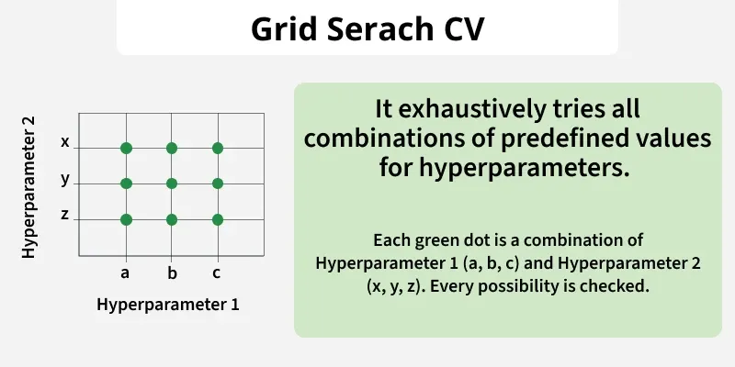

Slide 16
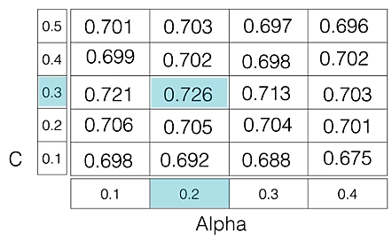
For example if we want to tune two hyperparameters C and Alpha for a Logistic Regression Classifier model with the following sets of values: C = [0.1, 0.2, 0.3, 0.4, 0.5] Alpha = [0.01, 0.1, 0.5, 1.0]
The grid search technique will construct multiple versions of the model with all possible combinations of C and Alpha, resulting in a total of 5 * 4 = 20 different models.
The best-performing combination is then chosen.

Slide 17
2. RandomizedSearchCV
As the name suggests RandomizedSearchCV picks random combinations of hyperparameters from the given ranges instead of checking every single combination like GridSearchCV.
In each iteration it tries a new random combination of hyperparameter values.
It records the model’s performance for each combination.
After several attempts it selects the best-performing set.

Slide 18
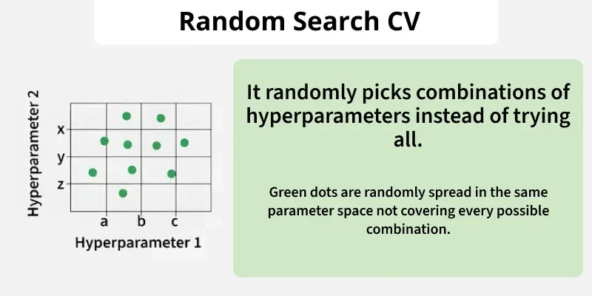

Slide 19
3. Bayesian Optimization
Grid Search and Random Search can be inefficient because they blindly try many hyperparameter combinations, even if some are clearly not useful. Bayesian Optimization takes a smarter approach.
It treats hyperparameter tuning like a mathematical optimization problem and learns from past results to decide what to try next.
Build a probabilistic model (surrogate function) that predicts performance based on hyperparameters.
Update this model after each evaluation.
Use the model to choose the next best set to try.
Repeat until the optimal combination is found. The surrogate function models:
P(score(y)∣hyperparameters(x))

Slide 20
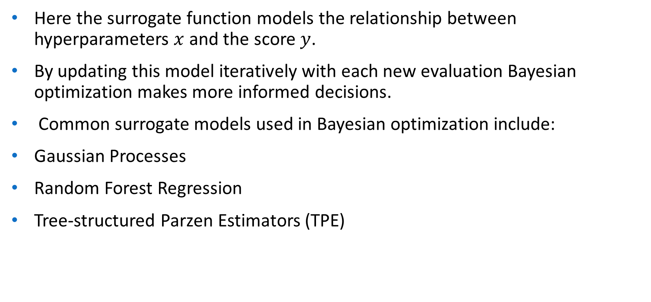
Here the surrogate function models the relationship between hyperparameters $x$ and the score $y$.
By updating this model iteratively with each new evaluation Bayesian optimization makes more informed decisions.
Common surrogate models used in Bayesian optimization include:
Gaussian Processes
Random Forest Regression
Tree-structured Parzen Estimators (TPE)

Slide 21
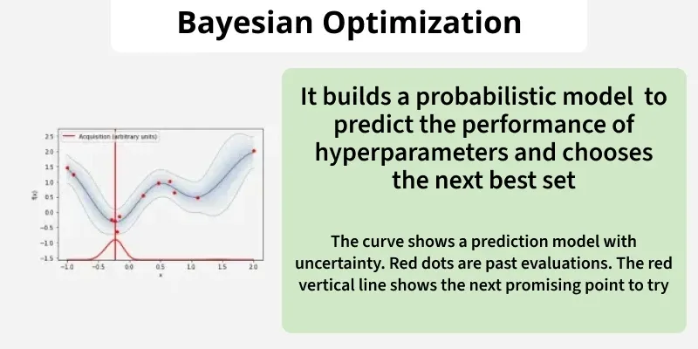

Slide 22
Advantages of Hyperparameter tuning
Improved Model Performance: Finding the optimal combination of hyperparameters can significantly boost model accuracy and robustness.
Reduced Overfitting and Underfitting: Tuning helps to prevent both overfitting and underfitting resulting in a well-balanced model.
Enhanced Model Generalizability: By selecting hyperparameters that optimize performance on validation data the model is more likely to generalize well to unseen data.
Optimized Resource Utilization: With careful tuning resources such as computation time and memory can be used more efficiently avoiding unnecessary work.
Improved Model Interpretability: Properly tuned hyperparameters can make the model simpler and easier to interpret.

Slide 23
Challenges
Dealing with High-Dimensional Hyperparameter Spaces: The larger the hyperparameter space the more combinations need to be explored. This makes the search process computationally expensive and time-consuming especially for complex models with many hyperparameters.
Incorporating Domain Knowledge: It can help guide the hyperparameter search, narrowing down the search space and making the process more efficient. Using insights from the problem context can improve both the efficiency and effectiveness of tuning.
Developing Adaptive Hyperparameter Tuning Methods: Dynamic adjustment of hyperparameters during training such as learning rate schedules or early stopping can lead to better model performance.

Slide 24
Important Hyperparameter Ranges
Category | Hyperparameter | Symbol | Typical Range / Values
Model Architecture | Number of layers | — | 1 – 100+
 | Neurons per layer | — | 8 – 4096
 | Activation function | — | ReLU, LeakyReLU, GELU, Tanh
 | Weight initialization | — | Xavier, He, Uniform
Regularization | Dropout rate | — | 0.1 – 0.7
 | L1 regularization | — | 1e-6 – 1e-3
 | L2 regularization | — | 1e-6 – 1e-2
 | Label smoothing | — | 0 – 0.2
CNN-Specific | Kernel size | — | 1×1 – 11×11
 | Stride | — | 1 – 4
 | Padding | — | same / valid
 | Number of filters | — | 16 – 1024
 | Pooling size | — | 2×2 – 3×3

Slide 25
Important Hyperparameter Ranges
Category | Hyperparameter | Symbol | Typical Range / Values
Optimization | Learning rate | α | 1e-5 – 1e-1 (log scale)
 | Momentum | β | 0.8 – 0.99
 | Adam first moment | β₁ | 0.85 – 0.95
 | Adam second moment | β₂ | 0.98 – 0.9999
 | Epsilon | ε | 1e-8 – 1e-4
 | Weight decay (L2) | λ | 1e-6 – 1e-2
 | Learning-rate decay | γ | 0.1 – 0.9
Training Process | Batch size | — | 8 – 1024
 | Epochs | — | 10 – 500+
 | Early stopping patience | — | 5 – 20
 | Gradient clipping | — | 0.5 – 5.0
 | Shuffle | — | True / False
 | Minimum LR | — | 1e-6 – 1e-4

Slide 26
Important Hyperparameter Ranges
Category | Hyperparameter | Symbol | Typical Range / Values
RNN / LSTM / GRU | Hidden units | — | 32 – 1024
 | Sequence length | — | 10 – 1000
 | Number of layers | — | 1 – 6
 | Recurrent dropout | — | 0.1 – 0.5
Transformer Models | Embedding dimension | — | 128 – 4096
 | Attention heads | — | 2 – 32
 | Feed-forward size | — | 2× – 8× embed dim
 | Number of layers | — | 2 – 96
 | Attention dropout | — | 0.1 – 0.3
Loss-Function Related | Label smoothing | — | 0 – 0.2
 | Focal loss γ | — | 1 – 5
 | Hinge loss margin | — | 0.5 – 2.0
LR Scheduling | Step size | — | 5 – 50 epochs
 | Decay rate | — | 0.9 – 0.99
 | Minimum LR | — | 1e-6 – 1e-4

Slide 27
Batch Normalization
Batch Normalization is used to reduce the problem of internal covariate shift in neural networks.
Covariance shift occurs when the input data distribution changes between training and testing, while the conditional distribution of the output given the input remains the same.
It works by normalizing the data within each mini-batch.
This means it calculates the mean and variance of data in a batch and then adjusts the values so that they have similar range.
After that it scales and shifts the values so that model learn effectively.

Slide 28
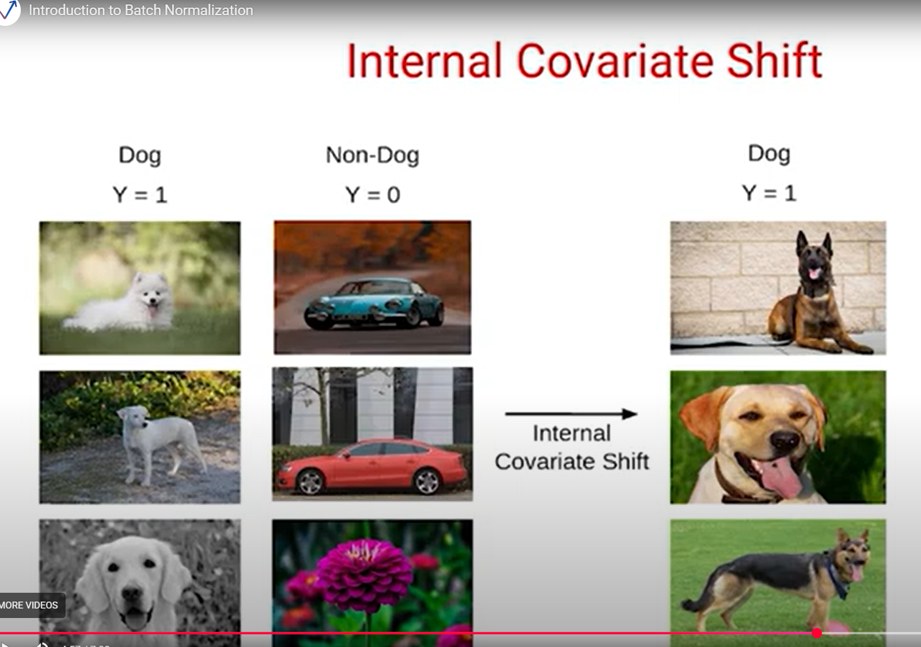

Slide 29
In traditional neural networks as the input data propagates through the network, the distribution of each layer's inputs changes.
This phenomenon is known as internal covariate shift and it can slow down training process.
Batch Normalization aims to reduce this issue by normalizing the inputs of each layer.
This process keeps the inputs to each layer of the network in a stable range even if the outputs of earlier layers change during training. As a result training becomes faster and more stable.

Slide 30
Need of Batch Normalization
Batch Normalization makes sure outputs of each layer stay steady as model learns. This helps model train faster and learn more effectively.
Solves the problem of internal covariate shift.
Makes training faster and more stable.
Allows use of higher learning rates.
Helps avoid vanishing or exploding gradients.
Can act like a regularizer sometimes reduce the need for dropout.

Slide 31
Where Batch Normalization is Applied
Before activation function (most common)
After linear transformation (Dense / Conv layer)
Linear → BatchNorm → Activation

Slide 32

Mathematical Formulation
For a mini-batch $B=\left\{x_{1} , x_{2} , … , x_{m}\right\}$:
Step 1: Compute batch statistics
$μ_{B}=\frac{1}{m}\sum_{i=1}^{m}{x_{i}}$
Step 2: Normalize
${\hat{x}}_{i}=\frac{x_{i}−μ_{B}}{\sqrt{σ_{B}^{2}+ε}}$
Step 3: Scale and shift
$\boxed{y_{i}=γ{\hat{x}}_{i}+β}$
where:
$γ$→ learnable scale parameter
$β$→ learnable shift parameter
$ε$→ small constant for numerical stability

Slide 33
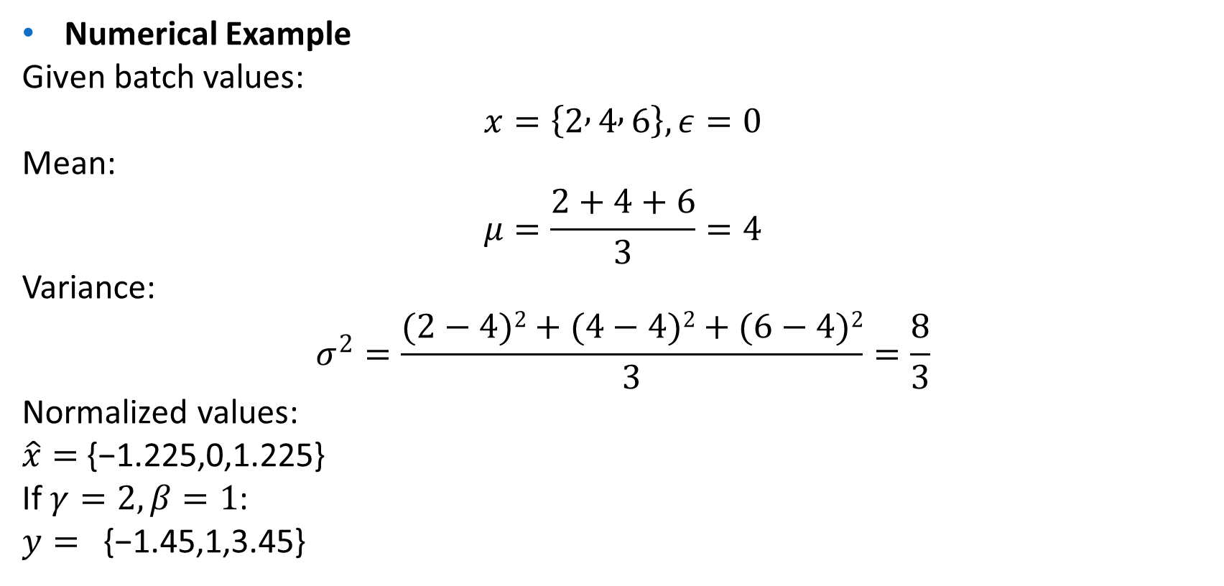
Numerical Example
Given batch values:
$$x=\left\{2 , 4 , 6\right\}, ε=0$$
Mean:
$$μ=\frac{2+4+6}{3}=4$$
Variance:
$$σ^{2}=\frac{(2−4)2+(4−4)2+(6−4)2}{3}=\frac{8}{3}$$
Normalized values:
$\hat{x}=$ {−1.225,0,1.225}
If $γ=2,β=1$:
$y=$ {−1.45,1,3.45}

Slide 34
Links
https://www.analyticsvidhya.com/blog/2021/03/introduction-to-batch-normalization/

Slide 35
Softmax Regression
Softmax Regression is a multiclass generalization of Logistic Regression used when the output variable has more than two mutually exclusive classes.
It is one of the most common classifiers used in deep learning and neural networks.
When to Use Softmax Regression
Multi-class classification (one correct class per sample)
Classes are mutually exclusive Examples: Handwritten digit recognition (0–9)
Image classification (cat / dog / car / …)
Text classification with multiple labels (single-label)

Slide 36

Model Structure
For input feature vector $x∈ℝ^{n}$and $K$classes:
Linear scores (logits):
$z_{k}=w_{k}^{T}x+b_{k}, k=1,2,…,K$

Slide 37
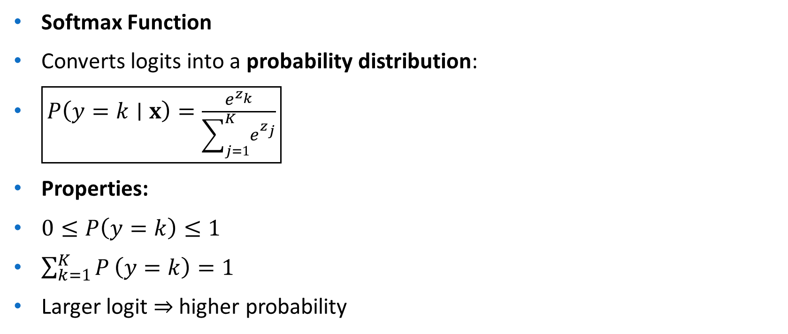
Softmax Function
Converts logits into a probability distribution:
$\boxed{P\left(y=k∣x\right)=\frac{e^{z_{k}}}{\sum_{j=1}^{K}{e^{z_{j}}}}}$
Properties:
$0≤P\left(y=k\right)≤1$
$\sum_{k=1}^{K}{P}\left(y=k\right)=1$
Larger logit ⇒ higher probability

Slide 38

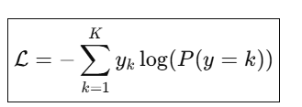

Decision Rule
Loss Function: Categorical Cross-Entropy
For one-hot encoded target $y$:
For a single sample with true class $c$:
L=−log(P(y=c))

Slide 39

Training Using Gradient Descent
Gradient of loss w.r.t. logits:
$\frac{∂ℒ}{∂z_{k}}=P\left(y=k\right)−y_{k}$
Simple and efficient Works well with backpropagation

Slide 40

Regularization in Softmax Regression
L2 Regularization:
$ℒ_{total}=ℒ+\frac{λ}{2}\sum_{k}{∥}w_{k}∥^{2}$
Reduces overfitting Controls weight magnitude

Slide 41
Data augmentation
Data augmentation is a technique used to artificially increase the size and diversity of a training dataset by applying label-preserving transformations to existing data.
It is mainly used to reduce overfitting and improve generalization.
Why Data Augmentation is Needed
Deep models need large datasets
Real-world data is often limited
Prevents memorization of training data
Improves robustness to variations
Acts as a regularization technique

Slide 42
Types of Data Augmentation
Image Data Augmentation
Technique | Description
Rotation | Rotate (±5° to ±30°)
Translation | Shift horizontally/vertically
Scaling / Zoom | Zoom in or out
Flipping | Horizontal / vertical
Cropping | Random or center crop
Shearing | Skewing image
Brightness / Contrast | Illumination change
Gaussian Noise | Add noise
Cutout | Randomly mask regions
MixUp | Linear combination of images
CutMix | Patch-based mixing

Slide 43
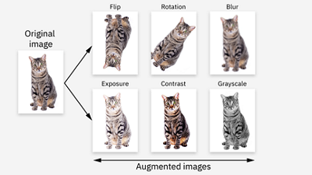

Slide 44


Slide 45
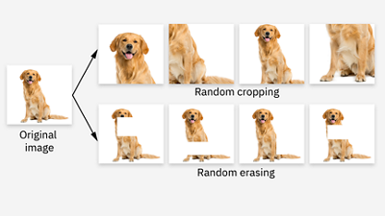

Slide 47
Text Data Augmentation (NLP)
Technique | Description
Synonym replacement | Replace words using WordNet
Random insertion | Insert random words
Random deletion | Remove words
Back translation | Translate → retranslate
Paraphrasing | Sentence rewording

Slide 48
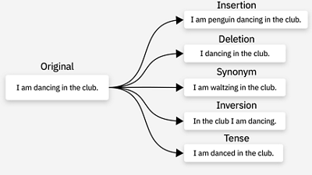

Slide 49
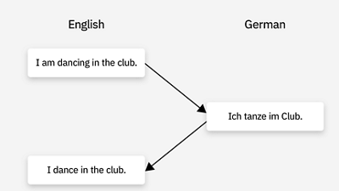

Slide 50
Audio Data Augmentation
Technique | Description
Time shifting | Shift waveform
Pitch shifting | Change pitch
Time stretching | Speed change
Add background noise | Improve robustness
SpecAugment | Mask time/frequency

Slide 51
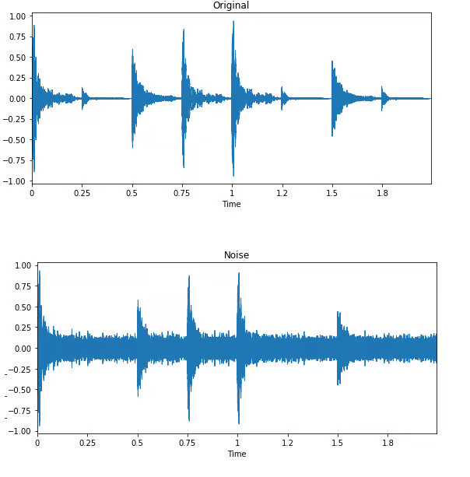

Slide 52
Tabular Data Augmentation
Technique | Description
SMOTE | Synthetic minority samples
ADASYN | Adaptive synthetic sampling
Noise injection | Add small noise
Feature swapping | Shuffle columns

Slide 53
Data Augmentation vs Regularization
Aspect | Data Augmentation | Regularization
Purpose | Increase data diversity | Control model complexity
Examples | Flip, rotate | L1, L2, dropout
Effect | Reduces variance | Reduces variance

Slide 54
Augmented vs. Synthetic data
Data augmentation and synthetic data generation are distinct yet complementary techniques in machine learning:
Augmented data: This involves creating modified versions of existing data to increase dataset diversity. For example, in image processing, applying transformations like rotations, flips, or color adjustments to existing images can help models generalize better.
Synthetic data: This refers to artificially generated data, which allows researchers and developers to test and improve algorithms without risking the privacy or security of real-world data.
Note: augmentation techniques are not limited to images. You can augment audio, video, text, and other types of data too.

Slide 55
Links
https://www.datacamp.com/tutorial/complete-guide-data-augmentation
https://www.ibm.com/think/topics/data-augmentation

Slide 56
Underfitting vs Overfitting
Underfitting
A model fails to learn the underlying pattern in the data.
Model is too simple
High error on training and test data
🔹 Overfitting
A model learns noise and details in training data instead of the true pattern.
Model is too complex
Low training error, high test error

Slide 57
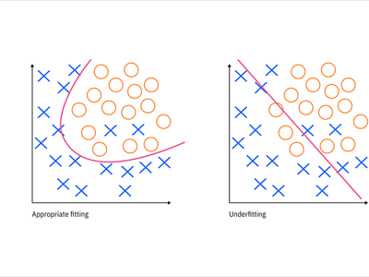

Slide 58
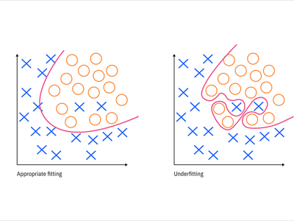

Slide 59
Core Comparison Table
Aspect | Underfitting | Overfitting
Training error | High | Very low
Validation/Test error | High | High
Model complexity | Too low | Too high
Bias | High bias | Low bias
Variance | Low variance | High variance
Generalization | Poor | Poor
Data memorization | ❌ | ✅
Decision boundary | Too simple | Too complex

Slide 60
Bias–Variance Perspective
Term | Underfitting | Overfitting
Bias | High | Low
Variance | Low | High
Error source | Wrong assumptions | Sensitivity to data

Slide 61
Causes
Causes of Underfitting
Model too simple
Insufficient features
Too much regularization
Too few training epochs
Causes of Overfitting
Model too complex
Too many parameters
Insufficient training data
Training too long
No regularization

Slide 62
Fixing Underfitting
Increase model complexity Add more features Reduce regularization Train longer Use better architecture
Fixing Overfitting
Collect more data Use data augmentation Add regularization (L1/L2) Apply dropout Use early stopping Reduce model size

