Slide 1
Module 5
Dr S.Rajarajeswari

Slide 2
Long-Term Dependencies
Long-term dependencies refer to the challenge in machine learning models, particularly recurrent neural networks (RNNs), where the model struggles to learn and retain information from earlier parts of a sequence when making predictions about later parts.
This issue arises due to the vanishing or exploding gradient problem during training, making it hard for the model to capture relationships over long distances in data like text, time series, or speech.

Slide 3
Why It Happens
In standard RNNs, information is passed through hidden states across time steps. As sequences grow longer:
Gradients (used in backpropagation) can diminish exponentially (vanishing gradients), causing the model to forget early information.
Or they can grow uncontrollably (exploding gradients), leading to unstable training.
For example, in natural language processing, a sentence like "The cat, which was chased by the dog after jumping over the fence and running through the yard, finally climbed the tree" requires remembering "cat" much later to resolve dependencies.

Slide 4
Problem with Long-Term Dependencies in RNN
Recurrent Neural Networks (RNNs) are designed to handle sequential data by maintaining a hidden state that captures information from previous time steps.
However they often face challenges in learning long-term dependencies where information from distant time steps becomes crucial for making accurate predictions for current state.
This problem is known as the vanishing gradient or exploding gradient problem.
Vanishing Gradient: When training a model over time, the gradients which help the model learn can shrink as they pass through many steps. This makes it hard for the model to learn long-term patterns since earlier information becomes almost irrelevant.
Exploding Gradient: Sometimes gradients can grow too large causing instability. This makes it difficult for the model to learn properly as the updates to the model become erratic and unpredictable.

Slide 5
Solutions
Several architectures and techniques address this:
Long Short-Term Memory (LSTM) Networks: Introduced gates (input, forget, output) to control what information to keep, discard, or output. This allows selective memory over long sequences.
Gated Recurrent Units (GRUs): A simplified LSTM variant with fewer gates, often performing similarly with less computational cost.
Transformers: Use self-attention mechanisms to directly connect all positions in a sequence, bypassing sequential processing. This enables parallel computation and better handling of long-range dependencies (e.g., in models like BERT or GPT).
Other Approaches: Residual connections (e.g., in ResNets adapted for sequences), attention mechanisms, or dilated convolutions in models like WaveNet.

Slide 6
Applications and Impact
This concept is crucial in fields like:
Language modeling (e.g., predicting the next word in a sentence).
Machine translation (e.g., aligning words across long sentences).
Time-series forecasting (e.g., stock prices over months).

Slide 7
Echo State Networks ( ESN)
Echo State Networks are a form of recurrent neural network (RNN) within the reservoir computing paradigm, designed to process sequential data efficiently.
Introduced by Herbert Jaeger in 2001, ESNs simplify training by using a large, fixed, randomly connected "reservoir" of neurons, where only the output weights are adjusted.
This approach avoids the gradient issues common in traditional RNNs, making ESNs suitable for tasks like time-series forecasting, speech recognition, and system control.
The key idea is:
The recurrent hidden layer (reservoir) is randomly generated and not trained.
Only the output layer weights are trained.
Because of this, ESNs are computationally efficient and easier to train than traditional RNNs.
They are widely used in problems involving temporal patterns and dynamic systems.

Slide 8
An Echo State Network (ESN) in Python is like a smart system that can predict what comes next in a sequence of data. Imagine you have a list of numbers or values, like the temperature each day. An ESN can learn from this data and then try to guess the temperature for the next day.
Here's how it works:
Reservoir: It has a special part called a "reservoir," which is like a pool of interconnected neurons. These neurons work together to remember patterns in the data. It's like having a memory of what happened before.
Training: We show the ESN some of our data and let it learn. It doesn't learn everything but gets the hang of the patterns. It's like giving a few examples to a friend so they can understand how to predict.
Predicting: Now, when we give the ESN a new piece of data (like the past temperatures), it uses what it learned to make a guess about what comes next.
Output: The ESN gives us its prediction, and we can compare it to the real answer. If it's good, great! If not, we might need to tweak things a bit.

Slide 9
Imagine an Echo State Network (ESN) in Python as a smart musical instrument player. Let's say you're trying to teach the player to mimic a song.
The player has a large collection of notes (reservoir), and when you play the first few notes of the song (input), the player responds with its interpretation of the melody.
Now, here's the trick: the player's ability to interpret the song is based on its own unique style (randomly initialized reservoir), and it doesn't change its playing style during practice (fixed weights).
As you play more notes, the player adjusts how it combines those notes to match the song's rhythm and melody.
So, the player becomes really good at predicting the next note in the song, even if it hasn't heard that specific sequence before.

Slide 10
In real life, ESNs are used for tasks like predicting stock prices or weather patterns, where past data helps forecast future trends.
The "echo" in Echo State Networks comes from their ability to retain and echo back the essential patterns from the input data, making them handy in situations where recognizing and predicting sequences is crucial

Slide 11
Concepts of Echo-State Networks
Reservoir Computing: Reservoir Computing is a framework that includes Echo State Networks. In ESNs, the reservoir is a dynamic memory of randomly initialized recurrent neurons that captures temporal patterns in sequential data.
Reservoir: The reservoir is a fixed and randomly initialized collection of recurrent neurons in an ESN. It serves as a dynamic memory capturing temporal dependencies in the input data.
Echo State Property: The Echo State Property is a key characteristic of the reservoir, indicating that its dynamics amplify and retain information from the input over time. This property ensures effective learning and memory of temporal patterns.
Input Layer: The input layer of an ESN receives sequential input data. Each input corresponds to a time step in the sequence.

Slide 12
Output Layer: The output layer produces the final result based on the combination of the reservoir states. It is typically a linear combination of the reservoir states, and only the output layer is trained.
Training: During training, the ESN learns to map the reservoir states to the desired output. The training focuses on adjusting the weights in the output layer while keeping the reservoir weights fixed.
Fixed Weights: The weights in the reservoir are randomly initialized and remain fixed during training. This simplifies the training process and enhances the network's ability to capture temporal pattern

Slide 13
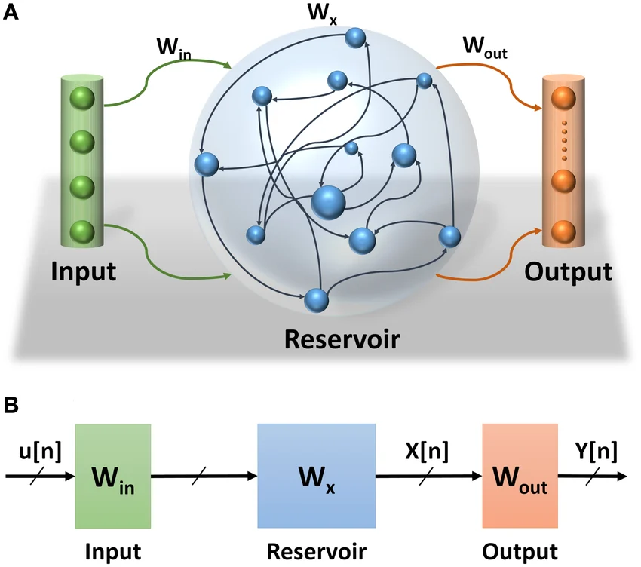

Slide 14
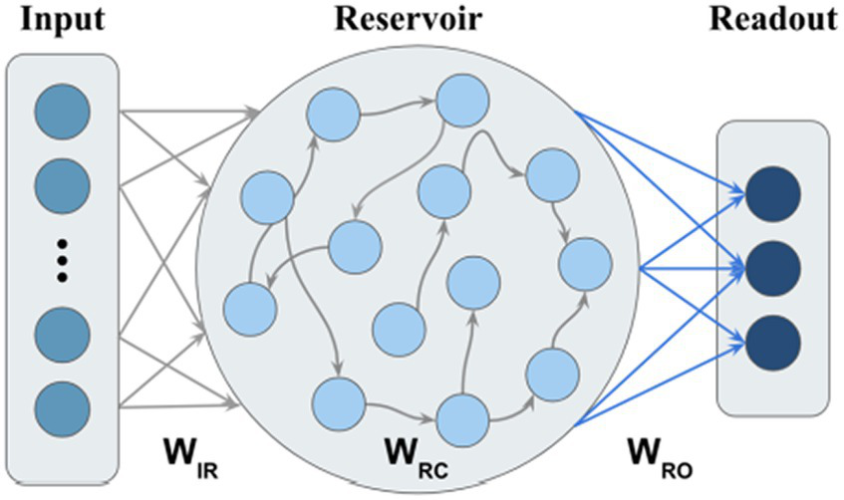
Architecture of Echo State Network

Slide 15

Architecture of Echo State Network
An ESN has three main components:
1. Input Layer
Receives the external input signal.
Connects input to reservoir neurons.
Weight matrix: $W_{in}$
Example inputs:
temperature time series
speech signals
stock prices
sensor signals

Slide 16
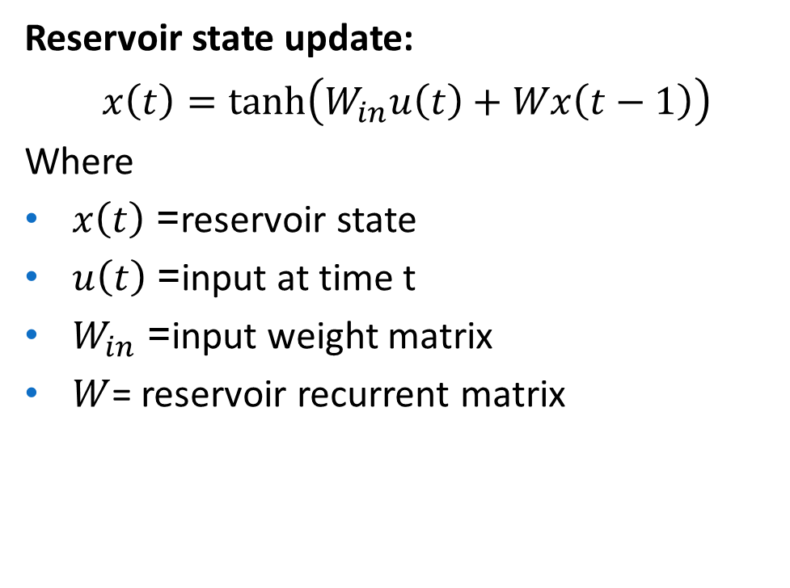
2. Reservoir (Dynamic Recurrent Layer)
The reservoir is a large network of randomly connected neurons.
Properties:
sparse connections
fixed weights
nonlinear activation functions
recurrent feedback loops
The reservoir acts like a dynamic memory system, where past inputs influence current states.
Reservoir state update:
$$x\left(t\right)=tanh⁡\left(W_{in}u\left(t\right)+Wx\left(t−1\right)\right)$$
Where
$x\left(t\right)$= reservoir state
$u\left(t\right)$= input at time t
$W_{in}$= input weight matrix
$W$= reservoir recurrent matrix

Slide 17
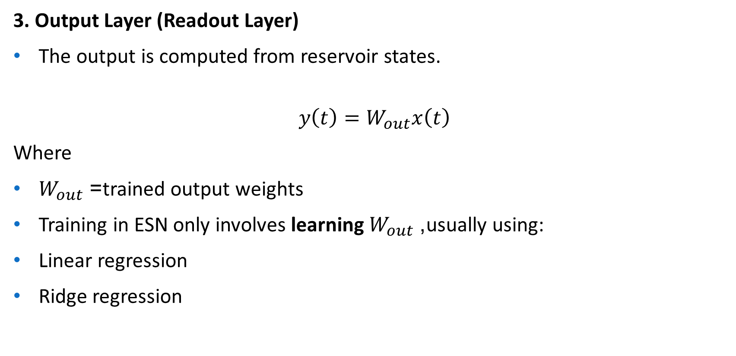
3. Output Layer (Readout Layer)
The output is computed from reservoir states.
$$y\left(t\right)=W_{out}x\left(t\right)$$
Where
$W_{out}$= trained output weights
Training in ESN only involves learning $W_{out}$, usually using:
Linear regression
Ridge regression

Slide 18
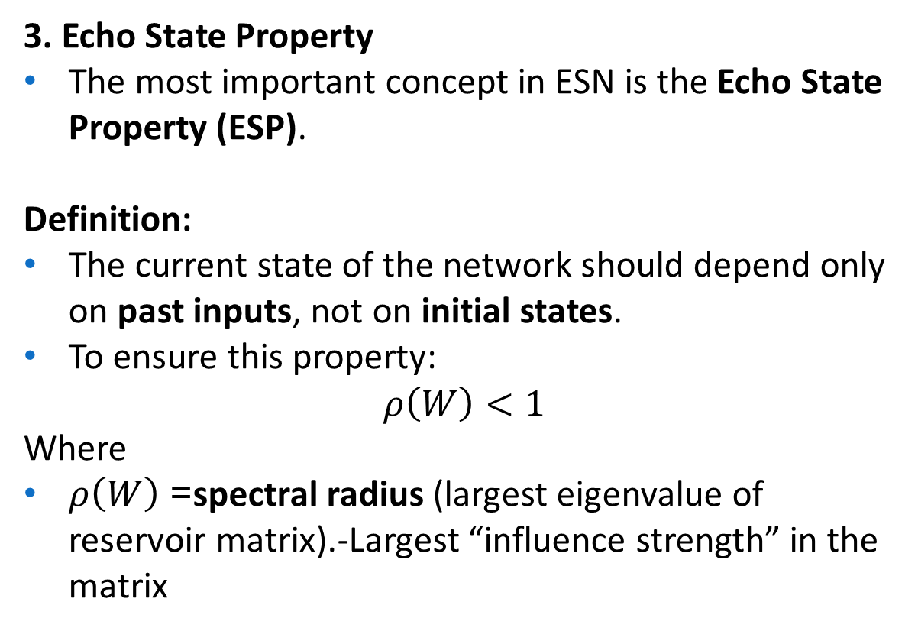
3. Echo State Property
The most important concept in ESN is the Echo State Property (ESP).
Definition:
The current state of the network should depend only on past inputs, not on initial states.
To ensure this property:
$$ρ\left(W\right)<1$$
Where
$ρ\left(W\right)$= spectral radius (largest eigenvalue of reservoir matrix).-Largest “influence strength” in the matrix
Spectral Radius | Behaviour
<1 | stable memory
≈1 | long temporal memory
>1 | unstable system

Slide 19
Working of Echo State Network
Step-by-step process:
Initialize reservoir with random weights
Feed input sequence to reservoir
Reservoir generates dynamic internal states
Collect reservoir states
Train output weights using regression
Predict future outputs
Thus the reservoir acts like a nonlinear feature extractor for time sequences.

Slide 20
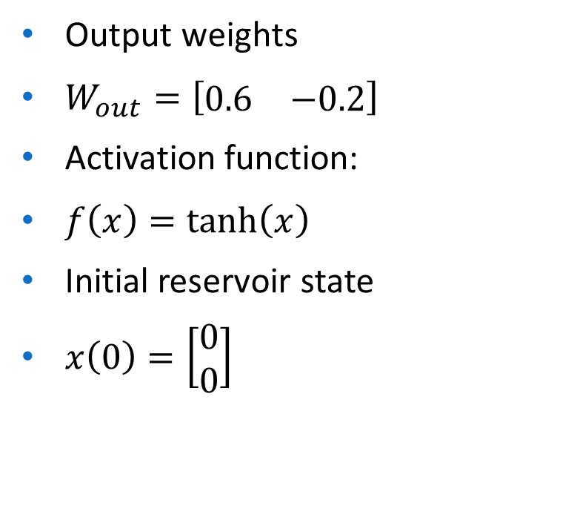
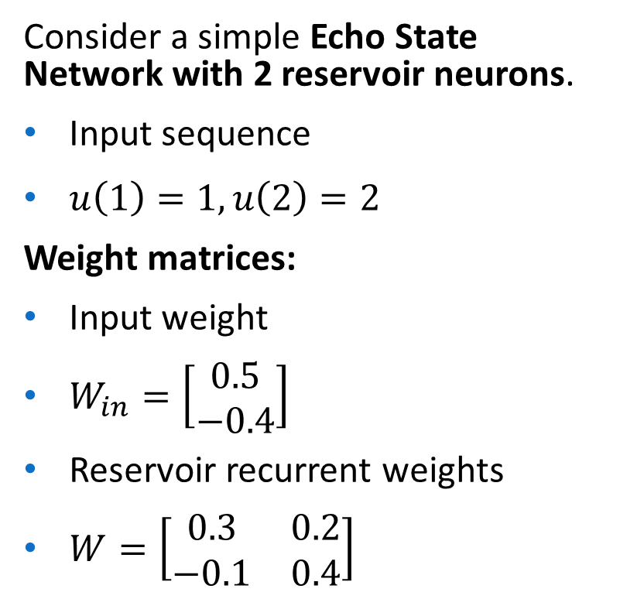
Consider a simple Echo State Network with 2 reservoir neurons.
Input sequence
$u\left(1\right)=1, u\left(2\right)=2$
Weight matrices:
Input weight
$W_{in}=\left[\begin{matrix}0.5 \\ −0.4\end{matrix}\right]$
Reservoir recurrent weights
$W=\left[\begin{matrix}0.3 & 0.2 \\ −0.1 & 0.4\end{matrix}\right]$
Output weights
$W_{out}=\left[\begin{matrix}0.6 & −0.2\end{matrix}\right]$
Activation function:
$f\left(x\right)=tanh⁡\left(x\right)$
Initial reservoir state
$x\left(0\right)=\left[\begin{matrix}0 \\ 0\end{matrix}\right]$

Slide 21
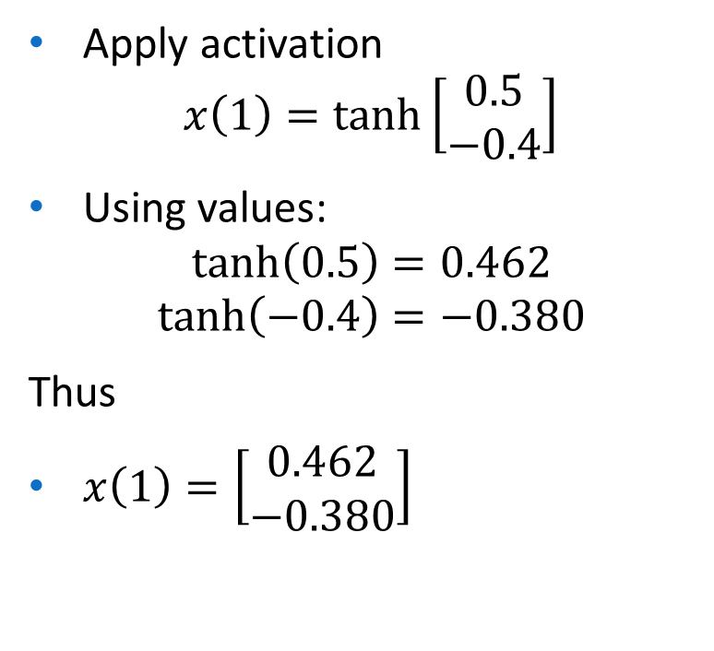
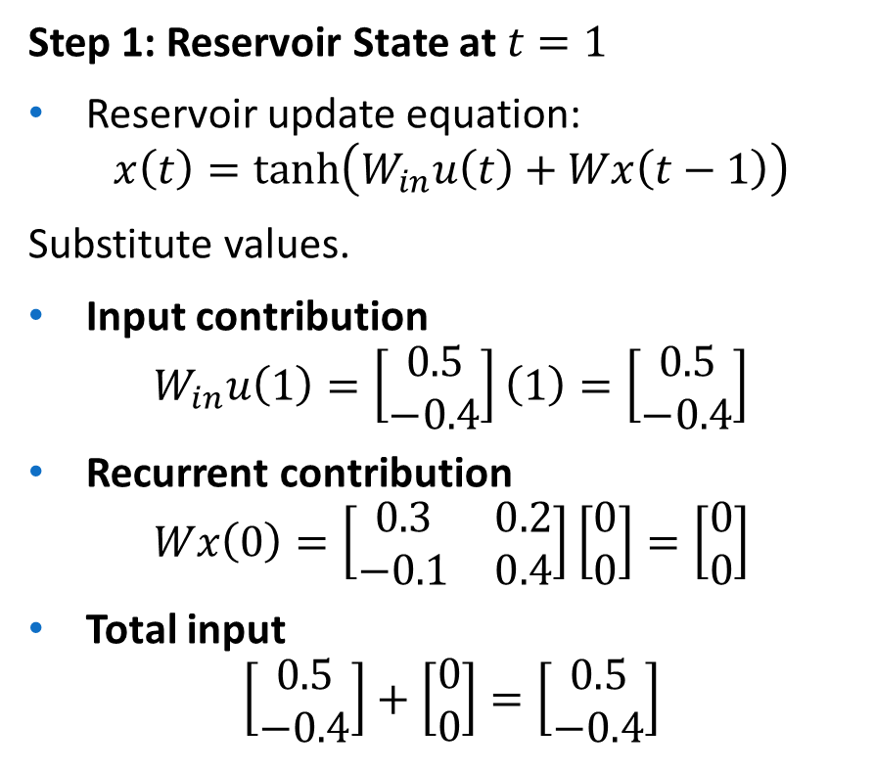
Step 1: Reservoir State at $t=1$
Reservoir update equation:
$$x\left(t\right)=tanh⁡\left(W_{in}u\left(t\right)+Wx\left(t−1\right)\right)$$
Substitute values.
Input contribution
$$W_{in}u\left(1\right)=\left[\begin{matrix}0.5 \\ −0.4\end{matrix}\right]\left(1\right)=\left[\begin{matrix}0.5 \\ −0.4\end{matrix}\right]$$
Recurrent contribution
$$Wx\left(0\right)=\left[\begin{matrix}0.3 & 0.2 \\ −0.1 & 0.4\end{matrix}\right]\left[\begin{matrix}0 \\ 0\end{matrix}\right]=\left[\begin{matrix}0 \\ 0\end{matrix}\right]$$
Total input
$$\left[\begin{matrix}0.5 \\ −0.4\end{matrix}\right]+\left[\begin{matrix}0 \\ 0\end{matrix}\right]=\left[\begin{matrix}0.5 \\ −0.4\end{matrix}\right]$$
Apply activation
$$x\left(1\right)=\tanh\left[\begin{matrix}0.5 \\ −0.4\end{matrix}\right]$$
Using values:
$$tanh⁡\left(0.5\right)=0.462$$
$$tanh⁡\left(−0.4\right)=−0.380$$
Thus
$x\left(1\right)=\left[\begin{matrix}0.462 \\ −0.380\end{matrix}\right]$

Slide 22
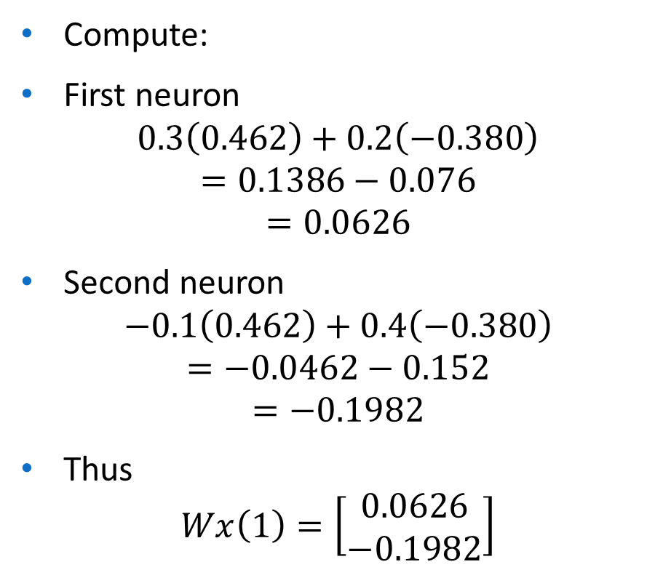
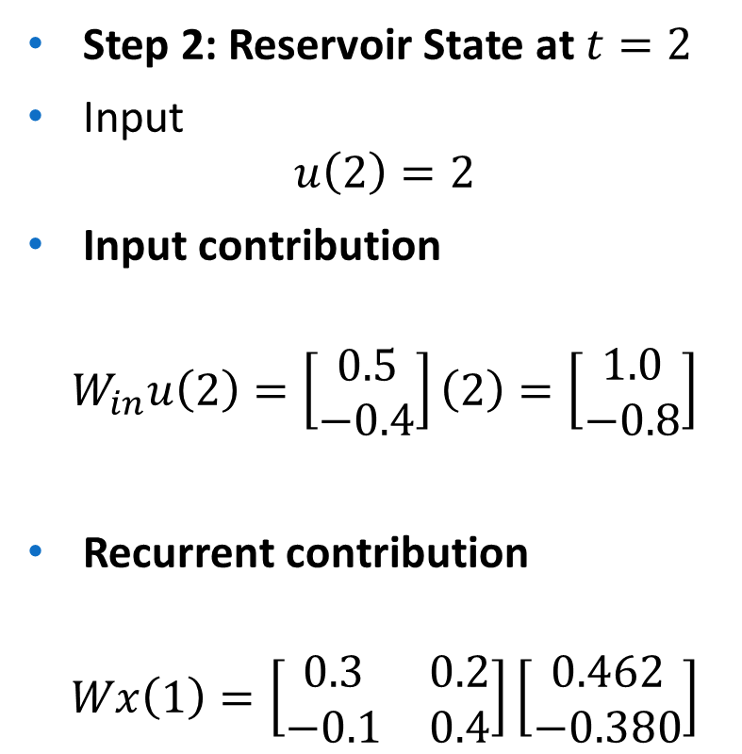
Step 2: Reservoir State at $t=2$
Input
$$u\left(2\right)=2$$
Input contribution
$$W_{in}u\left(2\right)=\left[\begin{matrix}0.5 \\ −0.4\end{matrix}\right]\left(2\right)=\left[\begin{matrix}1.0 \\ −0.8\end{matrix}\right]$$
Recurrent contribution
$$Wx\left(1\right)=\left[\begin{matrix}0.3 & 0.2 \\ −0.1 & 0.4\end{matrix}\right]\left[\begin{matrix}0.462 \\ −0.380\end{matrix}\right]$$
Compute:
First neuron
$$0.3\left(0.462\right)+0.2\left(−0.380\right)$$
$$=0.1386−0.076$$
$$=0.0626$$
Second neuron
$$−0.1\left(0.462\right)+0.4\left(−0.380\right)$$
$$=−0.0462−0.152$$
$$=−0.1982$$
Thus
$$Wx\left(1\right)=\left[\begin{matrix}0.0626 \\ −0.1982\end{matrix}\right]$$

Slide 23
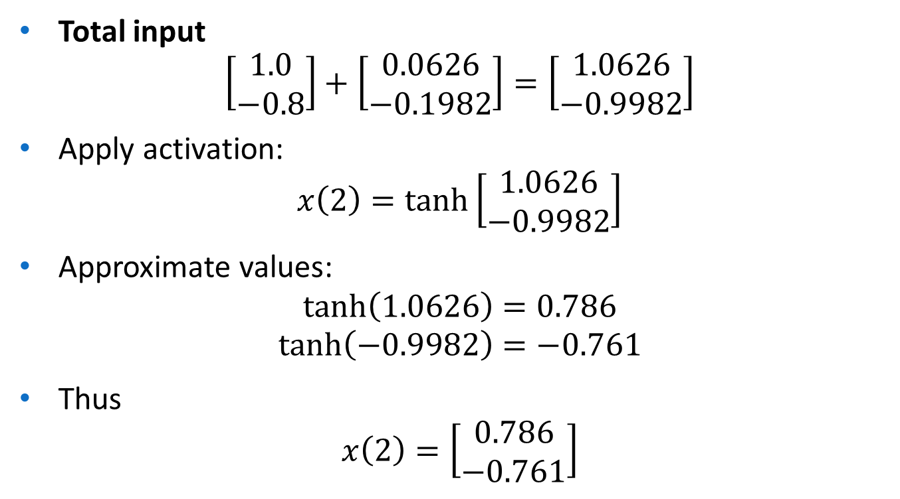
Total input
$$\left[\begin{matrix}1.0 \\ −0.8\end{matrix}\right]+\left[\begin{matrix}0.0626 \\ −0.1982\end{matrix}\right]=\left[\begin{matrix}1.0626 \\ −0.9982\end{matrix}\right]$$
Apply activation:
$$x\left(2\right)=\tanh\left[\begin{matrix}1.0626 \\ −0.9982\end{matrix}\right]$$
Approximate values:
$$tanh⁡\left(1.0626\right)=0.786$$
$$tanh⁡\left(−0.9982\right)=−0.761$$
Thus
$$x\left(2\right)=\left[\begin{matrix}0.786 \\ −0.761\end{matrix}\right]$$

Slide 24

Step 3: Compute Output
Output equation:
$$y\left(t\right)=W_{out}x\left(t\right)$$
For $t=2$
$$y\left(2\right)=\left[\begin{matrix}0.6 & −0.2\end{matrix}\right]\left[\begin{matrix}0.786 \\ −0.761\end{matrix}\right]$$
Compute
$$0.6\left(0.786\right)−0.2\left(−0.761\right)$$
$$=0.4716+0.1522$$
$$=0.6238$$

Slide 25

Final Result
Reservoir states
$$x\left(1\right)=\left[\begin{matrix}0.462 \\ −0.380\end{matrix}\right]$$
$$x\left(2\right)=\left[\begin{matrix}0.786 \\ −0.761\end{matrix}\right]$$
Final output
$$y\left(2\right)=0.624$$

Slide 26
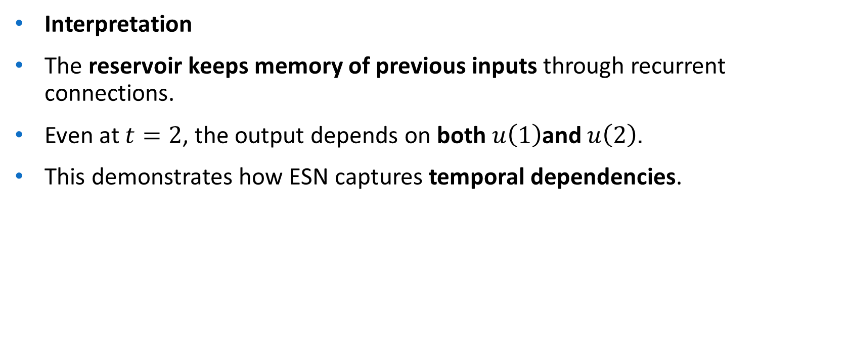
Interpretation
The reservoir keeps memory of previous inputs through recurrent connections.
Even at $t=2$, the output depends on both $u\left(1\right)$and $u\left(2\right)$.
This demonstrates how ESN captures temporal dependencies.

Slide 27
Long Short-Term Memory
Long Short-Term Memory (LSTM) is an enhanced version of the Recurrent Neural Network (RNN) designed by Hochreiter and Schmidhuber.
LSTMs can capture long-term dependencies in sequential data making them ideal for tasks like language translation, speech recognition and time series forecasting.
Unlike traditional RNNs which use a single hidden state passed through time LSTMs introduce a memory cell that holds information over extended periods addressing the challenge of learning long-term dependencies.

Slide 28
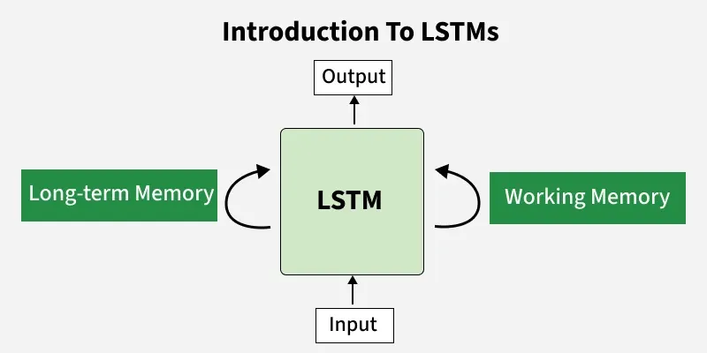

Slide 29
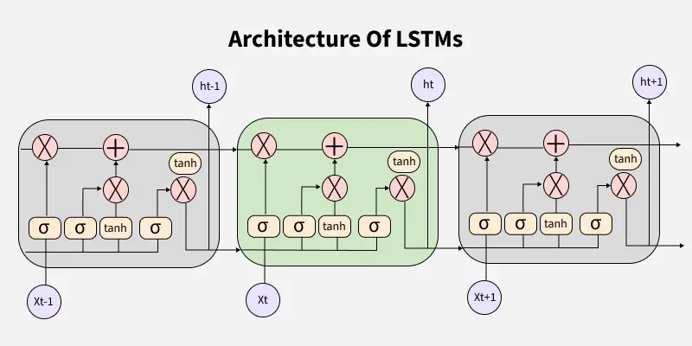

Slide 30


Slide 31
LSTM Architecture
LSTM architectures involves the memory cell which is controlled by three gates:
Input gate: Controls what information is added to the memory cell.
Forget gate: Determines what information is removed from the memory cell.
Output gate: Controls what information is output from the memory cell.
This allows LSTM networks to selectively retain or discard information as it flows through the network which allows them to learn long-term dependencies.
The network has a hidden state which is like its short-term memory.
This memory is updated using the current input, the previous hidden state and the current state of the memory cell.

Slide 32
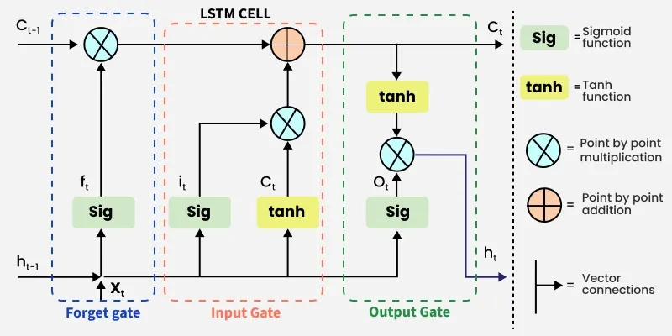
Working of LSTM
LSTM architecture has a chain structure that contains four neural networks and different memory blocks called cells.

Slide 33
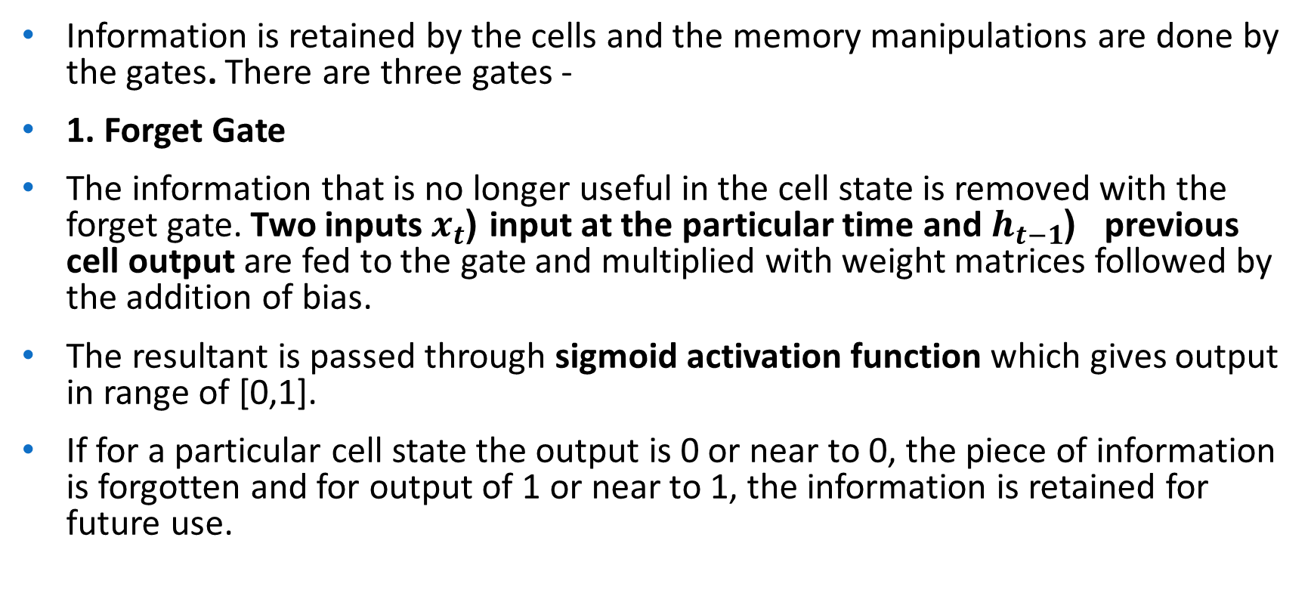
Information is retained by the cells and the memory manipulations are done by the gates. There are three gates -
1. Forget Gate
The information that is no longer useful in the cell state is removed with the forget gate. Two inputs $x_{t}$ (input at the particular time and $h_{t−1}$ ( previous cell output are fed to the gate and multiplied with weight matrices followed by the addition of bias.
The resultant is passed through sigmoid activation function which gives output in range of [0,1].
If for a particular cell state the output is 0 or near to 0, the piece of information is forgotten and for output of 1 or near to 1, the information is retained for future use.

Slide 34
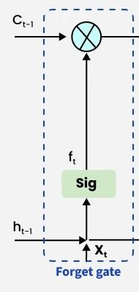

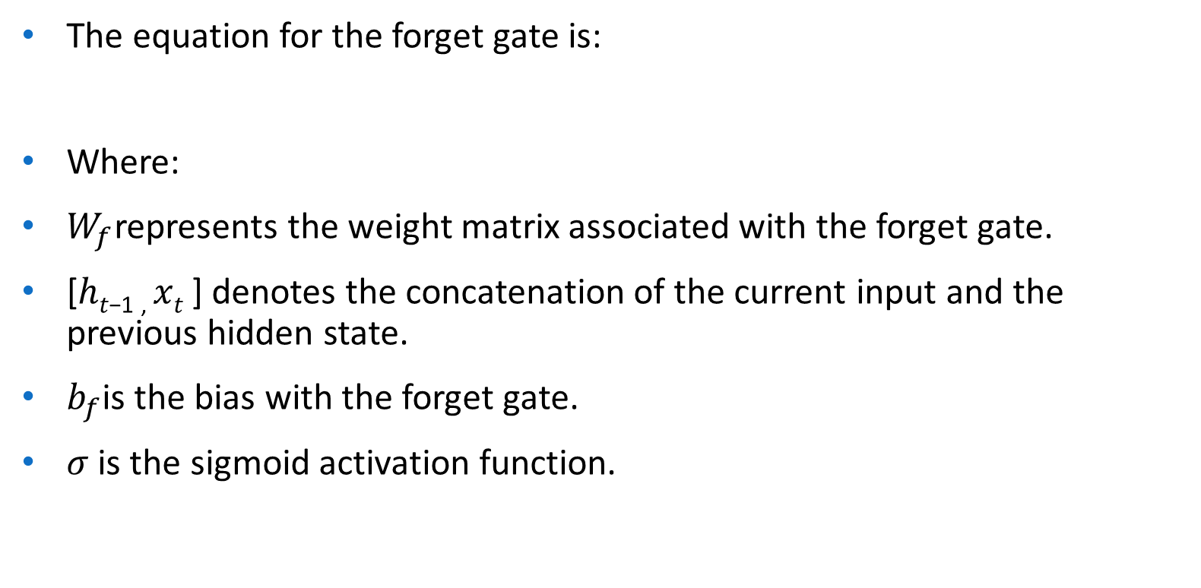
The equation for the forget gate is:
Where:
$W_{f}$represents the weight matrix associated with the forget gate.
[ℎ_{𝑡−1 ,} 𝑥_{𝑡} ] denotes the concatenation of the current input and the previous hidden state.
$b_{f}$is the bias with the forget gate.
$σ$ is the sigmoid activation function.

Slide 35

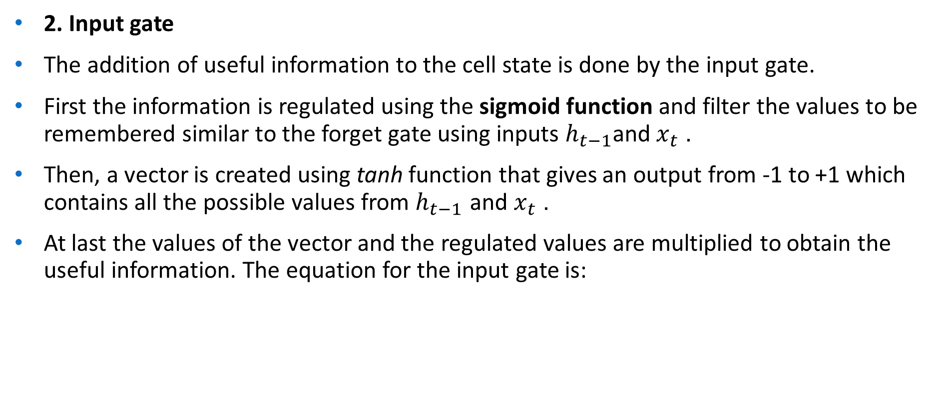
2. Input gate
The addition of useful information to the cell state is done by the input gate.
First the information is regulated using the sigmoid function and filter the values to be remembered similar to the forget gate using inputs $h_{t−1}$and $x_{t}$.
Then, a vector is created using tanh function that gives an output from -1 to +1 which contains all the possible values from $h_{t−1}$ and $x_{t}$.
At last the values of the vector and the regulated values are multiplied to obtain the useful information. The equation for the input gate is:

Slide 36
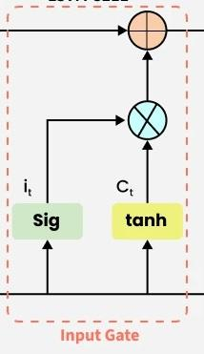

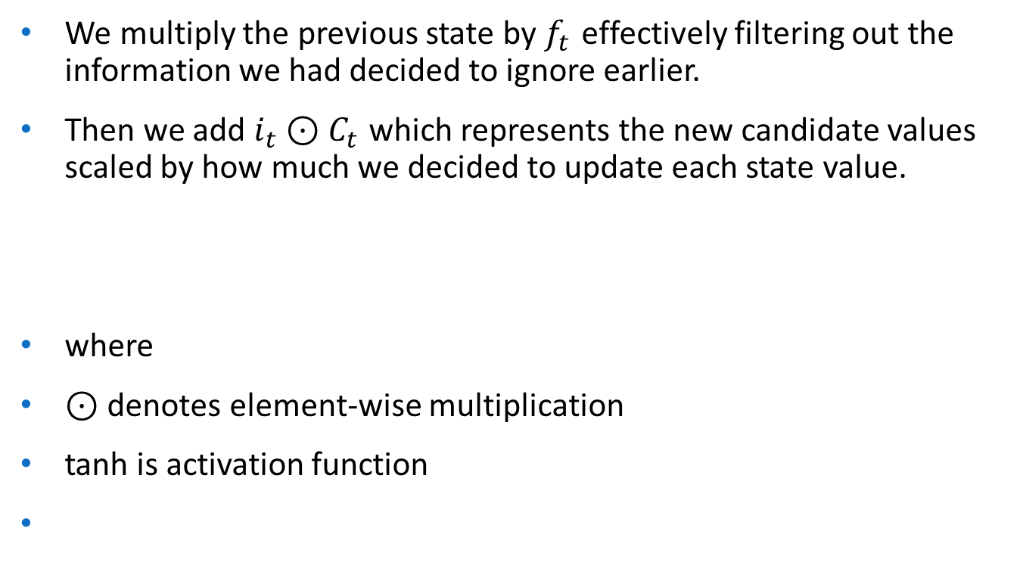
We multiply the previous state by $f_{t}$ effectively filtering out the information we had decided to ignore earlier.
Then we add $i_{t}⊙C_{t}$ which represents the new candidate values scaled by how much we decided to update each state value.
where
$⊙$ denotes element-wise multiplication
tanh is activation function

Slide 37


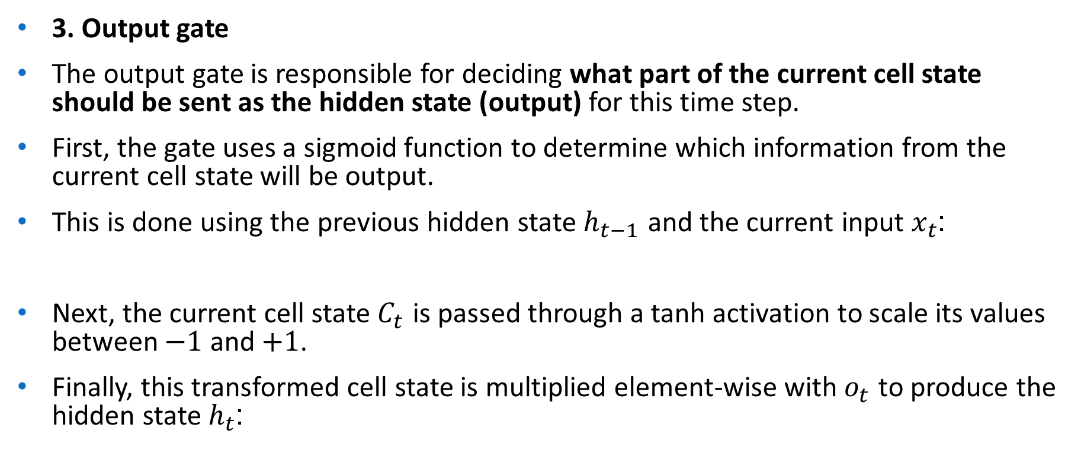
3. Output gate
The output gate is responsible for deciding what part of the current cell state should be sent as the hidden state (output) for this time step.
First, the gate uses a sigmoid function to determine which information from the current cell state will be output.
This is done using the previous hidden state $h_{t−1}$​ and the current input $x_{t}$​:
Next, the current cell state $C_{t}$​ is passed through a tanh activation to scale its values between $−1$ and $+1$.
Finally, this transformed cell state is multiplied element-wise with $o_{t}$​ to produce the hidden state $h_{t}$:

Slide 38
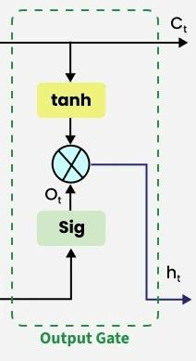
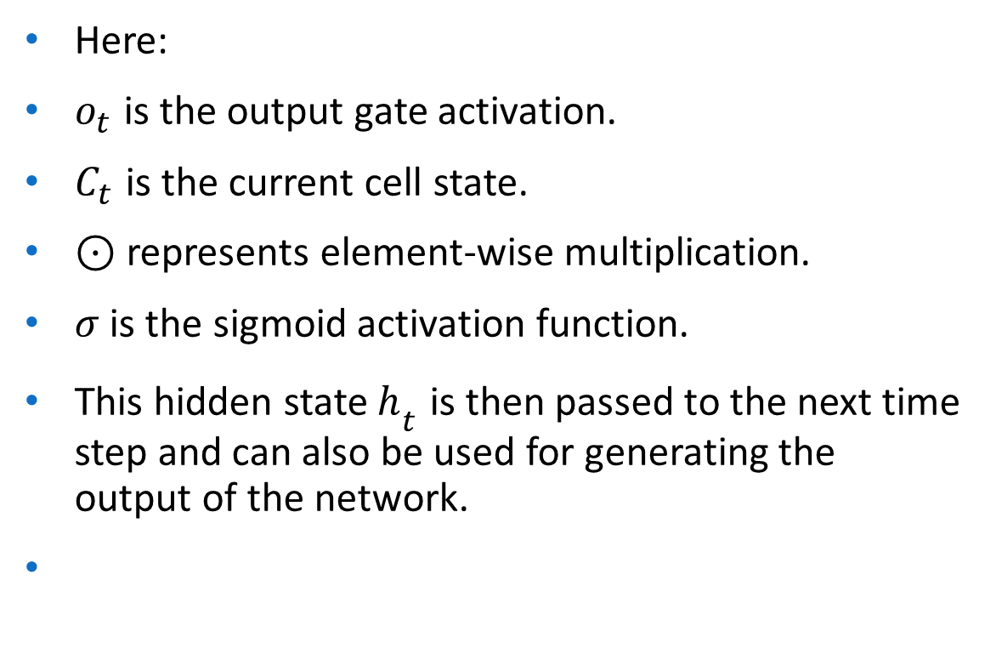
Here:
$o_{t}$​ is the output gate activation.
$C_{t}$​ is the current cell state.
$⊙$ represents element-wise multiplication.
$σ$ is the sigmoid activation function.
This hidden state $h_{t}$​ is then passed to the next time step and can also be used for generating the output of the network.

Slide 39
Intuition of Gates
Gate | Role
Forget Gate | Deletes unnecessary memory
Input Gate | Adds new useful information
Cell State | Long-term storage
Output Gate | Controls what to output

Slide 40

LSTM Workflow
For each time step:
Input $x_{t}$arrives
Forget gate removes old information
Input gate selects new information
Cell state updates memory
Output gate produces hidden state

Slide 41
Simple Example
Sentence:
“The movie was not good.”
Without memory → model predicts positive because of "good".
LSTM remembers “not”, so the final prediction becomes negative.

Slide 42
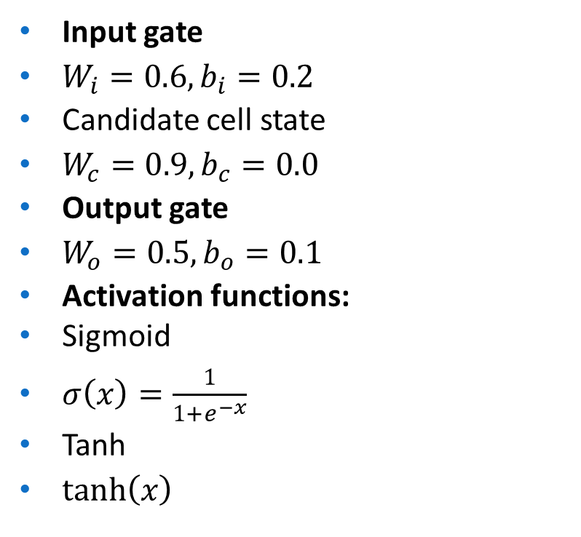
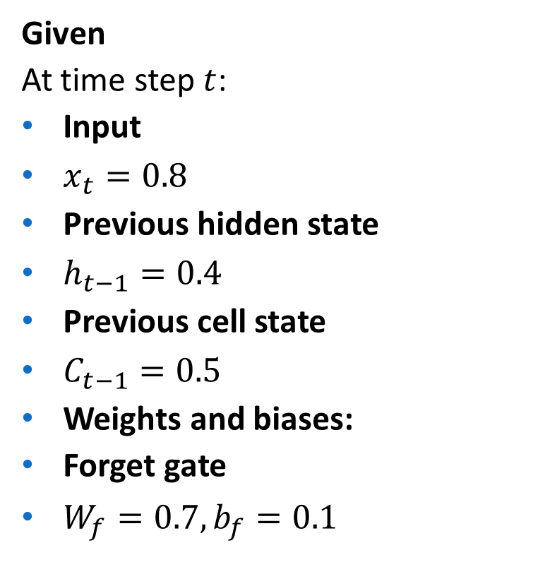
Given
At time step $t$:
Input
$x_{t}=0.8$
Previous hidden state
$h_{t−1}=0.4$
Previous cell state
$C_{t−1}=0.5$
Weights and biases:
Forget gate
$W_{f}=0.7, b_{f}=0.1$
Input gate
$W_{i}=0.6, b_{i}=0.2$
Candidate cell state
$W_{c}=0.9, b_{c}=0.0$
Output gate
$W_{o}=0.5, b_{o}=0.1$
Activation functions:
Sigmoid
$σ\left(x\right)=\frac{1}{1+e^{−x}}$
Tanh
$tanh⁡\left(x\right)$

Slide 43
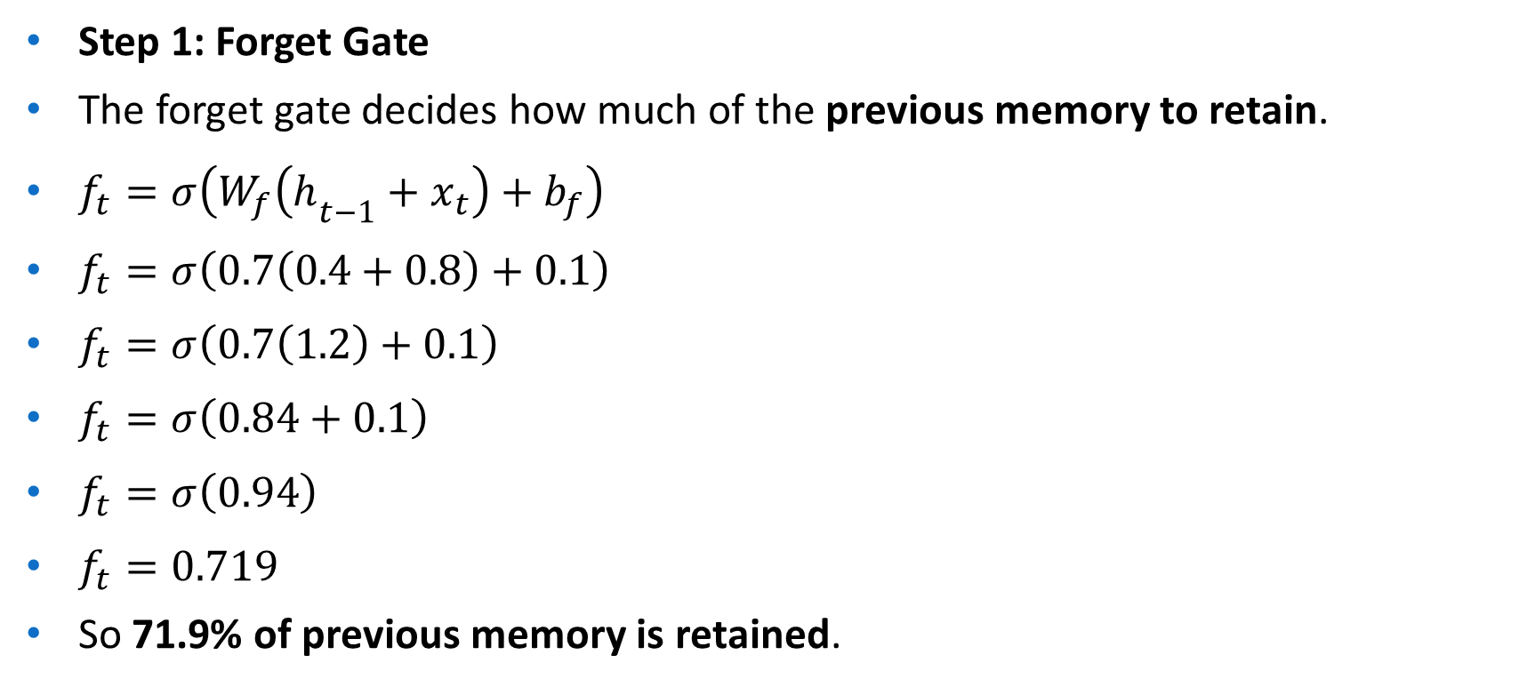
Step 1: Forget Gate
The forget gate decides how much of the previous memory to retain.
$f_{t}=σ\left(W_{f}\left(h_{t−1}+x_{t}\right)+b_{f}\right)$
$f_{t}=σ\left(0.7\left(0.4+0.8\right)+0.1\right)$
$f_{t}=σ\left(0.7\left(1.2\right)+0.1\right)$
$f_{t}=σ\left(0.84+0.1\right)$
$f_{t}=σ\left(0.94\right)$
$f_{t}=0.719$
So 71.9% of previous memory is retained.

Slide 44
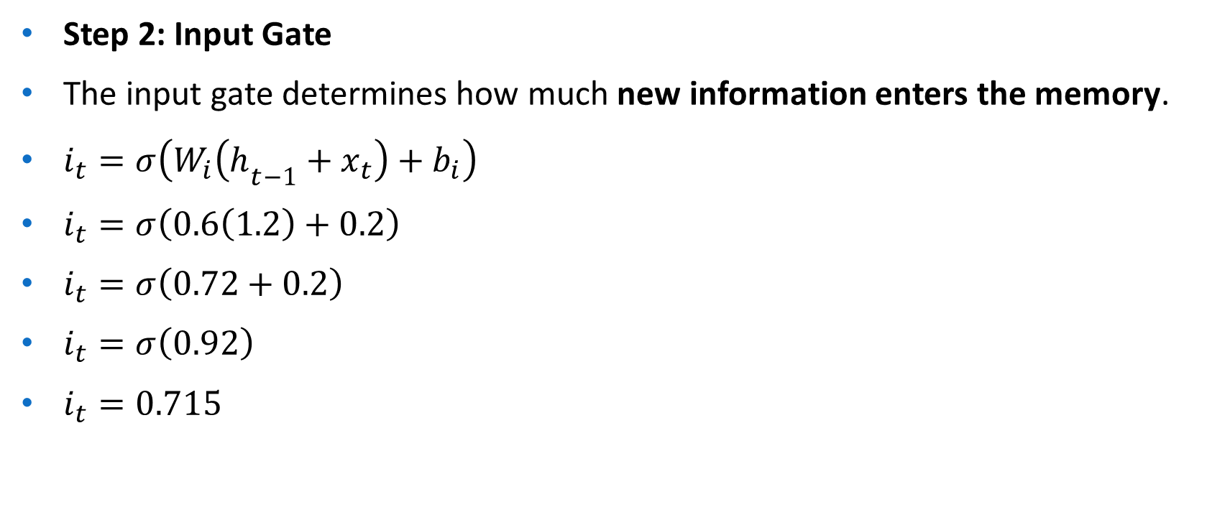
Step 2: Input Gate
The input gate determines how much new information enters the memory.
$i_{t}=σ\left(W_{i}\left(h_{t−1}+x_{t}\right)+b_{i}\right)$
$i_{t}=σ\left(0.6\left(1.2\right)+0.2\right)$
$i_{t}=σ\left(0.72+0.2\right)$
$i_{t}=σ\left(0.92\right)$
$i_{t}=0.715$

Slide 45
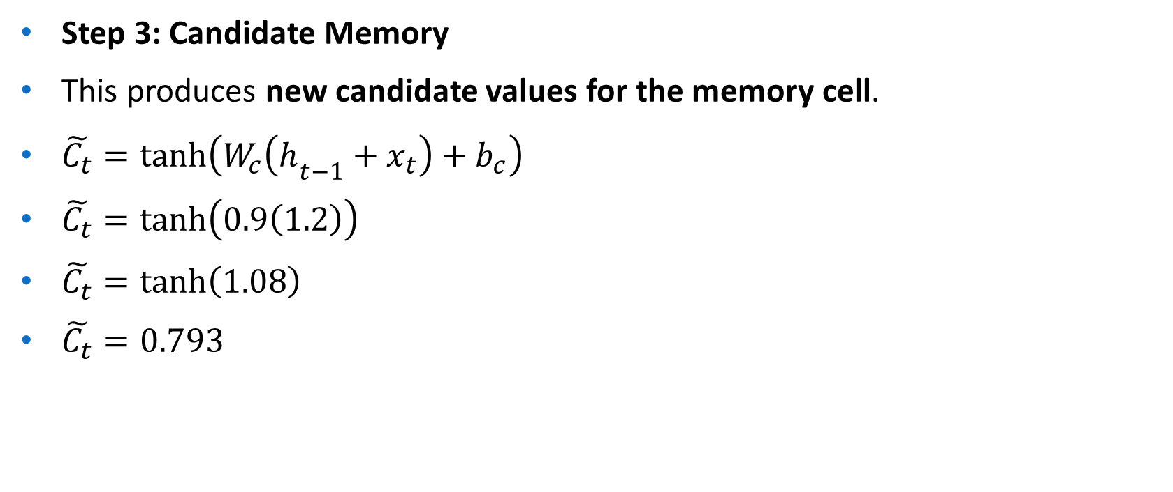
Step 3: Candidate Memory
This produces new candidate values for the memory cell.
$\tilde{C_{t}}=tanh⁡\left(W_{c}\left(h_{t−1}+x_{t}\right)+b_{c}\right)$
$\tilde{C_{t}}=tanh⁡\left(0.9\left(1.2\right)\right)$
$\tilde{C_{t}}=tanh⁡\left(1.08\right)$
$\tilde{C_{t}}=0.793$

Slide 46

Step 4: Update Cell State
The new cell state combines:
retained old memory
new candidate memory
$C_{t}=f_{t}C_{t−1}+i_{t}\tilde{C_{t}}$
$C_{t}=\left(0.719×0.5\right)+\left(0.715×0.793\right)$
$C_{t}=0.3595+0.567$
$C_{t}=0.9265$
New memory:
$C_{t}=0.927$

Slide 47

Step 5: Output Gate
The output gate controls the hidden state.
$o_{t}=σ\left(W_{o}\left(h_{t−1}+x_{t}\right)+b_{o}\right)$
$o_{t}=σ\left(0.5\left(1.2\right)+0.1\right)$
$o_{t}=σ\left(0.6+0.1\right)$
$o_{t}=σ\left(0.7\right)$
$o_{t}=0.668$

Slide 48

Step 6: Hidden State Output
$h_{t}=o_{t}×tanh⁡\left(C_{t}\right)$
$h_{t}=0.668×tanh⁡\left(0.927\right)$
$tanh⁡\left(0.927\right)=0.729$
$h_{t}=0.668×0.729$
$h_{t}=0.487$

Slide 49
Interpretation
Forget gate retained most of the previous memory.
Input gate allowed new information to enter.
Cell state increased from 0.5 → 0.927, showing updated memory.
Final hidden state 0.487 becomes input for the next time step.

Slide 50
Gated Recurrent Unit Networks
Gated Recurrent Unit (GRU) networks are a type of recurrent neural network designed to handle sequential data while reducing the complexity of traditional RNNs.
GRUs are a simplified advancement of LSTM, where they merge multiple gates into update and reset gates, hence learning long-term dependencies with faster training and fewer parameters.
Simplified alternative to LSTM
Handles sequence and time‑series data effectively
Widely used in NLP, speech and forecasting tasks

Slide 51
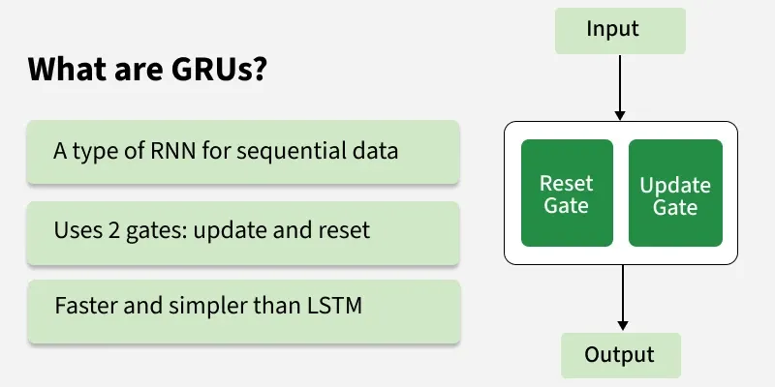
`

Slide 52
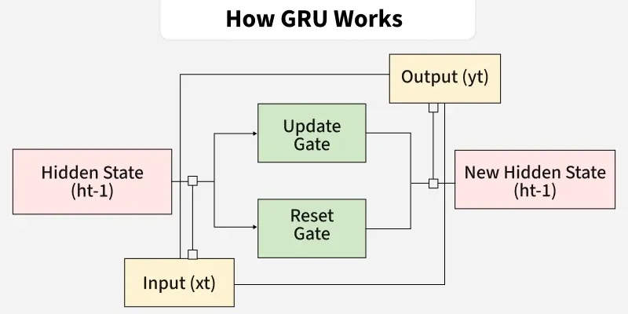

Slide 53
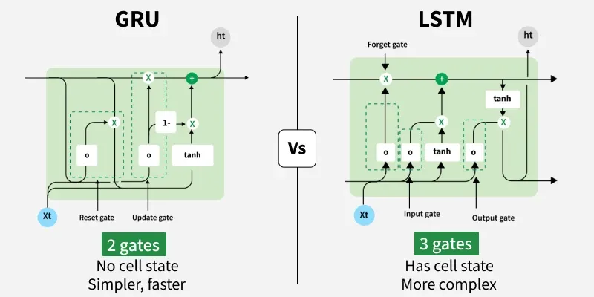

Slide 54
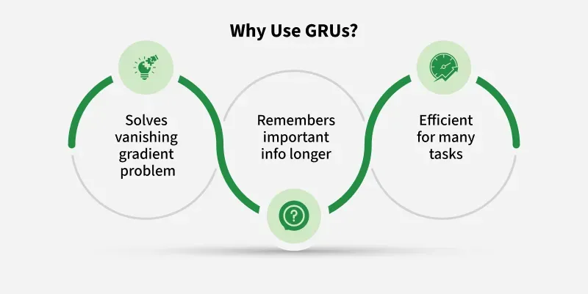

Slide 55
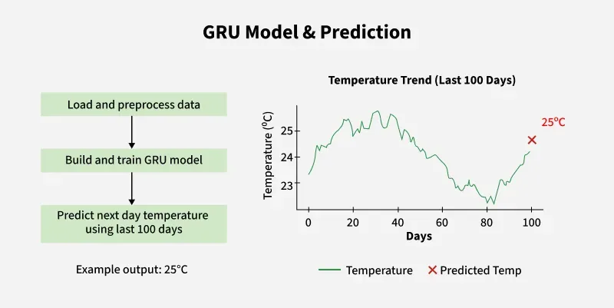

Slide 56
What are Gated Recurrent Units (GRU)?
Gated Recurrent Units (GRUs) are a type of RNN introduced by Cho et al. in 2014.
The core idea behind GRUs is to use gating mechanisms to selectively update the hidden state at each time step allowing them to remember important information while discarding irrelevant details.
GRUs aim to simplify the LSTM architecture by merging some of its components and focusing on just two main gates: the update gate and the reset gate.

Slide 57
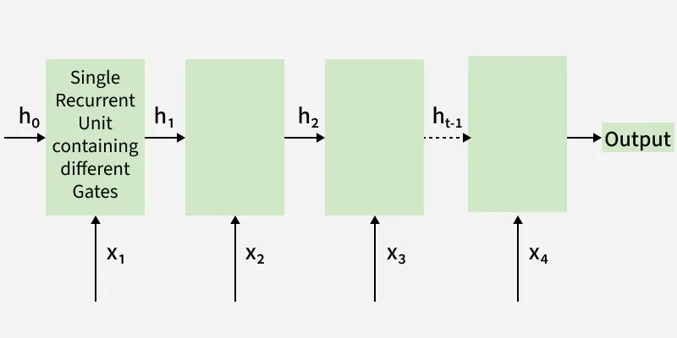

Slide 58
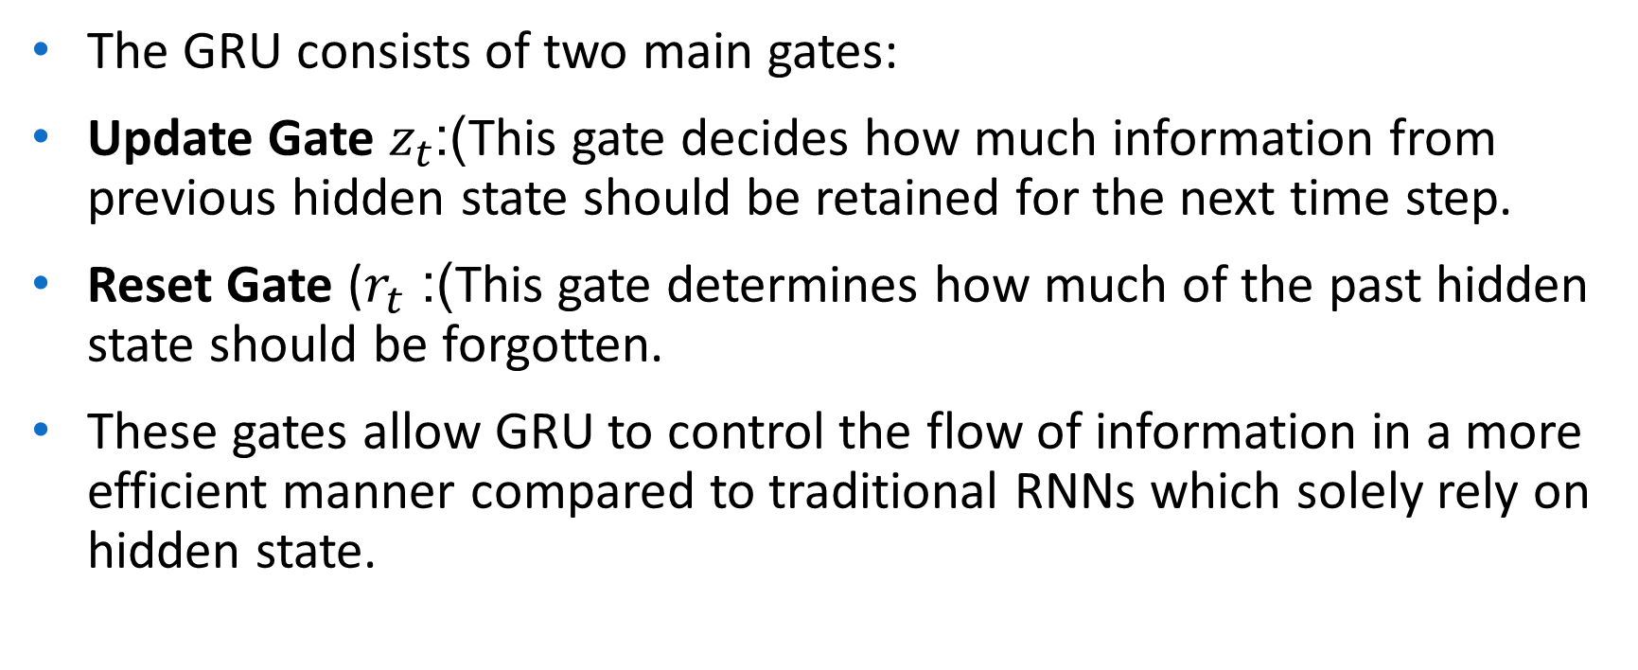
The GRU consists of two main gates:
Update Gate $z_{t}$​):This gate decides how much information from previous hidden state should be retained for the next time step.
Reset Gate ($r_{t}$​): This gate determines how much of the past hidden state should be forgotten.
These gates allow GRU to control the flow of information in a more efficient manner compared to traditional RNNs which solely rely on hidden state.

Slide 59
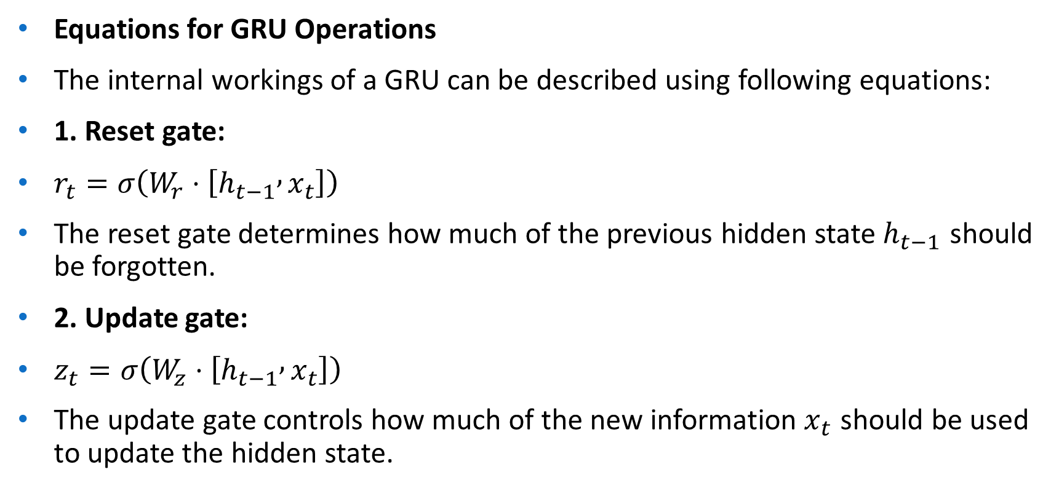
Equations for GRU Operations
The internal workings of a GRU can be described using following equations:
1. Reset gate:
$r_{t}=σ\left(W_{r}⋅\left[h_{t−1} , x_{t}\right]\right)$
The reset gate determines how much of the previous hidden state $h_{t−1}$ should be forgotten.
2. Update gate:
$z_{t}=σ\left(W_{z}⋅\left[h_{t−1} , x_{t}\right]\right)$
The update gate controls how much of the new information $x_{t}$​ should be used to update the hidden state.

Slide 60
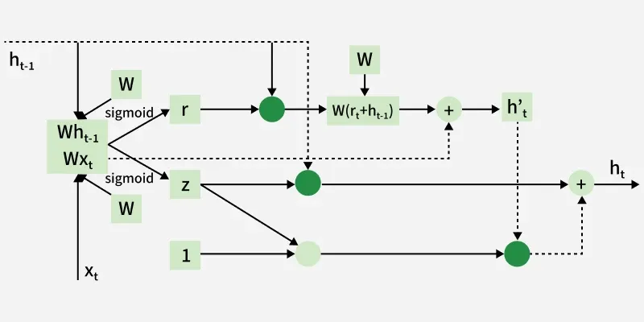

Slide 61
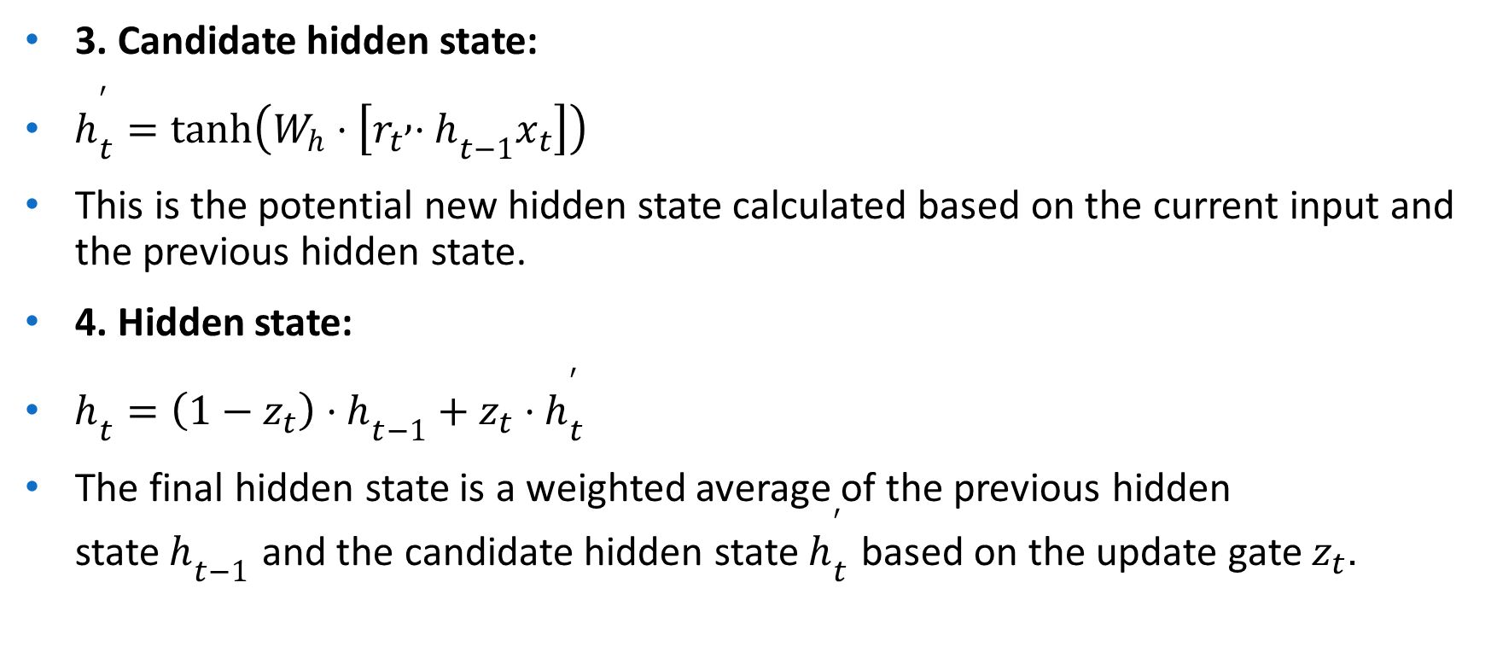
3. Candidate hidden state:
$h_{t}^{′}=tanh⁡\left(W_{h}⋅\left[r_{t} , ⋅h_{t−1}x_{t}\right]\right)$
This is the potential new hidden state calculated based on the current input and the previous hidden state.
4. Hidden state:
$h_{t}=\left(1−z_{t}\right)⋅h_{t−1}+z_{t}⋅h_{t}^{′}$
The final hidden state is a weighted average of the previous hidden state $h_{t−1}$ and the candidate hidden state $h_{t}^{′}$ based on the update gate $z_{t}$.

Slide 62
How GRUs Solve the Vanishing Gradient Problem
Like LSTMs, GRUs were designed to address the vanishing gradient problem which is common in traditional RNNs.
GRUs help mitigate this issue by using gates that regulate the flow of gradients during training ensuring that important information is preserved and that gradients do not shrink excessively over time.
By using these gates, GRUs maintain a balance between remembering important past information and learning new, relevant data.

Slide 63
GRU vs LSTM
GRUs are more computationally efficient because they combine the forget and input gates into a single update gate. GRUs do not maintain an internal cell state as LSTMs do, instead they store information directly in the hidden state making them simpler and faster.
Feature | LSTM (Long Short-Term Memory) | GRU (Gated Recurrent Unit)
Gates | 3 (Input, Forget, Output) | 2 (Update, Reset)
Cell State | Yes it has cell state | No (Hidden state only)
Training Speed | Slower due to complexity | Faster due to simpler architecture
Computational Load | Higher due to more gates and parameters | Lower due to fewer gates and parameters
Performance | Often better in tasks requiring long-term memory | Performs similarly in many tasks with less complexity

Slide 64
Working of GRU
At each time step:
Reset gate removes irrelevant past information.
Candidate state generates new memory.
Update gate decides the final memory update.
Thus GRU balances past and new information efficiently.

Slide 65

GRU Algorithm
Input sequence $x_{t}$
Compute update gate $z_{t}$
Compute reset gate $r_{t}$
Generate candidate hidden state
Combine past and candidate memory
Produce final hidden state

Slide 66

Given
Input
$x_{t}=0.6$
Previous hidden state
$h_{t−1}=0.4$
Weights
Biases = 0
Activation functions
Sigmoid
$σ\left(x\right)=\frac{1}{1+e^{−x}}$
Tanh
$tanh⁡\left(x\right)$
Parameter | Value
(W_z) | 0.5
(U_z) | 0.3
(W_r) | 0.4
(U_r) | 0.2
(W_h) | 0.6
(U_h) | 0.7

Slide 67

Step 1: Update Gate
$z_{t}=σ\left(0.5×0.6+0.3×0.4\right)$
$z_{t}=σ\left(0.30+0.12\right)$
$z_{t}=σ\left(0.42\right)$
$z_{t}=0.603$
Step 2: Reset Gate
$r_{t}=σ\left(0.4×0.6+0.2×0.4\right)$
$r_{t}=σ\left(0.24+0.08\right)$
$r_{t}=σ\left(0.32\right)$
$r_{t}=0.579$

Slide 68
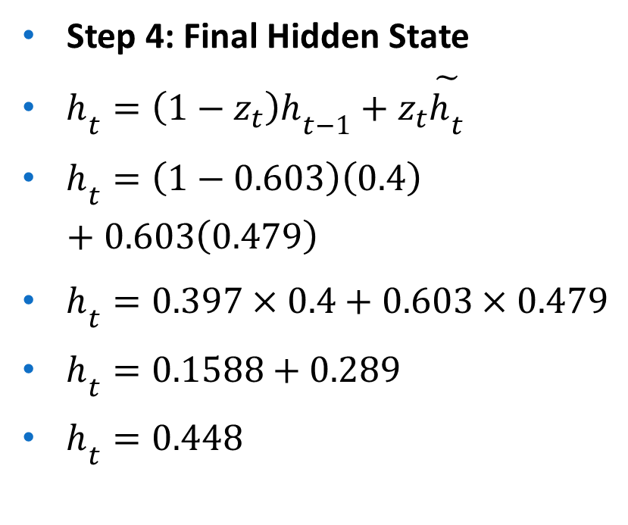

Step 3: Candidate Hidden State
First compute $r_{t}⋅h_{t−1}$
$0.579×0.4=0.2316$
Now compute candidate state
$\tilde{h_{t}}=tanh⁡\left(0.6×0.6+0.7×0.2316\right)$
$\tilde{h_{t}}=tanh⁡\left(0.36+0.162\right)$
$\tilde{h_{t}}=tanh⁡\left(0.522\right)$
$\tilde{h_{t}}=0.479$
Step 4: Final Hidden State
$h_{t}=\left(1−z_{t}\right)h_{t−1}+z_{t}\tilde{h_{t}}$
$h_{t}=\left(1−0.603\right)\left(0.4\right)+0.603\left(0.479\right)$
$h_{t}=0.397×0.4+0.603×0.479$
$h_{t}=0.1588+0.289$
$h_{t}=0.448$

Slide 69
Interpretation
Reset gate decides how much past memory is used.
Update gate balances old memory and new information.
Final hidden state 0.448 becomes input for the next time step.

Slide 70
Other Gated RNNS
Peephole LSTM
Minimal Gated Unit (MGU)
Update Gate RNN (UGRNN)
Delta-RNN

Slide 71

Peephole Architecture
Until now we have seen simple LSTM network but this architecture is modified along with time in each and every research paper.
One popular LSTM variant, introduced by Gers & Schmidhuber (2000), is adding “peephole connections.” This means that we let the gate layers look at the cell state.
Peephole LSTM is an advanced version of the standard LSTM network where gates (input, forget, output) can directly access the cell state $C_{t}$.
In standard LSTM:
Gates depend only on:
Previous hidden state $h_{t−1}$
Current input $x_{t}$
In Peephole LSTM:
Gates also “peek” (peephole) into:
Previous cell state $C_{t−1}$
Current cell state $C_{t}$

Slide 72
Why Peephole Connections?
Standard LSTM limitation:
Gates don’t know exact internal memory value
Peephole advantage:
Gates make more precise decisions using cell memory
Helps in:
Precise timing tasks
Sequence prediction with exact intervals
Speech recognition
Time-series forecasting

Slide 73

Architecture Modification
Each gate gets an additional weighted connection from the cell state.

Slide 74


Mathematical Formulation
Output Gate (Peephole from current cell state)
$o_{t}=σ\left(W_{o}x_{t}+U_{o}h_{t−1}+V_{o}C_{t}+b_{o}\right)$
Hidden State
$h_{t}=o_{t}⋅tanh⁡\left(C_{t}\right)$
Input Gate
$i_{t}=σ\left(W_{i}x_{t}+U_{i}h_{t−1}+V_{i}C_{t−1}+b_{i}\right)$
Forget Gate
$f_{t}=σ\left(W_{f}x_{t}+U_{f}h_{t−1}+V_{f}C_{t−1}+b_{f}\right)$
Cell State Update
${\tilde{C}}_{t}=tanh⁡\left(W_{c}x_{t}+U_{c}h_{t−1}+b_{c}\right)$
$C_{t}=f_{t}⋅C_{t−1}+i_{t}⋅{\tilde{C}}_{t}$

Slide 75

Step-by-Step Working
Step 1: Forget Gate
Uses $C_{t−1}$to decide what to forget
More informed memory pruning
Step 2: Input Gate
Looks at previous memory before adding new info
Step 3: Cell Update
Combines old + new information
Step 4: Output Gate
Uses current cell state $C_{t}$→ more accurate output control

Slide 76
Advantages
Better temporal modelling
Improved precision in sequence timing
Useful in:
Speech recognition
Music generation
Financial time series
Sensor data prediction
Limitations
More parameters → higher computation
Risk of overfitting (if data is small)
Slightly harder to train
When to Use Peephole LSTM?
Use it when:
Exact timing matters
Dependencies involve precise state values
Standard LSTM is not accurate enough

Slide 77

Given
At time step $t$:
Input: $x_{t}=0.8$
Previous hidden state: $h_{t−1}=0.3$
Previous cell state: $C_{t−1}=0.4$
Weights and Biases
Input Gate:
$W_{i}=0.7, U_{i}=0.5, V_{i}=0.6, b_{i}=0.2$
Forget Gate:
$W_{f}=0.6, U_{f}=0.4, V_{f}=0.5, b_{f}=0.1$
Cell Candidate:
$W_{c}=0.9, U_{c}=0.3, b_{c}=0$
Output Gate:
$W_{o}=0.8, U_{o}=0.2, V_{o}=0.7, b_{o}=0.1$

Slide 78

Step 1: Input Gate
$i_{t}=σ\left(W_{i}x_{t}+U_{i}h_{t−1}+V_{i}C_{t−1}+b_{i}\right)$
$=σ\left(0.7\left(0.8\right)+0.5\left(0.3\right)+0.6\left(0.4\right)+0.2\right)$
$=σ\left(0.56+0.15+0.24+0.2\right)=σ\left(1.15\right)$
$i_{t}=0.759$
Step 2: Forget Gate
$f_{t}=σ\left(0.6\left(0.8\right)+0.4\left(0.3\right)+0.5\left(0.4\right)+0.1\right)$
$=σ\left(0.48+0.12+0.2+0.1\right)=σ\left(0.90\right)$
$f_{t}=0.711$
Step 3: Candidate Cell State
${\tilde{C}}_{t}=tanh⁡\left(0.9\left(0.8\right)+0.3\left(0.3\right)\right)$
$=tanh⁡\left(0.72+0.09\right)=tanh⁡\left(0.81\right)$
${\tilde{C}}_{t}=0.670$

Slide 79

Step 4: Cell State Update
$C_{t}=f_{t}C_{t−1}+i_{t}{\tilde{C}}_{t}$
$=\left(0.711\right)\left(0.4\right)+\left(0.759\right)\left(0.670\right)$
$=0.284+0.508=0.792$
Step 5: Output Gate (Peephole)
$o_{t}=σ\left(0.8\left(0.8\right)+0.2\left(0.3\right)+0.7\left(0.792\right)+0.1\right)$
$=σ\left(0.64+0.06+0.554+0.1\right)=σ\left(1.354\right)$
$o_{t}=0.795$
Step 6: Hidden State
$h_{t}=o_{t}⋅tanh⁡\left(C_{t}\right)$
$tanh⁡\left(0.792\right)=0.659$
$h_{t}=0.795×0.659=0.524$

Slide 80
Component | Value
Input Gate (i_t) | 0.759
Forget Gate (f_t) | 0.711
Cell State (C_t) | 0.792
Output Gate (o_t) | 0.795
Hidden State (h_t) | 0.524

Slide 81
Minimal Gated Unit (MGU)
What is MGU?
Minimal Gated Unit (MGU) is a simplified version of gated RNNs like LSTM and GRU.
Key idea:
Use only ONE gate instead of multiple gates
Reduce parameters + computation
Maintain performance close to GRU

Slide 82
Model | Gates | Complexity
LSTM | 3 gates | High
GRU | 2 gates | Medium
MGU | 1 gate | Low

Slide 83
Goal:
Simpler architecture
Faster training
Less memory usage

Slide 84
Architecture of MGU
MGU uses only:
Forget Gate (fₜ)
Controls both:
Memory retention
New information addition
Unlike GRU:
No separate update/reset gates
Everything handled by one gate

Slide 85

Mathematical Formulation
Step 1: Forget Gate
$f_{t}=σ\left(W_{f}x_{t}+U_{f}h_{t−1}+b_{f}\right)$
Step 2: Candidate Hidden State
${\tilde{h}}_{t}=tanh⁡\left(W_{h}x_{t}+U_{h}\left(f_{t}⊙h_{t−1}\right)+b_{h}\right)$
Important:
Previous hidden state is filtered by $f_{t}$
Step 3: Final Hidden State
$h_{t}=\left(1−f_{t}\right)⊙h_{t−1}+f_{t}⊙{\tilde{h}}_{t}$

Slide 86
Function | Controlled by
Forget past | (1 - f_t)
Add new info | (f_t)

Slide 87

Step-by-Step Working
Step 1:
Compute $f_{t}$→ decides importance
Step 2:
Modify previous state:
$f_{t}⋅h_{t−1}$
Step 3:
Generate new candidate ${\tilde{h}}_{t}$
Step 4:
Combine:
Old memory
New information

Slide 88

Single control knob
If $f_{t}≈1$: Use new information
If $f_{t}≈0$: Keep old memory

Slide 89
Advantages
Fewer parameters → faster
Less memory consumption Easier to train
Works well for:
Real-time systems
Edge devices
Embedded AI
Limitations
Less expressive than LSTM May struggle with very long dependencies Reduced flexibility (only one gate)

Slide 90
Update Gate RNN (UGRNN)
What is UGRNN?
Update Gate RNN (UGRNN) is a simplified gated recurrent unit that uses only one gate (update gate) to control information flow.
It is simpler than:
LSTM (3 gates)
GRU (2 gates)
Similar to:
MGU (but slightly different formulation)

Slide 91

Core Idea
UGRNN uses a single gate:
Update Gate $z_{t}$
It decides:
How much old memory to keep
How much new information to add

Slide 92

Architecture
Only one gating mechanism:
No reset gate
No forget gate explicitly
No separate memory cell
Everything is controlled using $z_{t}$

Slide 93

Mathematical Formulation
Step 1: Update Gate
$z_{t}=σ\left(W_{z}x_{t}+U_{z}h_{t−1}+b_{z}\right)$
Step 2: Candidate Hidden State
${\tilde{h}}_{t}=tanh⁡\left(W_{h}x_{t}+U_{h}h_{t−1}+b_{h}\right)$
Step 3: Final Hidden State
$h_{t}=\left(1−z_{t}\right) h_{t−1}+z_{t} {\tilde{h}}_{t}$

Slide 94

Step-by-Step Working
Step 1: Compute update gate $z_{t}$
Controls information flow
Step 2: Compute candidate ${\tilde{h}}_{t}$
Uses full previous hidden state
Step 3: Combine:
$h_{t}=\left(1−z_{t}\right)h_{t−1}+z_{t}{\tilde{h}}_{t}$

Slide 95


Given:
$x_{t}=0.6, h_{t−1}=0.2$
Weights:
$W_{z}=0.5, U_{z}=0.4, b_{z}=0.1$
$W_{h}=0.7, U_{h}=0.3, b_{h}=0$
Step 1: Update Gate
$z_{t}=σ\left(0.5\left(0.6\right)+0.4\left(0.2\right)+0.1\right)$
$=σ\left(0.3+0.08+0.1\right)=σ\left(0.48\right)$
$z_{t}=0.617$
Step 2: Candidate State
${\tilde{h}}_{t}=tanh⁡\left(0.7\left(0.6\right)+0.3\left(0.2\right)\right)$
$=tanh⁡\left(0.42+0.06\right)=tanh⁡\left(0.48\right)$
$=0.446$
Step 3: Final Hidden State
$h_{t}=\left(1−0.617\right)\left(0.2\right)+\left(0.617\right)\left(0.446\right)$
$=0.383⋅0.2+0.617⋅0.446$
$=0.0766+0.275=0.352$
Final Answer:
$h_{t}=0.352$

Slide 96

Delta-RNN
What is Delta-RNN?
Delta-RNN (Δ-RNN) is a recurrent neural network that focuses on modeling changes (Δ = difference) in hidden states rather than recomputing everything at each time step.
Key idea:
Instead of computing $h_{t}$from scratch
Compute how much the hidden state should change

Slide 97

Traditional RNN:
$h_{t}=tanh⁡\left(Wx_{t}+Uh_{t−1}\right)$
Delta-RNN:
$h_{t}=h_{t−1}+Δh_{t}$
Only update what is necessary

Slide 98

Mathematical Formulation
Step 1: Compute Intermediate Representations
$d_{t}^{rec}=V_{d}h_{t−1}$
$d_{t}^{dat}=Wx_{t}$
Step 2: Combine (Element-wise Interaction)
$z_{t}=α⊙d_{t}^{rec}⊙d_{t}^{dat}$
$α$= learnable parameter Captures interaction between input & memory
Step 3: Nonlinear Transformation
${\tilde{h}}_{t}=tanh⁡\left(d_{t}^{rec}+d_{t}^{dat}+z_{t}\right)$

Slide 99

Step 4: Compute Delta (Change)
$Δh_{t}=Φ⊙\left({\tilde{h}}_{t}−h_{t−1}\right)$
$Φ$= gate-like scaling factor
Step 5: Final Hidden State
$h_{t}=h_{t−1}+Δh_{t}$

Slide 100
Step-by-Step Working
Step 1:
Compute influence of:
Previous state
Current input
Step 2:
Capture interaction (important!)
Step 3:
Generate candidate state
Step 4:
Compute difference from previous state
Step 5:
Update hidden state incrementally

Slide 101


Given:
$x_{t}=0.5, h_{t−1}=0.3$
Weights:
$W=0.6, V=0.4, α=0.5, Φ=0.7$
Step 1: Compute Components
$d_{t}^{rec}=0.4×0.3=0.12$
$d_{t}^{dat}=0.6×0.5=0.30$
Step 2: Interaction Term
$z_{t}=0.5×0.12×0.30=0.018$
Step 3: Candidate State
${\tilde{h}}_{t}=tanh⁡\left(0.12+0.30+0.018\right)$
$=tanh⁡\left(0.438\right)=0.412$
Step 4: Delta Update
$Δh_{t}=0.7×\left(0.412−0.3\right)$
$=0.7×0.112=0.0784$
Step 5: Final Hidden State
$h_{t}=0.3+0.0784=0.3784$
Final Answer:
$h_{t}=0.378$

Slide 102
Model | Gates | Memory Cell | Complexity
LSTM | 3 | Yes | High
GRU | 2 | No | Medium
MGU | 1 | No | Low
UGRNN | 1 | No | Low
Peephole LSTM | 3 | Yes | High

Slide 103
Optimization for Long-Term Dependencies
This section focuses on optimization strategies to mitigate the vanishing and exploding gradient problems that arise when training RNNs over long sequences via backpropagation through time (BPTT).
Even though architectural solutions like LSTMs help, pure optimization techniques can further improve training, especially for vanilla RNNs or as complements.
Key Challenges Revisited
RNNs unfold into very deep graphs (one layer per timestep).
Gradients involve repeated multiplications by Jacobians (or weight matrices), leading to exponential decay (vanishing) or growth (exploding).

Slide 104
Martens and Sutskever (2011) noted that second derivatives (Hessian) may vanish alongside first derivatives.
Second-order methods (which effectively divide the gradient by curvature, or multiply by the inverse Hessian) could theoretically stabilize updates if the ratio of first-to-second derivatives remains reasonable.
However, these methods are computationally expensive, require large minibatches, and are prone to saddle points.
Later work (Sutskever et al., 2013; Sutskever, 2012) showed that simpler first-order methods like Nesterov momentum with careful initialization could achieve similar results.
In practice, simple SGD (even without momentum) on well-designed models like LSTMs often suffices.
A recurring theme in the book: it is usually easier to design models that are easy to optimize than to invent powerful optimizers.

Slide 105

Gradient Clipping (for Exploding Gradients)
Strongly nonlinear functions over many timesteps create "cliffs" in the loss landscape: wide flat regions separated by tiny areas of sharp curvature (see figures 8.3 and 10.17 in the book). A large gradient step can catapult parameters far into a high-loss region, undoing progress.
Gradient clipping is a simple, effective heuristic used by practitioners for years (Mikolov, 2012; Pascanu et al., 2013).
Element-wise clipping (Mikolov et al., 2012): Cap each component of the gradient vector at a threshold.
Norm clipping (preferred, Pascanu et al., 2013): If the norm $∥g∥$of the gradient $g$exceeds a threshold $v$, rescale it while preserving direction:

Slide 106

$$g←g⋅\frac{v}{∥g∥} \text{if} ∥g∥>v$$
Advantages of norm clipping:
The entire update stays in the true gradient direction (though scaled).
It bounds the step size without changing direction per minibatch.
Experiments show both variants perform similarly.
Even a random step of fixed size $v$when gradients explode (or become Inf/NaN) often works well as a fallback—it moves away from unstable regions.

Slide 107
Clipping introduces a small bias in the averaged gradient but is cheap and highly effective.
without clipping, a step overshoots a ravine and gets propelled away by a steep cliff;
with clipping, the step is moderated, allowing continued progress near the solution.
Cliffs are exponentially steep in the number of timesteps because the recurrent weight matrix is multiplied by itself repeatedly.
Clipping applies to the full parameter gradient (weights + biases jointly) or sometimes to back-propagated hidden gradients.
Averaging clipped gradients over minibatches differs from clipping the average, but both work in practice.

Slide 108


Slide 109

Regularizing to Encourage Information Flow (for Vanishing Gradients)
Gradient clipping handles explosions but does little for vanishing gradients.
The goal is to create computational paths where gradients flow with magnitude near 1 over many timesteps (LSTMs achieve this via additive cell-state updates and gates).
Pascanu et al. (2013) propose a regularizer that penalizes shrinkage of the back-propagated gradient. Let $∇_{h^{\left(t\right)}}L$be the gradient of the loss w.r.t. the hidden state at time $t$. The aim is:
$$∥\left(∇_{h^{\left(t\right)}}L\right)⋅\frac{∂h^{\left(t\right)}}{∂h^{\left(t−1\right)}}∥≈∥∇_{h^{\left(t\right)}}L∥$$
across timesteps (encouraging the Jacobian multiplier to preserve norm).

Slide 110

The regularizer $Ω$is:
$$Ω=\sum_{t}{{\left(\frac{∥∇_{h^{\left(t\right)}}L⋅\frac{∂h^{\left(t\right)}}{∂h^{\left(t−1\right)}}∥}{∥∇_{h^{\left(t\right)}}L∥}−1\right)}^{2}}$$
Approximated by treating back-propagated gradients as constants when computing its gradient w.r.t. parameters.)
Combined with norm clipping (to control the resulting near-explosion dynamics), this significantly extends the range of learnable dependencies.
It keeps RNN dynamics near the "edge of explosion," making clipping essential—without it, training fails.

Slide 111
Limitations: This is less effective than LSTMs/GRUs when data is abundant (e.g., language modeling).
Architectural changes that make information flow easy often outperform optimization tweaks alone.
Summary
Targeted heuristics (clipping + regularization) help, but designing models with natural gradient pathways (gated units, proper initialization, orthogonal weights) is usually more powerful.
Second-order ideas are insightful but rarely used today in this context.

Slide 112
Explicit Memory
Standard neural networks (including RNNs and LSTMs) store knowledge implicitly in distributed weights.
This works well for subconscious/implicit skills (e.g., pattern recognition) but struggles with explicit, declarative knowledge (e.g., specific facts like "the meeting is at 3 PM" or rapid, precise storage/retrieval).
SGD requires many repeated presentations to store a fact accurately, and interference can corrupt it.
Humans use a "working memory" system for deliberate, goal-directed manipulation of information, enabling step-by-step reasoning .
Neural networks historically lacked an analogous mechanism, limiting their ability to perform algorithmic tasks or store/reason over discrete facts.

Slide 113


Slide 114
Memory Networks and Neural Turing Machines (NTMs)
Memory Networks : Introduce a set of memory cells with an addressing mechanism for read/write. Early versions required supervision on memory usage.
Neural Turing Machines : Extend this to fully differentiable, end-to-end trainable systems. An NTM couples a neural network "controller" (often an RNN/LSTM) with an external memory bank.
The controller learns to read from and write to memory via attentional processes—no explicit supervision on addressing is needed.
The architecture:
Controller (task network, bottom): Processes inputs/outputs, typically recurrent.
Memory: A matrix of vectors (not scalars).
Read/Write Heads: Learn soft attentional mechanisms to decide where and what to read/write (bold arrows in the figure).

Slide 115
Key Design Choices for Differentiability and Optimization:
Soft/Blurry Addressing (instead of hard discrete addresses): Read/write interacts with many cells simultaneously via weighted averages (reading) or differential updates (writing). Weights come from softmax over attention scores, focusing on a few cells while remaining differentiable. Gradients are large only for heavily weighted locations.
Vector-valued memory cells:
Offsets the cost of accessing many cells (vectors pack more information).
Enables content-based addressing: Retrieve based on similarity to a query vector (e.g., recall full lyrics from a snippet of a chorus). This contrasts with pure location-based addressing (fixed slot like "347").
Copy vs. Forget: If a cell's content is mostly copied (not erased) across steps, information and gradients propagate stably over very long durations without vanishing/exploding.

Slide 116
Addressing is closely related to the attention mechanism (Bahdanau et al., 2015; also used in machine translation and handwriting synthesis).
In NTMs/memory networks, attention can jump arbitrarily; in some generative tasks, it is more constrained.
Advantages and Alternatives
Explicit memory allows rapid, one-shot storage/retrieval and enables learning simple algorithms (copying, sorting, associative recall) from examples—tasks difficult for plain RNNs/LSTMs.
Information propagates reliably because memory acts like a stable "tape."

Slide 117
Alternative: Stochastic reading (interpret weights as probabilities and sample one cell; Zaremba and Sutskever, 2015).
This is harder to optimize (requires reinforcement learning-style methods for discrete choices; see section 20.9.1) compared to deterministic soft attention.
Later variants (e.g., Differentiable Neural Computers, end-to-end memory networks) built on these ideas, with soft attention becoming standard (Sukhbaatar et al., 2015; Joulin and Mikolov, 2015; etc.).

