Slide 1
Deep Learning Module 4
Dr S.Rajarajeswari

Slide 2
Recurrent Neural Networks
A recurrent neural network or RNN is a deep neural network trained on sequential or time series data to create a machine learning (ML) model that can make sequential predictions or conclusions based on sequential inputs.
Recurrent Neural Networks (RNNs) differ from regular neural networks in how they process information.
While standard neural networks pass information in one direction i.e. from input to output, RNNs feed information back into the network at each step.

Slide 3
Recurrent Neural Networks imitate the function of the human brain in the fields of Data science, Artificial intelligence, machine learning, and deep learning, allowing computer programs to recognize patterns and solve common issues.
RNNs are a type of neural network that can model sequence data. RNNs, which are formed from feedforward networks, are similar to human brains in their behaviour.
Simply said, recurrent neural networks can anticipate sequential data in a way that other algorithms can’t.

Slide 4
Lets understand RNN with a example:
Imagine reading a sentence and you try to predict the next word, you don’t rely only on the current word but also remember the words that came before.
RNNs work similarly by “remembering” past information and passing the output from one step as input to the next i.e it considers all the earlier words to choose the most likely next word.
This memory of previous steps helps the network understand context and make better predictions.

Slide 5
Let’s take an idiom, such as “feeling under the weather,” which is commonly used when someone is ill to aid us in the explanation of RNNs.
For the idiom to make sense, it needs to be expressed in that specific order.
As a result, recurrent networks need to account for the position of each word in the idiom, and they use that information to predict the next word in the sequence.

Slide 6
Each word in the phrase "feeling under the weather" is part of a sequence, where the order matters.
The RNN tracks the context by maintaining a hidden state at each time step. A feedback loop is created by passing the hidden state from one-time step to the next.
The hidden state acts as a memory that stores information about previous inputs.
At each time step, the RNN processes the current input (for example, a word in a sentence) along with the hidden state from the previous time step.
This allows the RNN to "remember" previous data points and use that information to influence the current output.

Slide 7
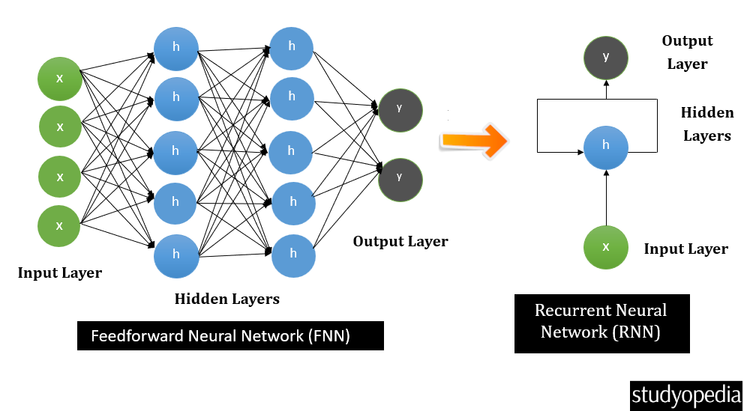

Slide 8
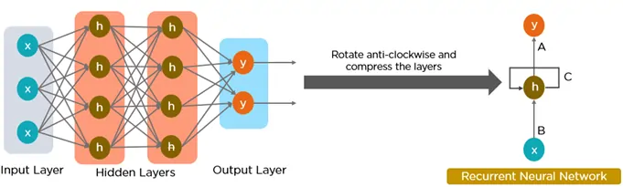

Slide 9
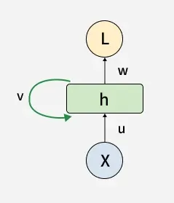
Key Components of RNNs
1. Recurrent Neurons
The fundamental processing unit in RNN is a Recurrent Unit.
They hold a hidden state that maintains information about previous inputs in a sequence.
Recurrent units can "remember" information from prior steps by feeding back their hidden state, allowing them to capture dependencies across time.

Slide 10
2. RNN Unfolding
RNN unfolding or unrolling is the process of expanding the recurrent structure over time steps.
During unfolding each step of the sequence is represented as a separate layer in a series illustrating how information flows across each time step.
This unrolling enables backpropagation through time (BPTT) a learning process where errors are propagated across time steps to adjust the network’s weights enhancing the RNN’s ability to learn dependencies within sequential data.

Slide 11
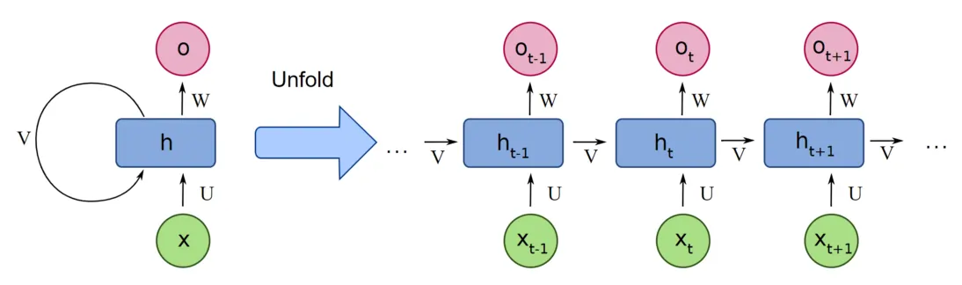

Slide 12
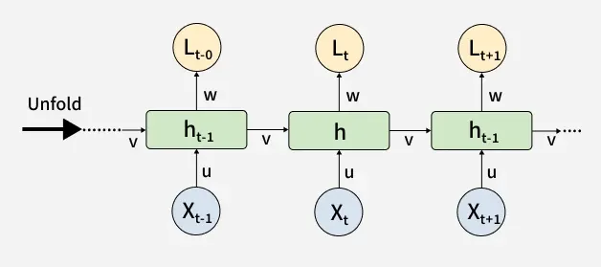

Slide 13
Why RNN?
Many problems depend on order and time:
Text, speech, language
Time-series data
Video frames
Sensor readings
Feedforward networks cannot model temporal dependency, but RNNs can.

Slide 14
All of the inputs and outputs in standard neural networks are independent of one another.
However, in some circumstances, such as when predicting the next word of a phrase, the prior words are necessary, and so the previous words must be remembered.
As a result, RNN was created, which used a hidden layer to overcome the problem.
The most important component of RNN is the hidden state, which remembers specific information about a sequence.

Slide 15
RNNs have a Memory that stores all information about the calculations.
They employ the same settings for each input since they produce the same outcome by performing the same task on all inputs or hidden layers.

Slide 16
What Makes RNN Special?
Recurrent Neural Networks (RNNs) set themselves apart from other neural networks with their unique capabilities:
Internal Memory: This is the key feature of RNNs. It allows them to remember past inputs and use that context when processing new information.
Sequential Data Processing: Because of their memory, RNNs are exceptional at handling sequential data where the order of elements matters. This makes them ideal for speech recognition, machine translation, natural language processing (NLP), and text generation.
Contextual Understanding: RNNs can analyze the current input about what they’ve “seen” before. This contextual understanding is crucial for tasks where meaning depends on prior information.
Dynamic Processing: RNNs can continuously update their internal memory as they process new data, allowing them to adapt to changing patterns within a sequence.

Slide 17
RNN Architecture
RNNs are a type of neural network that have hidden states and allow past outputs to be used as inputs.
They usually follow a certain architecture. One example is the Deep RNN: by stacking multiple RNN layers on top of each other, deep RNNs create a more complex architecture.
This allows them to capture intricate relationships within very long sequences of data.
They are particularly useful for tasks where the order of elements spans long stretches

Slide 18
Here’s a breakdown of its key components:
Input Layer: This layer receives the initial element of the sequence data. For example, in a sentence, it might receive the first word as a vector representation.
Hidden Layer: The heart of the RNN, the hidden layer contains a set of interconnected neurons. Each neuron processes the current input along with the information from the previous hidden layer’s state. This “state” captures the network’s memory of past inputs, allowing it to understand the current element in context.
Activation Function: This function introduces non-linearity into the network, enabling it to learn complex patterns. It transforms the combined input from the current input layer and the previous hidden layer state before passing it on.

Slide 19
Output Layer: The output layer generates the network’s prediction based on the processed information. In a language model, it might predict the next word in the sequence.
Recurrent Connection:
A key distinction of RNNs is the recurrent connection within the hidden layer.
This connection allows the network to pass the hidden state information (the network’s memory) to the next time step.
It’s like passing a baton in a relay race, carrying information about previous inputs forward

Slide 20
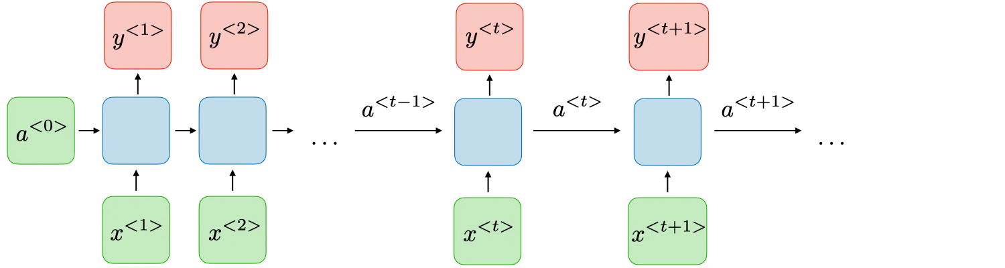
Architecture of a Traditional RNN
RNNs are a type of neural network with hidden states and allow past outputs to be used as inputs. They usually go like this:

Slide 21
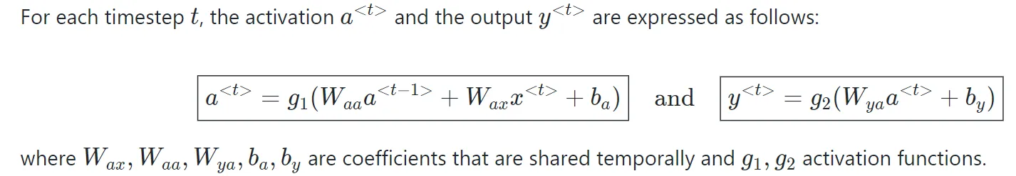

Slide 22
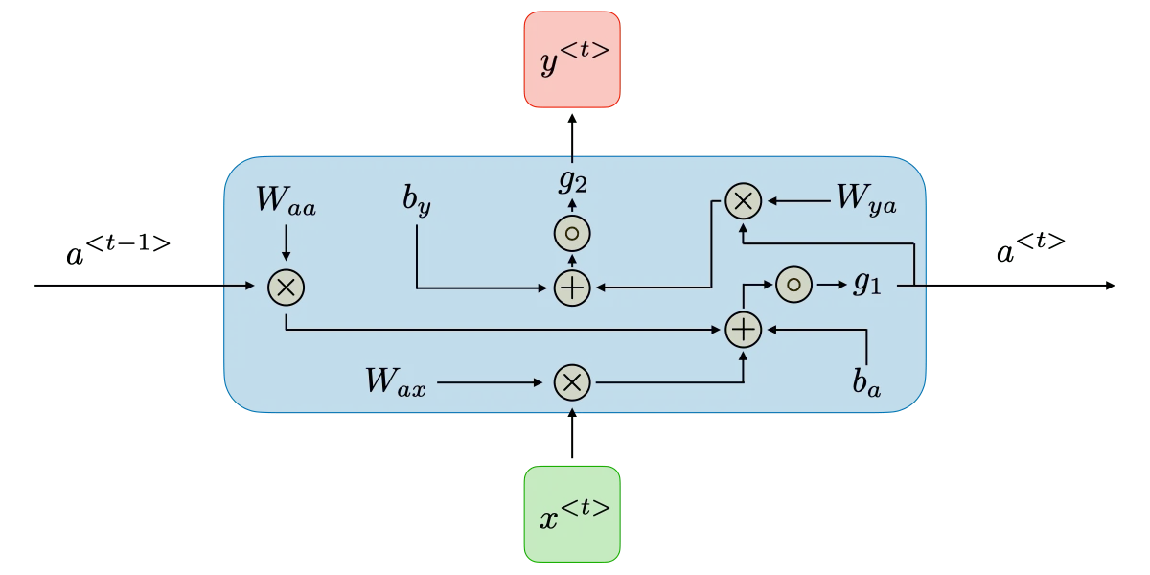

Slide 23
Below are some RNN architectures that can help you better understand this.
One-to-One: There is only one pair here. A one-to-one architecture is used in traditional neural networks.
One-to-Many: A single input in a one-to-many network might result in numerous outputs. One too many networks are used in music production. Example: Image captioning — input is one image (feature vector from CNN), output is a sequence of words: "a cat sitting on a mat".
Many-to-one: A single output combines inputs from distinct time steps in this scenario. Sentiment analysis and emotion identification use such networks, in which a sequence of words determines the class label. Example: Sentiment analysis — input is a review sentence ("This movie was absolutely fantastic!") → output is one label: Positive (or probability score).
Many-to-Many: For many-to-many, there are numerous options. Input and output are sequences of potentially different lengths. Machine translation systems, such as English to French or vice versa translation systems, use many-to-many networks.

Slide 24
Two main subtypes: Equal length (synchronous): Input and output same length.
Example: Part-of-speech tagging — "The cat sleeps" → [DET, NOUN, VERB].
Or Named Entity Recognition: "Elon Musk founded SpaceX" → [PER, PER, O, ORG].
Unequal length (asynchronous): Input and output different lengths (most common today).
Example: Machine translation — English "Hello, how are you?" → French "Salut, comment vas-tu ?".
Uses encoder-decoder architecture (seq2seq): Encoder reads entire source → Decoder generates target word-by-word.

Slide 25
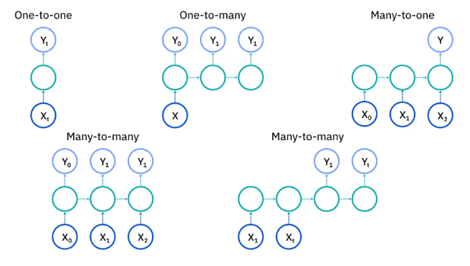

Slide 26
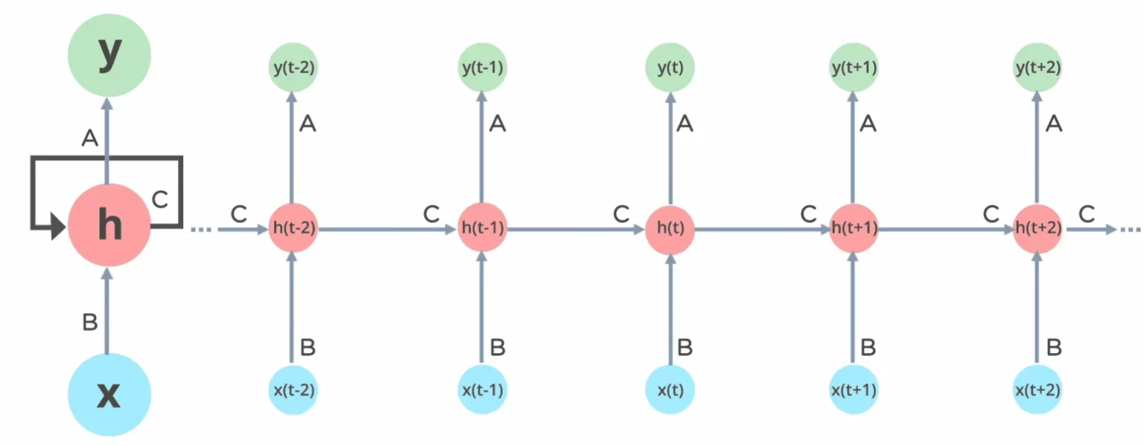
How do Recurrent Neural Networks Work?
The information in recurrent neural networks cycles through a loop to the middle hidden layer.

Slide 27
The input layer x receives and processes the neural network’s input before passing it on to the middle layer.
In the middle layer h, multiple hidden layers can be found, each with its activation functions, weights, and biases. There’s a single hidden layer that repeats over time steps.
The same weights are used across all steps. The hidden state is updated recursively using the current input and the previous hidden state.
The recurrent neural network will standardize the different activation functions, weights, and biases, ensuring that each hidden layer has the same characteristics.
Rather than constructing numerous hidden layers, it will create only one and loop over it as many times as necessary.

Slide 28
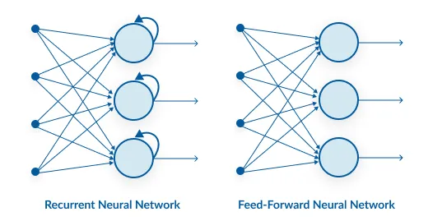
Recurrent Neural Network vs Feed-forward Neural Network

Slide 29
Feature | Feed-forward Neural Network (FNN) | Recurrent Neural Network (RNN)
Data Flow | Straight through (no loops) | Loops through time (with memory)
Memory | No memory of past inputs | Maintains memory via hidden states
Input Assumption | Inputs are independent | Inputs are sequentially dependent
Architecture | Static layers, no time dimension | Unfolds across time steps
Training | Standard backpropagation | Backpropagation Through Time (BPTT)

Slide 30
Backpropagation Through Time (BPTT)
When we apply a Backpropagation algorithm to a Recurrent Neural Network with time series data as its input, we call it backpropagation through time.
In a normal RNN, a single input is sent into the network at a time, and a single output is obtained.
On the other hand, backpropagation uses both the current and prior inputs as input.
This is referred to as a timestep, and one timestep will consist of multiple time series data points entering the RNN simultaneously.

Slide 31
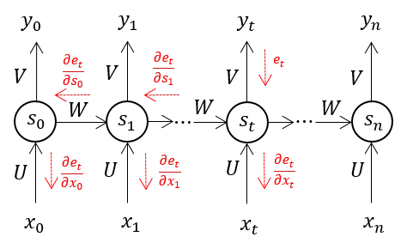

Slide 32
Once the neural network has trained on a set and given you an output, its output is used to calculate and collect the errors.
The network is then rolled back up, and weights are recalculated and adjusted to account for the faults.

Slide 33
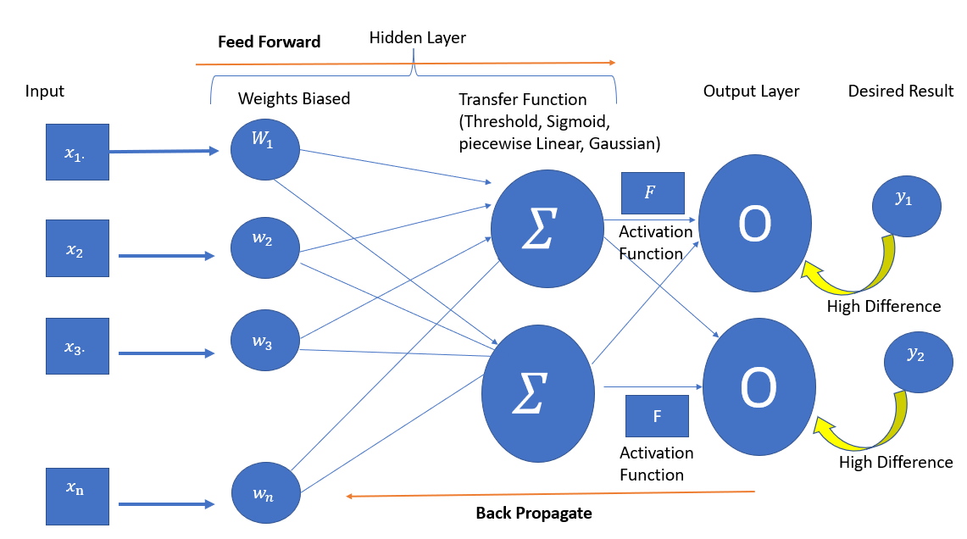
Feed Forward

Slide 34
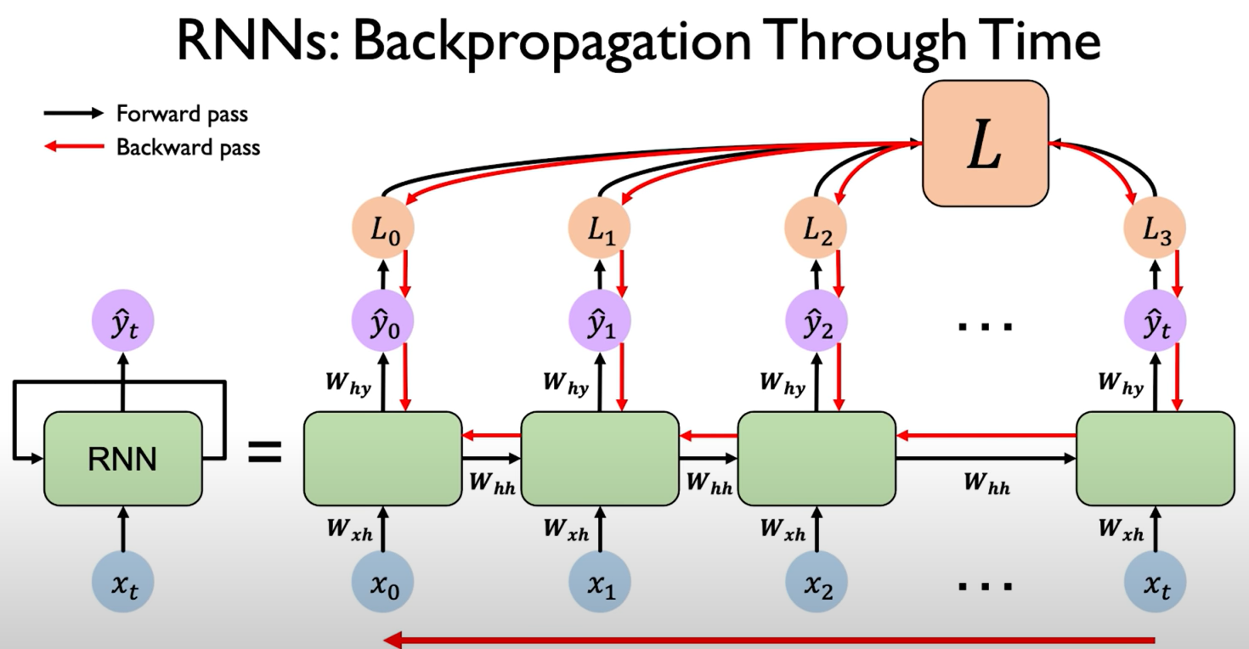

Slide 35
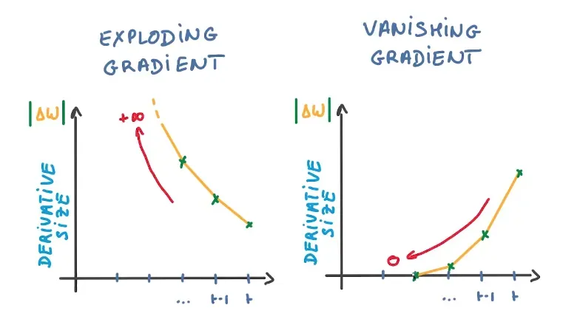
Two Issues of Standard RNNs
RNNs have had to overcome two key challenges, but to comprehend them, one must first grasp what a gradient is.

Slide 36
A function’s slope is also known as its gradient.
The steeper the slope, the faster a model can learn, and the higher the gradient.
The model, on the other hand, will stop learning if the slope is zero.
A gradient is used to measure the change in all weights about the change in error.
Exploding Gradients: Exploding gradients occur when the algorithm gives the weights an absurdly high priority for no apparent reason. Fortunately, truncating or squashing the gradients is a simple solution to this problem.
Vanishing Gradients: Vanishing gradients occur when the gradient values are too small, causing the model to stop learning or take far too long. This was a big issue in the 1990s, and it was far more difficult to address than the exploding gradients. Fortunately, Sepp Hochreiter and Juergen Schmidhuber’s LSTM concept solved the problem.

Slide 37
What Are the Different Variations of RNN?
Standard RNNs
The most basic version of an RNN, where the output at each time step depends on both the current input and the hidden state from the previous time step, suffers from problems such as vanishing gradients, making it difficult for them to learn long-term dependencies.
They excel in simple tasks with short-term dependencies, such as predicting the next word in a sentence (for short, simple sentences) or the next value in a simple time series.
RNNs are good for tasks that process data sequentially in real time, such as processing sensor data to detect anomalies in short time frames, where inputs are received one at a time and predictions need to be made immediately based on the most recent inputs.

Slide 38
Bidirectional recurrent neural networks (BRNNs)
While unidirectional RNNs can only be drawn from previous inputs to make predictions about the current state, bidirectional RNNs or BRNNs, pull in future data to improve the accuracy of it.
Returning to the example of “feeling under the weather”, a model based on a BRNN can better predict that the second word in that phrase is “under” if it knows that the last word in the sequence is “weather.”

Slide 39
Long Short-Term Memory (LSTM):
A popular choice for complex tasks.
LSTM networks introduce gates, i.e., input gate, output gate, and forget gate, that control the flow of information within the network, allowing them to learn long-term dependencies more effectively than vanilla RNNs.

Slide 40
Gated recurrent units (GRUs)
A GRU is similar to an LSTM as it also works to address the short-term memory problem of RNN models.
Instead of using a “cell state” to regulate information, it uses hidden states, and instead of 3 gates, it has 2: a reset gate and an update gate.
Similar to the gates within LSTMs, the reset and update gates control how much and which information to retain.
Because of its simpler architecture, GRUs are computationally more efficient and require fewer parameters compared to LSTMs.
This makes them faster to train and often more suitable for certain real-time or resource-constrained applications.

Slide 41
Encoder-decoder RNNs
These are commonly used for sequence-to-sequence tasks, such as machine translation.
The encoder processes the input sequence into a fixed-length vector (context), and the decoder uses that context to generate the output sequence.
However, the fixed-length context vector can be a bottleneck, especially for long input sequences.

Slide 42
Deep RNN:
Stacking multiple RNN layers on top of each other, deep RNNs create a more complex architecture.
This allows them to capture intricate relationships within very long sequences of data.
They are particularly useful for tasks where the order of elements spans long stretches.

Slide 43
RNN Applications
Recurrent neural networks (RNNs) shine in tasks involving sequential data, where order and context are crucial. Let’s explore some real-world use cases. Using RNN models and sequence datasets, you may tackle a variety of problems, including :
Speech Recognition: RNNs power virtual assistants like Siri and Alexa, allowing them to understand spoken language and respond accordingly.
Machine Translation: RNNs translate languages more accurately, like Google Translate by analysing sentence structure and context.
Text Generation: RNNs are behind chatbots that can hold conversations and even creative writing tools that generate different text formats.
Time Series Forecasting: RNNs analyze financial data to predict stock prices or weather patterns based on historical trends.

Slide 44
Music Generation: RNNs can generate music by learning patterns from existing pieces and generating new melodies or accompaniments.
Video Captioning: RNNs analyze video content and automatically generate captions, making video browsing more accessible.
Anomaly Detection: RNNs can learn normal patterns in data streams (e.g., network traffic) and detect anomalies that might indicate fraud or system failures.
Sentiment Analysis: RNNs can analyze sentiment in social media posts, reviews, or surveys by understanding the context and flow of text.
Stock Market Recommendation: RNNs can analyze market trends and news to suggest potential investment opportunities.
Sequence study of the genome and DNA: RNNs can analyze sequential data in genomes and DNA to identify patterns and predict gene function or disease risk.

Slide 45
Advantages and Disadvantages of RNNs
Advantages of RNNs | Disadvantages of RNNs
Handle sequential data effectively, including text, speech, and time series. | Prone to vanishing and exploding gradient problems, hindering learning.
Process inputs of any length, unlike feedforward neural networks. | Training can be challenging, especially for long sequences.
Share weights across time steps, enhancing training efficiency. | Computationally slower than other neural network architectures.

Slide 46
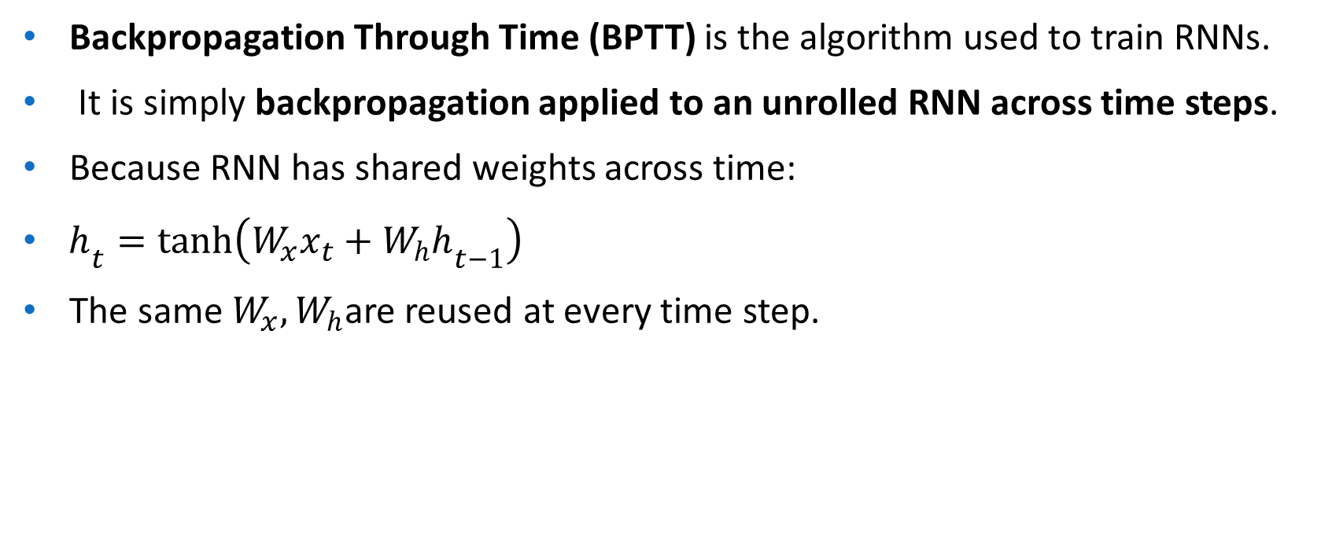
Back Propagation through time - RNN
Backpropagation Through Time (BPTT) is the algorithm used to train RNNs.
It is simply backpropagation applied to an unrolled RNN across time steps.
Because RNN has shared weights across time:
$h_{t}=tanh⁡\left(W_{x}x_{t}+W_{h}h_{t−1}\right)$
The same $W_{x},W_{h}$are reused at every time step.

Slide 47
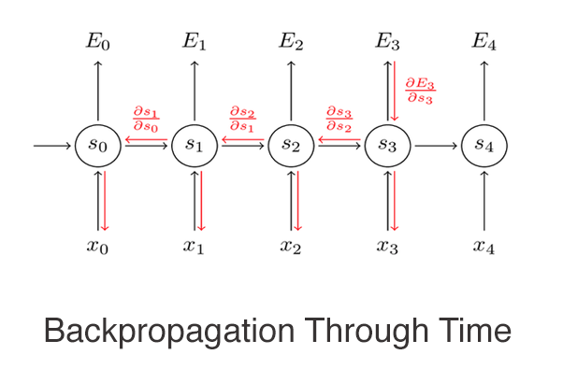

Slide 48
Example of BPTT:
Let’s consider a simple example of using BPTT to train a recurrent neural network (RNN) for time series prediction.
Suppose we have a time series dataset that consists of a sequence of data points: {x1, x2, x3, …, xn}.
The goal is to train an RNN to predict the next value in the sequence, x_{n+1}, given the previous values in the sequence.
To do this, we can use BPTT to backpropagate errors through time and update the weights of the RNN. Here’s how the BPTT algorithm might work:

Slide 49
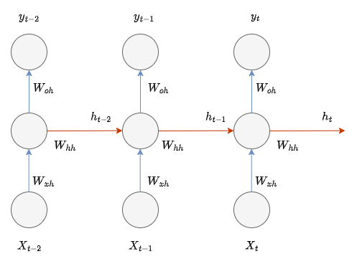
Derivation of BPTT
Forward Pass
Here is the diagram that shows the inputs, weights, outputs, and hidden states, of an RNN,

Slide 50



So considering this idea, the general formula for performing forward propagation through the hidden states will be,
In RNNs and their variations,use a Hyperbolic tangent (Tanh) activation function, so when applying the tanh activation the formula can be changed to,

Slide 51
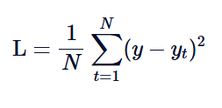
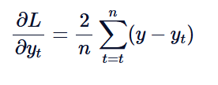
Backward pass
Let's figure out how to derive BPTT in RNN. The first thing we need to do is to choose a Loss function, Mean Squared Error (MSE) Loss, below is the formula for calculating the MSE loss function,
For propagating the loss backward, we need to find the derivative of loss, the derivative of MSE is simply,

Slide 52
The weights connecting inputs Wxh, the weights through hidden states Whh, and the output weights Woh.

Slide 53
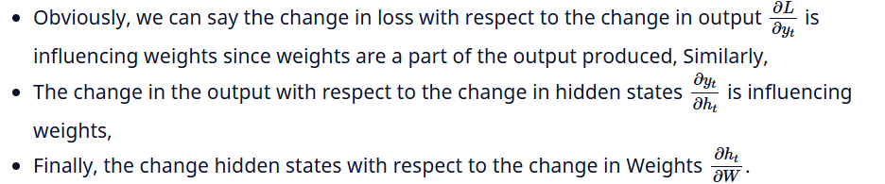
Derivative of Loss with respect to Weights Wxh, Whh, and, Woh

Slide 54
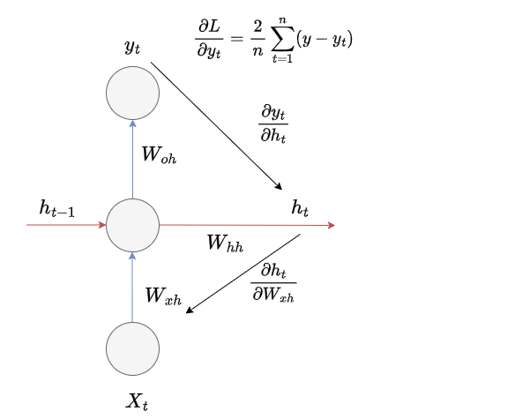
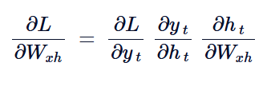
Let's consider Wxh, which is the weights connecting the input layer and hidden layer, and see how the gradients are passed through the network.

Slide 55
When dealing with multiple time steps, the gradients of each time step should be summed up.
But beyond this, due to the interconnected nature of hidden states across time, it's crucial to accumulate the gradients of these hidden states as well.
For this, you need to multiply the gradients of hidden states together in each time step.

Slide 56
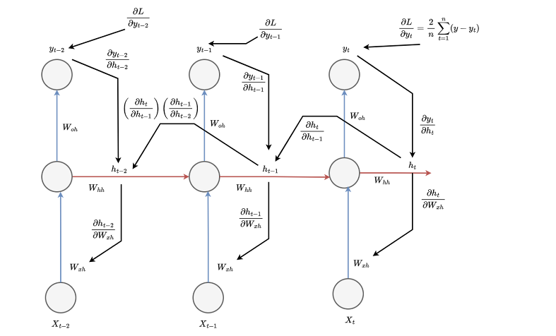

Slide 57
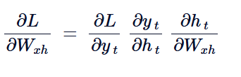
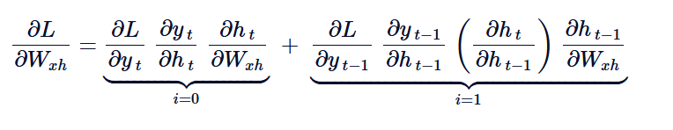
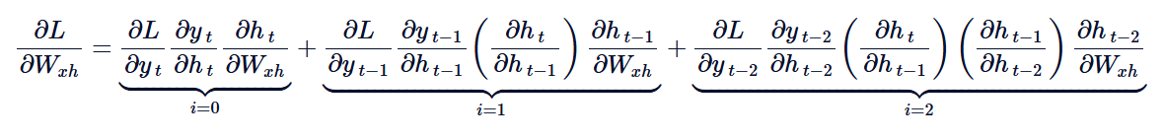
Considering single time step,
Considering 2 time steps,
And three time steps,

Slide 58
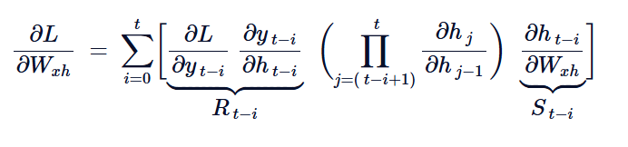

Slide 59
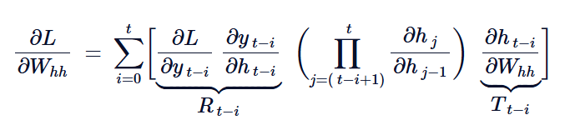
Let's find the derivative of loss with respect to weights in the hidden units, All we need to do is to substitute Whh in the place of Wxh in the equation,

Slide 60
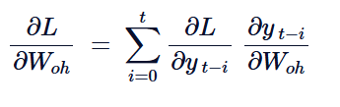
This can be a little different when comes to the output layer, for finding Woh, you just only need to consider the output yt and Weights Woh, so it can be written as,

Slide 61
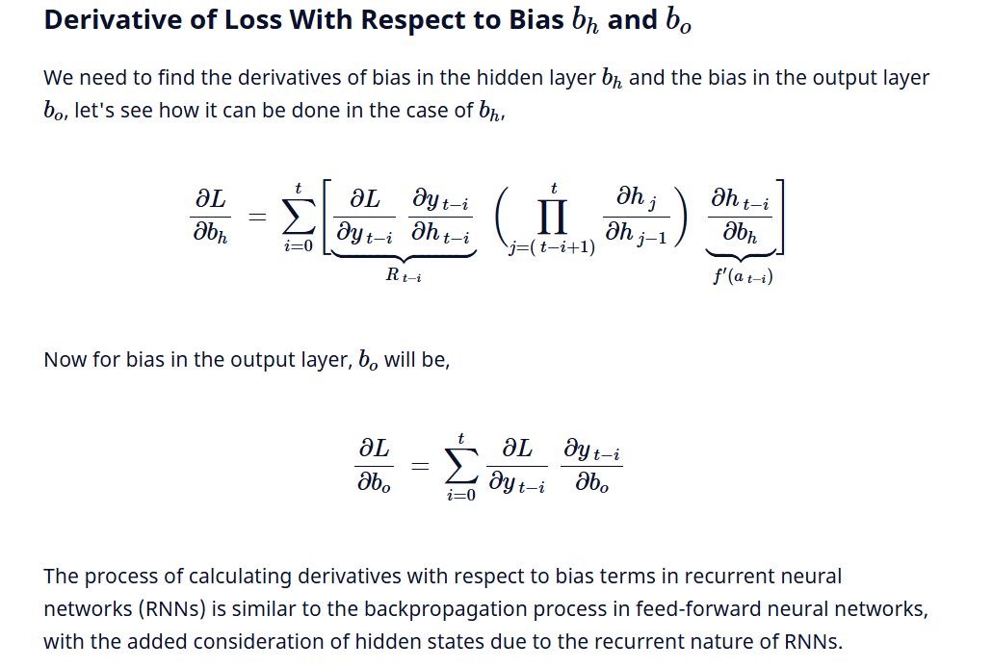

Slide 62
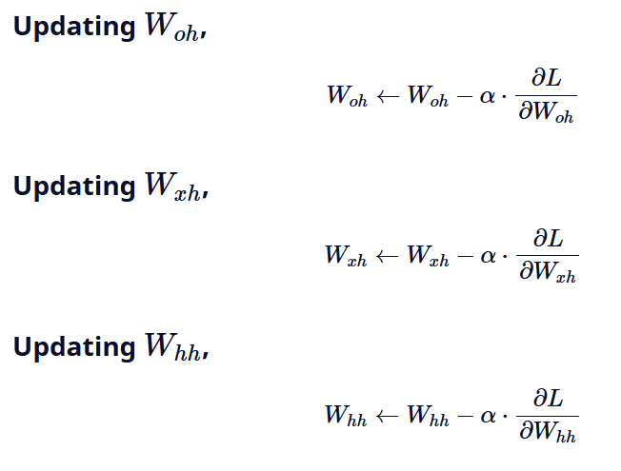
Updating Weights and Bias Using Gradient Descent

Slide 63
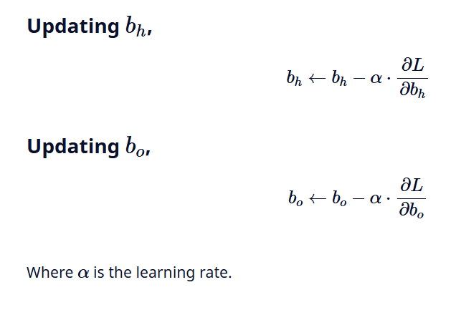

Slide 64
Bidirectional RNNs
A Bidirectional Recurrent Neural Network (BRNN) is an extension of the traditional RNN that processes sequential data in both forward and backward directions.
This allows the network to utilize both past and future context when making predictions providing a more comprehensive understanding of the sequence.
Like a traditional RNN, a BRNN moves forward through the sequence, updating the hidden state based on the current input and the prior hidden state at each time step.
The key difference is that a BRNN also has a backward hidden layer which processes the sequence in reverse, updating the hidden state based on the current input and the hidden state of the next time step.
Compared to unidirectional RNNs BRNNs improve accuracy by considering both the past and future context.
This is because the two hidden layers i.e forward and backward complement each other and predictions are made using the combined outputs of both layers.

Slide 65
Example:
Consider the sentence: "I like apple. It is very healthy."
In a traditional unidirectional RNN the network might struggle to understand whether "apple" refers to the fruit or the company based on the first sentence.
However a BRNN would have no such issue. By processing the sentence in both directions, it can easily understand that "apple" refers to the fruit, thanks to the future context provided by the second sentence ("It is very healthy.").

Slide 66
Consider an example where we could use the recurrent network to predict the masked word in a sentence.
Apple is my favorite _____.
Apple is my favourite _____, and I work there.
Apple is my favorite _____, and I am going to buy one.
In the first sentence, the answer could be fruit, company, or phone. But it can not be a fruit in the second and third sentences.
A Recurrent Neural Network that can only process the inputs from left to right may not accurately predict the right answer for sentences discussed above.
To perform well on natural language tasks, the model must be able to process the sequence in both directions.

Slide 67
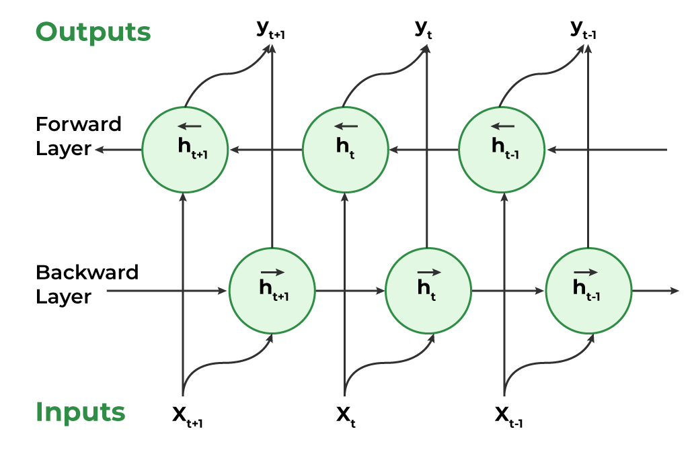

Slide 68
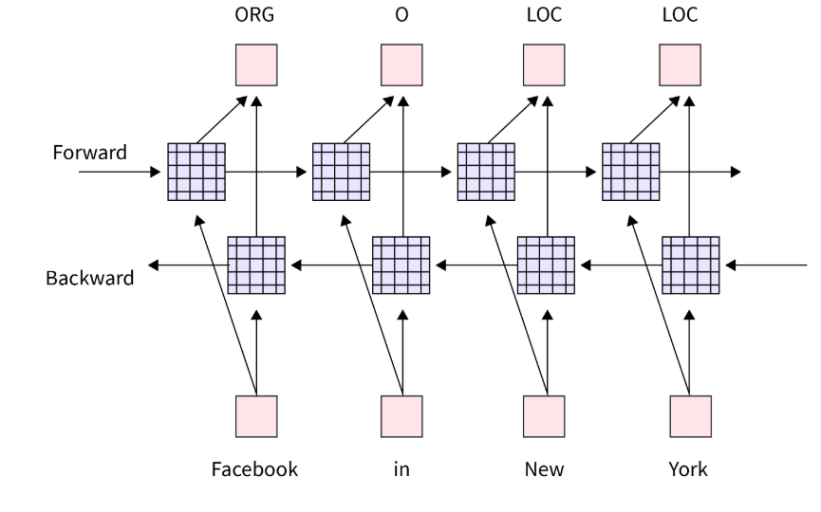

Slide 69
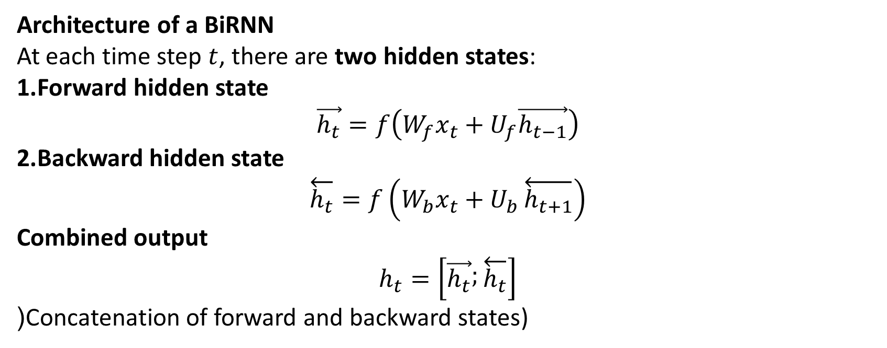
Architecture of a BiRNN
At each time step $t$, there are two hidden states:
Forward hidden state
$$\vec{h_{t}}=f\left(W_{f}x_{t}+U_{f}\vec{h_{t−1}}\right)$$
Backward hidden state
$$\overset{←}{h_{t}}=f\left(W_{b}x_{t}+U_{b}\overset{←}{h_{t+1}}\right)$$
Combined output
$$h_{t}=\left[\vec{h_{t}} ; \overset{←}{h_{t}}\right]$$
(Concatenation of forward and backward states)

Slide 70
Merge Modes in Bidirectional RNN
In a bidirectional recurrent neural network (RNN), two separate RNNs process the input data in opposite directions (forward and backward). The output of these two RNNs is then combined, or "merged," in some way to produce the final output of the model.
There are several ways in which the outputs of the forward and backward RNNs can be merged, depending on the specific needs of the model and the task it is being used for. Some common merge modes include:
Concatenation: In this mode, the outputs of the forward and backward RNNs are concatenated together, resulting in a single output tensor that is twice as long as the original input.
Sum: In this mode, the outputs of the forward and backward RNNs are added together element-wise, resulting in a single output tensor that has the same shape as the original input.
Average: In this mode, the outputs of the forward and backward RNNs are averaged element-wise, resulting in a single output tensor that has the same shape as the original input.
Maximum: In this mode, the maximum value of the forward and backward outputs is taken at each time step, resulting in a single output tensor with the same shape as the original input.
Which merge mode to use will depend on the specific needs of the model and the task it is being used for. Concatenation is generally a good default choice and works well in many cases, but other merge modes may be more appropriate for certain tasks.

Slide 71
Working of Bidirectional Recurrent Neural Networks (BRNNs)
1. Inputting a Sequence: A sequence of data points each represented as a vector with the same dimensionality is fed into the BRNN. The sequence may have varying lengths.
2. Dual Processing: BRNNs process data in two directions:
Forward direction: The hidden state at each time step is determined by the current input and the previous hidden state.
Backward direction: The hidden state at each time step is influenced by the current input and the next hidden state.
3. Computing the Hidden State: A non-linear activation function is applied to the weighted sum of the input and the previous hidden state creating a memory mechanism that allows the network to retain information from earlier steps.
4. Determining the Output: A non-linear activation function is applied to the weighted sum of the hidden state and output weights to compute the output at each step. This output can either be:
The final output of the network.
An input to another layer for further processing.

Slide 72
Advantages of BRNNs
Enhanced Context Understanding: Considers both past and future data for improved predictions.
Improved Accuracy: Particularly effective for NLP and speech processing tasks.
Better Handling of Variable-Length Sequences: More flexible than traditional RNNs making it suitable for varying sequence lengths.
Increased Robustness: Forward and backward processing help filter out noise and irrelevant information, improving robustness.

Slide 73
Challenges of BRNNs
High Computational Cost: Requires twice the processing time compared to unidirectional RNNs.
Longer Training Time: More parameters to optimize result in slower convergence.
Limited Real-Time Applicability: Since predictions depend on the entire sequence hence they are not ideal for real-time applications like live speech recognition.
Less Interpretability: The bidirectional nature of BRNNs makes it more difficult to interpret predictions compared to standard RNNs.

Slide 74
Characteristic | BRNN | RNN
Definition | Bidirectional Recurrent Neural Networks. | Recurrent Neural Networks.
Purpose | Process input sequences in both forward and backward directions. | Process input sequences in a single direction.
Output | Output at each time step depends on the past and future inputs. | Output at each time step depends only on the past inputs.
Training | Trained on both forward and backward sequences. | Trained on a single sequence.
Examples | Natural language processing tasks, speech recognition. | Time series prediction, language translation.

Slide 75
Encoder Decoder Models
In deep learning the encoder-decoder model is a type of neural network that is mainly used for tasks where both the input and output are sequences.
This architecture is used when the input and output sequences are not the same length for example translating a sentence from one language to another, summarizing a paragraph, describing an image with a caption or convert speech into text. It works in two stages:
Encoder: The encoder takes the input data like a sentence and processes each word one by one then creates a single, fixed-size summary of the entire input called a context vector or latent space.
Decoder: The decoder takes the context vector and begins to produce the output one step at a time.

Slide 76
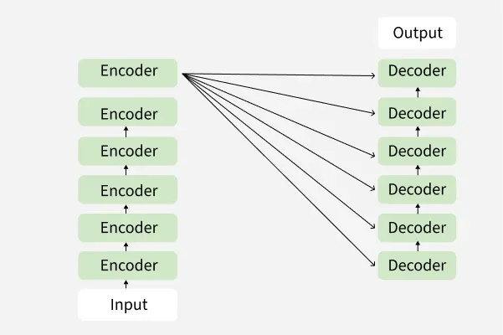
Encoder-Decoder Model Architecture
In an encoder-decoder model both the encoder and decoder are separate networks each one has its own specific task. These networks can be different types such as Recurrent Neural Networks (RNNs), Long Short-Term Memory networks (LSTMs), Gated Recurrent Units (GRUs), Convolutional Neural Networks (CNNs) or even more advanced models like Transformers.

Slide 77
Encoder
The encoder's job is to process the input data and convert it into a form that the model can understand. It does this using two main steps:
Self-Attention Layer: This layer helps the encoder focus on different parts of the input data that are important for understanding the context. For example in a sentence it allows the model to consider how each word relates to the others.
Feed-Forward Neural Network: After the self-attention layer this network processes the information further to capture complex patterns and relationships in the data.

Slide 78
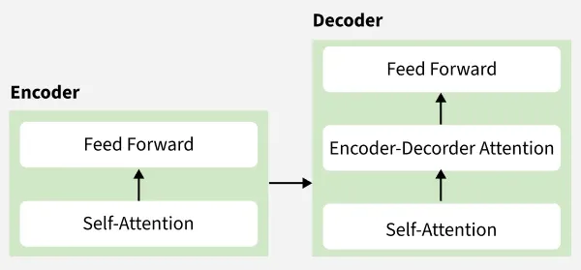
v

Slide 79
Decoder
The decoder takes the processed information from the encoder and generates the output. It also has three main components:
Self-Attention Layer: Similar to the encoder this layer allows the decoder to focus on different parts of the output it has generated.
Encoder-Decoder Attention Layer: This unique layer enables the decoder to focus on relevant parts of the input data help to generate more accurate outputs.
Feed-Forward Neural Network: Like the encoder the decoder uses this network to process the information and generate the final output.

Slide 80
What is Self-Attention?
Self-Attention allows a model to look at all parts of the input sequence simultaneously and learn which words/tokens are most important to each other.
It answers: "Which words in this sentence should I pay more attention to when processing this particular word?"
This is much more powerful than RNN/BiLSTM attention because:
It captures long-range dependencies perfectly
It is highly parallelizable (much faster training)
It doesn’t suffer from vanishing gradients

Slide 81
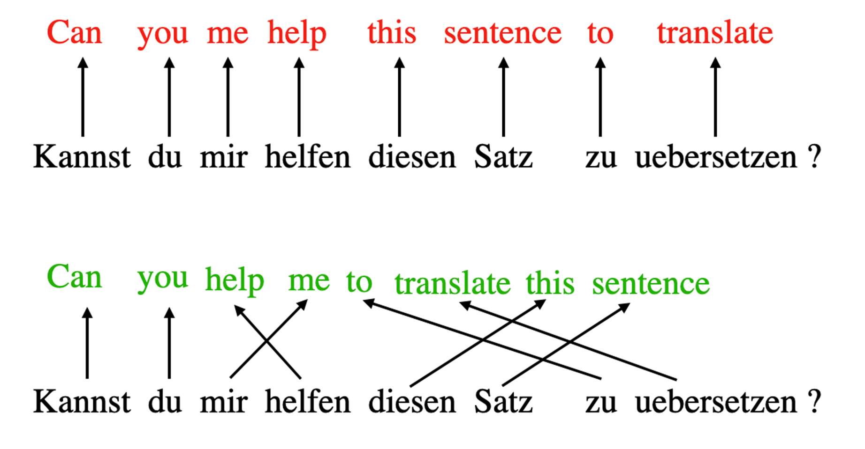
The concept of “attention” in deep learning has its roots in the effort to improve Recurrent Neural Networks (RNNs) for handling longer sequences or sentences. For instance, consider translating a sentence from one language to another. Translating a sentence word-by-word does not work effectively.

Slide 82
To overcome this issue, attention mechanisms were introduced to give access to all sequence elements at each time step.
The key is to be selective and determine which words are most important in a specific context. In 2017, the transformer architecture introduced a standalone self-attention mechanism,
In other words, the self-attention mechanism enables the model to weigh the importance of different elements in an input sequence and dynamically adjust their influence on the output.
This is especially important for language processing tasks, where the meaning of a word can change based on its context within a sentence or document.

Slide 84
1. Self-Attention in the Encoder
In the Encoder, Self-Attention is bidirectional — every token can attend to all other tokens (including future ones).
Key Points:
Input → Query (Q), Key (K), Value (V) matrices
Computes attention scores between every pair of tokens
Helps the model understand full context (e.g., pronouns, relationships between words)

Slide 85
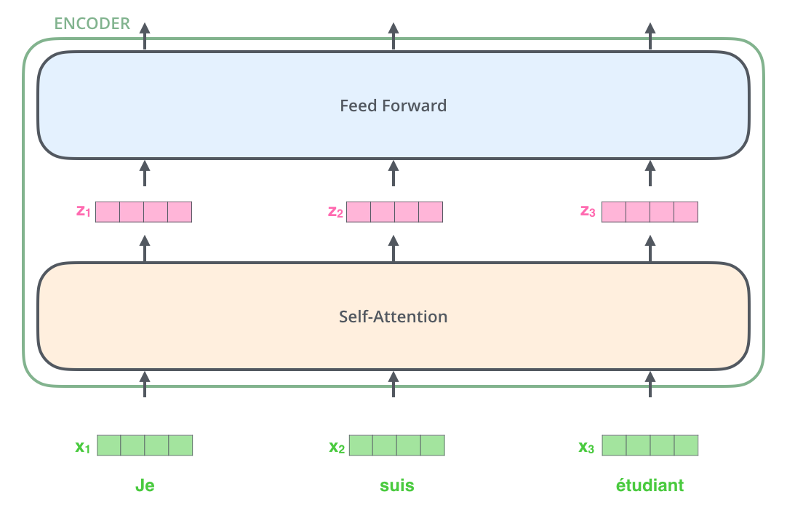

Slide 86
How it works inside Encoder:
Input → Embedding → Add Positional Encoding
Then → Multi-Head Self-Attention
Output → Goes to Feed Forward Network

Slide 87
3. Self-Attention in the Decoder (Masked Self-Attention)
Purpose: The Decoder generates output one word at a time (auto-regressive).
Important Rule: The model cannot see future words while predicting the current word.
This is solved by Masked Self-Attention (also called Causal Self-Attention).
Key Differences from Encoder:
Uses masking → Future tokens are hidden
Each token can only attend to previous tokens + itself

Slide 88
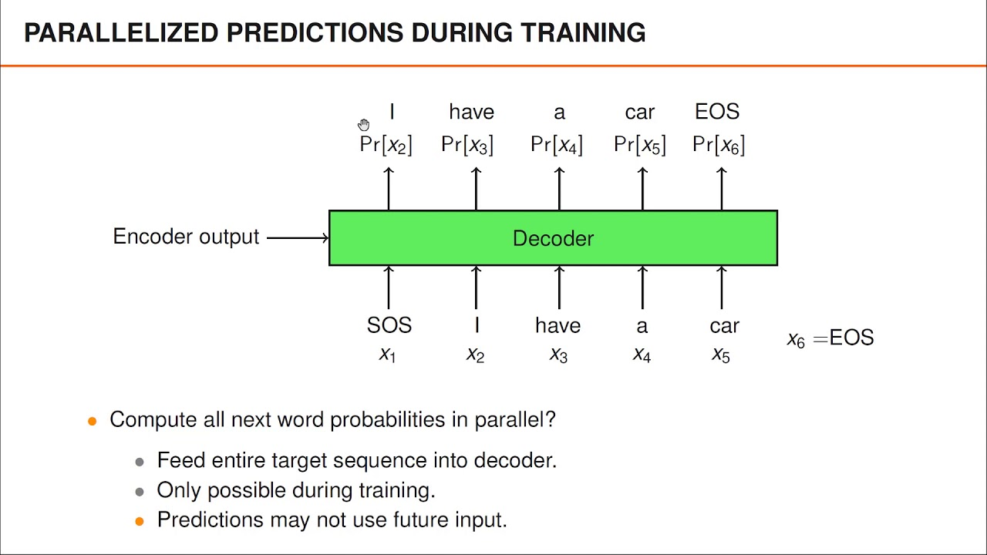

Slide 89
Masked Self-Attention
Example:
When predicting the 3rd word: → Can attend to word 1 and word 2 → Cannot attend to word 4, 5, 6...

Slide 90
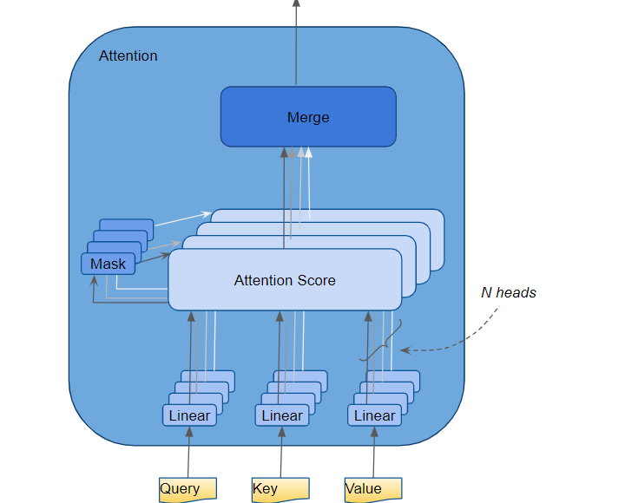
4. Multi-Head Self-Attention (Very Important)
Instead of computing attention once, we do it multiple times in parallel (usually 8 or 16 heads). Each head learns different relationships.

Slide 91
Visual Flow Summary:
Encoder Self-Attention → Full bidirectional attention
Decoder Self-Attention → Masked (causal) attention
Cross-Attention → Decoder attends to Encoder outputs
Component | Self-Attention Type | Can See Future Tokens? | Purpose
Encoder | Self-Attention | Yes | Understand full input context
Decoder | Masked Self-Attention | No | Generate output sequentially
Decoder (Cross-Attention) | Cross-Attention | Yes | Align output with input

Slide 92
Sentence we will use: "I love learning AI" (4 words)
1. Encoder Self-Attention (Full bidirectional context)
Goal: Help every word understand the whole sentence.
Word | What it attends to (importance)
I | Pays high attention to “love”, “learning”, “AI” (subject of the sentence)
love | Pays very high attention to “I” and “learning” (who loves what?)
learning | Pays high attention to “love” and “AI” (what is being learned?)
AI | Pays high attention to “learning” and “love” (what is loved and learned?)

Slide 93
Example: When processing the word “learning”, the model sees:
“I love learning AI” → “learning” strongly connects to “love” (the verb) and “AI” (the object). → So the representation of “learning” becomes richer: “the act of loving AI”.
This is normal self-attention (no mask).

Slide 94
2. Decoder Masked Self-Attention (Causal / Auto-regressive)
Goal: Generate one word at a time without peeking into the future.
Suppose the model is generating the translation: “Je adore apprendre l’IA”
Step | Current generated words | What the decoder is allowed to see | What it cannot see
1 | Je | Only “Je” | Future words
2 | Je adore | “Je adore” | Future words
3 | Je adore apprendre | “Je adore apprendre” | Future words
4 | Je adore apprendre l’IA | Full sentence (but still masked during training) | —

Slide 95
Example at step 2:
The decoder is about to generate “adore”.
It can only look at “Je” → it cannot look at “apprendre” or “l’IA” yet.
→ Masked self-attention puts -∞ (or very large negative) in the attention matrix for future positions.

Slide 96
3. Cross-Attention (Decoder attends to Encoder)
This is the most important connection between encoder and decoder.
Encoder output (understanding of English): “I love learning AI” → rich representations of each word.
Decoder (generating French): At the moment it is generating the word “apprendre”:
French word being generated | Which English words it focuses on (high attention)
adore | love
apprendre | learning
l’IA | AI

Slide 97
So when the decoder says “apprendre”, it strongly attends to the English word “learning” from the encoder.
This is cross-attention (Query from decoder, Key & Value from encoder).

Slide 98
4. Multi-Head Attention (8 heads working in parallel)
Instead of one attention mechanism, we run 8 different attention heads at the same time.
Toy example with sentence “The cat sat on the mat”
Head | What this head specializes in
Head 1 | Subject–Verb (The cat → sat)
Head 2 | Prepositional phrases (sat on the mat)
Head 3 | Coreference / repetition (the → the)
Head 4 | Syntactic structure (cat sat on mat)
… | …
Head 8 | Semantic similarity (cat & mat are both nouns)

Slide 99
After all 8 heads compute their attention, we concatenate them and pass through a linear layer.
This is why Transformers are so powerful — different heads learn different types of relationships.

Slide 100
Type | Where it happens | Can see future tokens? | Attends to whom? | Real-life analogy
Self-Attention | Encoder | Yes | All words in input | Reading a full paragraph at once
Masked Self-Attention | Decoder | No | Only previous words | Speaking word-by-word without knowing future
Cross-Attention | Decoder | Yes | Encoder hidden states | Translator looking back at original sentence
Multi-Head Attention | All layers | — | Multiple perspectives at once | 8 different experts reading the sentence

Slide 102
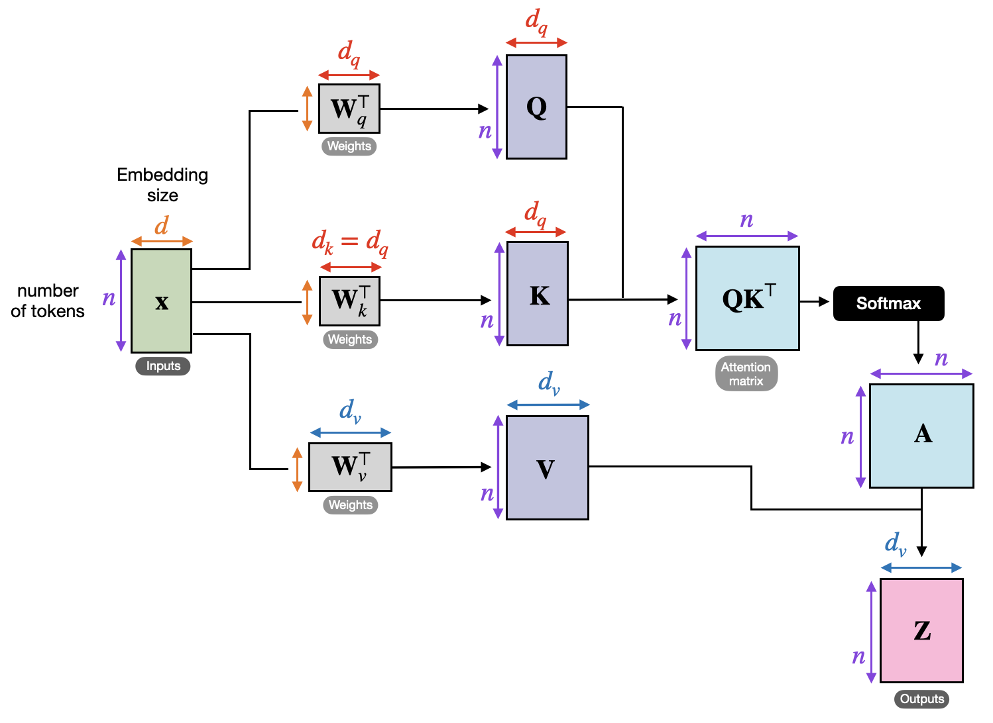
Encoder Self-Attention Block (Most Common Visualization)

Slide 103
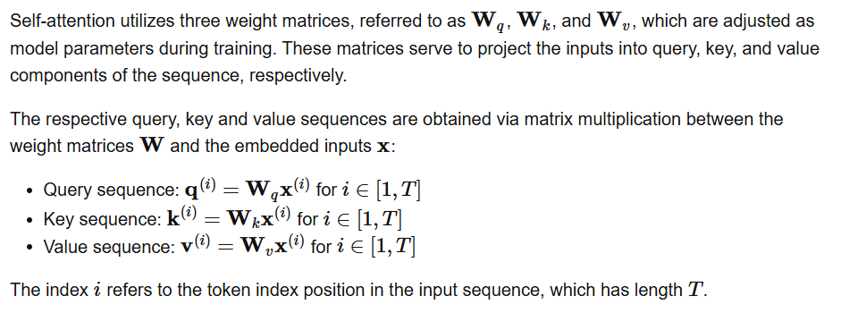
Defining the Weight Matrices

Slide 104
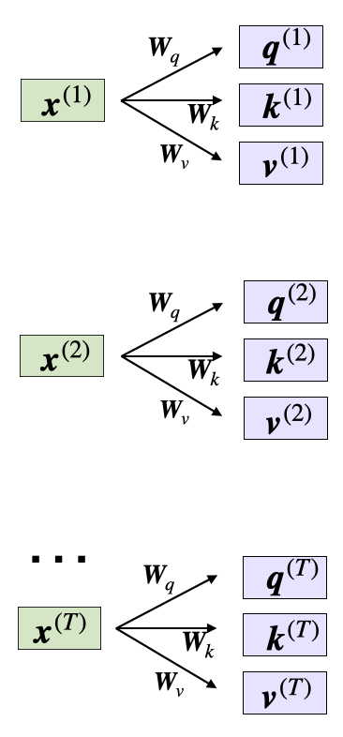
Here, both q(i) and k(i) are vectors of dimension dk.
The projection matrices Wq and Wk have a shape of dk×d, while Wv has the shape dv×d.
It’s important to note that d represents the size of each word vector, x
Since we are computing the dot-product between the query and key vectors, these two vectors have to contain the same number of elements (dq=dk
).
However, the number of elements in the value vector v(i)
, which determines the size of the resulting context vector, is arbitrary.

Slide 105
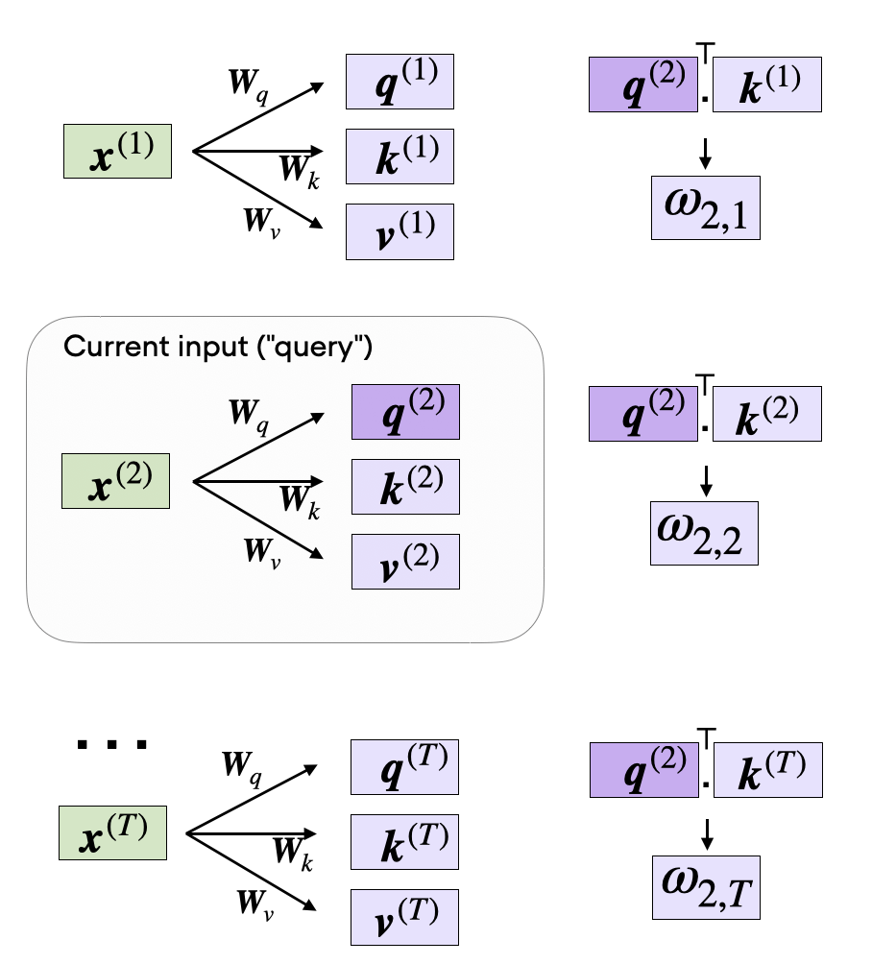
compute the unnormalized attention weights ω
which are illustrated in the figure below:
As illustrated in the figure above, we compute ωi,j
as the dot product between the query and key sequences, ωij=q(i)⊤k(j)
.

Slide 106
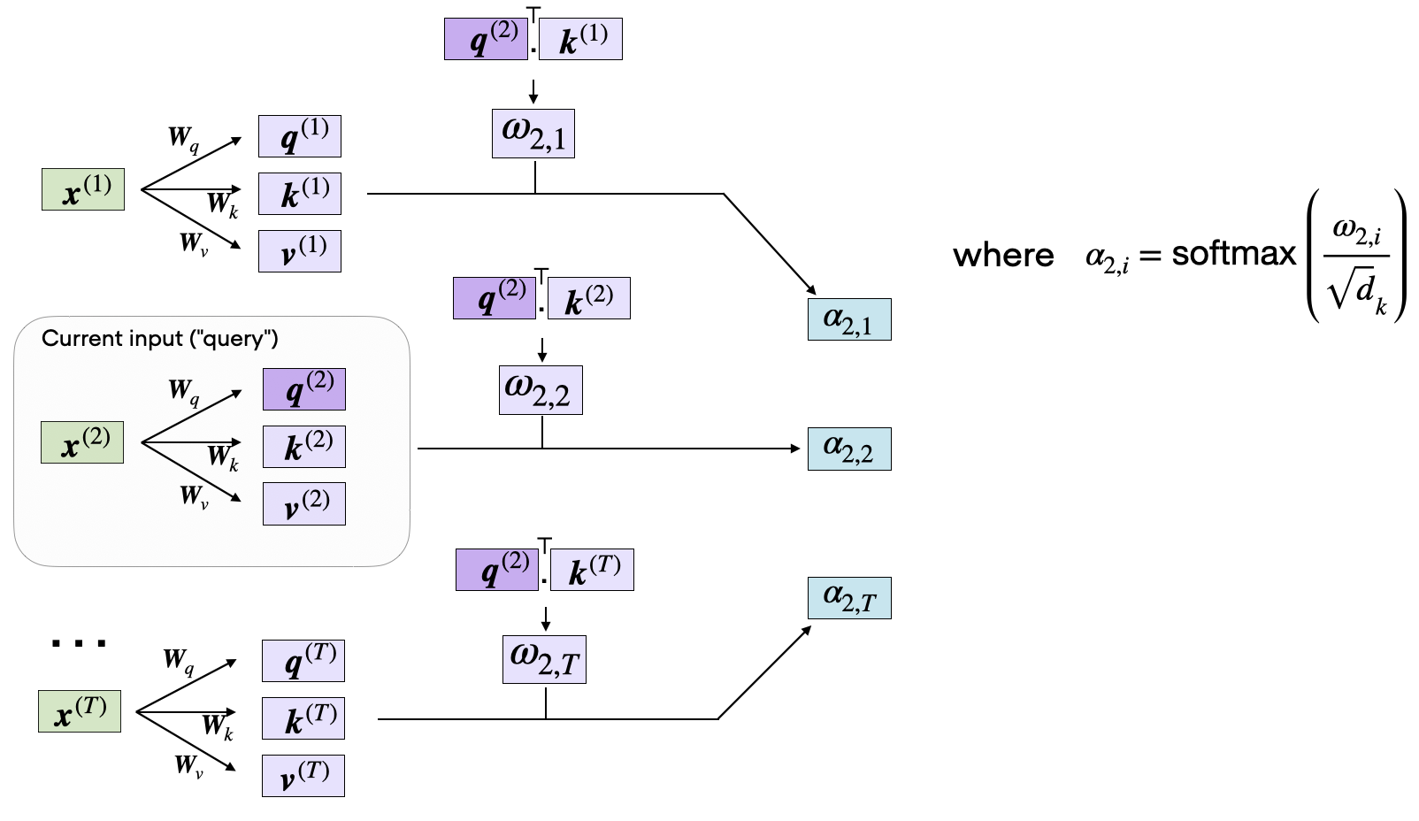
Computing the Attention Scores

Slide 107
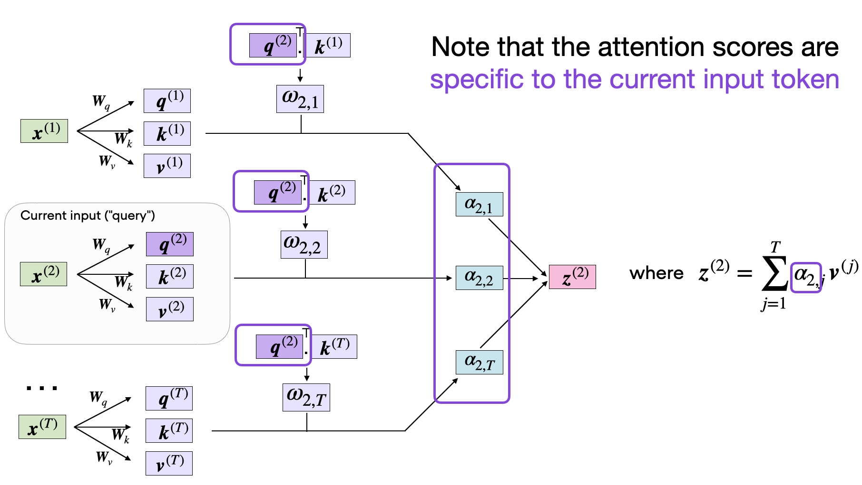
Finally, the last step is to compute the context vector z(2)
, which is an attention-weighted version of our original query input x(2)
, including all the other input elements as its context via the attention weights:

Slide 108
1. Encoder Self-Attention (Full bidirectional)
Step 1.1: Input Embeddings (made-up but realistic)
Step 1.2: Compute Q, K, V (using random weights, seed 42)
Q (Query):
text
[[ 0.0310, -0.0250, 0.0071, 0.1178],
[ 0.0334, -0.1810, -0.0226, 0.1033],
[-0.0367, -0.0647, 0.0694, 0.0521]]
Word | Embedding (4-dim)
I | [1.0, 0.0, 0.5, 0.2]
love | [0.8, 0.6, 0.3, 0.9]
AI | [0.2, 1.0, 0.7, 0.4]

Slide 109
K (Key):
text
[[-0.1405, 0.0311, -0.1604, -0.0854],
[-0.0635, -0.0113, -0.1573, -0.0205],
[ 0.0642, -0.0202, -0.1160, -0.0703]]
V (Value):
text
[[-0.1405, 0.0311, -0.1604, -0.0854],
[-0.0635, -0.0113, -0.1573, -0.0205],
[ 0.0642, -0.0202, -0.1160, -0.0703]]

Slide 110
Step 1.3: Raw Attention Scores (Q × Kᵀ / √d)
text
[[-0.0082, -0.0026, -0.0033],
[-0.0078, 0.0007, 0.0006],
[-0.0062, -0.0045, -0.0064]]
Step 1.4: Softmax → Attention Weights
text
[[0.3322, 0.3340, 0.3338], ← "I" attends almost equally
[0.3315, 0.3343, 0.3342], ← "love" attends slightly more to itself
[0.3332, 0.3337, 0.3331]] ← "AI" attends slightly more to itself
Step 1.5: Final Encoder Output (Attention × V)
text
[[-0.0268, -0.2026, -0.0450, -0.0329], ← new richer rep of "I"
[-0.0269, -0.2027, -0.0451, -0.0329], ← new rep of "love"
[-0.0268, -0.2025, -0.0448, -0.0331]] ← new rep of "AI"

Slide 111
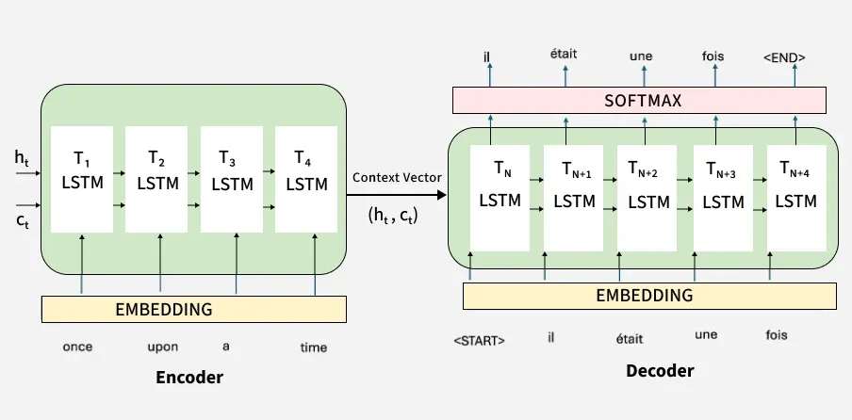
Working of Encoder Decoder Model
The actual working of the encoder decoder model is shown in below diagram. Now we will understand it stepwise:

Slide 112
Step 1: Tokenizing the Input Sentence
The sentence "I am learning AI" is first broken into tokens: ["I", "am", "learning", "AI"].
Each word (token) is converted into a vector that a machine can understand. This process is called embedding.
Step 2: Encoding the Input
The Encoder processes these embeddings using self-attention.
Self-attention helps the encoder to focus on important words. For example while encoding "learning", it understands its relation with "I" and "AI."
After processing the encoder generates a Context Vector which captures the meaning of the entire sentence. For example in the image The arrows show how each word relates to the others during encoding. The final output from the encoder is the context representation

Slide 113
Step 3: Passing the Context to the Decoder
The Context Vector is passed to the Decoder as shown in image.
It acts like a summary of the full input sentence.
Step 4: Decoder Generates Output Step-by-Step
The Decoder uses the context and starts creating the output one word at a time.
First it predicts the first word then uses that to predict the second word and so on
Step 5: Decoder Attention
While generating each word the decoder attends to different parts of the input sentence to make better predictions.
For example when translating "learning," it might pay more attention to the word "learning" in the input.

Slide 114
Step 6: Producing the Final Output
The decoder continues generating until the full translated sentence is produced.
Each output token depends on the previous ones and the input context. You finally see the output tokens generated on the right side of the diagram completing the translation.

Slide 115
Example
Input length = 2 words
Hidden size = 2
Very small numbers (for manual calculation)
Problem
Input sentence: “Hi You” Target sentence: “Salut Toi”
We will calculate:
Encoder hidden states
Context vector
Decoder predictions (with softmax)

Slide 116

Step 1: Given Parameters
Hidden size = 2
Initial hidden state:
$h_{0}=\left[\begin{matrix}0 \\ 0\end{matrix}\right]$
Weight matrices:
$W_{x}=\left[\begin{matrix}0.5 & 0.1 \\ 0.3 & 0.7\end{matrix}\right]$
$W_{h}=\left[\begin{matrix}0.6 & 0.2 \\ 0.4 & 0.8\end{matrix}\right]$
Activation function:
$tanh⁡\left(x\right)$

Slide 117

Step 2: Word Embeddings
Hi →
$x_{1}=\left[\begin{matrix}1 \\ 0\end{matrix}\right]$
You →
$x_{2}=\left[\begin{matrix}0 \\ 1\end{matrix}\right]$

Slide 118


Encoder Time Step 1
Formula:
$h_{1}=tanh⁡\left(W_{x}x_{1}+W_{h}h_{0}\right)$
Step 1: Compute $W_{x}x_{1}$
$W_{x}\left[\begin{matrix}1 \\ 0\end{matrix}\right]=\left[\begin{matrix}0.5 \\ 0.3\end{matrix}\right]$
Step 2: Compute $W_{h}h_{0}$
Since $h_{0}=0$:
$=\left[\begin{matrix}0 \\ 0\end{matrix}\right]$
Step 3: Add
$=\left[\begin{matrix}0.5 \\ 0.3\end{matrix}\right]$
Step 4: Apply tanh
$tanh⁡\left(0.5\right)=0.462$
$tanh⁡\left(0.3\right)=0.291$
$h_{1}=\left[\begin{matrix}0.462 \\ 0.291\end{matrix}\right]$

Slide 119


Encoder Time Step 2
$$h_{2}=tanh⁡\left(W_{x}x_{2}+W_{h}h_{1}\right)$$
Step 1: Compute $W_{x}x_{2}$
$$=\left[\begin{matrix}0.1 \\ 0.7\end{matrix}\right]$$
Step 2: Compute $W_{h}h_{1}$
$$=\left[\begin{matrix}0.6 & 0.2 \\ 0.4 & 0.8\end{matrix}\right]\left[\begin{matrix}0.462 \\ 0.291\end{matrix}\right]$$
Multiply:
First row:
$$\left(0.6\right)\left(0.462\right)+\left(0.2\right)\left(0.291\right)$$
$$=0.2772+0.0582=0.3354$$
Second row:
$$\left(0.4\right)\left(0.462\right)+\left(0.8\right)\left(0.291\right)$$
$$=0.1848+0.2328=0.4176$$
So,
$$=\left[\begin{matrix}0.3354 \\ 0.4176\end{matrix}\right]$$
Step 3: Add
$$=\left[\begin{matrix}0.1 \\ 0.7\end{matrix}\right]+\left[\begin{matrix}0.3354 \\ 0.4176\end{matrix}\right]=\left[\begin{matrix}0.4354 \\ 1.1176\end{matrix}\right]$$

Slide 120

Step 4: Apply tanh
$tanh⁡\left(0.4354\right)=0.410$
$tanh⁡\left(1.1176\right)=0.806$
Final encoder hidden state:
$h_{2}=\left[\begin{matrix}0.410 \\ 0.806\end{matrix}\right]$
Context Vector
$c=h_{2}=\left[\begin{matrix}0.410 \\ 0.806\end{matrix}\right]$
This is passed to decoder.

Slide 121

PART 2: DECODER CALCULATION
Initial decoder state:
$s_{0}=c=\left[\begin{matrix}0.410 \\ 0.806\end{matrix}\right]$
Assume output weight matrix:
$W_{o}=\left[\begin{matrix}0.2 & 0.6 \\ 0.5 & 0.1 \\ 0.4 & 0.3\end{matrix}\right]$
(3 output words

Slide 122

Decoder Output Calculation
$z=W_{o}s_{0}$
Multiply:
Row 1:
$\left(0.2\right)\left(0.410\right)+\left(0.6\right)\left(0.806\right)=0.082+0.4836=0.5656$
Row 2:
$\left(0.5\right)\left(0.410\right)+\left(0.1\right)\left(0.806\right)=0.205+0.0806=0.2856$
Row 3:
$\left(0.4\right)\left(0.410\right)+\left(0.3\right)\left(0.806\right)=0.164+0.2418=0.4058$
So logits:
$z=\left[\begin{matrix}0.5656 \\ 0.2856 \\ 0.4058\end{matrix}\right]$

Slide 123

Softmax
$$e^{0.5656}=1.760$$
$$e^{0.2856}=1.330$$
$$e^{0.4058}=1.500$$
Sum: $=4.590$
Probabilities:
$$P_{1}=1.760/4.590=0.383$$
$$P_{2}=0.290$$
$$P_{3}=0.327$$
Final Prediction
Highest probability = Word 1
Decoder predicts first word.

Slide 124
Encoder-Decoder Model
There are three main blocks in the encoder-decoder model,
Encoder
Hidden Vector
Decoder
The Encoder will convert the input sequence into a single-dimensional vector (hidden vector). The decoder will convert the hidden vector into the output sequence.
Encoder-Decoder models are jointly trained to maximize the conditional probabilities of the target sequence given the input sequence.

Slide 125

How the Sequence to Sequence Model works?
In order to fully understand the model’s underlying logic, we will go over the below illustration:

Slide 126


Slide 127


Slide 128

The Seq2Seq Architecture: An Encoder-Decoder Framework
A Seq2Seq model is composed of two main components, both of which are typically RNNs (usually more advanced versions like LSTM or GRU).

Slide 129
The Encoder: Its job is to process the entire input sequence, one item at a time (e.g., one word).
It doesn’t produce an output at each step. Instead, it aims to compress all the information from the input sequence into a single, dense vector representation.
This vector is called the context vector or, more poetically, the “thought vector.” It is the final hidden state of the encoder RNN.
The Decoder: Its job is to take the context vector from the encoder and generate the output sequence, one item at a time.
It uses the context vector as its initial hidden state, giving it the “thought” or “summary” of the entire input.

Slide 130

A Step-by-Step Walkthrough: Machine Translation

Slide 131
Encoder Phase:
The word “The” is fed into the encoder RNN. The RNN produces a hidden state h1.
The word “weather” is fed into the encoder, along with the previous hidden state h1. The RNN produces a new hidden state h2.
The word “is” is fed into the encoder, along with h2. The RNN produces the final hidden state h3.
The word “nice” is fed into the encoder, along with h3. The RNN produces the final hidden state h4.
The encoder’s job is done. It discards all intermediate outputs and passes its final state, h4 (the context vector), to the decoder. This vector h4 is now expected to contain the meaning of “The weather is nice”.

Slide 132
Decoder Phase:
The decoder is initialized with the encoder’s context vector h4 as its hidden state.
To start the generation process, we feed a special [START] token (or [GO]) into the decoder.
The decoder, using its hidden state (h4) and the [START] token, predicts the first word of the output. Ideally, it predicts “Il” and produces a new hidden state h5.
For the next step, it takes the word it just predicted (“Il”) and the previous hidden state (h5) as input. It then predicts the next word, “fait”, and produces a new state h6.
This process continues until the decoder predicts a special [END] token (or [EOS]), which signals that the translation is complete.

Slide 133

The Information Bottleneck and the “Attention” Solution
The basic Seq2Seq model has a significant weakness: it has to cram the entire meaning of a long input sequence into a single, fixed-size context vector.
This is a huge information bottleneck.
Imagine trying to summarize the entire Lord of the Rings trilogy in one short sentence — you’d lose a lot of detail.

Slide 134
This is where the Attention Mechanism comes in. It was a revolutionary improvement to Seq2Seq models.
Intuition: A human translator doesn’t just read the whole sentence once and then start translating from memory. As they write each translated word, they often look back (“pay attention to”) specific words in the original sentence that are most relevant to the word they are currently writing.
Attention was introduced in the paper Neural Machine Translation by Jointly Learning to Align and Translate to address the fixed representation problem.
Attention: At different steps, let a model “focus” on different parts of the input.

Slide 135


Slide 136
The encoder works as before, but instead of just providing its final hidden state, it provides all of its hidden states (h1, h2, h3, etc.) to the decoder.
At each step of the decoding process, the decoder performs an extra calculation:
It looks at its own current hidden state and compares it to all the encoder’s hidden states.
It generates a set of “attention scores” that measure how relevant each input word is to the current output word being generated.
These scores are converted into weights (using softmax).
The decoder then computes a new, weighted context vector that is a combination of all the encoder hidden states, weighted by the attention scores.
This means that if the decoder is about to generate the word “fait”, the attention mechanism might give high weights to the encoder states corresponding to “the” and “weather”, allowing it to focus on the relevant parts of the input.
This solves the bottleneck problem and allows the model to handle very long sequences effectively. This attention concept was so powerful that it became the foundation for the Transformer architecture.

Slide 137
Training vs. Inference: A Crucial Distinction
There’s a key difference in how a Seq2Seq model operates during training and when it’s actually used for inference.
Training (Teacher Forcing): During training, to make the process stable and fast, we use a technique called teacher forcing. When generating the output sequence, instead of feeding the decoder’s own prediction from the previous step, we feed it the correct word from the target sequence. This prevents errors from accumulating and helps the model learn the sequence patterns more quickly.
Inference (Autoregressive Generation): During inference, we don’t have the target sequence. Here, we must work autoregressively. We feed the [START] token, generate a word, then feed that generated word back into the decoder to generate the next word, and so on, until an [END] token is produced.

Slide 138
Deep Recurrent Networks (Deep RNNs)
Deep Recurrent Neural Networks (Deep RNNs) are an extension of standard Recurrent Neural Networks (RNNs), designed to process sequential data by incorporating recurrent connections that allow the network to maintain a "memory" of previous inputs.
The "deep" aspect refers to stacking multiple recurrent layers, enabling the model to learn more complex, hierarchical representations from sequences.
This is particularly useful for tasks where data has temporal dependencies, such as language modeling, speech recognition, or time-series prediction.
RNNs were first introduced in the 1980s, but deep variants gained prominence in the 2010s with advancements in training techniques and hardware.
They form the backbone of many sequence-based models before the rise of transformers (like BERT, which you mentioned earlier).

Slide 139

Core Architecture of Deep RNNs
At its simplest, a single-layer RNN processes a sequence of inputs $x_{1},x_{2},…,x_{T}$to produce outputs $y_{1},y_{2},…,y_{T}$(or sometimes just a final output). The hidden state $h_{t}$at time step $t$is updated as:
$h_{t}=tanh⁡\left(W_{xh}x_{t}+W_{hh}h_{t−1}+b_{h}\right)$
$y_{t}=W_{hy}h_{t}+b_{y}$
Here, $W_{xh}$, $W_{hh}$, and $W_{hy}$are weight matrices, $b_{h}$and $b_{y}$are biases, and $\tanh{}$is a non-linear activation function.
In Deep RNNs, we stack multiple such layers. The output of one recurrent layer becomes the input to the next. For a network with $L$layers, the update for layer $l$at time $t$is:
$h_{t}^{\left(l\right)}=tanh⁡\left(W_{xh}^{\left(l\right)}h_{t}^{\left(l−1\right)}+W_{hh}^{\left(l\right)}h_{t−1}^{\left(l\right)}+b_{h}^{\left(l\right)}\right)$
Where $h_{t}^{\left(0\right)}=x_{t}$(the input). This stacking allows lower layers to capture low-level features (e.g., phonemes in speech) and higher layers to learn abstract patterns (e.g., sentences or melodies).

Slide 140

Unidirectional vs. Bidirectional: In unidirectional Deep RNNs, information flows only forward in time. Bidirectional versions (Bi-RNNs) add a backward pass, processing the sequence in reverse to capture future context as well:
$\vec{h_{t}}=f\left(\vec{W}x_{t}+\vec{V}\vec{h_{t−1}}\right)$
$\overset{←}{h_{t}}=f\left(\overset{←}{W}x_{t}+\overset{←}{V}\overset{←}{h_{t+1}}\right)$
$h_{t}=\left[\vec{h_{t}} ; \overset{←}{h_{t}}\right]$
Deep Bi-RNNs stack these bidirectional layers, enhancing context understanding in tasks like named entity recognition.

Slide 141


Slide 142

Layer-wise computation
For time step $t$:
Layer 1:
$h_{t}^{\left(1\right)}=f\left(W^{\left(1\right)}x_{t}+U^{\left(1\right)}h_{t−1}^{\left(1\right)}\right)$
Layer 2:
$h_{t}^{\left(2\right)}=f\left(W^{\left(2\right)}h_{t}^{\left(1\right)}+U^{\left(2\right)}h_{t−1}^{\left(2\right)}\right)$
Layer L:
$h_{t}^{\left(L\right)}=f\left(W^{\left(L\right)}h_{t}^{\left(L−1\right)}+U^{\left(L\right)}h_{t−1}^{\left(L\right)}\right)$
Output:
$y_{t}=g\left(Vh_{t}^{\left(L\right)}\right)$

Slide 143
Autoencoders
Autoencoders are a special type of neural networks that learn to compress data into a compact form and then reconstruct it to closely match the original input. They consist of an:
Encoder that captures important features by reducing dimensionality.
Decoder that rebuilds the data from this compressed representation.
The model trains by minimizing reconstruction error using loss functions like Mean Squared Error or Binary Cross-Entropy.
These are applied in tasks such as noise removal, error detection and feature extraction where capturing efficient data representations is important.

Slide 144

As humans, when we’re asked to draw a tree with the least number of touches to the paper, (given that we’ve seen so many trees in our lifetime) we draw a line for the tree and couple of branches on top to provide an abstraction to how trees look like, this is what’s being done with autoencoder.

Slide 145


Slide 146
We have our input layer with 784 units (assuming we give 28x28 images) and we could simply stack a layer on top with 28 units, and our output layer will have 784 units again.
The first part is called “encoder” it encodes our inputs as latent variables, and second part is called “decoder” it will reconstruct our inputs from the latent variables.

Slide 147


Slide 148


Slide 149


Slide 150

Architecture of Autoencoder
An autoencoder’s architecture consists of three main components that work together to compress and then reconstruct data which are as follows:

Slide 151
1. Encoder
It compress the input data into a smaller, more manageable form by reducing its dimensionality while preserving important information. It has three layers which are:
Input Layer: This is where the original data enters the network. It can be images, text features or any other structured data.
Hidden Layers: These layers perform a series of transformations on the input data. Each hidden layer applies weights and activation functions to capture important patterns, progressively reducing the data's size and complexity.
Output(Latent Space): The encoder outputs a compressed vector known as the latent representation or encoding. This vector captures the important features of the input data in a condensed form helps in filtering out noise and redundancies.

Slide 152
2. Bottleneck (Latent Space)
It is the smallest layer of the network which represents the most compressed version of the input data. It serves as the information bottleneck which force the network to prioritize the most significant features. This compact representation helps the model learn the underlying structure and key patterns of the input helps in enabling better generalization and efficient data encoding.

Slide 153
3. Decoder
It is responsible for taking the compressed representation from the latent space and reconstructing it back into the original data form.
Hidden Layers: These layers progressively expand the latent vector back into a higher-dimensional space. Through successive transformations decoder attempts to restore the original data shape and details
Output Layer: The final layer produces the reconstructed output which aims to closely resemble the original input. The quality of reconstruction depends on how well the encoder-decoder pair can minimize the difference between the input and output during training.

Slide 154
Loss Function in Autoencoder Training
During training an autoencoder’s goal is to minimize the reconstruction loss which measures how different the reconstructed output is from the original input. The choice of loss function depends on the type of data being processed:
Mean Squared Error (MSE): This is commonly used for continuous data. It measures the average squared differences between the input and the reconstructed data.
Binary Cross-Entropy: Used for binary data (0 or 1 values). It calculates the difference in probability between the original and reconstructed output.
During training the network updates its weights using backpropagation to minimize this reconstruction loss. By doing this it learns to extract and retain the most important features of the input data which are encoded in the latent space.

Slide 155

Training Process
Forward Pass: Compute $z$and $\hat{x}$.
Backward Pass: Use backpropagation to update $θ$and $φ$via gradient descent.
Regularization: To prevent overfitting or trivial identity mapping (where the network just copies input to output), add techniques like:
Weight decay (L2 regularization on weights).
Dropout in hidden layers.
Autoencoders can be trained on unlabeled data, making them scalable to large datasets like images (e.g., MNIST) or text embeddings.

Slide 156

Types of Autoencoders
1.Vanilla (Basic) Autoencoder
The simplest form that learns to reconstruct input data.
Architecture
Fully connected layers
Bottleneck layer compresses features
Loss Function
$L=∣∣x−\hat{x}∣∣^{2}$
Purpose
learn compressed representation dimensionality reduction
Limitation
may learn identity function if bottleneck is large.

Slide 157

2. Sparse Autoencoder
Encourages most neurons to remain inactive, forcing the model to learn important features only.
How it works
Adds sparsity penalty:
$L=\text{Reconstruction} \text{Loss}+λ\sum{K}L\left(ρ∣∣\hat{ρ}\right)$
Where:
$ρ$= desired sparsity
$\hat{ρ}$= average activation
Why important?
avoids trivial copying
selects essential features
Applications
feature selection
anomaly detection
pattern recognition

Slide 158

3. Denoising Autoencoder (DAE)
Trained to reconstruct clean input from noisy input.
Training Process
Clean image → add noise → input to network → reconstruct original
$x_{noisy}→{\hat{x}}_{clean}$
Why useful?
learns robust features ignores noise
Applications
image denoising
speech enhancement
medical image cleaning

Slide 159

Contractive Autoencoders
Description: Focus on learning representations invariant to small input changes by penalizing the Jacobian of the encoder.
Architecture and How It Works: Standard setup, but adds a contractive penalty to make the mapping "contractive" in input space.
Loss:
$ℒ=∥x−\hat{x}∥^{2}+λ{∥\frac{∂f\left(x\right)}{∂x}∥}_{F}^{2}$
where $∥⋅∥_{F}$is Frobenius norm.
This encourages a smooth manifold in latent space.
Advantages: Robust to infinitesimal perturbations; learns invariant features.
Limitations: Computing the Jacobian is computationally expensive for large networks.
Applications: Manifold learning; robust classification (e.g., in adversarial settings); audio processing for noise invariance.

Slide 160
Convolutional Autoencoders (CAEs)
Description: Adapted for grid-structured data like images, using convolutional layers to preserve spatial hierarchies.
Architecture and How It Works: Encoder uses conv/pooling layers to downsample to latent (flattened or volumetric); decoder uses transposed conv/upsampling to reconstruct.
Loss: Similar to basic MSE, but often perceptual losses for images.
Variant: Can be denoising or variational (e.g., Convolutional VAEs).
Advantages: Efficient for high-dimensional spatial data; captures local patterns like textures.
Limitations: Assumes grid structure; less flexible for non-image data.
Applications: Image compression (better than JPEG for certain artifacts); video frame prediction; medical imaging (e.g., MRI reconstruction).

Slide 161

Adversarial Autoencoders (AAEs)
Description: Integrate Generative Adversarial Networks (GANs) to match the latent distribution to a prior, improving generation quality.
Architecture and How It Works: Encoder-decoder as in VAE, but a discriminator distinguishes latent samples from prior (e.g., Gaussian). Train adversarially: Encoder fools discriminator.
Loss: Reconstruction + adversarial (min-max game):
No explicit KL like VAEs.
Advantages: Sharper generations than VAEs; flexible priors.
Limitations: Inherits GAN instability (mode collapse, training oscillations).
Applications: Semi-supervised learning (use latent for classification); high-quality image synthesis; clustering with adversarial regularization.

Slide 162


Variational Autoencoders (VAEs)
Description: Probabilistic extension for generative modeling, where the latent space is a distribution rather than a fixed vector, enabling sampling and interpolation.
Architecture and How It Works: Encoder outputs parameters of a distribution (e.g., mean $μ$and variance $σ^{2}$for Gaussian). Sample $z∼𝒩\left(μ , σ^{2}\right)$using reparameterization trick ($z=μ+σ⊙ε$, $ε∼𝒩\left(0 , 1\right)$) for backpropagation. Decoder generates from $z$.
Loss: Evidence Lower Bound (ELBO):

Slide 163
where first term is reconstruction, second regularizes to a prior (e.g., standard Gaussian).To derive ELBO: Start from
approximate by maximizing the bound.
Advantages: Generative capabilities (sample new data); smooth, continuous latent space for interpolation.
Limitations: Reconstructions can be blurry due to averaging in the loss; assumes simple priors (e.g., Gaussian), limiting complex distributions.
Applications: Image generation (e.g., faces in CelebA dataset); anomaly detection (low likelihood flags outliers); drug discovery (generating molecular structures).

Slide 164
Comparisons and Evolution
Undercomplete vs. Overcomplete: Trade-off between compression and richness; sparse/denoising often build on these.
Deterministic vs. Probabilistic: Basic types are deterministic; VAEs/AAEs add stochasticity for generation.
Evolution: From simple compression (1980s) to generative (VAEs 2013, AAEs 2015); modern hybrids like VQ-VAE (vector-quantized) or beta-VAE (disentangled) address limitations.
Choosing a Type: For compression, use undercomplete/CAE; for generation, VAE/AAE; for robustness, DAE/sparse.

Slide 165
Type | Key Idea | Strength | Use Case
Vanilla | Basic reconstruction | Simple | Compression
Sparse | Few active neurons | Feature selection | Anomaly detection
Denoising | Remove noise | Robust learning | Image cleaning
Contractive | Robust to small changes | Stability | Signal processing
Variational | Probabilistic latent space | Data generation | AI creativity
Convolutional | Spatial features | Images | Vision tasks

Slide 166
Autoencoder use cases
Both generative and deterministic autoencoders have a wide variety of use cases across different fields and data types.
Data compression: Autoencoders naturally learn a compressed representation of input data.
Dimensionality reduction: The encodings learned by autoencoders can be used as input to larger, composite neural networks. Dimensionality reduction of complex data can extract features relevant to other tasks, as well as increase computational speed and efficiency.
Anomaly detection and facial recognition: Autoencoders can detect anomalies, fraud or other defects—and, conversely, confirm a genuine match—by determining the reconstruction loss of examined data relative to the “normal” or “genuine” example it’s compared against.
Image denoising and audio denoising: Denoising autoencoders can remove extraneous artifacts or corruption that does not match the latent space representation learned by the network.

Slide 167
Image reconstruction: Inverting techniques learned for denoising, autoencoders can fill in missing elements of an image. They can be similarly used to colorize images.
Generative tasks: VAEs and adversarial autoencoders (AAEs), which learn probabilistic distributions akin to those learned by VAEs but use an adversarial discriminator network (similar to generative adversarial networks) in place of KL divergence, have been used with great success for generative tasks. Prominent generative applications of autoencoders include OpenAI’s original Dall-E model for image generation⁶ and even the generation of molecular structures used for medications.⁷

Slide 168
Transformers
Transformers are a type of deep learning model that utilizes self-attention mechanisms to process and generate sequences of data efficiently.
They capture long-range dependencies and contextual relationships making them highly effective for tasks like language modeling, machine translation and text generation.
Transformer model is built on encoder-decoder architecture where both the encoder and decoder are composed of a series of layers that utilize self-attention mechanisms and feed-forward neural networks.
This architecture enables the model to process input data in parallel making it highly efficient and effective for tasks involving sequential data.
The encoder processes input sequences and creates meaningful representations.
The decoder generates outputs based on encoder representations and previously predicted tokens.
The encoder and decoder work together to transform the input into the desired output such as translating a sentence from one language to another or generating a response to a query.

Slide 169


Slide 170
Encoder Block Structure
Each encoder layer contains:
1️⃣ Multi-Head Self-Attention
2️⃣ Add & Layer Normalization
3️⃣ Feed Forward Network
4️⃣ Add & Layer Normalization

Slide 171
Decoder Block Structure
Each decoder layer contains:
1️⃣ Masked Multi-head self-attention 2️⃣ Encoder–Decoder attention 3️⃣ Feed-forward network

Slide 172
How Transformers Work
1. Input Representation
The first step in processing input data involves converting raw text into a format that the transformer model can understand. This involves tokenization and embedding.
Tokenization: The input text is split into smaller units called tokens, which can be words, sub words or characters. Tokenization ensures that the text is broken down into manageable pieces.
Embedding: Each token is then converted into a fixed-size vector using an embedding layer. This layer maps each token to a dense vector representation that captures its semantic meaning.
Positional encodings are added to these embeddings to provide information about the token positions within the sequence.

Slide 173
2. Encoder Process in Transformers
Input Embedding: The input sequence is tokenized and converted into embeddings with positional encodings added.
Self-Attention Mechanism: Each token in the input sequence attends to every other token to capture dependencies and contextual information.
Feed-Forward Network: The output from the self-attention mechanism is passed through a position-wise feed-forward network.
Layer Normalization and Residual Connections: Layer normalization and residual connections are applied.

Slide 174
3. Decoder Process
Input Embedding and Positional Encoding: The partially generated output sequence is tokenized and embedded with positional encodings added.
Masked Self-Attention Mechanism: The decoder uses masked self-attention to prevent attending to future tokens ensuring that the model generates the sequence step-by-step.
Encoder-Decoder Attention Mechanism: The decoder attends to the encoder's output allowing it to focus on relevant parts of the input sequence.
Feed-Forward Network: Similar to the encoder the output from the attention mechanisms is passed through a position-wise feed-forward network.
Layer Normalization and Residual Connections: Similar to the encoder Layer normalization and residual connections are applied.

Slide 175
4. Training and Inference
Transformers are trained with teacher forcing, where the correct previous tokens are provided during training to predict the next token. Their encoder-decoder architecture combined with multi-head attention and feed-forward networks enables highly effective handling of sequential data.
Transformers have transformed deep learning by using self-attention mechanisms to efficiently process and generate sequences capturing long-range dependencies and contextual relationships. Their encoder-decoder architecture combined with multi-head attention and feed-forward networks enables highly effective handling of sequential data.

Slide 176
BERT- Bidirectional Encoder Representations from Transformers
BERT stands for Bidirectional Encoder Representations from Transformers.
It is designed to pre-train deep bidirectional representations from unlabeled text by jointly conditioning on both left and right context.
As a result, the pre-trained BERT model can be fine-tuned with just one additional output layer to create state-of-the-art models for a wide range of NLP tasks.
That sounds way too complex as a starting point. But it does summarize what BERT does pretty well so let’s break it down:
First, it’s easy to get that BERT stands for Bidirectional Encoder Representations from Transformers.
Each word here has a meaning to it and we will encounter that one by one in this article. For now, the key takeaway from this line is – BERT is based on the Transformer architecture.

Slide 177
Second, BERT is pre-trained on a large corpus of unlabelled text including the entire Wikipedia(that’s 2,500 million words!) and Book Corpus (800 million words).
This pre-training step is half the magic behind BERT’s success.
This is because as we train a model on a large text corpus, our model starts to pick up the deeper and intimate understandings of how the language works.
This knowledge is the swiss army knife that is useful for almost any NLP task.
Third, BERT is a “deeply bidirectional” model. Bidirectional means that BERT learns information from both the left and the right side of a token’s context during the training phase.

Slide 178

BERT Example
The bidirectionality of a model is important for truly understanding the meaning of a language. Let’s see an example to illustrate this. There are two sentences in this example and both of them involve the word “bank”:

Slide 179
If we try to predict the nature of the word “bank” by only taking either the left or the right context, then we will be making an error in at least one of the two given examples.
One way to deal with this is to consider both the left and the right context before making a prediction. That’s exactly what BERT does! We will see later in the article how this is achieved.
And finally, the most impressive aspect of BERT. We can fine-tune it by adding just a couple of additional output layers to create state-of-the-art models for a variety of NLP tasks.

Slide 180
BERT’s Architecture
The BERT architecture builds on top of Transformer. We currently have two variants available:
BERT Base: 12 layers (transformer blocks), 12 attention heads, and 110 million parameters
BERT Large: 24 layers (transformer blocks), 16 attention heads and, 340 million parameters

Slide 181


Slide 182

Text Preprocessing
Notes:
CLS = classification token
Think “Classify the Sentence”

Slide 183
every input embedding is a combination of 3 embeddings:
Position Embeddings: BERT learns and uses positional embeddings to express the position of words in a sentence. These are added to overcome the limitation of Transformer which, unlike an RNN, is not able to capture “sequence” or “order” information
Segment Embeddings: BERT can also take sentence pairs as inputs for tasks (Question-Answering). That’s why it learns a unique embedding for the first and the second sentences to help the model distinguish between them. In the above example, all the tokens marked as EA belong to sentence A (and similarly for EB)
Token Embeddings: These are the embeddings learned for the specific token from the WordPiece token vocabulary

Slide 184
3. Pre-training Tasks
BERT is pre-trained on two NLP tasks:
Masked Language Modeling
Next Sentence Prediction
Let’s understand both of these tasks in a little more detail!

Slide 185
Masked Language Modeling (Bi-directionality)
BERT is designed as a deeply bidirectional model. The network effectively captures information from both the right and left context of a token from the first layer itself and all the way through to the last layer.
Traditionally, we had language models either trained to predict the next word in a sentence (right-to-left context used in GPT) or language models that were trained on a left-to-right context. This made our models susceptible to errors due to loss in information.

Slide 186

Predicting the word in a sequence

Slide 187

ELMo tried to deal with this problem by training two LSTM language models on left-to-right and right-to-left contexts and shallowly concatenating them. Even though it greatly improved upon existing techniques, it wasn’t enough.

Slide 188
he arrows indicate the information flow from one layer to the next. The green boxes at the top indicate the final contextualized representation of each input word.
It’s evident from the above image: BERT is bi-directional, GPT is unidirectional (information flows only from left-to-right), and ELMO is shallowly bidirectional.

Slide 189
Masked Language Model
Let’s say we have a sentence – “I love to read data science blogs on Analytics Vidhya”. We want to train a bi-directional language model. Instead of trying to predict the next word in the sequence, we can build a model to predict a missing word from within the sequence itself.
Let’s replace “Analytics” with “[MASK]”. This is a token to denote that the token is missing. We’ll then train the model in such a way that it should be able to predict “Analytics” as the missing token: “I love to read data science blogs on [MASK] Vidhya.”
This is the crux of a Masked Language Model. The authors of BERT also include some caveats to further improve this technique:
To prevent the model from focusing too much on a particular position or tokens that are masked, the researchers randomly masked 15% of the words
The masked words were not always replaced by the masked tokens [MASK] because the [MASK] token would never appear during fine-tuning

Slide 190
So, the researchers used the below technique:
80% of the time the words were replaced with the masked token [MASK]
10% of the time the words were replaced with random words
10% of the time the words were left unchanged

Slide 191
Before feeding word sequences into BERT, 15% of the words in each sequence are replaced with a [MASK] token. The model then attempts to predict the original value of the masked words, based on the context provided by the other, non-masked, words in the sequence. In technical terms, the prediction of the output words requires:
Adding a classification layer on top of the encoder output.
Multiplying the output vectors by the embedding matrix, transforming them into the vocabulary dimension.
Calculating the probability of each word in the vocabulary with softmax.

Slide 192


Slide 193
The BERT loss function takes into consideration only the prediction of the masked values and ignores the prediction of the non-masked words. As a consequence, the model converges slower than directional models, a characteristic which is offset by its increased context awareness (see Takeaways #3).

Slide 194
Next Sentence Prediction
Masked Language Models (MLMs) learn to understand the relationship between words. Additionally, BERT is also trained on the task of Next Sentence Prediction for tasks that require an understanding of the relationship between sentences.
A good example of such a task would be question answering systems.
The task is simple. Given two sentences – A and B, is B the actual next sentence that comes after A in the corpus, or just a random sentence?
Since it is a binary classification task, the data can be easily generated from any corpus by splitting it into sentence pairs. Just like MLMs, the authors have added some caveats here too. Let’s take this with an example:

Slide 195
Consider that we have a text dataset of 100,000 sentences. So, there will be 50,000 training examples or pairs of sentences as the training data.
For 50% of the pairs, the second sentence would actually be the next sentence to the first sentence
For the remaining 50% of the pairs, the second sentence would be a random sentence from the corpus
The labels for the first case would be ‘IsNext’ and ‘NotNext’ for the second case
And this is how BERT is able to become a true task-agnostic model. It combines both the Masked Language Model (MLM) and the Next Sentence Prediction (NSP) pre-training tasks.

Slide 196
In the BERT training process, the model receives pairs of sentences as input and learns to predict if the second sentence in the pair is the subsequent sentence in the original document.
During training, 50% of the inputs are a pair in which the second sentence is the subsequent sentence in the original document, while in the other 50% a random sentence from the corpus is chosen as the second sentence.
The assumption is that the random sentence will be disconnected from the first sentence.

Slide 197
To help the model distinguish between the two sentences in training, the input is processed in the following way before entering the model:
A [CLS] token is inserted at the beginning of the first sentence and a [SEP] token is inserted at the end of each sentence.
A sentence embedding indicating Sentence A or Sentence B is added to each token. Sentence embeddings are similar in concept to token embeddings with a vocabulary of 2.
A positional embedding is added to each token to indicate its position in the sequence. The concept and implementation of positional embedding are presented in the Transformer paper.

Slide 198


Slide 199
To predict if the second sentence is indeed connected to the first, the following steps are performed:
The entire input sequence goes through the Transformer model.
The output of the [CLS] token is transformed into a 2×1 shaped vector, using a simple classification layer (learned matrices of weights and biases).
Calculating the probability of IsNextSequence with softmax.
When training the BERT model, Masked LM and Next Sentence Prediction are trained together, with the goal of minimizing the combined loss function of the two strategies.

Slide 200
Pre-trained BERT Models
BERT-Base, Uncased | 12-layer, 768-hidden, 12-heads, 110M parameters
BERT-Large, Uncased | 24-layer, 1024-hidden, 16-heads, 340M parameters
BERT-Base, Cased | 12-layer, 768-hidden, 12-heads, 110M parameters
BERT-Large, Cased | 24-layer, 1024-hidden, 16-heads, 340M parameters
BERT-Base, Multilingual Cased (New) | 104 languages, 12-layer, 768-hidden, 12-heads, 110M parameters
BERT-Base, Multilingual Cased (Old) | 102 languages, 12-layer, 768-hidden, 12-heads, 110M parameters
BERT-Base, Chinese | Chinese Simplified and Traditional, 12-layer, 768-hidden, 12-heads, 110M parameters

Slide 201
https://dilipkumar.medium.com/sequence-to-sequence-seq2seq-models-37318a342b1d
https://www.geeksforgeeks.org/deep-learning/what-is-sequence-to-sequence-learning/

Slide 202
https://www.geeksforgeeks.org/machine-learning/introduction-to-recurrent-neural-network/
https://www.ibm.com/think/topics/recurrent-neural-networks
https://www.analyticsvidhya.com/blog/2022/03/a-brief-overview-of-recurrent-neural-networks-rnn/
https://www.d2l.ai/chapter_recurrent-neural-networks/

