Slide 1
Deep Learning Module 1
Dr S.Rajarajeswari

Slide 3
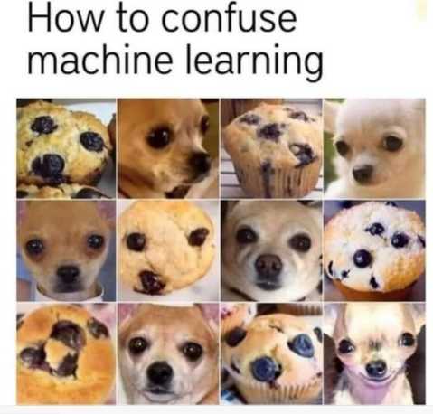

Slide 4
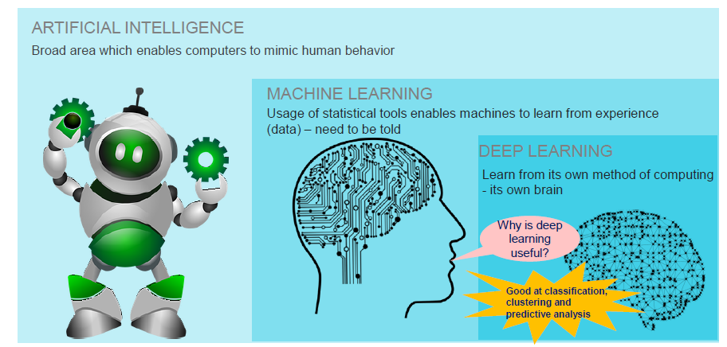

Slide 5
Introduction
Deep Learning is transforming the way machines understand, learn and interact with complex data.
Deep learning mimics neural networks of the human brain, it enables computers to autonomously uncover patterns and make informed decisions from vast amounts of unstructured data.

Slide 6
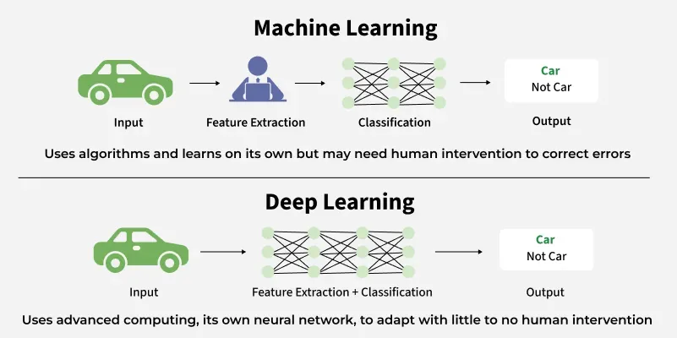

Slide 7
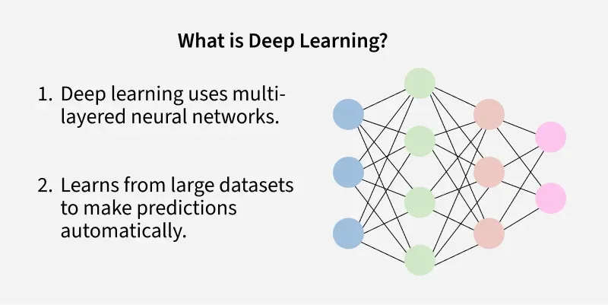

Slide 8
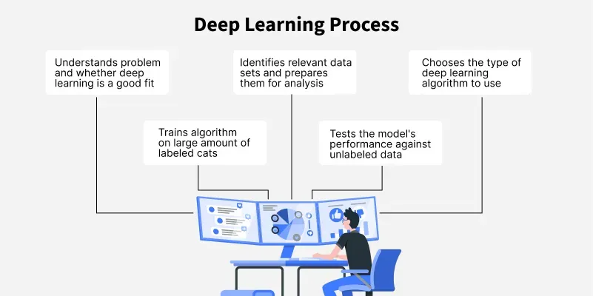

Slide 9
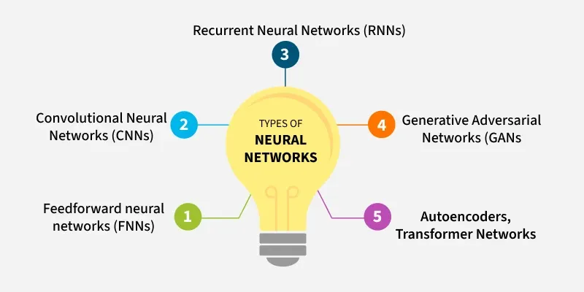

Slide 10
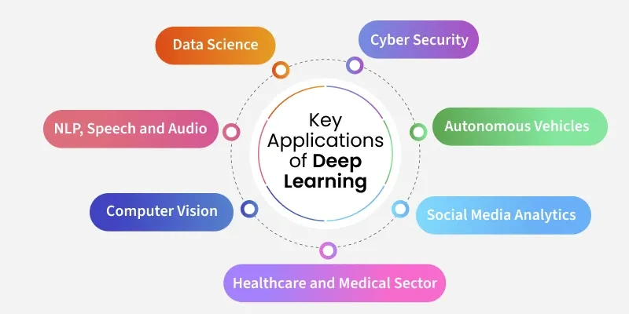

Slide 11
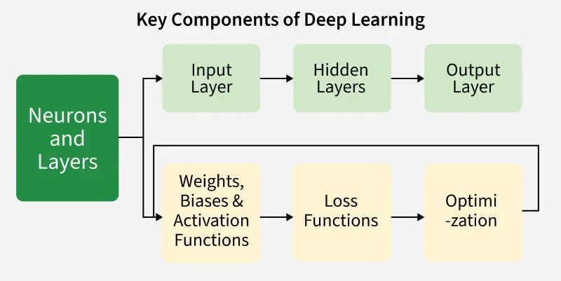

Slide 12
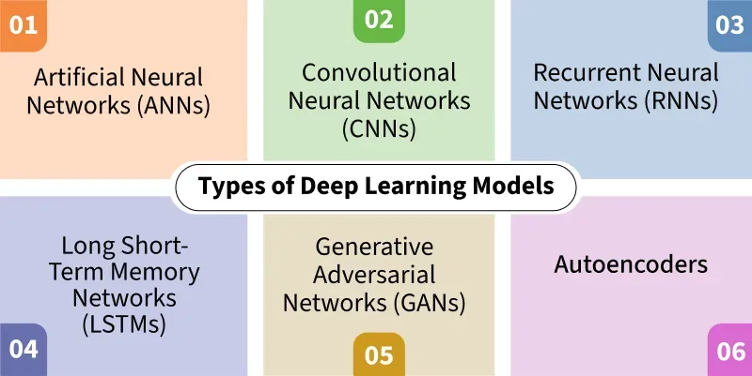

Slide 13
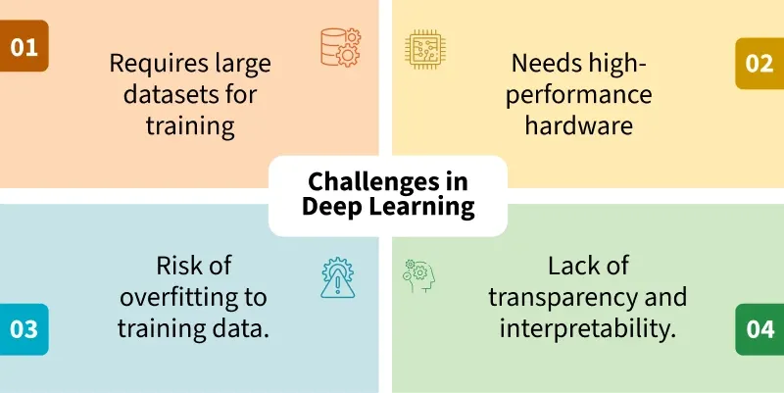

Slide 14
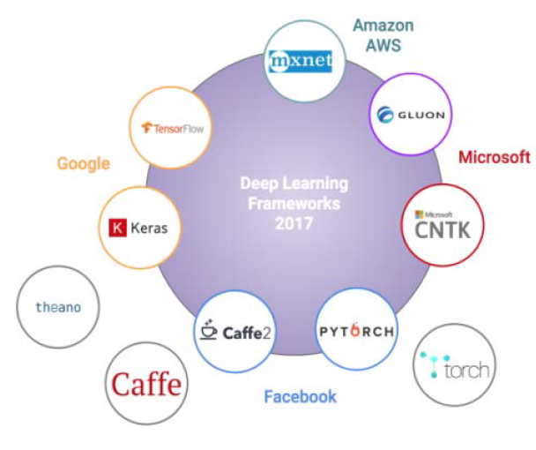

Slide 15
Introduction to Neural Networks
Neural Networks are fundamentals of deep learning inspired by human brain.
It consists of layers of interconnected nodes or "neurons" each designed to perform specific calculations.
These nodes receive input data, process it through various mathematical functions and pass the output to subsequent layers

Slide 16
History of Neural Network
1943: Warren S. McCulloch and Walter Pitts’s work ““A logical calculus of the ideas immanent in nervous activity ”,deals with cell and their connectivity in brain.
1958: Frank Rosenblatt’s work “The Perceptron: A Probabilistic Model for Information Storage and Organization in the Brain” introduced weight sum concept
1974: Paul Werbos’s work on backpropagation made the learning possible
1989: Yann LeCun’s implemented Hand written zip code recognition for US postal using neural network LeNet

Slide 17
What is a Neural Network?
Neural networks are machine learning models that mimic the complex functions of the human brain.
These models consist of interconnected nodes or neurons that process data, learn patterns and enable tasks such as pattern recognition and decision-making.

Slide 18
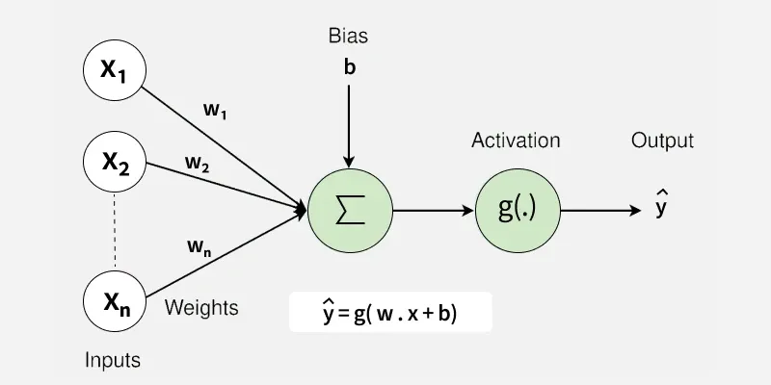

Slide 19
Neural networks are capable of learning and identifying patterns directly from data without pre-defined rules. These networks are built from several key components:
Neurons: The basic units that receive inputs, each neuron is governed by a threshold and an activation function.
Connections: Links between neurons that carry information, regulated by weights and biases.
Weights and Biases: These parameters determine the strength and influence of connections.
Propagation Functions: Mechanisms that help process and transfer data across layers of neurons.
Learning Rule: The method that adjusts weights and biases over time to improve accuracy.

Slide 20
Learning in neural networks follows a structured, three-stage process:
Input Computation: Data is fed into the network.
Output Generation: Based on the current parameters, the network generates an output.
Iterative Refinement: The network refines its output by adjusting weights and biases, gradually improving its performance on diverse tasks.

Slide 21
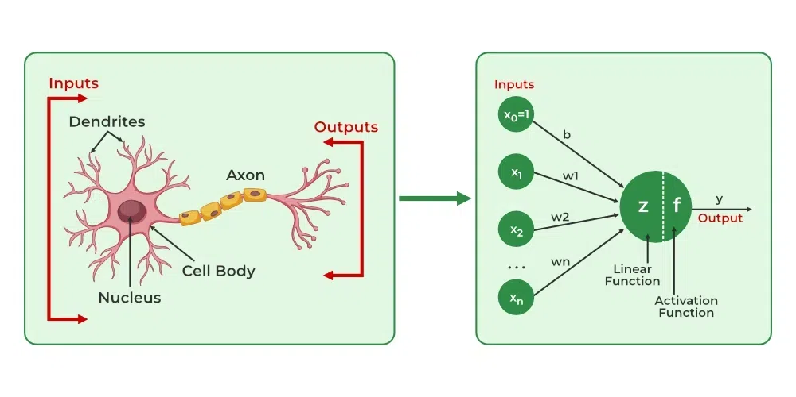

Slide 22
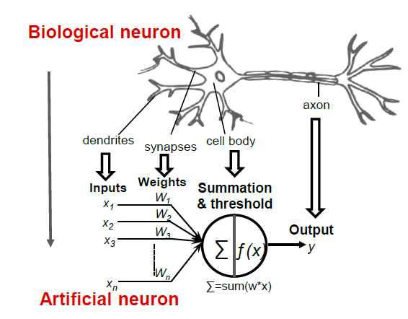
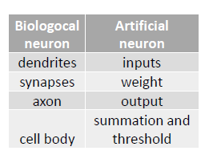
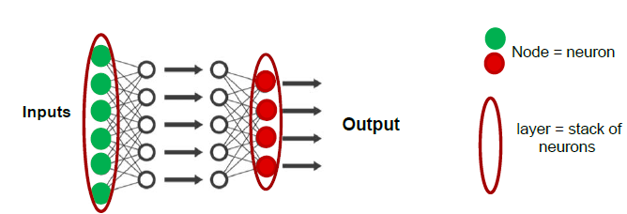

Slide 23
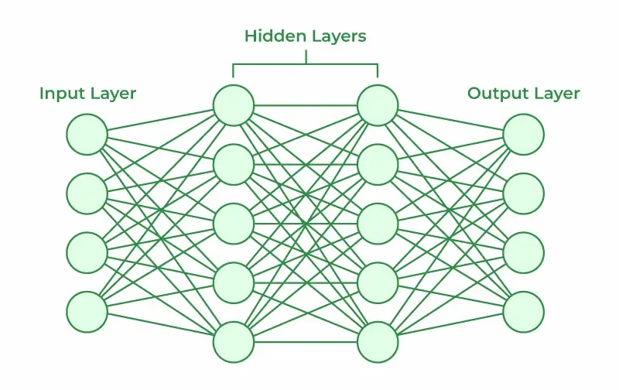
Layers in Neural Network Architecture

Slide 24
Working of Neural Networks
1. Forward Propagation
When data is input into the network, it passes through the network in the forward direction, from the input layer through the hidden layers to the output layer.
This process is known as forward propagation. Here’s what happens during this phase:
1. Linear Transformation: Each neuron in a layer receives inputs which are multiplied by the weights associated with the connections.
These products are summed together and a bias is added to the sum. This can be represented mathematically as:

Slide 25
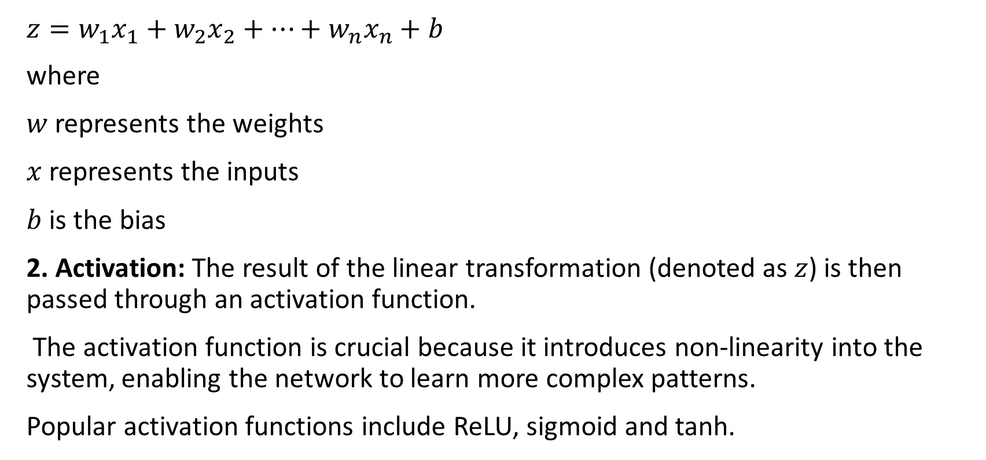
$z=w_{1}x_{1}+w_{2}x_{2}+…+w_{n}x_{n}+b$
where
$w$ represents the weights
$x$ represents the inputs
$b$ is the bias
2. Activation: The result of the linear transformation (denoted as $z$) is then passed through an activation function.
The activation function is crucial because it introduces non-linearity into the system, enabling the network to learn more complex patterns.
Popular activation functions include ReLU, sigmoid and tanh.

Slide 26
2. Backpropagation
After forward propagation, the network evaluates its performance using a loss function which measures the difference between the actual output and the predicted output. The goal of training is to minimize this loss. This is where backpropagation comes into play:
Loss Calculation: The network calculates the loss which provides a measure of error in the predictions.
The loss function could vary; common choices are mean squared error for regression tasks or cross-entropy loss for classification.
Gradient Calculation: The network computes the gradients of the loss function with respect to each weight and bias in the network.
This involves applying the chain rule of calculus to find out how much each part of the output error can be attributed to each weight and bias.

Slide 27
Weight Update: Once the gradients are calculated, the weights and biases are updated using an optimization algorithm like stochastic gradient descent (SGD).
The weights are adjusted in the opposite direction of the gradient to minimize the loss. The size of the step taken in each update is determined by the learning rate.
3. Iteration
This process of forward propagation, loss calculation, backpropagation and weight update is repeated for many iterations over the dataset. Over time, this iterative process reduces the loss and the network's predictions become more accurate.

Slide 28
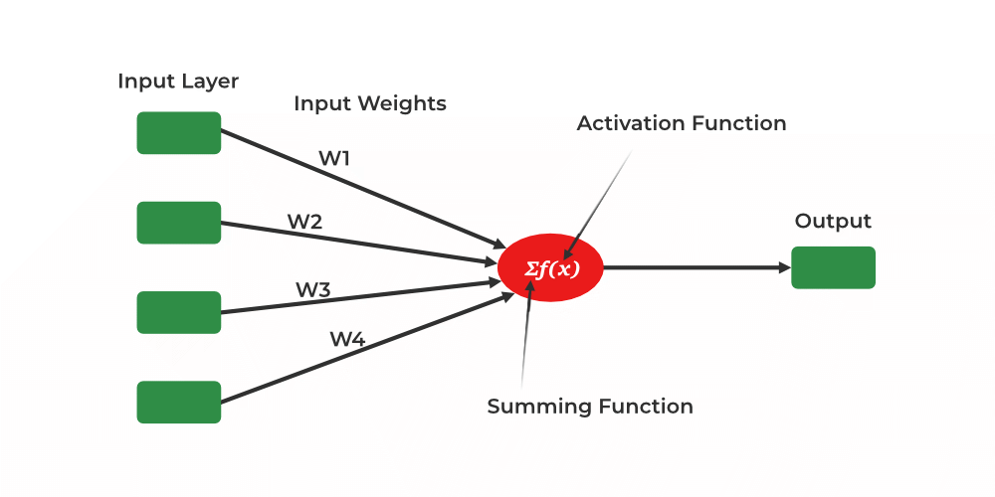
Single Layer Perceptron

Slide 29
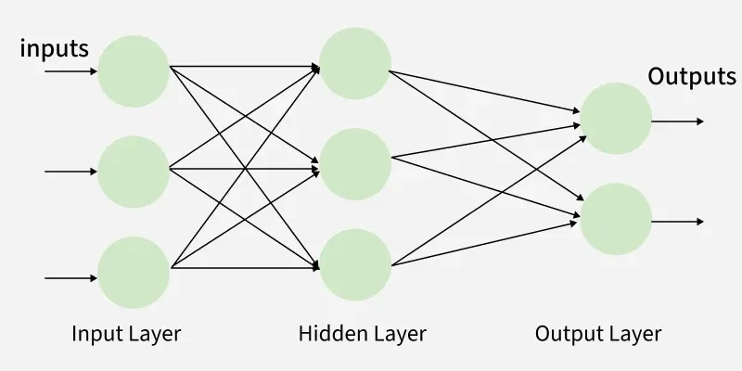
Multi-Layer Perceptron

Slide 30
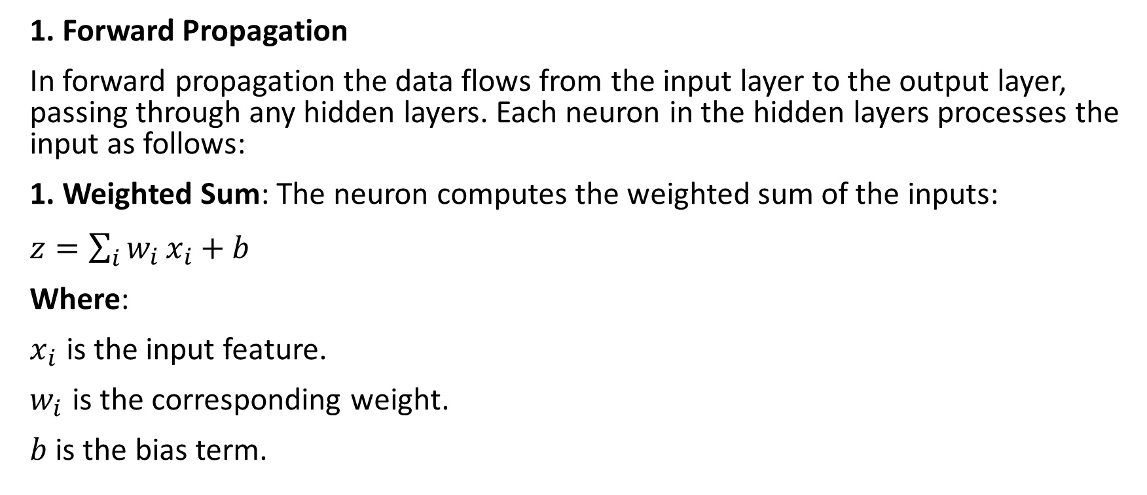
Working of Multi-Layer Perceptron
1. Forward Propagation
In forward propagation the data flows from the input layer to the output layer, passing through any hidden layers. Each neuron in the hidden layers processes the input as follows:
1. Weighted Sum: The neuron computes the weighted sum of the inputs:
$z=\sum_{i}{w_{i}}x_{i}+b$
Where:
$x_{i}$​ is the input feature.
$w_{i}$​ is the corresponding weight.
$b$ is the bias term.

Slide 31
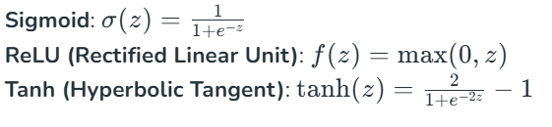
2. Activation Function: The weighted sum z is passed through an activation function to introduce non-linearity. Common activation functions include:

Slide 32

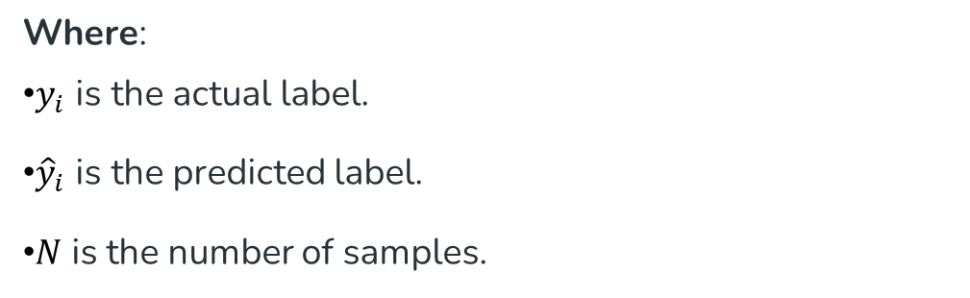
2. Loss Function
Once the network generates an output the next step is to calculate the loss using a loss function. In supervised learning this compares the predicted output to the actual label.
For a classification problem the commonly used binary cross-entropy loss function is:
Where:
$y_{i}$ is the actual label.
${\hat{y}}_{i}$ is the predicted label.
$N$ is the number of samples.

Slide 33

MSE

Slide 34
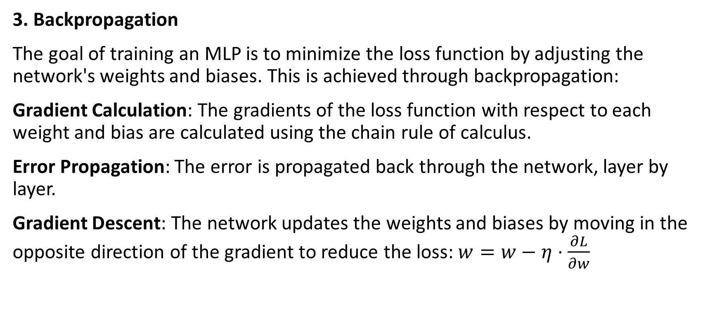
3. Backpropagation
The goal of training an MLP is to minimize the loss function by adjusting the network's weights and biases. This is achieved through backpropagation:
Gradient Calculation: The gradients of the loss function with respect to each weight and bias are calculated using the chain rule of calculus.
Error Propagation: The error is propagated back through the network, layer by layer.
Gradient Descent: The network updates the weights and biases by moving in the opposite direction of the gradient to reduce the loss: $w=w−η⋅\frac{∂L}{∂w}$

Slide 35

Where:
$w$ is the weight.
$η$ is the learning rate.
$\frac{∂L}{∂w}\text{​}$ is the gradient of the loss function with respect to the weight.

Slide 36
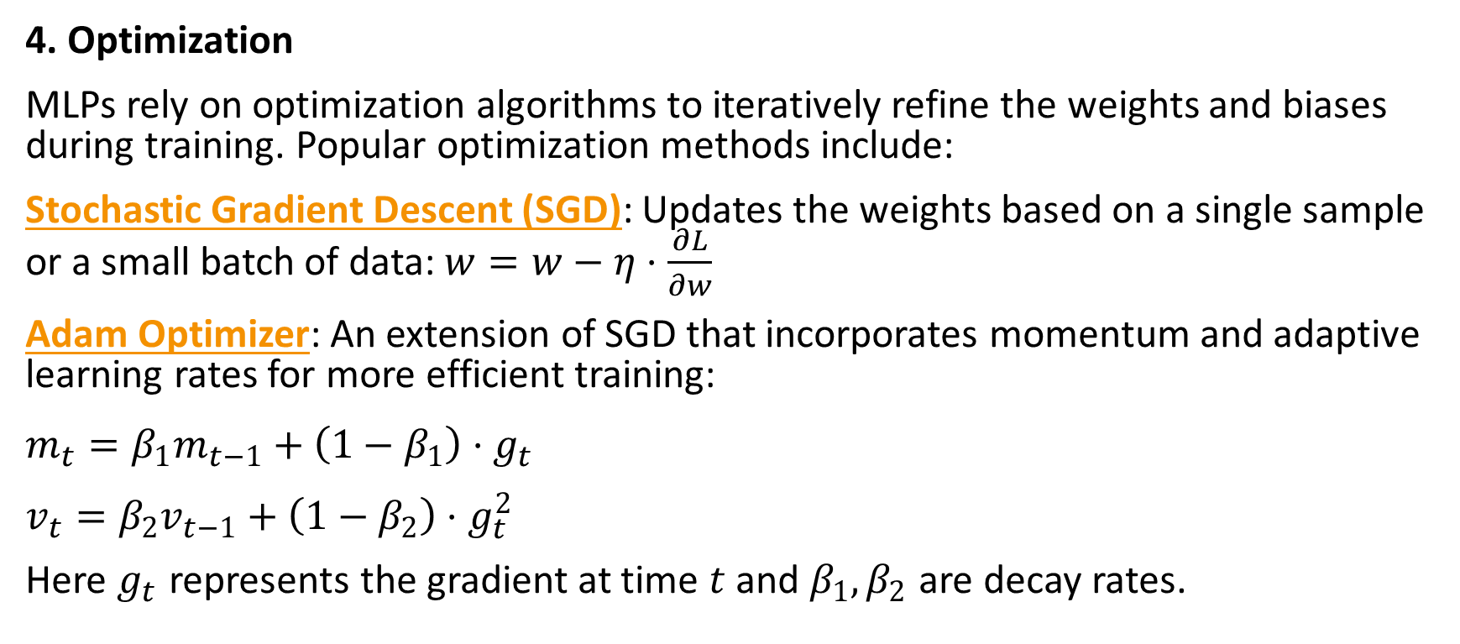
4. Optimization
MLPs rely on optimization algorithms to iteratively refine the weights and biases during training. Popular optimization methods include:
Stochastic Gradient Descent (SGD): Updates the weights based on a single sample or a small batch of data: $w=w−η⋅\frac{∂L}{∂w}$
Adam Optimizer: An extension of SGD that incorporates momentum and adaptive learning rates for more efficient training:
$m_{t}=β_{1}m_{t−1}+\left(1−β_{1}\right)⋅g_{t}$
$v_{t}=β_{2}v_{t−1}+\left(1−β_{2}\right)⋅g_{t}^{2}$
Here $g_{t}$​ represents the gradient at time $t$ and $β_{1},β_{2}$ are decay rates.

Slide 37
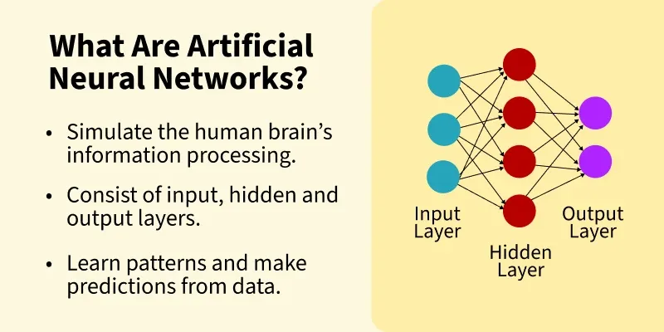
Artificial Neural Networks

Slide 38
Common Activation Functions in ANNs
Activation functions are important in neural networks because they introduce non-linearity and helps the network to learn complex patterns. Lets see some common activation functions used in ANNs:
Sigmoid Function: Outputs values between 0 and 1. It is used in binary classification tasks like deciding if an image is a cat or not.
ReLU (Rectified Linear Unit): A popular choice for hidden layers, it returns the input if positive and zero otherwise. It helps to solve the vanishing gradient problem.
Tanh (Hyperbolic Tangent): Similar to sigmoid but outputs values between -1 and 1. It is used in hidden layers when a broader range of outputs is needed.
Softmax: Converts raw outputs into probabilities used in the final layer of a network for multi-class classification tasks.
Leaky ReLU: A variant of ReLU that allows small negative values for inputs helps in preventing “dead neurons” during training.

Slide 39
Types of Artificial Neural Networks
1. Feedforward Neural Network (FNN)
Feedforward Neural Networks are one of the simplest types of ANNs.
In this network, data flows in one direction from the input layer to the output layer, passing through one or more hidden layers.
There are no loops or cycles means the data doesn’t return to any earlier layers.
This type of network does not use backpropagation and is mainly used for basic classification and regression tasks.

Slide 40
Types of Artificial Neural Networks
2. Convolutional Neural Network (CNN)
Convolutional Neural Networks (CNNs) are designed to process data that has a grid-like structure such as images.
It include convolutional layers that apply filters to extract important features from the data such as edges or textures.
This makes CNNs effective in image and speech recognition as they can identify patterns and structures in complex data.

Slide 41
Types of Artificial Neural Networks
3. Radial Basis Function Network (RBFN)
Radial Basis Function Networks are designed to work with data that can be modeled in a radial or circular way.
These networks consist of two layers: one that maps input to radial basis functions and another that finds the output.
They are used for classification and regression tasks especially when the data represents an underlying pattern or trend.

Slide 42
Types of Artificial Neural Networks
4. Recurrent Neural Network (RNN)
Recurrent Neural Networks are designed to handle sequential data such as time-series or text.
Unlike other networks, RNNs have feedback loops that allow information to be passed back into previous layers, giving the network memory.
This feature helps RNNs to make predictions based on the context provided by previous data helps in making them ideal for tasks like speech recognition, language modeling and forecasting.

Slide 43
Optimization Algorithms in ANN Training
Optimization algorithms adjust the weights of a neural network during training to minimize errors. The goal is to make the network’s predictions more accurate. Lets see key algorithms:
Gradient Descent: Most basic optimization algorithm that updates weights by calculating the gradient of the loss function.
Adam (Adaptive Moment Estimation): An efficient version of gradient descent that adapts learning rates for each weight used in deep learning.
RMSprop: A variation of gradient descent that adjusts the learning rate based on the average of recent gradients, it is useful in training recurrent neural networks (RNNs).
Stochastic Gradient Descent (SGD): Updates weights using one sample at a time helps in making it faster but more noisy.

Slide 44
Activation Function
expressed mathematically
Should differentiable
should easily calculate with spare computing power
Types: Step function, Linear function and nonlinear function(S shaped, hyperbolic tangents)

Slide 45
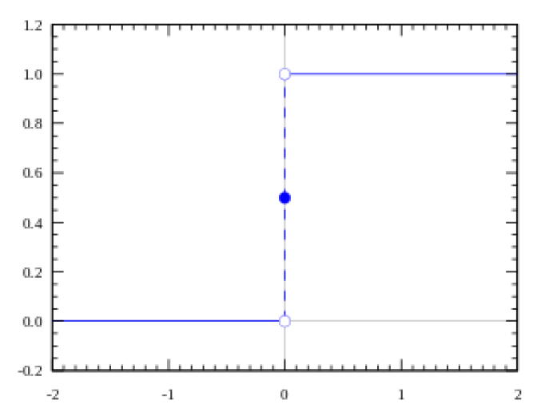

Step function
Step function: decision(firing of neuron) based on certain threshold value (activated if above else not activated)
linear separable problems, such as XOR gate, AND gate(binary class)
The zero gradients are the major problem

Slide 46

Linear Activation Function
The value of “a” varies with 1
Where “a” is the proportional input activation
Many and various neurons can be activated at the same time using linear activation
For multiple classes(we choose maximum)
It gives constant derivative function in all situations
At output layer can be used for regression problem

Slide 47
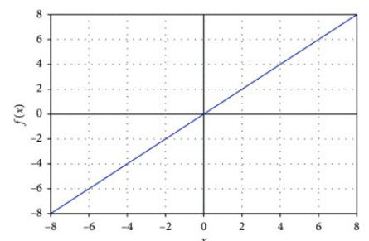
Linear Activation Function

Slide 48
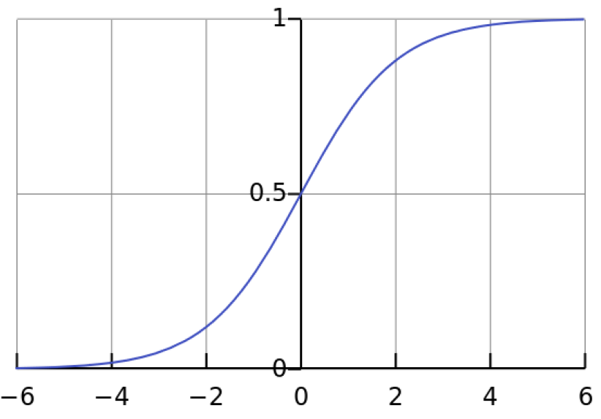

Non Linear- "S"-shaped Activation Functions
activation functions are not linear
the range of the function is between 0-1
Sigmoid Function-has a smooth gradient value
Also called Logistic function

Slide 49
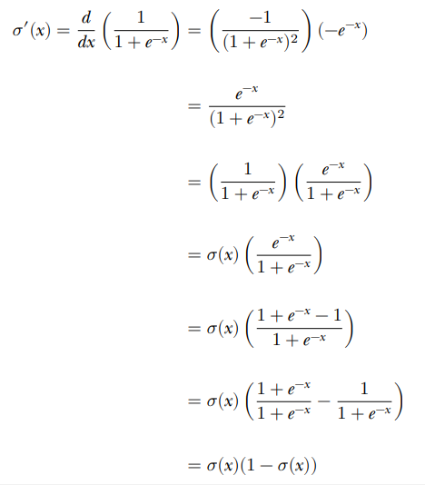

The derivative of the sigmoid

Slide 50
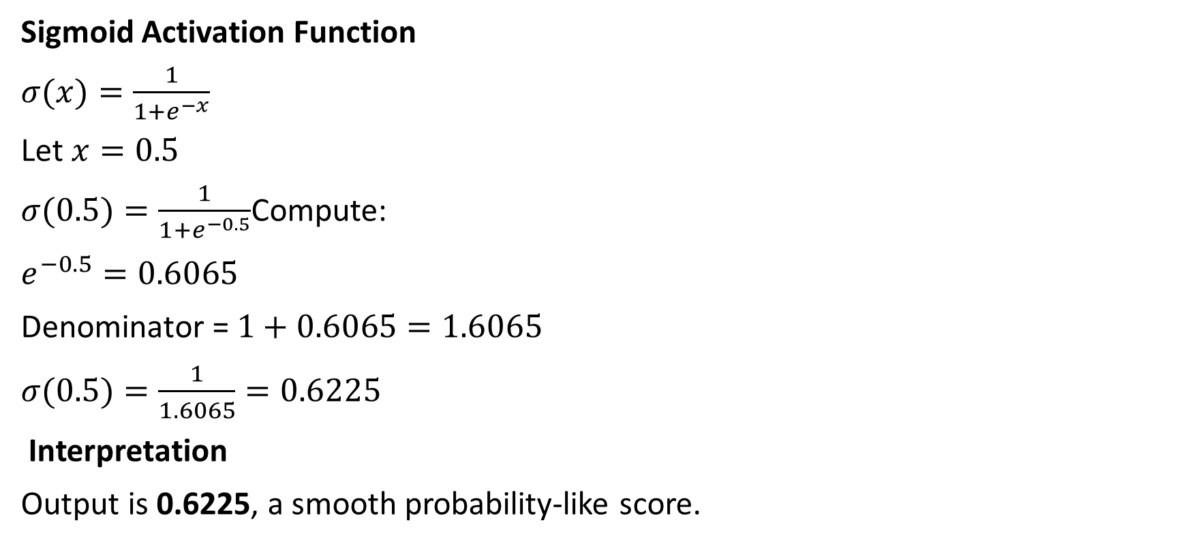
Example
Sigmoid Activation Function
$σ(x)=\frac{1}{1+e^{−x}}$
Let $x=0.5$
$σ(0.5)=\frac{1}{1+e^{−0.5}}$Compute:
$e^{−0.5}=0.6065$
Denominator = $1+0.6065=1.6065$
$σ(0.5)=\frac{1}{1.6065}=0.6225$
Interpretation
Output is 0.6225, a smooth probability-like score.

Slide 51

tanh function
output values range between −1 and 1
Like sigmoid functions
negative inputs of the hyperbolic functions will be mapped to a negative output
nearing zero will also be mapped to output values nearing zero
the network is not stuck due to the above features during training

Slide 52
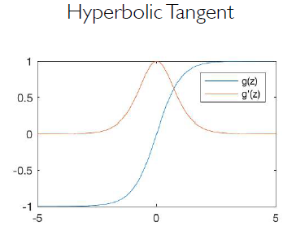
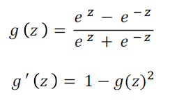
Derivative of Tanh

Slide 53
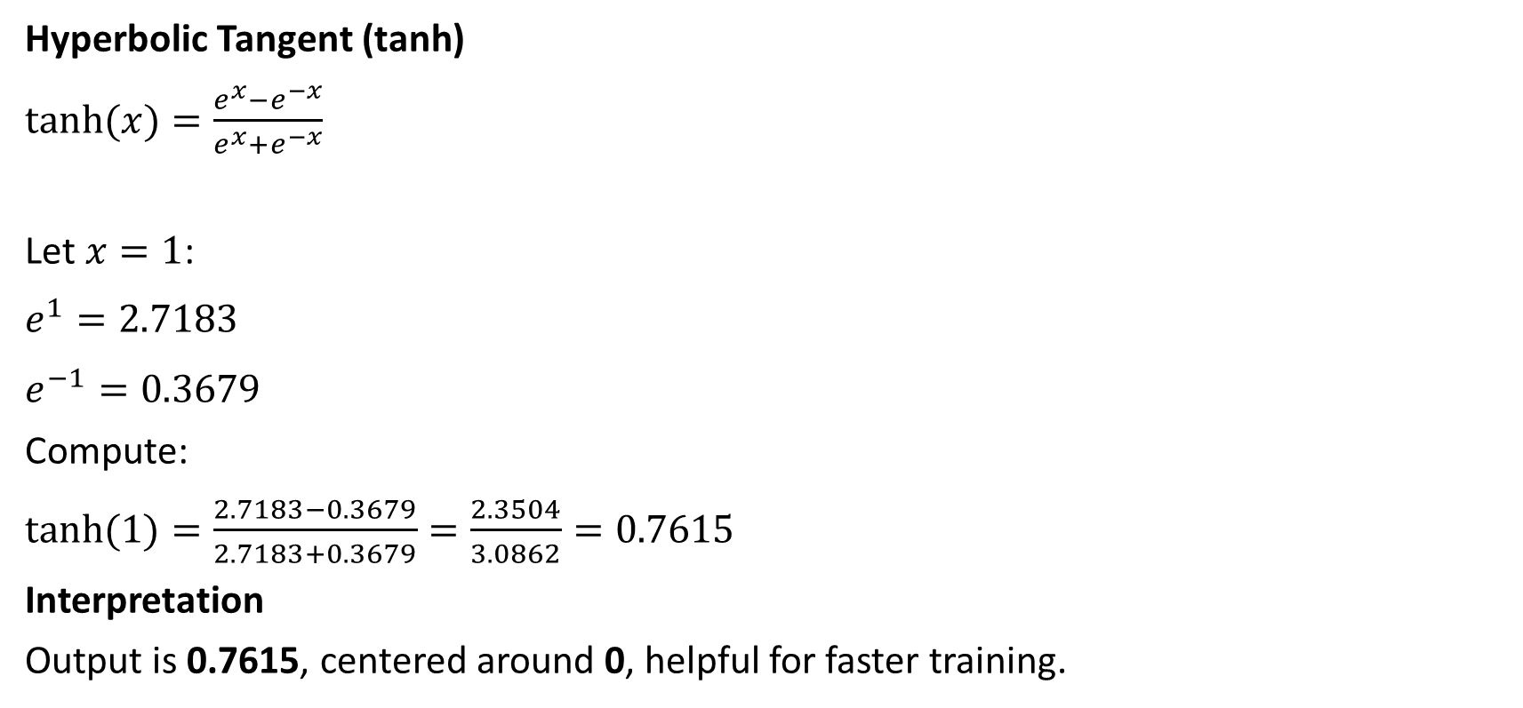
Example
Hyperbolic Tangent (tanh)
$tanh⁡(x)=\frac{e^{x}−e^{−x}}{e^{x}+e^{−x}}$
Let $x=1$:
$e^{1}=2.7183$
$e^{−1}=0.3679$
Compute:
$tanh⁡(1)=\frac{2.7183−0.3679}{2.7183+0.3679}=\frac{2.3504}{3.0862}=0.7615$
Interpretation
Output is 0.7615, centered around 0, helpful for faster training.

Slide 54
Rectified Linear Unit Activation Functions
transforming the weighted input to the strict output or proportional sum
piecewise linear functions that usually output the positive input directly, otherwise it the output is zero

Slide 55

Basic Rectified Linear Unit (ReLU)
also known as a ramp function and is analogous to half-wave rectification in electrical engineering
enabling the more efficient training of deeper networks, compared to the commonly-used activation functions

Slide 56
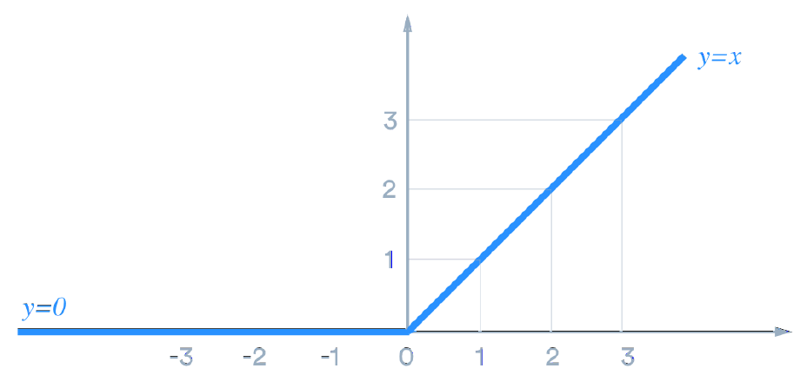

Slide 57


The derivative of ReLU

Slide 58
Dying ReLU Problem
ReLU has a significant problem known as “dying ReLU”
neutral network with weights distribution in the form of a low-variance Gaussian centered at + 0.1
by this condition, most inputs are positive and cause ReLU node to fire
During a particular backpropagation, large magnitude of gradient passing back to nodes
Possibilities of moving of the distribution a low variance Gaussian centered at −0.1

Slide 59
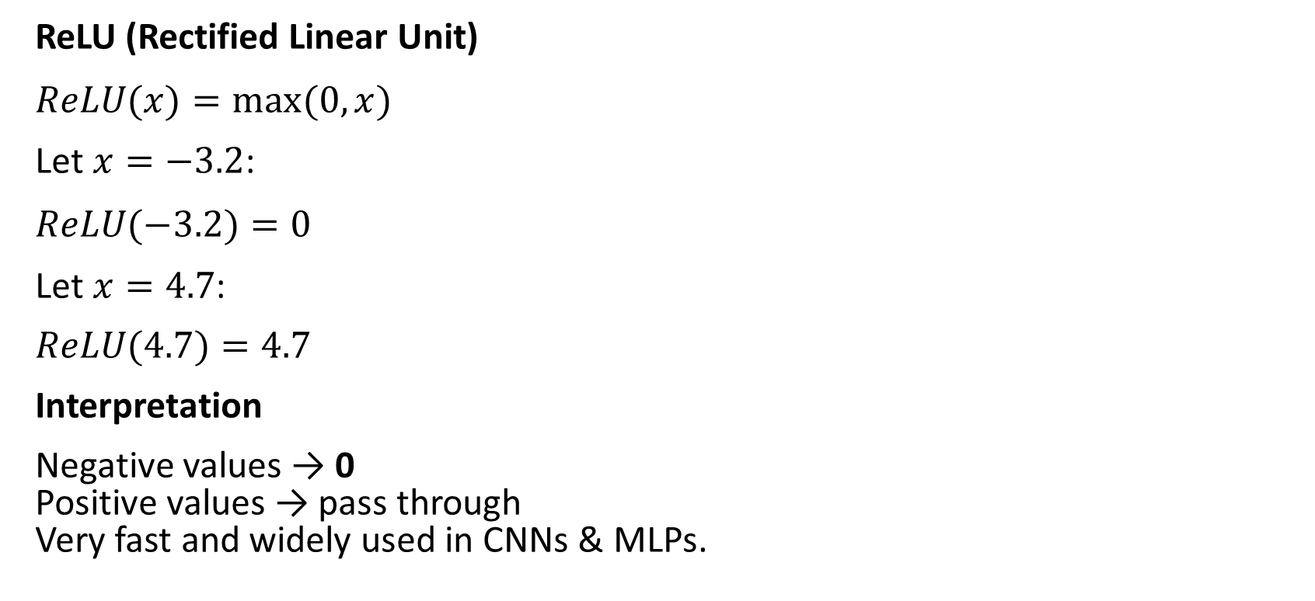
Example
ReLU (Rectified Linear Unit)
$ReLU(x)=max⁡(0,x)$
Let $x=−3.2$:
$ReLU(−3.2)=0$
Let $x=4.7$:
$ReLU(4.7)=4.7$
Interpretation
Negative values → 0 Positive values → pass through Very fast and widely used in CNNs & MLPs.

Slide 60

Leaky ReLU
All the inputs are negative, making the neuron inactive, omitting the weight updates during backpropagation
How to by pass this: Leaky ReLU
To achieve this, a small multiplier α , e.g., 0.01

Slide 61
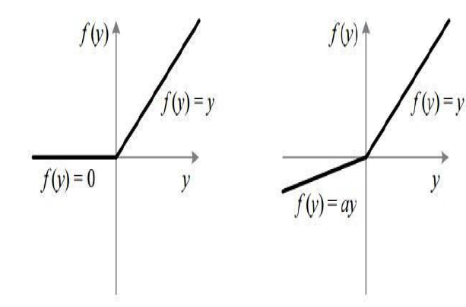


Slide 62
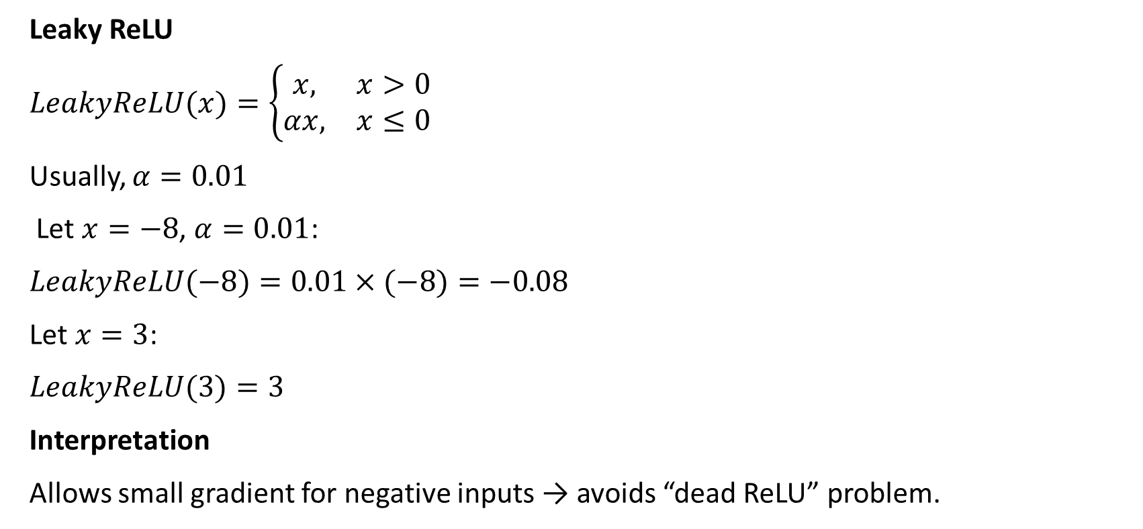
Example
Leaky ReLU
$LeakyReLU(x)=\left\{\begin{matrix}x, & x>0 \\ αx, & x≤0\end{matrix}\right.$
Usually, $α=0.01$
Let $x=−8$, $α=0.01$:
$LeakyReLU(−8)=0.01×(−8)=−0.08$
Let $x=3$:
$LeakyReLU(3)=3$
Interpretation
Allows small gradient for negative inputs → avoids “dead ReLU” problem.

Slide 63

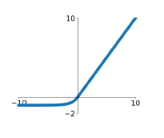

EXPONENTIAL LINEAR UNITS (ELUS)

Slide 64
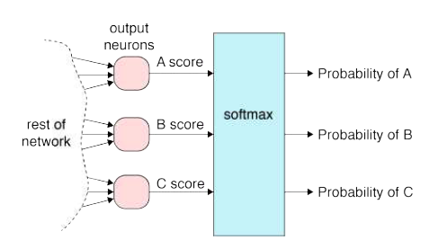
softmax function
The softmax function is a function that turns a vector of K real values into a vector of K real values that sum to 1
is normally used to convert from real-valued activations to class likelihoods
the softmax transforms them into values between 0 and 1, so that they can be interpreted as probabilities.

Slide 65
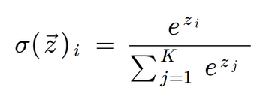
Softmax
zi values are the elements of the input vector and can take any real value.
K The number of classes in the multi-class classifier.

Slide 66
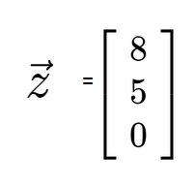
Example:Calculating the Softmax
Given
Compute sofmax output

Slide 67
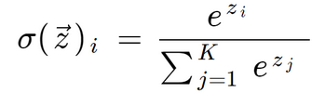
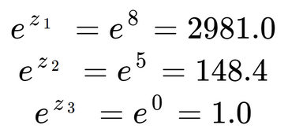
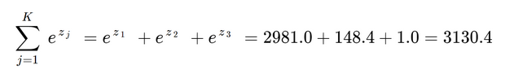
Example: Calculating the Softmax
Given

Slide 68
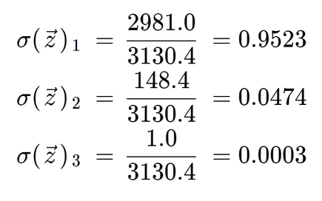

Slide 69
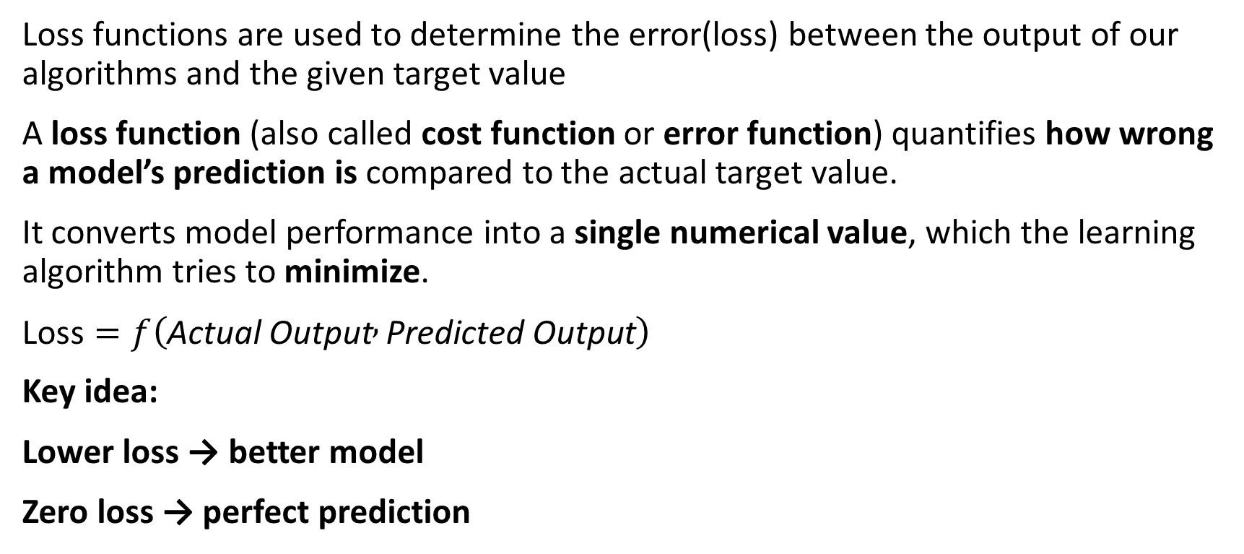
Loss /Error Function
Loss functions are used to determine the error(loss) between the output of our algorithms and the given target value
A loss function (also called cost function or error function) quantifies how wrong a model’s prediction is compared to the actual target value.
It converts model performance into a single numerical value, which the learning algorithm tries to minimize.
$\text{Loss}=f\left(\text{Actual} \text{Output} , \text{Predicted} \text{Output}\right)$
Key idea:
Lower loss → better model
Zero loss → perfect prediction

Slide 70
Why Loss Function is Needed in Deep Learning
A neural network cannot learn directly from accuracy. It learns by adjusting weights using gradients, which require a continuous, differentiable function.
Loss function provides:
Direction of error
Magnitude of error
Mathematical basis for backpropagation
Without a loss function:
No gradient
No weight update
No learning

Slide 71
Loss Function vs Activation Function
Aspect | Activation Function | Loss Function
Purpose | Introduce non-linearity | Measure prediction error
Applied at | Each neuron | Output layer
Depends on | Input signal | Prediction + target
Used in | Forward pass | Forward + backward pass

Slide 72


For a dataset with $n$samples:
where:
$θ$→ model parameters (weights, bias)
$L$→ loss function

Slide 73
Classification of Loss Functions
Loss functions are chosen based on the problem type:
Regression Loss Functions
Classification Loss Functions
Margin-based Loss Functions
Probabilistic / Information-Theoretic Losses

Slide 74


Regression Loss Functions (Continuous Output)
Mean Squared Error (MSE)
🔹 Penalizes large errors more heavily 🔹 Smooth and differentiable 🔹 Sensitive to outliers
Gradient:
$\frac{∂L}{∂\hat{y}}=−2\left(y−\hat{y}\right)$
Used in:
House price prediction
Temperature forecasting
Function approximation

Slide 75

Mean Absolute Error (MAE)
$\text{MAE}=\frac{1}{n}\sum{∣}y−\hat{y}∣$
🔹 Treats all errors equally 🔹 Robust to outliers 🔹 Not differentiable at zero
Used when:
Outliers should not dominate learning

Slide 76
Huber Loss (Hybrid)
Combines MSE + MAE:
Quadratic for small errors
Linear for large errors
Used in robust regression

Slide 77

Classification Loss Functions
Binary Cross-Entropy (Log Loss)
Used for binary classification.
L=−[ylog(p)+(1−y)log(1−p)]
Where:
$y∈\left\{0 , 1\right\}$
$p$= predicted probability
🔹 Penalizes confident wrong predictions heavily 🔹 Works naturally with sigmoid activation
Used in:
Spam detection
Disease diagnosis
Fraud detection

Slide 78

Categorical Cross-Entropy
Used for multi-class classification (one-hot labels).
🔹 Only the true class contributes to loss 🔹 Used with softmax activation
Used in:
Image classification
Object recognition
NLP intent classification

Slide 79
Sparse Categorical Cross-Entropy
Same as categorical CE but:
Labels are integers instead of one-hot vectors
Memory-efficient for large-class problems

Slide 80
Margin-Based Loss Functions
Hinge Loss (SVM-inspired)
🔹 Encourages correct classification with margin 🔹 Used in max-margin classifiers
L=max(0,1−yy^​)
Not probabilistic

Slide 81

Probabilistic & Information-Theoretic Losses
Kullback–Leibler (KL) Divergence
$D_{KL}\left(P∥Q\right)=\sum{P}\left(x\right)\log{\frac{P\left(x\right)}{Q\left(x\right)}}$
🔹 Measures distance between two probability distributions 🔹 Not symmetric
Used in:
Variational Autoencoders
Knowledge distillation

Slide 83

Loss Function and Backpropagation
Loss function provides the starting point for backpropagation.
Flow:
Forward pass → compute prediction
Compute loss
Compute gradient of loss w.r.t output
Chain rule propagates gradient backward
Weights updated using gradient descent
$w=w−η\frac{∂L}{∂w}$

Slide 84
Loss vs Cost Function
Loss → error for one sample
Cost → average loss over dataset

Slide 85
Choosing the Right Loss Function
Problem Type | Output | Loss Function
Linear regression | Continuous | MSE / MAE
Binary classification | Probability | Binary Cross-Entropy
Multi-class | Class probabilities | Softmax + CCE
Imbalanced data | Binary | Weighted BCE / Focal Loss
Representation learning | Distributions | KL Divergence

Slide 86


Slide 87

Example
Mean Squared Error
Actual values: $y=\left[2 , 4 , 6\right]$ Predicted values: $\hat{y}=\left[3 , 5 , 4\right]$
Solution
$\begin{matrix}\text{MSE} & =\frac{\left(2−3{\left.)\right.}^{2}+\left(4−5{\left.)\right.}^{2}+\left(6−4{\left.)\right.}^{2}\right.\right.\right.}{3} \\ & =\frac{1+1+4}{3} \\ & =\boxed{2}\end{matrix}$

Slide 88

Example
Mean Absolute Error
$y=\left[10,20,30\right], \hat{y}=$[12,18,33]
$\text{MAE}=\frac{∣10−12∣+∣20−18∣+∣30−33∣}{3}=\frac{2+2+3}{3}=\boxed{2.33}$

Slide 89

Example
Binary Cross-Entropy
Given 4 samples:
(y , p)=(1,0.9),(0,0.7),(1,0.2),(0,0.1)
Compute average BCE (natural log).
Solution BCE per sample:
BCE per sample: 𝐿=−[𝑦ln⁡𝑝+(1−𝑦)ln⁡(1−𝑝)]
𝐿1=−ln⁡(0.9)=0.1053 y=1, p=0.9:
𝐿2=−ln⁡(0.3)=1.2040 y=0,p=0.7:
𝐿3=−ln⁡(0.2)=1.6094 y=1,p=0.2:
𝐿4=−ln⁡(0.9)=0.1053 y=0, p=0.1:
Average:
$\overset{ˉ}{L}=\frac{0.1053+1.2040+1.6094+0.1053}{4}=\frac{3.024}{4}=\boxed{0.756}$

Slide 90


Example
Direct CCE (one-hot)
$y=$[0,1,0,0]
P=[0.10,0.60,0.20,0.10]

Slide 91

Example
Direct CCE (soft labels)

Slide 92

Example
Batch CCE (average loss)
3 samples, each has 4 classes (true class index shown):
S1 true=2, $p=$ [0.1,0.5,0.2,0.2]
S2 true=4, $p=$ [0.2,0.1,0.1,0.6]
S3 true=1, $p=$ [0.7,0.1,0.1,0.1]
Losses:
Average:
$\overset{ˉ}{L}=\frac{0.693+0.511+0.357}{3}=\boxed{0.520}$

Slide 93

Example
Softmax + CCE from logits

Slide 94

Example
Categorical Cross-Entropy (Tough: softmax from logits)
Logits z=[1.2,0.3,-0.7,2.0]
True class = class 4 (one-hot $y=[0,0,0,1]$ Compute Softmax probs and Cross-Entropy loss.
Solution
$e^{1.2}=3.320$
$e^{0.3}=1.350$
$e^{−0.7}=0.497$
$e^{2.0}=7.389$
Sum $S=3.320+1.350+0.497+7.389=12.556$
Softmax:
$p_{4}=\frac{7.389}{12.556}=0.5886$
Cross-entropy (only true class):

Slide 95

Example
Hinge Loss
For binary labels $y∈(−1,+1)$and score $\hat{y}$
Samples:
$y=+1,\hat{y}=0.2$
$y=+1,\hat{y}=1.4$
$y=−1,\hat{y}=−0.3$
$y=−1,\hat{y}=0.6$
Compute average hinge loss.

Slide 96

Example
L=max(0,1−yy^​)
$1−\left(+1\right)\left(0.2\right)=0.8⇒L_{1}=0.8$
$1−\left(+1\right)\left(1.4\right)=−0.4⇒L_{2}=0$
$1−\left(−1\right)\left(−0.3\right)=1−0.3=0.7⇒L_{3}=0.7$
$1−\left(−1\right)\left(0.6\right)=1+0.6=1.6⇒L_{4}=1.6$
Average:
$\overset{ˉ}{L}=\frac{0.8+0+0.7+1.6}{4}=\frac{3.1}{4}=\boxed{0.775}$

Slide 97

Example
KL Divergence
True distribution $P$and predicted $Q$:
$P=$ [0.50,0.25,0.15,0.10]
Q=[0.40,0.30,0.20,0.10]
Compute $D_{KL}\left(P∥Q\right)=\sum{p_{i}}\ln{\frac{p_{i}}{q_{i}}}$

Slide 98


Term-wise:
Sum:
$D_{KL}=0.1116−0.0456−0.0432+0=\boxed{0.0228}$
Small KL → predicted distribution close to true distribution.

Slide 99
Back Propagation
For a neural network, the vector input is the weights and biases, the parameters that define how the network performs
Back propagation is the algorithm that tells us what 𝜕L/𝜕w is for each weight and bias of the network
Our goal is to move through the space that the loss function defines to find the minimum
Symbolically, can write the loss function as L(𝛉), where 𝛉 (theta) is a vector of all the weights and biases in the network
Back propagation is the algorithm that finds the contribution of each weight and bias value to the network’s error, the 𝜕L/𝜕w’s.

Slide 100

Back propagation by Hand
simple neural network
the network with its six weights, w0 through w5 , and three bias values, b0 , b1 , and b2 . Each value is a scalar
sigmoid activation functions only in the hidden layer
squared-error loss function
where y is the label with value zero or one
the input associated with y, namely x0 and x1 .

Slide 101


A forward pass with this network
Notice that a₂ has no activation function

Slide 102
loss function
𝛉 represents the weights and biases; variables
after the semicolon are constants i.e (x0 , x1 ) & y
Find gradient of the loss function, ∇L(𝛉; x,y).
for all weights and biases: nine partial derivatives in total.

Slide 103


find expressions for w5 , w4 , and b2 for a2
Remember the chain rule!
If a = f(b) and b = g(c),
so that a = f(g(c)),
then da/dc = da/db · db/dc

Slide 104

similarly

Slide 105


The expressions for b1 , w1 , and w3

Slide 106

A similar calculation for Bias

Slide 107


Back propagation with regularizer
Adding a regularizer to the cost function
Lamda is a hyperparameter

Slide 108
In backpropagation, a regularizer in the loss function is used to control model complexity and prevent overfitting by penalizing large or unnecessary weights during training.
Why regularization is needed
During backpropagation, the network updates weights to minimize the loss. Without regularization:
Weights may grow very large
The model may memorize training data
Generalization to unseen data becomes poor (overfitting)
Regularization adds a penalty term to the loss so the model prefers simpler solutions.

Slide 109

How it affects backpropagation
During backpropagation, gradients are computed for both terms:
$\frac{∂}{∂w}\left(\text{Loss}+λR\left(w\right)\right)$
So weight updates become:
$w:=w−η\left(\frac{∂\text{Loss}}{∂w}+λ\frac{∂R\left(w\right)}{∂w}\right)$
This pushes weights toward smaller values, reducing overfitting.

Slide 110
Regularization
Overfitting Scenario
Training loss ↓
Validation loss ↑
Model memorizes noise instead of learning structure
Root Causes
Too many parameters
Small dataset
Noisy data
Deep architectures
Regularization acts as a penalty or constraint to control this behavior.

Slide 111

L2 Regularization (Weight Decay)
$R\left(w\right)=\frac{1}{2}\sum{w^{2}}$
Added loss
$L=L_{\text{data}}+λ\frac{1}{2}\sum{w^{2}}$
Effect
Penalizes large weights
Keeps all weights small (not zero)
Produces smooth decision boundaries
Used in: Most deep learning models

Slide 112

Gradient update:
$w←w−η\left(\frac{∂ℒ}{∂w}+λw\right)$

Slide 113

Regularized Loss Calculation
Given:
Weights: $w=\left[2 , − , 13\right]$
Original loss: $ℒ=5$
$λ=0.1$
Formula:
$ℒ_{reg}=ℒ+\frac{λ}{2}\sum{w^{2}}$
Solution:
$\sum{w^{2}}=2^{2}+\left(−1{\left.)\right.}^{2}+3^{2}=4+1+9=14\right.$
$ℒ_{reg}=5+\frac{0.1}{2}×14=5+0.7=\boxed{5.7}$

Slide 114

Weight Update with L2 Regularization
Given:
Gradient from data loss: $\frac{∂ℒ}{∂w}=4$
Current weight: $w=5$
Learning rate: $η=0.01$
$λ=0.1$
Gradient with L2:
$\frac{∂ℒ_{reg}}{∂w}=4+0.1\left(5\right)=4.5$
Update:
$w_{new}=5−0.01\left(4.5\right)=\boxed{4.955}$

Slide 115

L1 Regularization
$R\left(w\right)=\sum{∣}w∣$
Effect
Forces many weights to exactly zero
Performs feature selection
Creates sparse models
Used in: High-dimensional data

Slide 116

Effect on Gradients
$\frac{∂∣w∣}{∂w}=\left\{\begin{matrix}+1 & w>0 \\ −1 & w<0\end{matrix}\right.$

Slide 117

Regularized Loss with L1
Given:
Weights: $w=$[-2,0.5,1]
Original loss = 4
$λ=0.2$
Formula:
$ℒ_{reg}=ℒ+λ\sum{∣}w∣$
Solution:
$\sum{∣}w∣=2+0.5+1=3.5$
$ℒ_{reg}=4+0.2\left(3.5\right)=\boxed{4.7}$

Slide 118

Gradient with L1 Regularization
Given:
Weight $w=−3$
Learning rate $η=0.1$
Data gradient = 2
$λ=0.5$
Gradient of L1 term:
$\frac{∂∣w∣}{∂w}=−1$
Total gradient:
$2+\left(−0.5\right)=1.5$
Updated weight:
$w_{new}=−3−0.1\left(1.5\right)=\boxed{−3.15}$
Key Point: L1 pushes weights aggressively toward zero.

Slide 119

Elastic Net Regularization
$R\left(w\right)=α\sum{∣}w∣+\left(1−α\right)\frac{1}{2}\sum{w^{2}}$
Effect
Combines L1 + L2
Balances sparsity and stability
Used in: When features are correlated

Slide 120

Elastic Net Loss
Given:
Weights: $w=\left[1 , −2\right]$
Original loss = 3
$λ_{1}=0.1$, $λ_{2}=0.2$
Solution:
$\sum{∣}w∣=3, \sum{w^{2}}=5$
$ℒ_{reg}=3+0.1\left(3\right)+0.2\left(5\right)$
$=3+0.3+1=\boxed{4.3}$

Slide 121

Dropout Regularization
Randomly drops neurons during training.
$h_{i}=\left\{\begin{matrix}0 & \text{with} \text{probability} p \\ \frac{h_{i}}{1−p} & \text{otherwise}\end{matrix}\right.$
Effect
Prevents neuron co-adaptation
Acts like model averaging
Used in: Deep neural networks, CNNs

Slide 122

Dropout Scaling
Given:
Activation $h=10$
Dropout probability $p=0.5$
Neuron survives
Formula:
$h_{scaled}=\frac{h}{1−p}$
Solution:
$h_{scaled}=\frac{10}{0.5}=\boxed{20}$
Maintains expected activation value.

Slide 123
5. Early Stopping
Stop training when validation loss starts increasing.
Effect
Prevents overfitting
Saves computation
Used in: Practical ML pipelines
6. Data Augmentation
Create new training samples.
Examples:
Image rotation, flipping
Noise injection
Scaling
Effect
Improves generalization
Increases effective dataset size
Used in: CNNs, vision task

Slide 124
Identify Early Stopping Epoch
Answer: Validation loss increases after epoch 3 → Stop at epoch 3
Epoch | Train Loss | Val Loss
1 | 1.5 | 1.6
2 | 1.1 | 1.2
3 | 0.8 | 0.9
4 | 0.6 | 1.0
5 | 0.5 | 1.2

Slide 126

7. Max-Norm Regularization
$∥w∥_{2}≤c$
Effect
Restricts weight magnitude
Prevents exploding weights
Used in: RNNs, deep networks

Slide 127

8. Label Smoothing
Replace hard labels with soft labels.
Example:
$y=1⇒y=0.9, \text{others}=0.1$
Effect
Reduces overconfidence
Improves calibration
Used in: Classification, Transformers

Slide 128
9. Batch Normalization (Indirect Regularization)
Normalizes layer activations.
Effect
Adds noise during training
Improves stability
Acts as a regularizer
Used in: Deep CNNs Note: Not a direct loss penalty

Slide 129
Back Propagation
Adding a regularizer to the cost function
Lamda is a hyperparameter

Slide 130

expanding out the cost function in terms of w and b, compute the derivatives

Slide 132


Slide 134

Shallow and Deep Neural Network

Slide 135
Shallow network: Few layers, limited feature abstraction, suitable for simple problems.
Deep network: Many layers, hierarchical feature learning, powerful for complex data.
Shallow network Learns simple patterns directly from input → output. Example: linear or mildly non-linear decision boundaries.
Deep network Learns features of features:
Layer 1: edges / basic patterns
Layer 2: shapes / motifs
Layer 3+: objects / concepts
This hierarchy is why deep networks excel at images, speech, and text.

Slide 136

Mathematical view
Shallow
$y=f\left(W_{2}⋅g\left(W_{1}x+b_{1}\right)+b_{2}\right)$
Deep
$y=f\left(W_{n}⋅g_{n−1}\left(…g_{2}\left(W_{2}⋅g_{1}\left(W_{1}x\right)\right)\right)\right)$
Depth increases representational power without exploding width.

Slide 137
Typical use cases
Shallow Networks
Small datasets
Linear / low-complexity problems
Credit scoring (basic)
Simple regression / classification
Deep Networks
Image recognition (CNNs)
Speech recognition
NLP (Transformers)
Medical imaging
Autonomous driving

Slide 138
Training considerations
Shallow
Rarely suffers from vanishing gradients
Easy to tune
Deep
Needs:
ReLU / variants
Batch Normalization
Residual connections
Large datasets
GPUs/TPUs

Slide 139
Optimization
Optimization in deep learning is the process of adjusting model parameters (weights and biases) to minimize a loss function, thereby improving model performance on a task such as classification, regression, or generation.
Why Optimization Is Central to Deep Learning
Deep learning models:
Have millions of parameters
Use non-convex loss surfaces
Are trained on large, noisy datasets
Optimization determines:
How fast a model learns
Whether it converges at all
Whether it generalizes well or overfits

Slide 140
Optimization algorithms are responsible for reducing losses and provide most accurate results possible.
The weight is initialized using some initialization strategies and is updated with each epoch according to the equation.
The best results are achieved using some optimization strategies or algorithms called Optimizer.

Slide 141
The goal of Optimization in Deep learning
Although optimization may help deep learning by lowering the loss function, the aims of optimization and deep learning are fundamentally different.
The former is more focused on minimizing an objective, whereas the latter is more concerned with finding a good model given a finite quantity of data.
Training error and generalization error, for example, vary in that the optimization algorithm's objective function is usually a loss function based on the training dataset, and the purpose of optimization is to minimize training error.
Deep learning (or, to put it another way, statistical inference) aims to decrease generalization error.
In order to achieve the latter, we must be aware of overfitting as well as use the optimization procedure to lower the training error.

Slide 142

Generalization Error
Generalization error measures how well a deep learning model performs on unseen (new) data, compared to how well it performs on the training data.
Generalization Error=Expected Loss on Unseen Data−Training Loss
In practice, it is often estimated as:
$\text{Generalization} \text{Error}≈\text{Test} \text{Error}−\text{Training} \text{Error}$

Slide 143
Why Generalization Error Happens
Overfitting – model too complex
Small or biased datasets
Noise in training data
Too many parameters
Data leakage
Distribution shift between train and test data

Slide 144
Some of the techniques
· Gradient Descent
· Stochastic Gradient Descent (SGD)
· Mini-Batch Stochastic Gradient Descent (MB — SGD)
· SGD with Momentum
· Nesterov Accelerated Gradient (NAG)
· Adaptive Gradient (AdaGrad)
· AdaDelta
· RMSProp
· Adam
· Nadam

Slide 145
Optimization Challenges in Deep Learning
Local minima
Saddle points
Vanishing gradients

Slide 146

1. Local minima
For any objective function $f\left(x\right)$, if the value of $f\left(x\right)$at $x$is smaller than the values of $f\left(x\right)$at any other points in the vicinity of $x$, then $f\left(x\right)$could be a local minimum.
If the value of $f\left(x\right)$at $x$is the minimum of the objective function over the entire domain, then $f\left(x\right)$is the global minimum.
For example, given the function
f(x)=x⋅cos(πx) for −1.0≤x≤2.0,
we can approximate the local minimum and global minimum of this function.

Slide 147

The objective function of deep learning models usually has many local optima.
When the numerical solution of an optimization problem is near the local optimum, the numerical solution obtained by the final iteration may only minimize the objective function locally, rather than globally, as the gradient of the objective function’s solutions approaches or becomes zero.
Only some degree of noise might knock the parameter out of the local minimum. I

Slide 148


2. Saddle Points
A saddle point is any location where all gradients of a function vanish but which is neither a global nor a local minimum.
Consider the function $f\left(x\right)=x^{3}$. Its first and second derivatives vanish for $x=0$. Optimization might stall at this point, even though it is not a minimum.

Slide 149
a point at which the gradient is the zero vector is called a critical point.
“flat” regions that are potentially pesky but not necessarily deadly are called saddle points.
a point where the derivative is zero, but the curvature of the function changes, leading to neither a local minimum nor a local maximum
can slow down convergence
Gradient descent algorithms often get “stuck” in saddle points
The surface increases in some directions, but decreases in others

Slide 150

Saddle points in higher dimensions are even more insidious, as the example below shows. Consider the function
$f\left(x , y\right)=x^{2}−y^{2}.$
It has its saddle point at $\left(0 , 0\right)$.
This is a maximum with respect to $y$ and a minimum with respect to $x$.
Moreover, it looks like a saddle, which is where this mathematical property got its name.

Slide 151
We assume that the input of a function is a k-dimensional vector and its output is a scalar, so its Hessian matrix will have eigenvalues.
The solution of the function could be a local minimum, a local maximum, or a saddle point at a position where the function gradient is zero:
When the eigenvalues of the function’s Hessian matrix at the zero-gradient position are all positive, we have a local minimum for the function.
When the eigenvalues of the function’s Hessian matrix at the zero-gradient position are all negative, we have a local maximum for the function.
When the eigenvalues of the function’s Hessian matrix at the zero-gradient position are negative and positive, we have a saddle point for the function.

Slide 152

3. Vanishing Gradients
During backpropagation, gradients shrink exponentially as they move toward early layers, especially in deep networks with sigmoid/tanh.
As a result, earlier layers learn very slowly or stop learning entirely.
During backpropagation, gradients are computed using the chain rule:
$\frac{∂ℒ}{∂w_{1}}=\frac{∂ℒ}{∂a_{L}}⋅\frac{∂a_{L}}{∂a_{L−1}}⋅\frac{∂a_{L−1}}{∂a_{L−2}}⋯\frac{∂a_{1}}{∂w_{1}}$
If each term in the product is less than 1, their repeated multiplication causes the gradient to shrink exponentially as we move toward the input layer.

Slide 153

For instance, assume that we want to minimize the function and we happen to get started at $x=4$.
As we can see, the gradient of $f$is close to nil. More specifically,
$f^{′}\left(x\right)=1−\tanh^{2}\left(x\right)$
and thus
$f^{′}\left(4\right)=0.0013.$
Consequently, optimization will get stuck for a long time before we make progress.

Slide 154


Slide 155




Convexity
Sets are the basis of convexity. Simply put, a set $𝒳$in a vector space is convex if for any $a,b∈𝒳$the line segment connecting $a$ and $b$is also in $𝒳$.
In mathematical terms this means that for all $λ∈\left[0 , 1\right]$ we have
$λa+\left(1−λ\right)b∈𝒳 \text{whenever} a,b∈𝒳.$

Slide 156


Assume that $𝒳$and $𝒴$are convex sets. Then $𝒳∩𝒴$is also convex.
To see this, consider any $a,b∈𝒳∩𝒴$. Since $𝒳$and $𝒴$are convex, the line segments connecting $a$and $b$are contained in both $𝒳$and $𝒴$.
Given that, they also need to be contained in $𝒳∩𝒴$, thus proving our theorem.

Slide 157


Consider two disjoint sets $𝒳∩𝒴=∅$.
Now pick $a∈𝒳$and $b∈𝒴$. The line segment in figure connecting $a$ and $b$needs to contain some part that is neither in $𝒳$nor in $𝒴$, since we assumed that $𝒳∩𝒴=∅$.
Hence the line segment is not in $𝒳∪𝒴$either, thus proving that in general unions of convex sets need not be convex.

Slide 158

1. Gradient Descent

Slide 159
A Gradient Descent is an iterative algorithm, that starts from a random point on the function and traverses down its slope in steps until it reaches lowest point of that function.
This algorithm is apt for cases where optimal points cannot be found by equating the slope of the function to 0.
For the function to reach minimum value, the weights should be altered.
With the help of back propagation, loss is transferred from one layer to another and “weights” parameter are also modified depending on loss so that loss can be minimized.

Slide 160
Gradient descent works with a set of coefficients, calculates their cost, and looks for a cost value that is lower than the current one.
It shifts to a lesser weight and updates the values of the coefficients.
The procedure continues until the local minimum is found.
A local minimum is a point beyond which it is impossible to go any farther.
Calculating the gradients is time-consuming when the data is large.
For convex functions, gradient descent works well, but it doesn't know how far to travel down the gradient for nonconvex functions.
Gradient descent works well for convex functions
Cost function: θ=θ−α⋅∇J(θ)

Slide 161


Slide 162
Setting the Learning Rate
Small learning rate converges slowly and gets stuck in false local minima
Large learning rates overshoot, become unstable and diverge
Stable learning rates converge smoothly and avoid local minima

Slide 163

If the learning rate is too small, convergence to the optimal value is slow. If the learning rate is too high, the optimization overshoots the minimum.

Slide 164
Challenges
Local minima and saddle points: In complex cost landscapes, Gradient Descent can get stuck in local minima or saddle points, especially in non-convex optimization problems common in deep learning.
Choosing the right learning rate: Finding an optimal learning rate requires experimentation and tuning.
As for Gradient Descent algorithm, the entire data set is loaded at a time. This makes it computationally intensive.
Another drawback is there are chances the iteration values may get stuck at local minima or saddle point and never converge to minima.
To obtain the best solution, the must reach global minima.

Slide 165

Example-1
F (x)=x2+4x+7
Given: $x_{0}=3$, learning rate $η=0.2$. 3 iterations.
Step 1: Gradient
$f^{′}\left(x\right)=2x+4$
Iteration 1
$g_{0}=f^{′}\left(3\right)=2\left(3\right)+4=10$
$x_{1}=x_{0}−ηg_{0}=3−0.2\left(10\right)=3−2=1$
Iteration 2
$g_{1}=f^{′}\left(1\right)=2\left(1\right)+4=6$
$x_{2}=1−0.2\left(6\right)=1−1.2=−0.2$
Iteration 3
$g_{2}=f^{′}\left(−0.2\right)=2\left(−0.2\right)+4=−0.4+4=3.6$
$x_{3}=−0.2−0.2\left(3.6\right)=−0.2−0.72=−0.92$
Answer: $x_{1}=1, x_{2}=−0.2, x_{3}=−0.92$

Slide 166

Actual minimum is at $f^{′}\left(x\right)=0⇒2x+4=0⇒x=−2$
; GD is moving toward $−2$.
To find the true (global) minimum, we set the derivative to zero:
$f^{′}\left(x\right)=2x+4$
At the minimum, the slope must be zero:
$f^{′}\left(x\right)=0⇒2x+4=0⇒x=−2$
Interpretation: At $x=−2$, the curve reaches its lowest point. There is no smaller value of $f\left(x\right)$anywhere else.

Slide 167

In gradient descent, we start from an initial guess (for example $x_{0}=3$, $η=0.2$
$x_{t+1}=x_{t}−ηf^{′}\left(x_{t}\right)$
From the numerical steps:
$x_{0}=3$
$x_{1}=1$
$x_{2}=−0.2$
$x_{3}=−0.92$
You can see that:
$3 → 1 → −0.2 → −0.92 → ⋯$
These values are getting closer and closer to −2.

Slide 168

Example 2
2D GD on a Convex Function - 2 iterations
(x,y)=x²+2y²
Given $\left(x_{0} , y_{0}\right)=\left(2 , 1\right)$, learning rate $η=0.25$.
Step 1: Compute gradient
$∇f\left(x , y\right)=\left(\frac{∂f}{∂x} , \frac{∂f}{∂y}\right)=$ ( 2x,4y)
Iteration 1 (from (2,1))
$∇f\left(2 , 1\right)=\left(4 , 4\right)$
Update rule:
$\left(x_{1} , y_{1}\right)=\left(x_{0} , y_{0}\right)−η∇f\left(x_{0} , y_{0}\right)$
$\left(x_{1} , y_{1}\right)=\left(2 , 1\right)−0.25\left(4 , 4\right)=\left(2 , −1 1−1\right)=\left(1 , 0\right)$
Iteration 2 (from (1,0))
$∇f\left(1 , 0\right)=\left(2 , 0\right)$
$\left(x_{2} , y_{2}\right)=\left(1 , 0\right)−0.25\left(2 , 0\right)=\left(1 , −0.5 0\right)=\left(0.5 , 0\right)$
Answer: $\left(x_{1} , y_{1}\right)=\left(1 , 0\right)$ , $\left(x_{2} , y_{2}\right)=\left(0.5 , 0\right)$

Slide 169
2. Stochastic Gradient Descent (SGD)
On large datasets, gradient descent may not be the best solution.
We use stochastic gradient descent to solve the problem.
The word stochastic refers to the algorithm's underlying unpredictability.
Instead of using the entire dataset for each iteration, we use a random selection of data batches in stochastic gradient descent.
As a result, we only sample a small portion of the dataset.
The first step in this technique is to choose the starting parameters and learning rate.
Then, in each iteration, mix the data at random to get an estimated minimum.
When compared to the gradient descent approach, the path taken by the algorithm is full of noise since we are not using the entire dataset but only chunks of it for each iteration.

Slide 170
As a result, SGD requires more iterations to attain the local minimum.
The overall computing time increases as the number of iterations increases.
However, even when the number of iterations is increased, the computation cost remains lower than that of the gradient descent optimizer.
As a result, if the data is large and the processing time is a consideration, stochastic gradient descent should be favored over batch gradient descent.

Slide 171

How it works:
Initialization: Start with a random set of parameters for the model.
Gradient computation: Instead of calculating the gradient of the cost function over the entire training data, SGD computes the gradient based on a single randomly selected training example.
Update parameters: Update the model’s parameters using this computed gradient. The parameters are adjusted in the direction opposite to the gradient, similar to basic Gradient Descent.
Mathematical representation:
The parameter update rule in SGD is similar to that of Gradient Descent but applies to a single example i:
Here, w represents the model’s parameters (weights), 𝛼 is the learning rate, and ∆𝘸𝘑𝘪(𝘸) is the gradient of the cost function 𝐽i(w) for the ith training example with respect to w.

Slide 172
Challenges:
Variance: The updates can be noisy due to the reliance on a single example, potentially causing the cost function to fluctuate.
As a result, the algorithm does not converge to a minimum but jumps around the cost landscape.
Hyperparameter tuning: Correctly setting the learning rate requires experimentation.

Slide 173
3.Mini Batch — Stochastic Gradient Descent
MB-SGD is an extension of SGD algorithm.
It overcomes the time-consuming complexity of SGD by taking a batch of points / subset of points from dataset to compute derivative.
It is observed that the derivative of loss function of MB-SGD is similar to the loss function of GD after some iterations.
But the number iterations to achieve minima in MB-SGD is large compared to GD and is computationally expensive.
The update of weights in much noisier because the derivative is not always towards minima.

Slide 174
Initialization: Start with initial random values for the model’s parameters.
Gradient computation: Instead of calculating the gradient using the entire dataset (as in Gradient Descent) or a single example (as in SGD), Mini-batch Gradient Descent computes the gradient using a small subset of the training data, known as a mini-batch.
Update parameters: Adjust the parameters in the direction opposite to the computed gradient. This adjustment is made based on the gradient derived from the mini-batch, aiming to reduce the cost function.
Mathematical representation:
The parameter update rule for Mini-batch Gradient Descent can be represented as
where 𝑤 represents the model’s parameters (weights), 𝛼 is the learning rate, and ∆𝘸𝘑𝘪(𝘸) is the gradient of the cost function 𝘑𝘮𝘪𝘯𝘪-𝘣𝘢𝘵𝘤𝘩(𝘸) for the current mini-batch of training samples with respect to w.

Slide 175
Comparison
Feature | Batch GD | Stochastic GD | Mini-batch GD
Data used per update | All samples | One sample | Small batch
Batch size | (N) | 1 | 16–256
Updates per epoch | 1 | (N) | (N/B)
Convergence | Smooth | Noisy | Smooth & stable
Speed | Slow for large data | Fast but unstable | Fast & stable
Memory usage | High | Very low | Moderate
GPU utilization | Poor | Poor | Excellent
Oscillations | None | High | Low
Escapes local minima | No | Yes (due to noise) | Sometimes
Used in deep learning | Rare | Rare alone | Most common

Slide 176

SGD with Gradient Clipping
SGD with gradient clipping is Stochastic Gradient Descent where the gradient is limited (clipped) before updating the parameters.
This prevents exploding gradients, especially common in deep networks and RNNs.
In SGD, the update is:
${ w}_{t+1}=w_{t}−η g_{t}$
If the gradient $g_{t}$becomes very large, then:
The update step becomes huge
Training becomes unstable
Loss may diverge (NaNs)
Gradient clipping caps the gradient magnitude to keep updates stable.

Slide 177

Clipping by norm (most common)
The entire gradient vector is scaled if its norm exceeds a threshold.
$g←g⋅\frac{c}{∥g∥} \text{if} ∥g∥>c$
This preserves direction, only reduces magnitude.

Slide 178

Given
Gradient: $g=\left[6 , 8\right]$
Learning rate: $η=0.1$
Clip threshold: $c=5$
Step 1: Compute gradient norm
$$∥g∥=\sqrt{6^{2}+8^{2}}=\sqrt{36+64}=\sqrt{100}=10$$
Since $10>5$, clipping is applied.
Step 2: Scale the gradient
$$g_{\text{clipped}}=g⋅\frac{5}{10}=\left[6 , 8\right]⋅0.5=\left[3 , 4\right]$$
Step 3: SGD update
$$w_{t+1}=w_{t}−0.1⋅\left[3 , 4\right]$$
Instead of a large update:
$$w_{t}−0.1⋅\left[6 , 8\right]$$

Slide 179
Momentum
Momentum is an optimization technique used with Gradient Descent to speed up training, reduce oscillations, and improve convergence, especially in deep neural networks.
Why Do We Need Momentum?
Problem with Plain Gradient Descent
Zig-zag movement in ravines
Slow convergence on flat surfaces
Gets stuck near saddle points
Gradient Descent reacts only to current gradient, ignoring past trends.

Slide 180
Think of a ball rolling downhill:
It builds velocity
Gains speed in consistent direction
Slows down when direction changes
Momentum uses past gradients to guide current updates.

Slide 181
It is an adaptive optimization algorithm which exponentially uses weighted average gradients over previous iterations to stabilize the convergence, resulting in quicker optimization.
This is done by adding a fraction (gamma) to the previous iteration values.
Essentially the momentum term increase when the gradient points are in the same directions and reduce when gradients fluctuate.
As a result, the value of loss function converges faster than expected.
Cost function: V(t)=γV(t−1)+α.∇J(θ)
θ=θ - V(t)

Slide 182


Slide 183

SGD with and without Momentum
(A) SGD Without Momentum
$\boxed{θ_{t+1}=θ_{t}−αg_{t}}$
SGD With Momentum
$\boxed{v_{t}=βv_{t−1}+g_{t}}$
$\boxed{θ_{t+1}=θ_{t}−αv_{t}}$
Where:
vt​ = velocity
gt=∇J(θt;xi)
β = momentum coefficient (0.9 typical)

Slide 184
SGD Without Momentum
GivenLearning rate 𝛼=0.1
Initial weight 𝑤0=2.0
Gradients from 3 samples:
Iteration Gradient1: 0.6 Gradient 2=−0.4 Gradient 3 : 0.5
Iteration 1
𝑤1=2.0−0.1(0.6)=1.94
Iteration 2
𝑤2=1.94−0.1(−0.4)=1.98
Iteration 3
𝑤3=1.98−0.1(0.5)=1.93
Observation: Weight oscillates back and forth.

Slide 185


SGD With Momentum
Given
Learning rate $α=0.1$
Momentum $β=0.9$
Initial velocity $v_{0}=0$
Initial weight $w_{0}=2.0$
Same gradients as before
Step-by-Step Updates
Iteration 1
$v_{1}=0.9\left(0\right)+0.6=0.6$
$w_{1}=2.0−0.1\left(0.6\right)=1.94$
Iteration 2
$v_{2}=0.9\left(0.6\right)+\left(−0.4\right)=0.14$
$w_{2}=1.94−0.1\left(0.14\right)=1.926$
Iteration 3
$v_{3}=0.9\left(0.14\right)+0.5=0.626$
$w_{3}=1.926−0.1\left(0.626\right)=1.8634$
Observation: Smoother and consistent movement.

Slide 186

Example SGD without Momentum
Solving this objective function using stochastic gradient descent, starting at θ₀=−2.8 and a learning rate of Ƴ=0.05, gives a final solution of x=−1.59 and y=−1.46.

Slide 187



Slide 188


https://optimization.cbe.cornell.edu/index.php?title=Momentum

Slide 189

SGD with Momentum
By adding momentum, the solver is able to overcome the hill past the local minimum and settle in the global maximum.
The following example uses a momentum value of µ=0.7 , a learning rate of Ƴ=0.05 and starting point of θ=−2.8.
The solver iterates through the following equations:

Slide 190


The values of bi use momentum and information from previous iterations. For the first iteration, b0 =0 . Therefore, the first iteration will have the same solution as the example without momentum.

Slide 191
Nesterov Momentum (Nesterov Accelerated Gradient – NAG)
In momentum-based optimization, the current gradient takes the next step based on previous iteration values.
But we need a much smarter algorithm that knows when to intuitively stop so that the gradient doesn’t further increase.
To do this the algorithm should have an approximate idea of the parameter values in its next iteration.
In doing so we can efficiently look ahead by calculating the gradient values wrt to future position of parameters

Slide 192

From the previous equation, we know that momentum includes the term [γV(t−1)] to calculate the value of previous iterations.
Computing (θ-γV(t−1)) gives us an approximation of next position of parameters[θ].
We can now conclusively look ahead of current parameters by approximating future position with the help of below equation.
Momentum: “Move fast, then correct”
NAG: “Look where you’re going, then correct”

Slide 193

Nesterov Momentum – Core Update Rule
Classical Momentum
$\begin{matrix}v_{t} & =μv_{t−1}−η∇J\left(θ_{t−1}\right) \\ θ_{t} & =θ_{t−1}+v_{t}\end{matrix}$
Nesterov Momentum (Key Difference) Gradient is computed after looking ahead:
$\begin{matrix}v_{t} & =μv_{t−1}−η∇J\left(θ_{t−1}+μv_{t−1}\right) \\ θ_{t} & =θ_{t−1}+v_{t}\end{matrix}$
“Think first, then step” instead of “step blindly, then think”.

Slide 194

Given
Objective:
$J\left(θ\right)=θ^{2}⇒∇J\left(θ\right)=2θ$
Learning rate: $η=0.1$
Momentum: $μ=0.9$
Initial weight: $θ_{0}=5$
Initial velocity: $v_{0}=0$

Slide 195

Iteration 1
Look-ahead position
$θ_{0}+μv_{0}=5+0=5$
Gradient at look-ahead
$∇J\left(5\right)=2\left(5\right)=10$
Velocity update
$v_{1}=0.9\left(0\right)−0.1\left(10\right)=−1$
Parameter update
$θ_{1}=5+\left(−1\right)=4$

Slide 196

Iteration 2
Look-ahead
$θ_{1}+μv_{1}=4+0.9\left(−1\right)=3.1$
Gradient
$∇J\left(3.1\right)=6.2$
Velocity
$v_{2}=0.9\left(−1\right)−0.1\left(6.2\right)=−0.9−0.62=−1.52$
Weight
$θ_{2}=4−1.52=2.48$
Faster convergence than normal momentum

Slide 197
AdaGrad (Adaptive Gradient Algorithm)
Adaptive Gradient as the name suggests adopts the learning rate of parameters by updating it at each iteration depending on the position it is present, i.e- by adapting slower learning rates when features are occurring frequently and adapting higher learning rate when features are infrequent.
Technically it acts on learning rate parameter by dividing the learning rate by the square root of gamma, which is the summation of all gradients squared.
In the update rule, AdaGrad modifies the general learning rate N at each step for all the parameters based on past computations.
One of the biggest disadvantages is the accumulation of squared gradients in the denominator.
Since every added term is positive, the accumulated sum keeps growing during the training.
This makes the learning rate to shrink and eventually become small.
This method is not very sensitive to master step size and also converges faster.

Slide 198
Initialization: Begin with random values for the model’s parameters and initialize a gradient accumulation variable, typically a vector of zeros, of the same size as the parameters.
Gradient computation: Square and accumulate the gradients in the gradient accumulation variable, which consequently tracks the sum of squares of the gradients for each parameter.
Adjust learning rate: Modify the learning rate for each parameter inversely proportional to the square root of its accumulated gradient, ensuring parameters with smaller gradients to have larger updates.
Update parameters: Update each parameter using its adjusted learning rate and the computed gradient.
Mathematical representation:
The parameter update rule for adaptive gradient can be represented as

Slide 199

Where w represents the model’s parameters (weights),
𝛼 is the initial learning rate, 𝘎 is the accumulation of the squared gradients,
ϵ is a small smoothing term to prevent division by zero, and
∆𝘸𝘑(𝘸) is the gradient of the cost function 𝐽(w) for the training samples with respect to w.

Slide 200
Advantages:
Adaptive learning rates: By adjusting the learning rates based on past gradients, AdaGrad can effectively handle data with sparse features and different scales.
Simplicity and efficiency: AdaGrad simplifies the need for manual tuning of the learning rate, making the optimization process more straightforward.
Challenges:
Diminishing learning rates: As training progresses, the accumulated squared gradients can grow very large, causing the learning rates to shrink and become infinitesimally small. This can prematurely halt the learning process.

Slide 201

Given
Initial weight: $θ_{0}=10$
Learning rate: $η=1$
$ε={10}^{−8}$
Gradients over iterations:
Iteration | Gradient
1 | ( g_1 = 2 )
2 | ( g_2 = 2 )
3 | ( g_3 = 2 )

Slide 202

Iteration 1
$G_{1}=0+2^{2}=4$
$θ_{1}=10−\frac{1}{\sqrt{4}}\left(2\right)=10−1=9$
Iteration 2
$G_{2}=4+2^{2}=8$
$θ_{2}=9−\frac{1}{\sqrt{8}}\left(2\right)=9−0.707=8.293$
Iteration 3
$G_{3}=8+2^{2}=12$
$θ_{3}=8.293−\frac{1}{\sqrt{12}}\left(2\right)=8.293−0.577=7.716$
Learning rate automatically decreases over time

Slide 203
RMSprop (Root Mean Square Propagation)
Root Mean Squared Prop is another adaptive learning rate method that tries to improve AdaGrad.
Instead of taking cumulative sum of squared gradients like in AdaGrad, we take the exponential moving average.
The first step in both AdaGrad and RMSProp is identical. RMSProp simply divides learning rate by an exponentially decaying average.
Objective: RMSprop, like its predecessors, aims to optimize the model’s parameters to minimize the cost function.
Its key innovation lies in adjusting the learning rate for each parameter using a moving average of recent squared gradients, ensuring efficient and stable convergence.

Slide 204
Initialization: Start with random initial values for the model’s parameters and initialize a running average of squared gradients, typically as a vector of zeros of the same size as the parameters.
Compute gradient: Calculate the gradient of the cost function with respect to each parameter using a selected subset of the training data (mini-batch).
Update squared gradient average: Update the running average of squared gradients using a decay factor, γ, often set to 0.9. This moving average emphasizes more recent gradients, preventing the learning rate from diminishing too rapidly.
Adjust learning rate: Scale down the gradient by the square root of the updated running average, normalizing the updates and allowing for a consistent pace of learning across parameters.
Update parameters: Apply the adjusted gradients to update the model’s parameters.

Slide 205

The RMSProp formula can be written as:
Here:
v(t)​ is the accumulated moving average of squared gradients at time ttt.
β is a decay rate, typically around 0.9 or 0.95.
g(t) represents the gradient at time t.

Slide 206

Mathematical representation:
The parameter update rule for RMSprop can be represented as follows:
Here, 𝘸 represents the parameters, α is the initial learning rate, 𝘌[𝘨²]ₜ is the running average of squared gradients at a certain time, ∈ is a small smoothing term to prevent division by zero, and ∆𝘸𝘑(𝘸) is the gradient of the cost function 𝘑(𝘸) with respect to 𝘸.

Slide 207

Given:
Initial weight:
$w_{0}=2.0$
Learning rate:
$η=0.01$
Decay rate:
$ρ=0.9$
Epsilon:
$ε={10}^{−8}$
Initial cache:
$s_{0}=0$
Gradient at iteration 1:
$g_{1}=4$

Slide 208

Step 1: Update squared gradient average
$s_{1}=0.9⋅0+0.1⋅\left(4{\left.)\right.}^{2}\right.$
$s_{1}=0.1⋅16=1.6$
Step 2: Update weight
$w_{1}=2.0−\frac{0.01}{\sqrt{1.6}+{10}^{−8}}⋅4$
$\sqrt{1.6}≈1.265$
$w_{1}=2.0−\frac{0.01×4}{1.265}$
$w_{1}=2.0−0.0316$
$\boxed{w_{1}=1.9684}$

Slide 209

Given:
Gradient at iteration 2:
$g_{2}=2$
Step 1: Update running average
$s_{2}=0.9⋅1.6+0.1⋅\left(2{\left.)\right.}^{2}\right.$
$s_{2}=1.44+0.4=1.84$
Step 2: Update weight
$w_{2}=1.9684−\frac{0.01}{\sqrt{1.84}}⋅2$
$\sqrt{1.84}≈1.356$
$w_{2}=1.9684−0.01475$
$\boxed{w_{2}=1.9536}$

Slide 210
Advantages:
Adaptive learning rates: RMSprop dynamically adjusts learning rates, making it robust to the scale of gradients and well-suited for optimizing deep neural networks.
Overcoming AdaGrad’s limitations: By focusing on recent gradients, RMSprop prevents the aggressive, monotonically decreasing learning rate problem seen in AdaGrad, ensuring sustained progress in training.

Slide 211
Adam (Adaptive Moment Estimation)
Adam (Adaptive Moment Estimation) combines the best properties of AdaGrad and RMSprop to provide an optimization algorithm that can handle sparse gradients on noisy problems.
Using our hiking analogy, imagine that the hikers now have access to a state-of-the-art navigation tool that not only adapts to the terrain’s difficulty but also keeps track of their direction to ensure smooth progress.
This tool adjusts their pace based on both the recent and accumulated gradients, ensuring they efficiently navigate towards the valley’s bottom without veering off course.
Adam achieves this by maintaining estimates of the first and second moments of the gradients, thus providing an adaptive learning rate mechanism

Slide 212
Objective:
Adam seeks to optimize the model’s parameters to minimize the cost function, utilizing adaptive learning rates for each parameter.
It uniquely combines momentum (keeping track of past gradients) and scaling the learning rate based on the second moments of the gradients, making it effective for a wide range of problems.

Slide 213
How it works:
Initialization: Start with random initial parameter values and initialize a first moment vector (m) and a second moment vector (v). Each “moment vector” stores aggregated information about the gradients of the cost function with respect to the model’s parameters:
The first moment vector accumulates the means (or the first moments) of the gradients, acting like a momentum by averaging past gradients to determine the direction to update the parameters.
The second moment vector accumulates the variances (or second moments) of the gradients, helping adjust the size of the updates by considering the variability of past gradients.
Both moment vectors are initialized to zero at the start of the optimization. Their size is identical to the size of the model’s parameters (i.e., if a model has N parameters, both vectors will be vectors of size N).

Slide 214

Combining Momentum and RMSprop to form Adam Optimizer
Adam optimizer combines the momentum and RMSprop techniques to provide a more balanced and efficient optimization process. The key equations governing Adam are as follows:
First moment (mean) estimate:
$m_{t}=β_{1}m_{t−1}+\left(1−β_{1}\right)\frac{∂L}{∂w_{t}}$
Second moment (variance) estimate:
$v_{t}=β_{2}v_{t−1}+\left(1−β_{2}\right){\left(\frac{∂L}{∂w_{t}}\right)}^{2}$

Slide 215

Bias correction: Since both $m_{t}$​ and $v_{t}$ are initialized at zero, they tend to be biased toward zero, especially during the initial steps. To correct this bias, Adam computes the bias-corrected estimates:
$\hat{m_{t}}=\frac{m_{t}}{1−β_{1}^{t}}, \hat{v_{t}}=\frac{v_{t}}{1−β_{2}^{t}}$
Final weight update: The weights are then updated as:
$w_{t+1}=w_{t}−\frac{\hat{m_{t}}}{\sqrt{\hat{v_{t}}}+ε}α$

Slide 216

Key Parameters
$α$: The learning rate or step size (default is 0.001)
$β_{1}$​ and $β_{2}$​: Decay rates for the moving averages of the gradient and squared gradient, typically set to $β_{1}=0.9$ and $β_{2}=0.999$
$ε$: A small positive constant (e.g., $10^{−8}$) used to avoid division by zero when computing the final update

Slide 217
Why Adam Works So Well?
Adam addresses several challenges of gradient descent optimization:
Dynamic learning rates: Each parameter has its own adaptive learning rate based on past gradients and their magnitudes. This helps the optimizer avoid oscillations and get past local minima more effectively.
Bias correction: By adjusting for the initial bias when the first and second moment estimates are close to zero helping to prevent early-stage instability.
Efficient performance: Adam typically requires fewer hyperparameter tuning adjustments compared to other optimization algorithms like SGD making it a more convenient choice for most problems.

Slide 218


Slide 219

Given Values (Standard Defaults)
Initial weight:
$w_{0}=1.0$
Learning rate:
$η=0.001$
$β_{1}=0.9$, $β_{2}=0.999$
$ε={10}^{−8}$
Initial moments:
$m_{0}=0, v_{0}=0$

Slide 220

Iteration 1
Gradient:
$g_{1}=4$
Step 1: First moment
$m_{1}=0.9\left(0\right)+0.1\left(4\right)=0.4$
Step 2: Second moment
$v_{1}=0.999\left(0\right)+0.001\left(16\right)=0.016$
Step 3: Bias correction
${\hat{m}}_{1}=\frac{0.4}{1−0.9}=4$
${\hat{v}}_{1}=\frac{0.016}{1−0.999}=16$
Step 4: Weight update
$w_{1}=1.0−\frac{0.001}{\sqrt{16}}⋅4$
$w_{1}=1.0−0.001$
$\boxed{w_{1}=0.999}$

Slide 221

Iteration 2
Gradient:
$g_{2}=2$
Step 1: First moment
$m_{2}=0.9\left(0.4\right)+0.1\left(2\right)=0.56$
Step 2: Second moment
$v_{2}=0.999\left(0.016\right)+0.001\left(4\right)=0.019984$
Step 3: Bias correction
${\hat{m}}_{2}=\frac{0.56}{1−{0.9}^{2}}=\frac{0.56}{0.19}=2.947$
${\hat{v}}_{2}=\frac{0.019984}{1−{0.999}^{2}}=\frac{0.019984}{0.001999}=9.996$
Step 4: Weight update
$w_{2}=0.999−\frac{0.001}{\sqrt{9.996}}⋅2.947$
$w_{2}=0.999−0.000931$
$\boxed{w_{2}=0.99807}$

Slide 222
Adam vs RMSProp
RMSProp is often compared to the Adam (Adaptive Moment Estimation) optimization algorithm, another popular optimization method for deep learning.
Both algorithms combine elements of momentum and adaptive learning rates to improve the optimization process, but Adam uses a slightly different approach to compute the moving averages and adjust the learning rates.
Adam is generally more popular and widely used than the RMSProp optimizer, but both algorithms can be effective in different settings.

Slide 223
Algorithm | Pros | Cons | When to use
Gradient Descent | Simple and easy to implement | Computationally expensive on large datasets May get stuck in local minima | Small datasets When simplicity and clarity are preferred
SGD | Fast Handles large datasets well | High variance in updates can lead to instability | Large datasets; Online or incremental learning scenarios
Mini-batch Gradient Descent | Balances between efficiency and stability More generalizable updates | Requires tuning of batch size | Most deep learning tasks, especially when working with moderate to large datasets
AdaGrad | Adapts learning rate for each parameter Good for sparse data | Learning rate can diminish to zero, stopping learning | Sparse datasets like text and images where learning rate needs to adapt to feature frequency

Slide 224
Algorithm | Pros | Cons | When to use
RMSprop | Addresses diminishing learning rate of AdaGrad Adapts learning rate based on recent gradients | Can still get stuck in local minima on non-convex problems | Non-convex optimization problems Situations where AdaGrad’s learning rate diminishes too fast
AdaDelta | Eliminates the need to set a default learning rate Addresses diminishing learning rate issue | More complex than RMSprop and AdaGrad | Similar to RMSprop, but when you want to avoid manual learning rate setting
Adam | Combines advantages of AdaGrad and RMSprop Adaptive learning rates; Includes bias correction | Requires tuning of hyperparameters (though it often works well with defaults) | Most deep learning applications, due to its efficiency and effectiveness

Slide 225
HyperParameter
Hyperparameter | Role
Learning rate ((\eta)) | Step size
Number of layers | Model depth
Neurons per layer | Model capacity
Activation function | Non-linearity
Batch size | Gradient stability
Regularization ((\lambda)) | Overfitting control
Epochs | Training duration

Slide 226
Bias-Variance tradeoff
It is important to understand prediction errors (bias and variance) when it comes to accuracy in any machine-learning algorithm.
There is a tradeoff between a model’s ability to minimize bias and variance which is referred to as the best solution for selecting a value of Regularization constant.
A proper understanding of these errors would help to avoid the overfitting and underfitting of a data set while training the algorithm.

Slide 227
What is Bias?
The bias is known as the difference between the prediction of the values by the Machine Learning model and the correct value.
Being high in biasing gives a large error in training as well as testing data. It recommended that an algorithm should always be low-biased to avoid the problem of underfitting.
By high bias, the data predicted is in a straight line format, thus not fitting accurately in the data in the data set.
Such fitting is known as the Underfitting of Data. This happens when the hypothesis is too simple or linear in nature.
Refer to the graph given below for an example of such a situation.

Slide 228


In such a problem, a hypothesis looks like follows.
$h_{θ}\left(x\right)=g\left(θ_{0}+θ_{1}x_{1}+θ_{2}x_{2}\right)$

Slide 229
What is Variance?
The variability of model prediction for a given data point which tells us the spread of our data is called the variance of the model.
The model with high variance has a very complex fit to the training data and thus is not able to fit accurately on the data which it hasn’t seen before.
As a result, such models perform very well on training data but have high error rates on test data.
When a model is high on variance, it is then said to as Overfitting of Data.
Overfitting is fitting the training set accurately via complex curve and high order hypothesis but is not the solution as the error with unseen data is high.
While training a data model variance should be kept low.
The high variance data looks as follows.

Slide 230


In such a problem, a hypothesis looks like follows.
$h_{θ}\left(x\right)=g\left(θ_{0}+θ_{1}x+θ_{2}x^{2}+θ_{3}x^{3}+θ_{4}x^{4}\right)$

Slide 231
Bias Variance Tradeoff
If the algorithm is too simple (hypothesis with linear equation) then it may be on high bias and low variance condition and thus is error-prone.
If algorithms fit too complex (hypothesis with high degree equation) then it may be on high variance and low bias.
In the latter condition, the new entries will not perform well. Well, there is something between both of these conditions, known as a Trade-off or Bias Variance Trade-off.
This tradeoff in complexity is why there is a tradeoff between bias and variance.
An algorithm can’t be more complex and less complex at the same time.
For the graph, the perfect tradeoff will be like this.

Slide 232


We try to optimize the value of the total error for the model by using the Bias-Variance Tradeoff.
$TotalError=Bias^{2}+Variance+IrreducibleError$
The best fit will be given by the hypothesis on the tradeoff point.
The error to complexity graph to show trade-off is given as -

Slide 233


Slide 234


Slide 235
Controlling Bias and Variance
Reducing High Bias
✔ Increase model complexity ✔ Add hidden layers ✔ Use non-linear features ✔ Reduce regularization
Reducing High Variance
✔ More training data ✔ Regularization (L1/L2) ✔ Dropout ✔ Early stopping ✔ Reduce model complexity

Slide 236
Links
https://www.analyticsvidhya.com/blog/2020/08/bias-and-variance-tradeoff-machine-learning/

