Slide 1
NashForge
One instrument for three learning families in heads-up no-limit hold'em,
and what a live arena adds
Dheirav Prakash
Department of Computer Science and Engineering, College of Engineering Guindy, Anna University
CS23E02 Artificial Intelligence, mini project phase 2, September 2026

Slide 2
Objective
The question, the constraint, and what phase 2 adds
Compare three ways of learning to play poker on ONE instrument:
regret minimisation (MCCFR), evolutionary search, deep RL (PPO)
Same engine, same abstraction, same 40,000-hand evaluation with error bars,
so that a difference between families is a measurement and not an artefact.
Phase 2:
- the comparison itself, on a converged panel
- two abstraction findings (six buckets; estimator noise)
- a C++ core: 32.5x, a solver in 109 s
- the solver deployed as a rated bot on a public arena,
every decision logged, and the weakest point fixed
Base papers
Lanctot et al. 2009: Monte Carlo CFR (the solver)
Johanson et al. 2013: evaluating abstractions (the findings)
Ganzfried and Sandholm 2013: action translation (the bridge)
Contribution beyond them
The instrument; the three-way comparison; the noise
diagnosis of a bucket sweep; a native core; and live
rated play used as an instrument in its own right.

Slide 3
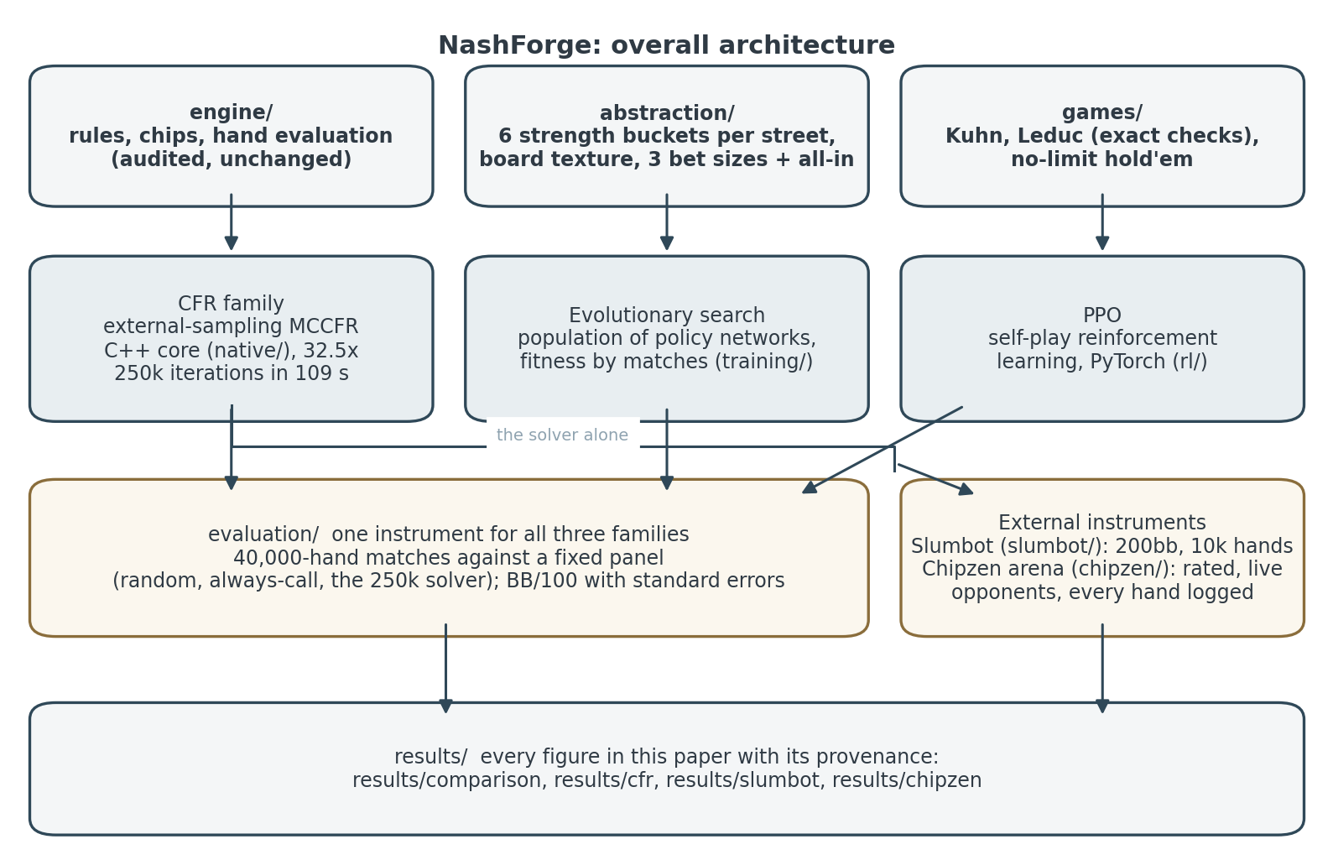
Overall architecture
engine and abstraction shared; three families; one internal instrument, two external

Slide 4
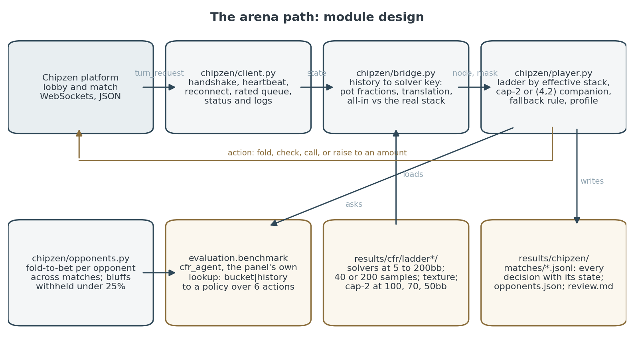
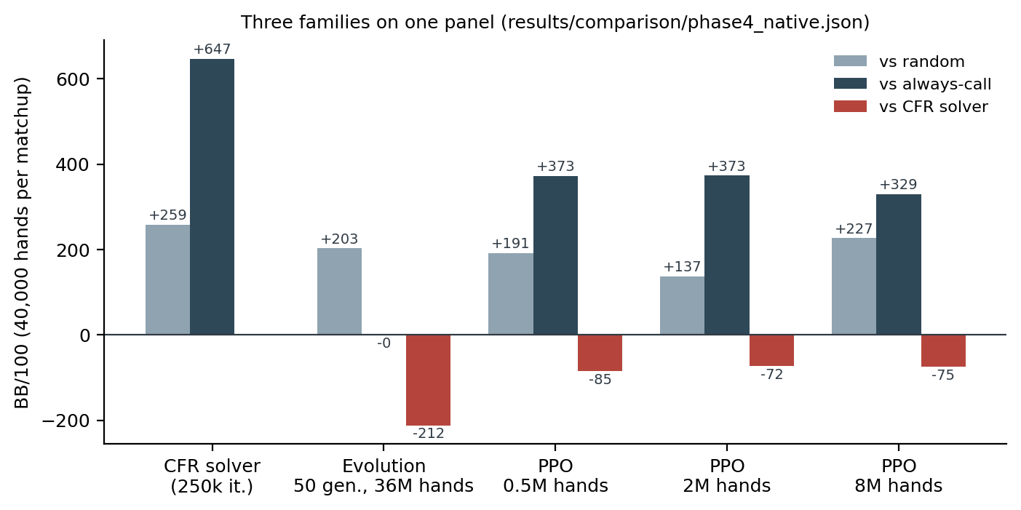
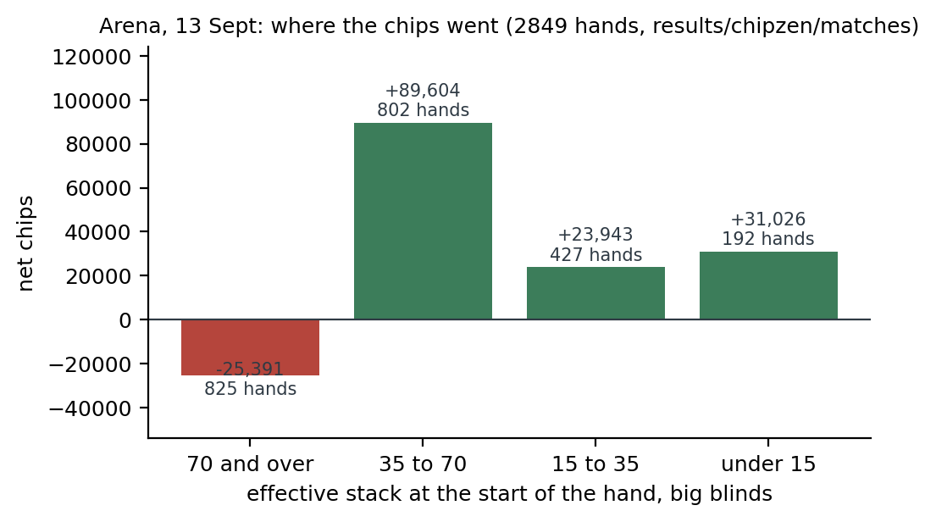
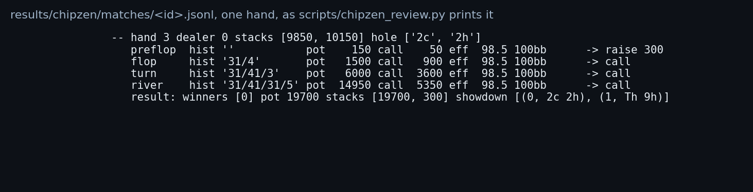
Module design, snapshots and results
arena: 73 matches, 46 won, 2,852 hands, +169,021 chips; decisions in under a millisecond
Solver over PPO +75,
over evolution +212
BB/100
200 samples: +5.9
BB/100
Deep stacks lose,
shallow win:
the re-raise gap

