Slide 1
ALGORITHMIC BIAS MITIGATION
An In-Processing, Algorithm-First Approach on the
Adult Census Income Dataset
Base paper · Agarwal et al. (2018), A Reductions Approach to Fair Classification
Protected attribute: Sex · Task: Income >$50K vs ≤$50K

Slide 2



Why Algorithmic Bias Matters
The same failure pattern repeats wherever a model gates access to something valuable.
Loan Approvals
Hiring Models
Insurance Pricing
Equally qualified applicants get different credit decisions based on a protected attribute.
A resume-screening model favors one group over another with comparable qualifications.
Premiums or coverage decisions correlate with group membership rather than risk alone.

Slide 3
What Is Algorithmic Bias?
A model makes systematically unfair predictions for certain groups because it learned biased patterns from training data not from any deliberate design choice. In the Adult Census dataset, historically more men are recorded with income >$50K than women. A classifier trained only to minimize error can absorb that base-rate gap as a shortcut.
Who the data says earns >$50K, and who the model says does
“A hiring model prefers men over women even when qualifications are similar.”
Real figures — data base rates vs. the unmitigated logistic regression, seed 0. The model widens the gap it learned from: a 0.36 ratio in the data becomes 0.30 in its predictions.

Slide 4
The Dataset
UCI Adult Census Income — archive.ics.uci.edu/dataset/2/adult
Binary
Sex
48K+
Classification task
Income >$50K vs ≤$50K
Protected attribute
Male / Female
Records in the
full dataset
Baseline pipeline scaffold
1
→
2
→
3
→
4
→
5
Load & clean
Encode categoricals
Train / test split
Train Decision Tree
Predict & evaluate
Scaffold adapted from the “Adult Census Income Project” (JcFreya, GitHub) — the fairness layer is what this project adds on top.

Slide 5
Problem Formulation — the Baseline
minₕ E₍ₓ,ᵧ₎~D [ 𝟙{h(x) ≠ y} ]
D = { (xᵢ, aᵢ, yᵢ) } — x = features, a ∈ {0,1} = protected attribute (Sex), y ∈ {0,1} = income label This objective never references a, and in this project a is removed from the feature matrix entirely — no model here can read Sex. But because P(y=1 | a=Male) ≫ P(y=1 | a=Female) in the data, the model reconstructs the gap from proxies: relationship (whose levels are Husband and Wife), marital-status, occupation. Removing the attribute does not remove the information.
Nothing malicious in the algorithm, it is plain empirical risk minimization on data with unequal base rates across groups. That gap is the entire source of the bias.

Slide 6
Measuring Bias: Fairness Metrics
φ(h) quantifies how much predictions depend on the protected attribute a.
Demographic Parity
Difference
Equalized Odds
Difference
Disparate Impact
(ratio form)
| P(h(x)=1|a=1) −
P(h(x)=1|a=0) |
max gap in TPR
and FPR across groups
P(h(x)=1|a=0) /
P(h(x)=1|a=1)
Gap in positive-prediction rate between groups.
Gap in true/false positive rates, conditioned on the real label.
Ratio version of demographic parity; 1.0 is exact parity.

Slide 7



Reframing as Constrained Optimization
This reframing is what makes the whole project purely algorithmic.
minₕ E[𝟙{h(x) ≠ y}] subject to φ(h) ≤ ε
Data untouched
Objective changes
Trade-off is explicit
D is never edited, reweighted-in-place, or filtered. The training set stays exactly as collected.
A constraint region φ(h) ≤ ε is added; the search is now for the best classifier inside that region.
Every method here trades some accuracy for lower φ(h) — the size of that trade-off is the result.

Slide 8
Base Paper: A Reductions Approach
Agarwal, Beygelzimer, Dudík, Langford & Wallach (2018) — ICML
Solves the constrained problem as a two-player zero-sum game:
minₕ maxλ error(h) + λᵀ (φ(h) − ε)
Learner: Picks h to minimize error minus a fairness penalty.
Regulator: Picks Lagrange multipliers λ, penalizing violations harder as h gets less fair.
Practically: iteratively reweight training examples and retrain the base classifier — wraps around any classifier without touching the dataset.
Reference implementation: fairlearn.reductions.ExponentiatedGradient and GridSearch

Slide 9
Base-Paper Track: Deliverables
Baseline Decision Tree
1
Accuracy + all three fairness metrics, no mitigation.
Exponentiated Gradient — Demographic Parity
2
Same tree, wrapped with a demographic-parity constraint.
Exponentiated Gradient — Equalized Odds
3
Same tree, wrapped with an equalized-odds constraint instead.
GridSearch Pareto Sweep
4
Sweep of λ values plotted as an accuracy-vs-fairness frontier.

Slide 10
Ablation Study: Swapping the Mitigation Method
Same data, same base classifier, same metrics — only the mitigation algorithm changes.
Method | Type | Mechanism
Baseline | — | No mitigation
Exponentiated Gradient | In-processing | Lagrangian game, reweight-and-retrain loop
GridSearch | In-processing | Sweep fixed λ values, select Pareto-frontier model
Prejudice Remover | In-processing | Fairness penalty folded directly into the loss
Adversarial Debiasing | In-processing | Adversary predicts a from h(x); predictor is penalized when it succeeds
Bolded row = the base-paper method (Agarwal et al., 2018).

Slide 11




Tooling & Pipeline
fairlearn
PyTorch
scikit-learn
shap
ExponentiatedGradient, GridSearch, MetricFrame reporting/plots
Prejudice Remover and Adversarial Debiasing implemented from their papers — aif360 was rejected (TF1 chain; temp-file subprocess). Verified by degenerate-case tests.
Decision tree and logistic regression, split, encoding
Before/after attribution — stretch goal, completed. It refuted our own prediction.

Slide 12
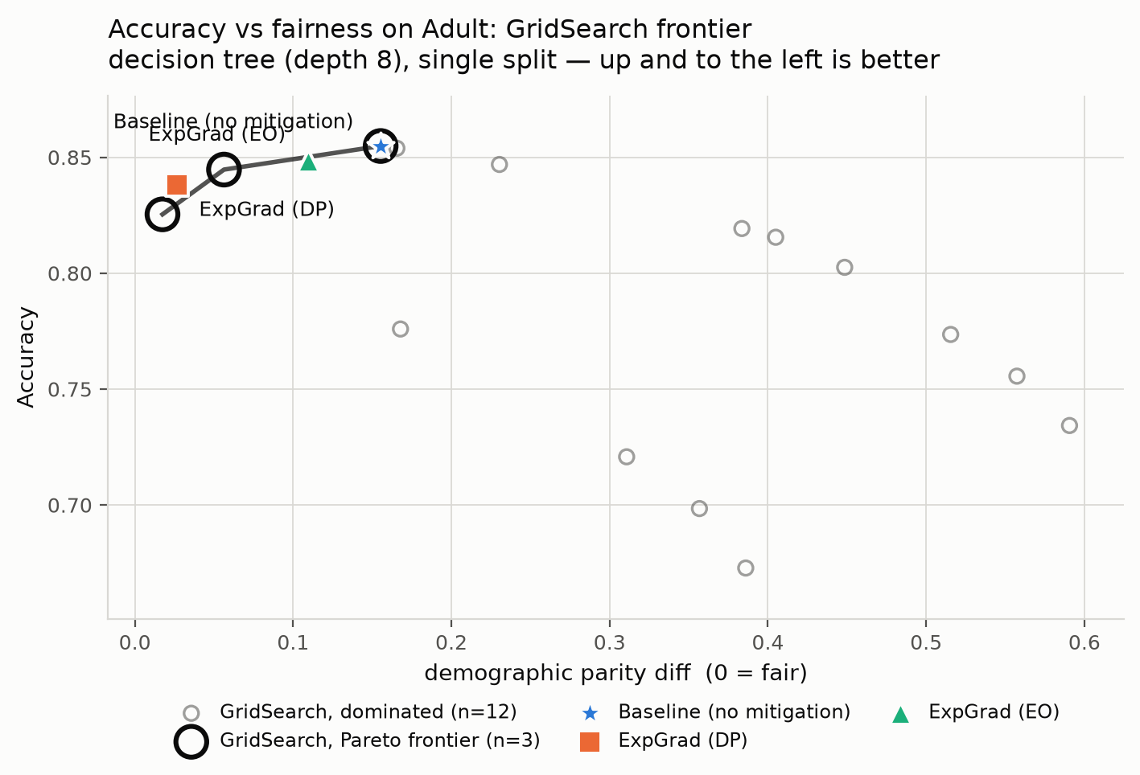

Definition of Done — all three met
Accuracy vs. demographic parity violation — measured
Results table
Rows: Baseline, Exp. Gradient (DP), Exp. Gradient (EO), GridSearch, Prejudice Remover, Adversarial Debiasing
Columns: Accuracy, Demographic Parity Diff, Equalized Odds Diff, Disparate Impact
Real GridSearch sweep, 15 λ values. Open rings mark the non-dominated frontier; dominated points are shown too.
The three ablation questions — answered
Closest to zero bias per accuracy point? Prejudice Remover (11.7 pts/pt) — but GridSearch reaches the lowest absolute gap.
Most stable? Adversarial Debiasing — the opposite of what we predicted. GridSearch is the least stable, by 6×.
Does the ranking change by metric? It inverts. Four of five methods are worse than no mitigation on equalized odds.

Slide 13
Result 1 — The Unmitigated Baseline
5 random seeds, mean ± std. This is what there is to fix.
Base classifier | Accuracy | DP diff | EO diff | Disparate impact
Decision tree | 0.8517 | 0.1613 | 0.0831 | 0.3086
Logistic regression | 0.8469 | 0.1861 | 0.0949 | 0.2996
Disparate impact of 0.29–0.31 means women are selected at under a third of the male rate. The EEOC four-fifths rule flags anything below 0.80 — this is off by nearly a factor of three.
0.30
85%
0
disparate impact
(0.80 is the legal threshold)
accuracy — the metric a team
would actually be watching
features naming Sex.
The model found it anyway.

Slide 14
Result 2 — The Base Paper Works
Agarwal et al. (2018), decision tree, ε = 0.01, 5 seeds. Every claim the paper makes held up.
Method | Accuracy | DP diff | EO diff | Disparate impact
Baseline tree | 0.8517 | 0.1613 | 0.0831 | 0.3086
ExpGrad — Demographic Parity | 0.8364 | 0.0187 | 0.2773 | 0.8834
ExpGrad — Equalized Odds | 0.8471 | 0.1125 | 0.0355 | 0.4573
−88%
1.5 pts
0.31 → 0.88
demographic parity violation
0.161 → 0.019
accuracy paid for it
0.8517 → 0.8364
disparate impact:
fails, then passes
Each constraint fixes only the metric it was given: ExpGrad-DP leaves equalized odds worse than the baseline. That is correct behaviour — the algorithm does what it is asked and nothing more — and it is the seed of Result 4.

Slide 15
Result 3 — Six Mitigations, One Table
Same data, same base classifier (logistic regression), same metrics. Only the mitigation changes. 5 seeds.
Method | Accuracy | DP diff | EO diff | Disp. impact
Baseline (no mitigation) | 0.8469 | 0.1861 | 0.0949 | 0.2996
Exponentiated Gradient (DP) | 0.8282 | 0.0178 | 0.2802 | 0.8951
Exponentiated Gradient (EO) | 0.8361 | 0.1072 | 0.0320 | 0.5214
GridSearch (DP) | 0.8265 | 0.0150 | 0.3040 | 0.9859
Prejudice Remover | 0.8365 | 0.0646 | 0.1884 | 0.6860
Adversarial Debiasing | 0.8260 | 0.0202 | 0.2504 | 0.8894
Prejudice Remover and Adversarial Debiasing were implemented from their papers in PyTorch, not taken from a library.
Verified by degenerate cases: with η = 0 the Prejudice Remover penalty vanishes and it must reduce to per-group logistic regression — it reproduces it to 99.88% prediction agreement. Both fairness knobs are checked for monotonicity, which is what would catch a sign error. 4/4 passing.

Slide 16
Result 4 — Two of Our Own Predictions Were Wrong
The three ablation questions, answered against the data rather than against intuition.
Q1 · Best value?
Q2 · Most stable?
Q3 · Ranking stable?
Prejudice Remover — 11.7 parity points per accuracy point, 30% better than ExpGrad-DP. But it stops at DP 0.065; GridSearch reaches 0.015.
Adversarial Debiasing — std 0.0011, the most stable in the study. We predicted it would be the least. GridSearch is 6× worse.
It inverts. The best DP method is the worst EO method. Four of five mitigations are worse than no mitigation on equalized odds.
Why the stability intuition failed
The variance is across seeds, and a seed changes the train/test split. GridSearch takes a discrete argmax over a coarse 15-point λ grid, so a small change in the data flips which grid point wins and the answer moves discontinuously. Adversarial Debiasing has no selection step. The instability came from model selection, not from stochastic training.
An engineer deploying GridSearch-DP on its parity score would take equalized odds from 0.095 to 0.304 — 3.2× worse than doing nothing — while the dashboard showed green.

Slide 17
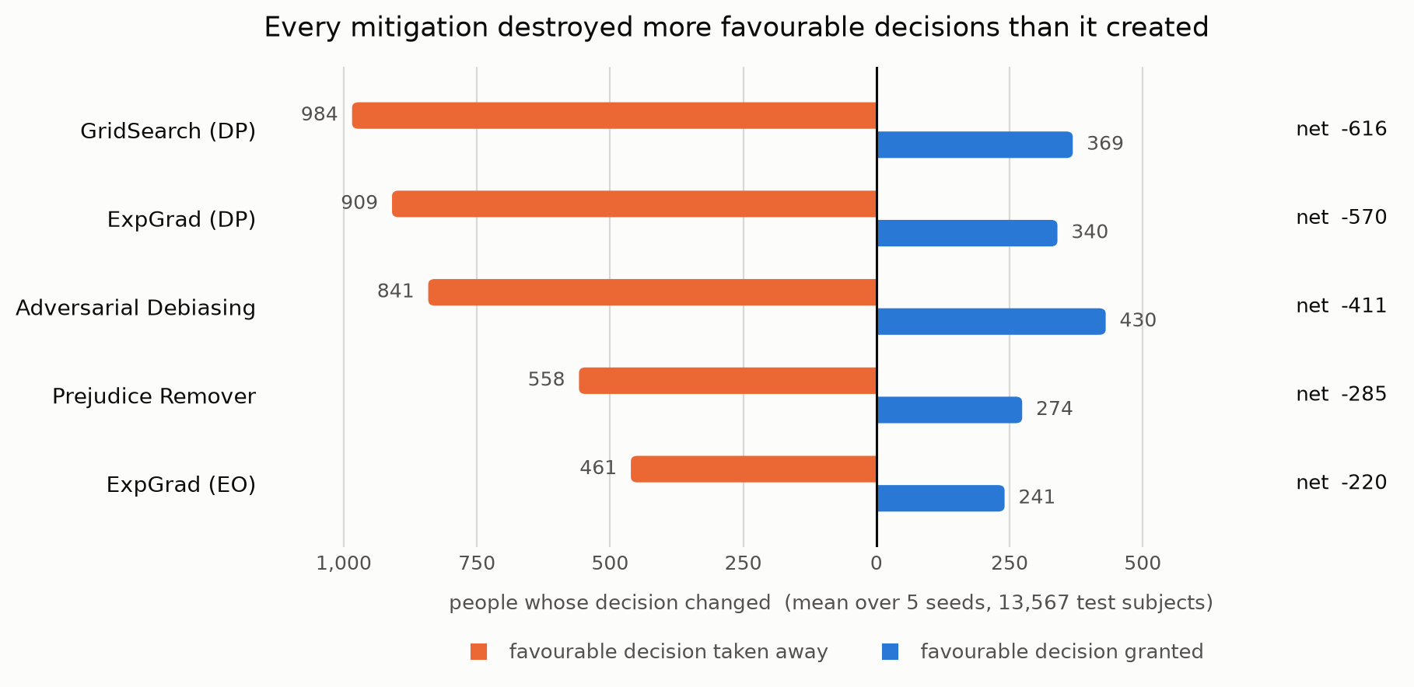
Contribution 1 — Who Pays for the Fairness Fix?
Not in the plan. A gap can close by lifting one group or lowering the other — the metric is identical either way. That is Ferry et al.'s (2023) starting point; the measurement is ours.
What the table cannot say
ExpGrad-DP took demographic parity from 0.186 to 0.018.
It did that by taking approval from 909 men so 316 women could gain it — 2.7 lost per 1 gained.
Measured in rates the split looks even (0.57); measured in people it is 0.74, because the privileged group is 2.1× larger.
Every method shrank the total number of favourable decisions. Not one levelled up.
And 62% of ExpGrad-EO's individual-level effect is not fairness at all — two draws from the same fitted model disagree on 3.2% of people, against a 5.2% total change. The same applicant can apply twice and get two answers.

Slide 18
Contribution 2 — The Fairest Models Use Sex Proxies MORE
Our plan predicted proxy reliance would shrink after mitigation. It grew.
Model | Reliance on sex proxies | vs baseline | 'relationship' alone
Baseline (no mitigation) | 0.545 | — | 0.075
ExpGrad (DP) | 0.586 | +7.6% | 0.189
GridSearch (DP) | 0.586 | +7.5% | 0.158
Prejudice Remover | 0.505 | -7.3% | 0.071
ExpGrad (EO) | 0.475 | -12.8% | 0.082
Adversarial Debiasing | 0.481 | -11.7% | 0.098
Sex is not in the feature matrix. At all.
Yet the two methods with the best demographic parity scores lean on sex proxies harder than the model with no fairness fix, and both more than doubled their use of 'relationship' — a feature whose values are literally Husband and Wife.
To equalise selection rates across sex while forbidden to read sex, the model must first work out who is a woman. The constraint gives it a reason to become a better sex-detector.
Not an artifact: ExpGrad's figure is sampled, but GridSearch's is exact linear SHAP and agrees. Two estimators, same conclusion.
The one method that does reduce proxy reliance is Adversarial Debiasing — the only one whose objective is to destroy sex information. Theory predicted the ranking.

Slide 19
Contribution 3 — Fixing Sex Leaves Sex × Race Behind
Every method so far constrains one binary attribute. That is the field's default, and it has a named blind spot (Kearns et al. 2018) that overall performance figures do not show (Maheshwari et al. 2023).
Arm | Accuracy | Sex gap | Sex × Race gap | Worst-off subgroup
No constraint | 0.8465 | 0.1897 | 0.3145 | Female x Black
ExpGrad-DP on Sex | 0.8295 | 0.0197 | 0.1776 | Male x Black
ExpGrad-DP on Sex × Race | 0.8129 | 0.0164 | 0.0481 | Female x White
9×
3.3×
5 of 10
larger gap at Sex × Race than on
the attribute it was constrained on
Asian men vs Black men selection
rate — after 'fixing' sex
subgroups too small to measure.
One has zero positive labels.
The sex constraint moved the worst-off subgroup from Black women to Black men.
Nothing was done to them. The constraint simply had nothing to say about them, and equalising the sex marginal while race went unconstrained left them as the residual.
Half of any Sex × Race heatmap on Adult is noise. Female × Other has 21 people and no positive labels — its TPR is 0÷0.
70% of the intersectional arm's apparent gap comes from cells too small to measure. We report Wilson intervals and gate on them.

Slide 20
Contribution 4 — "Just Delete the Leaky Feature" Backfires
A NEGATIVE CONTROL, deliberately outside the in-processing scope: we break the rule once to show what leaving it costs.
Features removed | Sex recoverable (AUC) | Baseline accuracy | Baseline DP | ExpGrad accuracy | ExpGrad DP
none removed | 0.934 | 0.8465 | 0.1897 | 0.8295 | 0.0197
−relationship | 0.868 | 0.8463 | 0.2054 | 0.8026 | 0.0172
−relationship, marital-status | 0.803 | 0.8171 | 0.1014 | 0.7946 | 0.0164
−relationship, marital-status, occupation | 0.691 | 0.8133 | 0.0932 | 0.7852 | 0.0182
−relationship, marital-status, occupation, hours-per-week | 0.625 | 0.8080 | 0.0761 | 0.7863 | 0.0186
Deleting the feature does not delete the information.
`relationship` determines sex outright for 45.9% of people. Removing it drops sex-recoverability only from 0.934 to 0.868 — the information is spread across the other features — and it makes the unmitigated model MORE unfair, 0.190 → 0.205. You must delete 4 of 11 features to suppress the leak, at which point the probe is no better than guessing the majority class.
Feature deletion is strictly dominated: 4 features removed gives DP 0.076 at 80.8% accuracy, while the constraint on the untouched feature set gives DP 0.020 at 83.0%. Worse fairness AND worse accuracy — and mitigation gets more expensive afterwards.

Slide 21
Contribution 5 — Loosening the Constraint Changes the Dose, Not the Mechanism
The strongest objection to Contribution 1: maybe levelling down is just what a very tight constraint forces. Tested by sweeping ε.
ε (fairness slack) | Accuracy | DP diff | Share paid by advantaged (people) | Lost per gained | Change in total approvals
0.005 | 0.8284 | 0.0122 | 0.746 | 2.74 | -22.0%
0.01 | 0.8295 | 0.0197 | 0.746 | 2.74 | -21.1%
0.02 | 0.8324 | 0.0342 | 0.744 | 2.73 | -19.1%
0.05 | 0.8388 | 0.0762 | 0.739 | 2.69 | -13.6%
0.1 | 0.8457 | 0.1557 | 0.777 | 3.41 | -5.0%
0.15 | 0.8465 | 0.1897 | not binding | — | +0.0%
0.2 | 0.8465 | 0.1897 | not binding | — | +0.0%
The share does not move. Only the amount of work does.
Across the whole binding range the advantaged group pays 0.74–0.78 of the closure in people, and closing a fixed amount of gap costs a near-constant number of approvals (≈120–146 per unit) at every ε. The two non-binding rows return the baseline exactly, which is the check that ε now does what it claims.
At the loosest binding setting the split is the MOST lopsided per unit of work — 3.41 favourable decisions destroyed per one created. A gentle constraint is gentler in degree, and not even that per unit of gap closed.

Slide 22
Verdict — What We Confirmed, Extended, and Refuted
The distinction matters. It is easy to present an extension as a refutation.
Confirmed
Extended
Refuted
Everything the base paper claims.
• 88% violation reduction for 1.5 accuracy points
• Works as a black box on a tree and on logistic regression
• Training data never modified
• GridSearch traces a usable frontier
The method works.
Six questions the paper's frame does not ask.
• Who was moved to satisfy the constraint
• Whether the total number of approvals fell
• What randomization costs an individual
• What the constrained model leans on
• What happens one level below the constrained attribute
• Whether deleting the proxy, or loosening ε, is a way out (neither is)
None of these contradict it.
Nothing in the base paper.
Two predictions from our own plan deck:
• 'Adversarial training is higher-variance' — inverted
• 'SHAP will show proxy reliance shrinking' — it grew
Predictions from intuition: 0 for 2. From theory: 3 for 3.
The base paper's method works as claimed. This project confirms it, then measures what it does not tell you: the gap closes mostly by withdrawing approvals from the advantaged group, and the constrained model relies on proxies for the protected attribute more than the unconstrained one.

