Slide 1
INT303: Networking Fundamentals – Lab 3
Lab 3: TCP/IP Protocol Stack and Packet Inspection Using OWASP Broken Web Application IP

Slide 2
Objective:
In this lab, students will delve into the Transmission Control Protocol/Internet Protocol (TCP/IP) stack, dissecting and inspecting the various layers involved in packet transmission. Students will focus on understanding how data travels across a network, analyzing packets, and troubleshooting issues related to the TCP/IP model.
Learning Outcomes:
the end of this lab, students will:
Understand the fundamentals of the TCP/IP model.
Be able to analyze packets at different layers (Application, Transport, Network, and Link).
Gain hands-on experience in dissecting TCP/IP traffic using packet inspection tools.
Learn how to apply practical troubleshooting techniques based on TCP/IP behavior.

Slide 3
Materials Needed:
Linux-based system (Kali, Ubuntu, etc.)
OWASP Broken Web Application VM (running and reachable on your network)
IP address of the OWASP Broken Web Application (e.g., 192.168.X.X)
Wireshark or tshark for packet capture and analysis

Slide 4
Lab Exercises:
Exercise 1: Understanding the TCP/IP Model
1. Task: Briefly review the layers of the TCP/IP model (Application, Transport, Network, and Link layers). Understand the purpose and function of each layer in data transmission.
2. Question:
Explain the differences between the TCP/IP and OSI models.
Which layers of the TCP/IP model correspond to specific OSI layers?

Slide 5
Exercise 2: Capturing and Analyzing TCP Packets
3. Task: Initiate a connection to the OWASP Broken Web Application VM via HTTP or SSH. Capture TCP packets related to this connection using
tcpdump
Command:
tcpdump -i <interface> tcp and host <OWASP_IP>
tcpdump -i eth0 tcp and host 192.168.56.101
Question:
What happens during the TCP handshake (SYN, SYN-ACK, ACK)?
Identify and describe the flags used in TCP communication (SYN, ACK, FIN, etc.).
How does the TCP connection maintain reliability during transmission?
Notes:
tcpdump -i <interface> tcp and host <OWASP_IP>tcpdump -i eth0 tcp and host 192.168.56.101

Slide 6
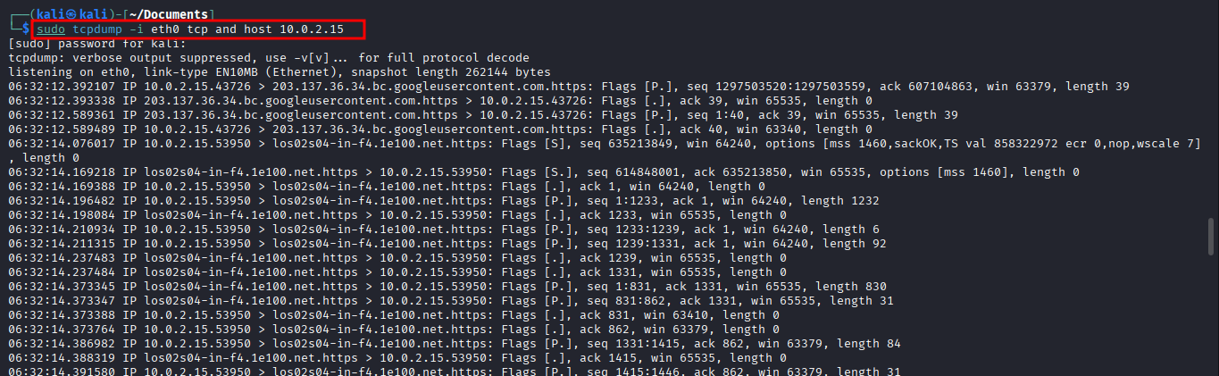

Slide 7
Exercise 3: Investigating IP Packets (Network Layer)
3. Task: Capture and analyze the IP packets from your connection to the OWASP Broken Web Application.
Command: Use Wireshark or
tcpdump
ip.addr == <OWASP_IP>
4. Question:
What fields can you see in the IP packet header (e.g., Source IP, Destination IP, TTL, etc.)?
What is the significance of each of these fields?
How does IP routing work in this scenario? Are there any hops between your system and the OWASP VM?

Slide 8
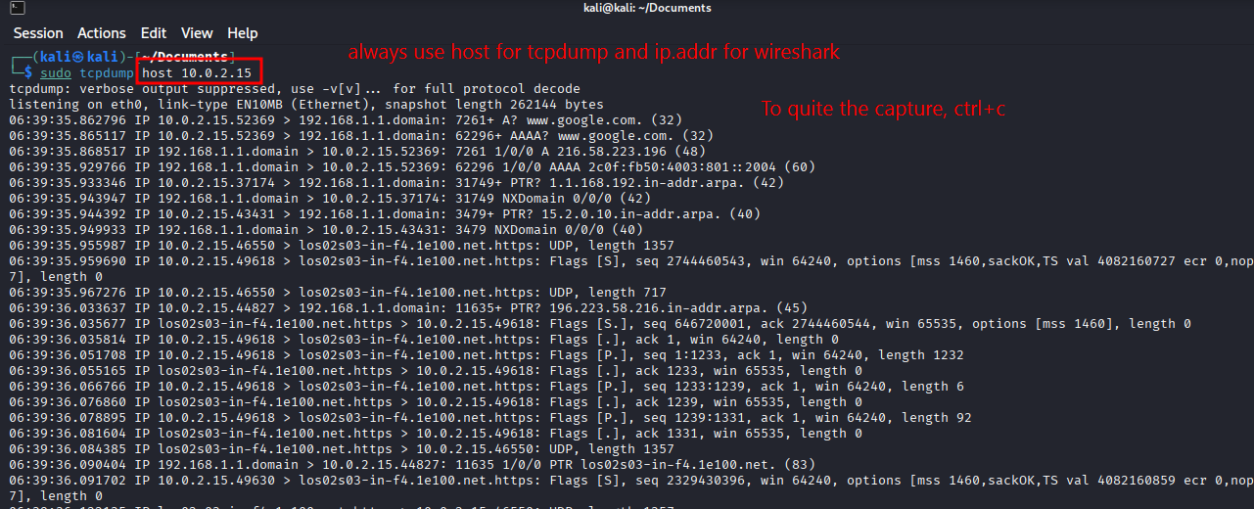

Slide 9
Exercise 4: Application Layer Analysis (HTTP/SSH Traffic)
7. Task: If you're using HTTP, filter the packets to capture only HTTP traffic using Wireshark or
Tcpdump
tcpdump -i <interface> port 80 and host <OWASP_IP>
tcpdump -i <interface> port 22 and host <OWASP_IP>
8. Question:
Analyze the HTTP packets. What information is available in the HTTP request and response?
For SSH traffic, what is the significance of encrypted packets? Can you analyze the payload?
How does the application layer play a role in data exchange between your system and the OWASP VM?

Slide 10
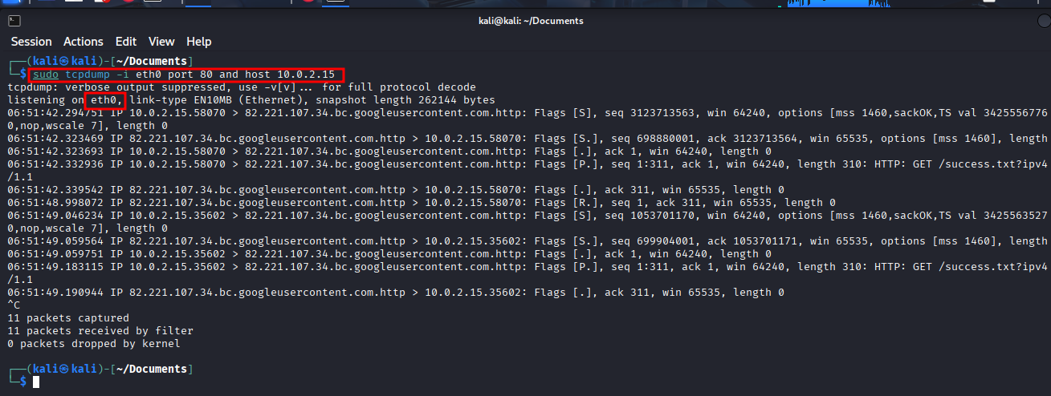

Slide 11
Exercise 5: Error Handling in TCP/IP Transmission
9. Task: Simulate packet loss or network issues by introducing a delay or stopping the network connection momentarily. Capture how TCP/IP handles this issue.
Command: Temporarily disable your network interface using
ifconfig <interface> down
10. Question:
What happens when packets are dropped or delayed?
How does TCP ensure data reliability in the presence of errors?
How do retransmissions and sequence numbers work in TCP to maintain a proper data flow?

Slide 12
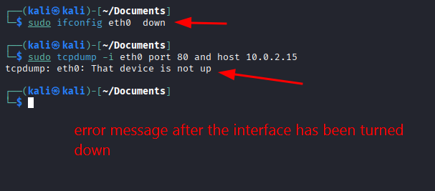

Slide 13
Exercise 6: ICMP and Ping Inspection (Network Layer)
11. Task: Send a series of
ping- Command:
ping <OWASP_IP>
tcpdump
icmp
12. Question:
What are the key fields in an ICMP packet (e.g., Type, Code, Checksum)?
How does ICMP assist in diagnosing network connectivity issues?
What is the significance of TTL in both ICMP packets and general IP packets?

Slide 14
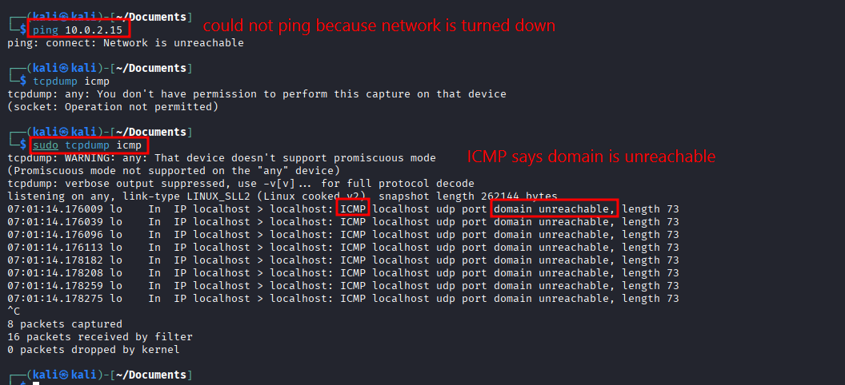

Slide 15
Exercise 7: Analyzing UDP Packets (Transport Layer)
13. Task: If available, generate some UDP traffic to the OWASP VM by using a simple application or UDP-based service. Capture and analyze the UDP packets.
Command:
tcpdump -i <interface> udp and host <OWASP_IP>
14. Question:
Compare UDP with TCP. What are the major differences in packet structure and behavior?
Why does UDP not ensure reliability, and in what scenarios would you prefer UDP over TCP?
How does UDP manage data transmission without the need for acknowledgments or retransmissions?

Slide 16
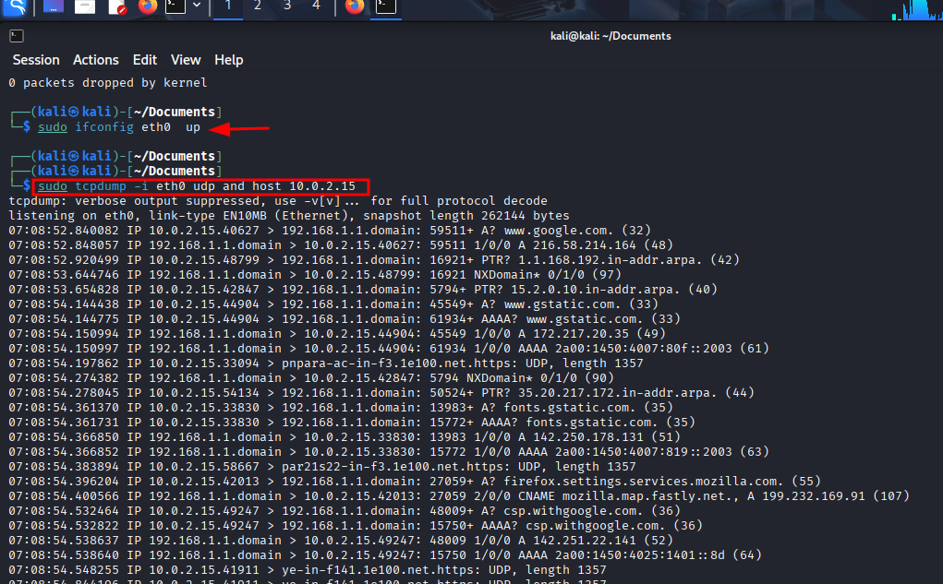

Slide 17
Exercise 8: OS Detection via Nmap (Network and Transport Layers)
15. Task: Use
nmap- Command:
nmap -O <OWASP_IP>
16. Question:
How does
Nmap
- What packet characteristics (TTL, window size, etc.) help in identifying the OS?
- Explain why OS detection can be an important step in network analysis and vulnerability assessment.

Slide 18
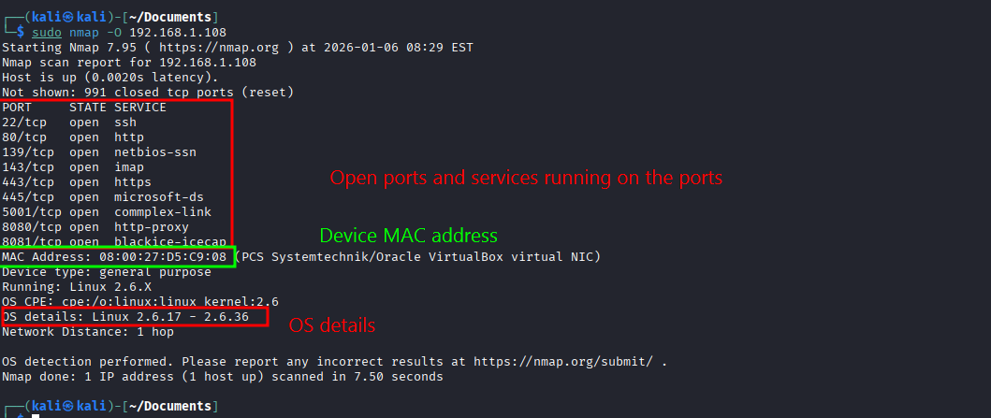

Slide 19
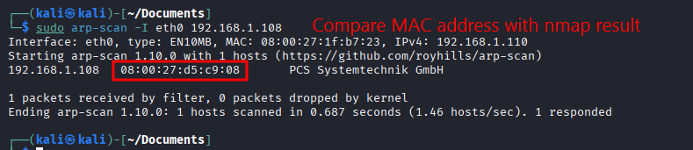
Exercise 9: Analyzing ARP Traffic (Link Layer)
17. Task: Use
arp-scan- Command:
arp-scan -I <interface> <OWASP_IP>
18. Question:
What information can you gather from ARP packets (e.g., MAC addresses)?
How does the ARP protocol function at the link layer?
What role does ARP play in the communication between your system and the OWASP VM?

Slide 20
Exercise 10: Troubleshooting Network Connectivity Using TCP/IP Knowledge
19. Task: Simulate a common network issue (e.g., incorrect subnet mask, gateway misconfiguration) and troubleshoot the issue using your understanding of the TCP/IP stack.
20. Question:
What is the issue you simulated, and how did it affect network communication?
How did you diagnose and resolve the issue using packet inspection and knowledge of the TCP/IP layers?
What tools and techniques would you recommend for real-world network troubleshooting?

Slide 21
Submission Requirements:
Submit a report that includes packet captures, command outputs, and explanations for each exercise.
Include screenshots and highlight key details in the packet captures.
Provide in-depth analysis of TCP/IP behavior observed during the lab.
Reflection:
Through this lab, students will gain practical experience in dissecting and troubleshooting network traffic using the TCP/IP stack. Understanding how data flows across the network at various layers will help in mastering network fundamentals and preparing for real-world challenges in network administration and cybersecurity.

