Slide 1
INT303 Networking Fundamentals
NETWORKING
AND IP ADDRESSING
PREPARED BY:
AMINU IDRIS,AMCPN
(CCNA, CompTIA Security+, CEH, OSCP, CISSP, CISM)

Slide 2
Addressing Schemes
FLAT
Used by Intranetworks
Used by Layer 2
Used in MAC address
Is assigned statically based on next available number or random
Social Security Number
Your Name
MAC- C0:AD:00:23:4F:89
HIERARCHICAL
Used by Internetworks
Used by Layer 3
Used by IP address
Is assigned dynamically based on your location
Phone System
ZIP Code
IP- 182.157.63.219

Slide 3
Internet Protocol Address (IPAddress)
A unique numerical label assigned to each device participating in anetwork
Every device on the Internet must have a unique IP address to identify itself
Internet Assigned Numbers Authority (IANA)
Manages the IP address space allocations globally
Delegates five regional Internet registries (RIRs) to allocate IP address blocks to local Internet registries (Internet service providers)
For an IP to be routable over the Internet, it must have:
IP address
Subnet Mask
Default Gateway
DNS address (only for address lookup, i.e. web sites)

Slide 4
TypesofAddressing
Static IP address
Manually assigned to a device by an administrator
Constant and does not change.
Dynamic IP address
Assigned to device each time it starts
Requires less human intervention
Less administration
Uses Dynamic Host Configuration Protocol (DHCP)
Enabled by default
No user intervention

Slide 5
Classful vs Classless
CLASSFUL
Divided into 5 classes A, B, C, D
(multicast) and
E (reserved)
Does not send subnet information
All networks are the same size
Have the same subnet mask
CLASSLESS
Also known as CIDR (Classless Inter-Domain Routing)
Sends subnet information
Network can be different sizes
Networks can have different
subnet masks using VLSM (Variable Length Subnet Mask)
5

Slide 6

Network & Host Number Formulas
 | 1 Byte 8 Bits | 1 Byte 8 Bits | 1 Byte 8 Bits | 1 Byte 8 Bits
Class A | N | H | H | H
Class B | N | N | H | H
Class C | N | N | N | H
The formulas are the default configuration for each class:
1.N = Network Number
Assigned by the American Registry for Internet Numbers (ARIN)
Administrator has no control over this part of the address
2.H = Host Number
Assigned and controlled by the network administrator

Slide 7
Class A Addresses
Class A
8 Bits | 24 Bits
Network | Host | Host | Host
First octet only identifies the network
When written in a binary format, the first (leftmost) bit of a Class A address is always
0 (zero)
Class A IP address example: 124.95.44.15
Range from 1-126 in their first octet
127 is part of a class A range but has been reserved for loopback testing
Zero (0) can’t be used
Remaining three octets can be used for the host portion of the address
2²⁴ or 16,777,216, possible IP addresses per class A network

Slide 8
Class B Addresses
Class B
16 Bits |  | 16 Bits
Network | Network | Host | Host
When written in a binary format, the first (leftmost) bit of a Class B address is always 10 (one and zero)
Class B IP address example: 151.10.13.28
The first two octets identify the network number assigned by ARIN
Range from 128 to 191 in their first octet
Remaining two octets can be used for the host portion of the address
2¹⁶ or 65,536, possible IP addresses per class B network

Slide 9
Class C Addresses
Class C
24 Bits |  |  | 8 Bits
Network | Network | Network | Host
When written in a binary format, the first (leftmost) bit of a Class C address is always 110 (one, one and zero)
Class C IP address example: 201.110.213.28
The first three octets identify the network number assigned by ARIN
Range from 192 to 223 in their first octet
Last octet can be used for the host portion of the address
2⁸ or 256, possible IP addresses per class C network

Slide 10
Address Ranges
IMPORTANT!!!
MEMORIZE
Class A Class B Class C
1 – 126
128 – 191
192 – 223
N.H.H.H
N.N.H.H
N.N.N.H

Slide 11
Network Address
Network |  |  |  | Host
32 Bits
152 | . | 21 | . |  | 0 | . | 0
Ends with binary 0s in all host bits
Also know as the wire address
Never used as a device IP address
Used by routers to forward data
Example IP address: 152.21.2.3
Class B
First two octets are assigned
Last two octets are host numbers used for devices in the network
Network address: 152.21.0.0

Slide 12
Examples of NetworkNumbers
What is the network number for this IPaddress?
1. 194.78.112.6 194.78.112.0
2. 117.23.8.3
117.0.0.0
3. 156.132.64.12
156.132.0.0
4. 208.150.112.16
208.150.112.0
5. 91.118.125.2
91.0.0.0

Slide 13
Broadcast Address
Network |  |  |  | Host
32 Bits
152 | . | 21 | . |  | 255 | . | 255
End with binary 1s in host bits
Used to send data to all devices on a network
Never used as a device IP address
Example IP address: 152.21.2.3
Class B address
First two octets are assigned
Last two octets are host numbers used for devices in the network
Broadcast address: 152.21.255.255

Slide 14
Examples of Broadcast Address
What is the Broadcast address for this IPaddress?
1. 194.78.112.6
194.78.112.255
2. 117.23.8.3
117.255.255.255
3. 156.132.64.12
156.132.255.255
4. 208.150.112.16
208.150.112.255
5. 91.118.125.2
91.255.255.255

Slide 15
NetworkNumberand BroadcastAddress
All 0’s in the host address is the Network Number
All 1’s in the host address in the Broadcast Address
These two addresses can never be used when assigning IP’s
When finding the number of useable host addresses, you will always subtract 2 (network & Broadcast)

Slide 16
Default Subnet Mask
Formal name: Extended Network Prefix
Tells the network devices which part of an address is the network field and which part is the host field
32 bits long and 4 octets, just like an IP address
Step to determine the subnet mask:
Express the subnetwork IP address in binary form
Replace the network portion of the address with all 1s
Replace the host portion of the address with all 0s
Convert the binary expression back to dotted-decimal notation

Slide 17
Examples of Default Subnet Mask
What is the Default Subnet Mask for this IPaddress?
1. 194.78.112.6
255.255.255.0
2. 117.23.8.3
255.0.0.0
3. 156.132.64.12
255.255.0.0
4. 208.150.112.16
255.255.255.0
5. 91.118.125.2
255.0.0.0

Slide 18
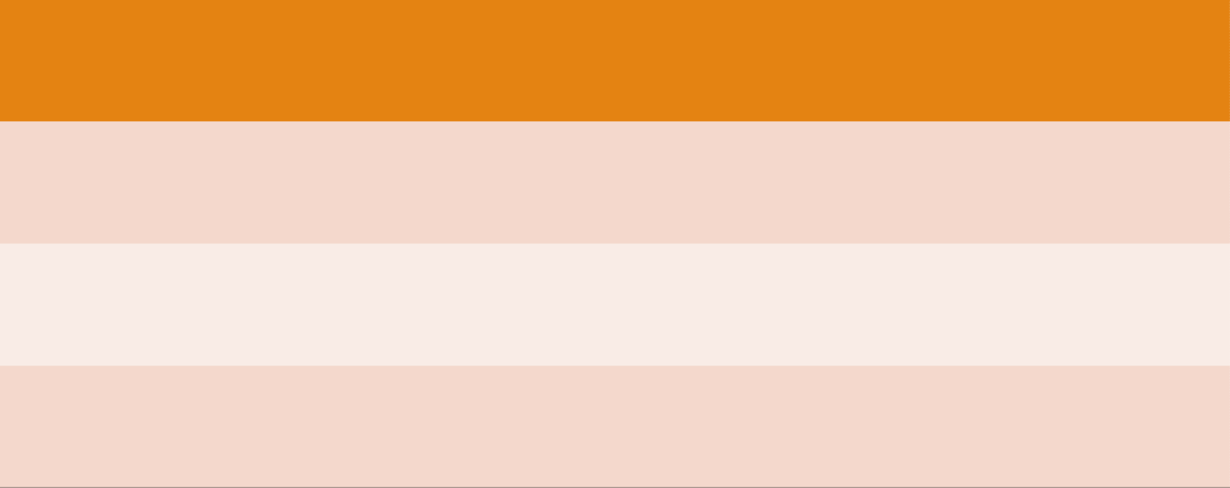
Default Subnet Mask
Class | Formula | Slash Notation | Default Mask
Class A | N.H.H.H | /8 | 255.0.0.0
Class B | N.N.H.H | /16 | 255.255.0.0
Class C | N.N.N.H | /24 | 255.255.255.0

Slide 19
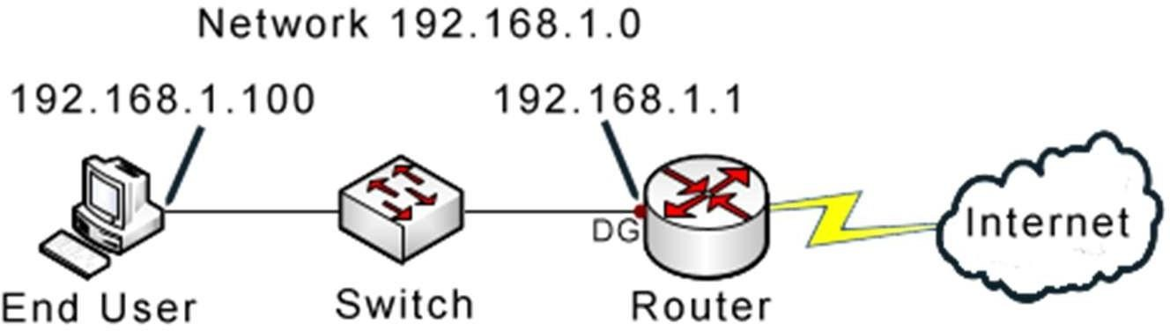
Default Gateway
A port on a router
Your connection to the Internet
IP address MUST be part of the network
Usually the first or last IP address in the network

