Slide 1
Lab 4: Intrusion Detection Systems (IDS) and Traffic Analysis on Linux

Slide 2
Objective:
This lab aims to familiarize students with setting up and configuring an Intrusion Detection System (IDS) on a Linux machine, analyzing network traffic against the OWASP Broken Web Applications VM IP, and identifying potential security threats.
Materials Required:
Linux operating system (Ubuntu, Kali Linux, or similar)
OWASP Broken Web Applications VM (make sure it's running)
Snort IDS installed on the Linux machine
Wireshark installed on the Linux machine
Terminal access

Slide 3
Lab Tasks:
1. Install and Configure Snort:
Ensure you have Snort installed. If not, install it using the following command:
sudo apt-get update
sudo apt-get install snort
During installation, you will be prompted to set the network interface. Choose the interface that is connected to the network (e.g., eth0, wlan0).
Notes:
sudo apt-get update
sudo apt-get install snort

Slide 4
2. Configure Snort:
Open the Snort configuration file for editing:
sudo nano /etc/snort/snort.conf
Set the HOME_NET variable to the OWASP VM IP address (e.g., 192.168.56.101).
Uncomment and adjust any relevant rules to ensure they are active.
3. Start Snort in IDS Mode:
Run Snort in IDS mode to monitor the network:
sudo snort -A console -c /etc/snort/snort.conf -i <interface>
Replace <interface> with the actual network interface (e.g., eth0).
Notes:
sudo nano /etc/snort/snort.conf
sudo snort -A console -c /etc/snort/snort.conf -i <interface>
IF SNORT.CONF DOES NOT OPEN TO A CONFIGURATION FILE, USE SNORT.LUA

Slide 5
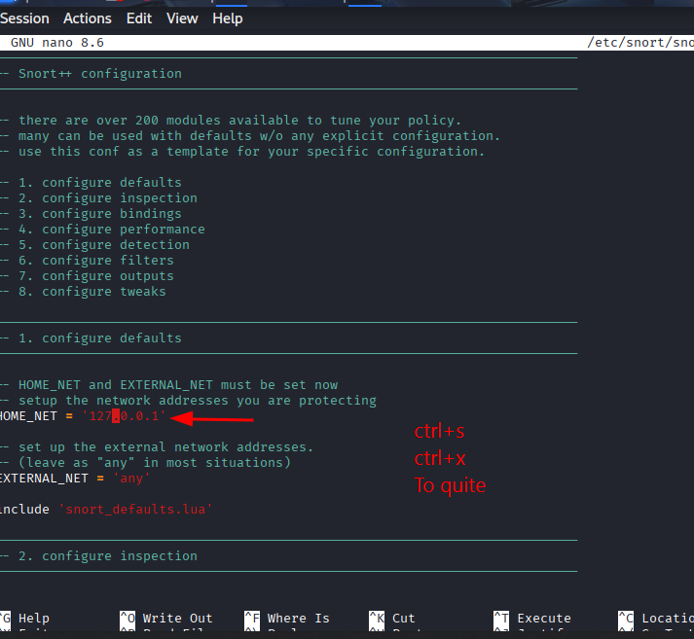
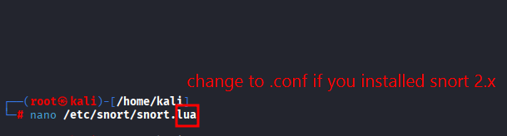
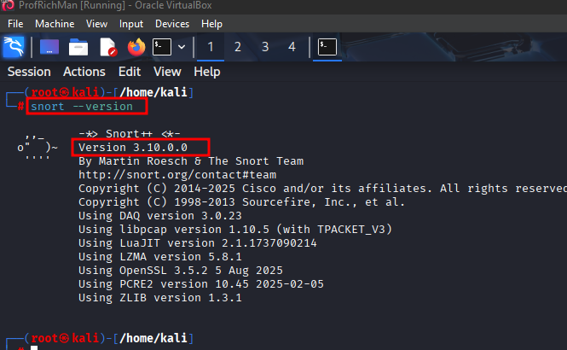

Slide 6
4. Generate Network Traffic:
Use a tool like hping3 to generate malicious traffic. First, install hping3 if not already installed:
sudo apt-get install hping3
Generate a SYN flood attack towards the OWASP VM:
hping3 -S -p 80 192.168.56.101
This simulates an attack on the web application running on the OWASP VM.
5. Monitor Traffic with Wireshark:
Open Wireshark and select the same interface Snort is monitoring.
Set a filter to display only TCP traffic:
tcp
Observe the incoming packets and look for SYN flood patterns.
Notes:
sudo apt-get install hping3
hping3 -S -p 80 192.168.56.101

Slide 7
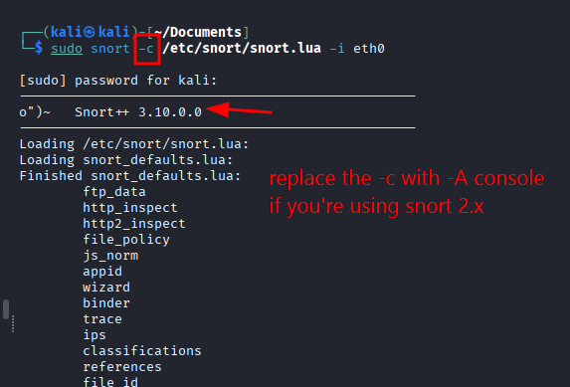
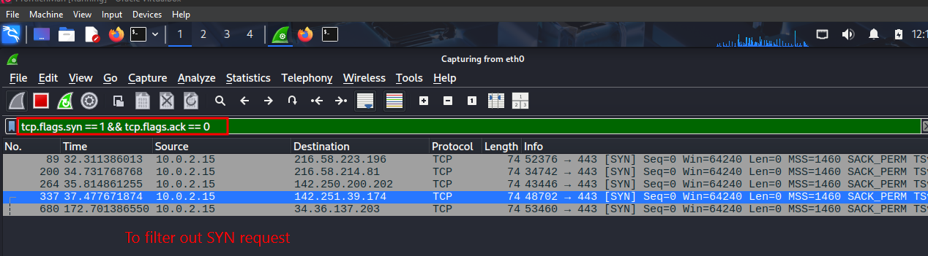

Slide 8
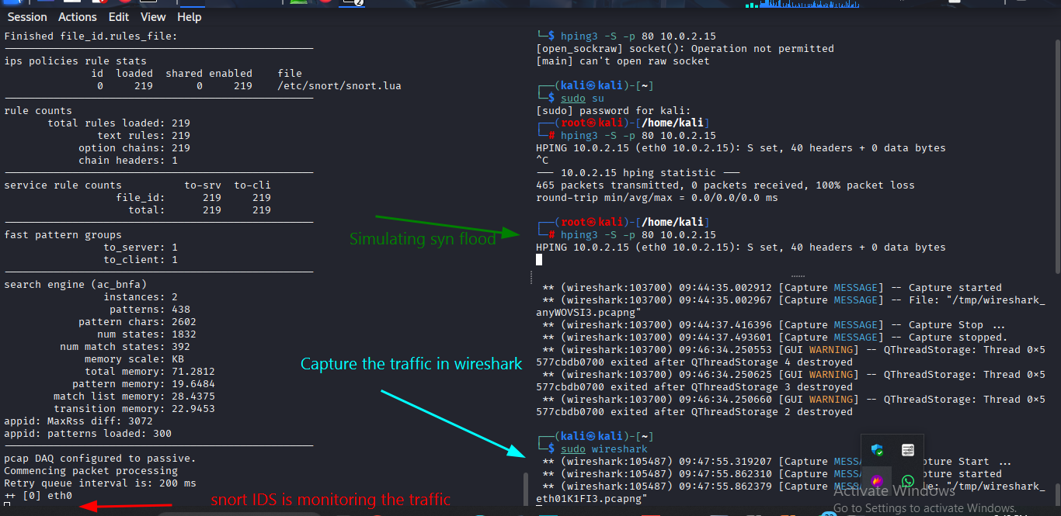

Slide 9
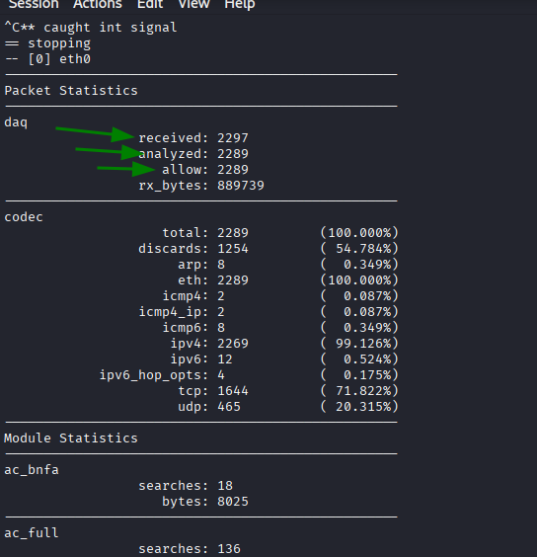

Slide 10
6. Analyze Snort Alerts:
Review the Snort console output for alerts triggered by the SYN flood attack.
Take note of the types of alerts and corresponding packet details.
7. Document Findings:
Create a report summarizing:
The steps taken to configure and run Snort.
Types of traffic generated and the corresponding alerts triggered by Snort.
Screenshots from Wireshark showing packet captures during the attack.
Analysis of Snort’s effectiveness in detecting and alerting on the simulated attack.

Slide 11
Submission Requirements:
Format: Submit your completed report as a PDF document.
Content: Include relevant screenshots, configurations, and analysis.
Deadline for submission: [Insert Deadline Date]
Conclusion:
This lab provides hands-on experience in setting up an IDS on a Linux environment, demonstrating how to generate malicious traffic against the OWASP BWA VM and analyze the effectiveness of intrusion detection in a practical setting. Understanding these concepts is crucial for maintaining network security.

