Slide 1
Student Digital Portfolio
STUDENT NAME: DHESIYAPRIYAN K
REGISTER NO AND NMID: 9A07100B1747B88BEBD4FD9DA81162A9
DEPARTMENT: B.Sc., Computer Science
COLLEGE: Government Arts and Science College, vanur / Annamalai University

Slide 2
PROJECT TITLE
STUDENT DIGITAL PORTFOLIO :
I create my own student digital portfolio by using
HTML, CSS and JS .
I create Student Digital portfolio to show my projects
and certificates.

Slide 3


AGENDA
Problem Statement
Project Overview
End Users
Tools and Technologies
Portfolio design and Layout
Features and Functionality
Results and Screenshots
Conclusion
Github Link
3/21/2024 Annual Review

Slide 4

PROBLEM STATEMENT
Students are struggle to showcase their skills, achievements, and learning skills.
Traditional resumes and report cards are not fully express student’s creativity, growth, and skills.
Student digital portfolio platform where students can present their academic work, projects, and extracurricular activities in one place.
A well-designed student digital portfolio can help students stand out during college admissions, internships, or job applications.

Slide 5

PROJECT OVERVIEW
This project for showcasing my skills and creativity . Student digital portfolio will be a presentation website that includes:
home page : I create home page for my project title
and navigation center.
ABOUT: In the about section ,I mainly talks about my
details like name, deportment, College and etc.
skills: My programming skills are.
1. Python
2. C++
3. HTML
4. CSS
5. JavaScript

Slide 6
PROJECT OVERVIEW
Project: My projects are.
1. Simple HTML Page: In this html page to show different types of heading,
Hyper links, images, order & unorder lists.
2. Types of CSS: In this page for the different types CSS are.
Inline CSS , internal CSS , External CSS.
3.FWD- Form: In this page I create a form for the FWD (FUNDEMENTAL OF
WEB DEVELOPMENT) Form for the Application.
certificates: I upload my skillbuild cource completion certificate . I completed 11
cources and then take my completion certification . This cources are
very use full for students.
contact: I give my email and github link for communication.
licence: © 2025 R.Kabilan | All Rights Reserved this is my licence line statement .

Slide 7

WHO ARE THE END USERS?
General Purpose :
showcase our work, growth, and achievements all in one place.
Think of our where ideas, effort, and creativity come together.
Easily upload, organize, and share what matters most to you.
Students:
To showcase Students learning journey from first project to final projects.
To Reflect, grow, and share . Students share progress with teachers, friends, and even future employers.
This is more than just grades , it is the students voice, vision, evolution.
Professionals:
Highlight our skills, projects, and accomplishments in a clean, modern format.
Our digital portfolio is their professional handshake that make it memorable.
Show not just what they are done, but how they think and solve problems.

Slide 8

TOOLS AND TECHNIQUES
HTML, CSS, JavaScript: The core technologies used to build and style this website.
Project Cards: Each project is displayed with a short description and a clickable link for easy viewing.
Responsive Design : The layout adjusts to different screen sizes, so it looks great on phones, tablets, and desktops.
Certificates Section : Highlights verified achievements to showcase learning and skills.
Contact Section : Allows visitors to connect via email or GitHub for collaboration.
Self-Reflection & Goal Setting : Through the “About Me” and “Projects” sections, I share my learning journey and future aspirations.

Slide 9
POTFOLIO DESIGN AND LAYOUT
DESIGN :
Responsive Design – Ensures the portfolio looks great on mobile phones, tablets, and desktops.
Grid & Flexbox Layouts – Used to neatly arrange sections like skills, projects, and certificates.
LAYOUT:
Clean Navigation Bar – Helps users easily move between sections like Home, About, Projects, and Contact.
Section-Based Design – Each part of the portfolio is organized into clear sections for better readability.
Call to action button – Like “My Projects” to guide users to important content quickly.
9

Slide 10
FEATURES AND FUNCTIONALITY
FEATURES:
HTML – Structures the content of each section like About, Skills, Projects, and Contact.
CSS – Styles the layout, colors, fonts, and spacing to make the portfolio visually appealing .
JavaScript – Adds interactivity, like toggling the menu and smooth scrolling between sections .
Responsive Design – Ensures the portfolio works well on mobile phones, tablets, and desktops .
External Links – Used to connect to certificates, GitHub projects, and contact email.

Slide 11
FEATURES AND FUNCTIONALITY
Functionality:
Navigation Bar – Lets users easily jump to different sections of the portfolio .
Project Cards – Each project is displayed with a title, description, and clickable link for easy access .
Skills Grid – Shows technical abilities in a clean, organized layout.
Call-to-Action Buttons – Like “My Projects” to guide users to key content quickly.
Semantic HTML Tags – Used to improve accessibility and make the site easier to understand for search engines and screen readers.
Contact Section – Provides direct ways to reach out via email or GitHub.

Slide 12
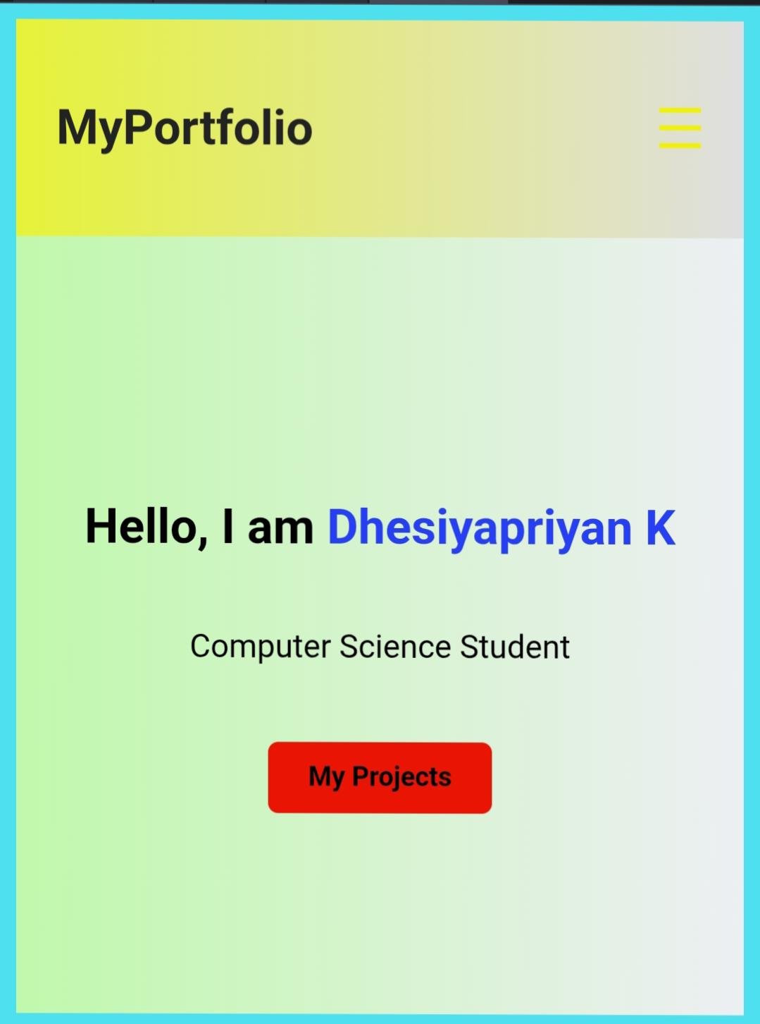
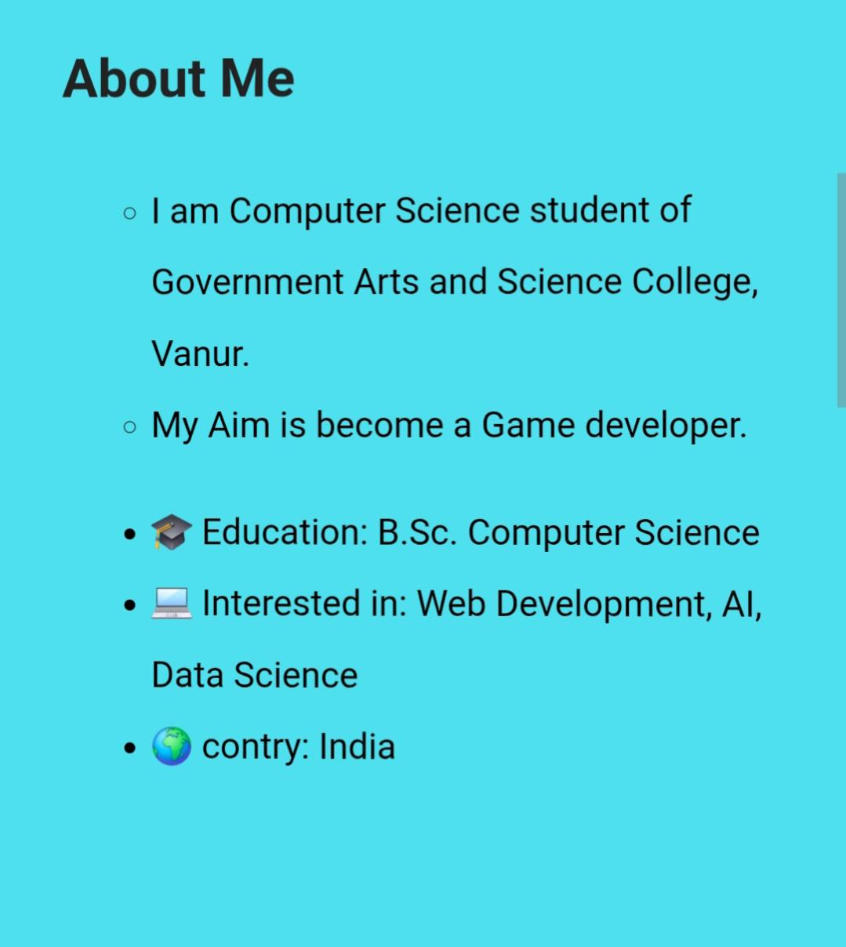

RESULTS AND SCREENSHOTS
3/21/2024 Annual Review
12

Slide 13

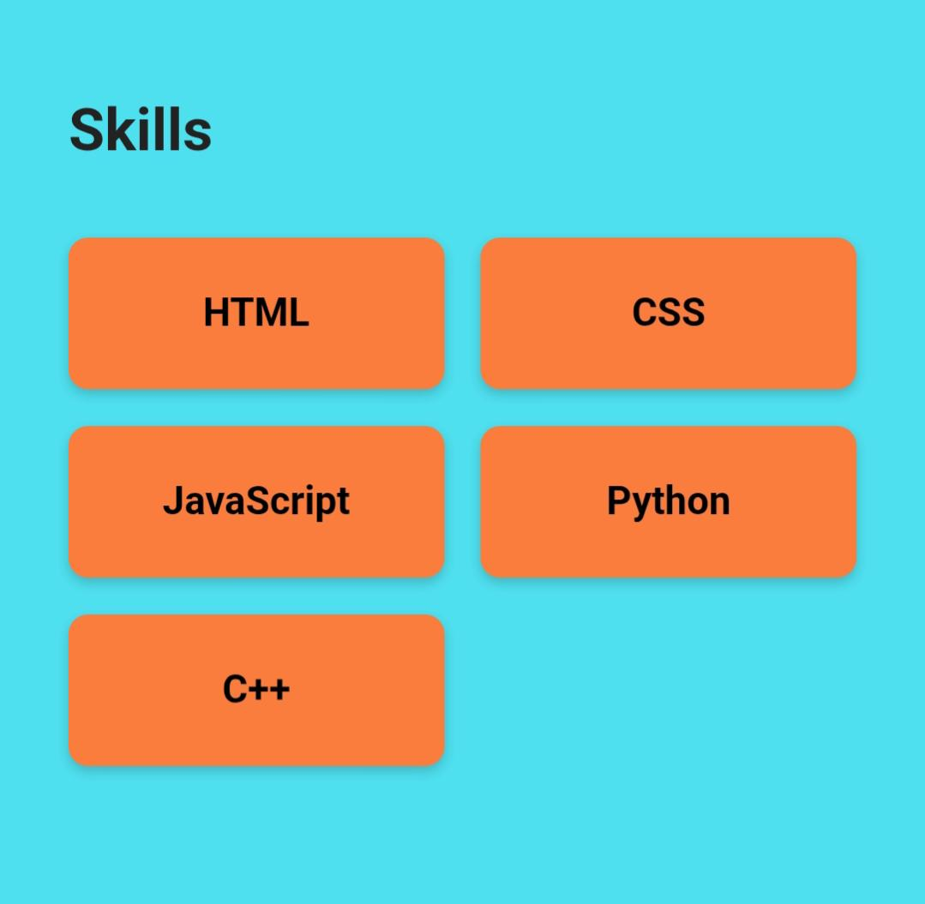
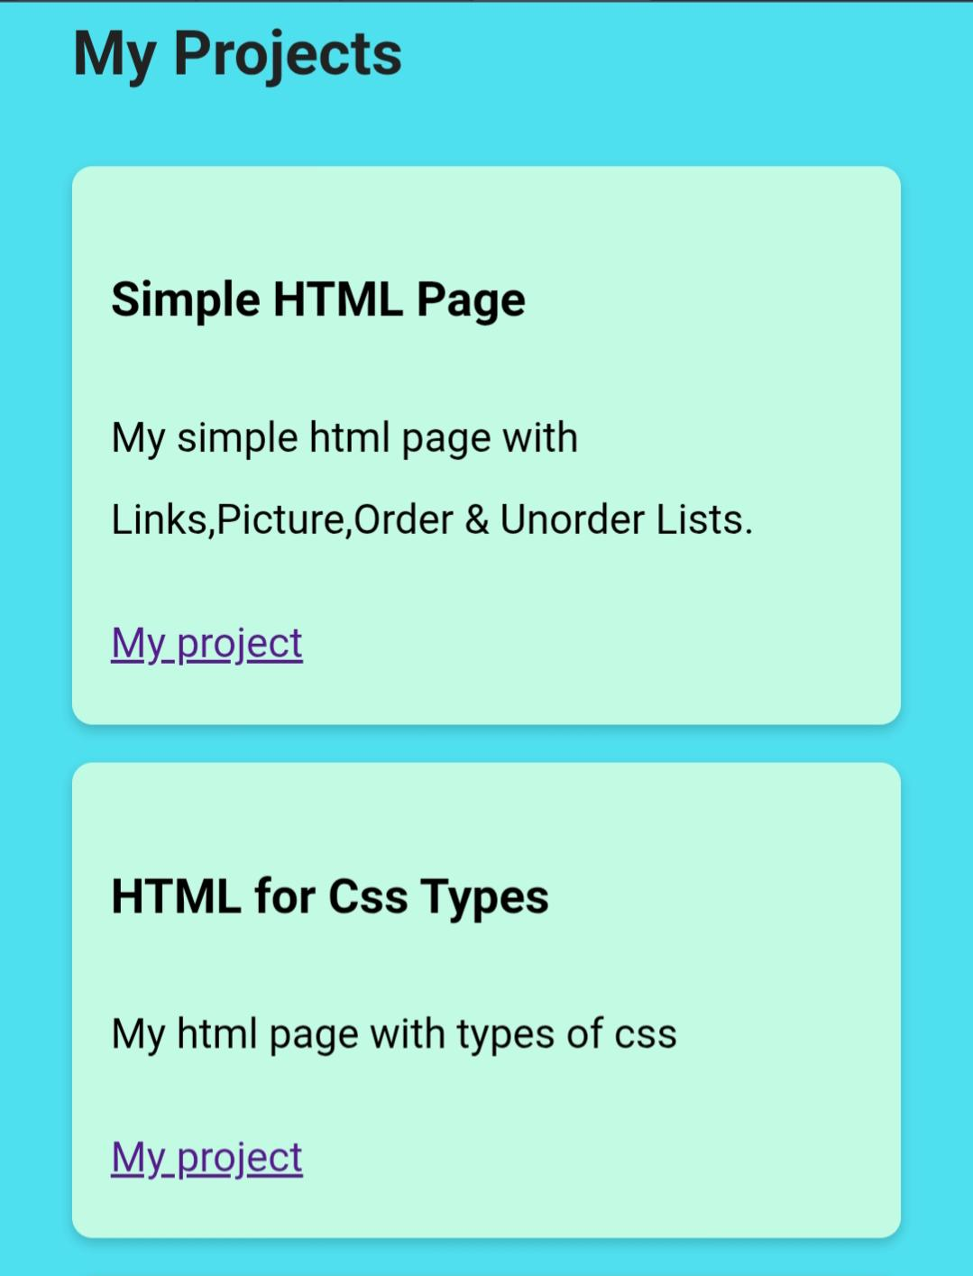
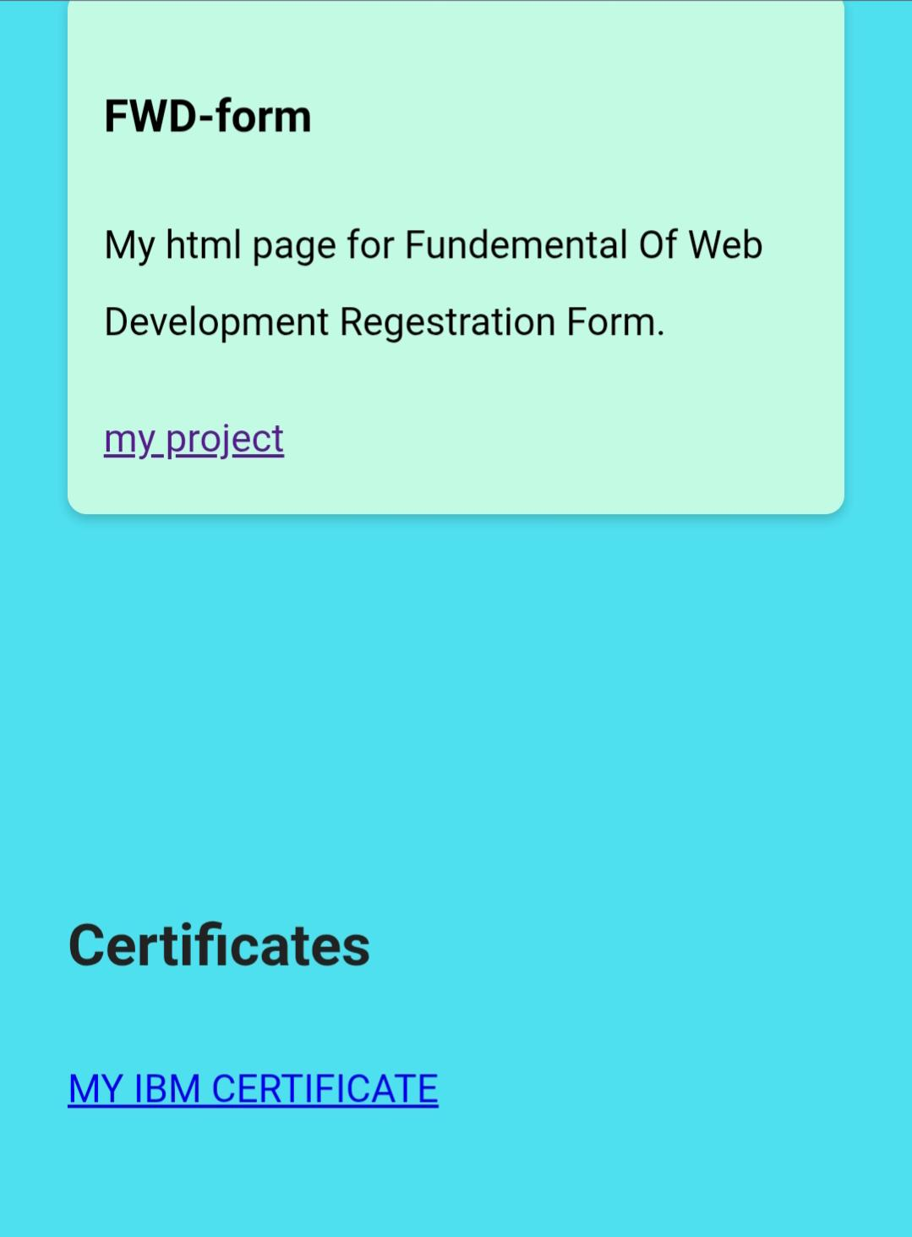
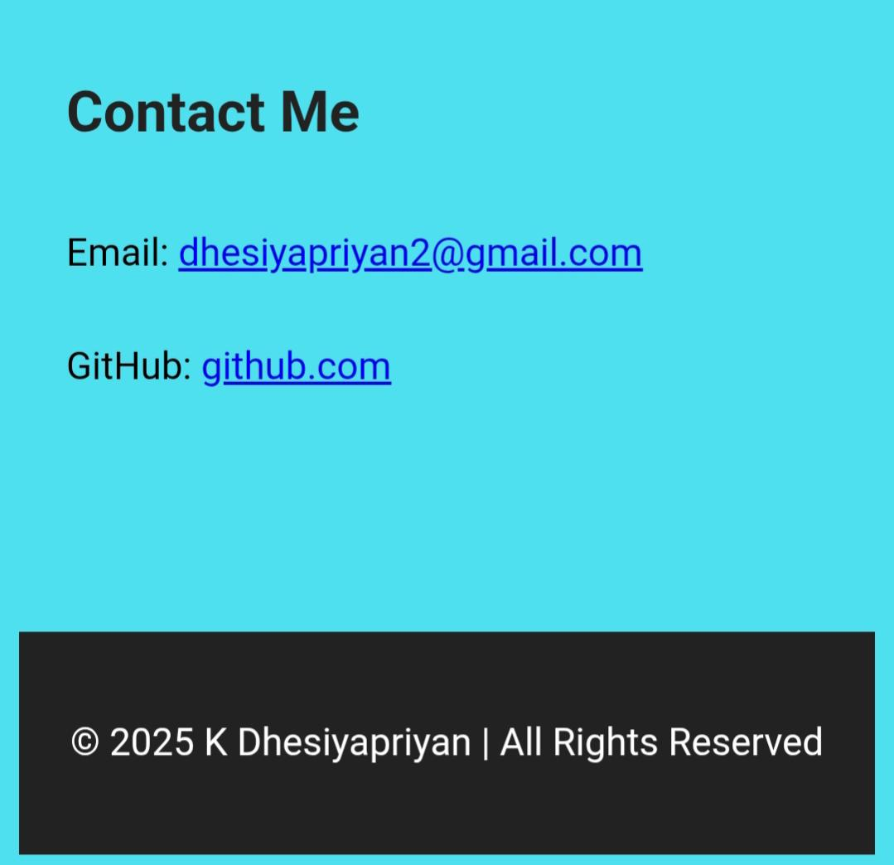
RESULTS AND SCREENSHOTS

Slide 14
CONCLUSION
Creating a student digital portfolio was more than just putting together a few web pages.
it was a hands-on journey through the tools and techniques that shape modern communication.
By using HTML, CSS, and JavaScript, I built a space that reflects my skills, achievements, and personality.
Responsive design ensures it looks great on any device, and interactive features make it easy to explore.
Every section from projects to certificates was carefully crafted to tell my story in a clear way.
These tools not just help me build a website, they helped me build confidence, creativity, and a deeper understanding of digital expression.
14

Slide 15
GITHUB LINK
https://github.com/Dhesiyapriyan/DHesiyapriyan-TNSDC-FWD-DP

