Slide 1
Language Identification in Text Mining using Machine Learning Algorithm
Subtitle

Slide 2
Objective
“Automatic language detection is the ﬁrst step toward achieving a variety of tasks like detecting the source language for machine translation, improving the search relevancy by personalizing the search results according to the query language, providing uniform search box for a multilingual dictionary, tagging data stream from Twitter with appropriate language etc.”

Slide 3
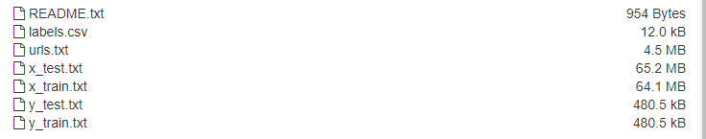
DATASET
dataset Link: https://zenodo.org/record/841984#.XL-6AOhKjIU
WiLI-2018, the Wikipedia language identification benchmark dataset, contains 235000 paragraphs of 235 languages. The dataset is balanced and a train-test split is provided.

Slide 4
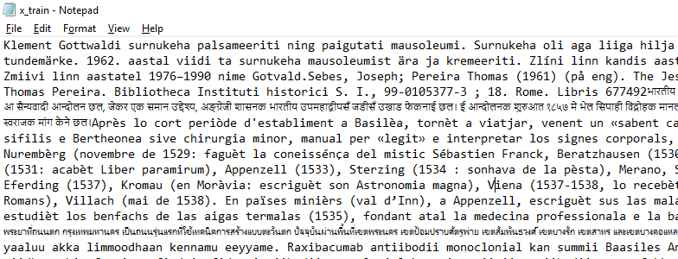
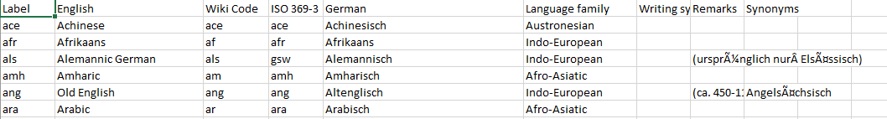
DATASET
Input
Output

Slide 5
Stages in Language verification
Our main contributions are:
we present a method for identifying multilingual documents, the languages contained therein and the relative proportion of the document in each language
we show that our method outperforms state-of-the-art methods for language identiﬁcation in multilingual documents
we show that our method is able to estimate the proportion of the document in each language to a high degree of accuracy
We show that our method is able to identify multilingual documents in real-world data.

Slide 6
Technology
In the past, a variety of methods have been tried like Naive Bayes, SVM, n-gram, graph-based n-gram, prediction partial matching (PPM), linear interpolation with post independent weight optimization and majority voting for combining multiple classiﬁers etc. and the best accuracy achieved are still in the lower ninety percent’s.
In this work we took advantage of recent advancement of deep neural network based models showing stellar performance in many natural language processing tasks to build a state of the art language classiﬁer.

Slide 7
PROPOSED ALGORITHM
Recurrent Neural Network - RNNs are a special kind of neural networks which possess an internal state by virtue of a cycle in their hidden units. As such, RNNs are able to record temporal dependencies among the input sequence, as opposed to most other machine learning algorithms where the inputs are considered independent of each other. Hence, they are very well suited to natural language processing tasks and have been successfully used for applications like speech recognition, hand writing recognition etc.
Hyper-parameter tuning: In our single layer networks, we had three model hyper parameters to search over
Epochs - the number of iterations over training data. We generally try to train until the network saturates.
Hidden layer size - Number of hidden units in the hidden layer.
Dropout - Deep neural networks with large number of parameters are very powerful machines but are extremely susceptible to overﬁtting. Dropout provides a simple way to remedy this problem by randomly dropping hidden units as each example propagates through the network and back

Slide 8
Future work
Further work is required in dealing with cross domain effects, to allow for “ off-the-shelf” language identiﬁcation in multilingual documents. Previous work has shown that it is possible to generate a document representation that is robust to variation across domains and we intend to investigate if these results are also applicable to language identiﬁcation in multilingual documents.

Slide 9
Thank you

