Slide 1
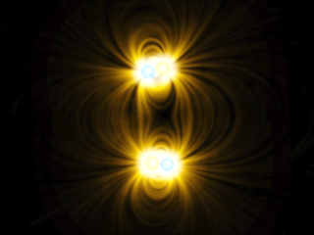
Electromagnetic Field Theory: A Project on Coulomb’s Law
Subject code: EC-210
Scholar ID: 18-14-071

Slide 2
Introduction:
The source of Electromagnetic Fields are charges, which puts them at the core of Electromagnetic Field Theory.
An Electrostatic Field can be considered as a special case of an Electromagnetic field, in which the charges are stationary.
Considering only the magnitude and position of the charges in this special case of static charge, the law centrally governing the study of Electrostatics, is Coulomb’s Law.

Slide 3
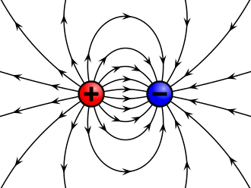
Revisiting the concept of Charges:
Electric charge is the physical property of matter that causes it to experience a force when placed in an electromagnetic field.
Electric charges are carried by subatomic particles, the Electrons and Protons.
Electric charge is a conserved property; the net charge of an isolated system, the amount of positive charge minus the amount of negative charge, cannot change.
A charged object creates an electric field, which surrounds it. If any other charged object enters that space it will feel the effect of the charge. Whether a charged object enters that space or not, the electric field exists.

Slide 4
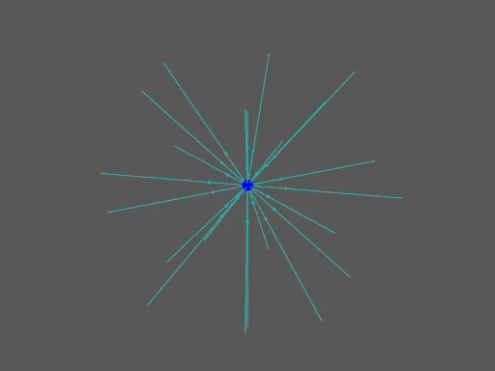
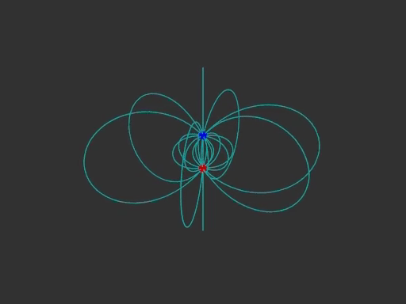
Electric fields created by Charges:
Fig: Single Positive charge and it’s associated perpendicularly outwards Electric field lines, ending at infinity.
Fig: Dipole and it’s Associated Electric field from positive to negative charge
Electric field strength is proportional to the relative number of field lines drawn at that particular region. They are clearly continuous and decrease in density as we move away from the charges.

Slide 5
Properties of Electric Field Lines:
Field lines never intersect each other.
They are perpendicular to the surface charge.
The field is strong when the lines are close together, and it is weak when the field lines move apart from each other.
The number of field lines is directly proportional to the magnitude of the charge.
Electric field line starts from the positive charge and ends at negative charge.
If the charge is single, then they start or end at infinity.
The line curves are continuous in a charge-free region.

Slide 6
The necessity to consider an Electric Field:
It was found experimentally that between any two charged bodies there exists a force that either tends to push them apart if the charges are like, or pull them close together if the charges are of opposite kinds.
This calls into question a reasoning behind this force and it’s Mathematical modelling.
( + ) ➔ ⬅ ( - ) ( - ) ➔ ⬅ ( + ) ( - ) ⬅ ➔ ( - ) ( + ) ⬅ ➔ ( + )
Unlike Charges
Like Charges

Slide 7
Assumptions made, to study this phenomenon:
If the charged bodies are considered to be spherical, the radius of the spheres must be much smaller than the distance between the charged objects.
Fig: Distance between charged bodies >> Radius of charged bodies

Slide 8
Assumptions made to study this phenomenon:
The charged bodies must be sufficiently away from conductive surfaces or from other dielectric media, i.e. media that can be polarized in the presence of Electric Fields. In ideal conditions, the charged bodies should be immersed in an infinite homogenous insulating medium.
Permittivity of the medium, ε:
The absolute permittivity of any medium, often simply called permittivity and denoted by the Greek letter ε, is a measure of the electric polarizability of the dielectric.
It has been experimentally found to have an inversely proportional effect on electrostatic force.

Slide 9
Assumptions made to study this phenomenon:
Individual charges are never stationary, having random velocities. For the study of electrostatics, we consider elementary macroscopic volume, with the assumption that net movement across any face of the volume will be zero, keeping the charged body as a whole stationary.
Fig: Free electrons are always in random motion. But net movement is zero in macro level.

Slide 10
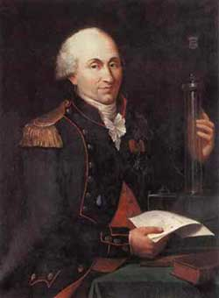
Charles Augustin Coulomb (1736-1806)
Much of the modern physical description of electrical forces, comes from careful experiments done by the French scientist Charles Augustin Coulomb.
Coulomb became interested in measuring the electrical force between small charged objects and perfected a torsion balance, which could reliably measure such small forces.
After the experiments were complete, he wrote “The repulsive force of two small globes with the same nature of electricity is inversely proportional to the square of the distance between the centers of the two globes” in C. A. Coulomb, Premiere Memoire sur l’electricite et le Magnetisme, Histoire de l’Academie Royale des Sciences (1785).

Slide 11
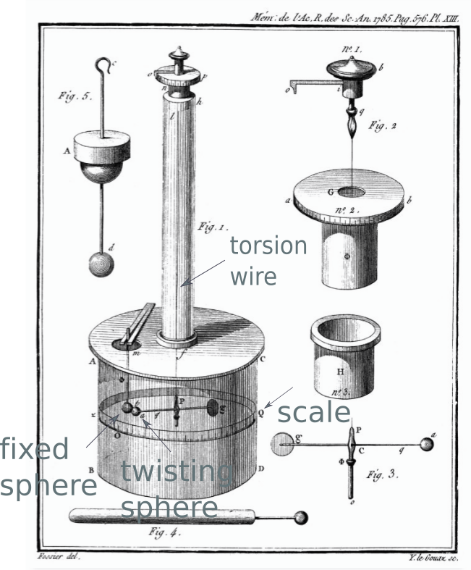
Coulomb’s Torsion Balance Experiments:
Coulomb suspended a needle on a fine fiber of silver, copper, or silk.
The needle held a small electrically charged pith ball at one end and a counterweight at the other end, balanced so that the needle could rotate in a horizontal plane.
The calibrated torsion balance measured the force needed to twist the needle through a given angle.
By bringing a similarly charged pith ball near the one on the needle, Coulomb determined the repulsive force between the charged balls as a function of their separation.
With these experiments, he launched the quantitative study of electric force.

Slide 12
Mathematical Modelling, keeping assumptions in mind:
Let Q₁, Q₂ be two charged bodies considered initially of radius r₁, r₂ respectively.
Let ε represent the permittivity of the medium.
Let Q₁, Q₂ be kept at a distance R apart. By Assumption 1, R >> r₁ and R >> r₂
Our Target is to find the mathematical relation for the force being applied on Q₁ and Q₂. Let this force be F. It is always in the direction connecting the charged bodies.
ε
ε
r₁
r₁
F
F
R
R
r₂
r₂

Slide 13

Inference from experimentally found data:
The Force experienced by the charged bodies was found to be directly proportional to the magnitude of the charge present on either body. i.e. F is directly proportional to Q₁ and F is directly proportional to Q₂ Therefore, F is directly proportional to Q₁ * Q₂
The Force experienced by the charged bodies was found to be proportional to the square of the inverse of the distance between the two charges. i.e. F is directly proportional to $\frac{1}{R^{2}}$
The radius of the charged bodies was found to have no notable effect on the Force experienced by the bodies.
In conclusion, F is directly proportional to Q₁ * Q₂ and F is directly proportional to $\frac{1}{R^{2}}$. Therefore, F is directly proportional to $\frac{\text{Q}\text{1}\text{ ∗ }\text{Q}\text{2}}{R^{2}}$ This was dubbed Coulomb’s Law.

Slide 14

Considering a medium-dependant constant of proportionality, k
Derived Coulomb’s Law formula is hence, $$F=\frac{\text{Q}\text{1}\text{∗ }\text{Q}\text{2}}{kR^{2}}$$
In CGS system, k = 1 was chosen arbitrarily, and Unit charge was hence defined from above equation.
In MKS system, Unit charge is already defined from other considerations, and units of length and Force are also defined. Therefore, the value of k had to be found experimentally.
F is along the line connecting the centres of the charged bodies.

Slide 15

The proportionality constant, k for MKS system:
The requirement arrives that force is to be measured in newtons (N), distance in meters(m), and charge to be measured in coulomb(C), which is defined as the charge accumulated when a current of 1 ampere flows for one second.
The parameter k should hence be allocated the unit C²⋅N⁻¹⋅m⁻² or equivalent units, in practice “farads per metre” as $\text{k}=\frac{\text{Q}\text{1}\text{∗ }\text{Q}\text{2}}{FR^{2}}$
In order to rationalize the units and to leave Maxwell’s Field equations free from the factor $4π$in further studies, we explicitly introduce the factor $4π$ into k and take permittivity ε₀ which determines k, into consideration. $k=4π\text{ε}$
The relationship existing between permittivity ε, permeability μ and the speed of light c in the particular medium, taking Ampere as the fundamental unit of electricity and magnetism, is used to derive ε for that particular medium.

Slide 16

Calculating permittivity for vacuum, ε₀:
In vacuum or free space, value of
Permeability of the medium, μ₀ = $4π ∗{10}^{−7}$ N/A²
Speed of light in the medium, c = 299792458 m/s
The fundamental relationship existing between permittivity ε, permeability μ and the speed of light c is ε = $\frac{1}{{\text{c}}^{2} ∗ \text{μ}}$. Hence, for vacuum and free space,
For any medium r, we can consider permittivity ε to be a linear multiple of permittivity of free space ε₀. Therefore, considering a ε_{r} scaling factor,
ε = ε_{r} * ε₀

Slide 17

Final Coulomb’s law formula:
Derived Coulomb’s Law formula in any medium r with permittivity ε_{r} is hence,
$$F=\frac{\text{Q}\text{1}\text{∗ }\text{Q}\text{2}}{4π\text{ε}{∗R}^{2}}\hat{r}$$
$\hat{r} i$s along the direction joining the centres of $\text{Q}\text{1}$ and $\text{Q}\text{2}$
ε = ε_{r} $∗$ε₀
ε₀ = $\frac{1}{{\text{c}}^{2} ∗ \text{μ}\text{0}}$ = 8.854 * 10⁻¹² F/m

Slide 18

Superposition principle for Coulomb’s law:
In case of a system of N charged bodies Q1, Q2, Q3, …, Qi, …, QN placed under the same assumptions of Coulomb’s law, any charged body Qi will face a net force on it represented by
(F_{Qi})_{Net} = F_{QiQ1} + F_{QiQ2} + F_{QiQ3} + … + F_{QiQN}
Where F_{AB} is the Force on A because of B.
This is because each charged particle exhibits an Electric field that is independent of all other electric fields present in the system.
Taking the medium dependant constant and Qi in common,
(F_{Qi})_{Net} = $\frac{\text{Q}i}{k}$ * $\sum_{x=1}^{N}{\frac{Qx}{{Rx}^{2}}}$ with x ≠ i

Slide 19

Results about Electric Field from Coulomb’s law:
If we consider a small probe charge ∆q at any point near another charge q, the small ∆F force on ∆q can be given by Coulomb’s law based on the distance R between them as:
$$∆F=\frac{\text{q}\text{ ∗ }∆\text{q}}{4π\text{ε}\text{r}R^{2}}$$
The direction is dependant on the relative location of the two charges.
About the charge q there is then said to be an Electric field of strength E, magnitude of which is given by the force on q per unit charge at the point. So, considering E = $\frac{∆F}{∆\text{q}}$,
$E=\frac{\text{q} }{4π\text{ε}\text{r}R^{2}}$ is the Electric field strength for the charge q

Slide 20
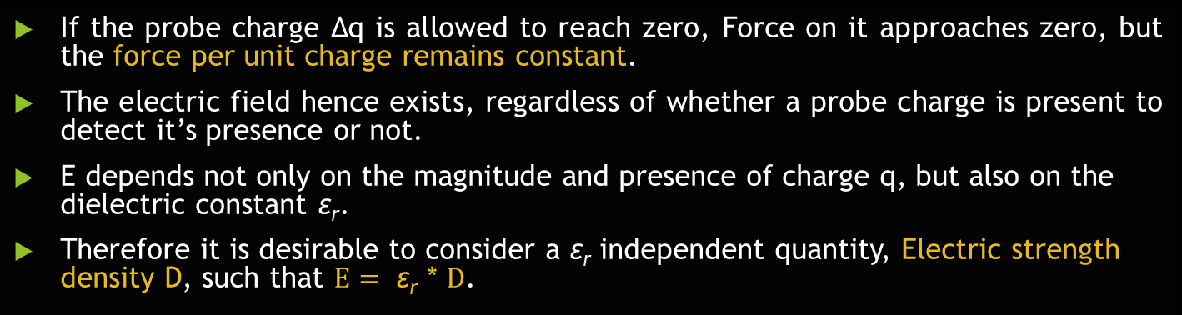

Further details about Electric Field Strength:
Vector form of Electric Field strength is, $E=\frac{\text{q} }{4π\text{ε}\text{r}R^{2}}$ $\hat{R}$
where $\hat{R}$ is the unit vector along the outer radial from charge q
If the probe charge ∆q is allowed to reach zero, Force on it approaches zero, but the force per unit charge remains constant.
The electric field hence exists, regardless of whether a probe charge is present to detect it’s presence or not.
E depends not only on the magnitude and presence of charge q, but also on the dielectric constant $\text{ε}\text{r}$.
Therefore it is desirable to consider a $\text{ε}\text{r}$ independent quantity, Electric strength density D, such that $E= \text{ε}\text{r}$ * $D$.

Slide 21
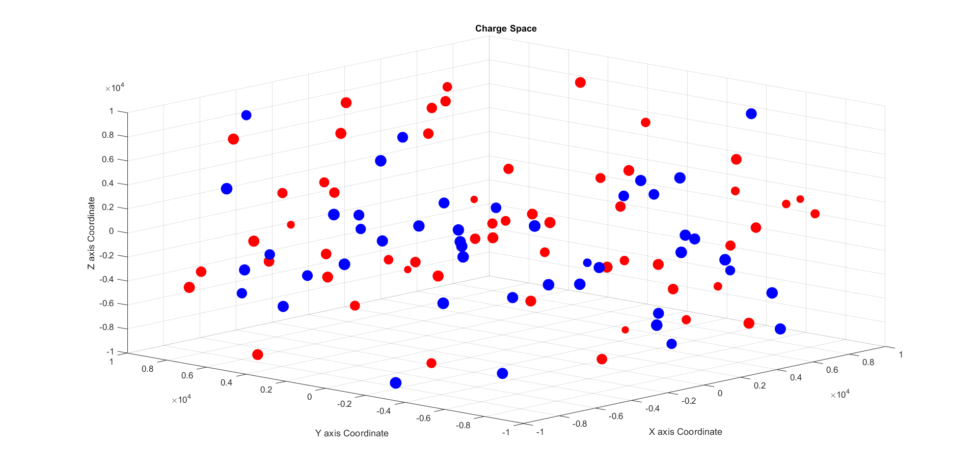
MATLAB Modelling, keeping assumptions in mind:
Let charge_space be a Structure Array with x_coord, y_coord, z_coord coordinates and mag magnitude as properties of the Structure, representing the simulated medium obeying the necessary assumptions of Coulomb’s Law.
Then, length(charged_space) gives the number of Charged particles in charge_space.
Let charge_space_permittivity represents the permittivity of the medium.
Fig: Simulation of a 3D Charge Space in MATLAB, where 100 random charges have been generated, for which force and Electric Field Strength can be calculated for any Charge.
Radius of the spheres highlight relative magnitudes of the charges.

Slide 22
Fig: The 3D Charge Space in MATLAB, where 100 random charges have been generated, represented as a 3D Scatter plot with positive charges as Red and negative charges as Blue. Radius of charge is not to scale.

Slide 23
Client functions coded into the MATLAB code for simulation and analysis:
The menu() client function can be called to
Add charged bodies into charge_space. Positive Charges are Red and Negative are Blue.
Remove charged bodies from charge_space.
Generate N random charged bodies in charge_space.
Display information i.e. Location and Magnitude of any charged body.
Plot the charge_space as a 3-Dimensional scatter plot.
The calc() client function can be called to
Change permittivity of charge_space.
Calculate net force on any charge in charge_space.
Calculate force between any two charges.
Calculate net Electric Field strength in any point in charge_space.
The plot_graphs() client function can be used to graphically test the relationship of the parameters with the force.

Slide 24
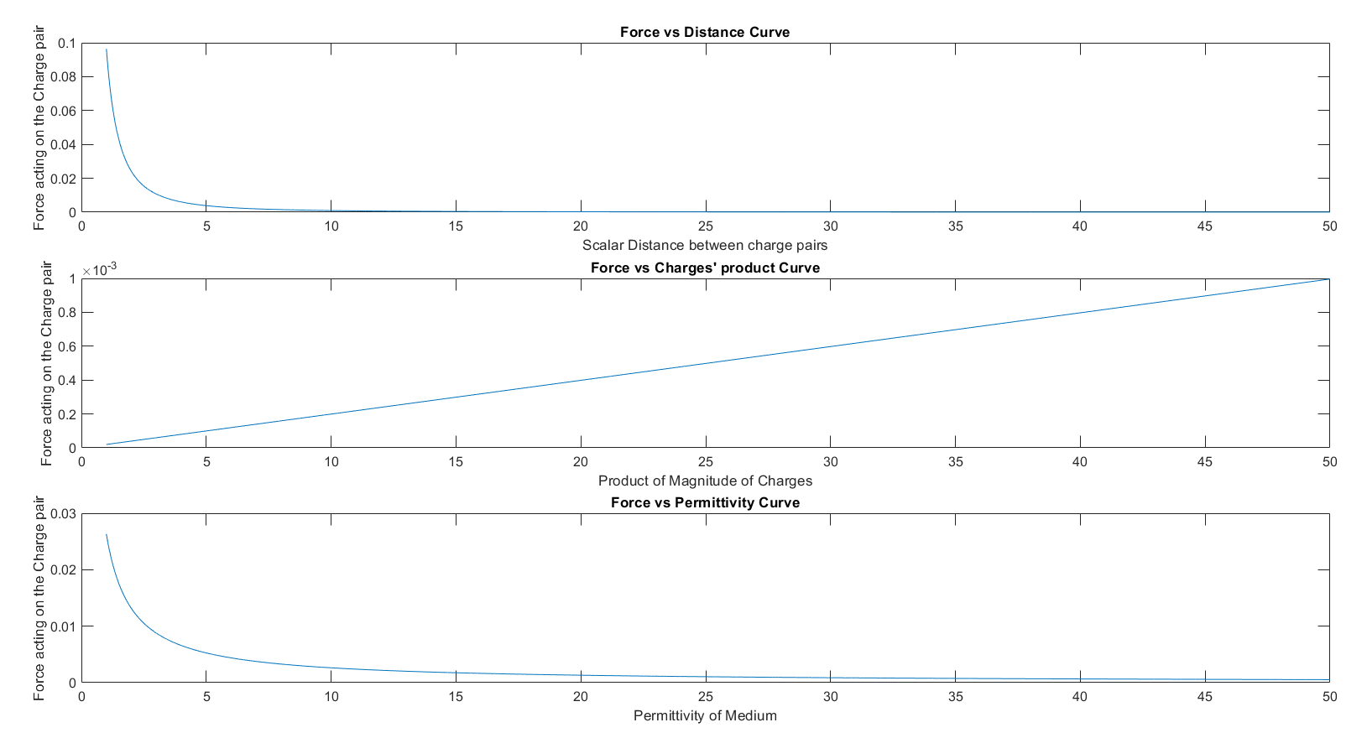
Fig: Graphical analysis of the parameters product of magnitude of charges, scalar distance between charges and permittivity of medium in Coulomb’s Law Formula, keeping other parameters constant in each case. Done using plot_graphs()

Slide 25
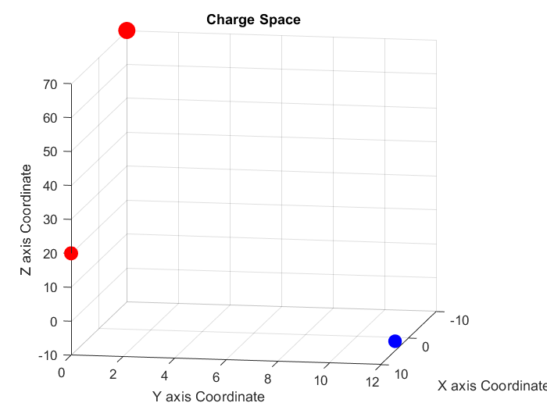
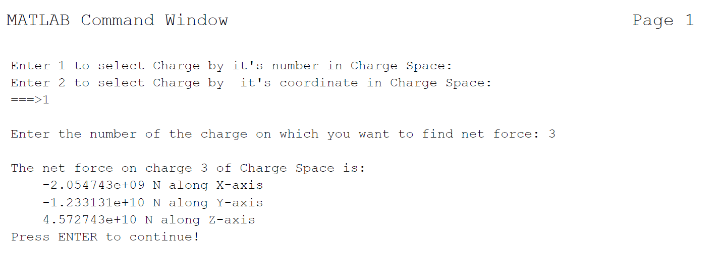
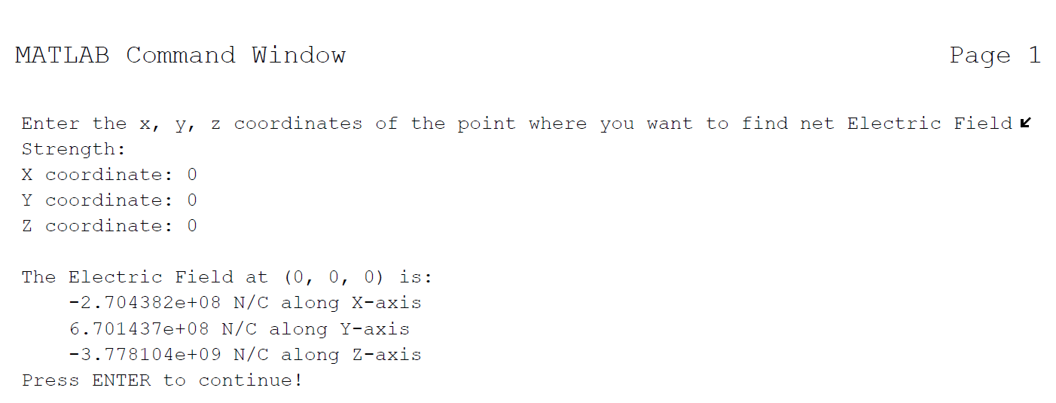
Example of a simulation using menu() function and calculation using calc() function:
Fig: Net Force calculated on Charge 3 (5, 12, -7) by the other two Charges, and verified to be correct.
Fig: Simulation of a 3D Charge Space in MATLAB, where 3 charges were generated in
(10, 0, 20); Magnitude = 100 C
(-10, 0, 70); Magnitude = 1000 C
(5, 12, -7); Magnitude = -20 C
Fig: Net Electric Field strength calculated in Charge Space at (0, 0, 0), and verified to be correct.

Slide 26
Sources:
Edward Conrad Jordan - Electromagnetic Waves and Radiating Systems-Prentice Hall (1968)
C. Stewart Gillmor, Coulomb and the Evolution of Physics and Engineering in Eighteenth Century France (Princeton University Press, Princeton, New Jersey, 1971).
C. A. Coulomb, Premiere Memoire sur l’electricite et le Magnetisme, Histoire de l’Academie Royale des Sciences, 569-577 (1785)
https://www.aps.org/publications/apsnews/201606/physicshistory.cfm
Animation of Electric Field Lines: http://phys23p.sl.psu.edu/phys_anim/EM/indexer_EMB.html
MATLAB Code CoulombsLaw.m, written for the purpose of this Project.

Slide 27
Thank You.
Subject code: EC-210
Scholar ID: 18-14-071

