Slide 1
Video Game Sales
Dhileas Heywood

Slide 2
Project Brief
To understand what types of games sell a lot of copies
In particular, analysis to help make a decision on which direction to take the company

Slide 3
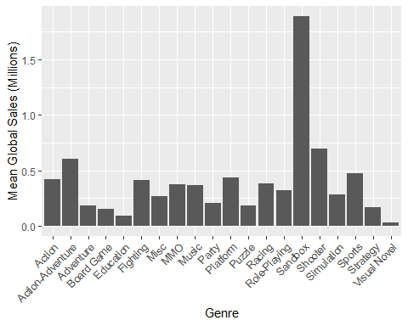
What Genre of Games Sells the Most Copies?

Slide 4
But How Many Games are in Each Category?
genre | Mean Global Sales | Number of Games
Education | 0.0900000 | 1
Sandbox | 1.8900000 | 1
Board Game | 0.1550000 | 2
MMO | 0.3706250 | 16
Party | 0.2073077 | 21
Music | 0.3693007 | 80
Visual Novel | 0.0304386 | 87
Action-Adventure | 0.6048638 | 120
Puzzle | 0.1854916 | 589
Platform | 0.4387177 | 614
Fighting | 0.4085360 | 641
Strategy | 0.1680186 | 733

Slide 5
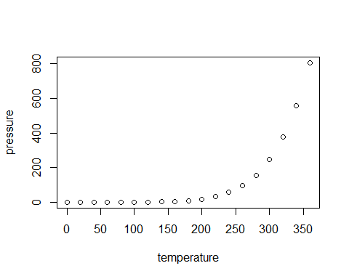
Slide with Plot

