Slide 1
Video Game Sales
Dhileas Heywood

Slide 2
Project Brief
To understand what types of games sell a lot of copies
In particular, analysis to help make a decision on which direction to take the company

Slide 3
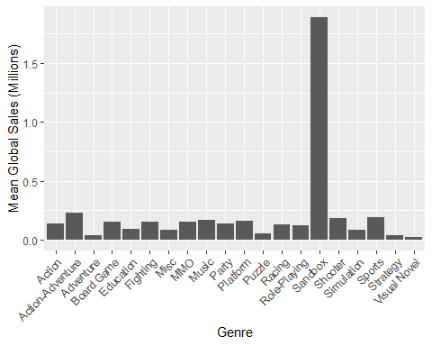
What Genre of Games Sells the Most Copies?

Slide 4
But How Many Games are in Each Category?
genre | Median Global Sales | Number of Games
Education | 0.090 | 1
Sandbox | 1.890 | 1
Board Game | 0.155 | 2
MMO | 0.150 | 16
Party | 0.135 | 21
Music | 0.170 | 80
Visual Novel | 0.020 | 87
Action-Adventure | 0.230 | 120
Fighting | 0.150 | 492
Platform | 0.160 | 508
Puzzle | 0.050 | 523
Strategy | 0.040 | 626

Slide 5
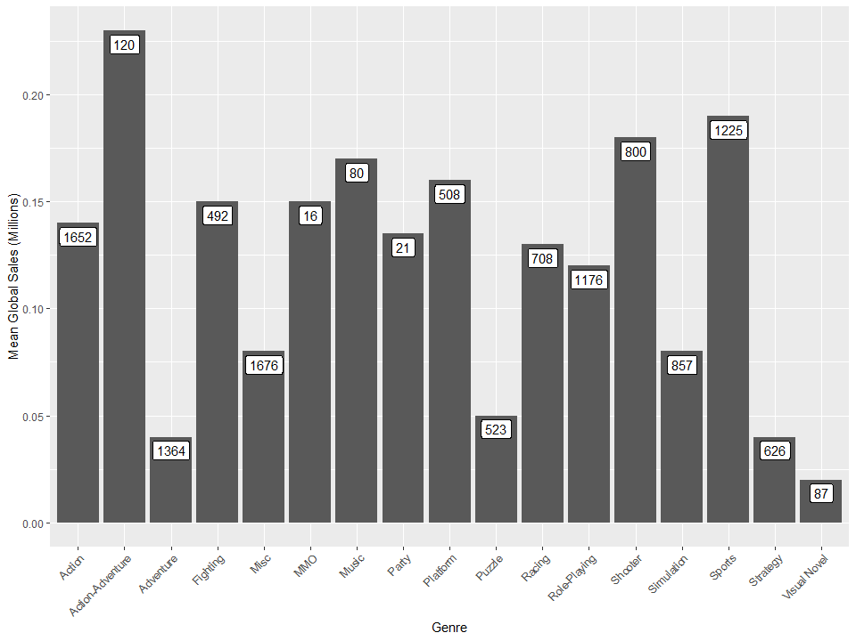
Corrected to Compensate for Minecraft

Slide 6
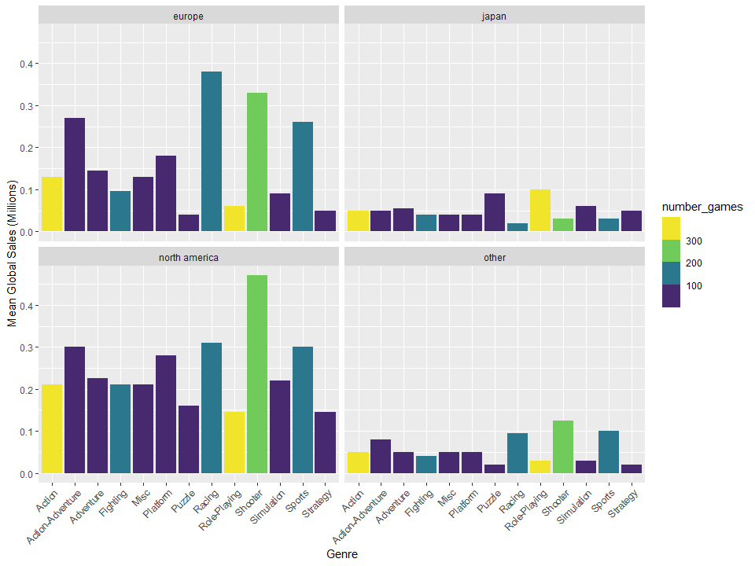
What About Seperate Markets?

Slide 7
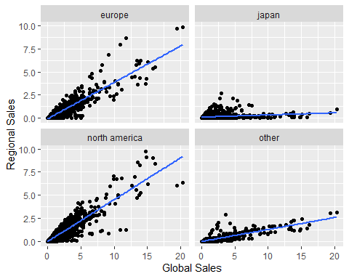
The Global Markets

Slide 8
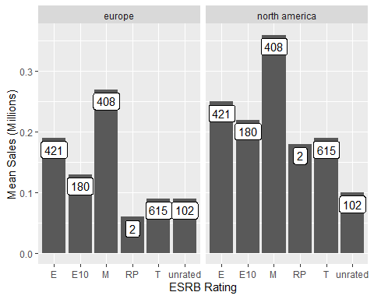
How do Sales Compare With Rating?

Slide 9
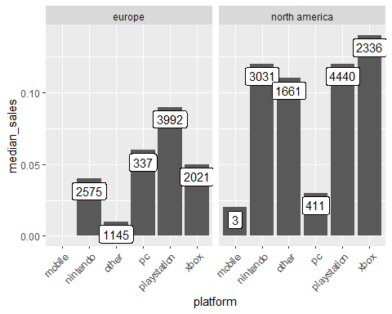
How Do Sales Differ for Different Platforms?

Slide 10
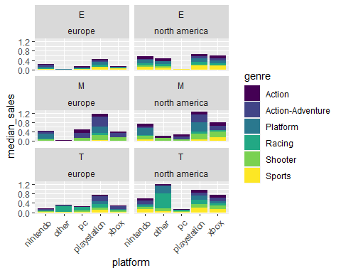
When This is Put Together

Slide 11
In Conclusion
Games with an ESRB rating of “Mature” sell more games on average
Games released on XBox and PlayStation sell well in Europe and North America
Games in the Shooter, Platform and Action/Action-Adventure genres sell well.

Slide 12
Any Questions?

