Slide 1
HEALTHCARE OPERATIONS ANALYTICS
NHS Outpatient Appointment Attendance & Operations Intelligence Platform
An End-to-End Data Engineering, MySQL Analytics, and Power BI Business Intelligence Project
Presenter : Dhiliban R | Junior Data Analyst
Target Audience : Clinical Operations Board & Healthcare BI Stakeholders
Domain : Healthcare - Hospital Operations & Patient Attendance Strategy
1

Slide 2
Project Executive Overview
•
Core Focus
Operational analytics platform built to evaluate patient non-attendance (“no-shows”) across NHS outpatient departments.
AT A GLANCE
110,527
•
Scope
Analysed 110,527 patient encounter records across 81 regional health centres.
Patient encounters analysed
Technical Approach
Ingested raw clinical data into MySQL 8.0+, performed ETL data cleaning and feature engineering, calculated advanced DAX measures in Power BI, and published a 2-page interactive executive report.
20.19%
•
Baseline no-show rate
•
Primary Goal
Identify scheduling bottlenecks, resolve statistical paradoxes in digital outreach, isolate demographic risk cohorts, and recommend data-driven operational interventions.
81
Regional health centres covered
2

Slide 3
Industry Context & Business Problem Statement
Non-attendance in outpatient clinics represents a major source of wasted clinical capacity and financial loss across the NHS.
20.19%
22,319
1 in 5
Unfulfilled No-Shows
consultation slots yields zero clinical output
Overall No-Show Rate
out of 110,527 scheduled appointments
⏱
↻
✉
Clinical Idle Time
Waiting Queue Inflation
Misleading Communication Metrics
1 in every 5 consultation slots yields zero clinical output, wasting scarce specialist capacity.
Missed consultations force patients back into scheduling queues, expanding regional waiting lists.
Unadjusted aggregate data misleadingly suggested SMS reminders increased non-attendance, confusing management.
3

Slide 4
Enterprise Analytics Tech Stack
DB
SQL
BI
GH
MySQL 8.0+
SQL
Power BI Desktop
GitHub
DATABASE ENGINE
DATA TRANSFORMATION
BUSINESS INTELLIGENCE
VERSION CONTROL
Enterprise relational database host for staging raw encounter records, schema constraints, and primary/foreign key definitions.
Scripted ETL pipeline for data type casting, string normalisation, lead-time calculation (DATEDIFF), and feature engineering (CASE WHEN).
Connected directly to the MySQL data mart via Power Query, modeling tabular relationships, custom DAX metrics, and interactive visuals.
Structured repository hosting SQL scripts, documentation, screenshots, and .pbix deliverables.
Additional staging layer: Power Query (M) — intermediate data transformation, date format standardisation, and column profiling.
4

Slide 5
Dataset Architecture & Source Metadata
SOURCE
RECORD VOLUME
GRANULARITY
NHS Outpatient Appointment Encounter Dataset
110,527 raw → 110,526 cleaned rows
1 row per AppointmentID
Key Raw Fields
Field Group | Fields
Unique Identifiers | PatientId, AppointmentID
Demographics & Location | Gender, Age, Neighbourhood
Timestamps | ScheduledDay, AppointmentDay
Medical Flags | Scholarship, Hipertension, Diabetes, Alcoholism, Handcap
Digital Outreach Flag | SMS_received (0 = No, 1 = Yes)
Target Status Label | No-show ('Yes' / 'No')
5

Slide 6
Relational Database Design in MySQL
CREATE DATABASE IF NOT EXISTS
NHS_Outpatient_DB;
USE NHS_Outpatient_DB;
CREATE TABLE raw_appointments (
PatientId BIGINT NOT NULL,
AppointmentID BIGINT NOT NULL
PRIMARY KEY,
Gender VARCHAR(10) NOT NULL,
ScheduledDay DATETIME NOT NULL,
...
);
✓
Database Creation
Created NHS_Outpatient_DB configured with utf8mb4 encoding (database_creation.sql).
✓
Staging Schema (raw_appointments)
Created initial landing table reflecting raw CSV structure with exact datatypes (table_creation.sql).
✓
Data Integrity Checks
Verified primary key uniqueness on AppointmentID and enforced NOT NULL constraints across demographic attributes.
6

Slide 7
Connecting MySQL to Power BI
Data Connector
MySQL Server
Utilized Power BI's native MySQL Database Connector via Database → MySQL Database.
↓
Connection Protocol
Power BI Connector
Specified Server (localhost:3306) and Database (NHS_Outpatient_DB).
↓
Import Mode (Selected)
Power Query Staging
Ingested data into Power BI's in-memory VertiPaq engine for high-performance DAX calculations and offline dashboard rendering.
↓
Authentication & Security
VertiPaq Data Model
Managed database user credentials using encrypted native database authentication.
7

Slide 8
Data Ingestion & Power Query ETL Transformations
1
2
3
4
Data Ingestion
Column Profiling
Type Enforcement
Data Model Setup
Loaded clean_appointments table generated from the MySQL script into Power Query Editor.
Checked data distributions, column quality, and zero-null assertions across 110,526 rows.
Formatted numerical values (percentage formats for rates, whole number for encounter counts).
Standardized date formats (Date type for scheduled_date and appointments_date), integer types for metrics, and text types for categorical slicers.
Mock: Power Query Editor — Applied Steps panel showing column type changes, filtered rows, and renamed columns in sequence.
8

Slide 9
SQL & ETL Data Cleaning Transformations
BEFORE
AFTER
Age (raw)
Age ≥ 0 (anomaly removed)
ScheduledDay / AppointmentDay
lead_time_days = DATEDIFF(...)
Age (continuous)
6 lead-time tiers + 4 age cohorts
Hipertension, Diabetes,
Alcoholism, Handcap
has_chronic_condition (composite flag)
• lead_time_days = DATEDIFF(AppointmentDay, ScheduledDay)
• 6 tiers: 0 Days (Same Day), 1–3, 4–7, 8–14, 15–30, 31+ Days
• 4 age_cohorts: 0–17 Pediatric, 18–35 Young Adult, 36–60 Adult, 61+ Senior
9

Slide 10
Core DAX KPI Metrics in Power BI
Total Appointments
110,526
Total No Shows
22,319
Total Appointments =
COUNT(clean_appointments[appointment_id])
Total No Shows =
SUM(clean_appointments[is_noshow])
Total Attended
88,207
No Show Rate %
20.19%
Total Attended =
[Total Appointments] - [Total No Shows]
No Show Rate % =
DIVIDE([Total No Shows],
[Total Appointments], 0)
Same Day No Show Rate % = CALCULATE([No Show Rate %], clean_appointments[lead_time_category] = "0 Days (Same Day)")
10

Slide 11
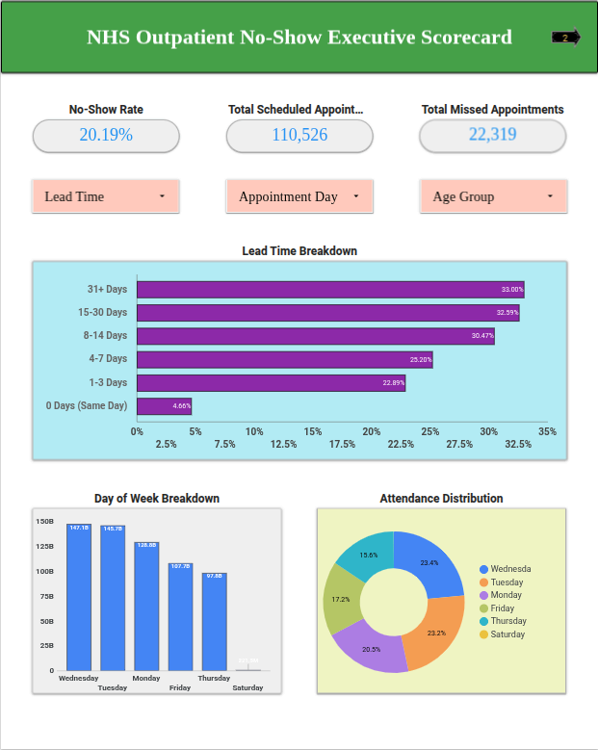
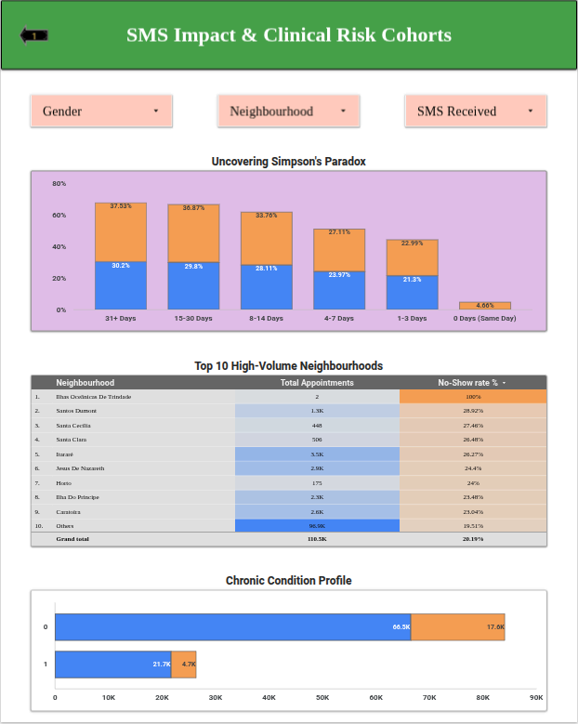
2-Page BI Dashboard Design Architecture
Built a structured 2-page executive report tailored for clinical leads and operations boards, following a top-to-bottom Z-pattern with global slicer headers, executive KPI scorecards, and lower detail visual grids.
Page 1 — Operational Executive Overview
Focuses on overall macro KPIs, attendance decay across lead times, weekday distribution, and attendance ratios.
Page 2 — Strategic Intervention & Clinical Risk Cohorts
Deep-dives into Simpson's Paradox (SMS efficiency), geographic neighbourhood clinic heatmaps, and chronic illness compliance profiles.
11

Slide 12
Key Dashboard Visualizations
Page 1 — Core Visuals
Page 2 — Core Visuals
Scorecard Banner — Total Appointments (110,526), Total No-Shows (22,319), No-Show Rate (20.19%)
Grouped Bar Chart — No-Show Rate % by sms_received across lead_time_category (resolves Simpson's Paradox)
Horizontal Bar Chart — No-Show Rate % by lead_time_category (attendance decay)
Heatmap Table — Top 10 neighbourhood clinics ranked by volume and no-show rate
Column Chart — No-Show Rate % by appointment_day_of_week
Stacked Bar Chart — Attendance status distribution across has_chronic_condition cohorts
Donut Chart — Attendance proportion share across weekday schedules
12

Slide 13
Interactive Filtering & Slicing Controls
Every dashboard page features top-aligned interactive slicer dropdowns for real-time cohort filtering.
Page 1 Slicers
Page 2 Slicers
appointment_day_of_week ( Mon–Sat )
gender ( Female / Male )
age_group ( Pediatric / Young Adult / Adult / Senior )
neighbourhood ( 81 regional clinic locations )
lead_time_category ( 0 Days – 31+ Days )
sms_received ( 0 = No SMS / 1 = SMS Sent )
has_chronic_condition ( Binary flag )
13

Slide 14
Strategic Business Insights
1
Simpson's Paradox Uncovered
2
Booking Lead-Time Decay
Aggregate data showed SMS receivers had higher no-shows (27.57% vs 16.70%). Controlling for lead time proves SMS reminders reduce non-attendance across every lead-time category — up to +7.44% attendance lift for 15–30 day bookings.
Attendance drops sharply as lead time increases — from 4.65% no-show rate for same-day bookings up to 32.59% for 15–30 day bookings.
3
Chronic Illness Compliance
4
Geographic Variance
Chronically ill patients achieve an 82.14% attendance rate (17.86% no-show rate), outperforming non-chronic patients (20.93% no-show rate).
High-volume clinics exhibit severe variance: Itararé experiences a 26.27% no-show rate compared to Santa Martha at 15.84%.
14

Slide 15
End-to-End Analytics Execution Workflow
Raw CSV Ingestion (110,527 records)
Power BI Import Integration & Data Modeling
1
→
5
↓
↓
MySQL Database Setup & Staging Schema Creation
↓
DAX Metric Engineering (KPIs, Rates, Aggregations)
2
6
↓
↓
↓
SQL Data Cleaning, Type Casting & Feature Engineering
2-Page Interactive BI Dashboard Construction
3
7
↓
↓
MySQL Analytical Query Execution (Cohort & Trend Analysis)
↓
Executive Documentation & GitHub Repository Publishing
4
→
8
15

Slide 16
GitHub Repository & Project Deliverables
Repository: Healthcare-Outpatient-Analytics
README.md
Master Project Documentation & Whitepaper
Healthcare-Outpatient-Analytics/
├── README.md
├── SQL/
│ ├── database_creation.sql
│ ├── table_creation.sql
│ ├── data_cleaning.sql
│ └── analysis_queries.sql
├── Dataset/
│ ├── raw_appointments.csv
│ └── clean_appointments.csv
├── PowerBI/
│ └── Health-Care_Report.pbix
├── Screenshots/
│ ├── Operational Executive Overview.png
│ └── Strategic Intervention & Clinical Risk Cohorts.png
└── Documentation/
├── Health-Care_Report.pdf
└── NHS_Healthcare_Analytics_Presentation.pptx
SQL/
database_creation.sql, table_creation.sql, data_cleaning.sql, analysis_queries.sql
Dataset/
raw_appointments.csv, clean_appointments.csv
PowerBI/
Health-Care_Report.pbix
Screenshots/
Operational Executive Overview.png, Strategic Intervention & Clinical Risk Cohorts.png
Documentation/
Health-Care_Report.pdf, NHS_Healthcare_Analytics_Presentation.pptx
Published — available for recruiter and technical stakeholder review
16

