Slide 1

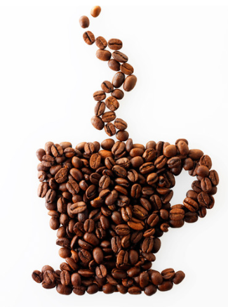
Exploring Coffee Quality Data with Power BI Overview
The Coffee Quality Institute (CQI)
Analysis of Coffee Quality and Attributes
Present by
Dhilip Prakash S

Slide 2

Project Overview
StakeHolders
Country & Region
Factors that contribute to Cup Points
Key Influencers
Quality Trends
How Altitude Influence Other Attributes
Defect Analysis
OutCome of the analysis

Slide 3

Project Overview
The Coffee Quality Institute (CQI) is a non-profit organization that works to improve the quality and value of coffee worldwide.
It was founded in 1996 and has its headquarters in California, USA.
CQI's mission is to promote coffee quality through a range of activities that include research, training, and certification programs. The organization works with coffee growers, processors, roasters, and other stakeholders to improve coffee quality standards, promote sustainability, and support the development of the specialty coffee industry.

Slide 4
StakeHolders
Coffee
Growers,
Processors,
Roasters, and
other stakeholders like Socitey, Nature, Government authorities

Slide 5
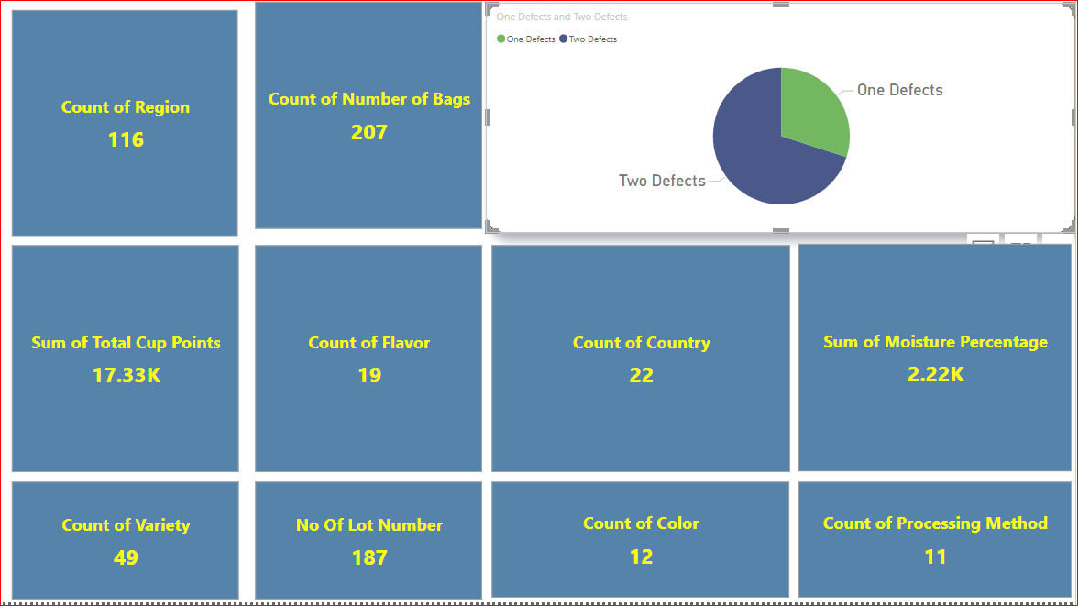

Slide 6
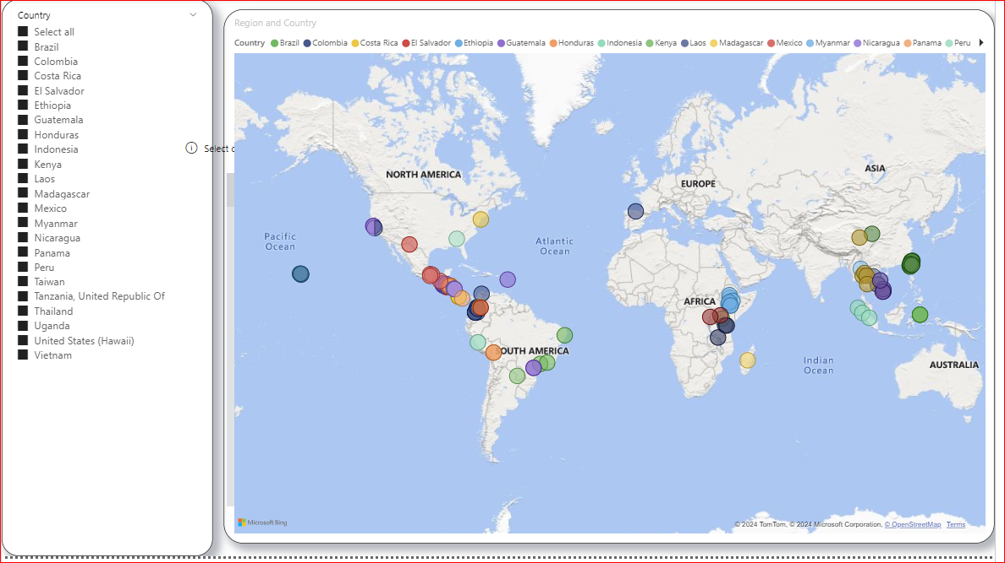
Country & Region
22 Countries 116 Region

Slide 7
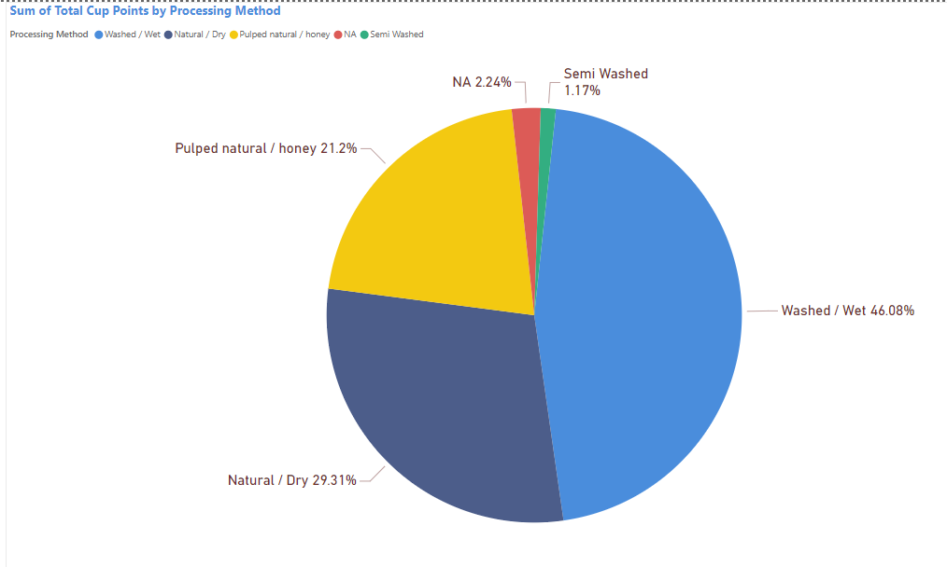
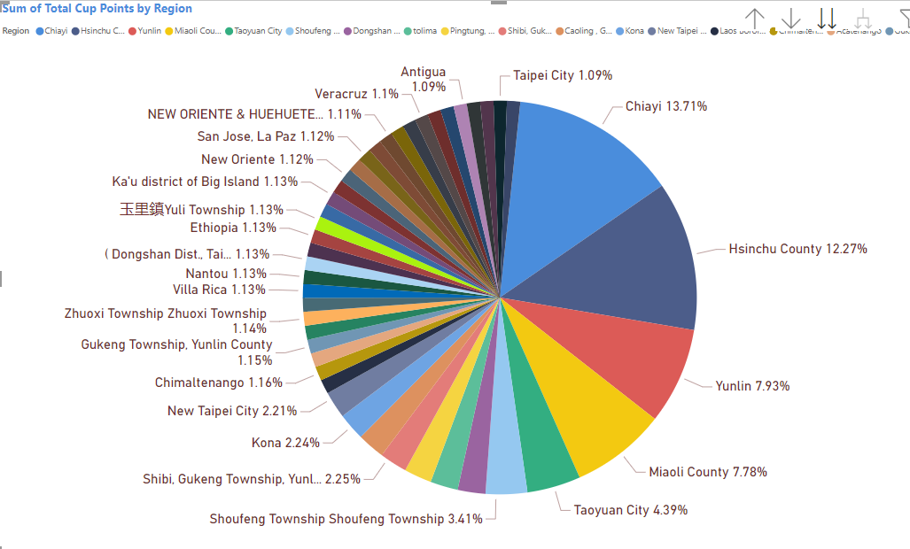
Factors that contribute to Cup Points
Continue.,

Slide 8
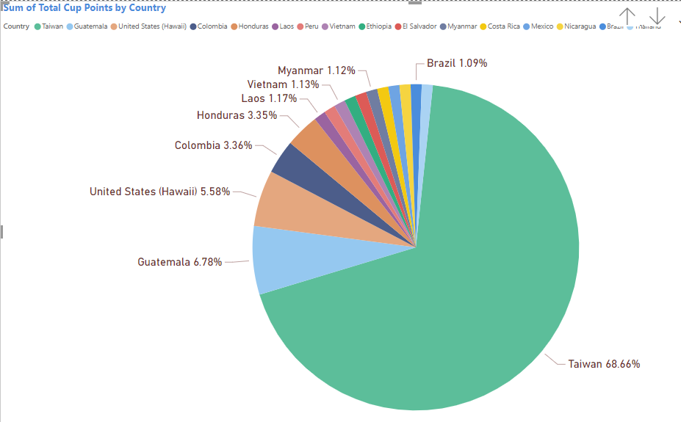
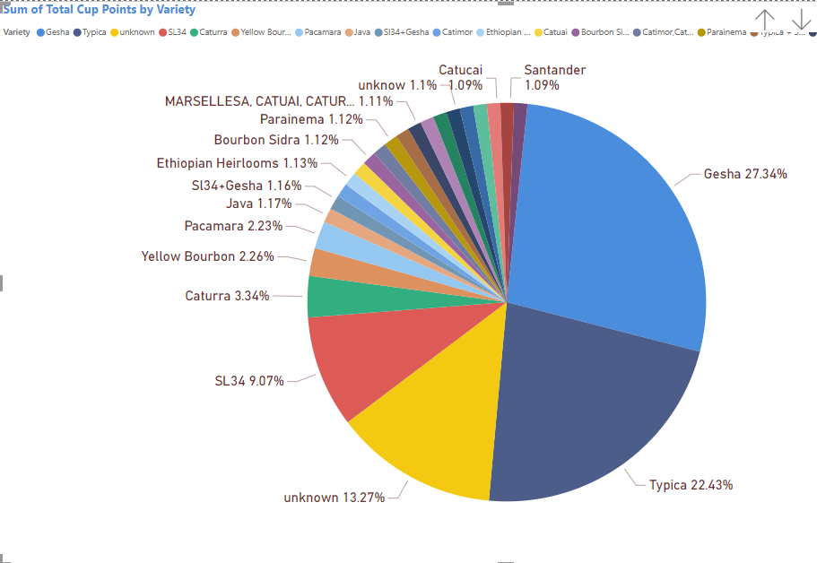
Factors that contribute to Cup Points

Slide 9
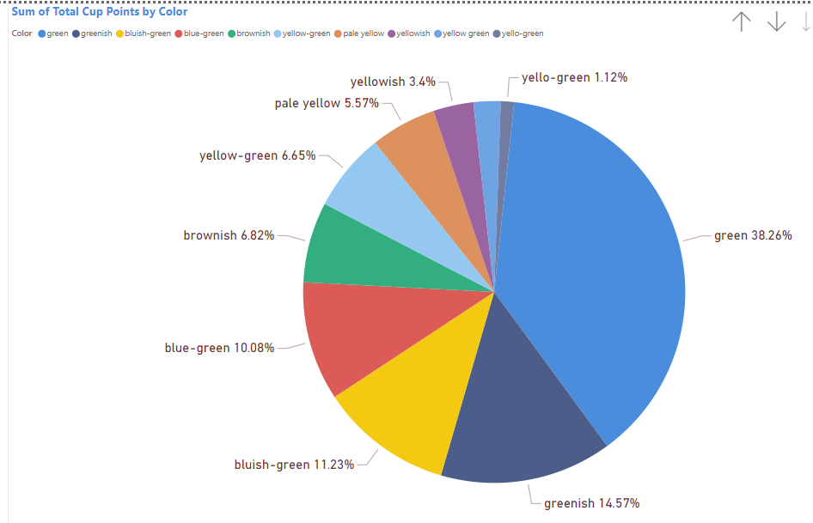
Factors that contribute to Cup Points

Slide 10
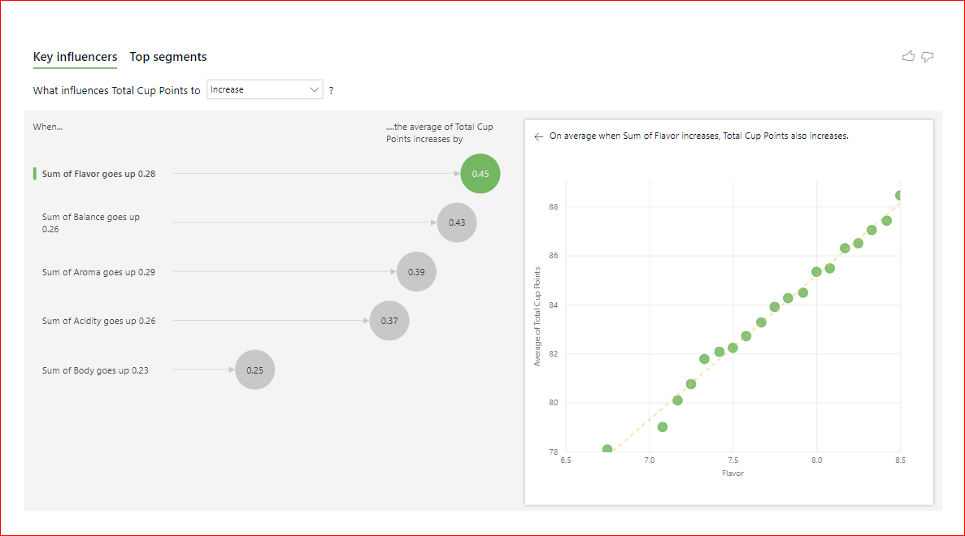
Key Influencers

Slide 11
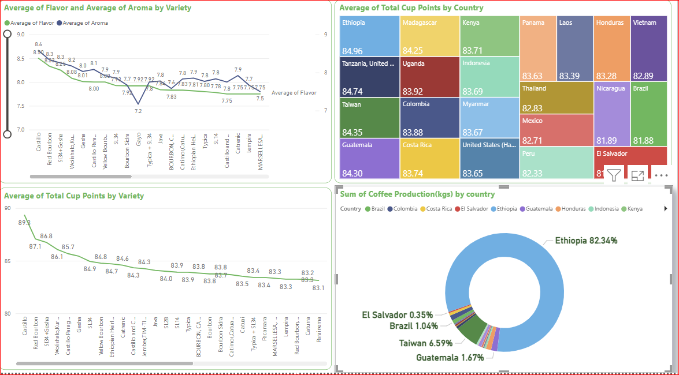
Quality Trends

Slide 12
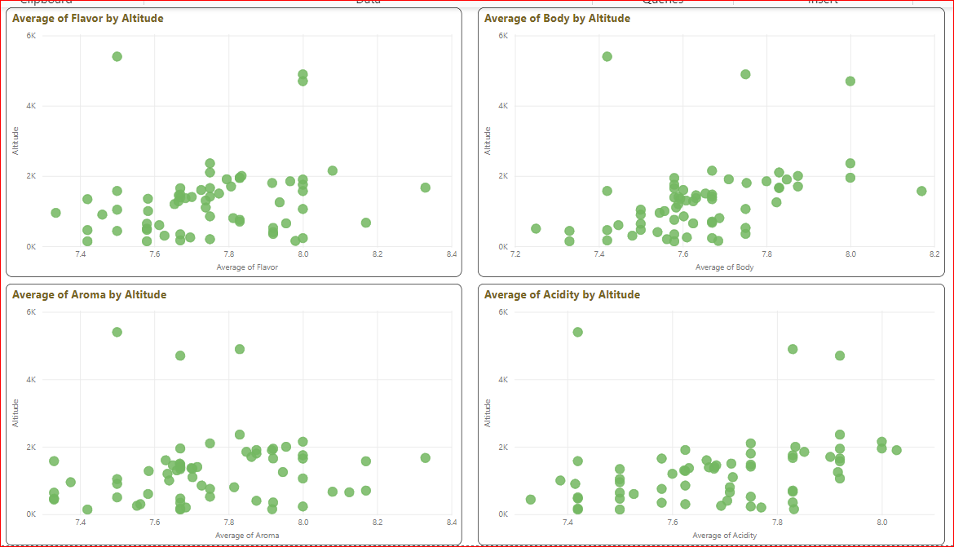
How Altitude Influence Other atributes

Slide 13
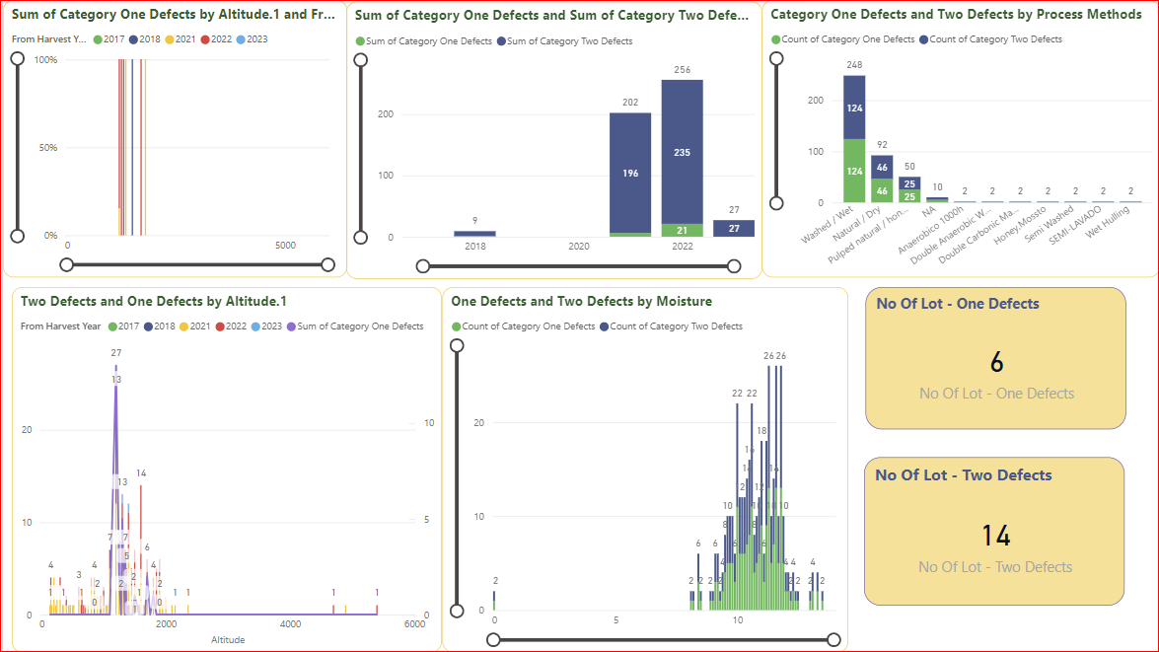
Defect Analysis

Slide 14
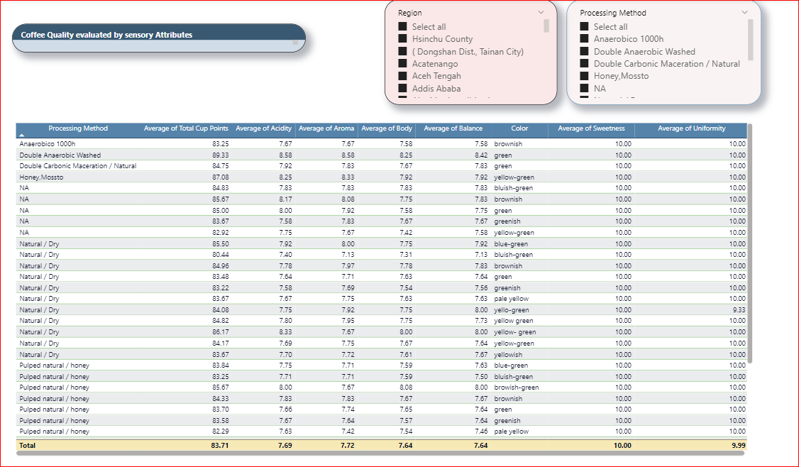
Quality Evaluated by Sensory

Slide 15
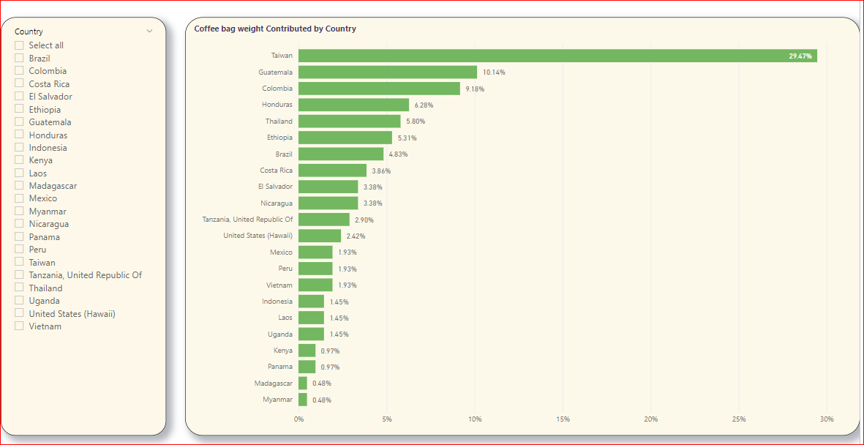
Coffee bag Weight Contributed by Country

Slide 16
OutCome of the analysis
What are the key determinants of coffee quality as evaluated through sensory attributes such as aroma, flavor, acidity, etc.?
Aroma, Flavor, Acidity, Body,Sweetness, Bitterness are the key attributes that impact on quality of Coffee
JAVA, SL34+Gesha, Gesha are the varieties, are top on quality coffees
Is there a correlation between processing methods, origin regions, and coffee quality scores?
The processing methods impacts on attributes like aroma,Flavor, Acidity,Body
High Altitude impacts and produce the high quality of coffee beans
Can we identify any trends or patterns in defect occurrences and their impact on overall coffee quality?
Defect two are more when compare to defect one, since the method which folow to process the coffee beans and more production during the year 2022/2023
How do different variables interact to influence the Total Cup Points, which represent an overall measure of coffee quality?
Overall Coffee cup points are influenced by it attributes - Aroma,Acidity,Flavor,sweetness,body,aftertaste

Slide 17
Thank you

