Slide 1
Applied Data Science Capstone Project
Author: Dhinakaran K

Slide 2
Content
Business Problem
Data description
Workflow
Challenges
Results
Conclusion
QnA

Slide 3
Business Problem
To identify the best area to open an ethnic Restaurant in foreign country, based on analyzing regional ethnic population and number of their restaurants already in that particular region.
For this project, identify the best location (ward) in London region to open an Indian Restaurant, based on analyzing Indian population and number of Indian restaurants already in that London region.

Slide 4
Data description
Dataset1 from UK government:
UK ethnic group population ward and borough detail. (Link : https://data.london.gov.uk/download/ethnic-group-ward-2001/884e5228-107c-4d91-812b-ccd2ae778e31/ethnic-group-ward-2001.csv)
Dataset 2 from FourSquare:
Indian restaurant detail from FourSquare location data API. This project will use this API to fetch data for a location based on Latitude, Longitude and search criteria “Indian Restaurant”.

Slide 5
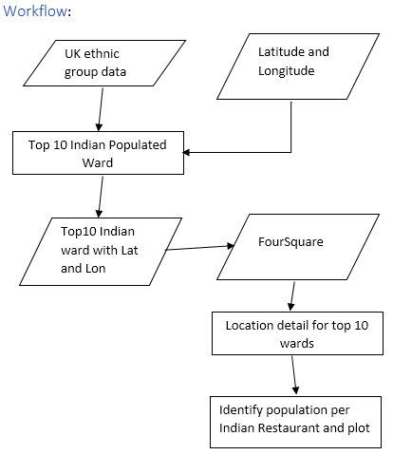
Workflow

Slide 6
Challenges
FourSquare result will have all information related to Indian and other restaurant, like Indian consulate, Indian Yoga center, Chinese restaurants etc, because API is designed to split the search string “Indian Restaurant” like “Indian”, “Restaurant”, “Indian Restaurant” and “Indian Restaurants” and perform the search. So, analyzing the result and extract correct the information is vital to this project.
And search area is important to this analysis, to avoid overlapping of information which will mislead the results. So, utilized different data (ward area information from UK gov site) to calculate average ward area. Total 625 wards are in London (including inner and outer London region) with total 1594 sq. meter – which make search limit average to 2500 sq. meter.
Because of some generic location name used in both USA and UK, google API returned US coordinates, so concatenated the Ward, Borough and country to make unique location and fetched correct and accurate coordinates from google API.

Slide 7
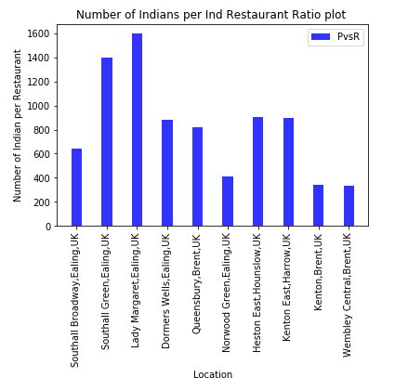
Results

Slide 8
Conclusion
Based on results, Ward which has a greater number of people per restaurant is the ideal place to open a new restaurant. Recommend to open a restaurant in ward Lady Margaret, Ealling, London,UK.
Further to add, this project can be reused to perform for any other ethnic group and restaurant or any other ethnic dependent business or investments.

Slide 9
Q and A
Thanks note

