Slide 1
Applied Data Science Capstone Project
Author: Dhinakaran K

Slide 2
Content
Business Problem
Data description
Workflow
Results
Conclusion
QnA

Slide 3
Business Problem
To identify the best area to open an ethnic Restaurant in foreign country, based on analyzing regional ethnic population and number of their restaurants already in that particular region.
For this project, identify the best location (ward) in London region to open an Indian Restaurant, based on analyzing Indian population and number of Indian restaurants already in that London region.

Slide 4
Data description
Dataset1 from UK government:
UK ethnic group population ward and borough detail. (Link : https://data.london.gov.uk/download/ethnic-group-ward-2001/884e5228-107c-4d91-812b-ccd2ae778e31/ethnic-group-ward-2001.csv)
Dataset 2 from FourSquare:
Indian restaurant detail from FourSquare location data API. This project will use this API to fetch data for a location based on Latitude, Longitude and search criteria “Indian Restaurant”.

Slide 5
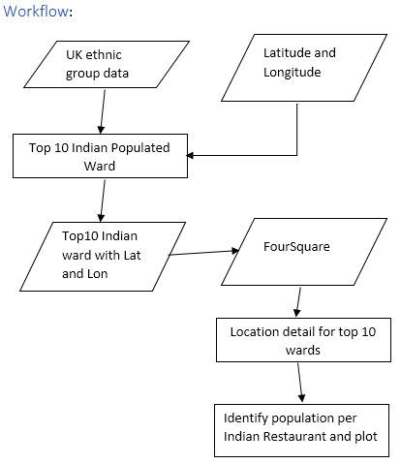
Workflow

Slide 6
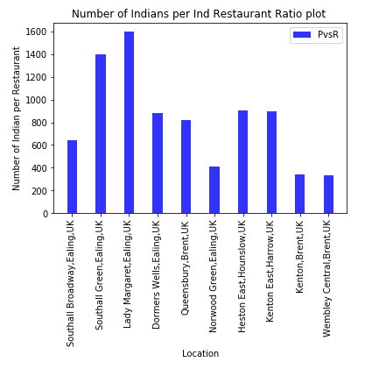
Results

Slide 7
Conclusion
Based on results, Ward which has a greater number of people per restaurant is the ideal place to open a new restaurant. Recommend to open a restaurant in ward Lady Margaret, Ealling, London,UK.
Further to add, this project can be reused to perform for any other ethnic group and restaurant or any other ethnic dependent business or investments.

Slide 8
Q and A
Thanks note

