Slide 1


SALES PATTERN ANALYIS & PROFIT MAXIMIZATION AT WIND SPARE PARTS SHOP
Dhinakar.S.P
23f2001456@ds.study.iitm.ac.in

Slide 2
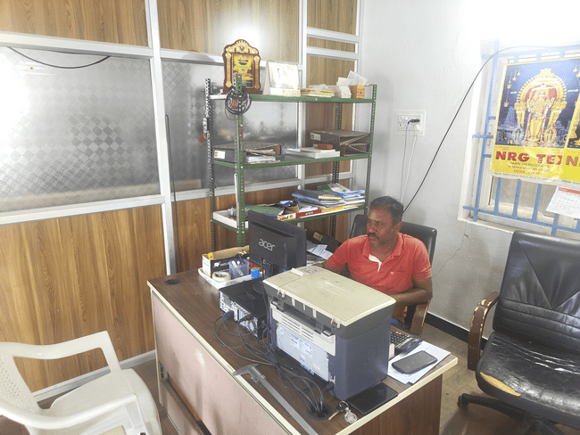
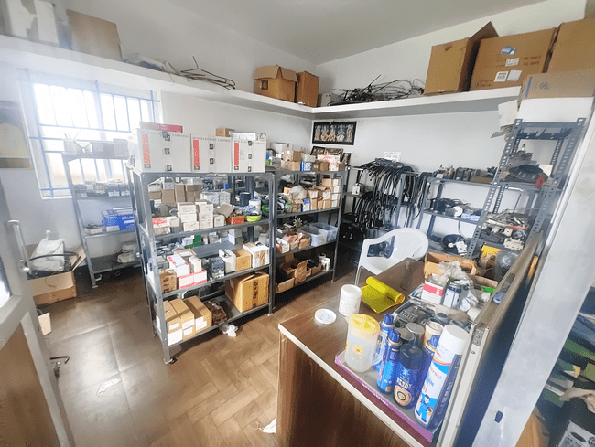
Business Background
Business Name: Gust wind Spares and Services
Address: 6/18, Gudimangalam (Po) Udumalpet (Tk)-642201.
Owner’s Name: Mr. Prakash
Fig. Mr.Prakash
Established in 2011, Gust Wind Spares and Services is a B2B shop specializes in providing windmill spare parts and services.
Started with investment of 20-30 lakhs, now it has been awarded with “Best Supplier Award” of 2019 by i-Fox Windtechnik.
The shop purchases its stocks from wholesale dealers of Coimbatore and sells it to wind farms like Rajalakshmi Energy pvt ltd nearby.
Fig. Spare parts shop

Slide 3
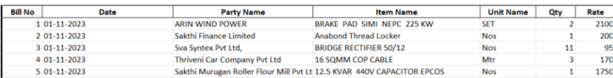
Meta Data
Purchase Dataset
HSN/SAC - HSN (Harmonized System of Nomenclature) is a six-digit code used to classify goods
in the GST. SAC (Services Accounting Code) is a code used to identify specific services under GST.
Sales Dataset
1310 x 7
Duration of Dataset : 2023 -2024 (1/11/23 – 30/10/24)

Slide 4








Challenges
Seasonal Demand Fluctuations
Overstocking Low-Demand Products
Minimal Profit
Transportation
cost
Employee Salary

Slide 5
Methodology & Approach
Financial Analysis
Stock Movement Analysis
Customer Behaviour Analysis
Total Revenue
Report
Seasonal Revenue
ARIMA
Prediction
Top Selling Items
Seasonal Frequent Items
Customer Segmentation
Frequent Customers

Slide 6
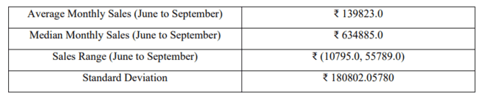
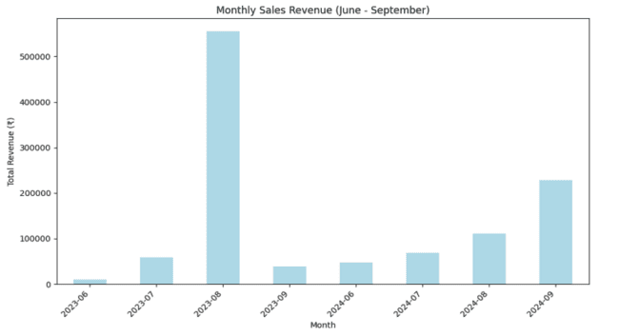
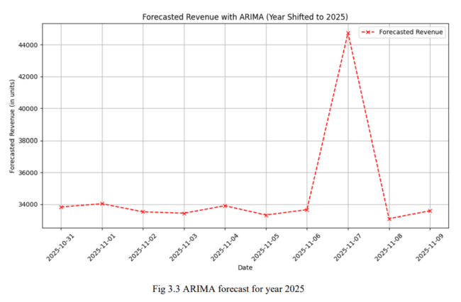
Financial Analysis
Over 40% of revenue lies in the seasonal months.
Peak revenue hikes in the month of August.
Also, the month of December signifies presence of wind.

Slide 7
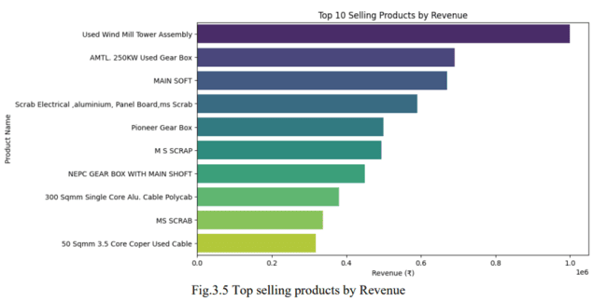
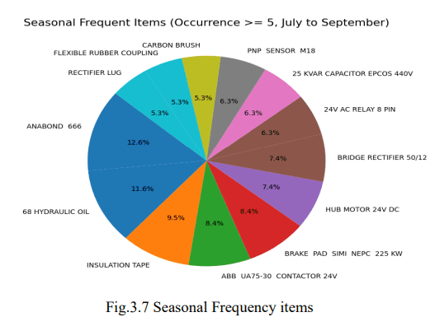
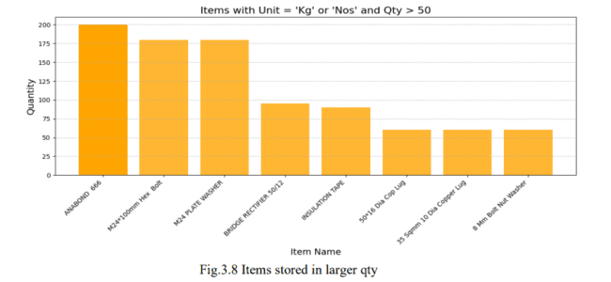
Stock Movement Analysis
Anabond 666, Bolt, Plate Washer, Hydraulic Oil are consistent items kept throughout the year.
Top selling items like the Assembly kit , Gear Box consume a huge space and should be in stock only when required.
16 other seasonal items should be kept available in the month of July – September.

Slide 8
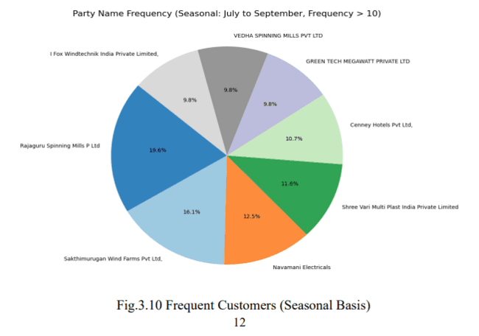
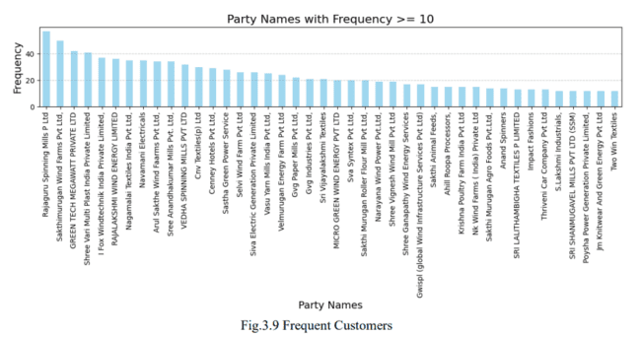
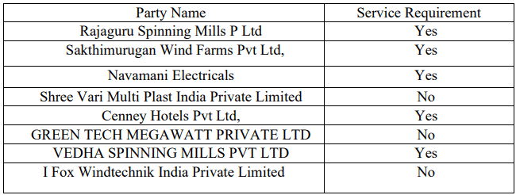
Customer Behaviour Analysis
Rajaguru Spinning Mills Pvt Ltd and Sakthimurugan Wind Farms Pvt Ltd achieves highest frequency of purchase through the year and also in seasonal months.
72% of customers require service in the seasonal months.
In terms of Revenue, Parties like SDM COT Spin India , Siva Wind Turbine, Prim traders helps to add up the annual revenue of the shop.
Customer Segmentation:

Slide 9








Recommendations
Temporary employees in the service sector.
Anabond 666, Bolt, Hydraulic Oil kept constantly
Prioritizing customers based on Revenue & Frequency.
Transportation of stock at the month of Jan - Mar
Brack Pad and Rectifier Lugs are seasonal purchase and kept in stock.
Expand Business and high attention towards seasonal months.

Slide 10
Thank you
Excel References – https://docs.google.com/spreadsheets/d/1gGyKOzlIytEWrw1reohUND7IR808jMM5CJqgMJXyP_8/edit?gid=863612024#gid=863612024

