Slide 1
Department of Information Technology
FEDIVERSE DECENTERALIZED SOCIAL MEDIA
GUIDED BY,
MR.S.J..Deepak , AP/IT
PRESENTED BY,
DhineshKumar T (611720205004)
Preethika S (611720205014)
Prasath M (611720205013)
B Tech IT – IV Year
DEPARTMENT OF INFORMATION TECHNOLOGY

Slide 2
CONTENTS
Abstract
Introduction
Problem Statement
Existing System
Environment Setup
Proposed System
Methodologies
System Flow Diagram
Conclusion
References
Department of Information Technology

Slide 3
Abstract
In The Era Of Digital Connectivity, The Need For A Secure And Privacy-centric Social Networking Platform Has Become Paramount. This Project Aims To Develop A Cutting-edge Social Networking Platform That Prioritizes User Privacy, Promotes Responsible Content Sharing, And Fosters A Positive Online Community. The Platform Will Incorporate Key Features To Address Contemporary Challenges Associated With Online Interactions.
Microblogging and Federated Short-Form Content Sharing
Regional Language Support:
Social Interaction Facilitation:
Age-Based Content Restrictions for Safety:
Image Encryption and Content Filtering:
Department of Information Technology

Slide 4
INTRODUCTION
Privacy-Centric Innovation: Introducing a revolutionary social networking platform focused on user privacy, leveraging advanced encryption techniques to safeguard personal information and interactions.
Enhanced User Experience: Redefining social connectivity through features such as microblogging, federated short-form content sharing, regional language support, and personalized social interaction facilitation.
Safety Measures: Prioritizing user safety with age-based content restrictions, ensuring a secure environment for all users, particularly minors, by implementing robust measures to filter explicit content.
Content Integrity: Implementing cutting-edge image encryption and content filtering to maintain the integrity of shared content, providing a responsible and positive online space for users.
Department of Information Technology

Slide 5
PROBLEM STATEMENT
Privacy Concerns:
Existing platforms often compromise user privacy through intrusive data collection practices, leading to potential breaches and misuse of personal information.
Safety and Content Moderation:
Inadequate content moderation mechanisms allow the circulation of explicit or harmful content, posing safety concerns for users, especially minors.
Limited Language Support:
Many platforms lack comprehensive regional language support, creating barriers for users who prefer to engage in languages other than the platform's primary language.
Outdated Interaction Dynamics:
Current systems lack features like federated short-form content sharing and personalized social interaction facilitation, hindering the evolution of user engagement dynamics.
Department of Information Technology

Slide 6
EXISTING SYSTEM
Privacy Challenges:
Current platforms often employ data collection practices for targeted advertising, compromising user anonymity and privacy.
Content Moderation Issues:
Ineffectual content filtering allows the proliferation of explicit content, leading to an unsafe online environment.
Language Barriers:
Limited language options exclude users who are more comfortable communicating in regional languages, limiting the platform's inclusivity.
Stagnant Interaction Features:
The absence of advanced features like federated short-form content sharing restricts the diversity of user interactions, leading to a monotonous user experience.
Department of Information Technology

Slide 7
PROPOSED SYSTEM
In response to the shortcomings of existing social networking platforms, this proposed project endeavors to develop a cutting-edge, privacy-enhanced social networking platform with a focus on safety, inclusivity, and innovative user interactions.
Privacy-Centric Design: Implement advanced encryption techniques to protect user data and communications, ensuring a secure and private online experience.
Enhanced Content Moderation: Employ state-of-the-art content filtering algorithms to proactively identify and restrict the dissemination of explicit or harmful content, promoting a safer online environment.
Regional Language Support: Introduce comprehensive regional language support to facilitate communication in diverse languages, fostering inclusivity and a more personalized user experience.
Innovative Interaction Dynamics: Integrate microblogging and federated short-form content sharing to diversify user interactions and encourage dynamic content creation and consumption.
Age-Based Content Restrictions: Implement age verification mechanisms to enforce age-based content restrictions, providing a secure space for users of all age groups, especially minors.
Image Encryption: Employ advanced image encryption methods to safeguard user-uploaded images, preserving the privacy of personal content shared on the platform.
Community Guidelines Enforcement: Develop and enforce enhanced community guidelines to foster positive online behavior and discourage harassment or inappropriate conduct within the platform.
Department of Information Technology

Slide 8
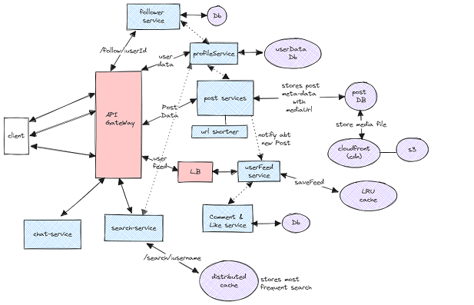
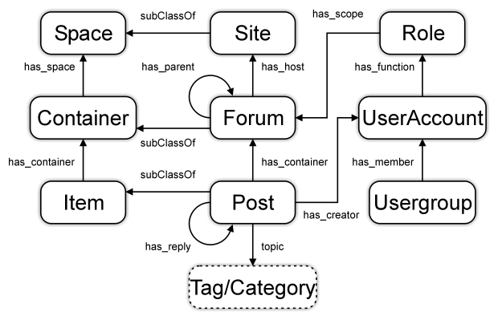
DATA FLOW DIAGRAM
SYSTEM
Department of Information Technology

Slide 9
LTRACHER REVIEW
1. Privacy Concerns in Social Networking Platforms
Privacy Challenges:
Explore existing literature on the privacy challenges associated with traditional social networking platforms.
Discuss issues related to data breaches, user tracking, and the misuse of personal information.
User Perspectives:
Review studies and articles that delve into user perceptions and concerns regarding privacy in online social spaces.
Examine the impact of privacy issues on user trust and engagement.
2. Existing Social Networking Platforms
Platform Comparison:
Analyze literature comparing features and privacy policies of major social networking platforms.(Facebook, twiter(x), Instagram , whatsapp, Linkdin, threads)
Highlight the strengths and weaknesses of current platforms in addressing user privacy.
Community Guidelines:
Investigate how existing platforms enforce community guidelines.
Discuss the role of content moderation and its impact on fostering a safe online community.
Department of Information Technology

Slide 10
LTRACHER REVIEW
3. Encryption Technologies in Social Media
Encryption Protocols:
Explore research on E2E encryption protocols applicable to social networking platforms.
Assess the effectiveness of various encryption methods in securing user data.
User-End Encryption:
Examine studies on user-end encryption and its role in protecting user-generated content.
Discuss potential challenges and benefits of implementing strong encryption measures.
Department of Information Technology

Slide 11
REFERENCE
Abadi, M., et al.: Tensorflow: large-scale machine learning on heterogeneous distributed systems. CoRR abs/1603.04467 (2016).
G. K. Kumar and M. Gobi, “Comparative Study on Blowfish & Twofish Algorithms for Cloud Security,” vol. 3, no. 9, pp. 1–11, 2017
A. K. B and P. A. A, “A New Hybrid Data Encryption and Decryption Technique to Enhance Data Security in Communication Networks: Algorithm Development,” vol. 5, no. 10, pp. 804–811,2014.
tensarflow ml modal for cryptoanalsis.
Wang, X., Malozemoff, A.J., Katz, J.: EMP-toolkit: efficient MultiParty computation toolkit (2016). https://github.com/emp-toolkit
Songhori, E.M., Hussain, S.U., Sadeghi, A., Schneider, T., Koushanfar, F.: TinyGarble: highly compressed and scalable sequential garbled circuits. In: IEEE S&P, pp. 411–428. IEEE (2015
Department of Information Technology

