Slide 1
A.M.DHINESH
Final Project

Slide 2
Gender and Age Prediction Using CNN

Slide 3

AGENDA
Problem Statement
Project Overview
Who are the end users?
Your solution and its value proposition
The Wow in your solution
Modelling
Results

Slide 4

PROBLEM STATEMENT
The goal of this project is to develop a CNN model that can accurately predict the gender and age of a person from a facial image. The model should be able to handle a wide range of facial images, including images with different lighting conditions, facial expressions, and head poses. The model should also be able to handle images of people from different ethnicities and age groups.

Slide 5

PROJECT OVERVIEW
A more imaginative and adaptable approach to creating models with greater complexity is provided by the Keras Functional API. A model that performs multiple supervised prediction types (such as regression and classification predictions) introduces a certain level of complexity. Used libraries :
Pandas – An open-source library to read and manipulate datasets. Here it was used to read the CSV file which contained pixel values for the image
Numpy – An open-source library with functions for high-level mathematical calculations as well as handling data that spans multiple dimensions
Matlplotlib – An open source library which is used to visualize our data and losses in our prediction model
Sklearn – This library consists of pre-defined functions and evaluation metrics that help in data preprocessing, model performance evaluation and model initialization.
Tensorflow – Developed by Google, It provides many methods to interpret data but mainly focuses on training and inference of Neural Networks

Slide 6


WHO ARE THE END USERS?
A more imaginative and adaptable approach to creating models with greater complexity is provided by the Keras Functional API. A model that performs multiple supervised prediction types (such as regression and classification predictions) introduces a certain level of complexity. To develop a model with regression and classification capabilities, we will dissect a comparable situation.
There are several potential end users for a project on "Gender and age prediction using CNN":
1. Marketing and Advertising
2. Retail and E-commerce
3. Law Enforcement and Security
4. Human-Computer Interaction (HCI)
5. Social Media and Entertainment

Slide 7

YOUR SOLUTION AND ITS VALUE PROPOSITION
Focus on Improved Accuracy and Transparency:
Large, Diverse Dataset: Make use of a sizable face dataset that spans a variety of ages, genders, ethnicities, and facial features. This lessens bias in the model's predictions and encourages generalizability.
Multi-stage CNN Architecture: Create a CNN architecture with several stages, each focused on extracting a different amount of information from the picture. This makes it possible for the model to accurately predict age by capturing both fine- and coarse-grained features, such as wrinkles and facial shape.
Real-time Processing: Make the model as resource-efficient as possible for real-time processing on devices. This makes it possible to verify age and gender in applications such as secure access control.

Slide 8
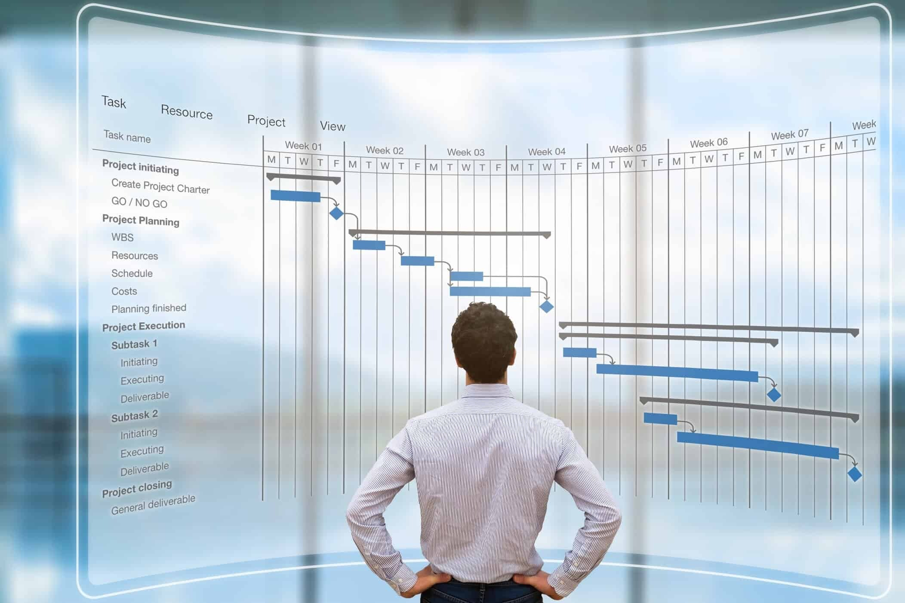
Proposition:
With accuracy, transparency, and responsible AI practices as top priorities, this project suggests a CNN-based age and gender prediction system. Explainable AI will be utilised in conjunction with a varied dataset to train the model, guaranteeing impartial and equitable predictions.
By emphasising privacy-preserving methods and real-time processing, the system can be integrated into different applications without compromising user privacy.

Slide 9


THE WOW IN YOUR SOLUTION
Improved accuracy in age and gender prediction compared to existing models.
Increased transparency and trust through explainable AI techniques.
Reduced bias through a diverse dataset and careful model design.
Potential for real-time applications with efficient processing.
Protects user privacy through techniques like federated learning

Slide 10
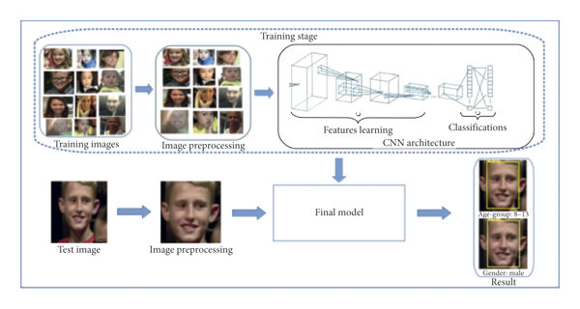
MODELLING

Slide 11
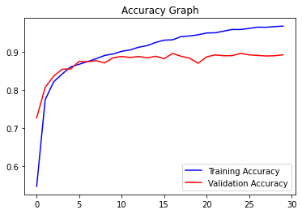
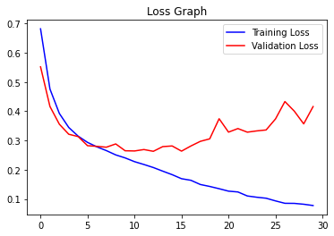
RESULTS

Slide 12
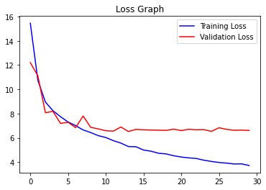
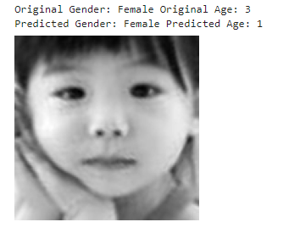

Slide 13
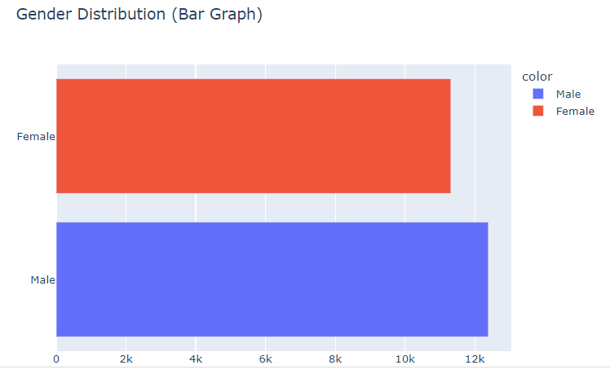

Slide 14
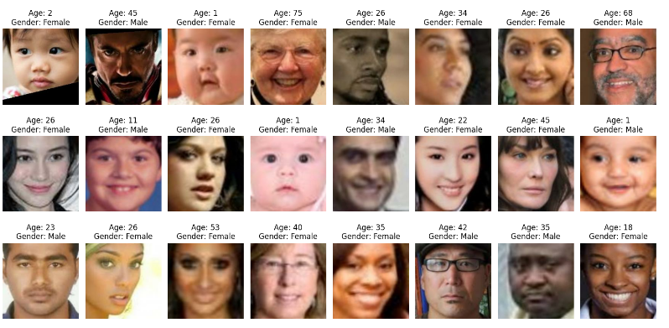

Slide 15
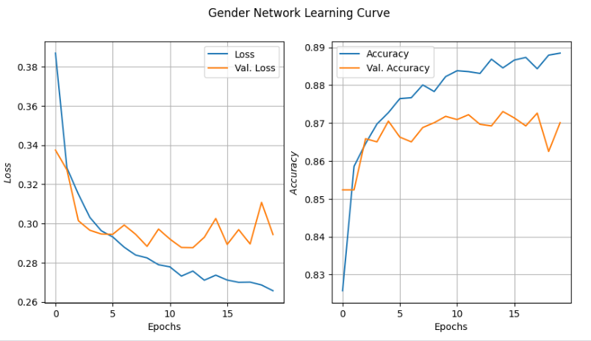

Slide 16
In the above subplot, the title at the top signifies actual age and gender whereas the title below signifies predicted age and gender. As you can see the predictions are quite good.
We saw how we processed a csv dataframe with object type pixel entries, used then with Functional Keras API and created a Model complex enough that it could Classify the Gender and Predict their Age.
CNN Network
Gender Accuracy: 90.00 Age MAE: 6.5
Project link :
https://github.com/Dhinesh7074/NalaiThiran.git

