Slide 1
Image to Audio Conversion to aid Visually Impaired People
Prepared by :
VENKATESHWARAN M
DHINESH S P
Project guide :
Dr. D. SIVAGANESAN
Presented at :
4th International Conference on Electronics and Sustainable Communication Systems (ICESC - 2023)

Slide 2
ABSTRACT
❏ Image to audio conversion is a challenging task that has potential applications in various fields, including accessibility, entertainment, and communication. In recent years, deep learning techniques, particularly convolutional neural networks (CNNs), have shown promising results in this area.
❏ In this proposed system, we aim to develop an image to audio conversion system using a CNN-based architecture. The system would take as input an image in a suitable format for audio generation, such as a spectrogram, and extract relevant features using a CNN.
❏ The extracted features would then be fed into a decoder to generate the corresponding audio output. The system would be evaluated using various metrics to ensure that the generated audio output meets the desired quality standards.

Slide 3
OBJECTIVES
❏ To Develop a website that converts images to audio descriptions that can be easily
understood by visually impaired individuals.
❏ To Create a user-friendly interface that allows visually impaired individuals with assistance to easily input an image and receive an audio description.
❏ To Collaborate with organizations that serve visually impaired individuals to ensure the software is meeting their needs and addressing their unique challenges.

Slide 4
INTRODUCTION
Advances made with new technologies have boosted the development of systems to assist the daily lives of the visually impaired people.
These systems intend to help by providing their user with some critical information about their environment using senses they can still use.
Blind people face a number of challenges when interacting with their environments because so much information is encoded visually.
The proposed method enables the visually impaired people to see with the help of ears.
The novelty of this paper is to convert the image to sound using the methodology of edge detection.

Slide 5
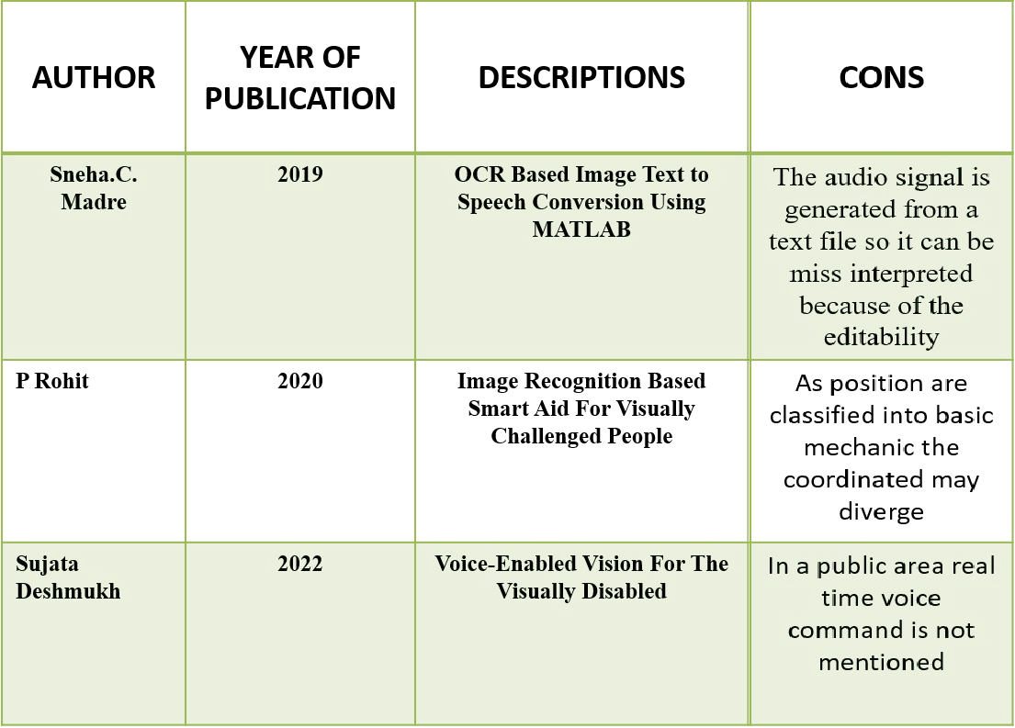
SURVEY

Slide 6
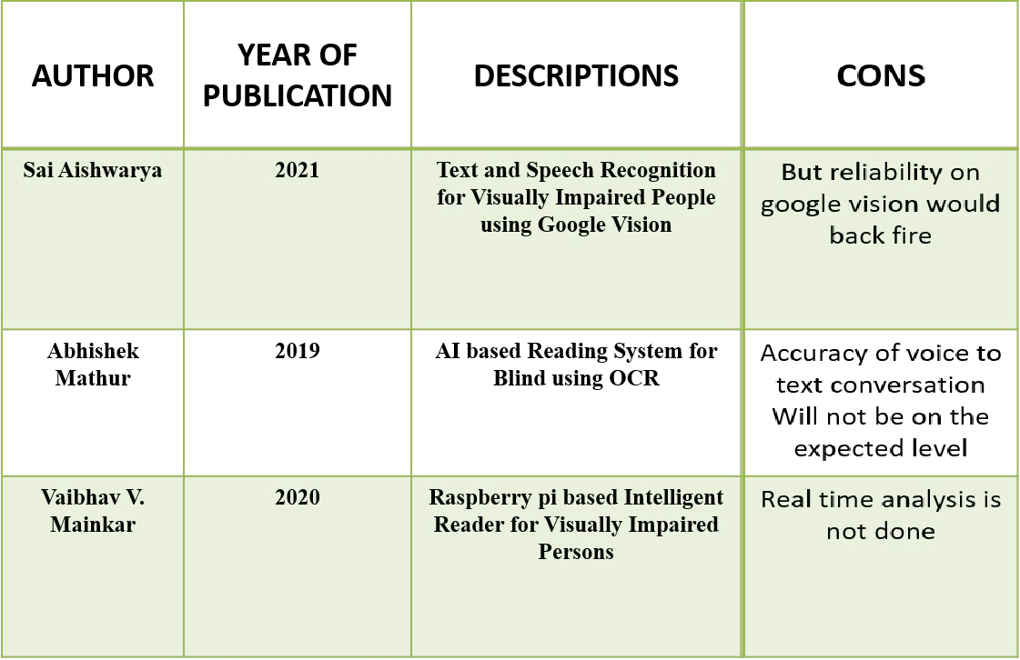
SURVEY

Slide 7
EXISTING SYSTEM
❏ There are several existing systems for image-to-audio conversion, and each has its own strengths and weaknesses. The NLP based models have several drawbacks, including:
❏ Limited diversity of output: Deep learning models are trained on a fixed set of input-output pairs, which limits the diversity of the output that they can generate. As a result, the generated audio may lack variety and sound similar to each other.
❏ Poor quality of output: Deep learning models may generate low-quality audio that contains artifacts or noise. This can be particularly problematic for applications that require high-fidelity audio, such as music composition or audio editing.
❏ Complexity of the model: Deep learning models for image-to-audio conversion can be complex and require large amounts of computational resources to train and run. This can make them unsuitable for deployment on resource-constrained devices.
❏ Lack of interpretability: Deep learning models can be difficult to interpret, making it hard to understand how they generate the output. This can be problematic for applications that require transparency and explainability, such as medical diagnosis or legal decision-making.
❏

Slide 8
PROPOSED SYSTEM
The proposed system for image-to-audio conversion using a convolutional neural network (CNN) has several advantages, including:
❏ High quality and diverse audio output: The proposed system can generate high-quality and diverse audio output from input images, thanks to the use of a CNN model that is trained on a large and diverse dataset of paired images and audio signals. The system can also generate audio in different styles and genres, making it suitable for a wide range of applications.
❏ Efficiency: The proposed system is computationally efficient and can run on resource-constrained devices. This makes it suitable for real-time applications such as assistive technology and accessibility for the visually impaired.

Slide 9
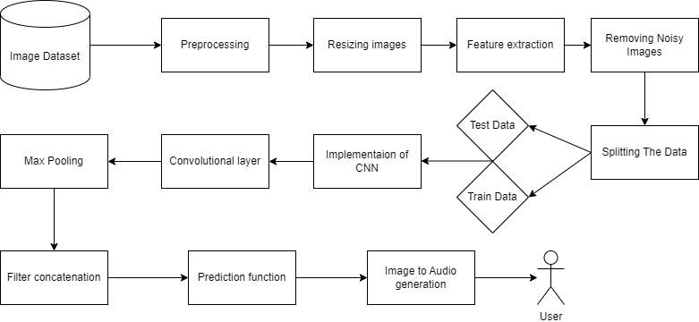
SYSTEM ARCHITECTURE

Slide 10
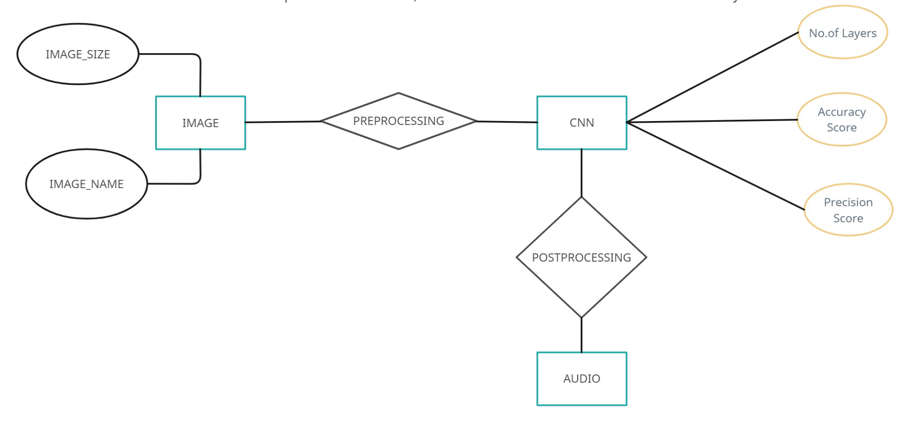
ER DIAGRAM

Slide 11
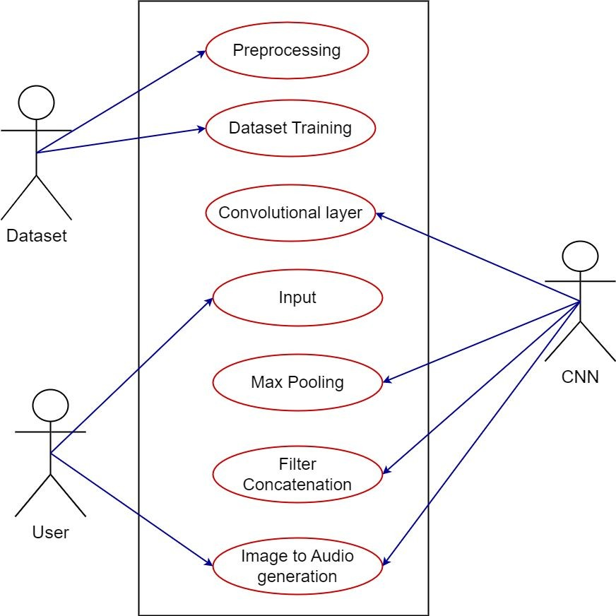
USE-CASE DIAGRAM

Slide 12
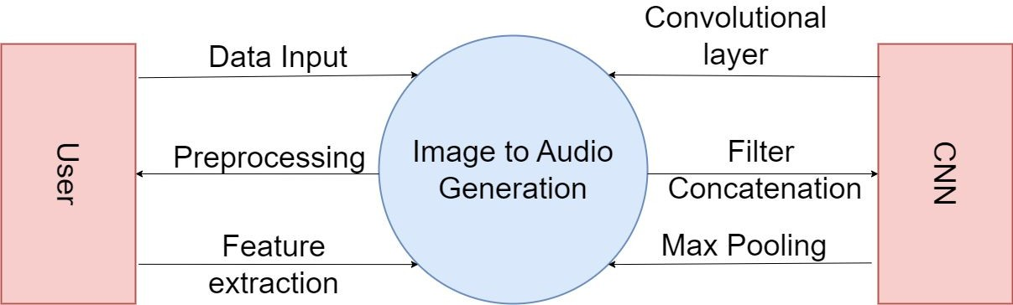
DFD-0 DIAGRAM

Slide 13
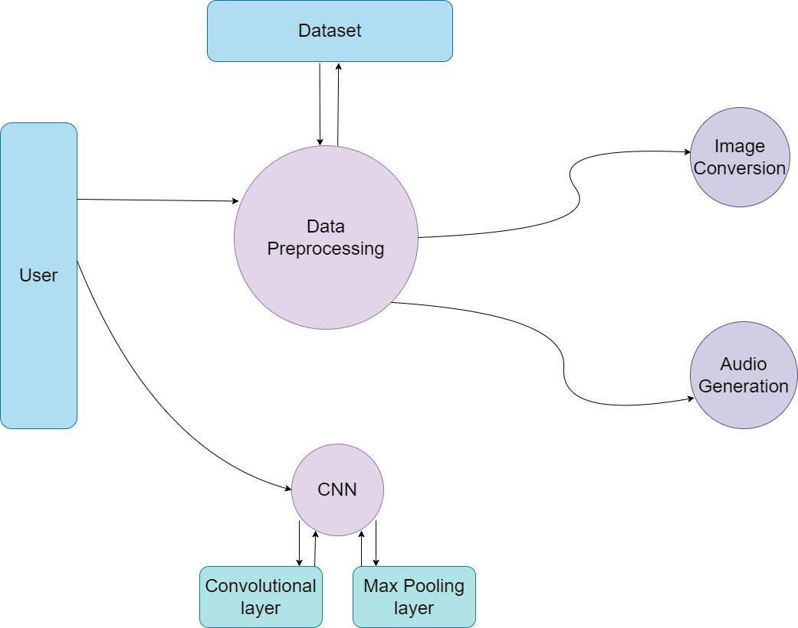
DFD-1 DIAGRAM

Slide 14
ALGORITHM USED
❏ A CNN is a type of deep neural network that is commonly used for image recognition tasks. It is made up of several layers of interconnected nodes, each performing a specific task, such as detecting edges, textures, or patterns in the input image.
❏ ResNet, short for "Residual Network," is a deep learning architecture that is commonly used for image classification tasks, where the goal is to classify an image into one of several categories
❏ The ResNet model would be trained on a large dataset of images, with each image labeled with its corresponding category. For example, if the image is of a dog, the label would be "dog."
❏ Once the ResNet model is trained, it can be used to classify new images. When a new image is inputted into the ResNet model, the model outputs a probability distribution over the different categories. For example, if the input image is of a cat, the output might be a probability distribution with a high probability for the "cat" category and lower probabilities for other categories.
❏ Based on the output of the ResNet model, an audio description can be generated that accurately describes the contents of the image. For example, if the ResNet model classifies an input image as a cat, the audio description might say "This image shows a cat sitting on a windowsill, looking out the window."

Slide 15
EXPECTED OUTCOMES
❏
Increased accessibility to visual information: The project can convert visual images into audio descriptions that allow visually impaired people to better understand the contents of an image, such as photos, diagrams, or charts. This can help blind people to access a range of visual information that they may have previously been excluded from.
Enhanced user experience: A well-designed user interface and easy-to-use system can provide visually impaired users with a more seamless and intuitive experience.
Adaptability: The system could potentially be adapted for use in a variety of settings, such as for automated image captioning or other applications that require image analysis and conversion to other formats.
❏
❏

Slide 16
SPECIFICATIONS
Hardware specifications:
Microsoft Server enabled computers, preferably workstations
Higher RAM, of about 4GB or above
Processor of frequency 1.5GHz or above
Software specifications:
Python 3.6 and higher
Anaconda software

Slide 17
MODULES DESCRIPTION - IMAGE PRE-PROCESSING
The image pre-processing module is the first one in the CNN-LSTM image to audio conversion system. For the CNN-LSTM to be trained efficiently, this module is essential in getting the input picture data ready. A number of methods and algorithms are employed in the pre-processing module to improve the quality of the input photos, extract valuable characteristics, and normalise the pixel values to a set scale.
The pre-processing module's first responsibility is to resize the photos to a particular resolution. In order to properly train the CNN-LSTM, this step makes sure that all of the images are the same size. Standardizing the picture size will assist the CNN-LSTM in recognising patterns and features from the images. Images of varied sizes may present difficulties in the network training.

Slide 18
MODULES DESCRIPTION – CNN-LSTM
The CNN-LSTM architecture module is the second component of the image to audio conversion system using CNN-LSTM. In order for the CNN-LSTM to learn the mapping between the input images and associated audio signals, the structure and parameters of the CNN-LSTM must be defined by this module.
Determining the number of LSTM layers, the number of pooling layers, the size of the filters, the number of convolutional layers, and the number of filters per layer are all tasks included in the CNN-LSTM architecture module. Applying a series of filters to the input image allows convolutional layers to learn features from the previously processed image data. The filters are made to recognise particular motifs or characteristics in the visual data, such as edges, forms, or textures. The size of the filters and the number of filters per layer are hyperparameters that can be adjusted to enhance the CNN-performance. LSTM's
In order to minimise the dimensionality of the data and avoid overfitting, pooling layers are employed to downsample the output of the convolutional layers. The maximum value within a local region of the input data is chosen by the max pooling layer, which is the most popular kind of pooling layer.

Slide 19
MODULES DESCRIPTION – POST PROCESSING
A series of feature vectors representing the likelihood of producing each audio sample is the CNN-output. LSTM's This series of feature vectors is examined by the post-processing module, which then creates the final audio signal.
The post-processing module may carry out operations like denoising, spectrogram creation, and inverse Fourier transform in order to do this. Denoising aids in removing any noise that might be present in the feature vector sequence.
In order to effectively manipulate and process the audio input, the sequence of feature vectors is represented in the frequency domain using spectrogram creation. The final audio signal is created by converting a series of feature vectors from the frequency domain to the time domain using the inverse Fourier transform.

Slide 20
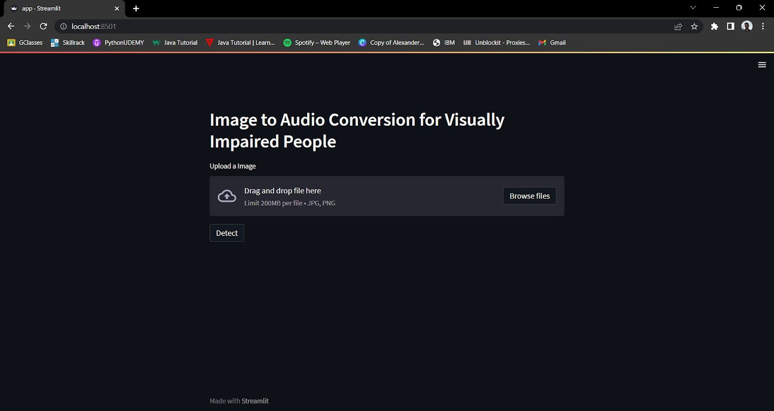
SCREENSHOTS AND RESULTS
Step1: Click on browse files and choose an image in the local storage of the device.

Slide 21
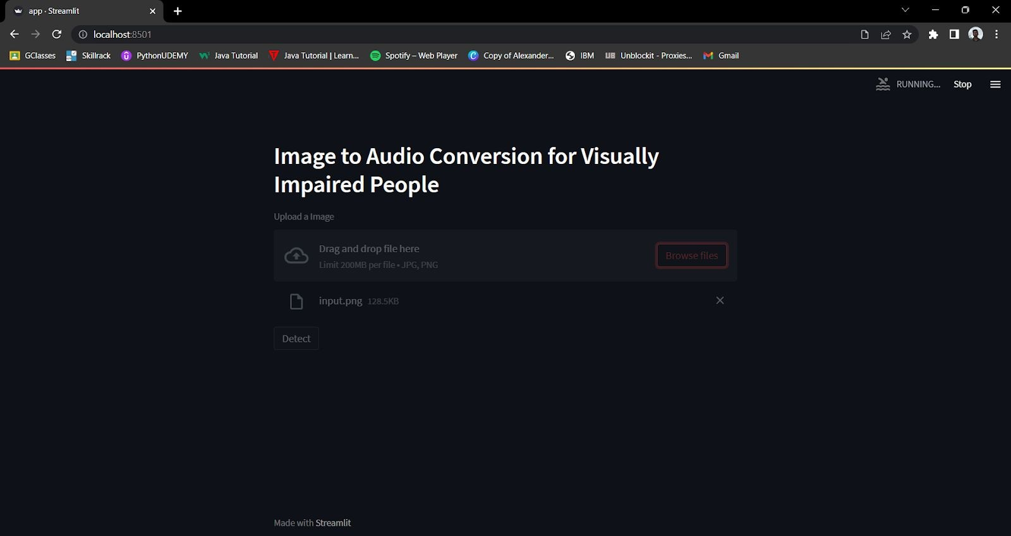
SCREENSHOTS AND RESULTS
Step 2: Once the image is uploaded click on the detect option to get the desired audio file.

Slide 22
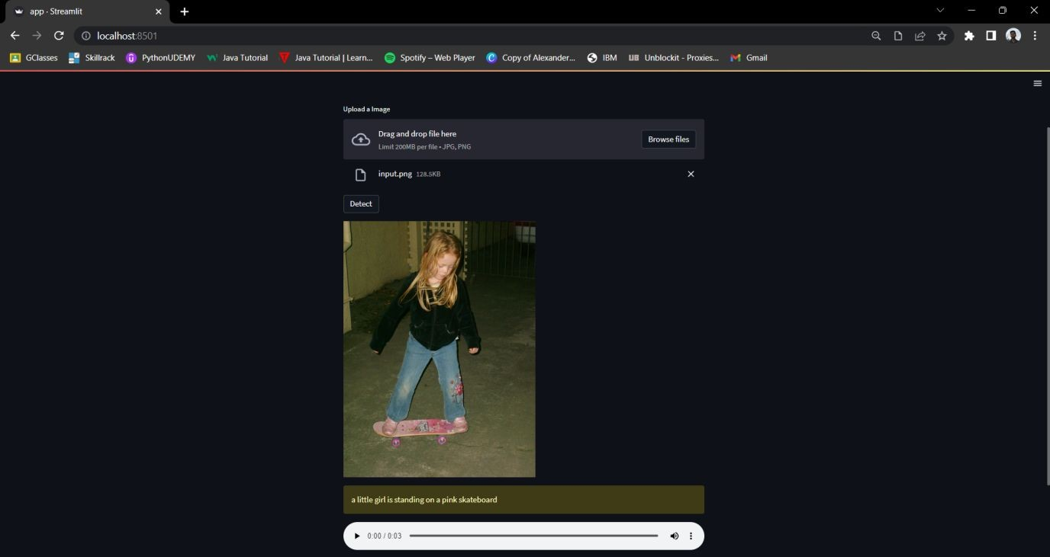
SCREENSHOTS AND RESULTS
Step3: The uploaded image pops up with the caption describing the image.

Slide 23
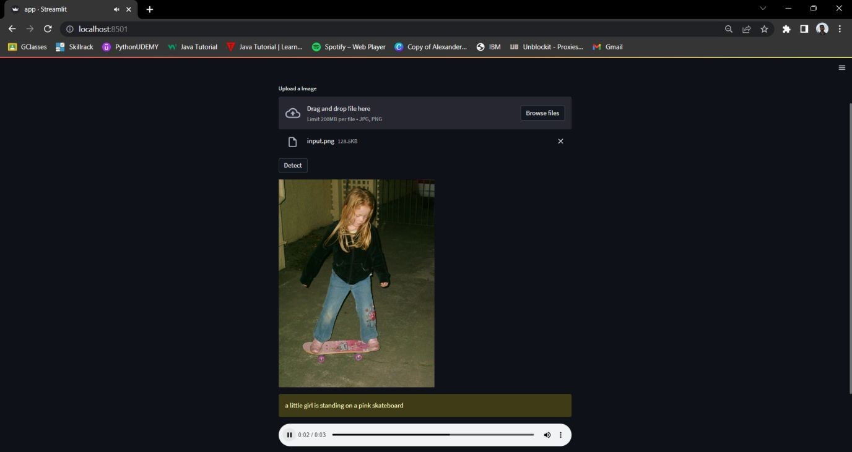
SCREENSHOTS AND RESULTS
Step4: Click on the audio button to hear the audio which would describe the image.

Slide 24
REFERENCES
Sneha.C. Madre, S.B. Gundre, “OCR Based Image Text to Speech Conversion Using MATLAB”,
Second International Conference on Intelligent Computing and Control Systems (ICICCS), 2019
P Rohit, M S Vinay Prasad, S J Ranganatha Gowda, D R Krishna Raju, Imran Quadri, “Image Recognition Based Smart Aid For Visually Challenged People”, International Conference on Communication and Electronics Systems (ICCES), 2020
Sujata Deshmukh, Praditi Rede, Sheetal Sharma, Sahaana Iyer, “Voice-Enabled Vision For The Visually Disabled”, International Conference on Advances in Computing, Communication, and Control (ICAC3), 2022
Sai Aishwarya Edupuganti, Vijaya Durga Koganti, Cheekati Sri Lakshmi, Ravuri Naveen Kumar, Ramya Paruchuri, “Text and Speech Recognition for Visually Impaired People using Google Vision”, 2nd International Conference on Smart Electronics and Communication (ICOSEC), 2021

Slide 25
REFERENCES
Abhishek Mathur, Akshada Pathare, Prerna Sharma, Sujata Oak, “AI based Reading System for Blind using OCR”, 3rd International conference on Electronics, Communication and Aerospace Technology (ICECA), 2019
Vaibhav V. Mainkar, Tejashree U. Bagayatkar, Siddhesh K. Shetye, Hrushikesh R. Tamhankar, Rahul
G. Jadhav, Rahul S. Tendolkar, “Raspberry pi based Intelligent Reader for Visually Impaired Persons”, 2nd International Conference on Innovative Mechanisms for Industry Applications (ICIMIA), 2020
[7] Javavrinda Vrindavanam, Raghunandan Srinath, Anisa Fathima, S. Arpitha, Chaitanya S Rao, T. Kavya, “Machine Learning based approach to Image Description for the Visually Impaired”, Asian Conference on Innovation in Technology (ASIANCON), 2021

