Slide 1

SEMANTICA
Making AI Explainable, Traceable and Auditable
Knowledge Graph & Decision Intelligence Infrastructure
PRESENTED BY
Dhinesha G
Trainee Programmer
GAIRAA Technology Solutions Pvt Ltd.,
Coiambatore.

Slide 2











What is Semantica?
LLMs
Vector Store
AI Agents
Semantica is the AI infrastructure layer that brings structure, provenance, and governance to intelligent systems.
SEMANTICA
AI Infrastructure Layer
Works beneath LLMs, vector stores, and agent frameworks
Creates structured, queryable context with Knowledge Graphs
Enables reasoning, provenance, decision tracking, and governance
KNOWLEDGE
REASONING
PROVENANCE
DECISIONS
Structured, queryable context
Meaningful inference
Origins and lineage
Tracked and governed
Graph construction, reasoning, and provenance do not require an LLM

Slide 3


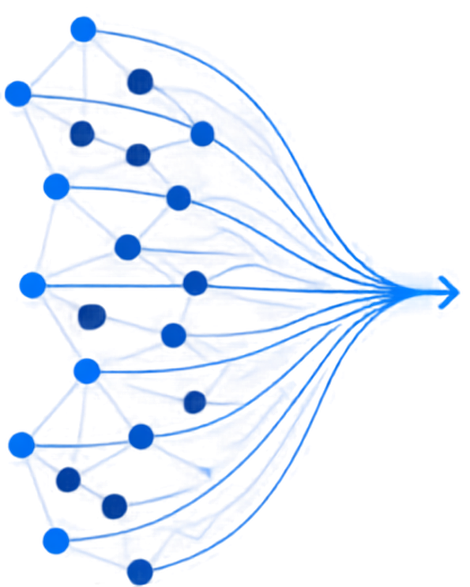






Why Do We Need Semantica?
AI answers often lack explanations for why decisions were made
Information is fragmented across sources
SEMANTICA
Difficult to track relationships between entities
adds structured context, reasoning, provenance and auditability.
Conflicting facts may go unnoticed
Decision history and provenance often missing
AI auditing is hard to perform

Slide 4











Why Semantica?
THE 5 WHYS
1
2
3
4
5
Better
AI context
Relationships
Traceability
Reasoning and provenance
Semantica
AI decisions depend on connected facts and entities.
to know where information and decisions came from.
combines Knowledge Graphs, reasoning, provenance, decision intelligence, and governance.
raw documents andembeddings lack full relationships.
to explain and audit AI decisions.
Semantica helps make AI more explainable and auditable.

Slide 5






























How Semantica Works
Data Sources
Ingest
Parse
Normalize
Split
Extract Entities/Relations/ Events
Conflict Detection
Knowledge Graph
Deduplication
Ontology + Reasoning + Provenance + Decisions
Enriched Knowledge Graph
Vector Store + Graph Store
Export / Visualization / REST / MCP /CLI
INGEST
EXTRACT
CLEANSE
ENRICH
STORE & DELIVER
Collect and parse data from multiple sources
Identify entities, relations, and events from unstructured data
Detect conflicts and remove duplicates for trusted data
Build a knowledge graph with reasoning, provenance, and decisions
Store for fast querying and deliver through multiple interfaces

Slide 6











What Can Semantica Do?
Semantica powers trustworthy AI with structured context, traceable decisions, and governed intelligence.
01
02
03
04
05
Context / Knowledge Graphs
Decision Intelligence
Deterministic Reasoning
Provenance & Lineage
Conflict Detection
06
07
08
09
10
Entity Resolution / Deduplication
Ontology & Governance
Graph Analytics
Visualization
Multi-source Knowledge Pipeline

Slide 7























Real-World Example
Drug Interaction Detection
Medicine A
Medicine B
Interacts with
  Semantica connects patients, medicines, interactions, and evidence.
  Builds a Knowledge Graph with provenance tracking.
  Applies reasoning rules to identify possible risks.
  Explains why recommendations occur.
  Maintains a complete audit trail.
Patient
Possible Risk
Evidence
AI Recommendation
Clinical Guideline

Slide 8









LLM VS RAG VS SEMANTICA
LLM
RAG
SEMANTICA
Builds structured context and Knowledge Graphs
Generates and understands language
Retieves relevant information
Uses graph traversal and semantic search
Uses learned knowledge and context
Usesembeddings and vector stores
Tracks decisions and provenance
No structured decision history or provenance
Focuses on retrieval and grounding
Supports reasoning and governance
Detects conflicts
Provides auditability
LLM =
Generate
RAG =
Retrieve
Semantica =
Connect +
Reason + Trace + Govern

Slide 9







Where Can Semantica Be Used?
FINANCE
HEALTHCARE
LEGAL
Loan underwriting
Fraud detection
Regulatory risk
Clinical decision support
Drug interaction graphs
Patient safety
Evidence research
Contract analysis
Case-law reasoning
GOVERNMENT & DEFENSE
CYBERSECURITY
AUTONOMOUS SYSTEMS
Policy decisions
Information governance
Risk and compliance
Threat attribution
Incident response
IOCprovenance
Decision logs
Safety validation
Explainable AI

Slide 10

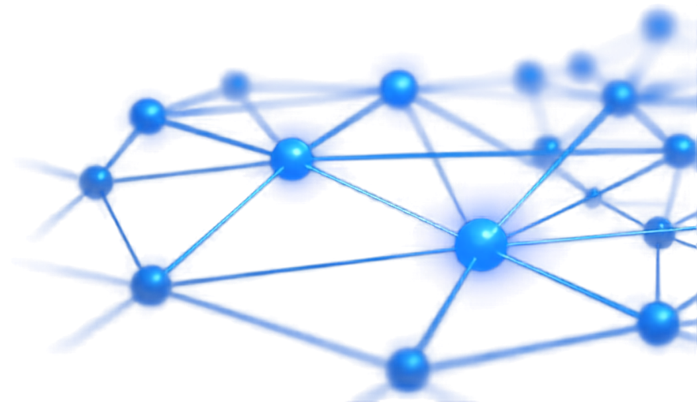





Conclusion
  Semantica is an infrastructure layer, not an LLM
  Complements LLMs, RAG, vector stores, and agents
  Builds Knowledge/Context Graphs
  Provides reasoning and decision intelligence
  Tracks provenance and lineage
  Detects conflicts and duplicates
  Supports governance and auditability
  Useful for high-stakes AI applications
LLM
RAG
structures, connects, reasons, traces
and audits.
SEMANTICA
generates
retrieves

Slide 11
Thank You!!!

