Slide 1
Name: S.DHINESHKUMAR
NM id: au730321104010
Reg. No: 730321104010
Year: III
Department: BE/COMPUTER SCIENCE AND ENGINEERING
College Name: BUILDERS ENGINEERING COLLEGE
3/21/2024
Annual Review
1

Slide 2
PROJECT TITLE
NUMBER PLATE DETECTION USING CNN
3/21/2024
Annual Review
2

Slide 3

1. Problem Statement.
2. Project Overview.
3. Who are the end users.
4. Special features.
5. Modeling.
6. Results.
7. Conclusion.
AGENDA
3/21/2024
Annual Review
3

Slide 4

PROBLEM STATEMENT
Design and implement a number plate detection system that can accurately locate number plates in images or video frames, extract the alphanumeric character from the plates, and recognize them.
Key Challenges:
1. Gesture Recognition Accuracy.
2. User Adaptation.
3. Compatibility and Accessibility.
3/21/2024
Annual Review
4

Slide 5

PROJECT OVERVIEW
Our Project aims to develop a RNN-based system for detect number plate.
Leveraging deep learning techniques, we seekto accurately identify and capture the user voice and avoid the background and surrounding noise to perform the google search.
The system will helpful for police department and other law enforcement agencies.
3/21/2024
Annual Review
5

Slide 6

WHO ARE THE END USERS?
1. Parking management companies.
2.Toll collection authorities.
3. Security and surveillance companies.
4. Commercial Agencies.
3/21/2024
Annual Review
6

Slide 7

Special features:
Integrating attention mechanism can help the model focus on relevant parts of the image especially in cases where the number plate.
Utilize multi-scale feature maps to capture information at different levels of granularity. This can help in detecting number plates of various sizes and aspect ratios.
3/21/2024
Annual Review
7

Slide 8

OUR SOLUTION:
correctly identifying and localizing number plates in vehicle. Higher accuracy indicates that the model is effectively learning the features associated with number plates and making correct predictions.
important outcome is the speed of the recognition process. Faster processing times are desirable, especially for real-time applications like traffic monitoring or automatic toll collection systems.
3/21/2024
Annual Review
8

Slide 9
MODELLING
Data collection
Data preprocessing
Model architecture
Training
Evolution
Deployment
3/21/2024
Annual Review
9

Slide 10
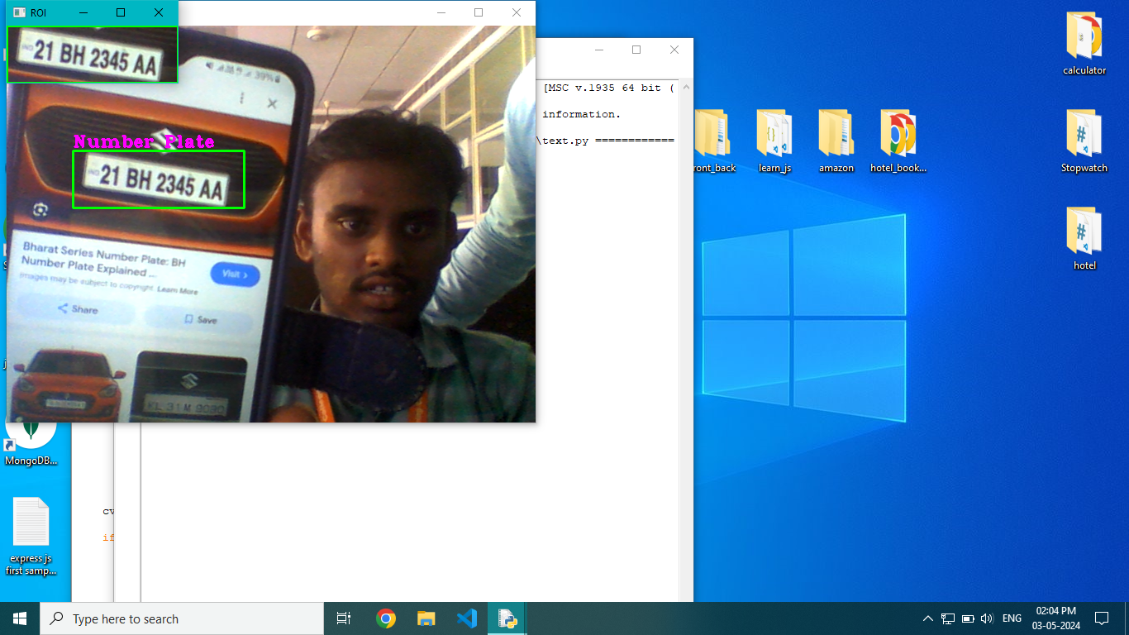
RESULTS
3/21/2024
Annual Review

