Slide 1
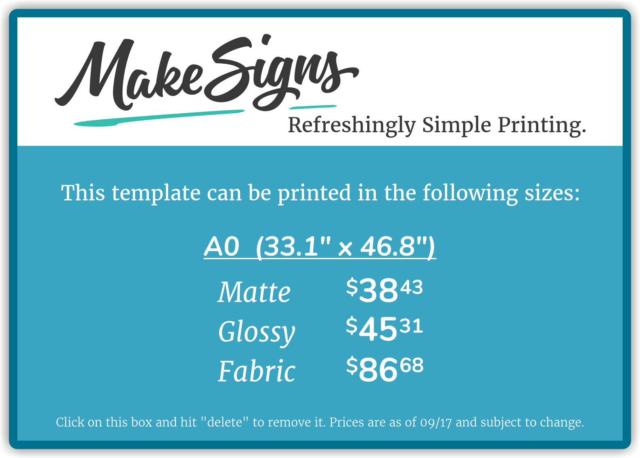


Introduction
Procedures
Results (Continued)
Your text goes here.
Your text goes here.
Your text goes here.
Methods
Your text goes here.
Results
Your text goes here.
Conclusion
Your text goes here.
References
Your text goes here.

