Slide 1
Data Presentation
Online Sales Dataset - Popular Marketplace Data

Slide 2
Objective
This report summarizes the analysis conducted on an online sales dataset to answer key business questions and ext actionable insights related to sales performance, payment methods, product categories, and regional trends.

Slide 3
Basic Questions:
Q1. Was there any discount on purchases?
A: No, there were no discounts identified in the dataset. A calculated column and conditional formatting confirmed that all purchases were made at full price.
Q2. Which payment method should we pay more attention to?
A: Credit card payments should be prioritized as they are the most frequently used and account for the highest total sales revenue.
Q3. Are there differences in payment methods across different regions?
A: Yes.
North America: 100% of transactions were made via credit card.
Europe: 100% of transactions used PayPal.
Asia: Transactions were equally split — 50% credit card and 50% debit card.
Q4. Is there any product category that differs from the others regarding the payment method?
A: No. All product categories in the dataset had a consistent use of a single payment method.

Slide 4
Insights

Slide 5
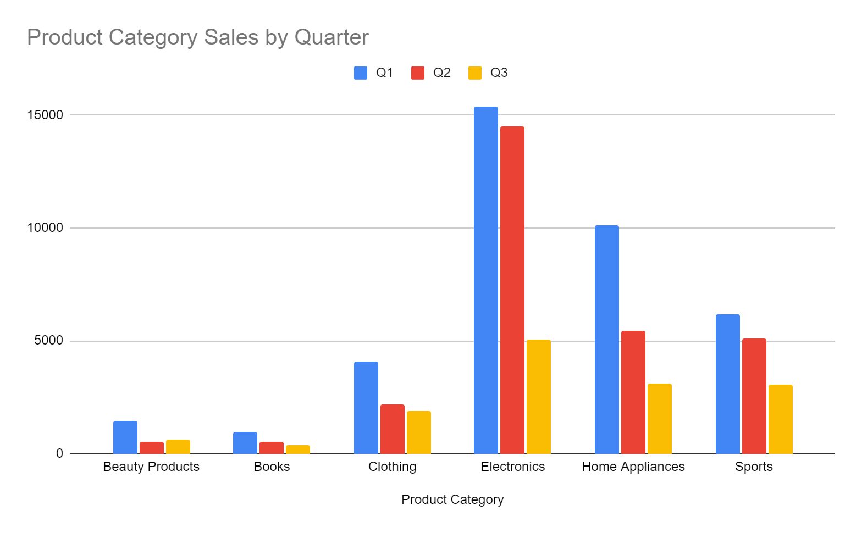
I1. Analyze sales trends over time to identify seasonal patterns or growth opportunities.
Sales tend to decrease throughout the year. A pivot table analysis by quarter (sheet: I1Analysis) reveals a general downward trend in total revenue over time.

Slide 6
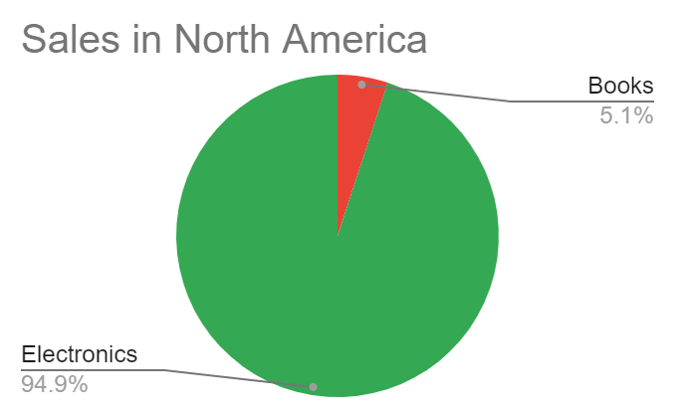
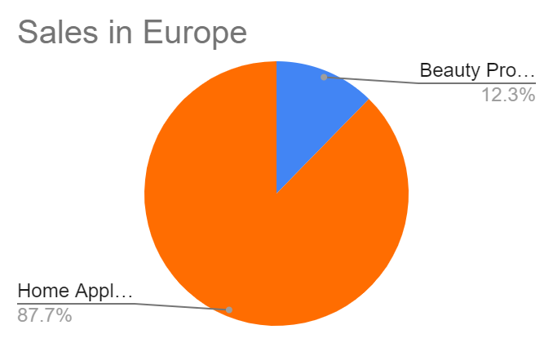
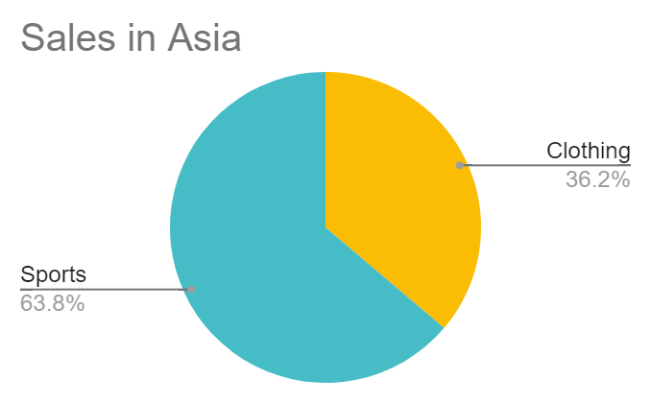
I2. Explore the popularity of different product categories across regions.
The preference for product categories varies across different regions. The I2Analysis sheet provides a detailed breakdown showing regional variation in category performance.

Slide 7
I3. Identify top-selling products within each category to optimize inventory and marketing strategies.
A: The I4Analysis sheet identifies the best-selling products within each category, providing key insights for inventory management and promotional focus. Below is a list of the top-selling products in each category:
Dyson Supersonic Hair Dryer (Beauty Products)
Becoming by Michelle Obama (Books)
Nike Air Force 1 (Clothing)
Canon EOS R5 Camera (Electronics)
LG OLED TV (Home Appliances)
Peloton Bike (Sports)

Slide 8
Conclusion
This analysis provides a clear view of how sales performance, payment behavior, and product preferences vary across time and regions. Credit cards dominate as the leading payment method, while regional preferences suggest the need for tailored marketing and product strategies. No discounts were present in the dataset, and product categories showed consistency in payment method usage. These insights serve as a valuable foundation for strategic decision-making across sales, marketing, and inventory planning.

