Slide 1


SMART INDIA HACKATHON 2025
Problem Statement ID – 25222
Problem Statement Title- Digital Twin for CO₂
Capture in Urban Settings
Theme- Clean & Green Technology
PS Category- Software
Team ID- 114634
Team Name (Registered on portal)- Javachip$

Slide 2
Proposed Solution
Javachip$
Our solution is a 3D digital twin that maps CO₂ across the city using real-time sensors, predicts hotspot formation, and allows planners to test interventions like vertical gardens or biofilters digitally.
We integrate environmental layers like NDVI, LULC, and albedo to generate realistic outcomes.
The system provides before–after comparisons and a simple decision-support dashboard, making urban CO₂ planning faster, smarter, and evidence-based.

Slide 3
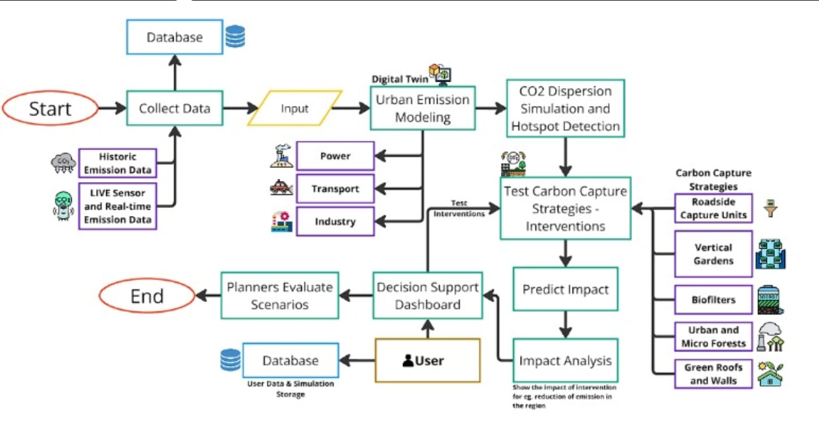
Flow Chart
Javachip$

Slide 4
User Experience
Javachip$
Simple, clean dashboard
Intuitive intervention tools
Clear color-coded hotspot visuals
Easy navigation over the city
Step-by-step workflow (View → Simulate → Compare → Decide)
Minimal cognitive load for non-technical users

Slide 5
Market Readiness
Javachip$
Our solution is immediately useful for:
  Smart City planning
  Pollution control boards
  Urban development authorities
  Climate policy teams
Why it is market-ready:
  Uses real environmental data (CPCB, OpenAQ)
  Can integrate with existing government platforms
  Scales easily to any city
  Provides measurable benefits like cost-saving and better intervention placement
Impact:
  Reduces trial-and-error in urban planning
  Improves CO₂ reduction strategies
  Enables data-driven decision-making

Slide 6
Scalability
Javachip$
1. Modular Architecture :
Each component works independently, hence new modules or datasets can be added easily without changing the core system.
2. Lightweight Computation :
Uses gaussian plum models instead of heavy CFD, ensuring fast performance even when scaling to large city grids.
3. Tiled 3D Rendering (Cesium) :
Loads only the visible area of the city, preventing lag and reduces memory load during large-scale simulations.
4. Plug-and-Play Inputs :
Works with different sensor networks (CPCB / DPCC / local sensors) and can integrate satellite layers (NDVI, LULC, albedo) of any city.

Slide 7
Feasibility
Javachip$
1. Technical Feasibility
Real-time CO₂ simulation and hotspot visualization are fully achievable with lightweight models and open data.
2. Operational Feasibility
supports instant reporting for efficient use.
3. Scalability Feasibility
The architecture extends to ML forecasting, and city-wide digital twin deployment.
4. Economic Feasibility
Low-cost, open-source implementation minimizes expenses and reduces real-world testing costs for governments.
5. User Feasibility
Simple dashboards and clear visual insights ensure easy adoption by planners and municipal authorities.

Slide 8
Why We Are Better
Javachip$
Without Us | With Us
Only sensor values | City-wide CO₂ modeling
Manual city setup | Plug-and-play new cities
Static readings | Real-time dynamic updates
No simulations | Full CO₂ spread simulations
Heavy full-map rendering | Fast tiled rendering
No intervention testing | Test capture & policy impacts
No forecasting | Future hotspot prediction

Slide 9
Future Scope
Javachip$
ML-based hotspot prediction
Full CFD–hybrid modeling for higher precision
Industry-level emission estimation module
Public mobile app for awareness
City-wide recommendation engine for optimal intervention placement
Integration with traffic cameras and IoT devices
the 3D map will be upgraded to display real-time CO₂ hotspots, dispersion layers, and interactive interventions directly within the digital twin.

Slide 10
Thank You!
Javachip$

