Slide 1


IMAGE TO PENCIL SKETCH USING CYCLE GAN
  P.Deekshith CB.SC.U4AIE24039
  S.Dheeraj CB.SC.U4AIE24050
  S.Sathwik CB.SC.U4AIE24051
  S.V.Dhiraj CB.SC.U4AIE24052

Slide 2
INTRODUCTION
CycleGAN stands for Cycle-Consistent Generative Adversarial Network, and it's a type of deep learning model used for unpaired image-to-image translation. That means it can learn to translate images from one domain to another (e.g., horses ↔ zebras, summer ↔ winter) without needing paired examples (i.e., the same image in both domains)..
It consists of two generator networks and two discriminator networks.
The network learns to map between two domains (e.g., photos to sketches and vice versa).

Slide 3
OBJECTIVES
  Build a CycleGAN model to transform real images into pencil sketches.
  Use unpaired datasets for training, eliminating the need for matched image-sketch pairs.
  Focus on generating high-quality pencil sketches with realistic shading and details. Optimize model performance for fast sketch generation.
  Test and evaluate the model on various image types (e.g., faces, landscapes).

Slide 4
METHODOLOGY
STEP 1: Collecting the Data
  We need two sets of images:
  Real-world images (natural photos of people, objects, or scenery).
  Pencil sketch images (hand-drawn or software-generated sketches).
  These images should be of the same size (e.g., 256×256 pixels).
  More diverse images = Better training.
STEP 2: Preprocessing the Data
  Before we feed images into the CycleGAN model, we prepare them properly:
  Resizing images to a fixed size (e.g., 256×256 pixels).
  Normalizing pixel values (changing them from 0-255 to 0-1 or -1 to 1 for better training).

Slide 5
STEP 3: Building the Generator (Creates Pencil Sketches)
  The Generator is a deep learning model that converts a normal image into a pencil sketch.
  Takes a normal image as input.
  Passes it through Convolutional layers (to extract features like edges, textures).
  Uses ResNet Blocks to retain details while modifying the image.
  Upsamples (increases the size back) to generate a pencil sketch.
  Outputs a transformed image that looks like a pencil sketch.

Slide 6
Lack of Brand Visibility
By defining your unique value proposition and creating a consistent brand identity, we ensure your business stands out and remains memorable in the minds of your target audience.
STEP 4: Building the Discriminator (Checks if Sketch is Real or Fake)
  The Discriminator is a deep learning model that checks whether a sketch is real(hand-drawn) or fake (generated by AI).
  Takes an image (either a real pencil sketch or a generated one).
  Passes it through multiple Convolutional Layers (extracts important details).
  Uses PatchGAN (checks if small parts of the image are real or fake).
  Outputs a probability score:
  Close to 1 → The image is real
  Close to 0 → The image is fake.
Ineffective Digital Presence
Through data-driven insights, we tailor strategies to maximize online visibility, engage your audience, and drive meaningful interactions, converting online engagements into tangible business outcomes.
Lack of Targeted Lead Generation
By leveraging strategic content, paid advertising, and personalized engagement tactics, we ensure that your marketing efforts are focused on reaching and converting the right audience.

Slide 7

STEP 5: CycleGAN Training Process
Thynk Unlimited
  Since we don’t have paired images, we use two Generators and two Discriminators.
  Training Process in Steps:
  Generator A converts a real image into a pencil sketch.
  Discriminator A checks whether the sketch is real or fake.
  Generator B tries to convert the sketch back into a real image (cycle consistency).
  Discriminator B checks if the reconstructed image looks like a real photo.
  Cycle loss is applied: If the generated image cannot be converted back properly.
  Both Generators and Discriminators are updated to improve performance over time.

Slide 8
STEP 6: Loss Functions
Adversarial Loss (GAN Loss) → It helps the generator learn to create images that are realistic enough to fool the discriminator.
Cycle Consistency Loss → Ensures that an image converted into a sketch can be converted back.
STEP 7: Training the CycleGAN Mode
Use Google Colab or a GPU-powered system to speed up training.
Load the preprocessed dataset and divide it into training and testing sets.
Train the CycleGAN model using Keras and TensorFlow.
STEP 8: Testing and Evaluating the Model
Input real images into the trained model and check the generated sketches.
Compare generated sketches with real hand-drawn sketches.
Use metrics like Structural Similarity Index Measure (SSIM)
With a global perspective, our marketing agency has proudly served multinational clients, delivering tailored strategies that transcend borders and cultures, ensuring consistent brand success on a worldwide scale.

Slide 9
STATISTIC
Thynk Unlimited
METRICS
SSIM measures the similarity between two images based on luminance, contrast, and structure. Unlike traditional pixel-wise metrics (e.g., MSE), SSIM focuses on the way human eyes perceive image quality
SSIM values range from -1 to 1:
1 → Perfectly similar images.
0 → No similarity.
-1 → Completely different images.

Slide 10

STATISTIC
Thynk Unlimited
μx and μy: Mean (average) intensity values of images x and y.
σx^2 and σy^2 : Variances of images x and y, which measure the spread of intensity values.
σxy : Covariance between x and y, which indicates how much the intensity values of the two images change together.
C1 and C2 : Small constants to stabilize the division and prevent instability when the denominator is close to zero.
Our model achieved an SSIM of 0.56

Slide 11

ADVERSIAL LOSS FUNCTION
STATISTIC
Thynk Unlimited
FOR GENERATOR LOSS:
FOR DISCRIMINATOR LOSS:
Where:
D(x) is the Discriminator's prediction for a real image x (the probability that x is real).
G(z) is the output of the Generator, i.e., the fake image generated from random noise z.
Pdata(x) is the distribution of real images in the training set.
p z(z) is the distribution of random noise input to the Generator.

Slide 12
CYCLE CONSISTENCY LOSS FUNCTION
x is an image from domain X (e.g., a photo).
y is an image from domain Y (e.g., a sketch).
GA(x) is the image generated by mapping x(from domain X) to domain Y.
GB(y) is the image generated by mapping y (from domain Y) to domain X.
GB(GA(x)) is the result of mapping x to domain Y and then back to domain X.
GA(GB(y)) is the result of mapping y to domain X and then back to domain Y.

Slide 13
RESULTS
  The model generated high-quality pencil sketches that closely resembled hand-drawn artwork.
  Facial features and shading were well-preserved, showing significant improvement over traditional methods.
  The average SSIM score was 0.56.
  The model performed efficiently, producing results in under 1 second per image on a GPU.

Slide 14
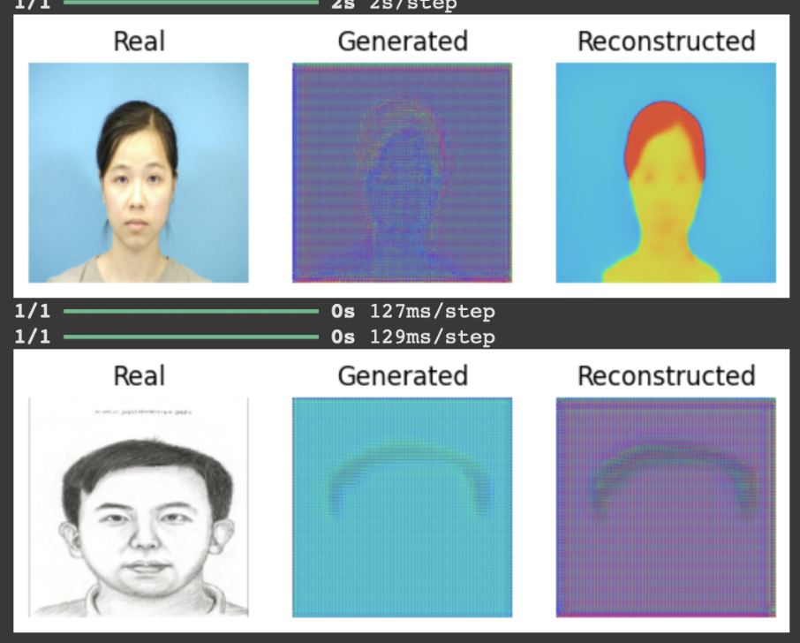

Slide 15
FUTURE SCOPE
This model can be used in mobile apps to turn photos into pencil sketches instantly.
It can help artists and designers create quick sketch versions of portraits for inspiration or editing.
It could be used in police sketch systems to generate suspect images from photos.
The technology can be improved to work with videos, turning live video frames into sketch-style animations.
In the future, it can be trained to generate different art styles like water colour or charcoal, not just pencil sketches.

Slide 16
CONCLUSION
  The proposed framework effectively transforms facial photographs into high-quality pencil sketches using CycleGAN.
  It overcomes the limitations of traditional methods by preserving fine textures, shading, and facial structures.
  The approach demonstrates potential for real-world applications in digital art, entertainment, and forensics.

Slide 17
THANK YOU

