Slide 1
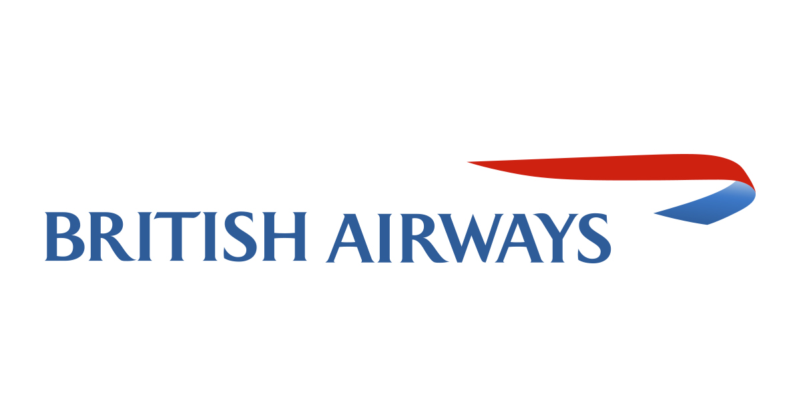
Data Analysis & Data Insights Using Skytrax Airline Review

Slide 2
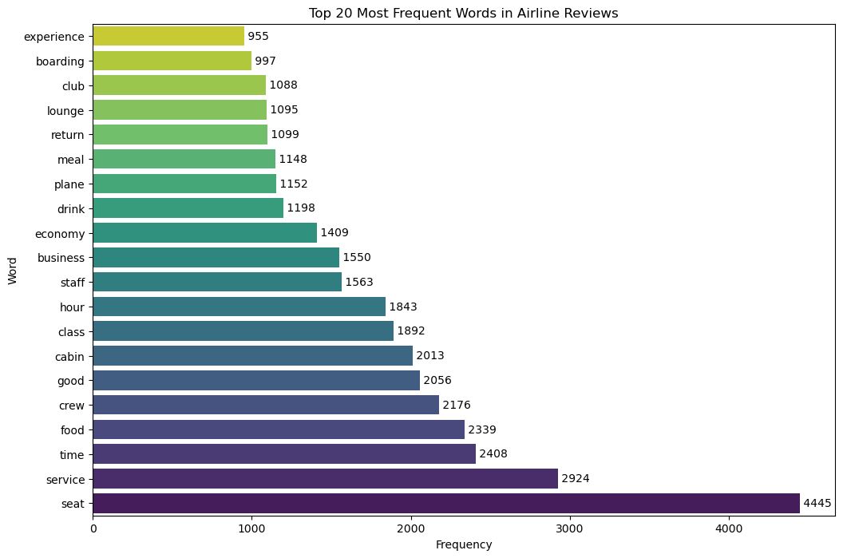
Data Insights
Based On Reviews and Ratings
7-10 ratings wrote about value for money, good cabin crew/staff service, decent business class, safety.
4-6 ratings faced problem with return policy, flight cancelling, long passport check queue, poor Wi-Fi connectivity.
1-3 ratings were about seat comfort, ground service, inflight entertainment, timings, service and food.
Here are some specific things that British Airways can do to improve:
Hire more customer service representatives and train them to be more helpful and responsive.
Invest in new technology to improve its flight scheduling and operations.
Implement a more robust baggage tracking system to prevent lost luggage.
Improve the quality of the food and drinks served on board.
Add more entertainment options to its in-flight entertainment system.
Conduct regular cleanings of its aircraft to ensure that they are clean and sanitary.
Conclusion:
Customer service: Many customers complained about the poor customer service they received from British Airways. They reported long wait times on the phone, rude and unhelpful staff, and a lack of resolution to their problems.
Flight delays and cancellations: British Airways was also criticized for its frequent flight delays and cancellations. Customers reported being stranded at airports for hours, missing connecting flights, and having to rebook their travel at their own expense.
In-flight service: The in-flight service was also criticized by some customers. They reported that the food was subpar, the drinks were overpriced, and the entertainment options were limited.
Offer something that comforts customers in their long journey(Good internet connectivity, wide range of entertainment, complementary drinks or food)
Baggage handling: British Airways also had a number of complaints about its baggage handling. Customers reported lost luggage, damaged luggage, and long delays in getting their luggage back.
Aircraft cleanliness: A few customers also complained about the cleanliness of the aircraft. They reported finding dirty seats, toilets, and galleys. Overall, the customer reviews of British Airways are not positive. The airline needs to improve its customer service, flight reliability, baggage handling, in-flight service, and aircraft cleanliness in order to improve its reputation.

