Slide 1

Society for Computer Technology & Research’s PUNE INSTITUTE OF COMPUTER TECHNOLOGY, Pune. DEPARTMENT OF INFORMATION TECHNOLOGY
SPLITBUDDIE
Presented by,
 | Name | Roll no.
 | Devraj Thakkar | 23358
 | Samir Thokal | 23359
 | Sahil Tiwade | 23360
 | Dhiraj Wadile | 23361
 | Atharva Banasure | 23366
Guided by,
Prof. A. Awati, PICT, Pune

Slide 2
Agenda
Problem statement
Introduction
Literature Survey
System Architecture
Implementation details
UML Diagrams
Snapshots
Scope of Project
Project Timeline
Advantages, drawback and future scope
Conclusion
References

Slide 3
Problem statement
To develop an expense sharing application, where you can add your expenses and split it among different people. The app keeps balances between people as in who owes how much to whom.

Slide 4
Introduction
Splitbuddie app is a digital tool designed to help people manage and split shared expenses with friends, family, or colleagues.
The app typically allows users to input expenses, split the costs among different users, and keep track of who owes what.
Splitbuddie app can be used in various scenarios, such as group vacations, shared rent or utilities, or even for managing expenses for small businesses.
The app can be especially useful for groups of people who share expenses but do not have a centralized way of tracking them, or for people who want to avoid awkward conversations about who owes what.
Expenses splitting apps typically offer a range of features, including expense tracking, payment management.
Overall, Splitbuddie app provide a convenient and efficient way to manage shared expenses and help users avoid conflicts over who owes what

Slide 5
Literature Survey – 1st method
Sr. No | Title | Author | Year | Aim/Objective | Methodology | Gaps/Findings
1 | Expenses Management System | Sai Gowthami. A., M. Vanitha, Alekhya. K . | 2020 | Developing an application which will be able to keep track on expenses and Receivables can solve & Manage monthly expenses problem. | 1.SQLITE Database, 2.Android Studio 3.Login, 4.Add expenses 5.View expenses 6.View Summary | 1.Creating user group, 2.Splitting expenses details, 3. All group expense details 4.Settlement of shares, 5.Payment Notifications, 6.Linking with payment getways.

Slide 6
Literature Survey – 2nd method
Sr. No | Title | Author | Year | Aim/Objective | Methodology | Gaps/Findings
2. | Bill Splitting and Expense Managing Assistant | Rishabh Agrawal | 2019 | A mobile application that managers all your expenses, personal Contribution toward group expenses, maintain monthly income, recurring and Adhoc payment. | 1.User login/registration, 2.Creating user group, 3.Adding expenses, 4.Splitting expenses details, 5.Graphical representation, 6.Collecting user data. | 1.Separate user expense details, 2.All group expense details, 3.Settlement of shares, 4.Payment notification, 5.Linking with payment getways.

Slide 7
system ARCHITECTURE
HOME PAGE
CREATE
HISTORY
+
SPLIT EXPENSES
USER
LOGIN
GROUP
ADD FRIEND
DATABASE
PAYMENT GATEWAY

Slide 8
IMPLEMENTATION PLAN
Software Requirements
Flutter
MongoDB
Node.js
Implementation Aspects:
User Management: SplitBuddie allows users to create accounts, sign in, and manage their profiles. The app typically implements user authentication and authorization mechanisms to ensure secure access to user-specific data.
Dashboard and Activity Feed: The app typically provides a user-friendly dashboard or activity feed, where users can see a summary of their recent activities, including expenses added, payments made, and invitations to join groups.

Slide 9
Expense Creation: SplitBuddie enables users to create new expenses and divide them among participants. The app usually provides an interface for users to enter details such as the expense amount, description, date, and the people involved in the expense.
Expense Splitting: SplitBuddie employs various algorithms and methodologies to divide expenses fairly among participants.
Group Management: Users can form groups with their friends or roommates to track shared expenses easily. SplitBuddie allows users to create groups, invite members, and manage group settings. Payment Tracking: SplitBuddie helps users keep track of who owes whom and simplifies settling expenses. The app typically provides options to record payments made by individuals and updates the overall balance between participants accordingly.

Slide 10
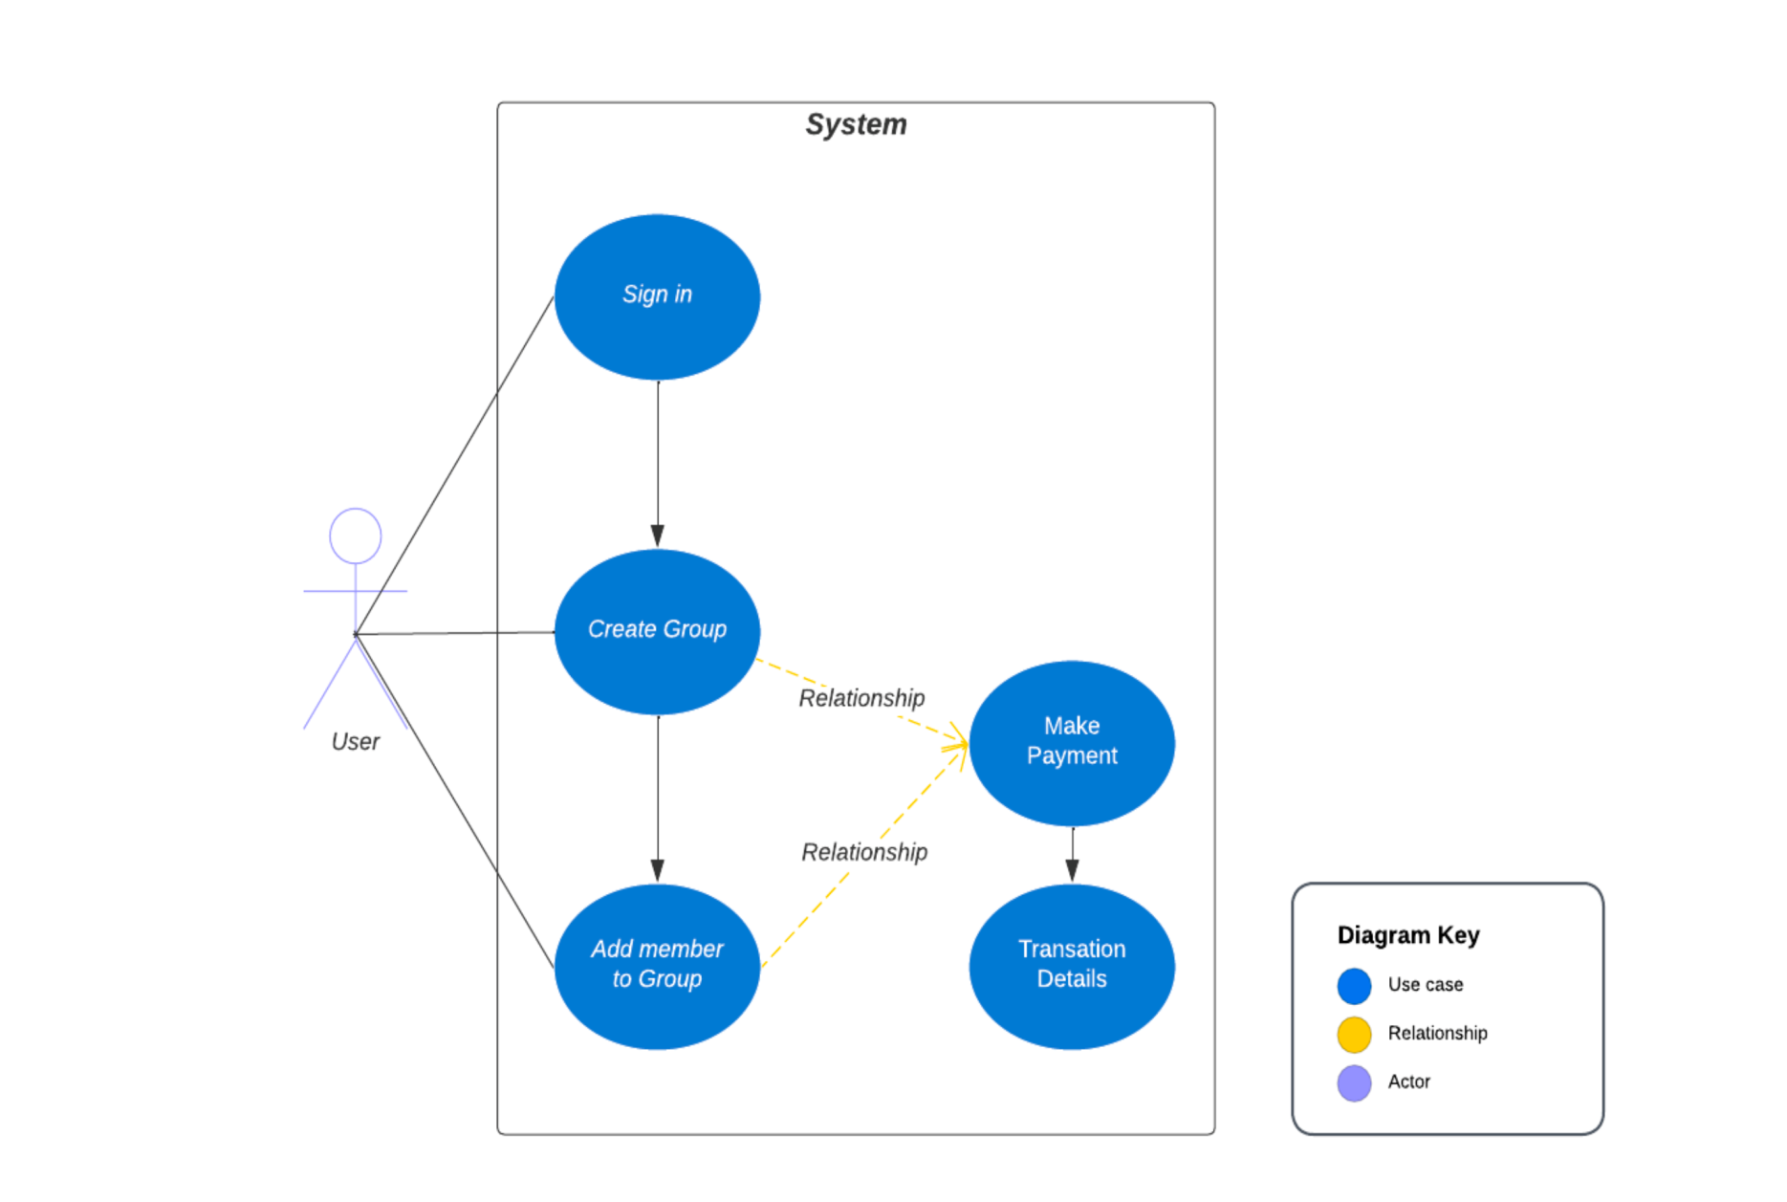
UML DIAGRAMS
Use-Case Diagram

Slide 11
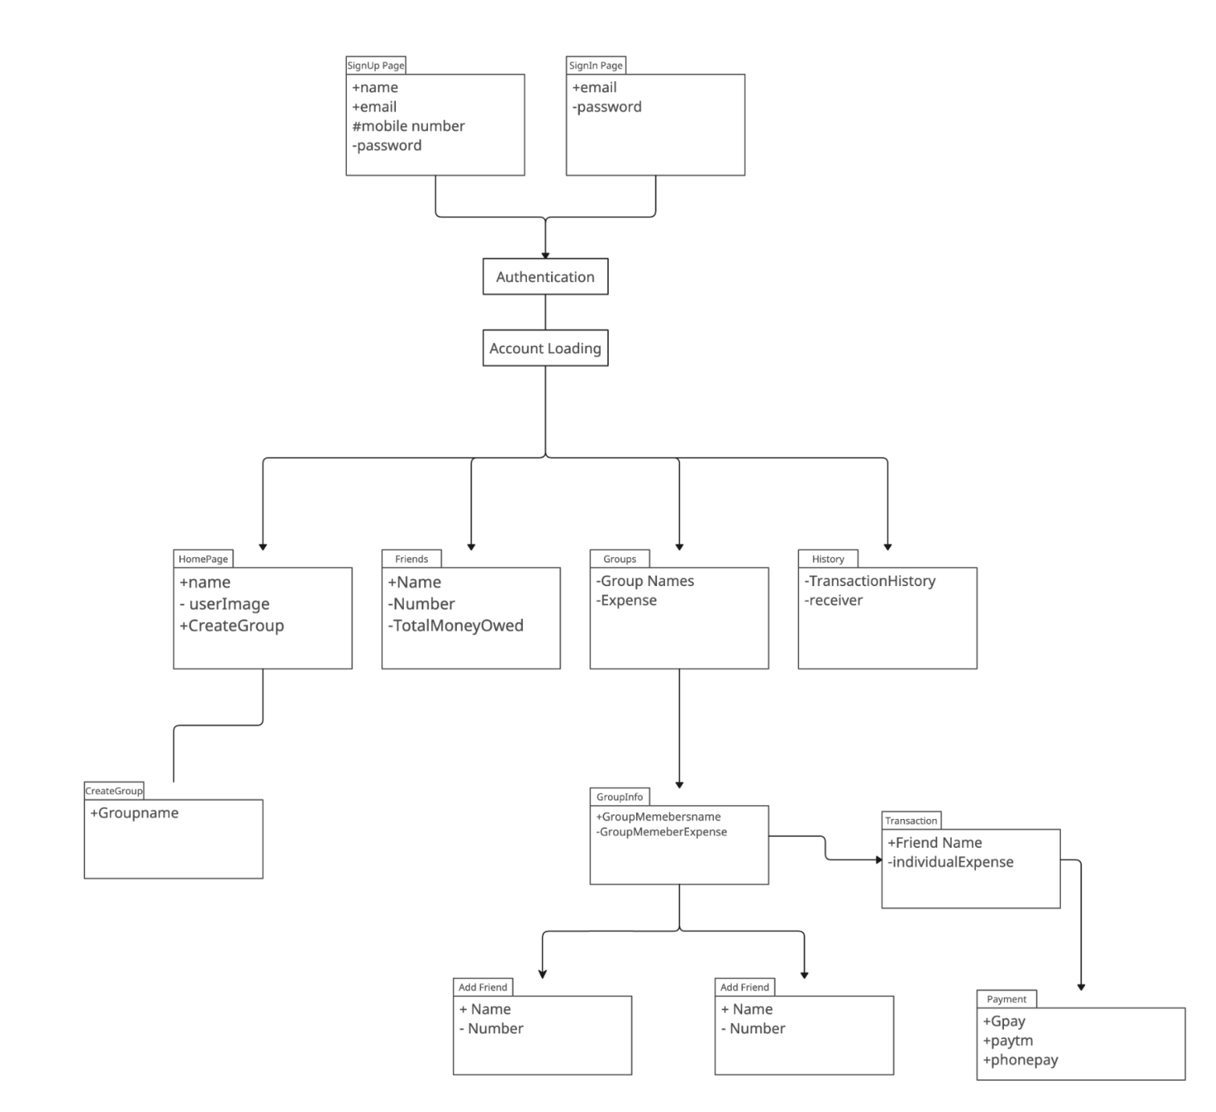
Package Diagram

Slide 12
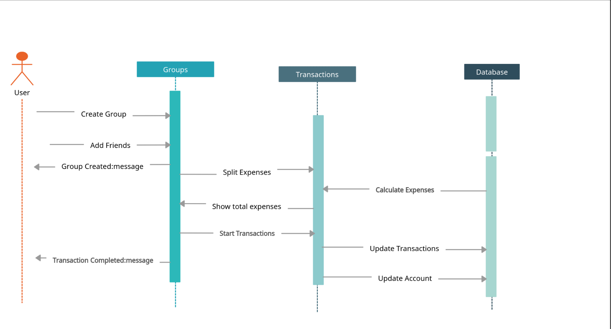
Sequence Diagram

Slide 13
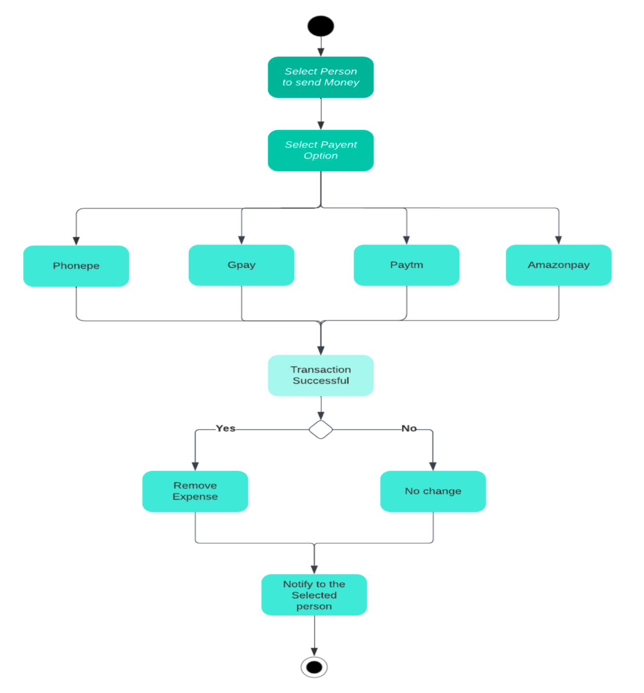
Activity Diagram for payment process

Slide 14
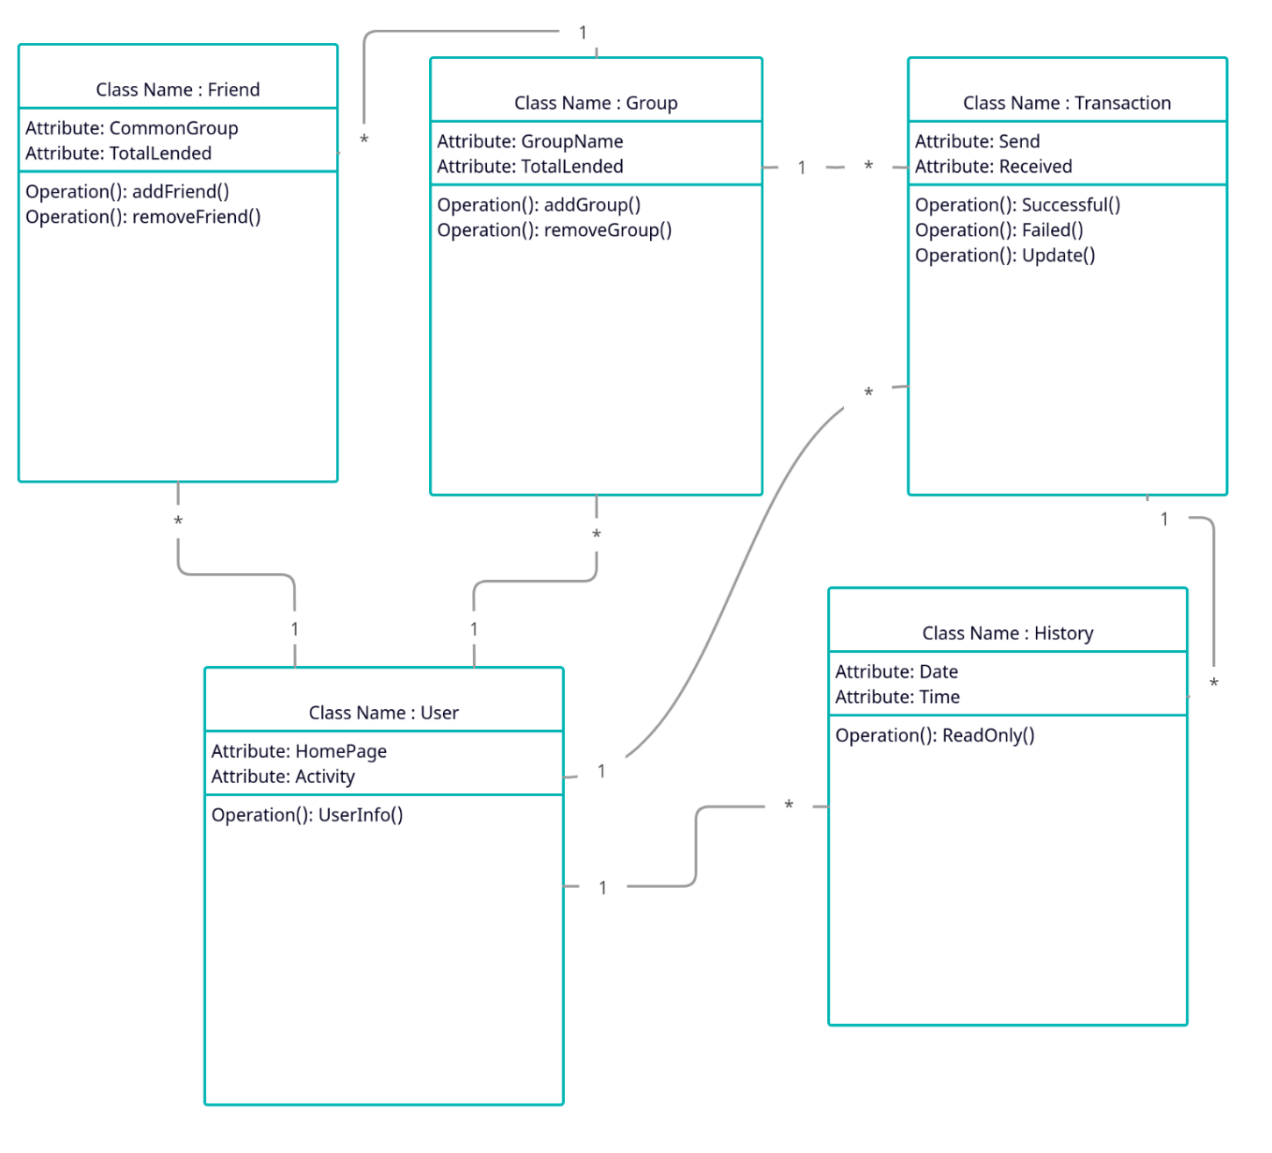
Class Diagram

Slide 15
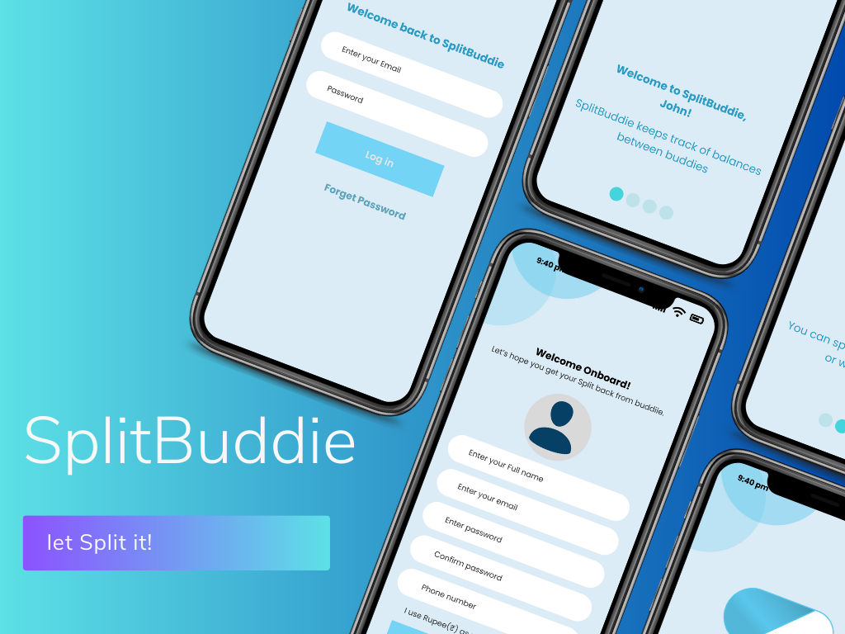
SNAPSHOTS

Slide 16
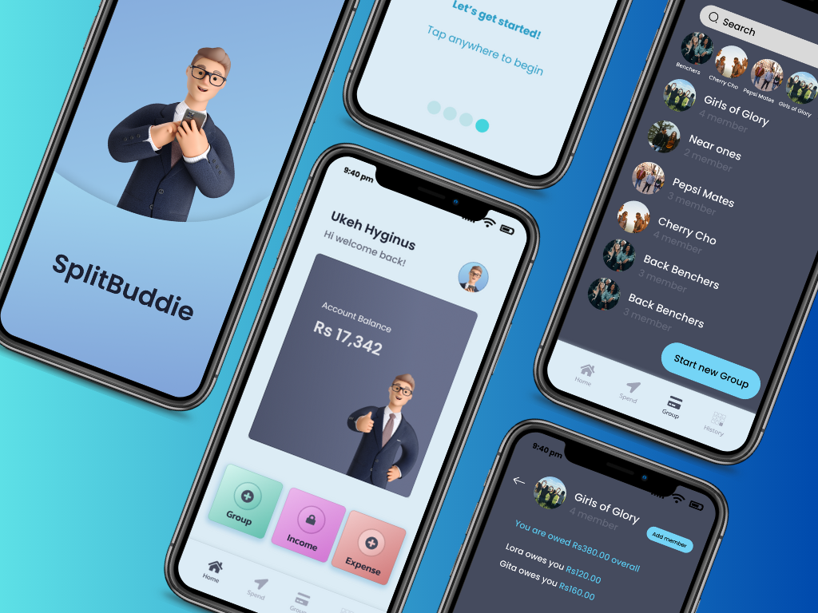

Slide 17
Scope of project
Expense tracking: The app should allow users to add expenses and track them easily. This may include adding a description, category, and date for each expense.
Splitting expenses: The app should allow users to split expenses with other people. This may involve dividing the expense equally or assigning specific amounts to each person.
Payment tracking: The app should allow users to track payments made towards an expense. This may include recording the date, amount, and method of payment.
Group expenses: The app should allow users to track expenses for a group or multiple people. This may include creating a group and inviting people to join, then allowing members to add expenses and track payments.

Slide 18
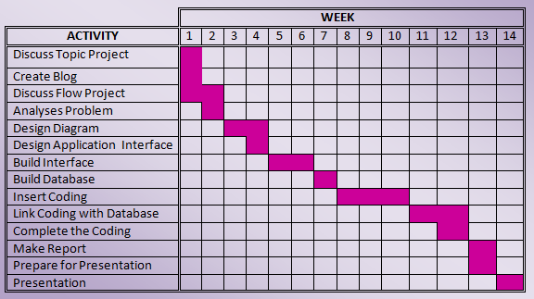
Project TimeLine

Slide 19
Advantages
Simplifies Payment Management: Splitbuddie app make it easy to manage payments and expenses. With such apps, you can track your expenses and split bills with your friends or colleagues effortlessly.
SplitBuddie app facilitate the transfer of money indirectly through its app.
Saves Time: Using SplitBuddie app saves time because you don't have to manually calculate and track expenses. The app does the calculations and splits payments for you, saving you the time and hassle of doing it manually.
Reduces Errors: Manual calculations are prone to errors, especially when there are many expenses to split. With a payment splitting app, the risk of errors is greatly reduced, as the app does the calculations automatically.
Improves Transparency: Splitbuddie app promote transparency because all parties involved can see the expenses and payments. This helps to prevent misunderstandings and conflicts over money.

Slide 20
limitations
Not all users are comfortable using apps for financial transactions or may prefer traditional methods like cash or checks.
This app does not provided direct payment gateway. It provides linkage between other payment apps such as GooglePay, Phonepe, Amazon pay, Paytm etc.
It doesn’t provides the net banking facility.

Slide 21
Future Scope
Integration with other financial apps: In the future, Splitbuddie app could become more integrated with other financial apps such as banking apps or investment apps. This would allow users to have a more comprehensive view of their finances and easily manage their expenses.
Artificial Intelligence: AI-powered Splitbuddie app could be developed to provide more personalized recommendations and suggestions based on a user's spending patterns. This could help users make more informed decisions about their finances.
Blockchain: Blockchain technology could be used to create a more secure and transparent platform SplitBuddie app. This would ensure that users' data is protected and that transactions are recorded accurately.
Internationalization: As people continue to travel and work across borders, SplitBuddie app could become more globally oriented. This could include the ability to split expenses across different currencies or to accommodate different tax regulations in different countries.

Slide 22
Conclusion
In conclusion, SplitBuddie app will become increasingly popular as more people seek convenient ways to manage their finances and share expenses with friends and family. These app can help users to easily split bills, track expenses, and manage their budgets.
Looking towards the future, expenses splitting apps have a promising scope with potential developments in areas such as integration with other financial apps, artificial intelligence, blockchain technology, and internationalization. As people continue on digital tools to manage their finances, SplitBuddie app will likely continue to update their changing needs.

Slide 23
References
https://renatopoulicer.medium.com/splitwise-usability-analysis-d4c5227e477f
https://www.pilotplans.com/blog/splitwise-review

Slide 24
Thank you

