Slide 1
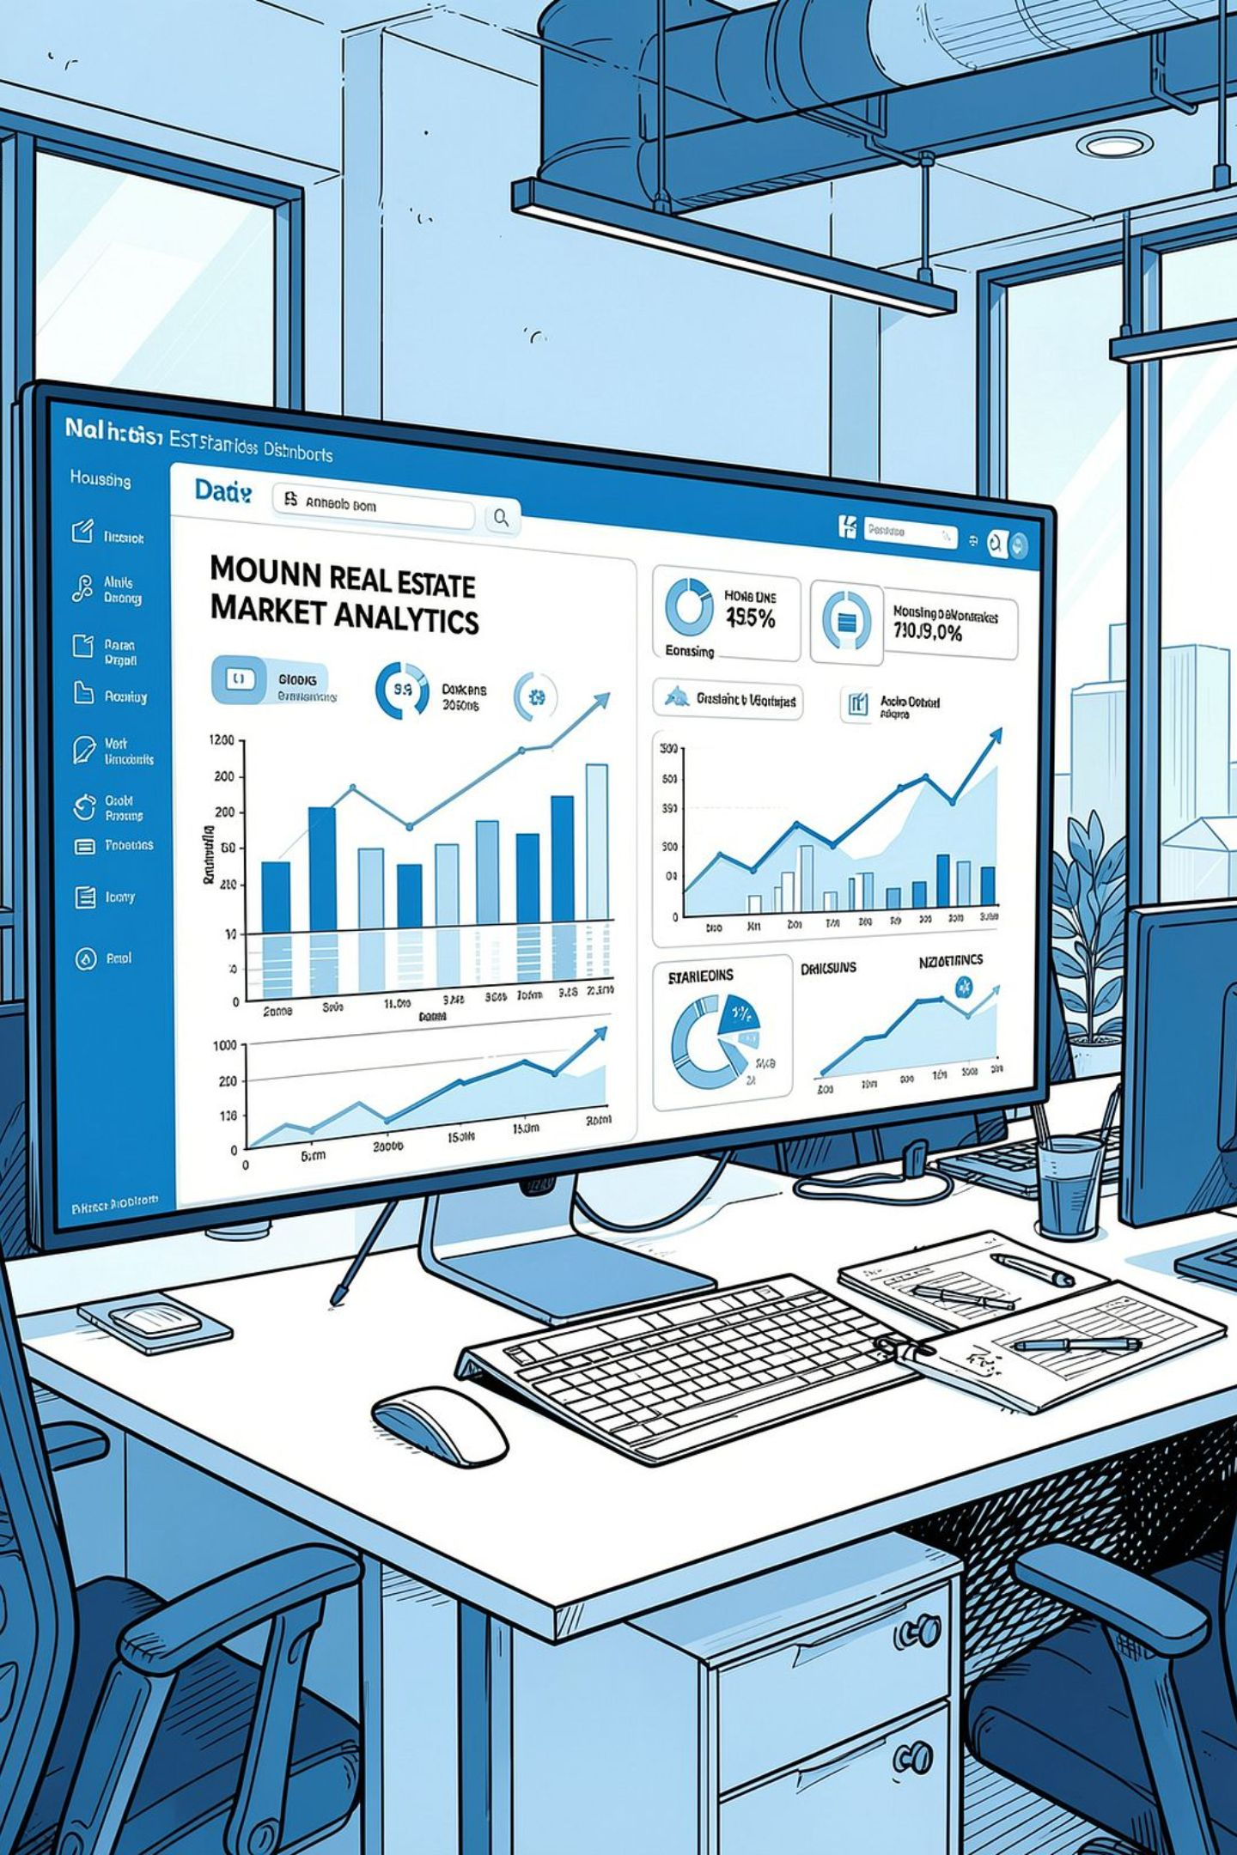
Housing Sales Analytics Dashboard
A decision-support system converting raw transaction data into actionable insights for sales and pricing management — covering regional performance, channel dynamics, property segmentation, and market context.
BUSINESS INTELLIGENCE
POWER BI + BIGQUERY
DENMARK HOUSING MARKET

Slide 2
Business Problem & Objectives
Six core challenges drive the need for an interactive reporting layer that enables decision-makers to identify growth drivers, detect declining segments, compare regional performance, and support pricing and sales strategy.
Sales Visibility
Regional Performance
Quick view of whether sales are growing or declining and which types drive change.
Different regions have different sales volumes and price movements; weak regions need investigation while strong regions may offer expansion opportunities.
Channel Behavior
Pricing Decisions
Auction, regular, other, and family sales may behave differently, but raw data does not make those differences immediately visible.
Offer price, purchase price, and price-per-SQM relationships need to be analyzed to understand pricing behavior.
Property Segmentation
Data Quality & Reporting
House types differ substantially in average transaction value, size, and market indicators.
Raw transaction data contains missing values and requires cleaning, transformation, and repeatable reporting.

Slide 3

Analytics Approach & Solution Architecture
The project follows a structured seven-stage pipeline from raw CSV data to a published, scheduled-refresh Power BI report — supporting descriptive and diagnostic analytics.
01
02
03
Ingest
SQL Analysis
Power BI Connection
Loaded the housing CSV dataset into Google BigQuery.
Created a test table, inspected records, calculated average purchase price by sales type, and performed data updates/validation.
Connected BigQuery to Power BI Desktop for reporting.
04
05
06
Data Cleaning
DAX Modeling
Visualization
Used Power Query to remove relevant null/missing values and prepare fields for analysis.
Created sales growth, rolling sales, YTD, units sold, pricing, and segmentation measures/columns.
Built three dashboard pages: House Market Overview, Sales Performance, and House Type Analysis.
07
Deployment
Published the report to Power BI Service with a workspace and scheduled refresh.
Key analytical principle: The dashboard supports descriptive and diagnostic analytics — showing what happened and where differences exist. It does not by itself prove that one factor caused a sales change.

Slide 4
KPI Framework
Nine key performance indicators track sales, pricing, and property metrics across regions and channels.
KPI
Business Purpose
YOY Sales Growth
Measures year-over-year change in purchase sales and compares sales types.
Rolling 12-Month Sales
Tracks sales value over the latest 12-month period; dashboard value ≈ 13bn.
Units Sold – Latest Year & Quarter
Distinct property count for the latest year/quarter; dashboard value = 77.
Total YTD Sales
Tracks cumulative sales from the start of the year.
Median Sales Price Change
Compares current-year and prior-year median purchase price by region.
Average Price SQM
Compares property price per square meter across regions.
Offer Price
Derived from purchase price and the dataset's offer-to-purchase percentage change.
Offer-to-SQM Ratio
Compares total offer value with total property area by sales type.
Property Age
Difference between transaction year and construction year.

Slide 5
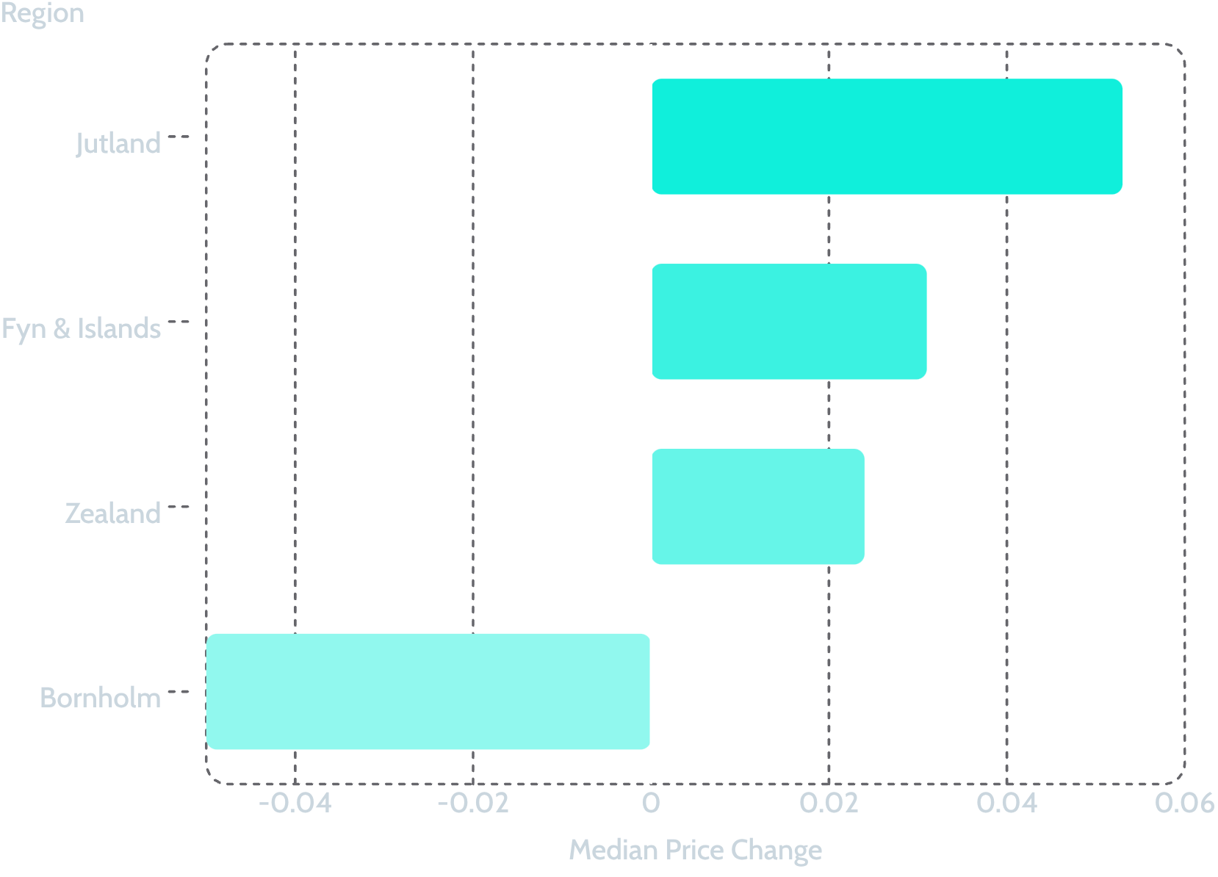
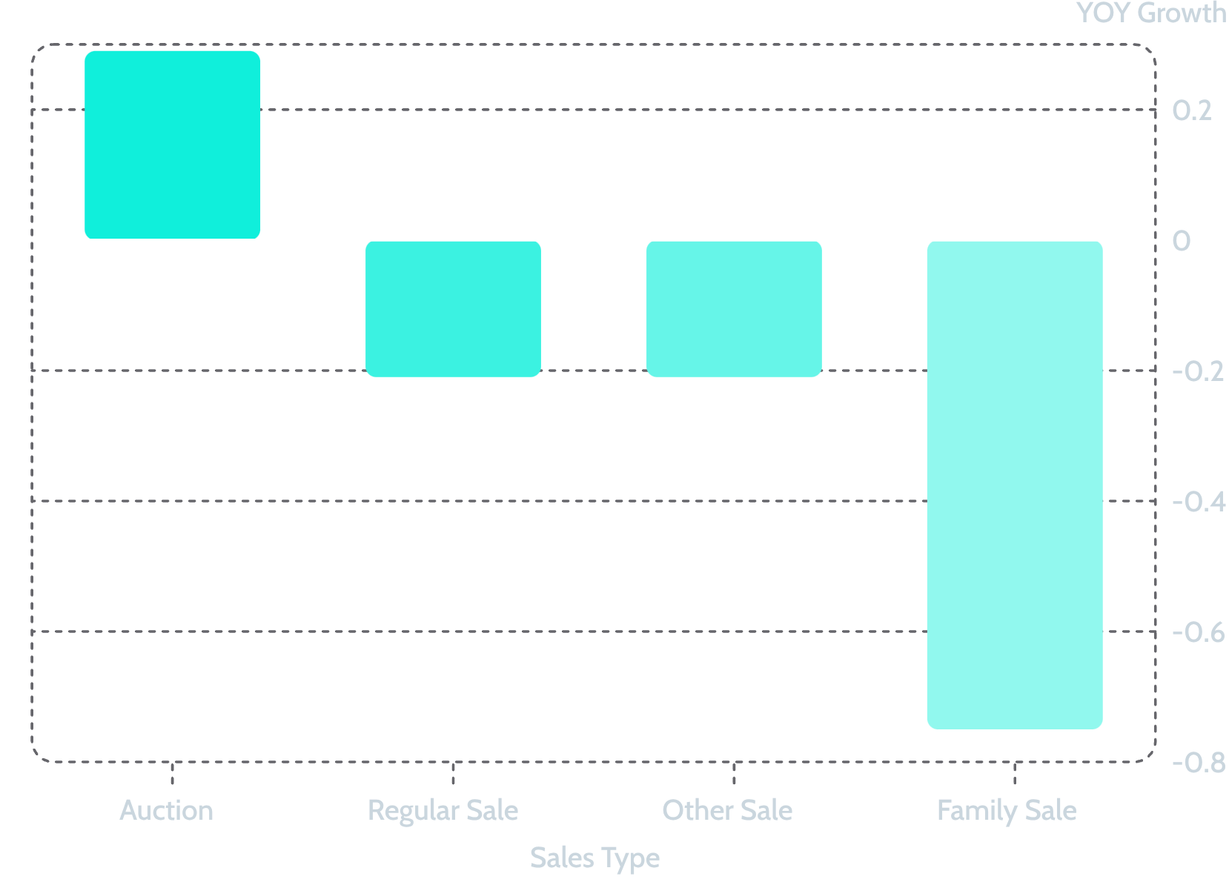
Dashboard 1 — House Market Overview
Median Sales Price Change by Region
YOY Sales Growth by Sales Type
77
13bn
Units Sold
12-Month Sales
Latest year & quarter
Rolling 12-month value
Offer price vs. purchase price scatter shows a strong diagonal correlation, confirming tight alignment between asking and final transaction values across the dataset.

Slide 6

Dashboard 2 — Sales Performance
Regional sales volume reveals strong concentration in Zealand (95bn) and Jutland (81bn), while Fyn & Islands (15bn) and Bornholm (1bn) represent smaller markets. Zealand also leads in average price per SQM at 20.85K, supporting differentiated pricing and market strategy by region.
Regional Sales Volume
Average Price per SQM
Zealand: 95bn · Jutland: 81bn · Fyn & Islands: 15bn · Bornholm: 1bn. Two regions account for the vast majority of reported sales values.
Zealand leads at 20.85K, followed by Fyn & Islands at 13.62K and Bornholm at 10.6K. This supports differentiated pricing and market strategy by region.
Key Influencers on Purchase Price
Offer-to-SQM Ratio by Sales Type
Property age is a significant driver: homes aged 2–16 years show an average price increase of 490.6K, while those over 75 years show 403.5K.
Regular sale: 15K · Other sale: 14K · Family sale: 12K · Auction: 11K. Provides a useful benchmark for pricing by sales channel.

Slide 7
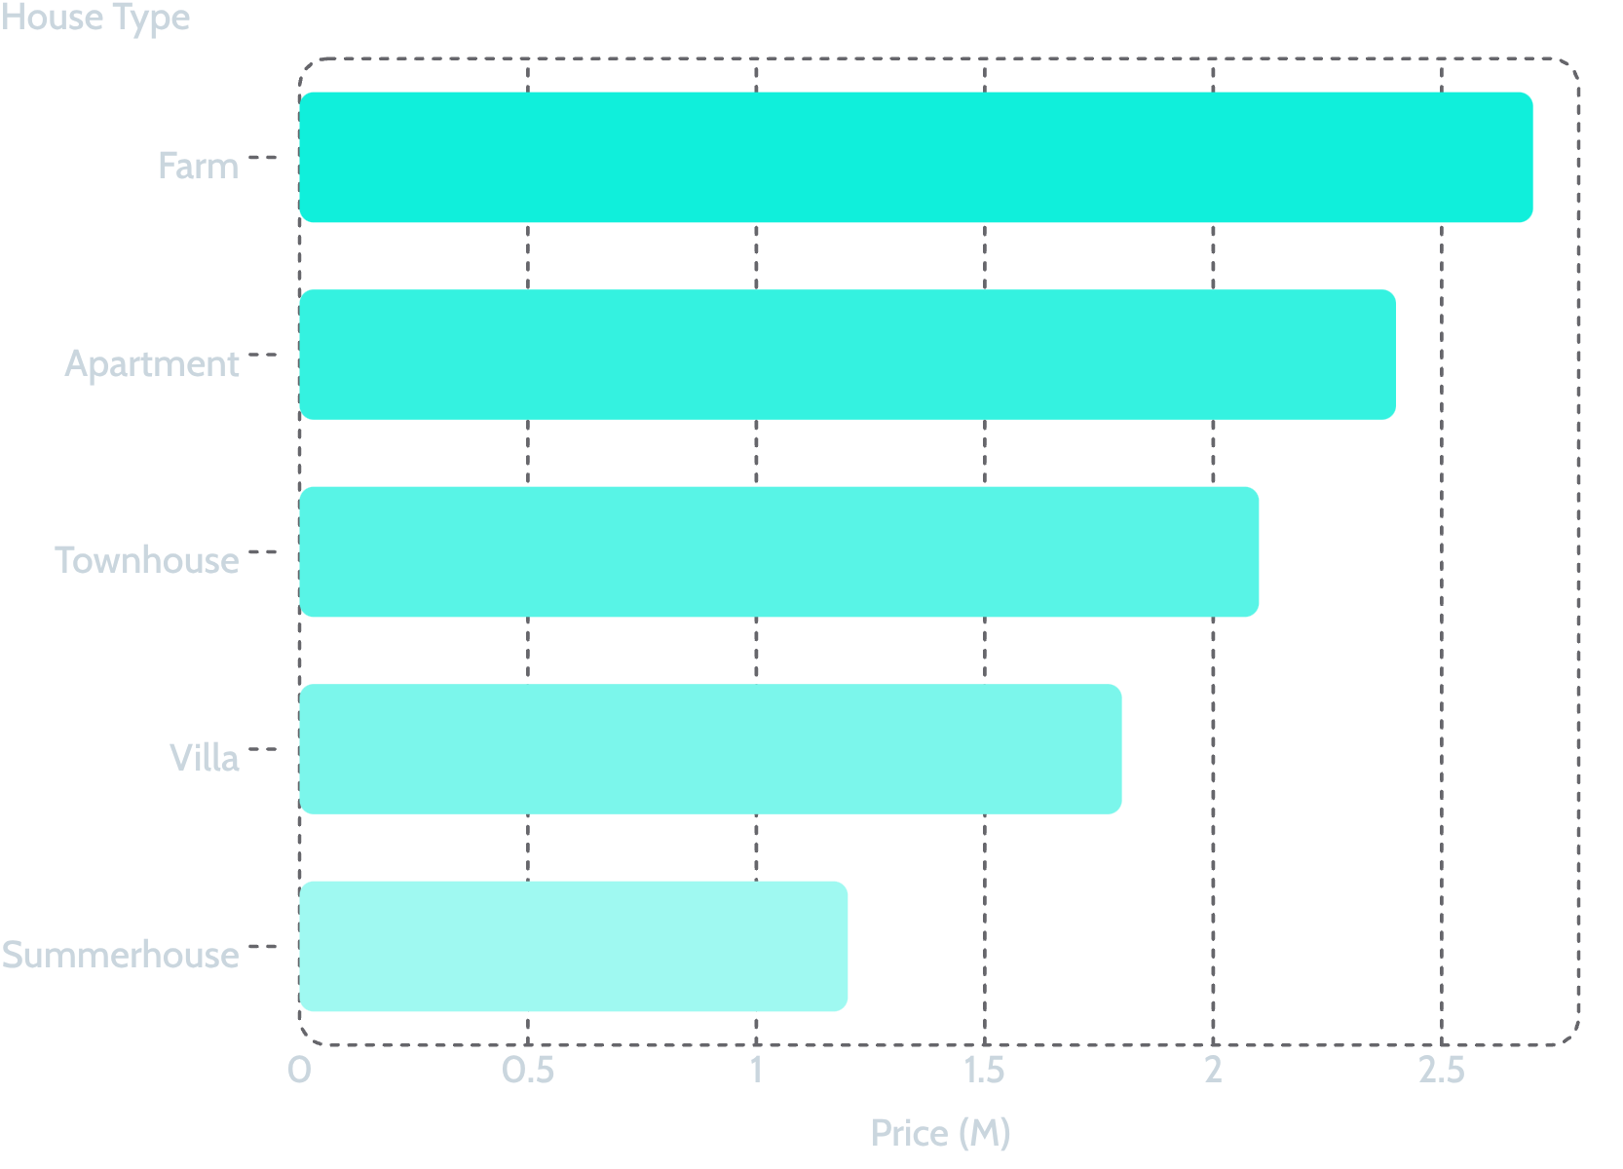
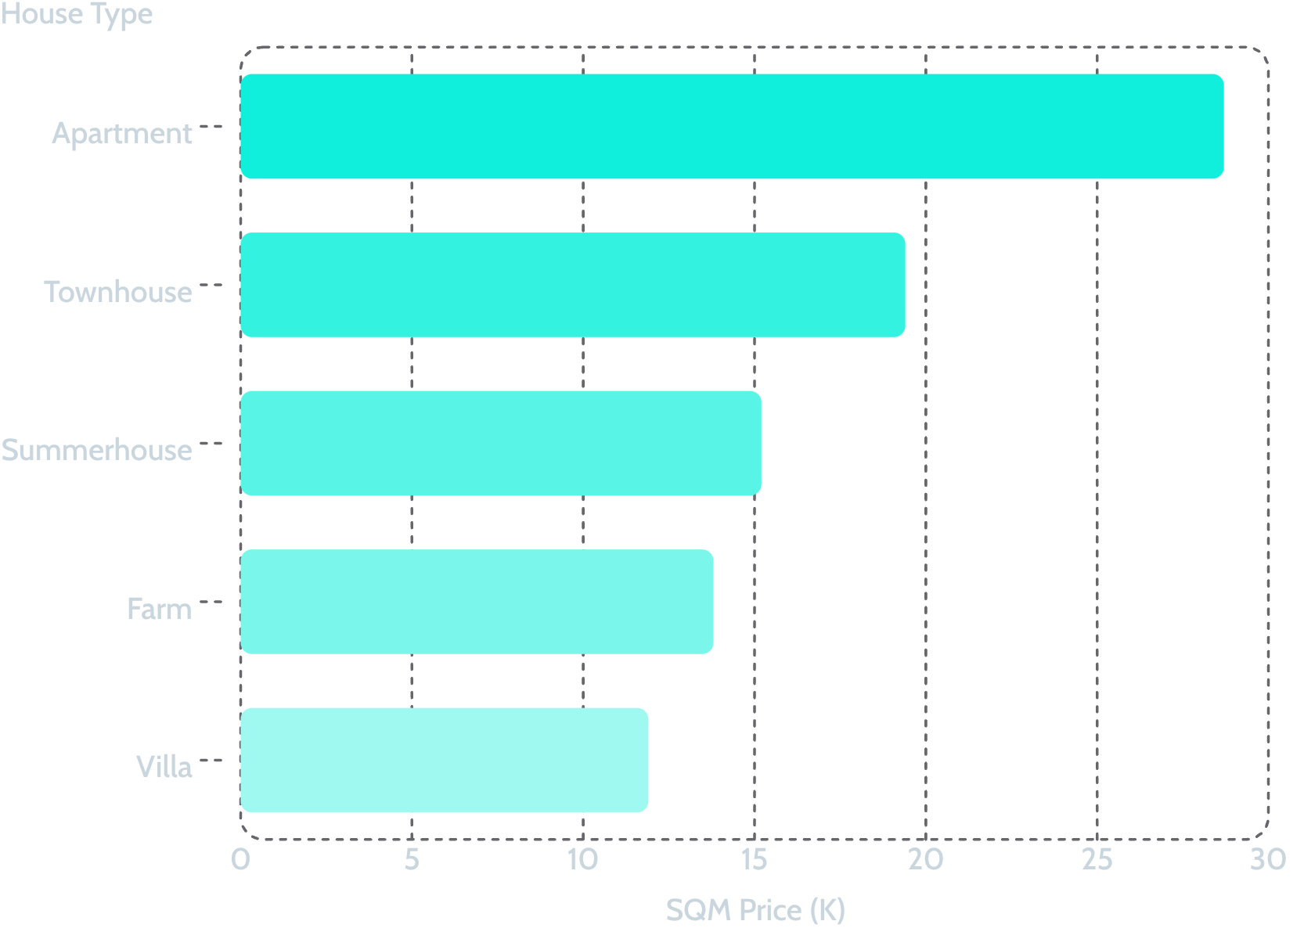
Dashboard 3 — House Type Analysis
Avg Offer / Purchase Price by House Type (M)
Avg SQM Price by House Type (K)
House Type
Inflation
Interest
Yield
Avg SQM
Farm
2.0
2.1
4.6
196.32
Villa
1.9
1.8
4.2
152.05
Apartment
1.9
1.5
3.9
86.67
Townhouse
1.9
1.5
3.9
108.51
Summerhouse
1.9
1.4
3.8
83.78
Inflation, interest, and yield were compared across house types. These indicators should be used as market context when explaining price and sales movements, rather than as proof of causation.

Slide 8
Key Outcomes of the Analysis
+29%
-75%
Auction Growth
Family Sale Decline
Only channel with positive YoY growth.
Largest channel decline; highest-priority review.
+5.3%
-5.0%
Jutland Price Change
Bornholm Price Change
Strongest median sales-price growth among regions.
Negative median price change; requires local investigation.
Channel Performance
Regional & Activity Metrics
Regular and other sales each declined 21%. Traditional channels are weakening and need corrective action. Family sales at -75% require the highest-priority diagnostic review.
Zealand (95bn) and Jutland (81bn) dominate sales volume. Rolling 12-month sales ≈ 13bn; 77 units in latest year/quarter. These provide a current performance benchmark.
Available metrics are sales/transaction and pricing only. A true profit percentage cannot be calculated — percentages represent sales growth/decline and price movement, not company profit.

Slide 9
Proposed Business Solution
Seven strategic actions address uneven channel performance, regional disparities, and pricing opportunities.
1
Scale the Auction Growth Engine
Auction sales grew 29% YoY. Identify the regions, cities, house types, and price bands behind this growth and test whether the same characteristics can be expanded.
2
Recover Declining Channels
Regular and other sales fell 21%, while family sales fell 75%. Build a root-cause review around pricing, inventory mix, geography, property age, and customer demand.
3
Protect High-Value Markets
Zealand has the highest reported sales volume at about 95bn, while Jutland shows the strongest median price growth at 5.3%. Use separate volume and growth strategies for these markets.
4
Address Weak Regions
Bornholm shows a 5.0% median price decline and only about 1bn in sales in the dashboard. Review local demand, property mix, and pricing before increasing inventory.
5
Introduce Data-Driven Pricing
Use offer price, purchase price, SQM, and SQM price together to establish pricing benchmarks by region, house type, and sales channel.
6
Segment Inventory
Prioritize premium property strategies for higher-value types such as farms and apartments, while using volume/affordability strategies for lower-ticket segments such as summerhouses.
7
Operationalize the Dashboard
Keep the Power BI Service report on scheduled refresh and establish a recurring management review of YOY growth, rolling sales, regional price change, and channel performance.
Recommended management cadence: Weekly review of channel and regional anomalies, monthly review of pricing and inventory mix, and quarterly review of growth strategy and regional expansion.

Slide 10

Executive Conclusion
The housing sales analytics project converts raw transaction data into a decision-support system for sales and pricing management. Performance is highly uneven: auction sales grew 29% YoY while family sales declined 75%. Jutland recorded the strongest median price growth at 5.3%, whereas Bornholm declined by 5.0%. At the sales-volume level, Zealand reported approximately 95bn and Jutland 81bn in the dashboard.
Scale Auction
Recover Channels
Expand the only channel with positive YoY growth.
Address declining sales types with root-cause analysis.
Protect Markets
Price Intelligently
Defend high-volume and high-growth regions.
Use property-level benchmarks to improve conversion.
Next step: The project establishes a reusable BI architecture — BigQuery + SQL + Power BI + DAX + Power BI Service — that can be extended with profit/margin data, customer segmentation, inventory availability, conversion rates, and forecasting in a future phase. Connect these insights to costs, margins, inventory, and conversion data so that sales growth can be translated into measurable profitability.

