Slide 1
Introduction to J2EE

Slide 2
J2EE and its Architecture
J2EE is not a product. Rather, it is a specification that defines the contract between application and the container. The container here refers to a standardized runtime environment, which provides specific services for the components deployed in it.
J2EE is an Open and standard based platform for developing, deploying and managing n-tier, Web-enabled, server-centric, and component-based enterprise applications.
The J2EE platform uses a multi-tiered distributed application model for enterprise applications.J2EE multi-tiered applications are generally considered to be three-tiered applications because they are distributed over three different locations
  client machines
  the J2EE server machine
  the database or legacy machines at the back end.

Slide 3
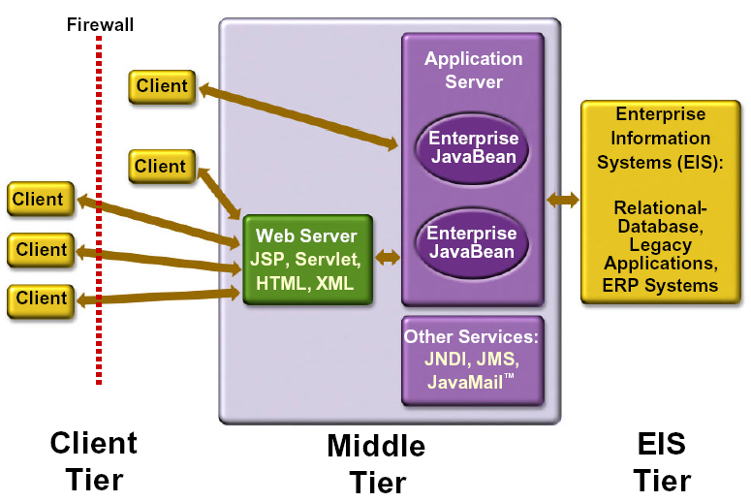

Slide 4
Application Server vs Web Server
1. Application Server supports distributed transaction and EJB. While Web Server only supports Servlets and JSP.
2. Application Server can contain web server in them. most of App server e.g. JBoss or WAS has Servlet and JSP container.
3. Though its not limited to Application Server but they used to provide services like Connection pooling, Transaction management, messaging, clustering, load balancing and persistence. Now Apache tomcat also provides connection pooling.
4. In terms of logical difference between web server and application server. web server is supposed to provide http protocol level service while application server provides support to web service and expose business level service e.g. EJB.
5. Application server are more heavy than web server in terms of resource utilization.

Slide 5
J2EE Containers
The application server maintains control and provides services through an interface or framework known as a container.
There are five defined container types in the J2EE specification
Three of these are server-side containers:
  The server itself, which provides the J2EE runtime environment and the other two containers
  An EJB container to manage EJB components
  A Web container to manage servlets and JSP pages
The other two container types are client-side:
  4. An application container for stand-alone GUIs, console
  5. An applet container, meaning a browser, usually with the Java Plug-in

Slide 6
J2EE Components
As said earlier, J2EE applications are made up of components
A J2EE component is a self-contained functional software unit that is assembled into a J2EE application with its related classes and files and that communicates with other components.
Client components run on the client machine, which correlate to the client containers
Web components -servlets and JSP pages
EJB Components

Slide 7
Need forJ2EE?
J2EE is essentially about Distributed Objects Technology, which is defined as invoking a method on an object residing in a remote machine as if it were local to the invoking program.
The invoking program can be a standalone mode java program. But , if this were so, it presents two problems. The first problem is that it requires JDK to have been installed in each end-user's machine.
Secondly, even with JDK installed in the end-user machine, the java program has to be distributed to each client personally.
Applets, are a possible solution. An applet is a java class file embedded in HTML document, downloaded from the web server and executed in the end-user's browser.

Slide 8
However, Applets also had two problems. First, standard browsers like InternetExplorer(Microsoft) and NetscapeNavigator (NetscapeCorp) did not implement JDK fully. This required a java-plug in from Sun.
Secondly, java applets, except in very simple cases, downloaded the classes from the server which meant that the process was a heavy one and entailed delay in downloading.
For these reasons, Applets also ceased to be the recommended method. That is why Sun developed the Servlets technology. Servlets are java class files , execeuted in server and the resulting html sent to the end-user's browser. Now, at one stroke , it solved many problems.
1) We no longer had to install JDK in end-user's machine.
2) We need not have a java-enabled browser at the user's end.
3) As the result was sent as html only to the browser, it is lightweight & very fast.

Slide 9
MVC Architecture
The main aim of the MVC architecture is to separate the business logic and application data from the presentation data to the user.
Here are the reasons why we should use the MVC design pattern.
They are resuable : When the problems recurs, there is no need to invent a new solution, we just have to follow the pattern and adapt it as necessary.
They are expressive: By using the MVC design pattern our application becomes more expressive.

Slide 10
1). Model: The model object knows about all the data that need to be displayed. It is model who is aware about all the operations that can be applied to transform that object. It only represents the data of an application. The model represents enterprise data and the business rules that govern access to and updates of this data. Model is not aware about the presentation data and how that data will be displayed to the browser.
2). View : The view represents the presentation of the application. The view object refers to the model. It uses the query methods of the model to obtain the contents and renders it. The view is not dependent on the application logic. It remains same if there is any modification in the business logic. In other words, we can say that it is the responsibility of the of the view's to maintain the consistency in its presentation when the model changes.
3). Controller: Whenever the user sends a request for something then it always go through the controller. The controller is responsible for intercepting the requests from view and passes it to the model for the appropriate action. After the action has been taken on the data, the controller is responsible for directing the appropriate view to the user. In GUIs, the views and the controllers often work very closely together.

Slide 11
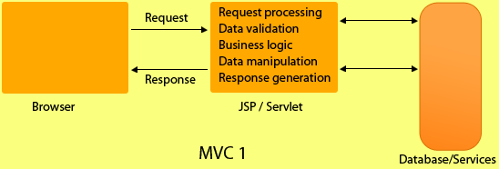
Features of MVC1
Html or jsp files are used to code the presentation. To retrieve the data JavaBean can be used.
In mvc1 archictecture all the view, control elements are implemented using Servlets or Jsp.
In MVC1 there is tight coupling between page and model as data access is usually done using Custom tag or through java bean call.

Slide 12
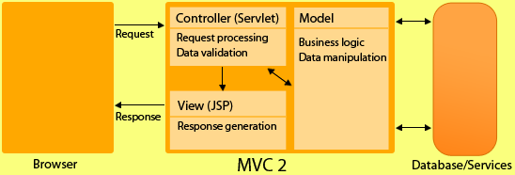
Features of MVC2
The MVC2 architecture removes the page centric property of MVC1 architecture by separating Presentation, control logic and the application state.
In MVC2 architecture there is only one controller which receives all the request for the application and is responsible for taking appropriate action in response to each request.

Slide 13
MVC 1 | MVC 2
MVC1 associates the presentation logic with the business logic. | MVC 2 isolates or disassociates the presentation logic from business logic
In MVC1, only one component is responsible for receiving request and sending response. | In MVC2, there is separate components for receiving and sending response. i.e. Controller & View.
In MVC 1, business logic and presentation Logic is combined so web designer and web developer cant work simulateously. | Since both logics are separate that's why designer and developer can work together.
Doesn't support reusability of application components. | Reusability of components
In MVC 1, controller and model,both are JSP. | While controller is servlet and model is java class.
In MVC1 there is tight coupling between page and model as data access is usually done using Custom tag or through java bean call. | In MVC2 architecture there is only one controller which receives all the request for the application and is responsible for taking appropriate action in response to each request.

Slide 14
What is Servlet?
Servlets are Java technology's answer to CGI programming. They are programs that run on a Web server and build Web pages. Building Web pages on the fly is useful (and commonly done) for a number of reasons:
The Web page is based on data submitted by the user. For example the results pages from search engines are generated this way, and programs that process orders for e-commerce sites do this as well.
The data changes frequently. For example, a weather-report or news headlines page might build the page dynamically, perhaps returning a previously built page if it is still up to date.
The Web page uses information from corporate databases or other such sources. For example, you would use this for making a Web page at an on-line store that lists current prices and number of items in stock.

Slide 15
What are the Advantage of Servlets Over "Traditional" CGI?
Java servlets are more efficient, easier to use, more powerful, more portable, and cheaper than traditional CGI and than many alternative CGI-like technologies.
Efficient
Convenient
Powerful
Portable
Inexpensive

Slide 16
Efficient. With traditional CGI, a new process is started for each HTTP request. If the CGI program does a relatively fast operation, the overhead of starting the process can dominate the execution time. With servlets, the Java Virtual Machine stays up, and each request is handled by a lightweight Java thread, not a heavyweight operating system process. Similarly, in traditional CGI, if there are N simultaneous request to the same CGI program, then the code for the CGI program is loaded into memory N times. With servlets, however, there are N threads but only a single copy of the servlet class. Servlets also have more alternatives than do regular CGI programs for optimizations such as caching previous computations, keeping database connections open, and the like.
Convenient. Besides the convenience of being able to use a familiar language, servlets have an extensive infrastructure for automatically parsing and decoding HTML form data, reading and setting HTTP headers, handling cookies, tracking sessions, and many other such utilities.

Slide 17
Powerful. Java servlets let you easily do several things that are difficult or impossible with regular CGI. For one thing, servlets can talk directly to the Web server (regular CGI programs can't). This simplifies operations that need to look up images and other data stored in standard places. Servlets can also share data among each other, making useful things like database connection pools easy to implement. They can also maintain information from request to request, simplifying things like session tracking and caching of previous computations.
Portable. Servlets are written in Java and follow a well-standardized API. Consequently, servlets written for, say I-Planet Enterprise Server can run virtually unchanged on Apache, Microsoft IIS, or WebStar. Servlets are supported directly or via a plugin on almost every major Web server.
Inexpensive. There are a number of free or very inexpensive Web servers available that are good for "personal" use or low-volume Web sites. However, with the major exception of Apache, which is free, most commercial-quality Web servers are relatively expensive. Nevertheless, once you have a Web server, no matter the cost of that server, adding servlet support to it (if it doesn't come preconfigured to support servlets) is generally free or cheap.

Slide 18
What is JSP?
Java Server Pages (JSP) is a technology that lets you mix regular, static HTML with dynamically-generated HTML. Many Web pages that are built by CGI programs are mostly static, with the dynamic part limited to a few small locations. But most CGI variations, including servlets, make you generate the entire page via your program, even though most of it is always the same.

Slide 19
JSP lets you create the two parts separately. Here's an example:
<!DOCTYPE HTML PUBLIC "-//W3C//DTD HTML 4.0 Transitional//EN">
<HTML>
<HEAD>
<TITLE>Welcome to Our Store</TITLE>
</HEAD>
<BODY>
<H1>Welcome to Our Store</H1>
<SMALL>Welcome,
<!-- User name is "New User" for first-time visitors -->
<% out.println(Utils.getUserNameFromCookie(request)); %>
To access your account settings, click
<A HREF="Account-Settings.html">here.</A>
</SMALL>
<P>Regular HTML for all the rest of the on-line store's Web page.
</BODY>
</HTML>

Slide 20
What are the Advantages of JSP?
vs. Active Server Pages (ASP). ASP is a similar technology from Microsoft. The advantages of JSP are twofold. First, the dynamic part is written in Java, not Visual Basic or other MS-specific language, so it is more powerful and easier to use. Second, it is portable to other operating systems and non-Microsoft Web servers.
vs. Pure Servlets. JSP doesn't give you anything that you couldn't in principle do with a servlet. But it is more convenient to write (and to modify!) regular HTML than to have a zillion println statements that generate the HTML. Plus, by separating the look from the content you can put different people on different tasks: your Web page design experts can build the HTML, leaving places for your servlet programmers to insert the dynamic content.

Slide 21
vs. Server-Side Includes (SSI). SSI is a widely-supported technology for including externally-defined pieces into a static Web page. JSP is better because it lets you use servlets instead of a separate program to generate that dynamic part. Besides, SSI is really only intended for simple inclusions, not for "real" programs that use form data, make database connections, and the like.
vs. JavaScript. JavaScript can generate HTML dynamically on the client. This is a useful capability, but only handles situations where the dynamic information is based on the client's environment. With the exception of cookies, HTTP and form submission data is not available to JavaScript. And, since it runs on the client, JavaScript can't access server-side resources like databases, catalogs, pricing information, and the like.
vs. Static HTML. Regular HTML, of course, cannot contain dynamic information. JSP is so easy and convenient that it is quite feasible to augment HTML pages that only benefit marginally by the insertion of small amounts of dynamic data. Previously, the cost of using dynamic data would preclude its use in all but the most valuable instances.

