Slide 1
Servlets

Slide 2
Java Servlets are programs that run on a Web or Application server and act as a middle layer between a request coming from a Web browser or other HTTP client and databases or applications on the HTTP server.
Using Servlets, you can collect input from users through web page forms, present records from a database or another source, and create web pages dynamically.
Java Servlets often serve the same purpose as programs implemented using the Common Gateway Interface (CGI). But Servlets offer several advantages in comparison with the CGI.
• Performance is significantly better.
• Servlets execute within the address space of a Web server. It is not necessary to create a separate process to handle each client request.
• Servlets are platform-independent because they are written in Java.
• Java security manager on the server enforces a set of restrictions to protect the resources on a server machine. So servlets are trusted.
• The full functionality of the Java class libraries is available to a servlet. It can communicate with applets, databases, or other software via the sockets and RMI mechanisms.

Slide 3
Definition: Servlets are java programs that run on a Web server and build Web pages.
Working of a servlet: A client program, which could be a Web browser or some other program that can make connections across the Internet, accesses a Web server and makes a request. This request is processed by the servlet engine that runs within the Web server, which returns a response to a servlet. The servlet in turn sends a response in HTTP form to the client.

Slide 4
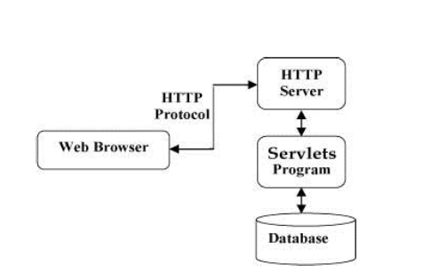
Servlets Architecture

Slide 5
Servlets Tasks:
Servlets perform the following major tasks:
• Read the explicit data sent by the clients (browsers). This includes an HTML form on a Web page or it could also come from an applet or a custom HTTP client program.
• Read the implicit HTTP request data sent by the clients (browsers). This includes cookies, media types and compression schemes the browser understands, and so forth.
• Process the data and generate the results. This process may require talking to a database, executing an RMI or CORBA call, invoking a Web service, or computing the response directly.
• Send the explicit data (i.e., the document) to the clients (browsers). This document can be sent in a variety of formats, including text (HTML or XML), binary (GIF images), Excel, etc.
• Send the implicit HTTP response to the clients (browsers). This includes telling the browsers or other clients what type of document is being returned (e.g., HTML), setting cookies and caching parameters, and other such tasks.

Slide 6
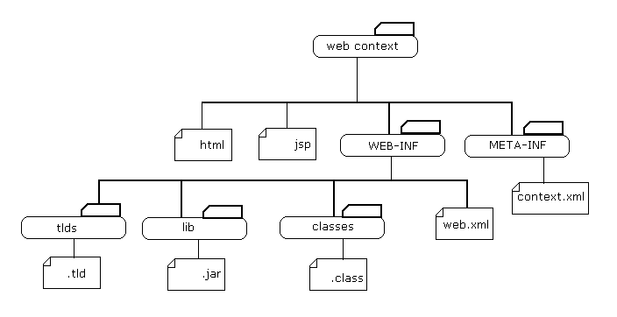
Java Web Application Structure

Slide 7
Java Servlet Packages:
Two packages make up the servlet architecture:
javax.servlet, contains the generic interfaces and classes that are implemented and extended by all servlets.
javax.servlet.http packages. contains the classes that are extended when creating HTTP-specific servlets.
At the heart of this architecture is the interface javax.servlet.Servlet. It provides the framework for all servlets.

Slide 8
Servlet Interface
It provides the framework for all servlets. The Servlet interface defines five methods. The three most important are as follows:
init ( ) method – initializes a servlet
service () method – Receives and responds to client requests.
destroy ( ) method – performs cleanup.
Other two are:
getServletConfig() method
getServletInfo() method
All servlets must implement this interface, either directly or through inheritance. It is a very clean object- oriented approach that makes the interface very easy to extend.

Slide 9
Servlet Lifecycle
A Java servlet has a lifecycle that defines how the servlet is loaded and initialized, how it receives and responds to requests, and how it is taken out of service. In code, the servlet lifecycle is defined by the javax.servlet.Servlet interface. All Java servlets must, either directly or indirectly, implement the Javax.servlet.Servlet interfaces so that they can run in a servlet engine.
The servlet engine is a customized extension to a Web server for processing servlets, built in conformance with the Java Servlet API by the Web server vendor. The servlet engine provides network services and runs servlet containers.
The javax.servlet.Servlet interface defines methods that are called at specific times and in a specific order during the servlet lifecycle.

Slide 10
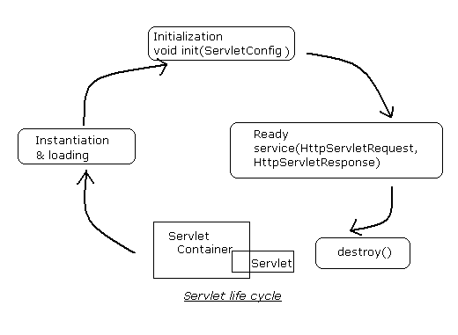
The entire servlet lifecycle is

Slide 11
How a Servlet is Loaded and Instantiated?
The servlet engine instantiates and loads a servlet. The instantiation and loading can occur when the engine starts, when it needs the servlet in order to respond to a request, or any time in between. The servlet engine loads a servlet using the Java class loading facility. The servlet engine can load the servlet from the local file system, a remote file system, or a network source.
How a Servlet is Initialized?
After the servlet engine loads the servlet, the engine must initialize the servlet. Initialization is a good time for a servlet to read any persistent data it may have stored, initialize JDBC database connections, and establish references to other costly resources. During initialization, the init method of the javax.servlet.Servlet interface gives the servlet initialization information, so that the servlet has an opportunity to configure itself. This init method is called exactly once to indicate that the servlet is being placed for service.
The signature of this method is:
public void init(ServletConfig config) throws ServletException

Slide 12
How a Servlet Handles Requests?
After the servlet is initialized, it is ready to handle requests from the client. Each client request that is made of a servlet is represented by a servlet request object (of type ServletRequest). The response the servlet sends to the client is represented by a servlet response object (of type ServletResponse). When the client makes a request, the servlet engine passes both the servlet request object and the servlet response object to the servlet. The objects are passed as parameters to the service method, defined in the Service interface and which the servlet implements.
The method has following signature:
public void service(ServletRequest request, ServletResponse resonse) throws ServletException,IOException
How a Servlet is Destroyed?
Servlet engines are free to use servlets or retire them at any time. When the servlet engine determines that a servlet should be destroyed (for example, if the engine is shut down or needs to conserve resources), the engine must allow the servlet to release any resources it is using and save persistent state. To do this, the engine calls the servlet’s destroy method. Once the engine destroys a servlet, the engine cannot route any more requests to the servlet.
The method signature is:
public void destroy()

Slide 13
public class Lifecycle implements Servlet{
public void destroy() {
System.out.println("destroy");
}
public void init(ServletConfig config) throws ServletException {
System.out.println("init");
}
public void service(ServletRequest req, ServletResponse res)
throws ServletException, IOException {
System.out.println("service");
    PrintWriter out=response.getWriter();
    out.println("<HTML>");
    out.println("<BODY>");
    out.println("Extending GenericServlet makes code simpler");
    out.println("</BODY>");
    out.println("</HTML>");
}
public ServletConfig getServletConfig() {
return null;
}
public String getServletInfo() {
return null;
}
}

Slide 14
Deployment Descriptors
A web application's deployment descriptor describes the classes, resources and configuration of the application and how the web server uses them to serve web requests.
When the web server receives a request for the application, it uses the deployment descriptor to map the URL of the request to the code that ought to handle the request.
The deployment descriptor is a file named web.xml. It resides in the app's WAR under the WEB-INF/ directory. The file is an XML file whose root element is <web-app>.
Servlet and URL mapping: web.xml defines mappings between URL paths and the servlets that handle requests with those paths. The web server uses this configuration to identify the servlet to handle a given request and call the class method that corresponds to the request method.
Welcome file list: The deployment descriptor can specify a list of filenames that the server should try when the user accesses a path that represents a WAR subdirectory (that is not already explicitly mapped to a servlet). The servlet standard calls this the "welcome file list."

Slide 15
Example
<web-app xmlns="http://java.sun.com/xml/ns/javaee" version="2.5">
<welcome-file-list>
<welcome-file>index.html</welcome-file>
<welcome-file>index.jsp</welcome-file>
</welcome-file-list>
<servlet>
<servlet-name>First</servlet-name>
<servlet-class>First</servlet-class>
</servlet>
<servlet-mapping>
<servlet-name>First</servlet-name>
<url-pattern>/First</url-pattern>
</servlet-mapping>
</web-app>

Slide 16
Generic Servlet and HttpServlet
The two main classes which are extended by the servlets are
GenericServlet and
HttpServlet, extended from GenericServlet
GenericServlet:
Two drawbacks of implementing the javax.servlet.Servlet interface are:
Firstly, all the five methods need to be imlemented.
Secondly, ServletConfig object needs to be reserved to use it from other methods.
For this, javax.servlet package provides a wrapper class, GenericServlet that implements two interfaces from javax.servlet package:
Servlet and ServletConfig,
as well as the java.io.Serializable interface.
Every time a server receives a request that points to a servlet, it calls that servlet’s service ( ) method.The service () method had been defined as an abstract method in order to force to follow this framework.
The service () method prototype is defined as follows:
  public abstract void service (ServletRequest req, ServletResponse res) through ServletException, IOException
While extending GenericServlet, this method needs to be implemented manually.

Slide 17
Example
public class genericServ extends GenericServlet{
public void service(ServletRequest req, ServletResponse res)
throws ServletException, IOException{
PrintWriter out=res.getWriter();
out.println(“<HTML>”);
out.println(“<BODY>”);
out.println(“Extending GenericServlet makes code simpler”);
out.println(“</BODY>”);
out.println(“</HTML>”);
}
}

Slide 18
HttpServlet:
The HttpServlet class is an extension of GenericServlet that includes methods for handling HTTP-specific data.
Unlike with GenericServlet, when HttpServlet is extended, the service () method is not implemented manually. The HttpServlet class has already implemented it. The prototype for HttpServlet .service () method is given as follows :
protected void service(HttpServletRequest req,HttpServletResponse resp)throws ServletException, IOException;
HttpServlet provides a number of methods, such as doGet(), doPost(), and doPut(), to handle particular types of HTTP requests (GET, POST, and so on).
These methods are called by the default implementation of the service() method, which figures out what kind of request is being made and then invokes the appropriate method.

Slide 19
When the HttpServlet.service( ) method is invoked, it reads the method type stored in the request and determines which method to invoke based upon this value. If the method type is GET, it will call doGet ( ). If the method type is POST, it will call doPost().
Note the different request / response types in the parameter list of the HttpServlet versus the GenericServlet class. The HttpServletRequest and HttpServletResponse classes are just extensions of ServletRequest and ServletResponse with HTTPspecific information stored in them.

Slide 20
Example:
public class httpServ extends HttpServlet {
protected void doGet(HttpServletRequest request, HttpServletResponse response) throws ServletException, IOException {
PrintWriter out=res.getWriter();
out.println(“<HTML>”);
out.println(“<BODY>”);
out.println(“Default method called from browser”);
out.println(“</BODY>”);
out.println(“</HTML>”);
}
protected void doPost(HttpServletRequest request, HttpServletResponse response) throws ServletException, IOException {
}
}

Slide 21
Servlet Configuration
The servlet specification allows to configure your application using ServletConfig Interface and web.xml file.
An object of ServletConfig is created by the web container for each servlet. This object can be used to get configuration information from web.xml file.
For each servlet registered in the web.xml file, one have the option of specifying a set of initial parameter name/value pairs that can be retrieved from inside the servlet.
If the configuration information is modified from the web.xml file, we don’t need to change the servlet.
Adv: One don’t need to edit the servlet and recompile it if information changes.
getServletConfig() method of Servlet interface returns the object of ServletConfig.

Slide 22
Methods of ServletConfig interface
public String getInitParameter(String name): Returns the parameter value for the specified parameter name.
public Enumeration getInitParameterNames(): Returns an enumeration of all the initialization parameter names.
public String getServletName(): Returns the name of the servlet.
public ServletContext getServletContext(): Returns an object of ServletContext.

Slide 23
Example
public class DemoServlet extends HttpServlet {
public void doGet(HttpServletRequest request, HttpServletResponse response)
throws ServletException, IOException {
response.setContentType("text/html");
PrintWriter out = response.getWriter();
ServletConfig config=getServletConfig();
Enumeration<String> e=config.getInitParameterNames();
String str="";
while(e.hasMoreElements()){
str=e.nextElement();
out.print("<br>Name: "+str);
out.print(" value: "+config.getInitParameter(str));
}
out.close();
}
}

Slide 24
Coding of web.xml file:
<servlet>
  <servlet-name>DemoServlet</servlet-name>
  <servlet-class>DemoServlet</servlet-class>
  <init-param>
  <param-name>username</param-name>
  <param-value>system</param-value>
  </init-param>
  <init-param>
  <param-name>password</param-name>
  <param-value>admin</param-value>
  </init-param>
  </servlet>
<servlet-mapping>
<servlet-name>DemoServlet</servlet-name>
<url-pattern>/servlet1</url-pattern>
</servlet-mapping>

Slide 25
Servlet Context
ServletContext is a interface which helps us to communicate with the servlet container.
There is only one ServletContext for the entire web application and the components of the web application can share it. The information in the ServletContext will be common to all the components. Remember that each servlet will have its own ServletConfig.
The ServetContext is created by the container when the web application is deployed and after that only the context is available to each servlet in the web application.
The ServletContext object is contained within the ServletConfig object. That is, the ServletContext can be accessed using the ServletConfig object within a servlet.
You can specify param-value pairs for ServletContext object in <context-param> tags in web.xml file.

Slide 26
Methods
void setAttribute (String name, Object value) : This method binds the specified object to the specified attribute name in the ServletContext.
Object getAttribute (String name) : This method returns the attribute with the given name, or null if there is no attribute by that name. The attribute is returned as a java.lang.Object instance.
Enumeration getAttributeNames() : This method returns a java.util.Enumeration instance containing the names of all available attributes of the ServletContext.
void removeAttribute (String attrname) : This method removes the specified attribute from the ServletContext.
String getInitParameter (String name) : This method returns a string that indicates the value of the specified context-wide initialization parameter, or null if there is no parameter by that name. This allows access to configuration information that is useful to the Web Application associated with this ServletContext.
Enumeration getInitParameterNames() : This method returns a java.util.Enumeration instance containing the names of the initialization parameters of the ServletContext.

Slide 27
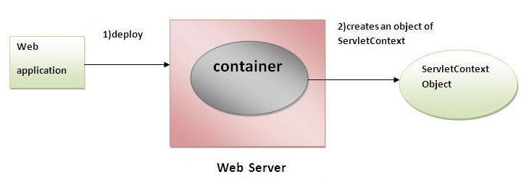
Usage of Servlet Context interface
The object of ServletContext provides an interface between container and servlet.
The ServletContext object can be used to get configuration information from web.xml file.
The ServletContext object can be used to set, get or remove attribute from web.xml file.
The ServletContext object can be used to provide inter-application communication.

Slide 28
Code in web.xml:
<servlet>
<servlet-name>Mapping</servlet-name>
<servlet-class>ContextMapping</servlet-class>
</servlet>
<context-param>
<param-name>Email</param-name>
<param-value>admin@gmail.com</param-value>
</context-param>
Code in servlet:
ServletContext sc = getServletConfig().getServletContext();
String adminEmail = sc.getInitParameter(“Email");

