Slide 1
Servlet…cont(1)

Slide 2
ServletRequest Interface
An object of ServletRequest is used to provide the client request information to a servlet such as content type, content length, parameter names and values, header informations, attributes etc.
Some important methods of this interface are:
  String getParameter( String name): returns value of parameter by name
  String[] getParameterValues( String name): returns an array of string containing all the values of given parameter name.
  Enumeration getParameterNames(): returns all parameter names.

Slide 3
Example
Index.html:
<form action=“welcome” method=“get”>
Enter your name<input type=“text” name=“name”/><br/>
<input type=“submit” value=“Login”/>
</form>
DemoServlet.java:
  public void doGet(HttpServletRequest req,HttpServletResponse res)throws ServletException,IOException
  {
    res.setContentType("text/html");
    PrintWriter pw=res.getWriter();
    String name=req.getParameter("name");
    pw.println("Welcome "+name);
  }

Slide 4
Servlet collaboration
Servlet collaboration is all about sharing information among the servlets. Collaborating servlets is to pass the common information that is to be shared directly by one servlet to another through various invocations of the methods.
Servlets running together in the same server have several ways to communicate with one another. There are two main styles of servlet collaboration:
  Sharing information: This involves two or more servlets sharing state or resources. For example, a set of servlets managing an online store could share the store's product inventory count or share a database connection. Session tracking is a special case of sharing information.
  (ServletContext area act as a shared information repository- for details read Servlet Context section)
  2. Sharing control: This involves two or more servlets sharing control of the request. For example, one servlet could receive the request but let another servlet handle some or all of the request-handling responsibilities.

Slide 5
Sharing control - RequestDispatcher Interface
The RequestDispatcher interface provides the facility of dispatching the request to another resource it may be html, servlet or jsp.
This interface can also be used to include the content of another resource.
There are two methods defined in this interface:
- public void forward( ServletRequest request, ServletResponse response) throws ServletExcetion, IOException : Forwards a request from a servlet to another resource on the server.
- public void include(ServletRequest request, ServletResponse response) throws ServletExcetion, IOException : Inlcudes the content of a resource in the response.

Slide 6
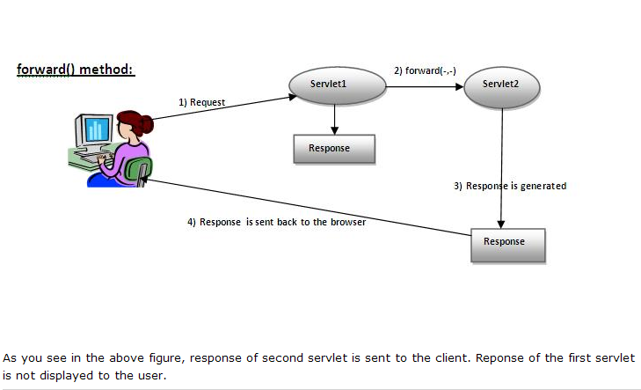

Slide 7
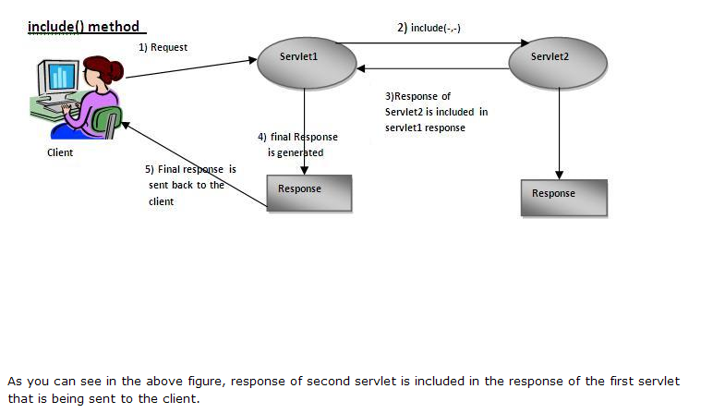

Slide 8
How to get the object of RequestDispatcher:
The getRequestDispatcher() method of ServletRequest interface returns the object of RequestDispatcher.
Syntax: public RequestDispatcher getRequestDispatcher(String resource);
Example:
RequestDispatcher rd = request.getRequestDispatcher(“myServlet”);
Rd.forward( request, response);

Slide 9
Example

Slide 10
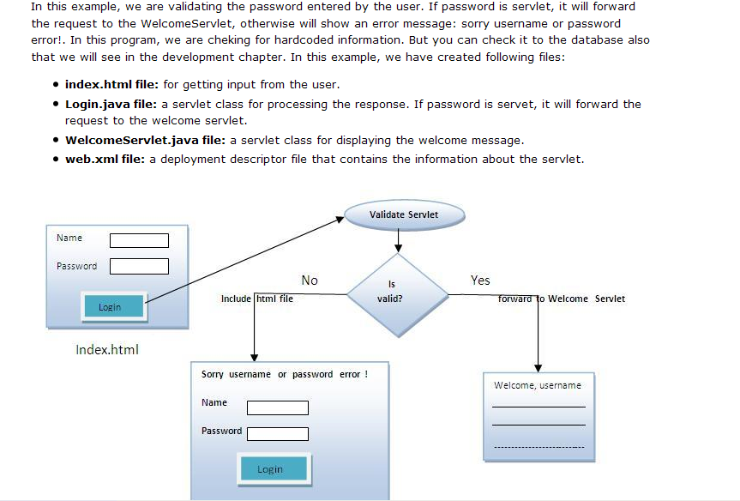

Slide 11
Index.html
<form action=“servlet1" method=“post">
Name:<input type="text" name="userName"/><br/>
Password:<input type="password" name="userPass"/><br/>
<input type="submit" value="login"/>
</form>

Slide 12
Login.java
public class Login extends HttpServlet {
public void doPost(HttpServletRequest request, HttpServletResponse response) throws ServletException, IOException {
response.setContentType("text/html");
PrintWriter out = response.getWriter();
String p=request.getParameter("userPass");
if(p.equals("servlet")){
RequestDispatcher rd = request.getRequestDispatcher(“servlet2");
rd.forward(request, response);
}
else{
out.print("Sorry username or password error!");
RequestDispatcher rd = request.getRequestDispatcher(“index.html");
rd.include(request, response);
}
}
}

Slide 13
WelcomeServlet.java
public class WelcomeServlet extends HttpServlet {
public void doGet(HttpServletRequest request, HttpServletResponse response)
throws ServletException, IOException {
response.setContentType("text/html");
PrintWriter out = response.getWriter();
String n=request.getParameter("userName");
out.print("Welcome "+n);
}
}

Slide 14
Web.xml
<web-app>
<welcome-file-list>
<welcome-file>index.html</welcome-file>
</welcome-file-list>
<servlet>
<servlet-name>Login</servlet-name>
<servlet-class>Login</servlet-class>
</servlet>
<servlet>
<servlet-name>WelcomeServlet</servlet-name>
<servlet-class>WelcomeServlet</servlet-class>
</servlet>
<servlet-mapping>
<servlet-name>Login</servlet-name>
<url-pattern>/servlet1</url-pattern>
</servlet-mapping>
<servlet-mapping>
<servlet-name>WelcomeServlet</servlet-name>
<url-pattern>/servlet2</url-pattern>
</servlet-mapping>
</web-app>

Slide 15
Sharing control – SendRedirect() method
The sendRedirect() method of HttpServletResponse interface can be used to redirect response to another resource, it may be servlet, js or html file.
It can accept relative URL as well.
This method can work inside and outside the server as it uses the URL bar of the browser.
Syntax:
  public void sendRedirect(String URL) throws IOException;
Example:
public void doGet(HttpServletRequest req, HttpServletResponse res) throws ServletException, IOException{
      PrintWriter w = response.getWriter();
      response.sendRedirect(“http://www.google.com”);
      }

Slide 16
What is Servlet chaining?
A Servlet chaining is a technique in which two or more servlets can cooperate in servicing a single request. In servlet chaining, one servlet’s output is the input of next servlet.
This process continues until the last servlet is reached. Its output is then sent back to the client.
We are achieving Servlet Chaining with the help of RequestDispatcher.

