Slide 1
LINUX

Slide 2
Books
Evi Nemeyh, “Linux Administration Handbook”
Red Hat LINUX “Kerry Cox”
Sumitabha Das, "Unix : Concepts and Applications"
R. Stevens, “UNIX Network Programming”, PHI, 3rd Ed., 2008.
Shubhra Saggar

Slide 3
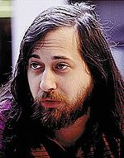
Richard Stallman founder of the GNU project
The GNU Project, started in 1984 by Richard Stallman, had the goal of creating a "complete Unix-compatible software system” made entirely of free software

Slide 4
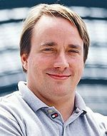
Linus Torvalds, creator of the Linux kernel
“Collection of programs distributed with the "Linux Kernel", and most often with several additional applications. Often programs and tools included are from GNU, BSDBerkeley Software Distribution and many other contributors.”
Shubhra Saggar

Slide 5
Linux
Linux is a free Unix-type operating system originally created by Linus Torvalds with the assistance of developers around the world.
It originated in 1991 as a personal project of Linus Torvalds, a Finnish graduate student.
The Kernel version 1.0 was released in 1994 and today the most recent stable version is 3.4
Developed under the GNU General Public License , the source code for Linux is freely available to everyone.
Shubhra Saggar

Slide 6
Open source - the software development model used by the free and open source software (FOSS) movement
closed source (or proprietary software) are two approaches to the development, control and commercialization of computer software.
Shubhra Saggar

Slide 7
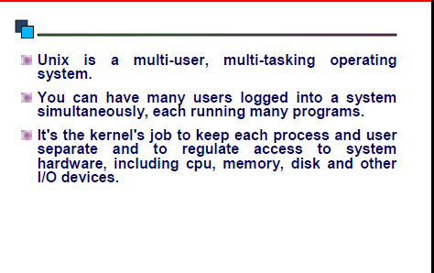
Unix
Shubhra Saggar

Slide 8
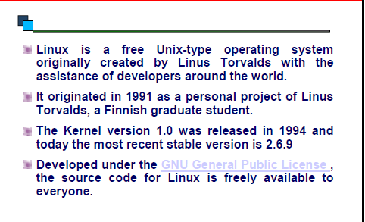
What is Linux
Shubhra Saggar

Slide 9
History of LINUX
Linux is a system kernel (the core of that do the hard work like dealing with Hardware).
Linux is written by Linus Benedict Torvalds from Finland at Helinki University in 1991 when he was student there he was dreaming to have UNIX at home on his own PC (but just as what we've said UNIX systems cost a fortune).
He started to study MINIX system ,then he made his full featured system to be suprerior not only to usual personal systems but also to other UNIX systems.
He put the source files on the internet and form the Linux kernel project www.kernel.org , first version of Linux was released on 1994.
Now thousands of programmers is helping him developing it, so that only about 2% of the current Linux kernel is written by him, although he still control it. Linus now works for Open Source Development Labs (OSDL)
Shubhra Saggar

Slide 10
What is Free software ?
It's a software that gives you the free right to use, copy, sell, modify,...etc the software. A type of Free software is called copylefted which is a way of copyrighting software to protect it but not from being copied or modified (developed) but instead from taking away your freedom. Each and every one has the right to copy, distribute, modified, and get the source code of a free software.
Shubhra Saggar

Slide 11
What is the minimum requirement ?
At least you need a 80386 (before Pentium, and 80486) and at least 4MB of ram to run Linux kernel,basic GNU tools, and apache web server without graphical interface, but to be able to run a usual distribution you may need 16MB to use textual installler and at least 32MB to run the graphical installer, at least you need 200-400 MB of hard drive to be able to install an old graphical environment (NeXT Step like) , but you need 1-2GB to run KDE and/or GNOME, this is the minimum double all that for the recommended.
Shubhra Saggar

Slide 12
How GNU/Linux differ from other OSs ?
Faster, more powerful, safer, robust, and reliable.
Designed from ground to be secure and network aware.
Low reviving cost
Free as freedom since it's licensed under GPL
Self-Contained.
Backword compatiblity
well-documented (if the documentation is not enough you may look at the code)
Support many languages, support unicode standard.
A real 32-Bit system, with real multitasking, real multiuser, ,multithread, and multiprocessors.
You can control prioroty and priviliges of programs
Full developing tools, with many programing languages using GNU Compiler Collection (GCC)
Zillions of software.
Shubhra Saggar

Slide 13
Why Use LUNIX?
multi-tasking / multi-user
lots of software
networking capability
graphical (with command line)
easy to program
portable (PCs, mainframes,
super-computers) free! (LINUX, FreeBSD, GNU)
popular
not tied to one company
active community
continued
Shubhra Saggar

Slide 14
How Does One Get Linux ?
Buy a distribution
Download a distribution
Build you own distribution
Shubhra Saggar

Slide 15
Common Distributions
Choosing the distribution is no more than self taste as Isam Bayasidi says it's like fruit flavors, all distribitions have the same kernle, same GNU tools, and maybe same KDE and GNOME, some distributions has the same package format or even the installation program.
Slackware
RedHat
Caldera
Mandrake
Debian
Corel
Shubhra Saggar

Slide 16

Red Hat
The open source leading copmany, it has a good share of the market, most books talks about it's distributions, commercial developers consider it as the official Linux for testing compatibility of their products with Linux. Red Hat gives Red Hat Certifications that is widly acceptable.
Shubhra Saggar

Slide 17

Fedora
Red Hat has split Red Hat Linux into two projects one is community driven and for free download but no phone support this is called Fedora Core see http://fedora.redhat.com, Fedora is updated frequently (3 or 2 times a year a new version is released) and supported by the community see www.FedoraForum.org. The other project is RedHat Enterprise Linux (RHEL) it's very expensive to normal home users (there is a cheap educational version) but the price is for support service, this distribution is targeted to giant companies and critical missions, RHEL is released each one and half years. Both projects are open source (according to OSD).
Shubhra Saggar

Slide 18

Mandriva Linux (formerly known as Mandrake Linux)
Mandrake (some times called Mandy) is renmed to be Mandriva is a french company that makes MandrivaLinux (formerly called MandrakeLinux) distribution one of the most easy and beautiful one, I like it and many others do, it has simple installation program (DrakeX) and a nice and easy to use configaration tool called Mandrake Control Center (mcc), the urpmi package managment tool is another reason that people loves Mandrake. if you want more packages you may see http://ftp.du.se/pub/os/mandrakelinux/ and plf.zarb.org. Mandrake has other producs like MandrakeMove which is a live CD that works without installation, just put the CD and reboot.
Shubhra Saggar

Slide 19

SuSE
SuSE is a large European company that offer commercial support for Linux, It's community disappeared when SuSE had stoped the free downloadable version! and replace it with a Live-CD for evolution. SuSE now is back and there is a downloadable version of SuSE that you can install. SuSE is a user-friendely distribution for desktop users.
Shubhra Saggar

Slide 20

Debian
It's a nonprofitable organization has made a 'Social Contract' with the Community that "promise to keep the Debian GNU/Linux Distribution entirely free software". About a thousand of active volunteers (Debian repository contains more than 50,000 package) and it supports many architectures (see www.debian.org/ports/), and even many operating systems (other than GNU/Linux) like Debian GNU/Hurd and Debian FreeBSD!
Shubhra Saggar

Slide 21

Slackware
It's lazy BSD-like distribution, it's makers did not try to put any tool on it, the installing and those few reconfiguring tools are just a smart shell script!! they has made a packaging format but it's just a normal tarball (tar'ed and gzip'ed files), their site is just like a white screen with black writings on it, even the Slackware logo is just the word Slackware! Other logos are contributed by Slackware fans. You are wondering why people loves it, thats because the famous words 'simple is good, simple is secure.' you don't need to wast memory while installing with colored wallpaper, you don't want to wast it in drawing buttons when you are configaring a server. If you want to test you UNIX skills try this one. Slackware is one of the first Linux distributions.
Shubhra Saggar

Slide 22
Your Account
Each user has their own space called their account.
Type your login ID and password to enter your account.
Only if the login ID and password match will you be let in.

Slide 23
Login to your Account
login: ad You type your ID and RETURN.
Password: You type your password and
RETURN. It does not appear.
$ The UNIX prompt (or similar).
You can now enter commands.

Slide 24
Logout from your Account
logout
or
^D Press CONTROL and D
together
or
exit

Slide 25
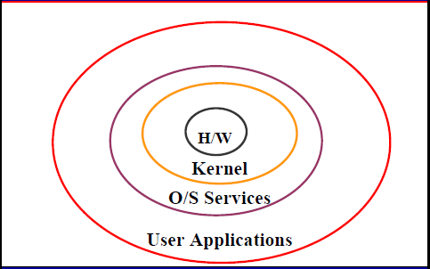
Linux Architecture: Overview
Shubhra Saggar

Slide 26
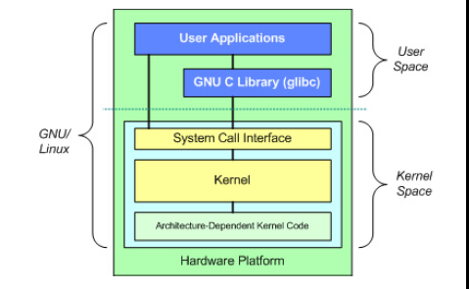
Linux Architecture
Shubhra Saggar

Slide 27
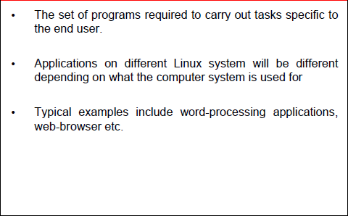
Linux Architecture: User Applications
Shubhra Saggar

Slide 28
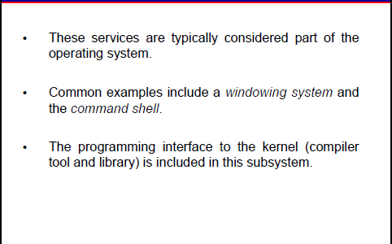
Linux Architecture: O/S services
Shubhra Saggar

Slide 29
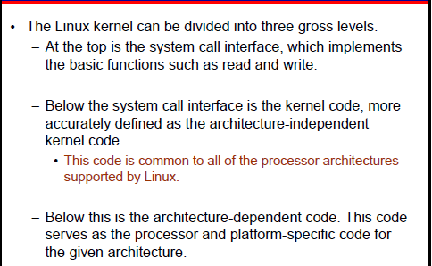
Linux Kernal
Shubhra Saggar

Slide 30
Kernel-Shell Relationship
Other Application/ System Software
User
User
Unix Commands
Shell
Shell
Hardware
Database Packages
Internet Tools
Kernel
Shell
Compilers
Shell
User
User

Slide 31
The Shell
The Linux user interface is called the shell.
The shell does 4 jobs repeatedly:
display
prompt
read
command
execute
command
the shell
process
command

Slide 32
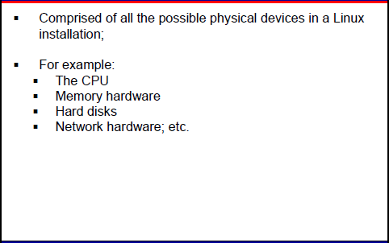
Linux Architecture: Hardware
Shubhra Saggar

Slide 33
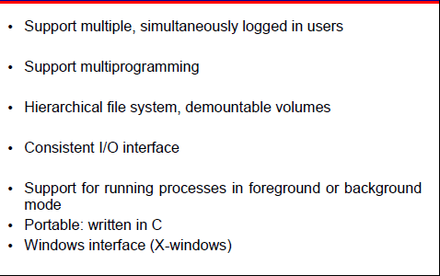
Linux/Unix: Common Features
Shubhra Saggar

Slide 34
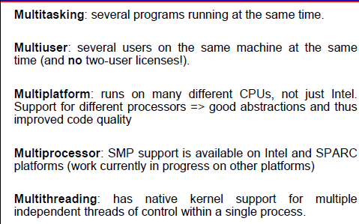
Linux Features
Shubhra Saggar

Slide 35
Linux resources on the web
www.linux.com
www.linux.org
www.linuxdoc.org
www.linuxtoday.com
www.kernel.org
www.linuxworld.com
www.freshmeat.com
www.linuxhq.com
Shubhra Saggar

