Slide 1
AI-Assisted Yield Trend Analysis and Farm Planning System

Slide 2
Name of the team: SKYROCKET
Details of Team members
TEAM MEMBER NAME | Email ID | Phone number [WhatsApp]
Dhiraj Kumar Ray | dhirajkumar.mca25@bmsce.ac.in | 7483289842
Karthikeya R Hegde | karthikeya.mca25@bmsce.ac.in | 9739666547
K Mohammed Ahad | mohammedahad.mca25@bmsce.ac.in | 8050476717

Slide 3
Problem Statement
Farmers face unpredictable crop yields due to climate change, lack of data-driven planning, and limited access to expert agricultural advice. This results in crop loss and financial instability.

Slide 4
Need of the Project
• Traditional farming relies on intuition
• No yield prediction tools for small farmers
• Poor crop planning leads to losses
• AI-based decision support is required

Slide 5
Proposed Solution
An Agentic AI-powered system that analyzes historical yield trends and assists farmers in crop planning using IBM Watsonx Granite models.

Slide 6
Agentic AI Approach
• AI Agent reasons, plans, and recommends
• Analyzes trends and seasonality
• Generates explainable recommendations

Slide 7
End Users
• Farmers
• Agriculture Departments
• Agri-startups
• Research Institutions

Slide 8
Technology Stack
• IBM Cloud
• Langflow
• IBM Watsonx.ai
• Granite LLM (ibm-granite-3-2-8b)
• Python

Slide 9
Langflow Components Used
• Chat Input
• IBM Watsonx AI Agent
• Prompt Template
• Chat Output

Slide 10
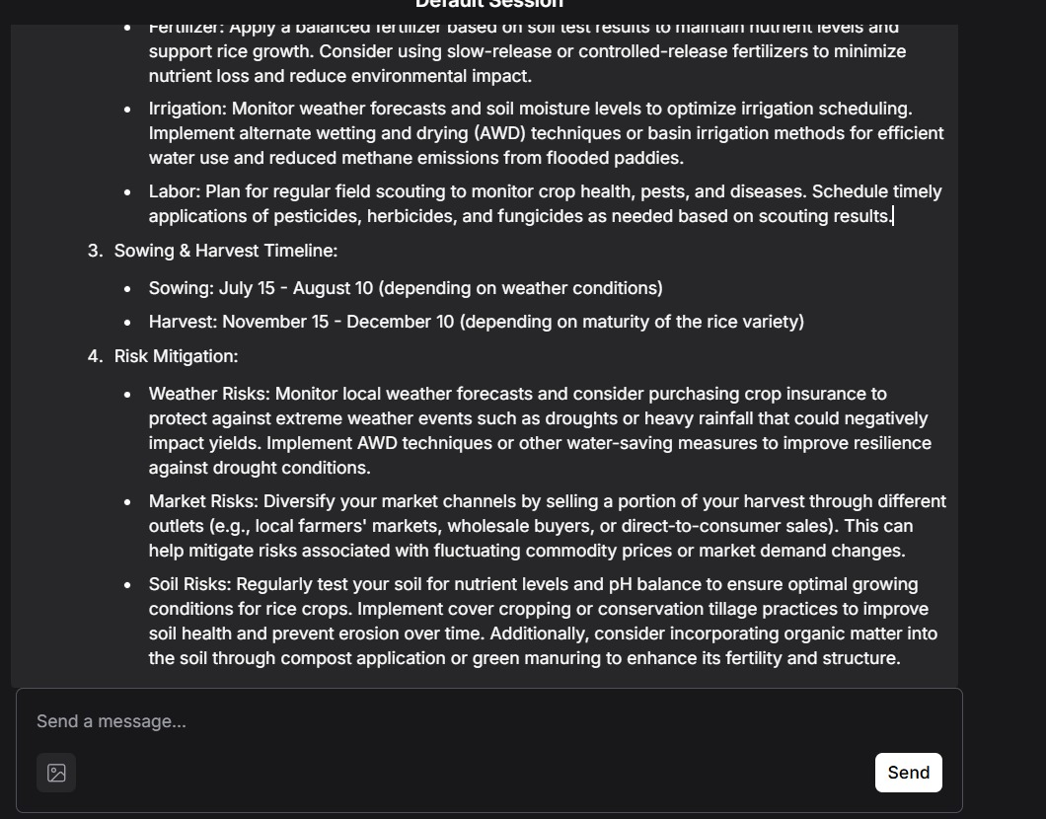
Input Screenshot 1

Slide 11
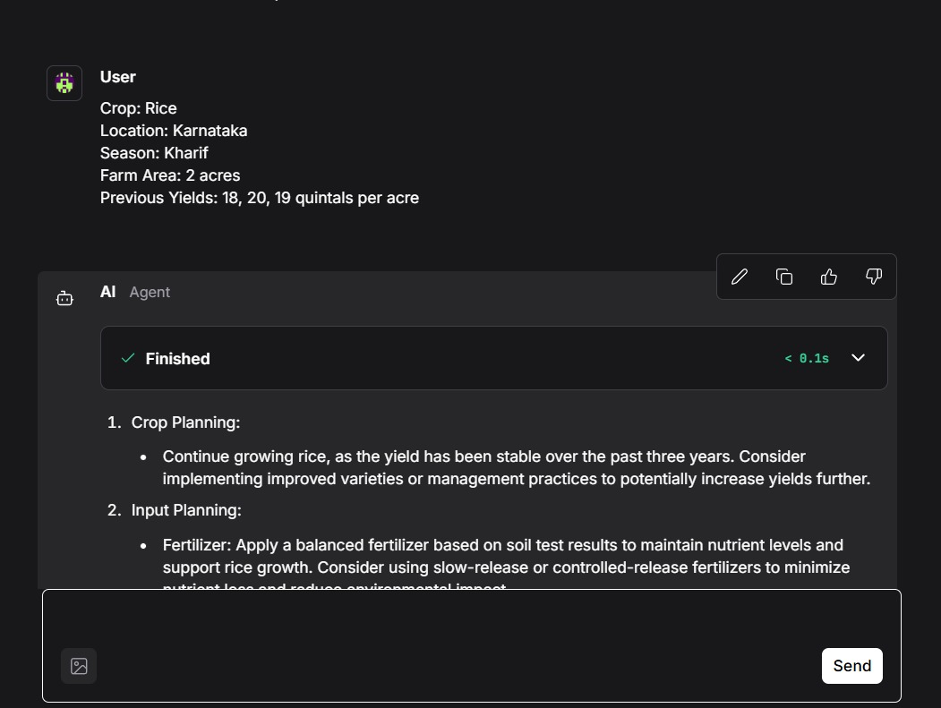
Input Screenshot 2

Slide 12
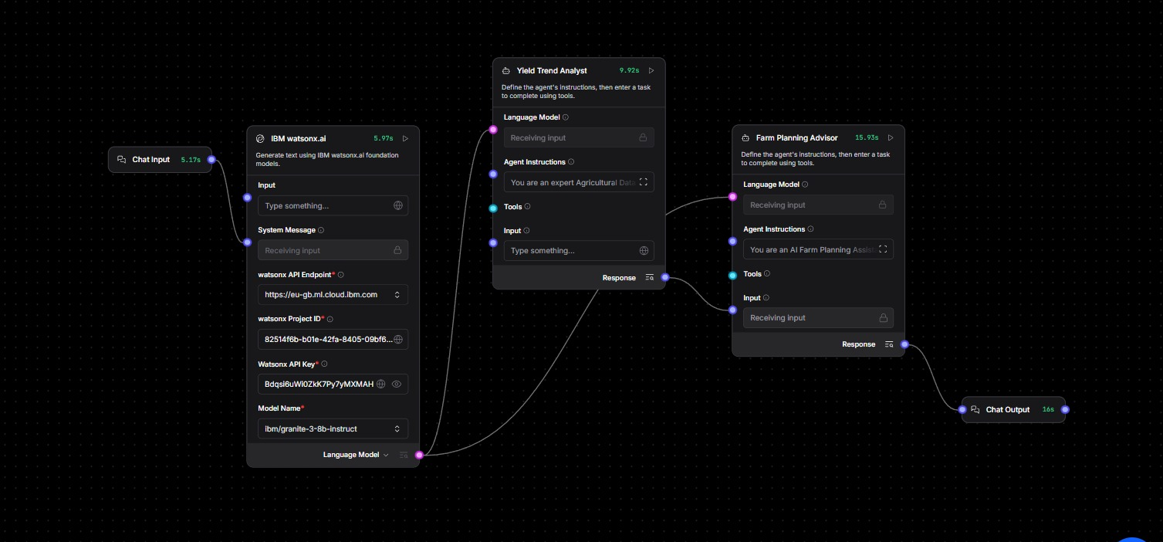
Output Screenshot

Slide 13
System Architecture
1. Farmer Input
2. Langflow Agent
3. IBM Granite Reasoning
4. Yield Prediction
5. Recommendations

Slide 14
Novelty & Uniqueness
• Agentic AI-based farm planning
• Explainable AI decisions
• Scalable agriculture solution

Slide 15
Future Scope
• Weather API integration
• Satellite data usage
• Mobile app for farmers
• Multi-language support

Slide 16
Git Hub Link
· https://github.com/Dhiraj-tech/Crop_yield
·
·
·

Slide 17
References
• IBM Watsonx Documentation
• FAO Agriculture Data
• Government Crop Reports

