Slide 1
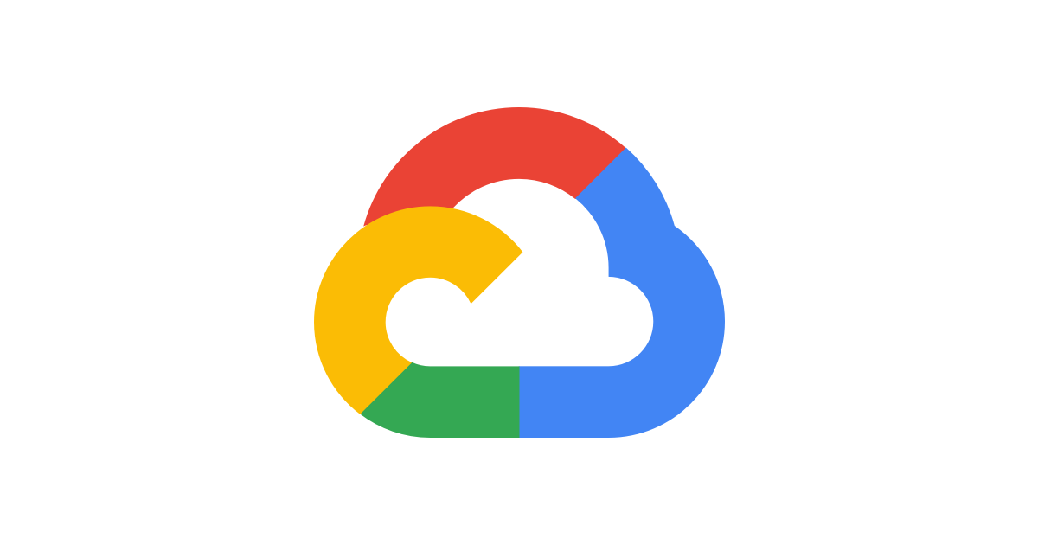
Deployment of app using Google cloud platform (GCP)
Framework : Flutter Backend: Firebase
Presented by –
Dhiraj Ravindra Bodake
18141216

Slide 2
Introduction
GCP(Google cloud platform):
Google Cloud Platform is a suite of Public cloud computing services offered by Google. The platform includes a range of hosted services for compute, storage and application development that run on Google hardware. Google Cloud Platform services can be accessed by software developers, cloud administrators and other enterprise IT professionals over the public internet or through a dedicated network connection. Google Cloud Platform is a suite of Public cloud computing services offered by Google. The platform includes a range of hosted services for compute, storage and application development that run on Google hardware. Google Cloud Platform services can be accessed by software developers, cloud administrators and other enterprise IT professionals over the public internet or through a dedicated network connection.

Slide 3

Google Firebase:
Google Firebase is a Google-backed application development software that enables developers to develop iOS, Android and Web apps. ... Real-time database – the Firebase Real-time Database is a cloud-hosted NoSQL database that enables data to be stored and synced between users in real time.

Slide 4

Flutter :
Flutter is an open-source UI software development kit created by Google. It is used to develop cross platform applications for Android, iOS, Linux, Mac, Windows, Google Fuchsia, and the web from a single codebase.
Flutter avoids using a bridge to communicate with the native layer (such as Android or iOS)., Flutter having its own programming language means that to get your app developed, you'll need developers to code in Dart

Slide 5
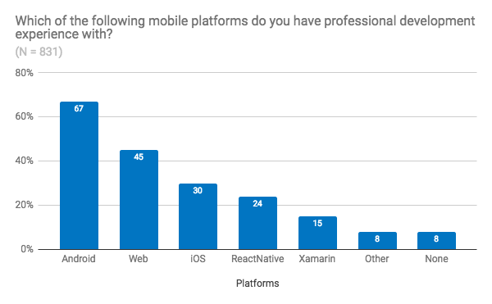
Literature survey
Flutter Firebase developer survey 2018
The User Experience Research team conducted a survey to review user satisfaction and needs. A respectable 1,016 developers responded to the survey. So, what did they find out ? First off, Flutter developers are a diverse bunch with all kinds of backgrounds. Given that it’s for mobile development, it’s a given that Android developers are well represented (67%), but web developers (45%) and iOS developers (30%) made a decent showing.

Slide 6
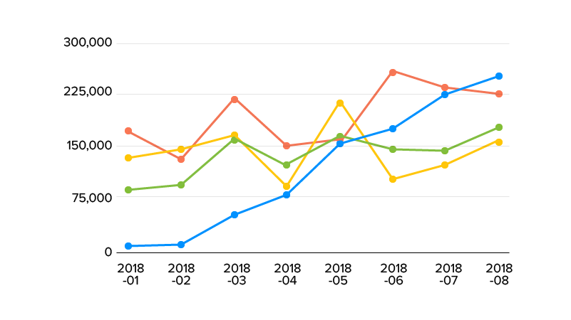
Flutter went live in December 2018 but it reached 2 million users by April 2020.
Google released version 1.20 of its Flutter cross-platform framework for mobile, web and desktop, and reports that the number of Flutter-built apps in the Play store has increased from 50,000 to 90,000 since April 2020.
Flutter’s beta version was launched on 13th March 2018 and it was first to live on 4th December 2018. In such a short amount of time, Flutter had already established its position in the market. Let’s take a look at the graph below to understand the popularity of Flutter when it was just launched as compared to other mobile platforms.

Slide 7
Current Case study
A Research Paper on a Progress Tracking Application using Flutter and Firebase .
ISSN: 2321-9653; IC Value: 45.98; SJ Impact Factor: 7.429 Volume 9 Issue 5 May 2021
Parth Jindal, Piyush Sharma, Mohit Kumar (B. Tech Students, Department of Computer Science and Engineering, Global Institute of Technology, Jaipur, Rajasthan, India)
“Considering current times and situations we carried out several interviews among students and people working tech. and business jobs, and found out that most people find it difficult to manage the sudden paradigm change as they suddenly find themselves in a situation in which they have no monitoring system set in place to maintain or even measure their productivity. .”

Slide 8
Application of Firebase in Android App Development-A Study
International Journal of Computer Applications (0975 – 8887) Volume 179 – No.46, June 2020
1.Chunnu Khawas (Department of Computer Applications Sikkim University Gangtok, India) 2.Pritam Shah (Department of Computer Applications Sikkim University Gangtok, India )
“ The web application has become more and more reliant upon large amount of database and unorganized data such as videos, images, audio, text, files and other arbitrary types. It is difficult for Relational Database Management System (RDBMS) to handle the unstructured data. Firebase is a relatively new technology for handling large amount of unstructured data. ”

Slide 9
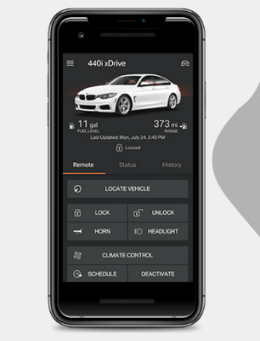

Current Trends in Topic
1. BMW Builds its Car Application with Flutter.
2. Alibaba Chooses Flutter to Develop a Versatile App.

Slide 10


3. Cryptograph App
4. Dream 11 App

Slide 11
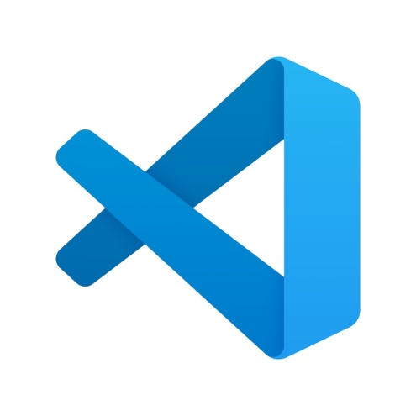

Tools and Technology
VS Code :
Visual Studio Code is a streamlined code editor with support for development operations like debugging, task running, and version control. It aims to provide just the tools a developer needs for a quick code-build-debug cycle and leaves more complex workflows to fuller featured IDEs, such as Visual Studio IDE.
Android Studio :
Android Studio provides a unified environment where you can build apps for Android phones, tablets, Android Wear, Android TV, and Android Auto. Structured code modules allow you to divide your project into units of functionality that you can independently build, test, and debug.

Slide 12
Adding Firebase to your Flutter app
Step 1: Create a Firebase project
Step 2: Register your app with Firebase
Step 3: Add a Firebase configuration file
Step 4: Add Flutter Fire plugins
    open your pubspec.yaml file.
    Add the Flutter Fire plugin for the Firebase Core Flutter SDK.
    Run flutter packages get.

Slide 13
Conclusion
In conclusion, Flutter is a good framework to consider in mobile application development. With all the convenience widgets and support for both Material and Cupertino design it is easy to create a good-looking user interface fast. One of the most helpful features of Flutter that speeds up the development process is the stateful hot reload of the application which allows (in most cases) the developer to see the changes in code immediately in the running application without actually restarting the app and losing its state.

Slide 14
Reference
1. https://codewithandrea.com/articles/migrating-flutter-firebase-app-null-safety/
2. l International Journal for Research in Applied Science & Engineering Technology (IJRASEThttps: //www.ijraset.com/
3. https://appinventiv.com/blog/flutter-setting-app-development-trends/
4. https://www.angularminds.com/blog/article/top-apps-built-with-flutter.html
5. https://firebase.google.com/docs/flutter/setup?platform=ios

Slide 15


