Slide 1

“Automation With Ansible - DevOps”.
RH294
Submitted by:-
  Dhiraj Bodake(18141216)

Slide 2
AGENDA
Introduction
Industrial Training Certificate
Importance of Industrial Training
Modules Learned
Technical Knowledge Gained
Used Modern Tools

Slide 3
INTRODUCTION
Previously, After the product planning phase, we move to the product development phase and then the testing phase and then the product building phase. No effort is done in parallel. So, the software release life cycle is also very very long. After automation Concepts we had been using different scripting languages to automate manual processes. But these all language are imperative in nature hence we can’t rely on these language because these languages reduce the performance of target system. But now days we have configuration tools like puppet,ansible etc. These tools are declarative in nature. The ansible is most used tool in all other configuration tool because it more powerful and has many more features

Slide 4
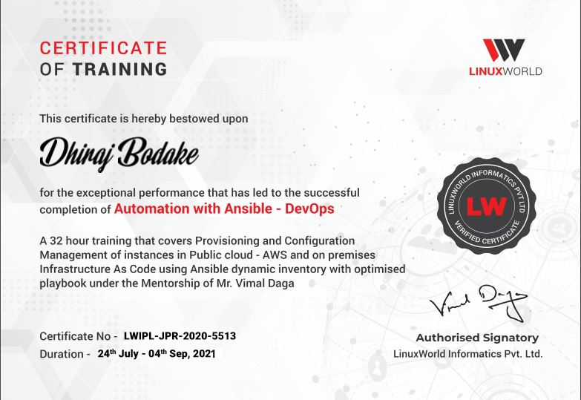
Industrial Training Certificate

Slide 5
Importance of Industrial Training
After automation Concepts we had been using different scripting languages to automate manual processes. But these all language are imperative in nature hence we can’t rely on these language because these languages reduce the performance of target system. But now days we have configuration tools like puppet,ansible etc. These tools aredeclarative in nature. The ansible is most used tool in all other configuration tool because it more powerful and has many more features.
Importance of the training/projects: Helps to remove manual processes hence it will increase speed of SDLC. It won’t affect performance of target system. This project also helps to solved real world problems. Proposed project helps to improve Availability,Scalability.

Slide 6
Modules Learned
In this industrial training i have learned different modules/features of ansible like
Configuration Management: Centralizing configuration file management and deployment is a common use case for Ansible, and it is how many power users are first introduced to the Ansible automation platform.
Application Deployment: When you define your application with Ansible, and manage the deployment with Red Hat Ansible Tower, teams can effectively manage the entire application life cycle from development to production.
Security and Compliance: When your security policy is defined in Ansible Playbooks, scanning and remediation of sitewide security policies can be integrated into other automated processes. Instead of being an afterthought, it

Slide 7
Orchestration: Configurations alone do not define your environment. You need to define how multiple configurations interact, and ensure the disparate pieces can be managed as a whole.
Continuous Delivery: Creating a CI/CD pipeline requires coordination and buy-in from numerous teams. You cannot do it without a simple automation platform that everyone in your organization can use. Ansible Playbooks keep your applications properly deployed (and managed) throughout their entire life cycle.
Provisioning: Applications have to be deployed or installed on systems. Ansible and Red Hat Ansible Tower can help streamline the process of provisioning systems, whether you are PXE booting and kickstarting bare-metal servers or virtual machines, or creating virtual machines or cloud instances from templates. Applications have to be deployed or installed on systems

Slide 8
Technical Knowledge Gained
When I was analyzing the task then I found out that,I need to learn some other technologies to complete it. In this way I have learned different tools of DevOps and worked on different Technologies which includes AWS,Docker,Linux etc. Additionally, I developed my own projects by integrating these tools.
The tasks I undertook included:
Analyzing problem,requirements.
Finding efficient solution to it.
Implementing Task.
Writing articles on Task

Slide 9
Tasks 1 :
Write an Ansible playbook that does the following operations in the managed nodes:
• Configure Docker.
• Start and enable Docker services.
• Pull the httpd server image from the Docker Hub.
• Run the httpd container and expose it to the public.
• Copy the html code in /var/www/html directory and start the webserver.
Link : https://github.com/Dhiraj55/Intership_Projects/

Slide 10
Task 2:
Deploy Web Server on AWS through ANSIBLE
• Provision EC2 instance through ansible.
• Retrieve the IP Address of instance using a hashtag #dynamic inventory concept.
• Configure the webserver through ansible!
Link: https://github.com/Dhiraj55/Intership_Projects/

Slide 11
Task 3 :
Want to create a hadoop cluster with 50 slaves in one minute.
• Here Ansible automation comes to my mind . I am interested in using Hadoop to process large sets of data, including use of higher level abstractions. What has surprised me most is that , if i have to connect 50 slaves . In each case I start by manually provisioning some servers and then follow a series of tutorials to manually install and configure a cluster. The typical experience seems to take about a week to setup a cluster (50 slaves). There is often a lot of wasted time to deal with networking and connectivity between hosts.
• For all these problems I create an article based on ansible automation . By using ansible within couple of minutes we configure hadoop in 100 slaves . • Also start the hadoop daemon . Not only 50 we also create clusters of more than 100.
Link: https://github.com/Dhiraj55/Intership_Projects/

Slide 12
Task 4 :
Configuring Load Balancer on AWS using Ansible with dynamic inventory.
• Provision EC2 instances through ansible.
• Retrieve the IP Address of instances using the dynamic inventory concept.
• Configure the web servers through the ansible role.
• Configure the load balancer through the ansible role.
• The target nodes of the load balancer should auto-update as per the status of web servers.
Link : https://github.com/Dhiraj55/Intership_Projects

Slide 13
Used Modern Tools
Ansible
Linux
Virtual-Box
AWS
Docker
K8s
Hadoop
MYSQL

Slide 14


