Slide 1
SkillGapAI: Resume & JD Skill Gap Analysis
BY TEAM – B
Dheeraj Kushwaha
Tharun Kumar Marati
Rublin Renisha
Ickra Khan

Slide 2
Introduction
SkillGapAI helps users understand their skills easily.
This project compares user skills with job requirements.
It uses AI to analyze resumes and job descriptions.
Manual skill checking is replaced by an automated system.
The system quickly finds missing skills (skill gaps).

Slide 3
Project Objective
The main objective is to identify skill gaps between users and job requirements.
The system should provide accurate and meaningful skill matching results.
The system works in real time using Python and machine learning techniques.
It should analyze resumes and job descriptions quickly and efficiently.

Slide 4
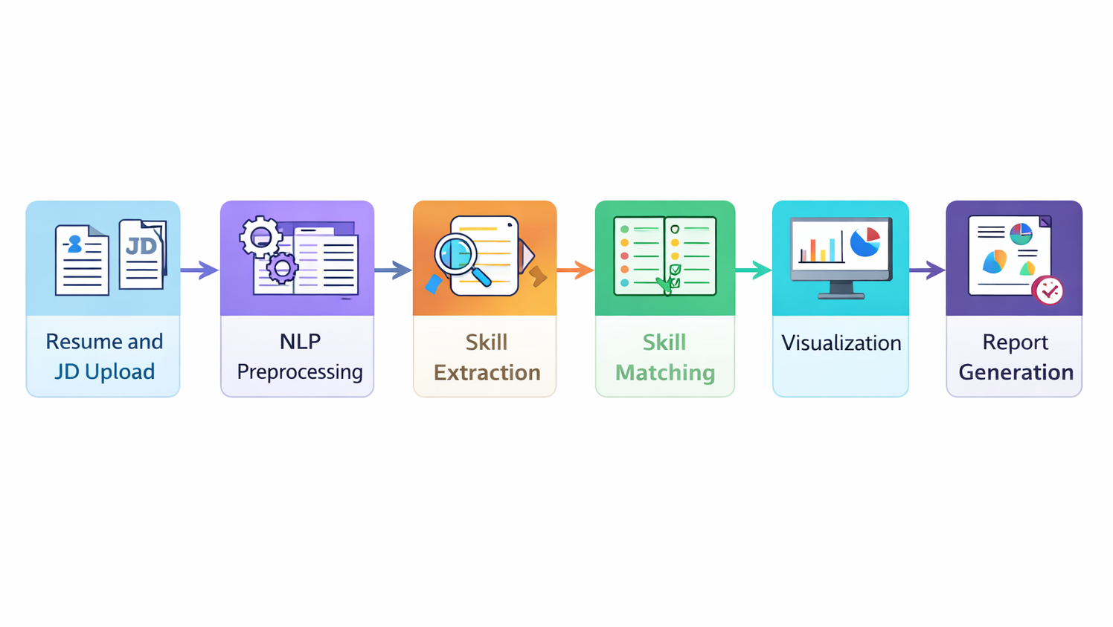
.
WORKFLOW

Slide 5
Milestone 1: Focuses on extracting and cleaning resume and job description data to create structured, NLP-ready input.
Milestone 2: Identifies and extracts relevant technical and soft skills using NLP techniques.
Milestone 3: Compares extracted skills to detect matches and identify skill gaps between candidates and job requirements.
Milestone 4: Presents insights through visualizations and provides actionable recommendations for improvement.
SkillGapAI – Project Milestones Overview
Milestone 1: Focuses on extracting and cleaning resume and job description data to create structured, NLP-ready input.
Milestone 2: Identifies and extracts relevant technical and soft skills using NLP techniques.
Milestone 3: Compares extracted skills to detect matches and identify skill gaps between candidates and job requirements.
Milestone 4: Presents insights through visualizations and provides actionable recommendations for improvement.

Slide 6
Milestone 1: Resume & Job Description Data Processing
.
Focuses on processing resumes and job descriptions
Handles multiple file formats such as PDF, DOCX, and TXT
Extracts and parses accurate textual data from unstructured documents and Extract raw text from uploaded documents using appropriate libraries:
  PDFs → PyPDF2 / pdfplumber
  DOCX → python-docx
Converts raw text into a clean and structured format
Includes file upload handling for user input
Performs text extraction from uploaded documents
Applies essential preprocessing steps, including:
Removing unnecessary characters
Normalizing text and Fixing formatting issues

Slide 7

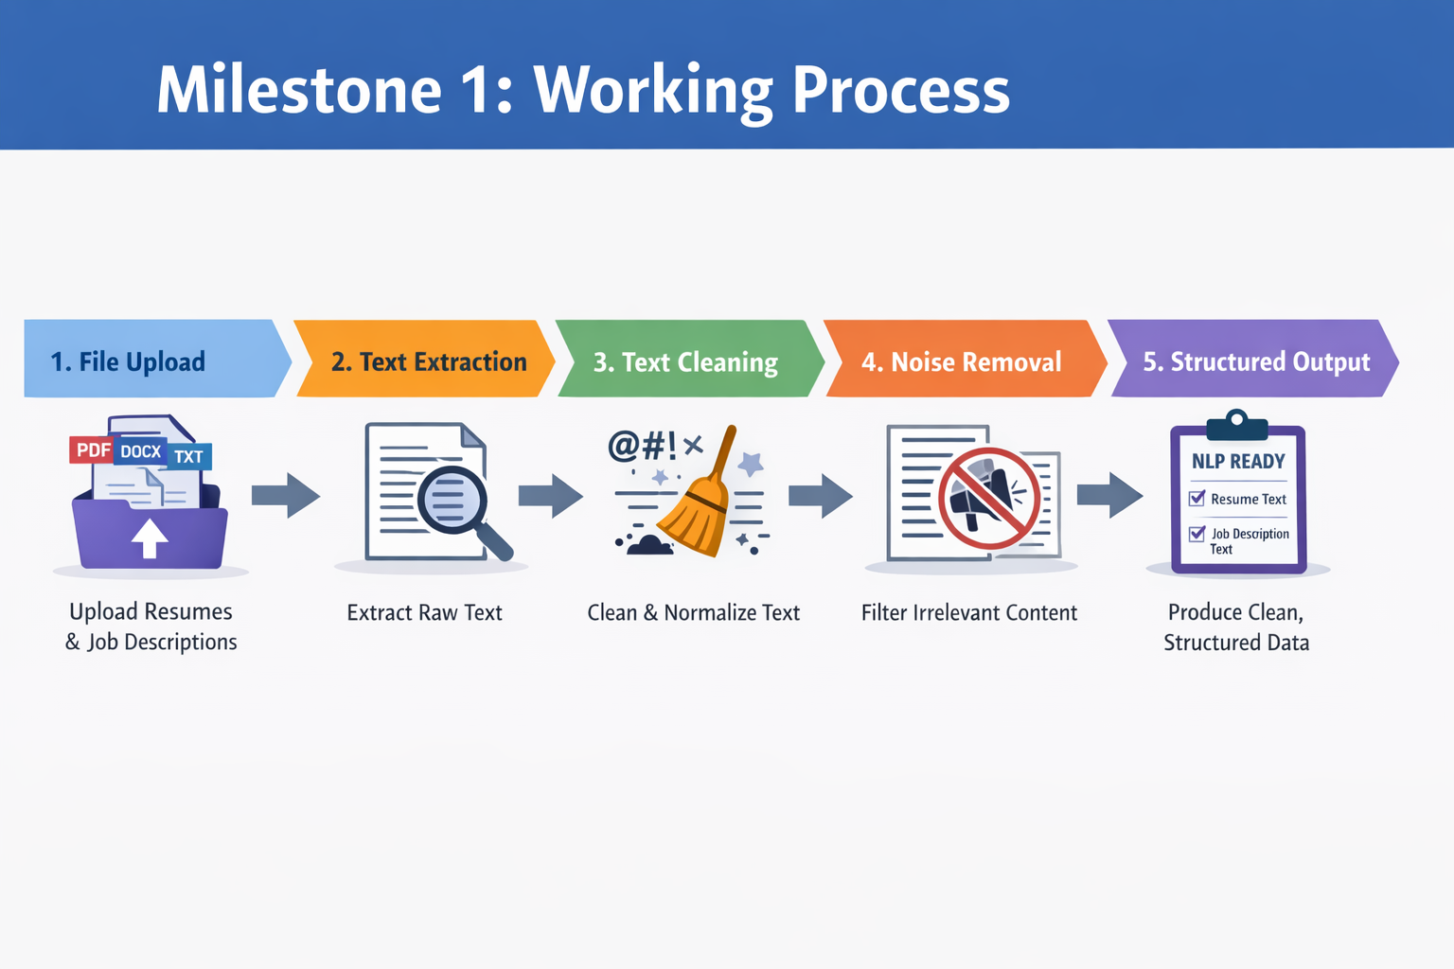

Slide 8
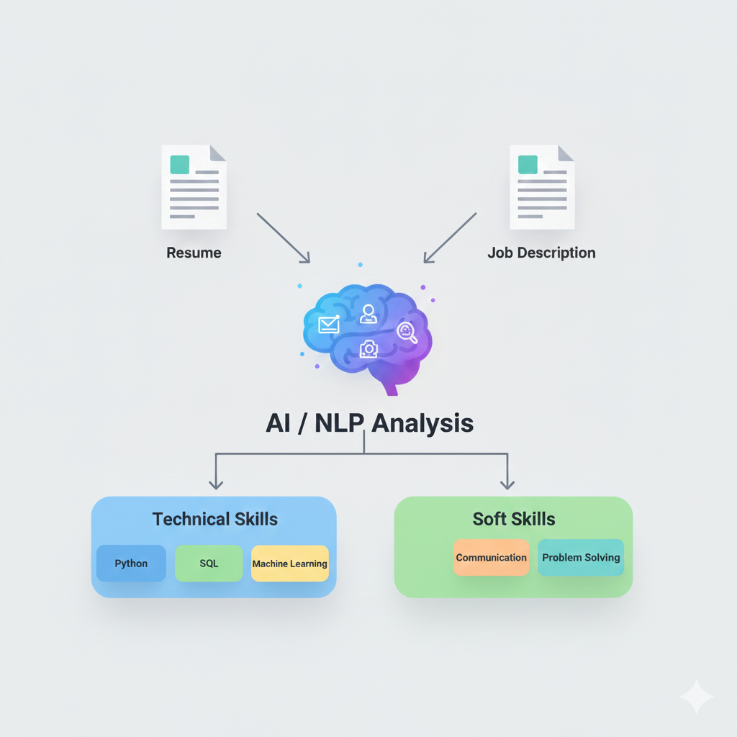
Milestone 2 : Skill Extraction & Classification
Converts unstructured resume and JD text into meaningful skills
Acts as the foundation for skill comparison and gap analysis
Separates skills into Technical and Soft Skills
Ensures clean, duplicate-free skill data

Slide 9
Skill Extraction Module – Identifies relevant skills from resume and JD text
Skill Classification Module – Separates skills into Technical and Soft Skills
Data Cleaning Module – Removes duplicate and irrelevant skills
Natural Language Processing (NLP) – For understanding unstructured text
Rule-based Skill Matching – Matches predefined skill vocabulary
SpaCy – Text processing and NLP analysis
Python – Core programming language
Plotly – Skill visualization using charts
Streamlit – UI integration and display

Slide 10
Milestone 3: Skill Gap Analysis & Similarity Matching
.
Focuses on comparing extracted resume skills with job description skills
Converts skills into semantic embeddings using BERT-based models
Measures similarity scores between resume skills and job-required skills
Uses cosine similarity to determine how closely skills are related
Categorizes skills based on predefined similarity thresholds
Identifies:
  Fully matched skills
  Partially matched skills
  Missing skills
Outputs structured results for:
  Skill comparison

Slide 11
.
Libraries & Tools Used:
• Sentence-Transformers / BERT
– Generates semantic embeddings for extracted skills.
– Enables contextual understanding of skill similarity.
• scikit-learn
– Used for cosine similarity computation.
• NumPy
– Handles vector operations and numerical computations.
Key Advantages:
Goes beyond keyword-based matching.
Captures semantic similarity between skills.
Provides accurate and meaningful skill gap analysis.

Slide 12
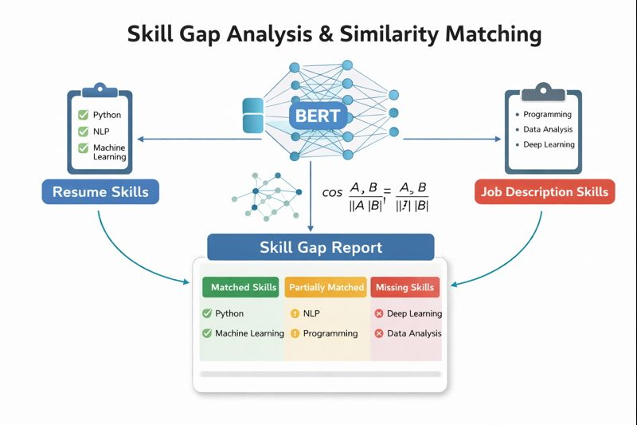
.

Slide 13
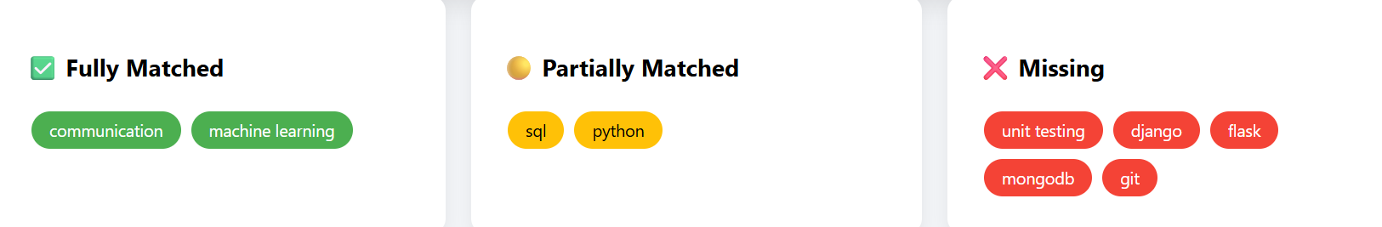
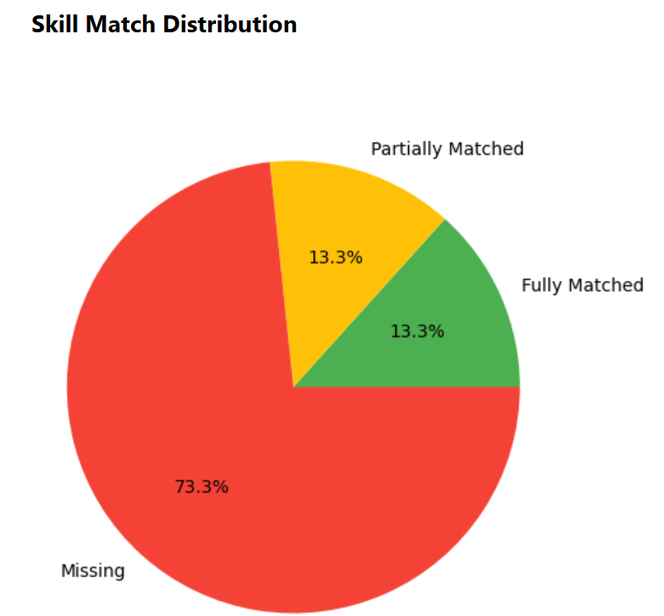
.
Milestone 3: Output

Slide 14
Milestone 4: Dashboard &
Report Export
Designed interactive end-to-end dashboard
Displayed skill match scores and comparisons
Enabled PDF and CSV report downloads
Improved usability with clean UI.

Slide 15
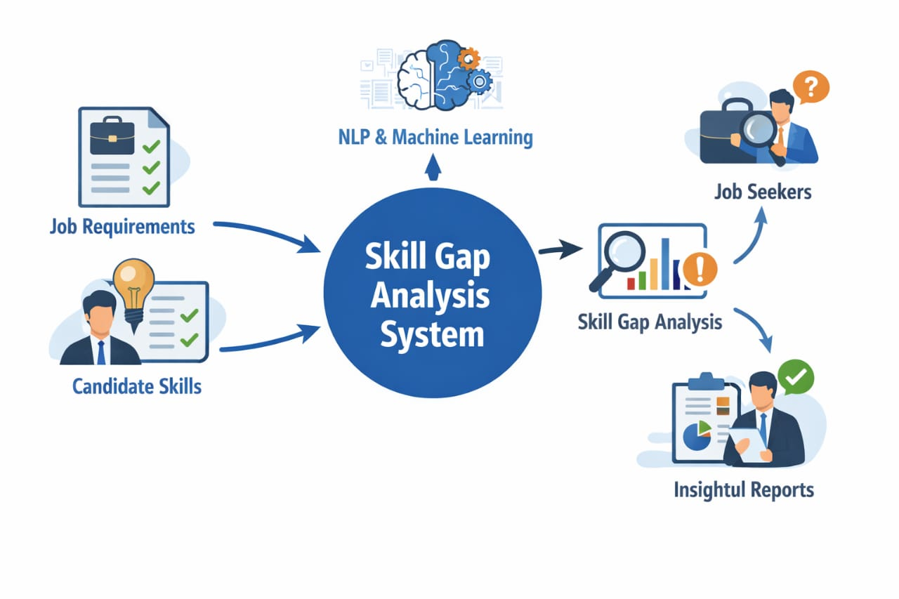
WORKFLOW
1. Upload Resume
2. Upload Job Description
3. Skill Extraction
4. Match Analysis
5. Visualization & Reports

Slide 16
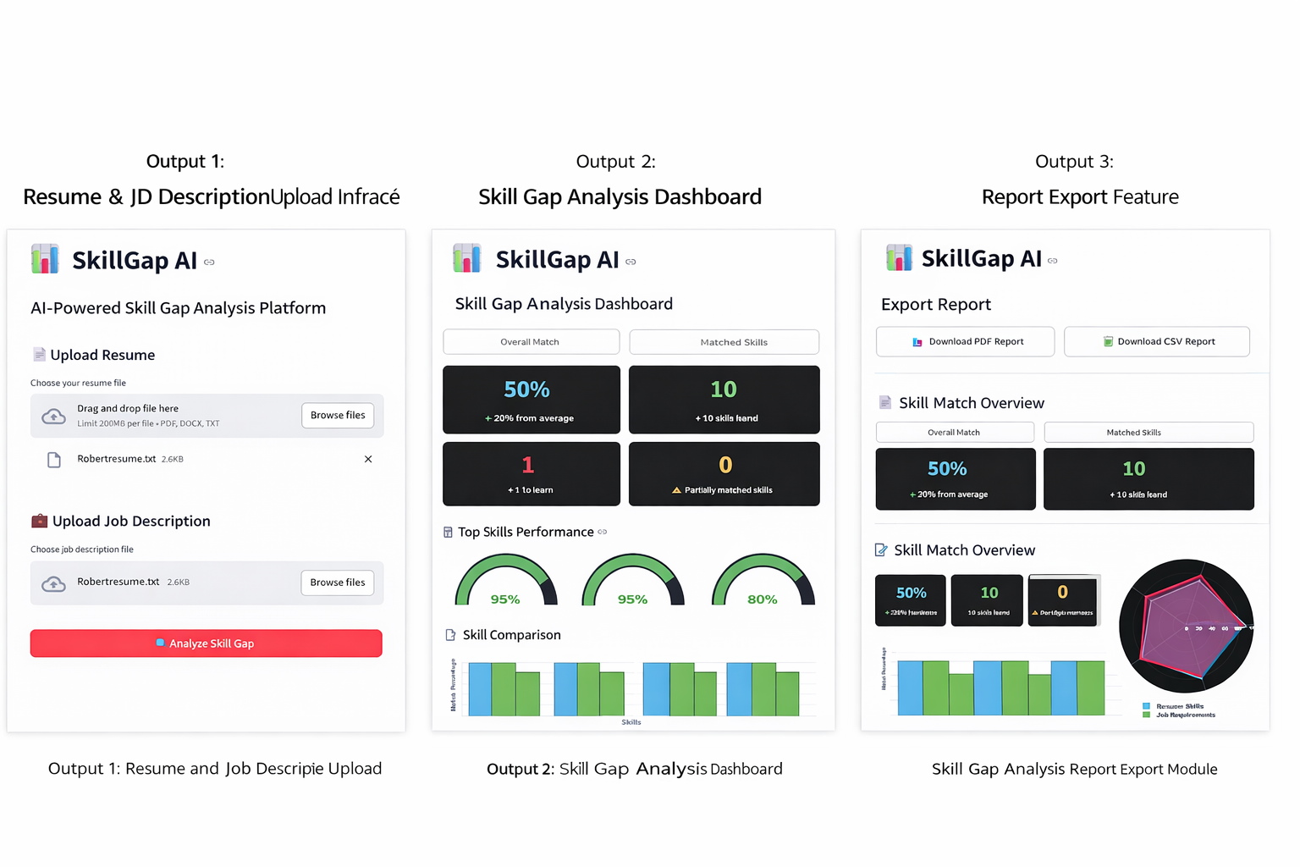
Milestone 4 : Output

Slide 17
Conclusion
Successfully developed an end-to-end Skill Gap Analysis system
Used NLP and Machine Learning to solve a real-world problem
The system compares job requirements and candidate skills effectively
Helps job seekers understand missing skills and improve employability
Helps recruiters make better, data-driven hiring decisions.

Slide 18
THANK YOU

