Slide 1
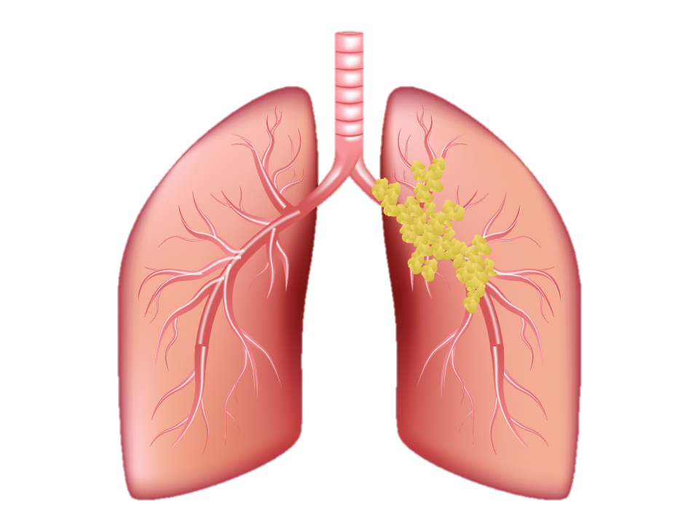
A DEEP LEARNING APPROACH FOR LUNG CANCER DETECTION
Dhiraj Sanjay Landge 50479342
https://www.drugwatch.com/health/cancer/lung-cancer/

Slide 2
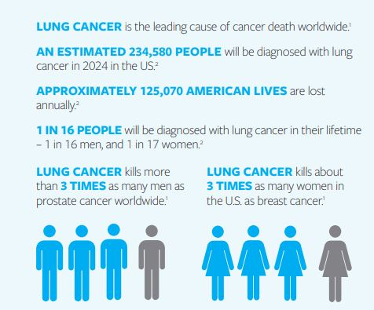
Motivation
Early detection is crucial but challenging due to the disease's asymptomatic nature in early stages.
Traditional diagnostic methods like biopsies and imaging have limitations in accuracy and are time-consuming .
Deep learning offers the potential to enhance detection and diagnostic accuracy by analyzing extensive imaging data, identifying patterns that may be missed by humans .
The project aims to develop a deep learning model that enhances early detection rates, thereby potentially increasing survival rates among lung cancer patients.
This aligns with the broader goal of shifting lung cancer diagnosis towards more preventative measures rather than reactive treatments.
Lung Cancer Facts 2023 - Lung Cancer Research Foundation

Slide 3
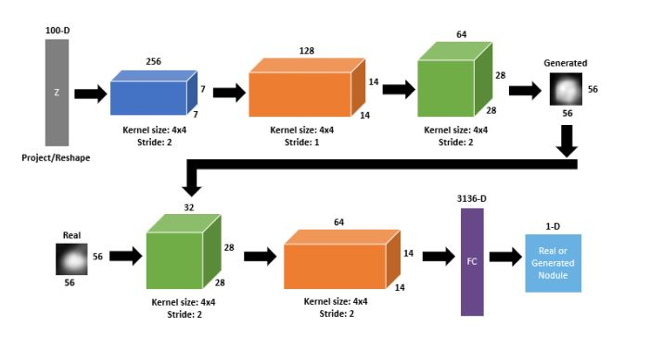
Literature Review (State-of-the-art)
Machine Learning in Lung Cancer Detection:
Support Vector Machines (SVM), k-Nearest Neighbors (KNN), and Naive Bayes. KNN demonstrated superior precision, achieving an average precision rate of 98.5%, indicating its effectiveness in lung cancer detection using LIDC-IDRI dataset.
These findings underscore the significant potential of machine learning, particularly KNN, to improve diagnostic accuracy and reliability in lung cancer detection.
Generative Adversarial Networks in Lung Cancer Detection:
Deep Convolutional Generative Adversarial Networks (DC-GANs) for generating realistic lung nodule images. Utilized the Lung Image Database Consortium (LIDC-IDRI), which includes detailed annotations of lung nodules.
Enhances radiologists' diagnostic accuracy and improves the training of computer-aided diagnosis (CAD) systems. Provides a novel method for producing high-quality synthetic medical images to aid in lung cancer detection.
(PDF) Machine Learning Approaches for Early Detection of Lung Cancer (researchgate.net) [1710.09762]
How to Fool Radiologists with Generative Adversarial Networks? A Visual Turing Test for Lung Cancer Diagnosis (arxiv.org) (PDF)

Slide 4
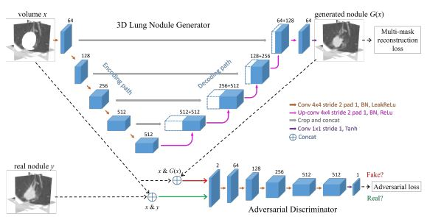
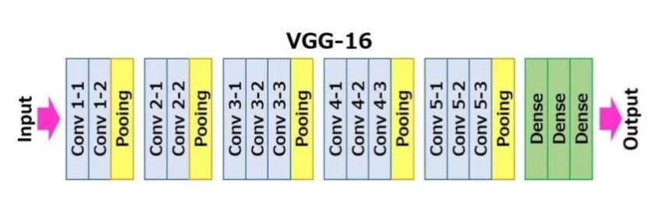
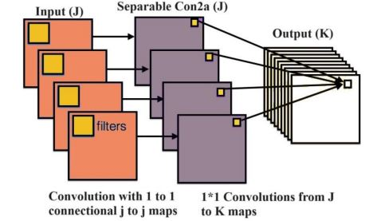
(PDF) Using VGG16 Algorithms for classification of lung cancer in CT scans Image (researchgate.net) (PDF) Using Deep Learning for Classification of Lung Cancer on CT Images in Ardabil Province : Classification of Lung Cancer using Xception (researchgate.net) CT-Realistic Lung Nodule Simulation from 3D Conditional Generative Adversarial Networks for Robust Lung Segmentation: 21st International Conference, Granada, Spain, September 16–20, 2018, Proceedings, Part II (researchgate.net)
3D CGANs for Lung Nodule Simulation:
Uses 3D Conditional Generative Adversarial Networks to create synthetic lung nodule images. Utilizes the LIDC dataset with detailed thoracic CT scans.
Enhances the accuracy of the P-HNN model for segmenting lung diseases in CT images. Shows how artificial data can improve training models, especially for detecting lung nodules near lung edges, helping to mitigate the shortage of real medical images for training.
VGG16 for Lung Cancer Classification:
Uses the VGG16 deep learning algorithm to classify lung nodules in CT scan images as malignant, benign, or healthy. Analyzes images from the Kaggle IQ-OTH/NCCD - Lung Cancer Dataset.
Demonstrated high performance with 92.08% sensitivity, 91% accuracy, and an AUC of 93%, enhancing the early detection and diagnosis of lung cancer.
Xception for Lung Cancer Classification:
Utilizes the Xception deep learning model to classify CT scan images for the presence of lung cancer. Employs CT images from patients in Ardabil, focusing on distinguishing between malignant, benign, and healthy lung conditions.
Achieved an accuracy of 79.76%, significantly improving detection capabilities and aiding in the early diagnosis of lung conditions.

Slide 5
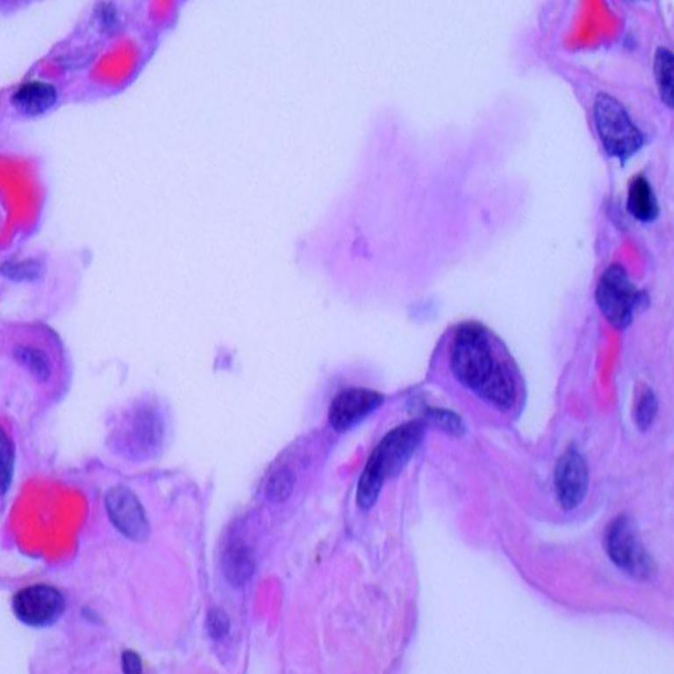
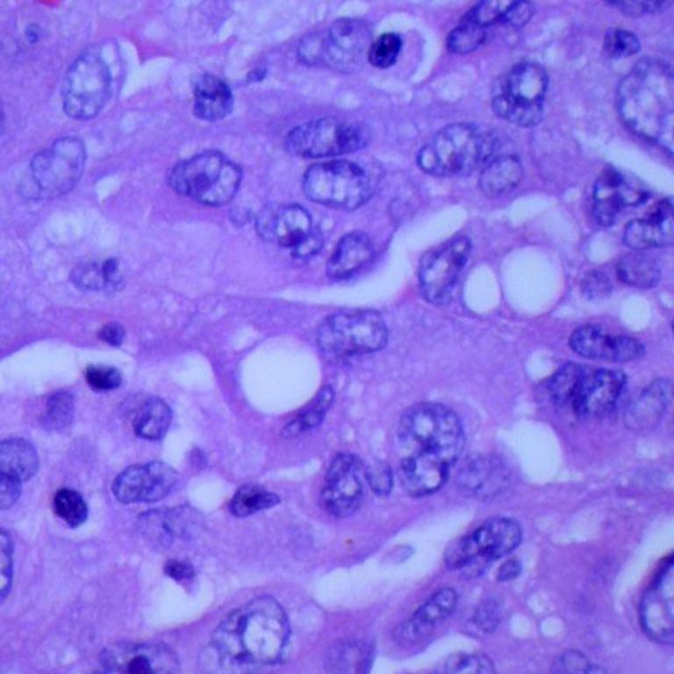
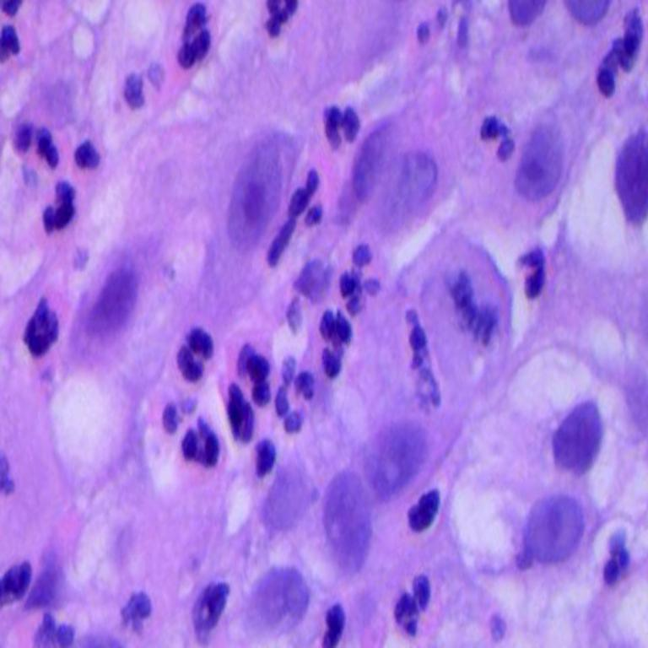
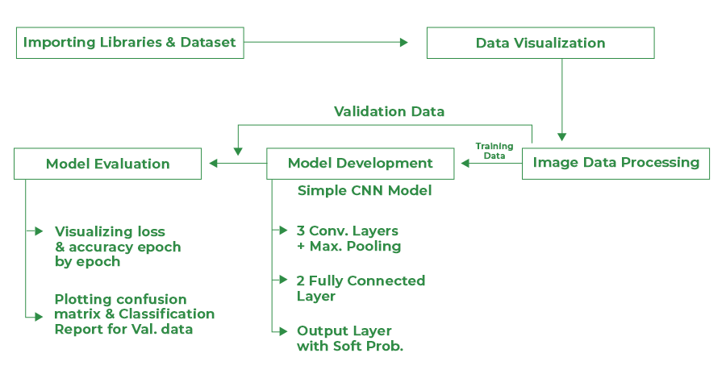
Methodology
Data collection:
Dataset sourced from Kaggle, renowned for its comprehensive medical image datasets. Includes Lung Benign Tissue, Lung Adenocarcinoma, and Lung Squamous Cell Carcinoma, covering both benign and malignant conditions to enhance model training and diagnostic accuracy.
Approximately 5,000 images per type, totalling around 15,000 images, ensuring a robust dataset for extensive training, validation and test.
Data Preprocessing:
All images uniformly resized to 128x128 pixels, ensuring consistency in input data size for the neural network.
Pixel values normalized across all images to scale the data into a range that aids in faster and more stable convergence during neural network training.
Implemented augmentation techniques such as random rotations (up to 30 degrees) and horizontal flipping to increase the robustness of the model against variations in image orientation and structure.
sample images from each category
[1912.12142v1] Lung and Colon Cancer Histopathological Image Dataset (LC25000) (arxiv.org)

Slide 6
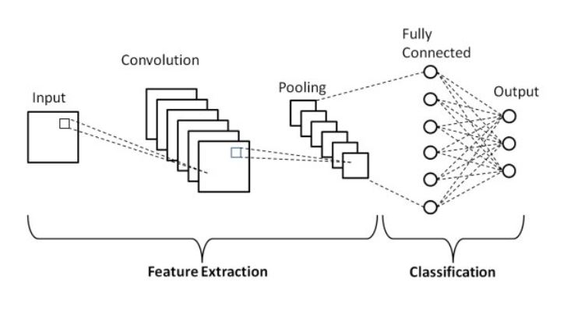
CNN Model Architecture:
Layer Configuration:
Initial Layer: Conv2D with 32 filters of size 5x5, activation='relu', input shape set to (128, 128, 3) for colored images, and padding='same'. Includes L2 regularization to reduce overfitting.
Pooling Layer 1: MaxPooling2D with a pool size of 2x2, following the initial convolutional layer to reduce spatial dimensions.
Intermediate Convolutional Layers:
Conv2D with 64 filters of size 3x3, activation='relu', padding='same', and L2 regularization.
MaxPooling2D with a pool size of 2x2 following the second convolutional layer.
Further Conv2D with 128 filters, same configuration for activation, padding, and regularization.
Another MaxPooling2D with pool size 2x2 to further downsample the feature maps.
(PDF) A High-Accuracy Model Average Ensemble of Convolutional Neural Networks for Classification of Cloud Image Patches on Small Datasets (researchgate.net)

Slide 7
Flattening and Dense Layers:
Flatten Layer: Converts the 2D feature maps into a 1D feature vector, preparing data for the dense (fully connected) layers.
First Dense Layer: 256 units with activation='relu' and L2 regularization, ensuring complex relationships in data are captured.
Batch Normalization: Applied after the first dense layer to normalize the activations and speed up learning.
Second Dense Layer: 128 units with activation='relu' and L2 regularization. Incorporates dropout of 0.3 to prevent overfitting.
Final Batch Normalization: Ensures that the model outputs are standardized before the final output layer.
Output Layer:
Softmax Layer: Dense layer with units equal to the number of classes, using softmax activation to output probabilities for each class.
Training Execution:
Epochs and Batch Size: The model is trained for 15 epochs using a batch size of 500, balancing training speed and model performance.
Callbacks: Utilizes EarlyStopping to cease training if the validation loss does not improve for five epochs, preventing overfitting. ReduceLROnPlateau is employed to reduce the learning rate by 80% if no improvement in validation loss is observed over two consecutive epochs, enhancing the model's ability to converge to a better local minimum.

Slide 8
Experimental Setup
Computational Environment:
Hardware Configuration: The model training and testing were conducted on a high-performance computing environment equipped with GPUs to accelerate the computation-intensive tasks of deep learning.
Software Framework: Implemented using TensorFlow and Keras, which are robust frameworks for building and training advanced deep learning models.
Training and Testing Protocols:
Split Ratio: The dataset was strategically split into 60% for training, 20% for validation, and 20% for final testing. This setup ensures rigorous model tuning and unbiased evaluation against new data.
Model Specifications: A convolutional neural network architecture featuring multiple convolutional and pooling layers, integrated with dropout and batch normalization to optimize learning and mitigate overfitting.
Optimization Techniques: Used Adam optimizer for its adaptive learning rate capabilities, complemented by callbacks such as Early Stopping to minimize overtraining and ReduceLROnPlateau for adjusting the learning rate when performance plateaus are detected.
Performance Evaluation:
Metrics Employed: The model's effectiveness was quantitatively measured using comprehensive metrics like accuracy, precision, recall, and F1 scores, tailored to evaluate its diagnostic accuracy and reliability.
Advanced Analytics: Utilized ROC curves to assess the sensitivity and specificity of the model across different classes, providing insights into its discriminative power and robustness.

Slide 9
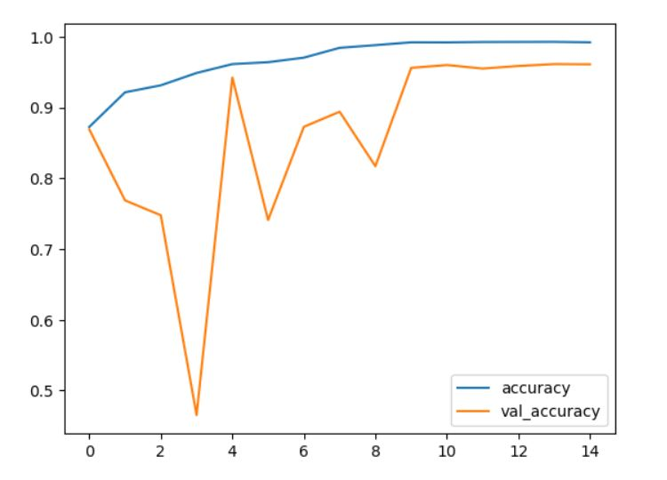
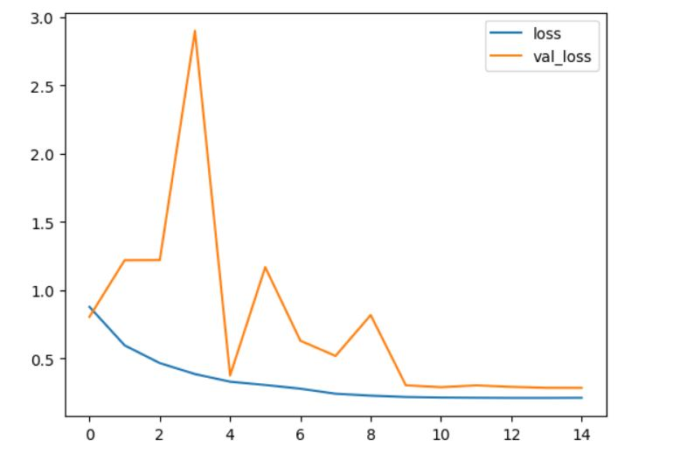
Result
Accuracy and Validation:
Validation Accuracy: Achieved a validation accuracy of 96.1%, indicating the model’s effectiveness on data it was not trained on, which bodes well for its real-world applicability.
Training Accuracy: The training accuracy curve shows a consistent increase, demonstrating the model's learning efficiency.
Loss Metrics:
Converging Loss Graphs: The training and validation loss graphs indicate a good fit, with both metrics decreasing in tandem and leveling out as epochs progress.

Slide 10

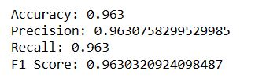
Test Set Evaluation:
Test Accuracy: The model achieved a test accuracy of approximately 96.3%, showcasing its high predictive performance.
Precision and Recall: Both precision and recall metrics are at 96.3%, indicating balanced classification capabilities for both identifying true positives and minimizing false negatives.
F1 Score: The model scored an F1 score of approximately 96.3%, representing a harmonic balance between precision and recall.
Confusion Matrix
Calculated from Confusion Matrix
After evaluating model on test set

Slide 11
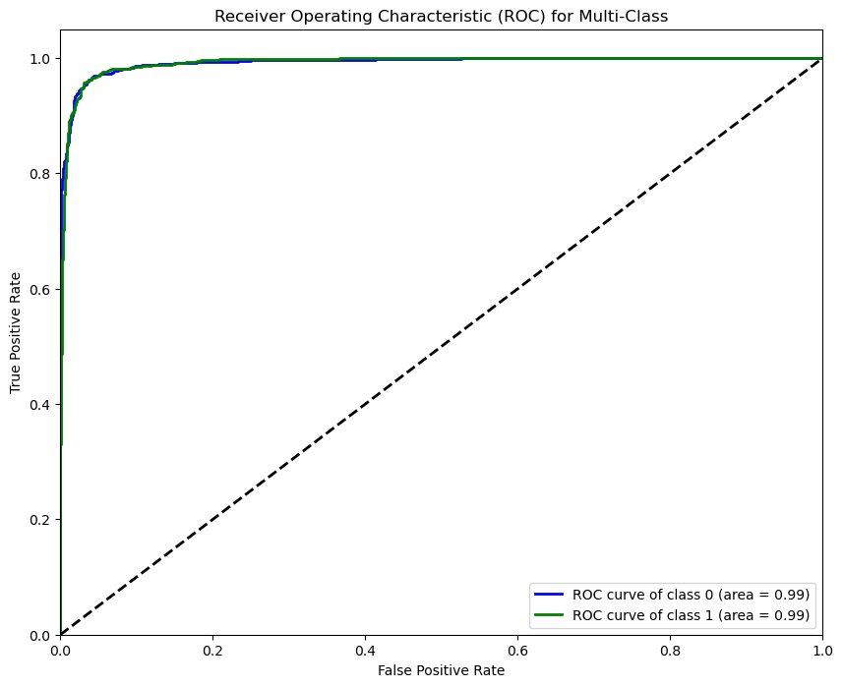
ROC Curve Analysis:
Class-specific AUC: The Receiver Operating Characteristic (ROC) curves for each class show an area under the curve (AUC) close to 0.99, implying excellent model discrimination between Cancerous or not.
Summary:
Comprehensive Success: These results highlight the model’s robustness and accuracy in classifying lung cancer images into benign tissue, adenocarcinoma, and squamous cell carcinoma classes.
Implications: The high level of accuracy across all metrics indicates the model's potential as a reliable tool for aiding in the early detection and diagnosis of lung cancer from imaging data.

Slide 12
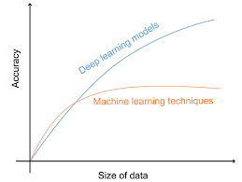
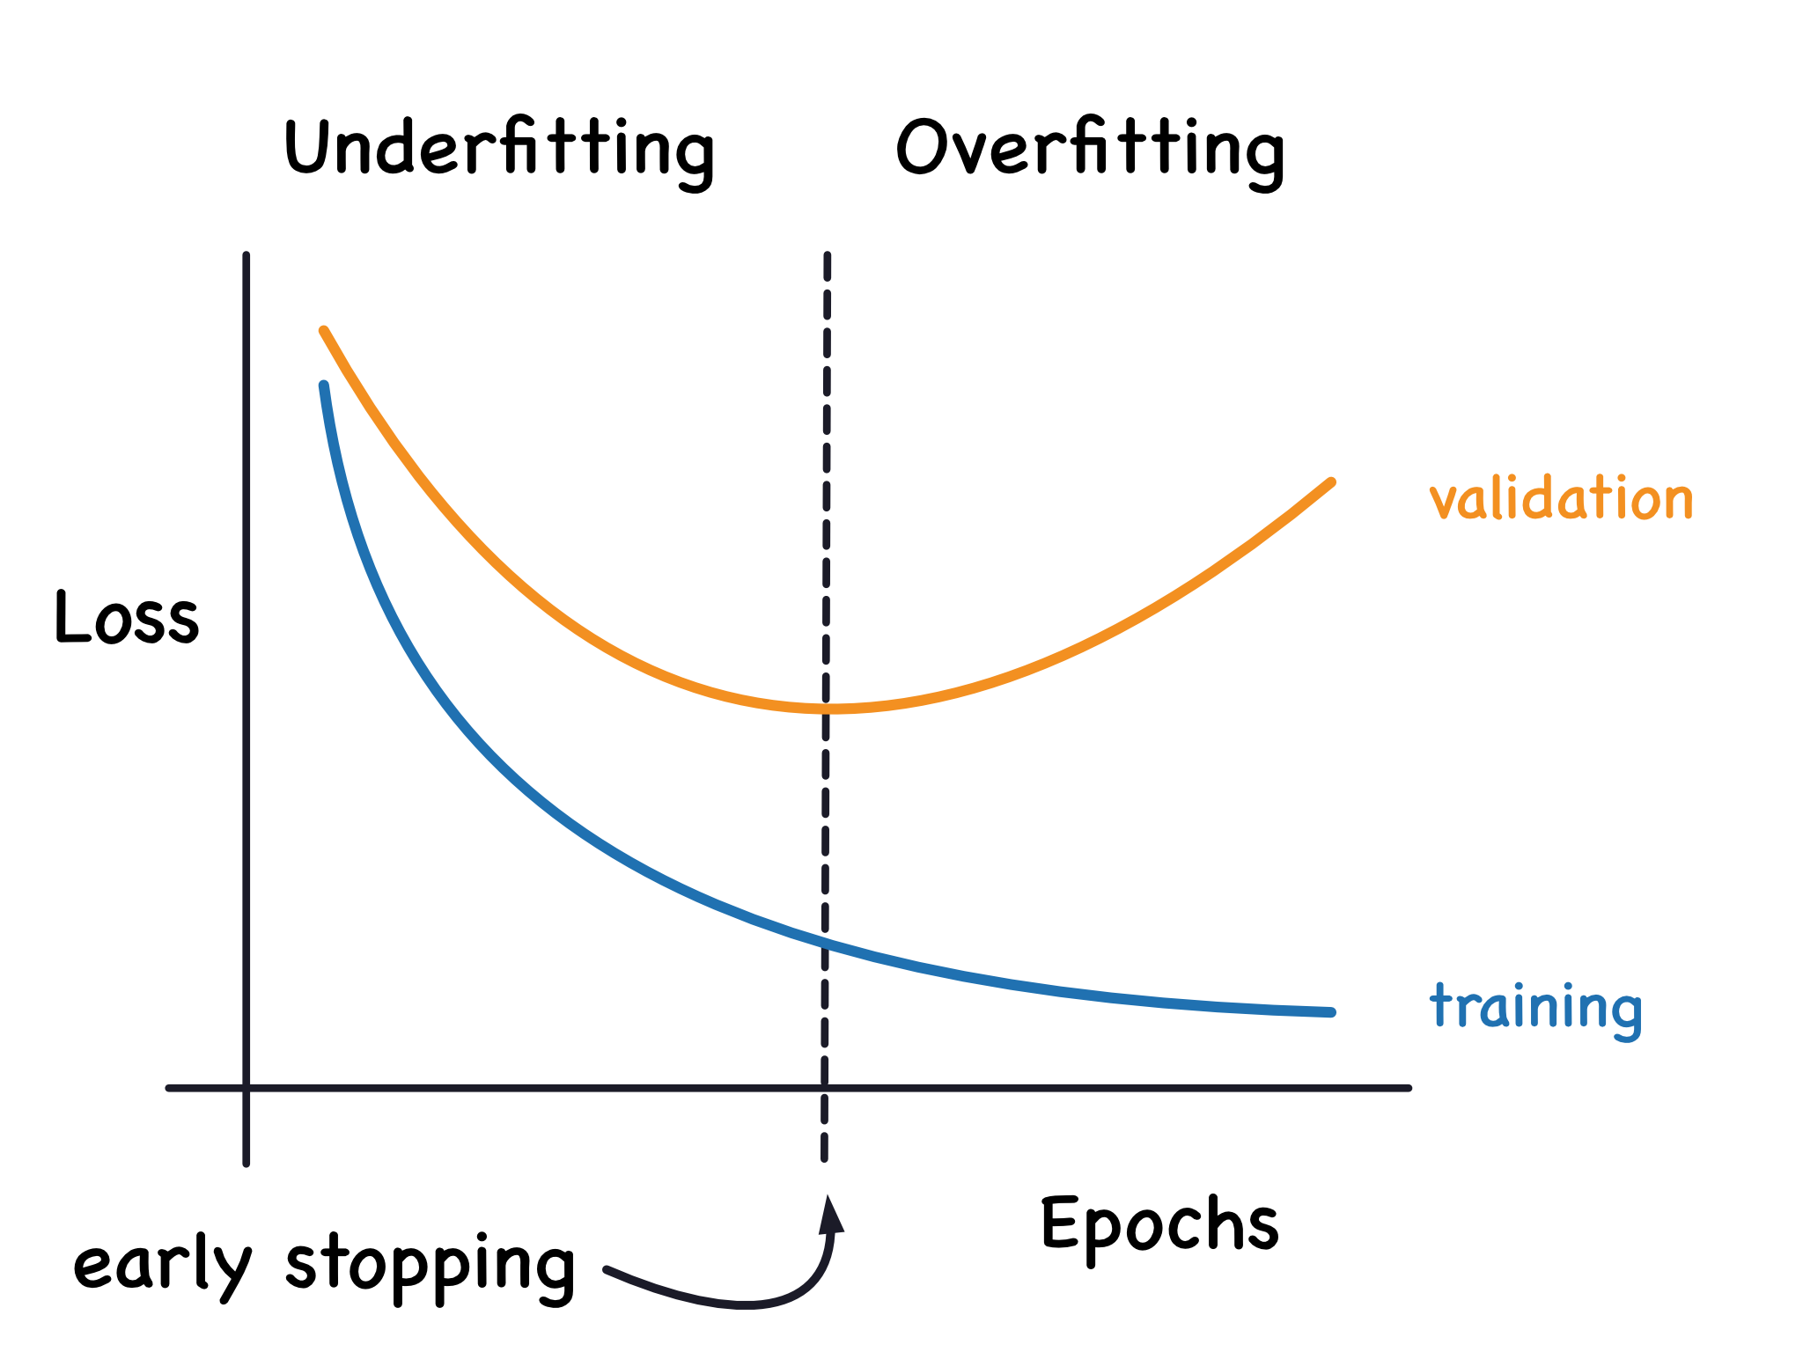
Discussion
Conclusions:
High Predictive Accuracy: The model's high accuracy on both validation (96.1%) and test sets (96.3%) suggests that it is adept at classifying lung cancer images, demonstrating potential for aiding in clinical diagnoses.
Consistent Performance Metrics: The balance in precision, recall, and F1 scores indicates the model's robustness, emphasizing its utility in a clinical setting where false negatives and false positives hold significant implications.
Challenges Addressed:
Overfitting Risk: Initially, the model exhibited signs of overfitting; this was mitigated by implementing dropout and L2 regularization which enhanced the generalization capabilities of the model.
Data Imbalance Management: Although the dataset was balanced, real-world deployment may encounter imbalanced data. Techniques like image augmentation were crucial in preparing the model for such scenarios.
(PDF) Sentence-Level Classification Using Parallel Fuzzy Deep Learning Classifier (researchgate.net)
Overfitting and Underfitting (kaggle.com)

Slide 13
Future Work:
Model Complexity Reduction: Explore methods to streamline the model, potentially reducing its complexity without compromising performance, to facilitate deployment in computational resource-constrained environments.
Transfer Learning: Implement transfer learning to leverage pre-trained models, which could improve performance, especially in distinguishing subtle features of early-stage cancers.
Broader Dataset Application: Extend the dataset to include a more diverse set of images from various demographics and imaging equipment to further validate the model's generalizability.
Clinical Trial Proposals: Conduct prospective studies and clinical trials to evaluate the model's performance in a real-world clinical workflow and its impact on patient outcomes.
Enhancements and Benefits:
Model Clarity: Utilize Class Activation Maps for greater transparency in the model's decision-making.
GAN Utilization: Generate synthetic images with GANs to enhance data diversity and model robustness.
Deep Learning Diversity: Test on a variety of deep learning architectures, like DenseNet and Transformers, to improve feature capture and contextual understanding.
Ensemble Methods: Combine multiple models to improve overall prediction accuracy and stability.
Real-Time Application: Fine-tune the model for use in real-time diagnostic imaging, supporting immediate clinical decision-making.

Slide 14



