Slide 1
Introduction to
Machine Learning
Er. Dhiraj Bashyal

Slide 2



WHO AM I
MSc in Informatics and Intelligent Systems Engineering(MSIISE)
Thapathali campus
Research paper : AN ENCODER DECODER MODEL FOR GRAMMATICAL ERROR CORRECTION OF NEPALI TEXT
Dhiraj Bashyal
AI/ML Engineer

Slide 3
Day 1: ML Fundamentals + Colab Setup
Introduction to Machine Learning
ML Pipeline overview
Google Colab setup and usage

Slide 4
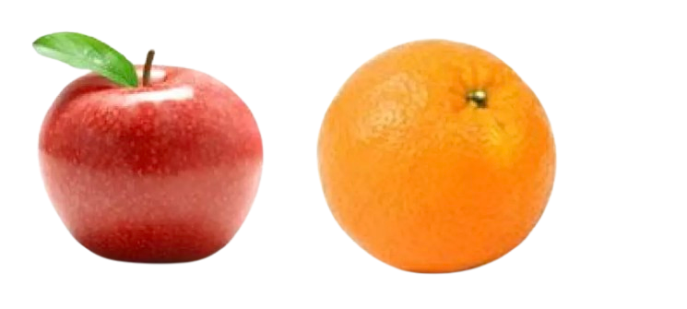
Human Learning
Humans learn by observing features and associating them with labels.
Features |  |  | Labels
Colour | Texture | Taste | Fruit
Red | Smooth | Sweet | Apple
Orange | Bumpy | Sweet-Sour | Orange

Slide 5
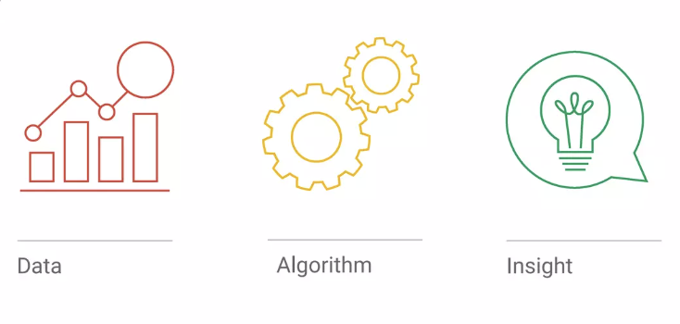
Machine Learning
The ability to learn without being explicitly programmed.
D
A
I
Algorithm or model that learns patterns in data and predicts similar patterns in new data.
Data
Algorithm
Insight
Learning from experiences and examples.

Slide 6
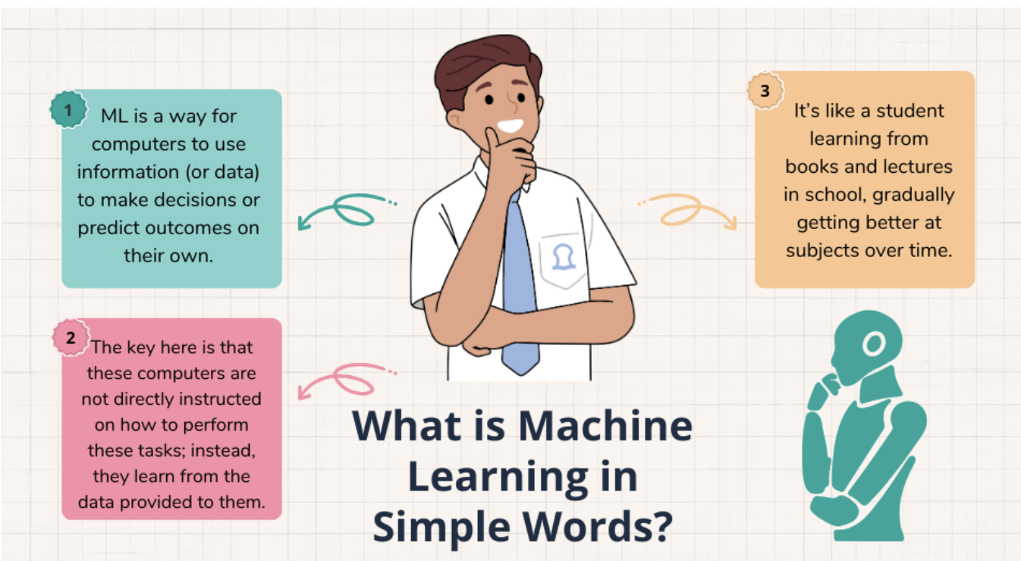

Slide 7
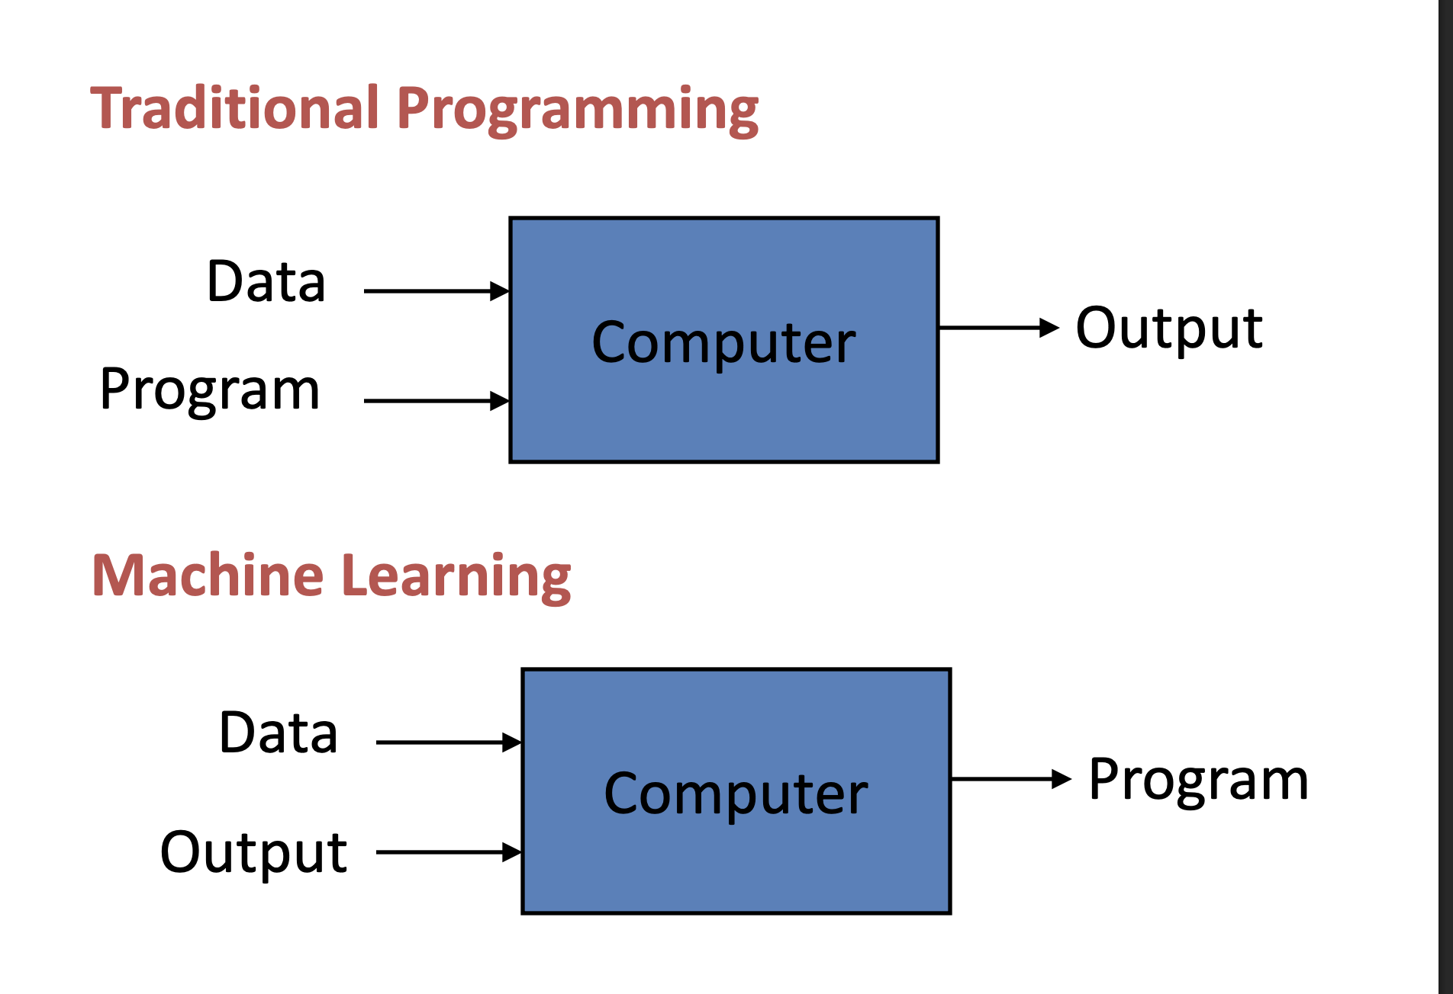

Slide 8
Can you recall the last time you experienced machine learning in your daily life?

Slide 9
How Can You Get Started with ML?
Three ways, with varying complexity:
More flexible,
but more
effort
required
1
Use a Cloud-based or Mobile API (Vision, Natural Language, etc.)
2
Use an existing model architecture, and retrain it or fine tune on your dataset
3
Develop your own machine learning models for new problems

Slide 10
Why is ML important?
🎤 Speech Recognition ML makes it possible for systems to understand human voice (like voice assistants).
🌐 Machine Translation ML helps translate languages automatically (e.g., English → Nepali).
📸 Smart Search in Photos Apps like Google Photos use ML to find images by people, places, or objects.
🚗 Self-driving Cars ML helps detect pedestrians, roads, and other vehicles to drive safely.

Slide 11
AI, ML, NN - Are all the same?
These three terms are often used interchangeably, but they are distinct concepts that build upon one another.
Artificial Intelligence Technology of making things smart
Machine Learning Building machines that can learn
Neural Network A type of algorithm in machine learning

Slide 12
AI (Artificial Intelligence)
AI is the broad field of making machines “intelligent,” meaning they can perform tasks that usually require human intelligence.
Goal: To simulate human reasoning, learning, problem-solving, and decision-making.
Examples in real life:
Siri or Google Assistant
Self-driving cars
Recommendation systems (Netflix, YouTube)
AI doesn’t always learn; sometimes it just follows rules (like chess algorithms).

Slide 13
ML (Machine Learning)
ML is a subset of AI where machines learn from data instead of being explicitly programmed with rules.
Goal: Teach machines to identify patterns and make predictions based on data.
How it works:
You give the model data (e.g., images, text, numbers).
It learns patterns from the data.
It can predict or make decisions for new unseen data.
Examples:
Spam email detection
Fraud detection in banks
Stock price prediction
ML requires data to improve performance over time.

Slide 14
NN (Neural Network)
NN is a type of ML model inspired by the human brain. It consists of layers of “neurons” (nodes) that process data.
Goal: Learn complex patterns in data, especially when relationships are nonlinear.
Structure:
Input layer: receives data
Hidden layers: process data through mathematical operations
Output layer: gives prediction or classification
Examples: Image recognition (detect cats vs dogs)
Voice recognition (Alexa, Google Assistant)
Language translation (Google Translate)
Key point: Neural networks are very powerful for complex tasks like vision, speech, and NLP.

Slide 15
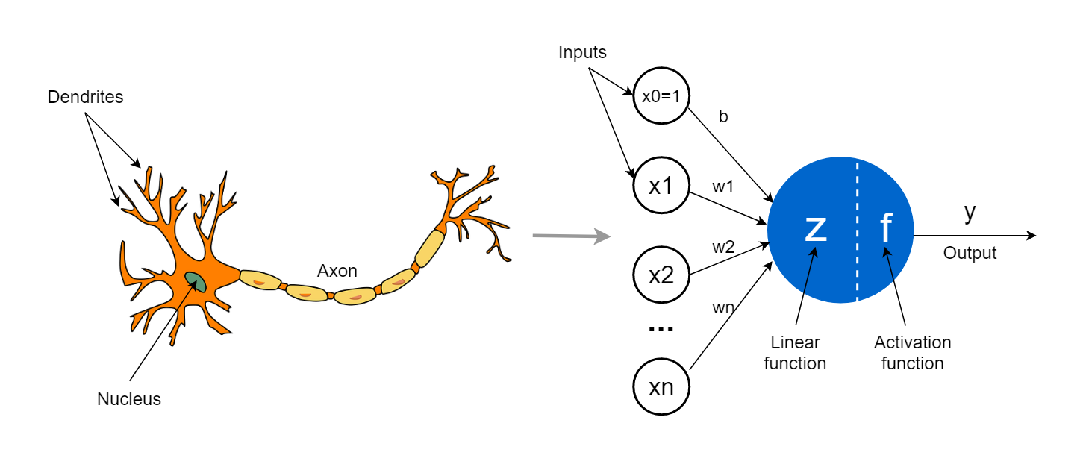
NN (Neural Network)

Slide 16
Review: What/Why/How of ML
WHAT
Algorithms that can generate insights by learning from data.
WHY
Because algorithms can learn faster, cheaper, and better than humans.
HOW
By finding patterns in data.

Slide 17
The Process
New Data
Algorithm
Training
Model
Examples
Predictions

Slide 18
Work flow
(a) Training
Input
(label: Apple)
Feature
Extractor
Features
ML
Algorithm
(b) Prediction
Input
(Orange)
Feature
Extractor
Features
Classifier
Model
Orange

Slide 19
The process of 'Learning'
SUPERVISED
UNSUPERVISED
REINFORCEMENT
Trains with labeled data. Teacher guides the learning process.
Finds hidden patterns without labels. Data-driven grouping.
Agent learns by trial and error to achieve goals via rewards.

Slide 20
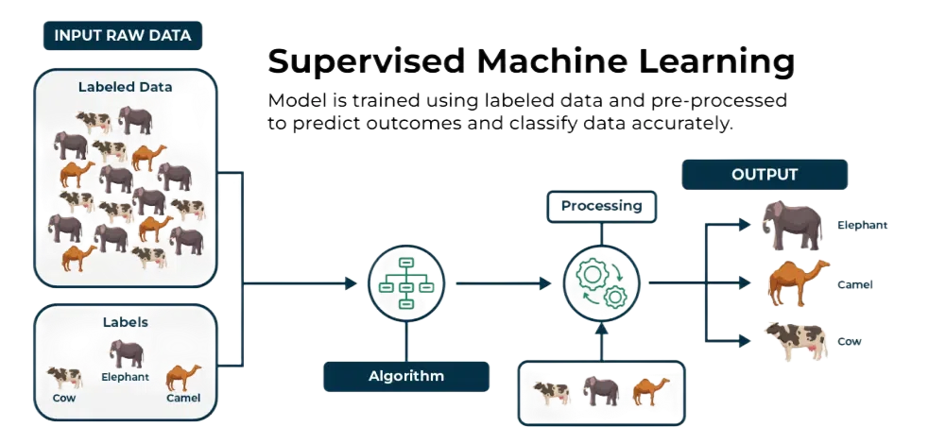
Supervised Learning
Teach the machine using data that's well labelled
Has prior knowledge of output
Data is labelled with class or value
Task driven
Goal: predict class or value label
Neural network, support vector machines, decision trees etc.

Slide 21
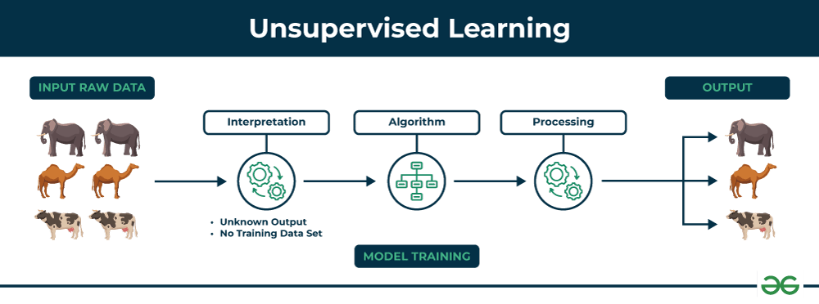
Unsupervised Learning
Data set with no label
Learning algorithm is not told what is being learnt
No knowledge of output class or value
Data driven
Goal: determine patterns or grouping
K-means clustering

Slide 22
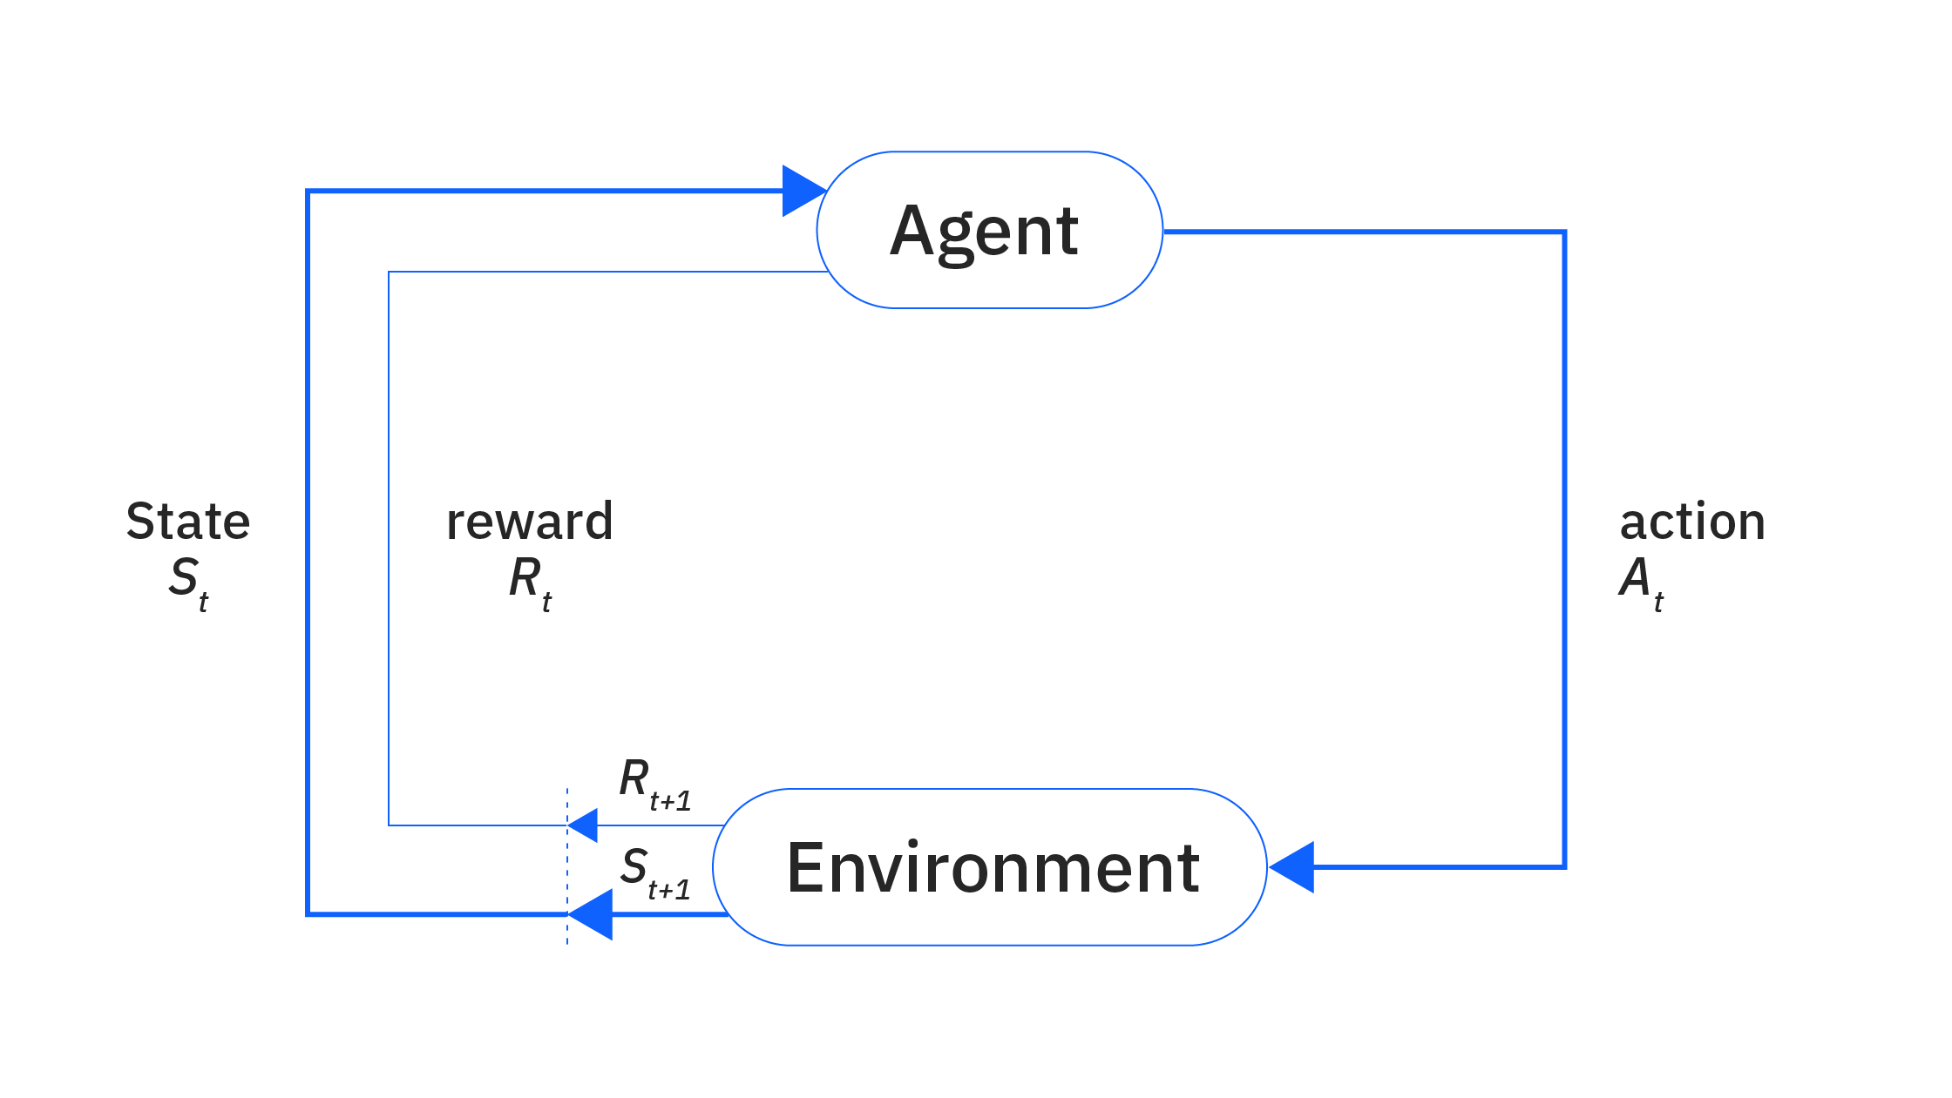
Reinforcement Learning
Similar to unsupervised learning
Uses unlabelled data
Outcome is evaluated and reward is fed back to change the algorithm
Algorithm learns to act in a given environment to achieve a goal
Goal driven

Slide 23
Do you have hands-on experience working with Python and its data science libraries, including Pandas, NumPy, scikit-learn, and Matplotlib?

